Slide 1
Managing Chronic Diseases in Resource Poor Environments
Hans Dethlefs, MD
Chronic Care International

Slide 2
General Discussion Points
Diabetes & hypertension – the scope of the problem
Chronic Care International’s approach
CCI’s clinical results
Tackling the economic and social challenges with patient associations

Slide 3
WHO: Diabetes among top 4 causes of deaths worldwide
Diabetes, cancer, heart and lung diseases account for 71% of deaths around the world, killing a total of 41 million people annually, according to a report released by the World Health Organization and published in The Lancet. "We need to move quickly to save lives, prevent needless suffering and keep fragile health systems from collapsing," said Sania Nishtar, co-chair of the WHO Independent High-level Commission on Noncommunicable Diseases, which called for governments to prioritize prevention and control of non-communicable diseases.

Slide 4
Prevalence of diabetes and hypertension
Diabetes 451 million
up by 29 million from last year’s estimate
Hypertension 1 billion
#1 risk factor for premature death and disability

Slide 5
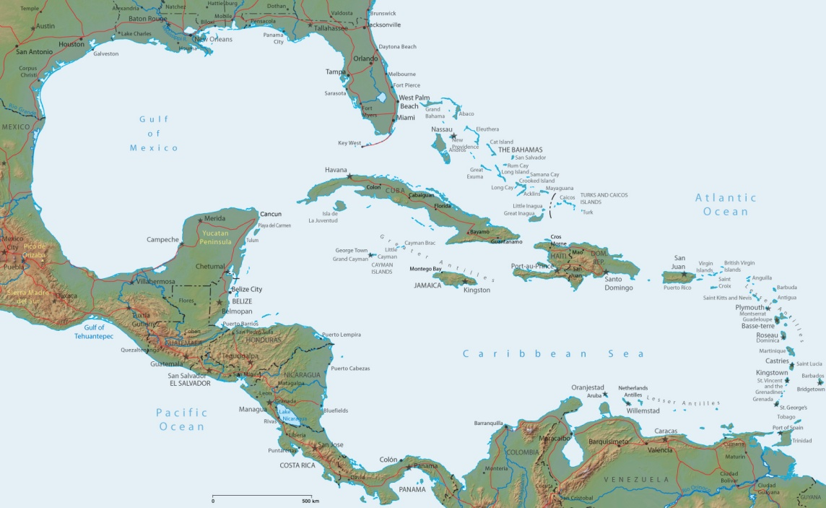
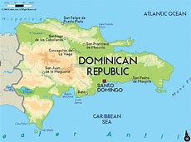
Chronic Care International (CCI)
Omaha based non-profit
Began working in 2010
Focus is chronic disease care for the poor
Primary area is north central Dominican Republic

Slide 6
Primary CCI Partners
Creighton University / Institute for Latin American Concern (ILAC)
Center in Santiago, DR
40 year history of working in DR
Well established health promoter program
Chicago Cubs Charities
Seed money and ongoing financial support
The Diabetes Institute
Multispecialty diabetes clinic in Santiago

Slide 7
CCI Program Evolution
Prompted by perceived need
Began as a community based screening program
Transitioned into a treatment program
1 rural clinic in 2010 with addition of a second in 2012
Managing diabetes and hypertension and concomitant dyslipidemia
Incorporation of Quality Improvement

Slide 8
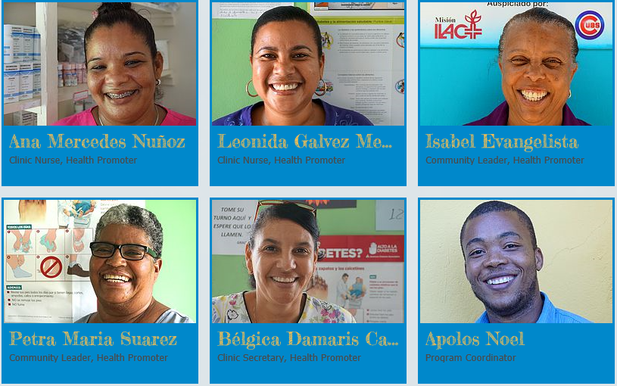
CCI Team
US Team
Multidisciplinary volunteer board
3 physicians
1 certified diabetes educators
1 diabetes researcher
2 teachers
Dominican team
3 physicians
2 nurses
9 health promoters
1 program manager

Slide 9
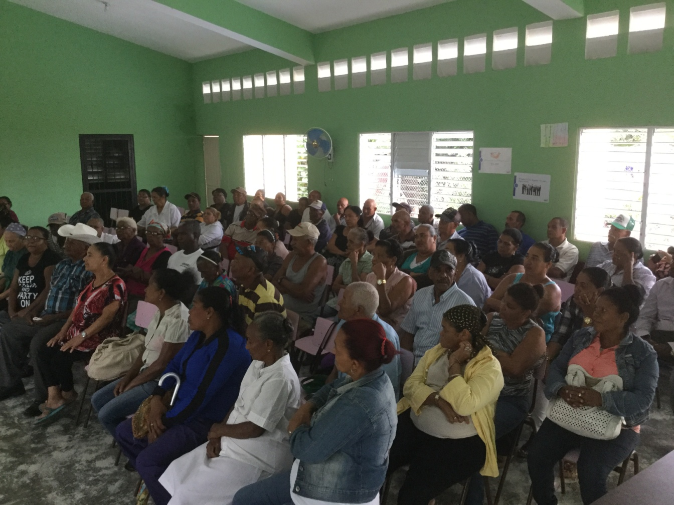
Patient Population
1092 patients
56% female / 44% male
872 with diabetes
743 with hypertension
Ages 18 to 100
Rural
Waiting list of 400 patients
Over 30 communities

Slide 10
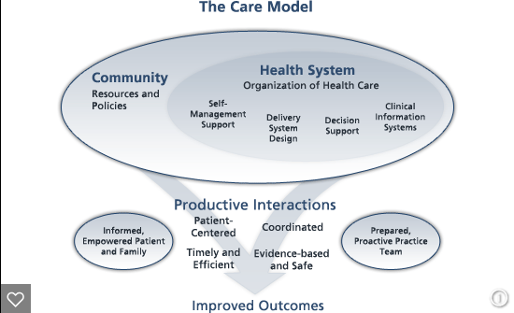
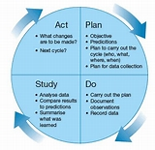
Quality Improvement Framework
Chronic Care Model
PDSA model
Quarterly meetings

Slide 11
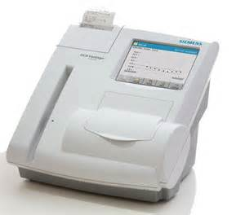
Services Provided
Medical visits every 1 to 3 months
Medications
Laboratory testing
Education and self-management support
Rosa’s Story
Jose’s Story
Specialty referrals

Slide 12
Medication Formulary
Metformin 500 & 1000 mg
Glipizide 5 &10 mg
Lisinopril 20 & 40 mg
Losartan 50 & 100 mg
Hctz 25 mg
Amlodipine 5 & 10 mg
Atenolol 50 & 100 mg
Gabapentin 300 mg
Sertraline 50 mg

Slide 13
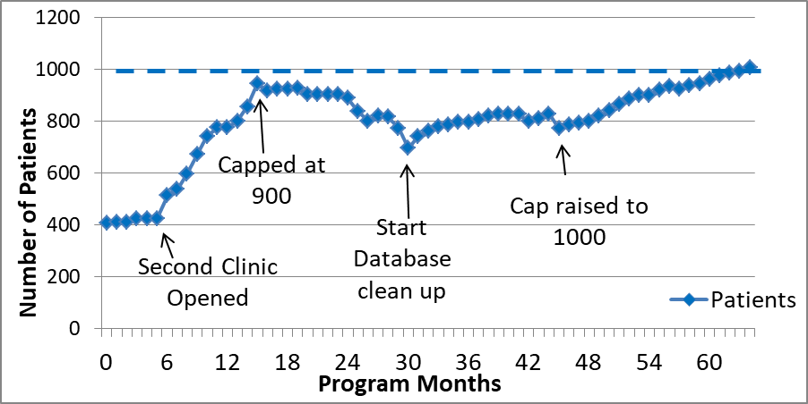
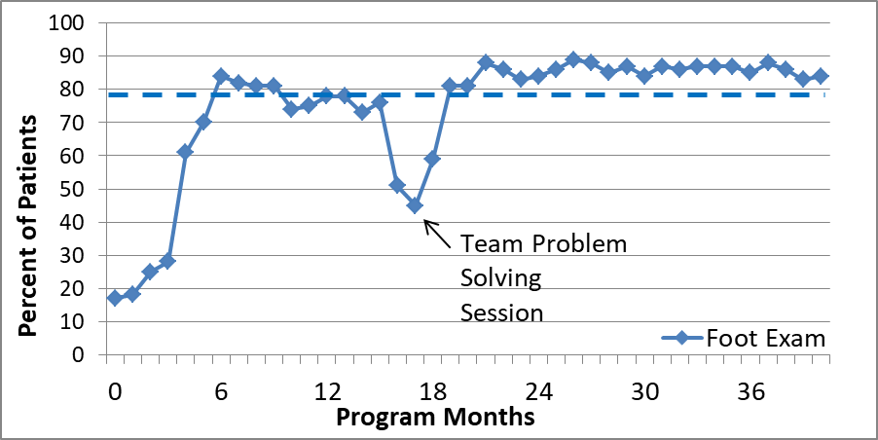
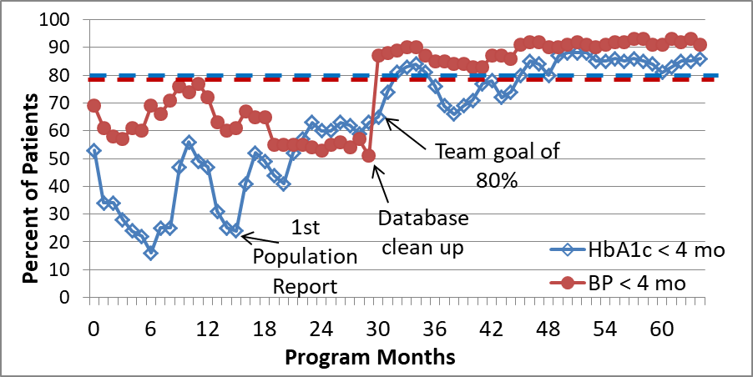
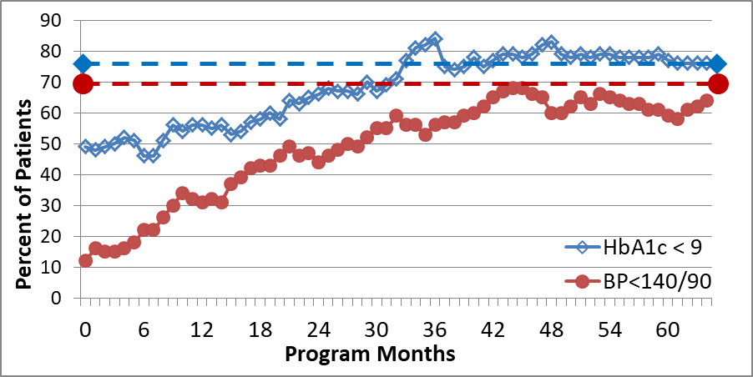
Dashboard
A. Number of Patients With Diabetes or Hypertension Receiving Care
C. % of Diabetes Patients with Foot Exam < 1 Year
B. % of Patients with HbA1c and Blood Pressure in Last 4 Months
D. % of Patients with Last HbA1c < 9% (<75 mmol/mol) and BP < 140/90

Slide 14
The Other 2/3 of the Problem
Healthcare Model
Economic Model
Social Change Model

Slide 15
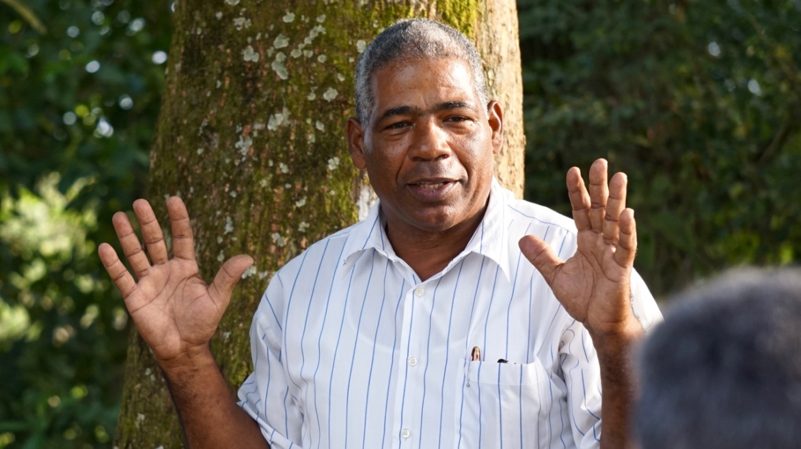
The Patient Associations
Based on history of Co-operative movement
Alignment of key factors
Connectedness of Latino culture (la impostura)
Deep pool of talent within patient population
Under-employment
Recurrent meeting place (clinic)
“Chronic” binding potential of chronic diseases
Density of chronic disease within communities
Leadership age of chronic disease patients
“Paying it forward” mindset

Slide 16
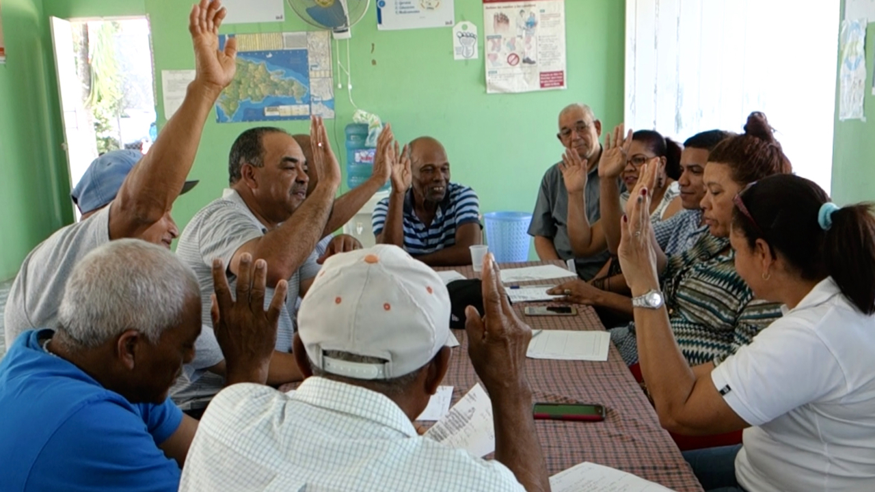
Patient Association Evolution
Vetting idea / planting seed with partners
Town hall meetings with patients
Naming associations / regular meetings
Formation of patient boards
Development of the mission
Initial projects – purchasing land
Annual strategic planning
Regular deposits
Groups of 5

Slide 17
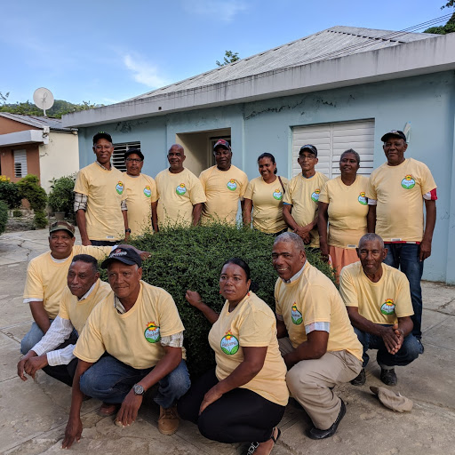
Patient Association Mission
Conectar – to connect patients with one another
Apoyar – to support the association by giving 4 hours per week
Transformar – to transform the environment and culture to favor health instead of illness

Slide 18
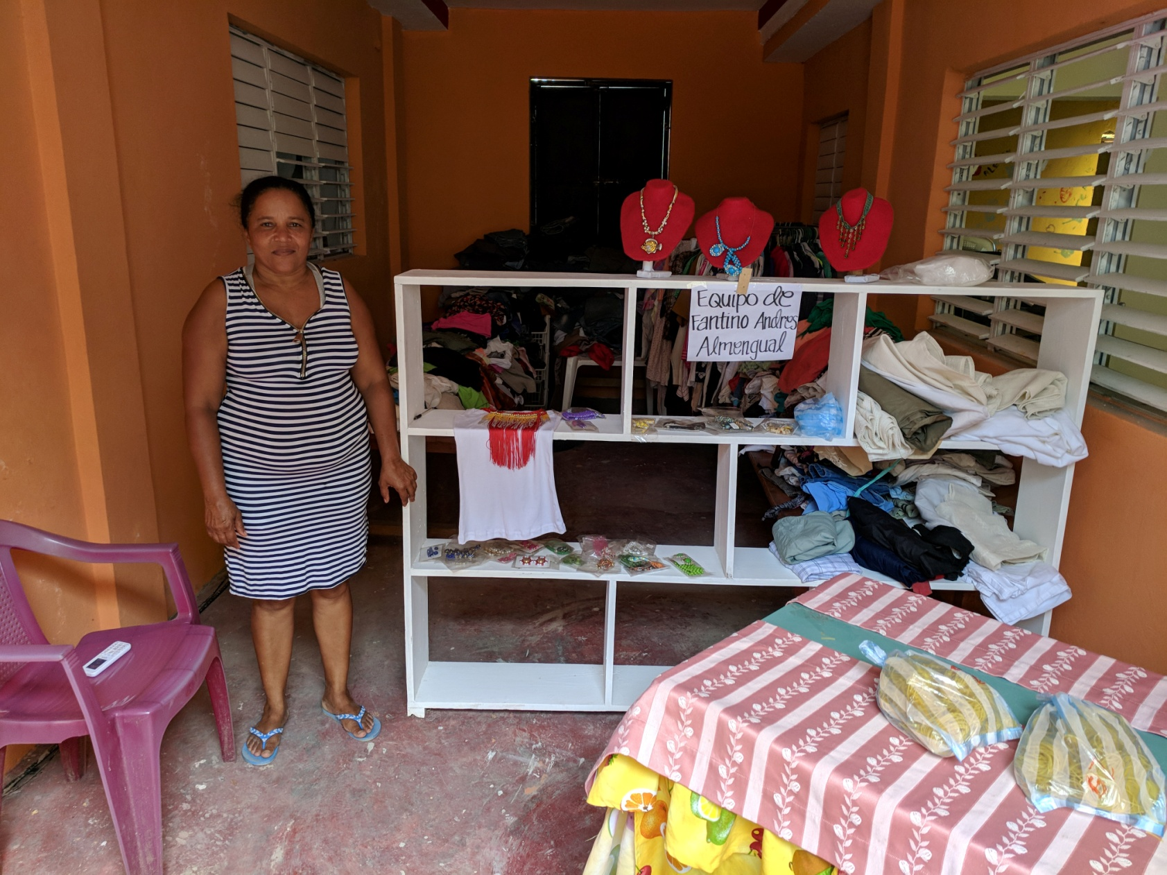
The Store

Slide 19
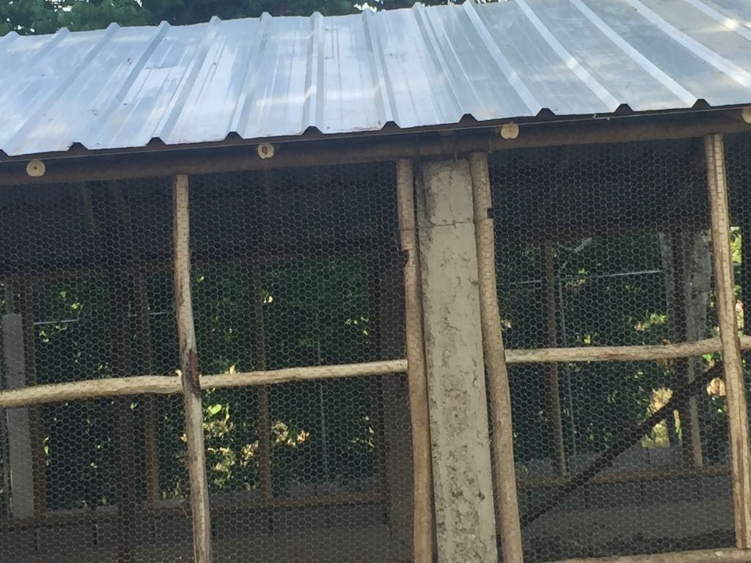
La Granja

Slide 20
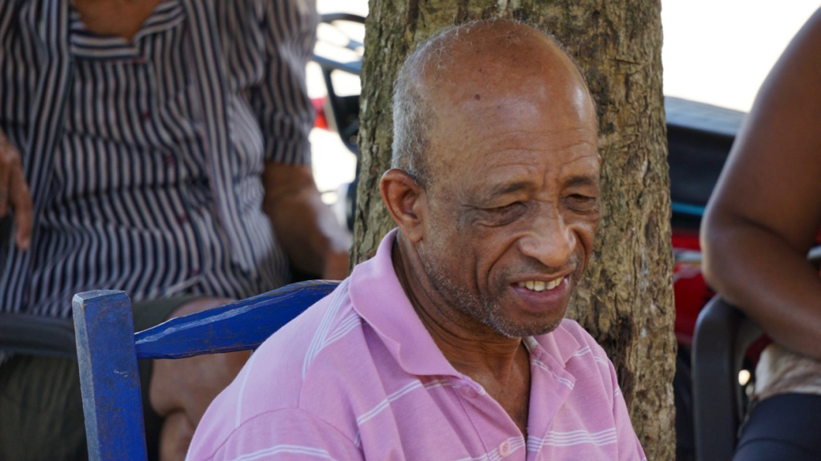
Groups of 5
Groups of 5 patients that live near one another
Borrowed from world of micro-financing
Accountability / peer support groups
Basic unit of patient association activity and communication

Slide 21
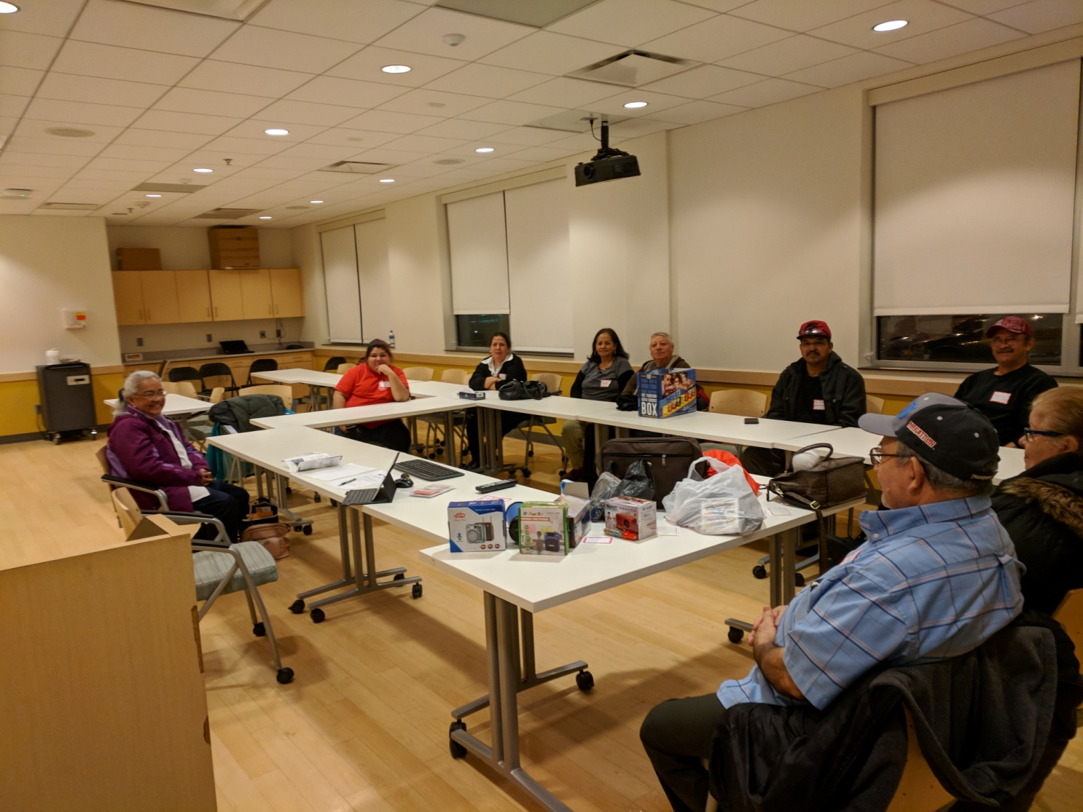
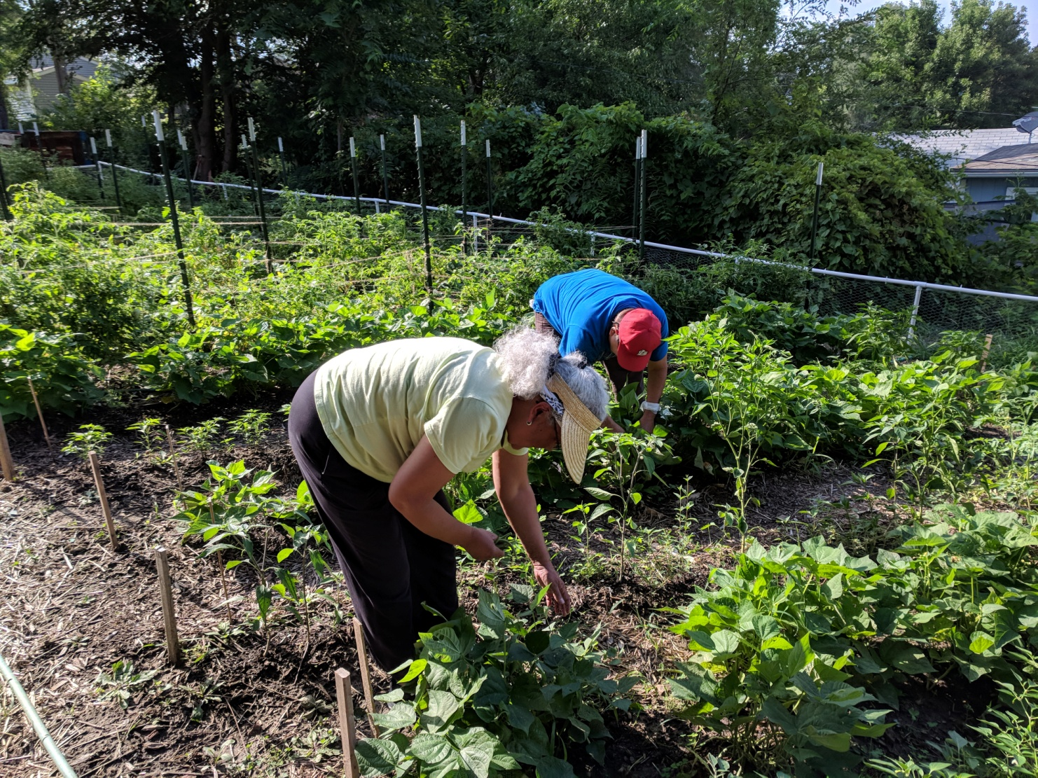
Patient Association U.S. Version

Slide 22
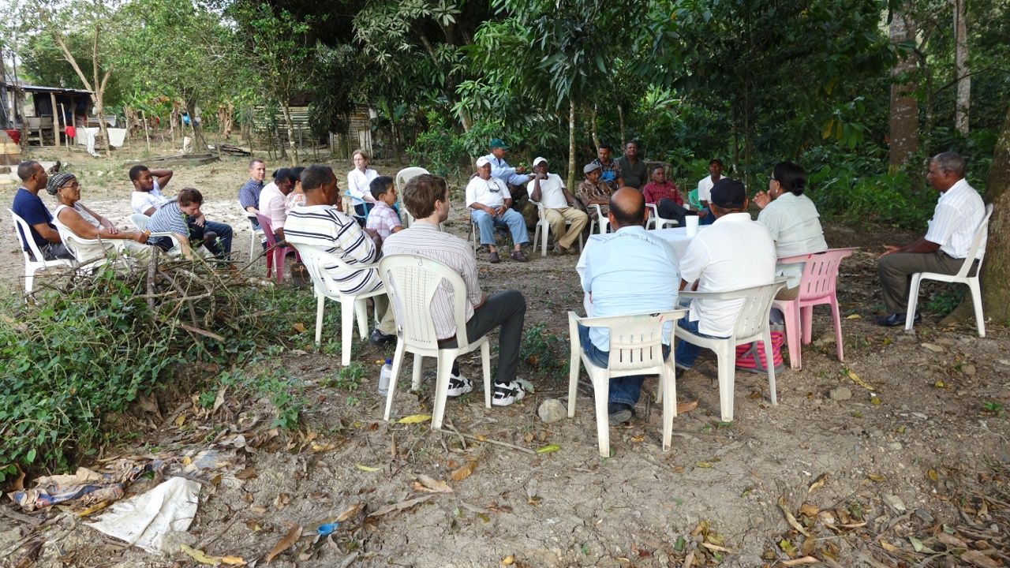
The Problem and The Solution of Chronic Diseases Reside with La Gente

Slide 23
Chronic Care International
Hans Dethlefs, MD
hdethlefs@oneoworldomaha.org
ChronicCareInternational.org

Slide 24
© 2018 American Academy of Family Physicians. All rights reserved.
All materials/content herein are protected by copyright and are for the sole, personal use of the user.
No part of the materials/content may be copied, duplicated, distributed or retransmitted
in any form or medium without the prior permission of the applicable copyright owner.

