Slide 1
Opioid Improvements – One Practice at a Time
Bryan L. Goddard, M.D.
Community Care Physicians
Albany, NY

Slide 2
Disclosures
None

Slide 3
Please evaluate this presentation using the conference mobile app! Simply click on the "clipboard" icon on the presentation page.

Slide 4
What are you doing with opioids?
Rx for acute pain and hospice only
Rx for chronic pain with only pure agonists
Rx for chronic pain with buprenorphine
Rx for opioid use disorder – your practice
Rx for opioid use disorder – referrals

Slide 5
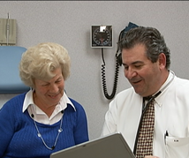
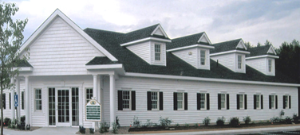
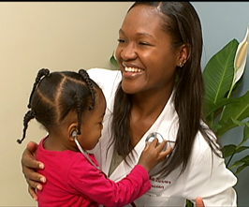
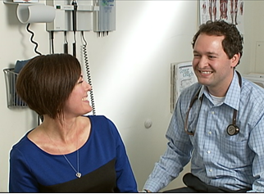
Community Care Physicians, Albany, NY 420 Providers, 80 locations, 30 specialties

Slide 6
How did we decide we had to do something about opioids?

Slide 7
Rosemary
71 y.o. with extensive history
Asthma and RA – many bursts of oral steroids
Multiple lumbar surgeries – pain mgmt. failed
Burst Fx lumbar vertebra – wheelchair bound
180 MME for chronic pain
Admission for delirium with pneumonia
Ambulance reported she roused with Narcan

Slide 8
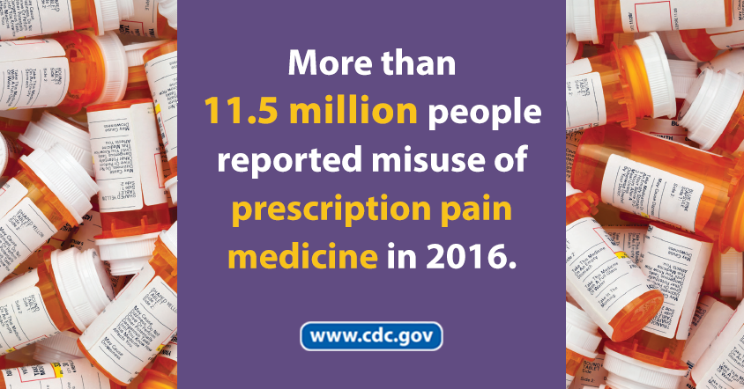
Moving from a hunch to a commitment
“Pain as a fifth vital sign”
CDC “Prescribing Opioids for Chronic Pain”
Creating a “registry” for our site
92 patients >50 MME

Slide 9
Agreeing to Practice Standards
We needed to screen urines.
“Care Plans,” not “Opioid Contracts.”
Require visits for refills.
It takes longer to find an alternative.
Refills are “ticket in the door” for chronic care.
Demonstrating care for the whole person.
Notes:
Photo of urine collection cup
Packet of Chronic Pain Care Plan

Slide 10
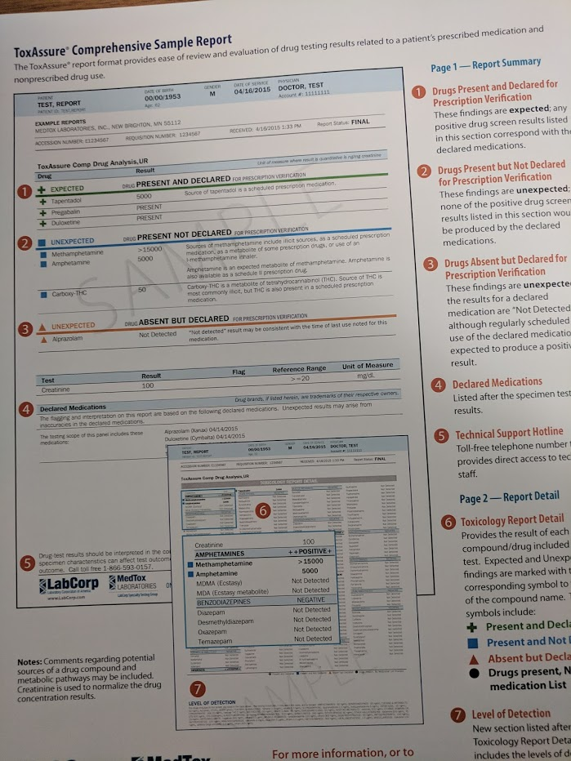
Finding a Urine Drug Test

Slide 11
Simple measures – Satisfying Results
Twenty patients had no opioids in urine.
Need to ask time of last use to avoid argument!
Counting “Care Plans” was hard, but …
Many (~20) “chronic users” were not using three months later.
Refill-without-visits for long-term patients.
Notes:
Taper measure photo

Slide 12
The Data Made Me Do It!
Practice panel grew.
Surgeons stopped prescribing the chronic opioids they had started.
Patients advised to change to PCP-management by surgeons or pain management.

Slide 13
Looking for Provider of Buprenorphine
Chastised for focus on pain management (by Medically Assisted Treatment (MAT) provider).
Community resources for buprenorphine were maxed out with MAT.
Many community “treatment programs” lacked ability to provide MAT. They lacked capacity to provide safer pain management to elders.

Slide 14
Getting Data-2000 Waiver
Lots of options
8 hours for physicians; 24 hours for PA/NPs
2/3 never use their waiver!
Free and on-line worked for me!
Policies and Procedures took more time
Educating other providers/staff
Talking to insurer and pharmacies

Slide 15
Getting Ready for First Patient
Bupe FAQs – Counseling personalizes risk, FAQs often prompted new insights.
Chronic Pain Care Plan – We now include co-prescription of Nasal Naloxone.
Buprenorphine Induction
Insurance picks the product
Set date for Induction
Stress importance of not “winging it.”

Slide 16
Induction Labor is good metaphor!
Nobody wants to go into withdrawal!
COWS – Score it with patient (and support)
Coach first dose administration
COWS – “So that was withdrawal!”
Educate for repeat self-assessments.
Plan follow up call 6-8 hours later.
Dosing call 2-3 d later.

Slide 17
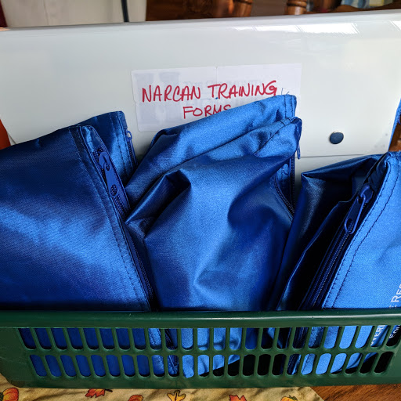
Community Resources
Opioid Treatment Programs
Comparing apples and oranges
Inpatient Induction Services
Opioid Overdose Prevention Training

Slide 18
Can You Become An Opioid Overdose Prevention Program?
Greene County – home of ~1/2 our patients – has had highest death rate in NYS
Rural volunteer ambulance crews don’t arrive in time to rescue!
Recommend Nasal Naloxone for everyone with >50 MME
Simple in NYS

Slide 19
Office Training Nasal Narcan
Trainer does not need to be provider
Checklist simple enough for peer-training
Patient agrees to co-prescription
Staff can train while provider moves on.

Slide 20
Taking it into the Community
6-week educational series
Word gets out!
Practice had street addicts needing MAT
5-10 requests for MAT weekly
Waiver limits
Year One – 30
Year Two – 100
Year Three + 275

Slide 21
Has it been worth it?
Business model
For safer chronic pain – long loss-leader
Insurer has asked about “right-pricing” MAT
Office role development
Your staff are closer to this epidemic!
Healing is better than enabling

Slide 22
Success Stories
Caroline
Opioid Hyperalgesia
“You saved my life!”
Jeffrey
330 MME – Total permanent disability
Nearly fatal accidental overdose
Now q 3 months, no benzos, 3 less drugs
“I’m a different person. I have a life again!”

Slide 23
Success Stories
Francesca
Relapsed after many treatment programs
Now business manager
Rosemary
Family got naloxone training
180 MME weaned to 17.5 MME

Slide 24
Questions

Slide 25
Please evaluate this presentation using the conference mobile app! Simply click on the "clipboard" icon on the presentation page.

