Slide 1
Reflecting with early graduates and senior family medicine leaders about career transitions: Introducing Faculty Whispering” May 9, 2017
Lucy M. Candib, MD
University of Massachusetts Medical School
Joseph Hobbs, MD
Medical College of Georgia
Macaran A. Baird, MD, MS
University of Minnesota Medical School
William Shore, MD
UCSF School of Medicine
John Frey, MD
University of Wisconsin School of Medicine and Public Health
Jeannette South-Paul, MD
University of Pittsburgh School of Medicine
James Greenwald, MD
SUNY Upstate Medical University

Slide 2
Disclosures
None

Slide 3
Becoming a faculty whisperer
An assessment of what one has learned
Dealing with people, learning from mistakes, making choices, setting priorities, self-in-relation
An active outreach process
Approach people you know, call people you don’t, making yourself available, have a Mickies Dairy Bar
Setting parameters
Focus on others’ careers, no administrative talk, minimize war stories, it is not about me
Maintain one’s own network of whisperers
Practice what you practice

Slide 4
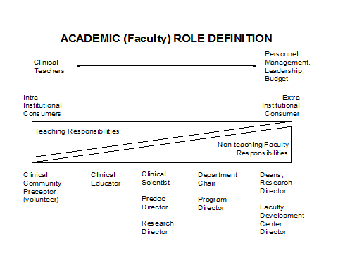

Slide 5
Lucy M. Candib, MD
Transitions:
No-children to parenting
Full time clinical to parttime clinical (and unpaid writing)
Part-time clinical to retirement

Slide 6
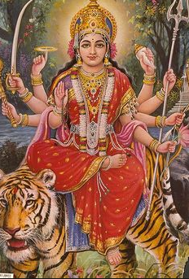

Slide 7
Joseph Hobbs, MD (an entire career at a single institution)
Transition: Delaying private practice for academic department post
Factors influencing transition
FM Chair
Spouse and family
Dearth of local group practice opportunities
Residency Program Director attrition
By products
Residency Program Director, FMIS Program, FMIS Director
Opportunities for leadership posts at other universities

Slide 8
Joseph Hobbs, MD (an entire career at a single institution)
Transition: Residency Program Director to Student Program Director
Factors influencing transition
Mariam Bishop, Martha Evans, David Swee, Roger Sherwood
STFM Education Committee and Group on Pre-Doctoral Education Directors
New decentralized Family Medicine Clerkship
By products
HRSA training grant reviewer and recipient
Publications, presentations, consultations
STFM (Board Member-at-Large, President)
Promotion to professor and tenure
Opportunities for leadership posts at other universities

Slide 9
Joseph Hobbs, MD (an entire career at a single institution)
Leadership Transition: MCG at Augusta University
Department Chair
Deans Office appointments
ADFM (Board Member-at-Large, President)
Factors influencing transition
Former FM Chair at MCG and UVA, former MCG Dean
Bishop Fellowship (IU Dean)
By products
COGME, ABFM Board
University Health System, Dean, Academic Affairs leadership
Opportunities for leadership posts at other universities

Slide 10
Macaran A. Baird, MD, MS
Transitions:
Rural practice
Residency director
Professor and chair of Family Medicine – Syracuse
Associate medical director for Primary Care, HealthPartners, Minneapolis
Professor and medical director for Mayo Clinic insurance company
Professor and head, Department of Family Medicine & Community Health, University of MN

Slide 11
William Shore, MD
Significant career transitions and coaches/whisperers:
Early/Mid -career-transition from community health center practice to faculty position. Concern: Am I selling out by stopping full time practice? Will there be time for family?
Mid/Late career: Step down from leadership position as MSE director. Concern: Where will I fit into the organization? Finding new ways to contribute.
Late career: Retirement/stop direct clinical practice, continue teaching: Concern-What will my identity be if not seeing patients? With this, will I be able to have more time with our grandchildren?
Post-retirement: End of hospital privileges w/out ABFM re-certification: Concern: Final loss of identify.

Slide 12
Jeannette South-Paul, MD
Choosing an Army Health Professions Scholarship
Guaranteeing departure from my home community
Joining a new culture with few women
Mandating a level of physical training I had never pursued

Slide 13
Jeannette South-Paul, MD
Pursuing an academic career – uncommon in the Army
Engaging in clinical research as a resident
Seeking involvement in national, civilian organizations – AAFP
Juggling marriage to a civilian from a different culture and motherhood as an Army mom
Balancing a dual career relationship – Private practice and the Army

Slide 14
Jeannette South-Paul, MD
Joining the medical school environment
Embracing scholarship requirements while keeping up with clinical responsibilities
Advocating for change and stumbling into institutional leadership
Pursuing volunteer leadership opportunities in AAFP, AAMC, STFM
Transitioning from military academic leadership to academic leadership in a civilian institution

Slide 15
Jeannette South-Paul, MD
Deciding when to make the next move
Seeing opportunities for further change
How to continue being involved as a senior academician
Balancing changing family needs
Changing role of a maturing mentor – close geographic relationships to more distant mentoring relationships

Slide 16
James L Greenwald, MD
Biggest Transitions
Switch from Tenure to Clinical/Educator Track
Medical Director Correctional Health
Rural Medical Education Program Director
Semi-Retirement
Guiding principals
Discovering, accepting, and honing my skills
Seeking balance (discovering and accepting limits)
Functioning at small and broad levels simultaneously
Notes:
Will tell one or more of the following stories:
-being adopted by a patient while I was developing a clinic for formerly homeless mentally ill men
-being fired from the tenure track by my boss and wife
-dreading letting go but finding it wonderful

