Slide 1
Keeping Clinically Current and How to Perform Critical Appraisal in Everyday Practice
COL Douglas M. Maurer, DO, MPH, FAAFP
Program Director
MAJ Jeffrey H. Burket, MD
Madigan Faculty Development Fellowship
Notes:
Now I stand before you a convinced woman. Convinced of the value of having a system to plan learning events. I love this session because this is where we get practical and put it all together. I promise you that, by the end of this session, you will be as excited as I am about planning your next learning event and convinced to use this system! I am Amanda Cuda, a second year faculty development fellow.

Slide 2
How do you keep up with the medical literature?
How are you currently teaching your residents critical appraisal skills?
Do you feel comfortable doing it?
Notes:
Sara mentioned at the end of her session that you could use many of her principles in a future talk that you are planning. Think about that learning event that you need to plan in the near future. Do you feel excited to plan it? Many of you listed time as a significant challenge to planning a learning event. Yes! Many of you mentioned the challenges of how to make something interesting, how to use technology, limited teaching experience. Yes, yes, and yes! I was there with you 1 year ago.

Slide 3
Keeping Clinically Current and How to Perform Critical Appraisal in Everyday Practice
COL Douglas Maurer, DO, MPH, FAAFP
Program Director
MAJ Jeffrey Burket, MD
Madigan Faculty Development Fellowship
Notes:
Now I stand before you a convinced woman. Convinced of the value of having a system to plan learning events. I love this session because this is where we get practical and put it all together. I promise you that, by the end of this session, you will be as excited as I am about planning your next learning event and convinced to use this system! I am Amanda Cuda, a second year faculty development fellow.

Slide 4
Disclosures
The views expressed are those of the author(s) and do not reflect the official policy of the Department of the Army, the Department of Defense or the U.S. Government.

Slide 5
iMedicalApps Associate Editor

Slide 6
Objectives
Discussed the 6S approach to EBM
Practiced answering EBM questions using the best sources on our mobile devices
Reviewed one critical appraisal system
Practiced using that system on a journal article
Notes:
By the end of this session, we will have…

Slide 7
Where to Find the Best Evidence?
Burn your traditional textbooks
Use the 6S approach to EBM info access
Organize access to EBM info services
Change your approach: prompt/pull/push
Notes:
Elizabeth Simpson’s (1966) taxonomy is focused on the progression of a skill from guided response (i.e., doing what you are told to do) to reflex or habitual response (i.e., not having to think about what you’re doing), then inclu
Simpson E.J. (1972). The Classification of Educational Objectives in the Psychomotor Domain. Washington, DC: Gryphon House.des origination as the highest level (i.e., invention of a new way to perform a task). Technically is 7 levels not 5!

Slide 8
Burn Your Textbooks
Text must have in-line references to support each key recommendation
References for each key recommendation must be no more than 2-3 years old
Activity 1 (2 min)
Go to your favorite EBM resources and see if they “pass” these two steps

Slide 9
6S Approach
Notes:
2. Dreyfus S, Dreyfus H. A five stage model of the mental activities involved in directed skill acquisition. California University Berkeley Operations Research Center [monograph on the Internet]; 1980. Available from: http://www.dtic.mil/dtic/index.html
Stuart and Hubert U of Calif. Berkeley, USAF contract (Dept. of Industrial Engineering and Operations Research and Dept. of Philosophy)
Original document listed in syllabus
The designer of training aids and courses must at all times be aware of the developmental stage of the student, so as to facilitate the trainee's advancement to the next stage, and to avoid the temptation to introduce intricate and sophisticated aids which, although they might improve performance at a particular level, would impede advancement to a higher stage, or even encourage regression to a lower one.”
From consciously competent (thinking about what you are doing) to unconsciously competent (autopilot---you can do it in your sleep/with your eyes closed)…not even thinking about what/how you are doing (to a point).

Slide 10
6S Approach
Systems
Summaries
Synopses of syntheses
Syntheses
Synopses of studies
Studies
Notes:
2. Dreyfus S, Dreyfus H. A five stage model of the mental activities involved in directed skill acquisition. California University Berkeley Operations Research Center [monograph on the Internet]; 1980. Available from: http://www.dtic.mil/dtic/index.html
Stuart and Hubert U of Calif. Berkeley, USAF contract (Dept. of Industrial Engineering and Operations Research and Dept. of Philosophy)
Original document listed in syllabus
The designer of training aids and courses must at all times be aware of the developmental stage of the student, so as to facilitate the trainee's advancement to the next stage, and to avoid the temptation to introduce intricate and sophisticated aids which, although they might improve performance at a particular level, would impede advancement to a higher stage, or even encourage regression to a lower one.”
From consciously competent (thinking about what you are doing) to unconsciously competent (autopilot---you can do it in your sleep/with your eyes closed)…not even thinking about what/how you are doing (to a point).

Slide 11
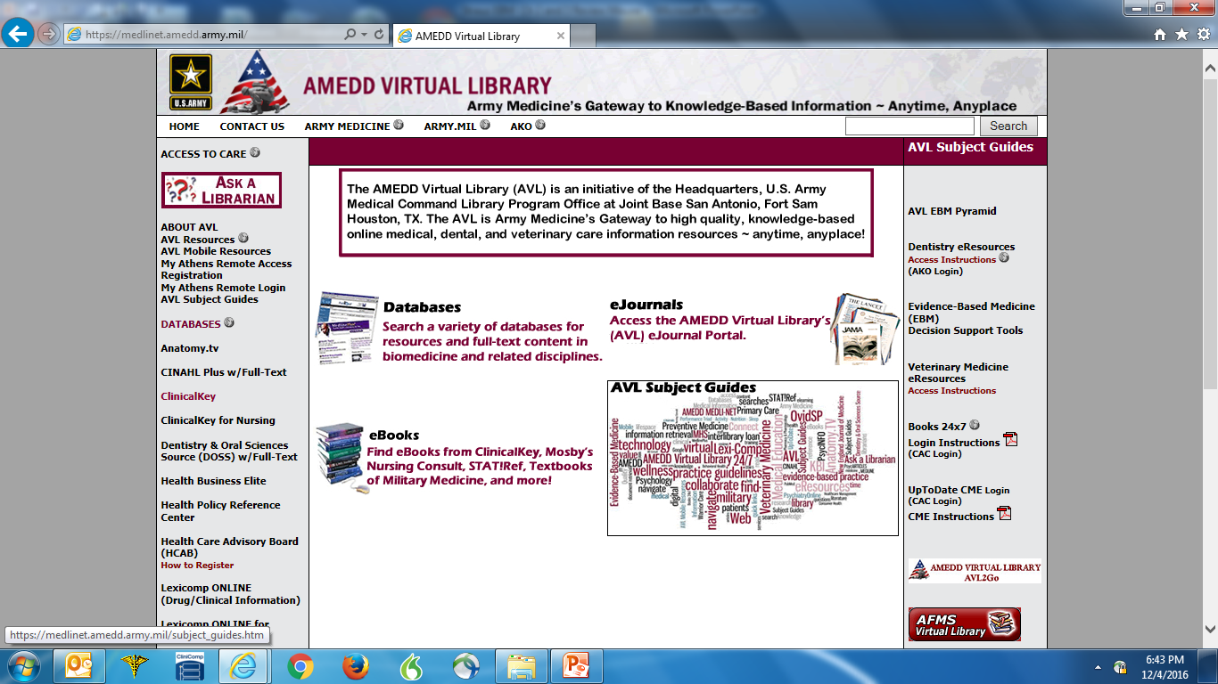
Organize Access to EBM Info Services
Madigan Library Homepage
AMEDD Virtual Library
UW Healthlinks
USU LRC
Clinical Key
Others?
Notes:
BASED ON SIMPSONs Psychomotor Domain:
Motor vs verbal skills, and tacit vs explicit knowledge
Conceptualization – the learner must understand the cognitive elements of the skill, = why it’s done, why it’s not done, and the precautions involved. The learner must know the instruments and tools involved.
Visualization – the learner must see the skill demonstrated in its entirety from beginning to end so as to have a model of the performance expected. This leads to learner imitation.
Verbalization – the learner must hear a narration of the steps of the skill along with a second demonstration If the learner is able to narrate correctly the steps of the skill before demonstrating there is a greater likelihood that the learner will correctly perform the skill. This leads to learner manipulation.
Practice – the learner now performs the skill. The skill may be broken down into discreet units for practice.
Represent a chain of responses.
Require eye-hand coordination.
Require organization of subroutines.
Correction and reinforcement – skill errors need immediate correction. Positive reinforcement should be used to cement correct performance.
Skill mastery – the ability to routinely perform a sequence of skills in a practice situation without error.
Skill autonomy – the ability to regularly perform the skill as a routine in real-life situations without error.
Based on these principles, a five-step method was created.

Slide 12
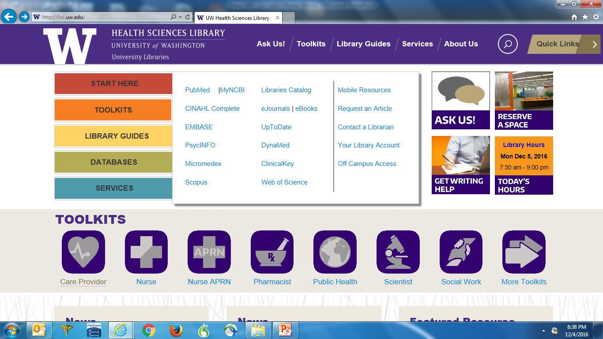

Slide 13
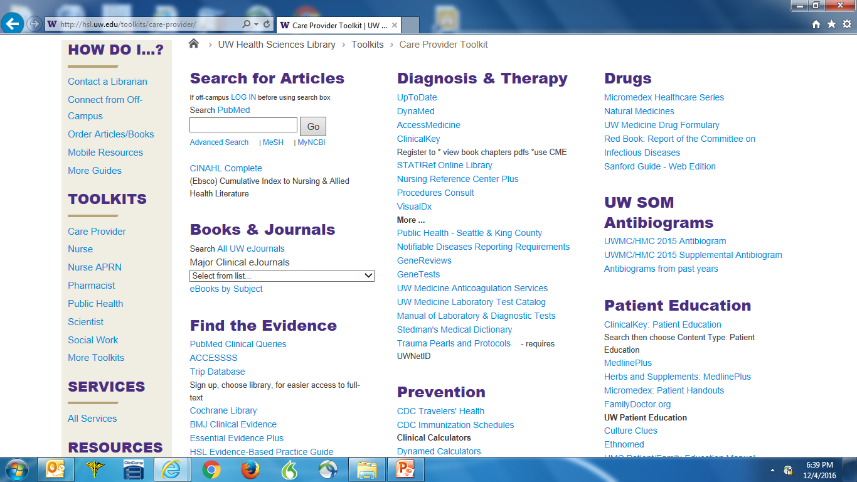

Slide 14
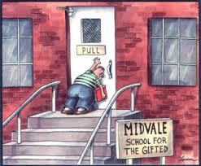
Prompt/Pull/Push
Prompt: “highest” level; system level fix
Pull: you go searching for the evidence
Push: evidence info is sent to you
Notes:
To be motivated to learn a skill,
the learner must understand why the skill is needed and how it is used in the delivery of care.
Student must learn appropriate clinical scenario in which the skill is used.
Must know the precautions involved.
Know the tools needed to perform the skill.
(emphasize the decision making process)
ASSESS the learner

Slide 15
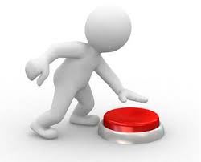
How to “Push” Evidence
Cancel your full-text journal subscriptions
Subscribe to table of contents
Invest in EBM journals and online services
Journal Watch
Medscape/MedPage
Daily POEM
Podcasts: BS Medicine, Primary Care RAP
Prescriber’s Letter/Medical Letter
ACP Journal Club
Notes:
The preceptor should demonstrate the skill exactly as it should be done without talking through the procedure.
This silent demonstration gives students a mental picture of what the skill looks like when it is being done correctly.
Allows for visualization of a model of the performance expected.
This image is important since students will use this picture to self-evaluate their own performance when practicing the skill.

Slide 16
Got Apps?
How many of you have a smartphone?
How often do you use it in clinic? Wards?
Which apps do you use the most?

Slide 17
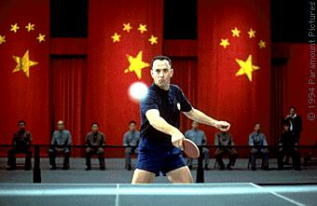
Information Anxiety
Too much information
“Ping-pong” between sources
“My last case…In my experience…”
How do we find the “truth”?
Notes:
Most physicians suffer from TMI: Too Much Information; Medline indexes over 2000 articles/day; If it takes 30 min to read an article and critically appraise it and you read continuously for 16 hours/day, you would be 2 months behind in 1 day, 3 months if you stopped to eat
the local newspaper or CNN has this week’s NEJM abstracts before you do!—your patients are bringing you articles/news bytes off the internet;
As we sit in this lecture, a pharm rep is probably outside waiting patiently to tell you all about their newest medication;
Furthermore, we often find our most trusted sources conflicting: causing the dreaded “ping-pong effect”
The American Urological Association recommends a PSA on asymptomatic men over age 50 with a 10 year life expectancy, earlier if there is a fam. Hx of prostate CA, BUT the US Preventative Services Task Force states there is insufficient evidence for or against routine PSA testing? What should you do?
You Must avoid the traps of “my last case”/”In my experience”—we can’t practice “best” medicine with an “N” of 1 or even 10 or 20
How do we find the “truth”? How do we find POEMS?

Slide 18
DOE versus POEM
Disease-Oriented Evidence
Etiology, pathophysiology, pharmacology
Intermediate outcomes
Patient-Oriented Evidence that Matters
Morbidity, mortality, quality of life
The “so-what” questions
Notes:
So by a show of hands, who has heard of the EBM acronyms: DOE and POEM?
Great! Anyone care to share with us what they stand for?
(Audience Participation)
So a DOE: deals with etiology, pathophysiology, pharmacology; intermediate outcomes; ie-H. pylori is associated with afib. DOE’s are crucial to medicine, w/o DOE’s there would be no POEMs; we must know how a disease works before we can dx, tx or cure it
POEMs: deals with morbidity, mortality, quality of life; outcomes; the “so-what”! Ie-Treating H. pylori decreases risk of Afib—not been proven yet but under study! Another example is the CAST I trial. It looked at suppressing ventricular ectopy post MI c flecainide and encainide etc—sounded good on paper, but in reality, it actually increased mortality!! (the DOE was that class I antiarrthymics could suppress ectopy, the POEM was that suppressing ectopy increased mortality!)
So how much of the literature is composed of DOES and POEMS? The Numbers….
In a 6 month survey of 90 journals:
8,047 articles
213 POEMs
97% DOEs and other material
3% POEMs
So YES they are illusive!

Slide 19
DOE versus POEM
Disease-Oriented Evidence
Etiology, pathophysiology, pharmacology
Intermediate outcomes
Patient-Oriented Evidence that Matters
Morbidity, mortality, quality of life
The “so-what” questions
Notes:
So by a show of hands, who has heard of the EBM acronyms: DOE and POEM?
Great! Anyone care to share with us what they stand for?
(Audience Participation)
So a DOE: deals with etiology, pathophysiology, pharmacology; intermediate outcomes; ie-H. pylori is associated with afib. DOE’s are crucial to medicine, w/o DOE’s there would be no POEMs; we must know how a disease works before we can dx, tx or cure it
POEMs: deals with morbidity, mortality, quality of life; outcomes; the “so-what”! Ie-Treating H. pylori decreases risk of Afib—not been proven yet but under study! Another example is the CAST I trial. It looked at suppressing ventricular ectopy post MI c flecainide and encainide etc—sounded good on paper, but in reality, it actually increased mortality!! (the DOE was that class I antiarrthymics could suppress ectopy, the POEM was that suppressing ectopy increased mortality!)
So how much of the literature is composed of DOES and POEMS? The Numbers….
In a 6 month survey of 90 journals:
8,047 articles
213 POEMs
97% DOEs and other material
3% POEMs
So YES they are illusive!

Slide 20
DOE versus POEM
Disease-Oriented Evidence
Etiology, pathophysiology, pharmacology
Intermediate outcomes
Patient-Oriented Evidence that Matters
Morbidity, mortality, quality of life
The “so-what” questions
Notes:
So by a show of hands, who has heard of the EBM acronyms: DOE and POEM?
Great! Anyone care to share with us what they stand for?
(Audience Participation)
So a DOE: deals with etiology, pathophysiology, pharmacology; intermediate outcomes; ie-H. pylori is associated with afib. DOE’s are crucial to medicine, w/o DOE’s there would be no POEMs; we must know how a disease works before we can dx, tx or cure it
POEMs: deals with morbidity, mortality, quality of life; outcomes; the “so-what”! Ie-Treating H. pylori decreases risk of Afib—not been proven yet but under study! Another example is the CAST I trial. It looked at suppressing ventricular ectopy post MI c flecainide and encainide etc—sounded good on paper, but in reality, it actually increased mortality!! (the DOE was that class I antiarrthymics could suppress ectopy, the POEM was that suppressing ectopy increased mortality!)
So how much of the literature is composed of DOES and POEMS? The Numbers….
In a 6 month survey of 90 journals:
8,047 articles
213 POEMs
97% DOEs and other material
3% POEMs
So YES they are illusive!

Slide 21
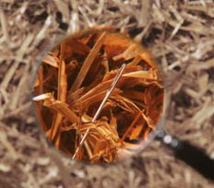
Dr Maurer’s POEM Finder
Qx Calculate
Dr Steinberg, Dr Brancel
Epocrates or Lexicomp
Hopkins or Sanford Guide
Prescriber’s Letter
Kidometer
UpToDate
Dynamed
Essential Evidence Plus
AFP by Topic
Medscape
PubMed4Hh
Notes:
So how do you pick? How do you find the “needle in the haystack?”
The real trick of what source to pick depends on the particular question/clinical scenario…ie—”it depends”…J
So, here are my suggestions based “my expert opinion”, but before you laugh, there ARE studies on UpToDate, InfoPOEMS, and Epocrates that demonstrate their ease of use, timeliness and most importantly, ACCURACY!!! So really, my Algorithm of sorts IS evidence based…
For general knowledge, most EBM or expert opinion type questions—UpToDate is a great place to start.
For specific EBM, clinical calculations, practice guideline questions—go to InfoPOEMS—just make sure you get a subscription!
For drug/bug questions, Johns Hopkins Guide and/or Epocrates
Use PubMed if you want to see the specific reference or if the 1st 3 aren’t working!
If you still aren’t getting the answer, then the sources on this next page (next slide) is a great next step!

Slide 22
Dr Maurer’s POEM Finder
MDCalc or Qx Calculate
Dr Steinberg, Dr Brancel
Epocrates or Lexicomp
Hopkins or Sanford Guide
ASCVD, Aspirin Guide
Pedi QuikCalc, PediSTAT
OB Wheel, GBS, Preg A-Z
HEART Pathway, SI Sepsis
UpToDate
Dynamed Plus
EE+
Medscape
AFP by Topic
PubMed4Hh
AHRQ ePSS
Prescriber’s Letter
Notes:
May want to consider working in HEART Pathway?? SmartIntern Sepsis? AAP NRP?
So how do you pick? How do you find the “needle in the haystack?”
The real trick of what source to pick depends on the particular question/clinical scenario…ie—”it depends”…J
So, here are my suggestions based “my expert opinion”, but before you laugh, there ARE studies on UpToDate, InfoPOEMS, and Epocrates that demonstrate their ease of use, timeliness and most importantly, ACCURACY!!! So really, my Algorithm of sorts IS evidence based…
For general knowledge, most EBM or expert opinion type questions—UpToDate is a great place to start.
For specific EBM, clinical calculations, practice guideline questions—go to InfoPOEMS—just make sure you get a subscription!
For drug/bug questions, Johns Hopkins Guide and/or Epocrates
Use PubMed if you want to see the specific reference or if the 1st 3 aren’t working!
If you still aren’t getting the answer, then the sources on this next page (next slide) is a great next step!

Slide 23
Case 1
An 85 y/o male with Type II diabetes, hypertension, and hyperlipidemia has an A1c of 8, and a blood pressure of 145/90.
What is his goal A1C?
What is his goal blood pressure?
He is on a statin. Should he be?
3 Minutes
Notes:
I want you to first think about the best answer to each question you already have stored in your brain, then think about which information source you would usually turn to first to answer the question. So where would you like to go to answer these questions? (let the audience name several sources)
OK, those are all great ideas, lets go (here) first….(trial of their chosen source for about 3 mins)…

Slide 24
Where Would I Go?
UpToDate
OR
Dynamed
+/-
ASCVD, ADA, AgileMD, ePSS
Notes:
OK, so if I had this question, I would go here—UpToDate.
Let me show you some tricks on UpToDate
(show answers to case 1 via UpToDate, show how to search on UpToDate and how to narrow searches…)

Slide 25
Case 2
A 65 y/o male presents with CAP, PMHx of Afib, CHF, Tmax 101.5, RR 35, HR 130, and BUN 35.
Should the patient be hospitalized?
What antibiotics to use?
What about drug interactions with warfarin?
What immunizations should he receive?
3 Minutes
Notes:
Lot’s of questions here! Where would you go to answer them? Options?? (collect their options again, but this time…)
Those are all great ideas. Let me show you one of my favorite sources and give THAT a try for these questions…its called InfoPOEMS!
Has anyone here, used InfoPOEMS? I noticed TAMC does NOT have an institutional subscription, but more on that latter…L

Slide 26
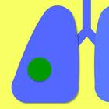
Where Would I Go?
UpToDate, Dynamed, EE+
OR
Pneumonia, Qx Calculate
AND/OR
Hopkins Abx Guide, Sanford Guide
AND/OR
Epocrates, Lexicomp
AND
SHOTS

Slide 27
Case 3
An 55 y/o AA male with Type II diabetes, hypertension, and hyperlipidemia has an A1c of 7, and a BP 145/90. No history of GI bleeding. Non-smoker.
Should this patient be on aspirin? NNT? NNH?
What if the patient has a history of PVD?
What if they had a history of PUD?
What if he were a she? 75 years old?
3 Minutes
Notes:
I want you to first think about the best answer to each question you already have stored in your brain, then think about which information source you would usually turn to first to answer the question. So where would you like to go to answer these questions? (let the audience name several sources)
OK, those are all great ideas, lets go (here) first….(trial of their chosen source for about 3 mins)…

Slide 28
Where Would I Go?
Aspirin Guide
OR
ePSS
Notes:
OK, so if I had this question, I would go here—UpToDate.
Let me show you some tricks on UpToDate
(show answers to case 1 via UpToDate, show how to search on UpToDate and how to narrow searches…)

Slide 29
Case 4
A 47 y/o male presents to ER with chest pain: left-sided, worse with exertion, no nausea, diaphoresis or radiation. PMHx sig for HTN, Fam hx of CAD 1st relative at 56. EKG wnl.
Admit and rule-out? GXT in ER?
Would you do serial troponins? How many?
What if patient was 65? Female?
3 Minutes
Notes:
Lot’s of questions here! Where would you go to answer them? Options?? (collect their options again, but this time…)
Those are all great ideas. Let me show you one of my favorite sources and give THAT a try for these questions…its called InfoPOEMS!
Has anyone here, used InfoPOEMS? I noticed TAMC does NOT have an institutional subscription, but more on that latter…L

Slide 30
Where Would I Go?
HEART Pathway
OR
QxCalculate
Notes:
OK, so if I had this question, I would go here—UpToDate.
Let me show you some tricks on UpToDate
(show answers to case 1 via UpToDate, show how to search on UpToDate and how to narrow searches…)

Slide 31
Case 5
A 30 y/o G2P101 at 38 wks presents in active labor. NO GBS testing was performed. Membranes ruptured at home 8 hours ago and baby delivers precipitously….
Did this patient require GBS prophylaxis?
What work-up does the infant require?
What if the newborn is ill appearing/febrile?
3 Minutes
Notes:
I want you to first think about the best answer to each question you already have stored in your brain, then think about which information source you would usually turn to first to answer the question. So where would you like to go to answer these questions? (let the audience name several sources)
OK, those are all great ideas, lets go (here) first….(trial of their chosen source for about 3 mins)…

Slide 32
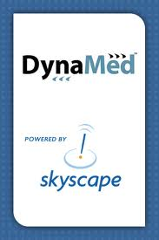
Where Would I Go?
UpToDate
OR
Dynamed
OR
Prevent GBS
Notes:
OK, so if I had this question, I would go here—UpToDate.
Let me show you some tricks on UpToDate
(show answers to case 1 via UpToDate, show how to search on UpToDate and how to narrow searches…)

Slide 33
Dr Maurer’s POEM Finder
Qx Calculate
Dr Steinberg, Dr Brancel
Epocrates or Lexicomp
Hopkins or Sanford Guide
Prescriber’s Letter
Kidometer
UpToDate
Dynamed
Essential Evidence Plus
AFP by Topic
Medscape
PubMed4Hh
Notes:
So how do you pick? How do you find the “needle in the haystack?”
The real trick of what source to pick depends on the particular question/clinical scenario…ie—”it depends”…J
So, here are my suggestions based “my expert opinion”, but before you laugh, there ARE studies on UpToDate, InfoPOEMS, and Epocrates that demonstrate their ease of use, timeliness and most importantly, ACCURACY!!! So really, my Algorithm of sorts IS evidence based…
For general knowledge, most EBM or expert opinion type questions—UpToDate is a great place to start.
For specific EBM, clinical calculations, practice guideline questions—go to InfoPOEMS—just make sure you get a subscription!
For drug/bug questions, Johns Hopkins Guide and/or Epocrates
Use PubMed if you want to see the specific reference or if the 1st 3 aren’t working!
If you still aren’t getting the answer, then the sources on this next page (next slide) is a great next step!

Slide 34
Dr Maurer’s POEM Finder
MDCalc or Qx Calculate
Dr Steinberg, Dr Brancel
Epocrates or Lexicomp
Hopkins or Sanford Guide
ASCVD, Aspirin Guide
Pedi QuikCalc, PediSTAT
OB Wheel, GBS, Preg A-Z
HEART Pathway, SI Sepsis
UpToDate
Dynamed Plus
EE+
Medscape
AFP by Topic
PubMed4Hh
AHRQ ePSS
Prescriber’s Letter
Notes:
May want to consider working in HEART Pathway?? SmartIntern Sepsis? AAP NRP?
So how do you pick? How do you find the “needle in the haystack?”
The real trick of what source to pick depends on the particular question/clinical scenario…ie—”it depends”…J
So, here are my suggestions based “my expert opinion”, but before you laugh, there ARE studies on UpToDate, InfoPOEMS, and Epocrates that demonstrate their ease of use, timeliness and most importantly, ACCURACY!!! So really, my Algorithm of sorts IS evidence based…
For general knowledge, most EBM or expert opinion type questions—UpToDate is a great place to start.
For specific EBM, clinical calculations, practice guideline questions—go to InfoPOEMS—just make sure you get a subscription!
For drug/bug questions, Johns Hopkins Guide and/or Epocrates
Use PubMed if you want to see the specific reference or if the 1st 3 aren’t working!
If you still aren’t getting the answer, then the sources on this next page (next slide) is a great next step!

Slide 35
Best of the Rest
Medical Letter
RxFiles
QxRead
STAT!Ref
ClinicalKey
Journal Club
CASP
Anticoag Eval
VisualDx
ASCCP
AACE Diabetes
Endo Companion
AAP NRP
Kids Doc
Postpartum Hemorrhage
Ilithyia
AGS GEMS
Psych on Demand
COPD Pocket Consultant
ESCAVO Sepsis

Slide 36
ACCORD Trial

Slide 37
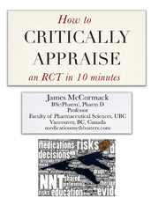
How to Review an RCT in 10 Minutes

Slide 38
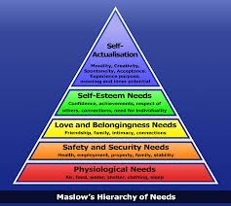
What Are Your Needs?
Read the title…does it interest you?
What was the comparison? (PICO!)
What are the outcomes? DOE or POEM?
Look for the duration…long enough?
Read the conclusion…game changer?

Slide 39
Search for Bias
Randomized?
Blinded?
Allocation/concealment?
Intention to treat?
Follow-up/dropouts?
Conflicts of interest?

Slide 40
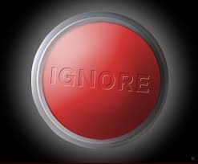
Ignore the Rest of the Paper!
Ignore the Introduction
Ignore the rest of the Methods
Ignore the statistical testing(!)
Ignore the Discussion

Slide 41
Who Was Studied?
AKA Table 1
Any major group differences?
Study participants like your patients?

Slide 42
What Happened?
AKA Table 2 and 3
Outcomes
Primary outcome
ARR, RRR
Confidence intervals, P values
Adverse events

Slide 43
Who Cares?
Create a summary table
Create a summary PICO statement

Slide 44
Resources
How to Review an RCT in Ten Minutes
https://itunes.apple.com/ca/book/how-to-critically-appraise/id524600667?mt=11
Best Science Medicine Podcast
http://therapeuticseducation.org/
Critical Appraisal Worksheets
http://www.casp-uk.net/#!casp-tools-checklists/c18f8
Club J
http://www.usafp.org/committees/education/fellowships/madigan-faculty-development/madigan-fac-dev-journal-club/
Madigan Faculty Development Fellowship APAN
https://apan.org

Slide 45
Objectives
Discussed the 6S approach to EBM
Practiced answering EBM questions using the best sources on our mobile devices
Reviewed one critical appraisal system
Practiced using that system on a journal article
Notes:
By the end of this session, we will have…

Slide 46
Questions?

