Slide 1
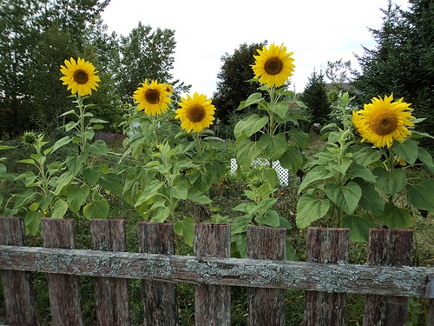
Growing Your Engagement Garden: Making Patient and Family Engagement Work in a Family Medicine Resident Clinic
Aimee English MD, University of CO FMR
Roxanne Radi, University of CO FMR
Emilie Buscaj MPH, Health TeamWorks

Slide 2
Disclosures
Aimee English – nothing to disclose
Roxanne Radi – nothing to disclose
Emilie Buscaj – employed as a practice facilitation program manager by HealthTeamWorks, a nonprofit company that provides practice transformation support

Slide 3
Objectives
Upon completion of this session, participants should be able to:
Name at least three methods of soliciting patient and family member feedback in a meaningful way in the ambulatory setting.
Identify three tips for a successful start to engaging patients and families within their residency practice.
Identify one to two ways to incorporate learners into the clinic’s patient and family engagement work
Notes:
3 methods
3 tips for successful start
1-2 ways to incorporate learners

Slide 4
“Patients do not focus on prettier waiting rooms, better hospital food, or problems with parking. Rather, they are concerned about issues of clinical significance that have nothing to do with what we think of as the doctor’s ‘image’ or the hospital’s ‘atmosphere.’ They want to be able to trust the competence and efficiency of their caregivers. They want to be able to negotiate the health care system effectively and to be treated with dignity and respect.” – Thomas L Debanco, MD
Delbanco, Thomas L. Enriching the Doctor-Patient Relationship by Inviting the Patient’s Perspective. Ann Int Med. 1992; 116:414-418.
Notes:
Delbanco - Researcher who did a series of 8 focus groups in 1988 of patients recently discharged from hospitals; included patients, families, nurses, physicians, social workers, health administrators.

Slide 5
Overview
Background
Methods of Engaging Patients and Families within Your Clinic
Overcoming Perceived Barriers
Tips for Success
Advisor Recruitment Strategies
Integrating Learners

Slide 6
Background
Carman KL, et al. Patient and Family Engagement: A Framework for Understanding the Elements and Developing Interventions and Policies. Health Affairs 32, No 2 (2013): 223 – 231.

Slide 7
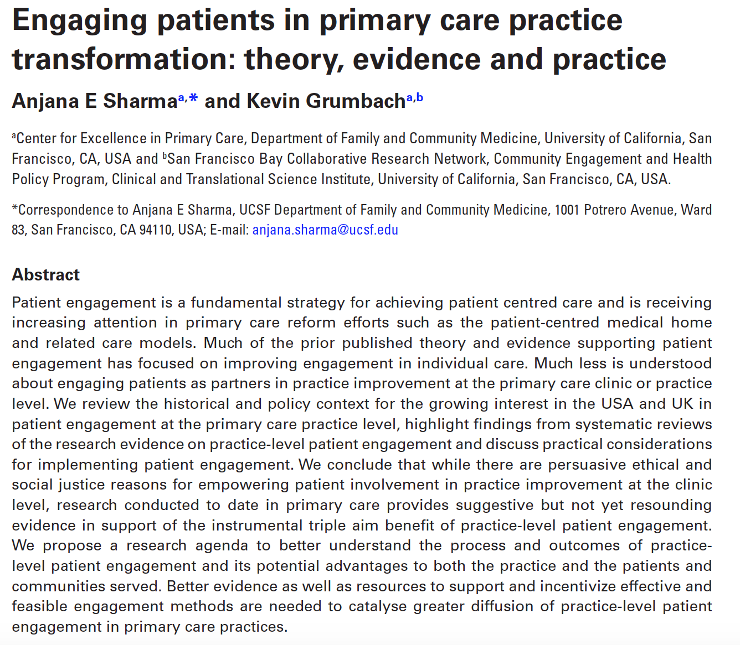
Background
Notes:
1st Review on Pt and Fam engagement at the practice level – published in Oxford’s Family Practice (international journal)
Ethical call to engage pts/families
Strong evidence does not yet exist on its effect on triple aim
Propose research agenda
Propose incentivizing practice-level patient engagement in PC practices

Slide 8
Background
When patients assist in selecting quality improvement topics the choices they make are more aligned with core components of the Chronic Care Model. Time to reach consensus is only minimally increased (by 10%).²
High value on patient engagement in clinic quality improvement may enhance individual self-management support¹
Patient feedback on practice redesign offers information that can improve patient satisfaction³
1 Han, E.; Hudson Scholle, S.; Morton, S.; Bechtel, C.; Kessler, R., Health affairs (Project Hope) 2013, 32 (2), 368-75.
2 Boivin, A.; Lehoux, P.; Lacombe, R.; Burgers, J.; Grol, R., Implement Sci 2014, 9.
3 Van Berckelaer, A.; DiRocco, D.; Ferguson, M.; Gray, P.; Marcus, N.; Day, S., J Am Board Fam Med 2012, 25 (2), 192-8.

Slide 9
Background – Growing National Trend
FMAH – engagement is 1 of 6 priority areas
CMS:
TCPI – $$ to Support and Alliance Network to facilitate increased patient engagement
CPCI/CPC+ - pt/family engagement in practice is core component
NCQA 2017 guidelines – earn 2 credits for pt/fam/caregiver involvement in practice’s governance structure or on stakeholder committees.
Notes:
FMAH –1 of 6 priority areas
CMS – TCPI and CPCI/CPC+
NCQA 2017

Slide 10
Presenters’ Personal Experience
Practice Facilitation
CO Residency Project (PI: Perry Dickinson)
AF Williams Clinic Patient Advisory Council
Patients as Teachers

Slide 11
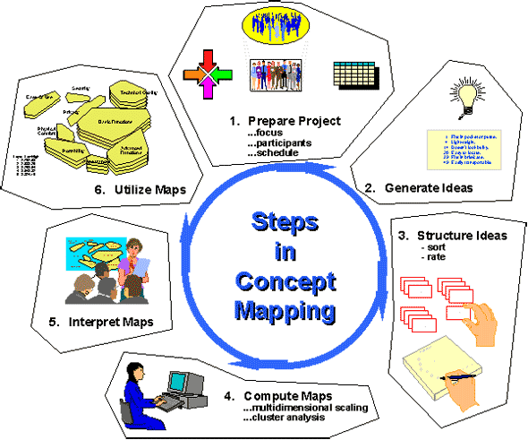
Methods of Engaging Patients & Families or Getting Feedback
Experience Surveys
QI Teams
Leadership Mtgs
PFAC
Group Concept Mapping
One-time Focus Groups
Waiting Room Rounds
LaNoue M, et al. Concept Mapping as a Method to Engage Patients in Clinical Quality Improvement. Ann Fam Med. 2016, 14(2): 370 – 376.
Notes:
Experience Surveys
PFAC
QI Teams
Focus Groups
Group Concept Mapping – has been used in community-based participatory research, but some have applied to practice. Pts recruited from waiting room over 6 half day sessions, $10 gc for participation, 41 pts; given a question prompt (“What are some ways that patients can be involved at our practice in order to improve the care we provide?”, participants brainstorm – participate individually or in groups after Ovs – responses were left on the board all day so subsequent involved parties could build off prior ideas; the data is then sorted – for this project, pts asked to rank on a scale of 1-5 the impact and feasibility of each idea generated; can use mapping software based on ranking
Waiting Room Rounds
Discuss longitudinal vs. one point in time
Bidirectional feedback
Shared agendas vs. not
Time of work varies per method (not going to do a project with waiting room rounds, etc). One touch might be good for gaining insight on a specific issues or ranking priorities for QI work.

Slide 12
Methods of Engaging Patients & Families or Getting Feedback
Experience Surveys
QI Teams
Leadership Mtgs
PFAC
?
Group Concept Mapping
Focus Groups
Waiting Room Rounds
Notes:
Experience Surveys
PFAC
QI Teams
Focus Groups
Group Concept Mapping
Waiting Room Rounds
Discuss longitudinal vs. one point in time
Bidirectional feedback
Shared agendas vs. not
Time of work varies per method (not going to do a project with waiting room rounds, etc). One touch might be good for gaining insight on a specific issues or ranking priorities for QI work.

Slide 13
Patient experience surveys
Waiting room rounds
Clinic focus groups
Patient and family advisory boards
Patient and family advisors on QI teams
Carman KL, et al. Patient and Family Engagement: A Framework for Understanding the Elements and Developing Interventions and Policies. Health Affairs 32, No 2 (2013): 223 – 231.

Slide 14
Patient Experience Surveys
Pros | Cons | Might Be a Good Fit If:
Relatively easy to use | Results can only be as good as the questions asked | A practice is very unable to adopt more involved methods on the continuum of engagement
May be required of clinic by larger (hospital, payer) system | Low response rates are typical and responders are often polarized | A practice is required to do a survey based on institution requirements
May be more helpful if internally developed with specific questions in mind for informing QI efforts |  | A practice is unable to protect a staff member’s time to organize other methods of pt/fam engagement
Notes:
Slides will be uploaded
Pros – easy, consistent with hospital requirements
Cons – only as good as the questions you ask
Good fit if – already required, not ready to do other things

Slide 15
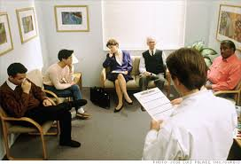
Waiting Room Rounding
Pros | Cons | Might Be a Good Fit If:
Relatively easy to do | Does not afford patients and families time to give thoughtful feedback | Leadership is ready to act on direct patient feedback, but not yet ready to support higher methods of patient partnership
Allows two-way conversation to develop | May promote discourage accurate feedback given lack of anonymity | A practice is unable to protect a staff member’s time to organize other methods of pt/fam engagement
Allows catchment of patients/families who may not otherwise complete surveys or attend meetings | May be hard to put into action without a follow up implementation plan | Practice has a specific issue that they would like feedback on
Can tailor questions to specific clinic issues
Notes:
Pros – fairly easy to do
Cons – Time to give thoughtful feedback, loss of group think, need to think about implementation plan
Good fit if – engaged leadership limited by administrative resources to do a more longitudinal methods; have a specific issue looking for feedback on

Slide 16
Group Concept Mapping
Pros | Cons | Might Be a Good Fit If:
Relatively easy to do | May not allow for “group think” | Leadership is ready to act on direct patient feedback, but not yet ready to support higher methods of patient partnership
Allows two-way conversation to develop | May discourage accurate feedback given lack of anonymity | A practice is unable to protect a staff member’s time to organize other methods of pt/fam engagement
Allows catchment of patients/families who may not otherwise complete surveys or attend meetings | May be hard to put into action without a follow up implementation plan | Practice has a specific issue that they would like feedback on
Can tailor questions to specific clinic issues
Notes:
Pros – convenient to catch pts and families while they are there; occurs outside of waiting room – might yield more honest results
Cons – May be hard to put into actions without a follow up plan; pts/fams don’t get to hear results
Good fit if – Same as waiting room rounding

Slide 17
Focus Groups
Pros | Cons | Might Be a Good Fit If:
Great for one touch issue discussions | Requires recruitment | Clinic has an engaged pt/fam engagement champion, but leadership not willing to support higher methods of patient partnership
Can be a method for engaging non-english speaking patients if translation services are limited | Requires strong facilitation skills to engage group given lack of time to develop team dynamics/trust | Clinic has been dissatisfied with patient surveys as a means of engaging patients in improving the clinic
May be more meaningful than survey data; May stimulate some “group think” |  | QI teams have projects already established and leadership is not well poised to implement change from advisory board feedback
Can be used as a “try out” for developing an advisory board |  | Clinic has a desire to capture a target population for one-time feedback.
Notes:
Pros – Use of group brainstorming for specific issues; translation services
Cons – recruitment = more administrative effort; facilitation key
Good fit if – Practice ready to start moving toward more longitudinal methods of engagement – can be used as a way to find pt/fam advisors

Slide 18
Advisors on QI Teams
Pros | Cons | Might Be a Good Fit If:
Allows platform for shared leadership | Requires investment in educating pt/fam advisors about QI | QI team is lead by a strong facilitator who values patient and family engagement
Patients can serve as powerful source of persuasion for staff or providers reluctant to engage in QI/practice transformation | Requires investment in creating a level playing field during meetings | Clinic has been dissatisfied with patient surveys as a means of engaging patients in improving the clinic
Allows for patients/families and health professionals to learn from each other | Requires recruitment and selection of patient/family advisors | QI teams are newly forming and have not yet developed implementation plans (i.e. there is opportunity for pt/family input)
Allows clinic to avoid wasting time on QI projects patients don’t care about |  | Bulk of clinic’s practice transformation work happens in small, QI teams
Notes:
Pros – shared leadership, smaller group may allow pt voice to soar
Cons – Requires widespread in pt/fam engagement to level the playing field
Good Fit if – QI teams are just starting! Or starting new projects – to avoid tokenism

Slide 19
Advisory Boards
Pros | Cons | Might Be a Good Fit If:
Allows platform for shared leadership | Requires investment in educating pt/fam advisors about clinic work flows | Clinic has been dissatisfied with patient surveys as a means of engaging patients in improving the clinic
Patients can serve as powerful source of persuasion for staff or providers reluctant to engage in QI/practice transformation | Requires investment in creating a level playing field during meetings | Clinic practice transformation works happens mostly in all clinic meeting and not in smaller QI teams (advisory board leader can bridge to this meeting)
Allows for patients/families and health professionals to learn from each other | Requires recruitment and selection of patient/family advisors | Clinic leadership has capacity/interest to make changes based on advisory board suggestions
Allows clinic to avoid wasting time on directions patients don’t care about | Requires protection of staff member(s) time for meetings, agenda creation, e-mailing, etc.
Notes:
Pros – helps move culture on pt engagement; group dynamics, true advisor role can develop
Cons – Takes time which needs to be protected
Good fit if – large QI teams

Slide 20
Overcoming Perceived Barriers
“We’re just not ready. We need to get our QI teams off the ground and then we’ll invite patients and families to the table.”
Common concern about revealing “what’s behind the curtain” when in reality, patients already know healthcare is messy.
Patient/family advisors engaged from the onset are more likely to productively contribute
“It is most likely that the majority of patient advisors have been exposed to a variety of health care facilities and would understand that there are barriers to system changes that an individual clinic or office are unable to make unilateral changes.” – CO patient advisor
Notes:
Surveyed pt advisors about what to tell practices that are reluctant to engage pts at the practice level?

Slide 21
Overcoming Perceived Barriers
“What if patient and family advisors ask us to change something we just can’t change?”
“Explain at the initial meeting or via email that while feedback, suggestions, recommendations are appreciated, they are not always feasible to implement. As long as this is made clear to the members, most people will understand that there are limitations to what a large organization can accomplish.” – CO patient advisor
They probably will…and it won’t be the end of the world.
These are often the greatest opportunities for discussions that foster mutual understanding of each other’s roles.

Slide 22
Overcoming Perceived Barriers
“We don’t have funding to start an advisory board or focus groups.”
Incentives are nice, but saying thank you can be free.
Many patient and family advisory boards run for years without a funding source.
The clinic does, however, need to be prepared to protect staff members’ time to attend meetings, create agendas, record and send out minutes, etc.

Slide 23
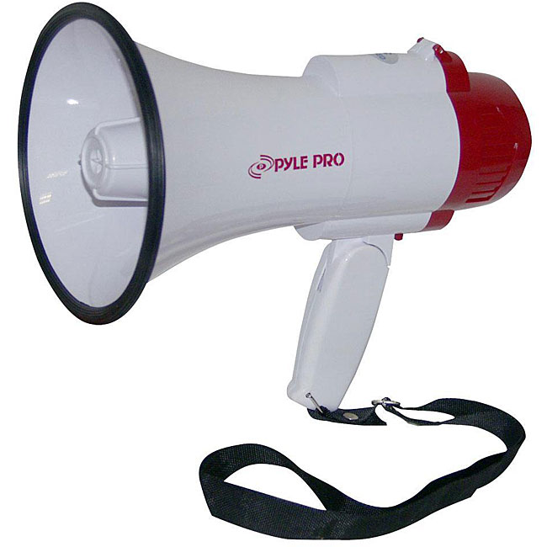
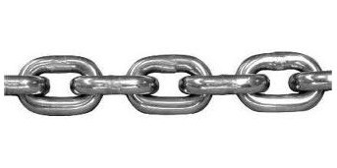
Tips for Success
Pt/Family Recommendations/Recommendations
Clinic
Leadership/Practice Members on Advisory Board
Other Clinic Staff and Providers
Strong interconnection between engaged leadership and patient/family advisors.
Advisors need to know results/updates.
Notes:
System for communication – info in the breakroom, standing agenda item at leadership meetings, emails, bathroom flyers, etc.

Slide 24
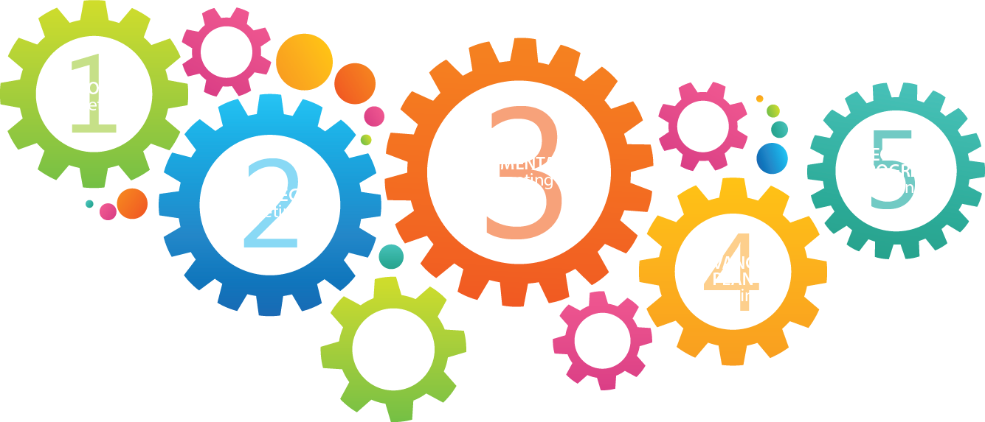
Tips for Success
Ask patient advisors for feedback?
Engage patients early in an intervention.

Slide 25
Tips for Success
Ask patient advisors for feedback?
Otherwise, they might feel tokenistic or that their advice won’t matter.

Slide 26
Tips for Success
Recruit Thoughtfully
Methods
The “right” patient
Meeting times → selection
Seek representation
Define advisor roles/mission upfront
Notes:
Methods – next slide
Think about the times you meet and how they influence who may or may not be able to attend (working adults, parents of young children)

Slide 27
Methods of Recruitment
Waiting room sign up
Provider referrals
Staff referrals
Use focus groups, group concept mapping, etc as a starting point
Notes:
Provider referrals may solicit more “experience in health care” type folks.

Slide 28
The “Right” Advisor
Willing to share their opinions and to listen to differing opinions of others
Willing to offer constructive criticism
Respectful of differing opinions and others with different backgrounds and experiences
Realize they represent others
Don’t have one agenda
Are motivated to affect change in ways that match mission
Notes:
Mission – next slide

Slide 29
Tips for Success
Have a clear mission that’s well understood by leadership, clinic members, and advisors.

Slide 30
Integrating Learners
Engage resident learners in PFAC meetings and QI teams with patients
Seek patient feedback or involvement on resident QI projects
Katz “Council of Elders” model
Katz AM et al. A council of elders: creating a multi-voiced dialogue in a community of care. Social Sciences & Medicine; 2000 (50): 851 – 860.
Notes:
“`Council of Elders' as an educational innovation in which we invited
community elders to function as our `Senior Faculty', to whom medical residents present their challenging and
heartfelt dilemmas in caring for elder patients. In the conversations that ensue, the elders come to function not
simply as teachers, but collaborators in a process in which doctors, researchers, and elders together create a
community of resources, capable of identifying novel ways to overcome health-related di.culties which might not
have been apparent to either group separately.
Meetings with the council became a required part of the residency

Slide 31
Integrating Learners – Case Presentations to Pt/Family Advisors
During AFW Patient Advisory Board
Meetings coincided with resident didactics
Every 4th meeting
3 residents attend – try to different years
1 presents, 2 observe; solicit case early
Case: “A patient case that sticks with you, preferably of a patient that you’ll see again.”
Notes:
Roxi/Aimee
Roxi: Share personal story

Slide 32
Integrating Learners – Case Presentations to Pt/Family Advisors
What Residents Thought:
“It was great! The council was very helpful in identifying that the presenter MD could only do so much for the patient--the patient had to help herself…”
“Good overall—a few thing I wouldn’t have thought of and was surprised at similar perspectives some of the advisors had.”
“I liked it! I go a lot from the discussion and I though the patient representatives were kind and it was a useful exercise.”
“I got some great advice on how to approach similar situations.”
“I learned the value of being open about all experiences; not just the ‘pretty ones.’ I think the most valuable thing I took away was communication.”
Notes:
Roxi

Slide 33
Integrating Learners – Case Presentations to Pt/Family Advisors
What Advisors Thought:
“The feedback was received well and my confidence was boosted as a contributing member of the group.”
“I really enjoyed it. It was educational, and very satisfying to think that we may have been of some assistance.”
“Interested but frustrating as situations all the same…doctor wants patient success, patient not as invested in success as doctor.”
“It was a valuable chance to hear story and give resident the point of view of a patient.”
Notes:
Roxi

Slide 34
Questions?
Email: Aimee.english@ucdenver.edu

Slide 35
Please evaluate this presentation using the conference mobile app! Simply click on the "clipboard" icon on the presentation page.

