Slide 1
Leveraging Support for the Design of Interdisciplinary Global Health Programs for Resident Physicians
Shay Slifko, MA
Martha Carlough, MD, MPH
Notes:
Martha does background of starting resident support/ political instability incites better risk mgmt

Slide 2
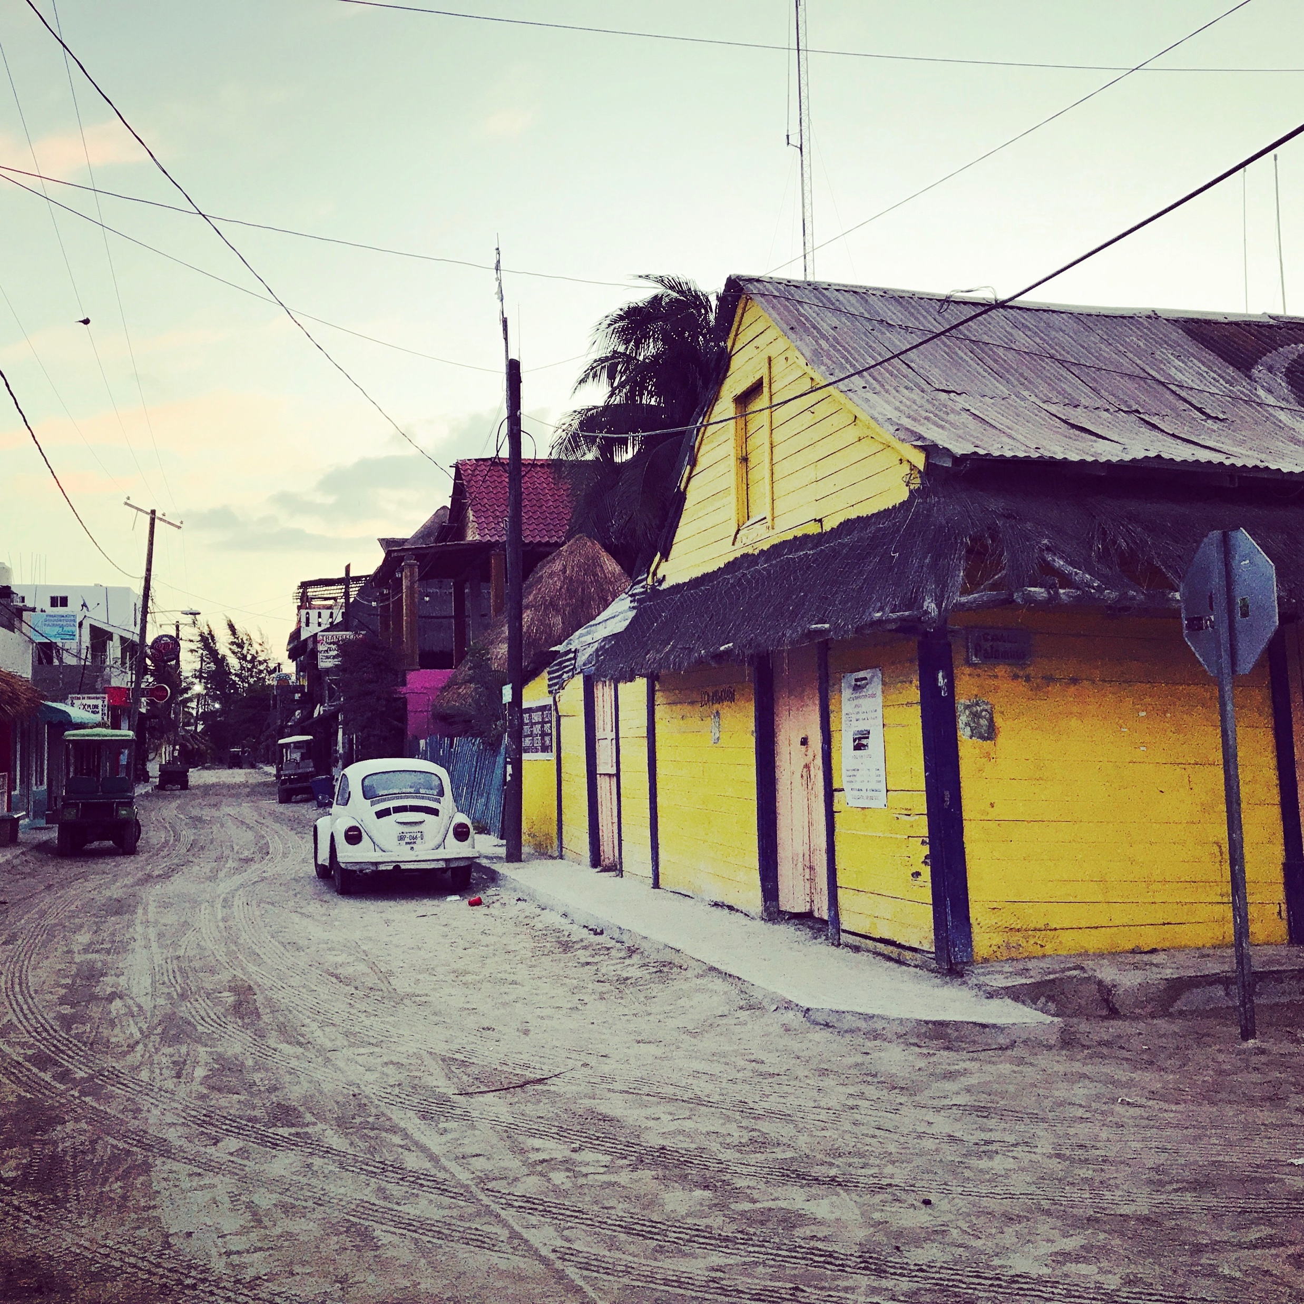
Introductions

Slide 3
UNC Office of International Activities (OIA) Objectives
Inform initiatives to broaden global health engagement
Brainstorm programmatic frameworks for resident involvement
Discuss lessons learned in a large university, interdisciplinary global health setting: what worked and what didn’t work
Notes:
The Office of International Activities (OIA) at University of North Carolina was founded to provide support to students and residents in global health. In order to more fully understand resident physicians’ educational needs, the OIA surveyed incoming first‑year residents of all specialties in July 2012. The residents identified significant barriers impeding their involvement in global health opportunities during residency including time constraints, finances and mentorship. In response to the survey results, an interdisciplinary educational initiative was developed at UNC. This included obtaining buy‑in from core residency and departmental leadership, establishing a clear process to arrange international experiences, provide mentorship and link resident with UNC faculty with ongoing expertise in their area and specialty of interest, provide competitive scholarships for travel, and initiation of interdisciplinary educational opportunities. Since integrating the programmatic, academic, and leadership endeavors , we now aim to revisit our residency global health support and assess lessons learned and creative methods for leveraging university-wide resources to robustly support and alleviate barriers for resident physician engagement in global health

Slide 4
Office of International Activities (OIA) Overview
Martha Carlough, MD, MPH, Director,
Shay Slifko, MA, Program Manager
Sylvia Becker-Dreps, MD, MPH, Associate Director, Latin America focus
Justin Myers, DO, MPH, Associate Director, Africa focus
Rawley Crews, Admin Support
Support, promote, publicize, and coordinate activities, accomplishments, and opportunities in global health and international medical education at UNC
Develop programmatic structure and support for UNC medical students and resident physicians interested in global health.
Guidance to student-led initiatives in global health formally supported by UNC, including: Physicians for Human Rights (Refugee health), Honduran Health Alliance, and Proyecto Puentes de Salud
Coordinate the International Visiting Student Program at UNC/SOM
Collaborate and cooperate with broader initiatives in global health and education at UNC
Take an active role in membership of Consortium of Universities in Global Health and other organizations to become a model for global health education and programming in medical school
Notes:
this is a CAMPUS wide agenda - interdisciplinary, but great to have FM leadership from Sylvia and I...

Slide 5
Key UNC Partners
UNC Hospital
GME Office
Residency Program Directors
School of Medicine
Institute for Global Health & Infectious Disease
Office of International Activities
Resident Physicians doing international rotations & global health center
Occupational Health
Notes:
Partner site team and partner site/UNC faculty …….Some are departmental, others site reps

Slide 6
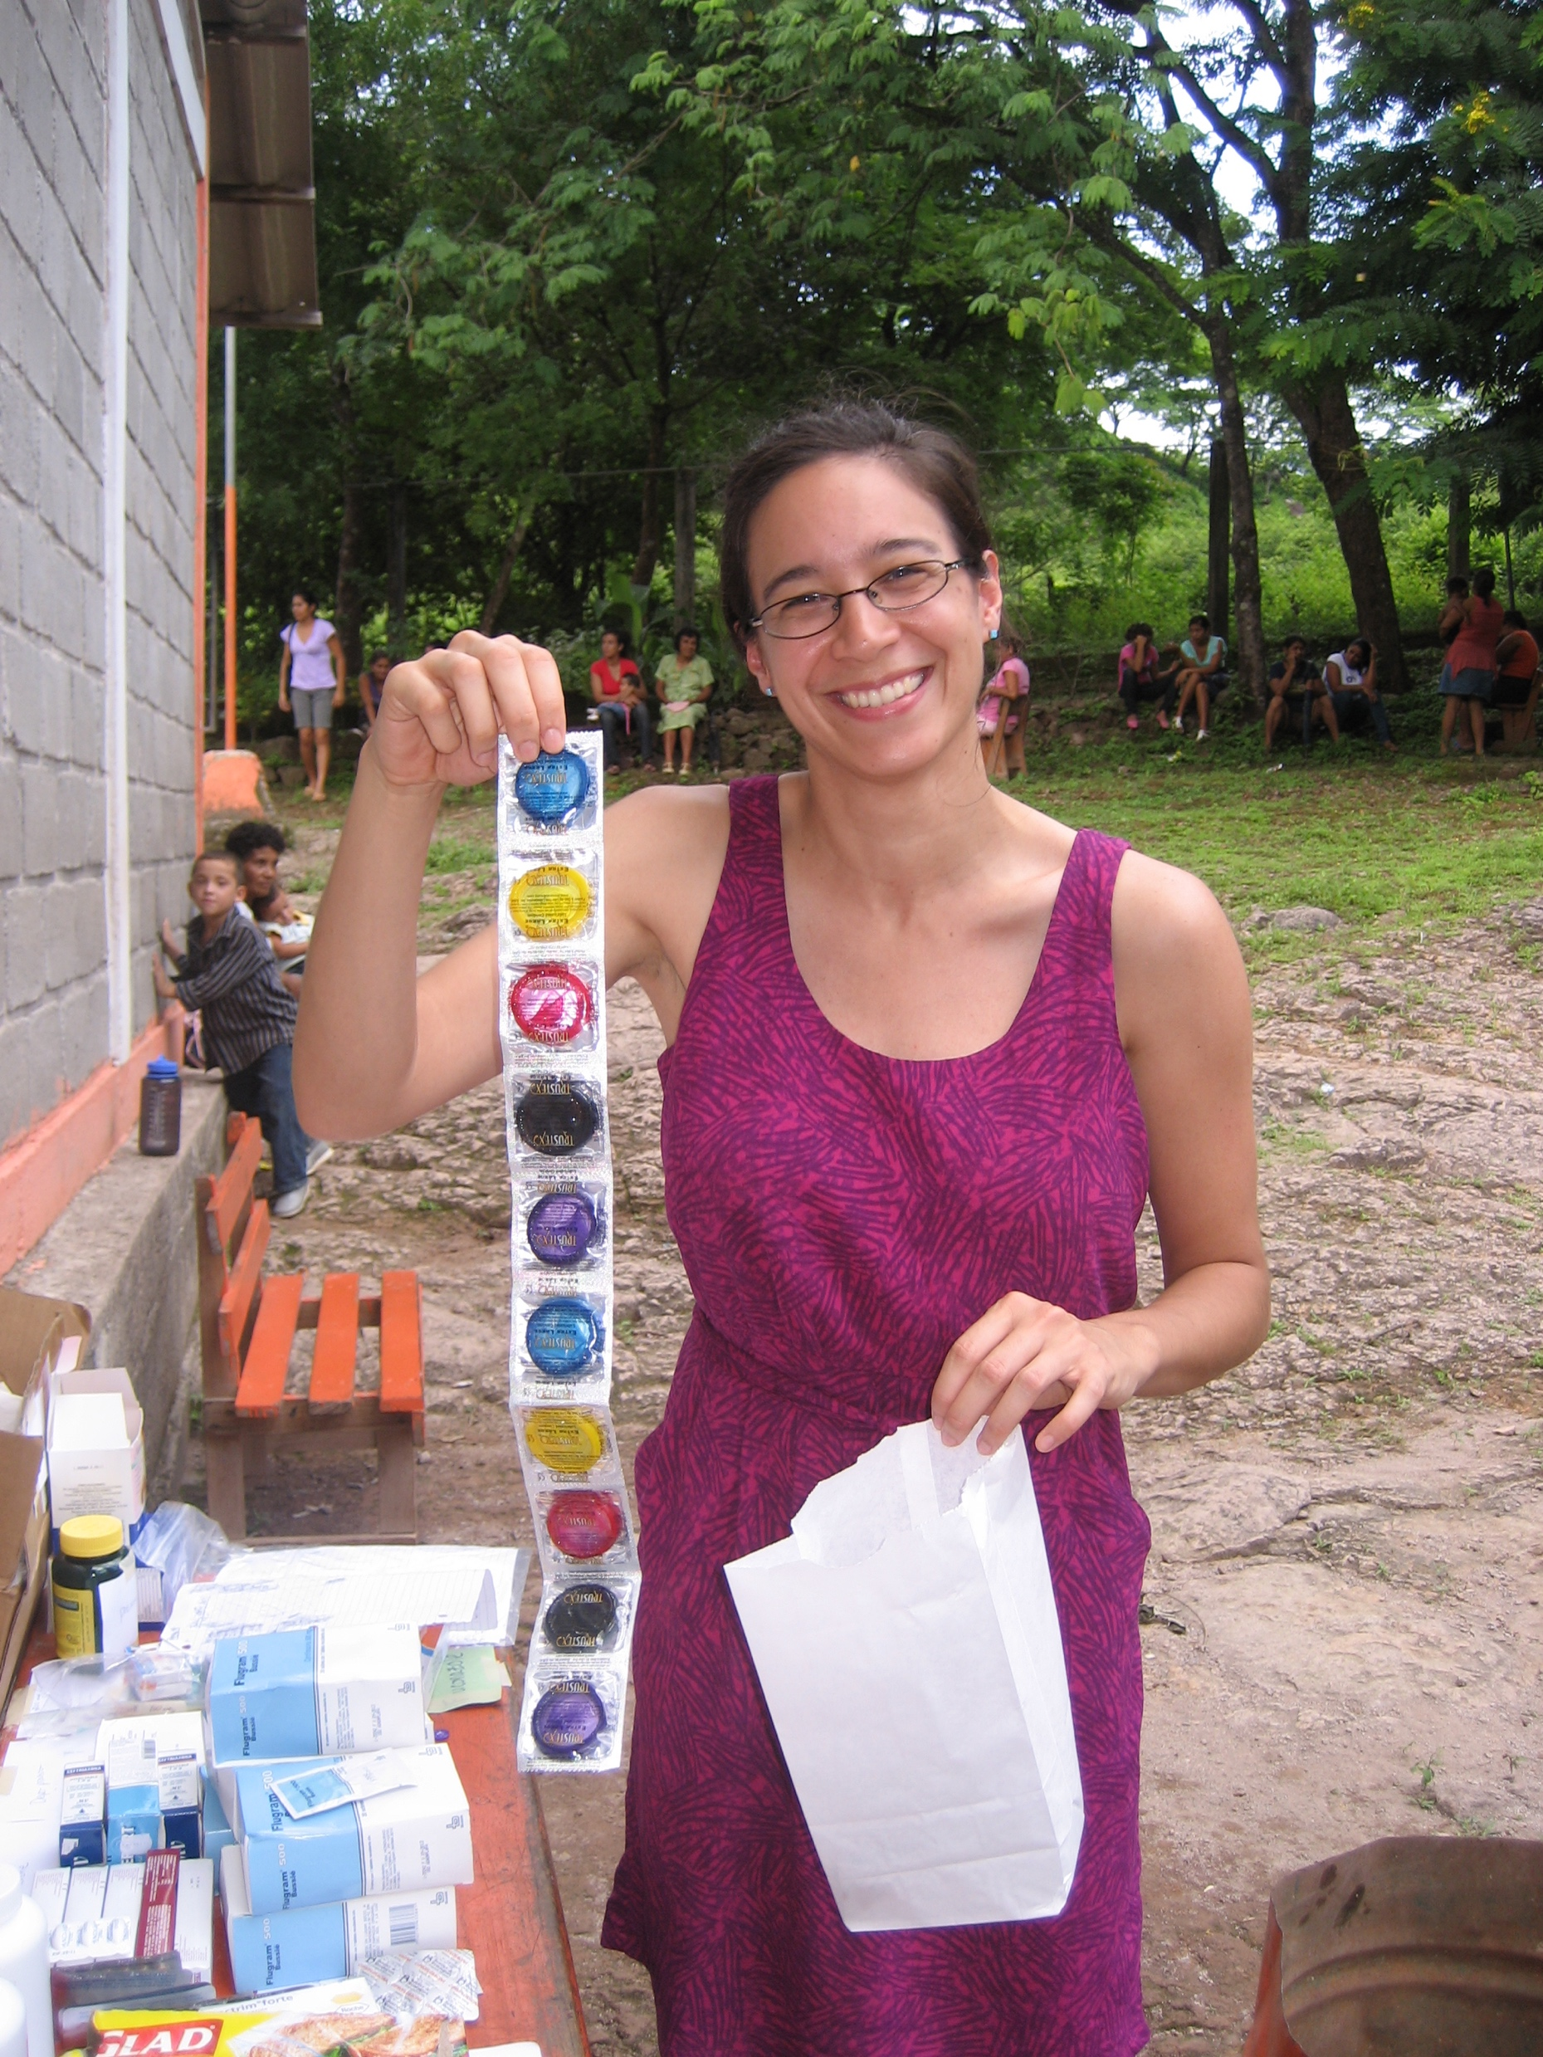
Background Resident Physicians Support
In January, 2012, UNC Office of International Activities expanded to support resident physicians’ global health rotations and research by assisting with issues involving:
site selection/partnership communication
advising
development of educational objectives
providing travel health and safety information (and tracking for emergency planning)
funding possibilities
support for adherence with the UNC Hospitals Office of Graduate Medical Education (GME) requirements for international rotations
The GME and OIA jointly agreed that all UNC resident physicians and fellows under the GME office are required to matriculate through the OIA in coordination with the GME Office.

Slide 7
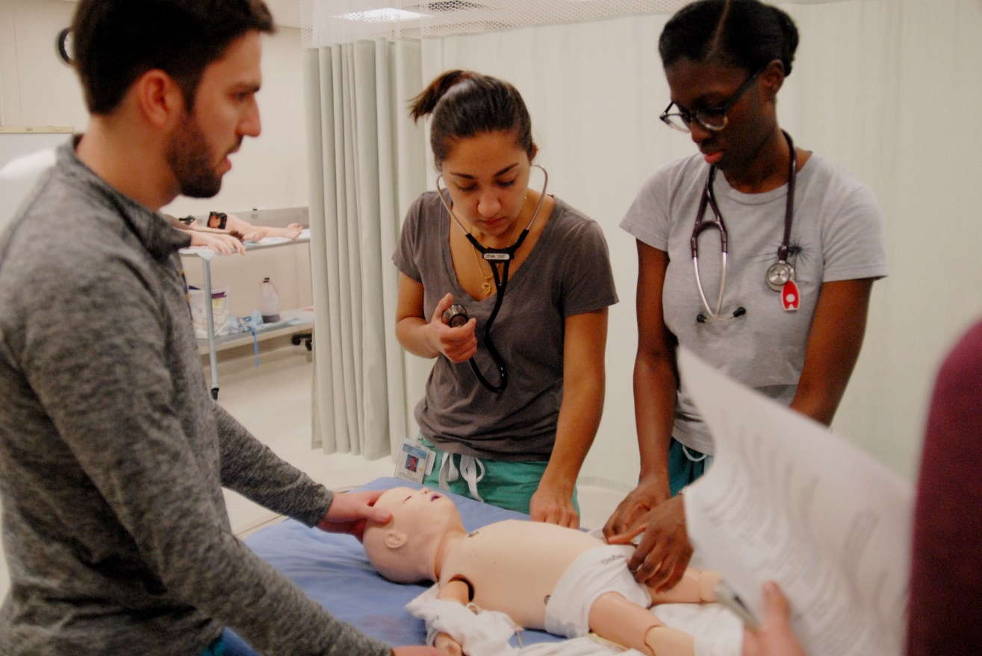
Office of International Activities Resident Physicians Support & Areas of Strength
Interdisciplinary Educational Involvement
Faculty Engagement
Residency Department Buy-In
Funding
Mentorship
Travel, Health and Safety Risk Management

Slide 8
Office of International Activities (OIA) Resident & Faculty Engagement
OIA Global Health Scholars Program
In Conjunction with the UNC GME, the OIA offers a competitive two-year, multi-disciplinary program with funding ($8,000) to support the career and leadership development of UNC residents physicians with a vested commitment to global health practice.
OIA advertised a call for a contract resident physician technical assistant to assist with the technical development of the OIA/ Global Health Scholarly Concentration in the UNC SOM curriculum
OIA Global Health Forum
Monthly speaker series invites faculty, residents, and staff to present their current GH scholarly work
Facilitate med student post-travel debriefing
Residents joined small group debriefings with medical students who returned from summer international experiences
Faculty Scholarship Review Committee for bi-annual funding selections
Notes:
Gh Scholars program
Paired mentorship among GH Scholars and a residency program mentor for duration of longitudinal project
Resident-led research
Travel for an international elective
Resident travel expenses tied to attendance/presentation at a global health-related conference
Formal global health-related coursework, certification, or degree

Slide 9
OIA Global Health Forum
OIA Global Health Forum Topics & Speakers include:
Surgery and Global Public Health- Anthony Charles, MD, MPH
Primary Care for Displaced Persons: Experiences in Greece- Sonya Patel-Young, MD
Improving Neonatal Outcomes in Low Resource Settings through Education & Research- Carl Bose, MD
Cervical Cancer: Case Study on Global Health Disparities- Carla Chibwesha, MD, MSc
Discovery science to field-ready serodiagnostics for Zika- Matthew Collins, MD, PhD
Away Rotations to NIH Grants: Building Blocks for a Career in Global Health- Ross Boyce, MD, MSc
Asthma in Latin America and Community Health Worker Screening for Asthma in Nicaragua- Mary Crocker, MD
Where There Is No Doctor: Case Studies and Best Practices of Community Health Workers from India to Nicaragua- Nadeem Modan, MD & Serena Zhou-Talbert, MD

Slide 10
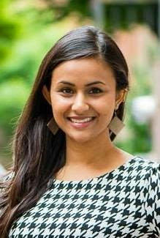
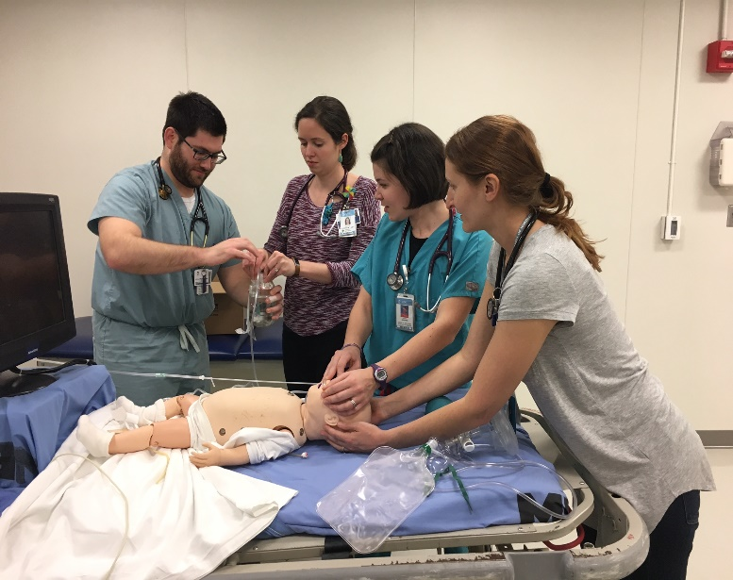
Interdisciplinary Educational Engagement
Sonya Patel-Nguyen, MD, MPH PGY3, UNC Pediatrics, OIA Global Health Scholar
Served as a facilitator during OIA annual student post-travel debriefing session
Presented her work with SAMS in Greece at OIA Global Health Forum
“Primary Care for Displaced Persons: Experiences in Greece”
Continues to mentor medical students vested in refugee health
Emily Ciccone, MD, ID Fellow & Alyssa Tilly, MD, PGY4, MED/PEDS
Served as a facilitator during OIA annual students post-travel debriefing session
Designed and Implemented Global Health PEDS Simulation course (continuing)
Collaborate with OIA and residency faculty to provide student involvement
Open to residents and senior med students planning an international rotation
Cerebral Malaria- SIM of doing LP
Shock in malnourished child: practical skills involving calculating drip rate
Building bubble c-pap- respiratory distress: how to build bubble c-pap in context
Introducing bed-side ultra sound component: diagnosing pneumonia
Dr. Alyssa Tilly was hired as a technical assistant to assist the OIA with the charge
of designing the global health scholarly concentration for the medical school curriculum.
Notes:
This year, we selected the second cohort of 9 OIA Resident Global Health Scholars (two year, competitive program with $8,000 funding)
Approached the UNC Institute for Global Health & Infectious Diseases. Their Institute sponsors two Infectious Diseases Fellows as OIA Global Health Scholars
SAMS: Syrian American Medical Society

Slide 11
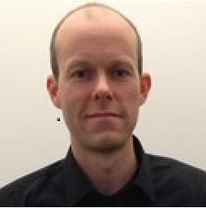
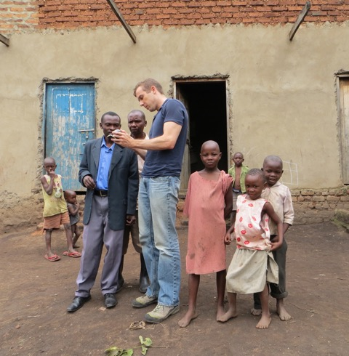
Interdisciplinary Educational Engagement Global health Scholars
Matt Collins, ID Fellow, OIA Global Health Scholar
Involved in large research study on Zika virus and Dengue in Sri Lanka and Nicaragua
“Banco a campo: Discovery science to field-ready serodiagnostics for Zika”
Ross Boyce, MD, MSc, ID
“Away Rotations to NIH Grants: Building Blocks for a Career in Global Health”
Served as a facilitator during OIA annual student post-travel debriefing session
Notes:
This year, we selected the second cohort of 9 OIA Resident Global Health Scholars (two year, competitive program with $8,000 funding)
Approached the UNC Institute for Global Health & Infectious Diseases. Their Institute sponsors two Infectious Diseases Fellows as OIA Global Health Scholars
SAMS: Syrian American Medical Society

Slide 12
UNC Office of International Activities Funding for Resident Physicians
2016-2017 Supported 33 Residents traveling to 17 countries
5 YR Total= 145 residents to 37 countries
Global Health Conference funding to promote scholarly work
UNC Resident Scholarship for Global Health Rotations. Biannual awards total $20,000.
Those with opportunity for resident and host site continuity given preference
Funding support UNC Resident’s involvement:
Facilitate clinical week with student group to Honduras in well-women’s clinic
UNC Malawi thriving partnership for ongoing collaborations. Peds residents developing QI with Malawi medical team and documenting trauma cases in new digital medical records system.
Nicaragua partner site hosts residents developing ID research with their team
Resident’s trip to Greece to work in Syrian Refugee camp
Notes:
$2,000 max per scholarship
Eligibility
Experiences must be at least 2 weeks in duration to qualify, can be clinical, research or public health

Slide 13
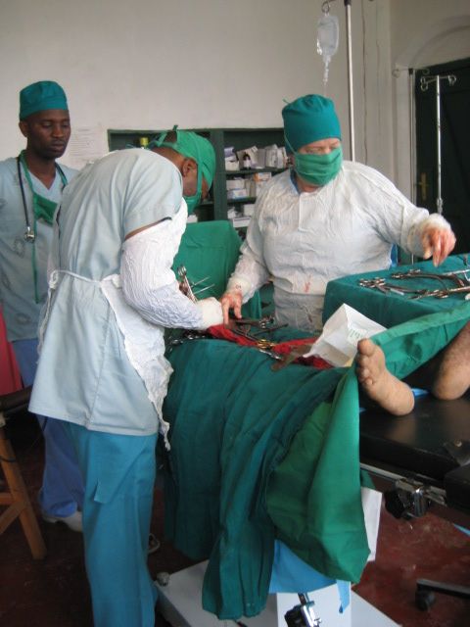
UNC Office of International Activities Educational Support/Resources
Launched UNC scholarship for global health rotations in January 2012.
Global Health Resource Library: introductory academic texts, books, documentaries
Online modules: “Travel Health and Safety” and “Cross-cultural Issues, Ethics and Professionalism” (required) plus 16 other modules to name a few
HIV: A Global Update, Neonatal Health Childhood Diarrhea, Research Ethics, and Trauma & Surgery in Low Income Countries

Slide 14
Preparing for a Global Health Elective
Resident identifies international rotation site,
obtains support of departmental advisor and
residency program director, and completes all
GME requirements
The OIA assists resident in finding an
appropriate international rotation site,
identifying departmental advisor, and reviews
all GME requirements
Resident completes GME requirements:
1) Letter from program director for non-clinical away rotations
2) Letter of Agreement between UNC and Host Institution
3) Special Projects Professional Liability Agreement
4) Voluntary Participation and Assumption of Risk Agreement
The OIA ensures that the resident:
1) Is aware of biannual UNC resident scholarship opportunities
2) Purchases UNC sanctioned travel health/evacuation insurance
3) Completes the required online travel modules and quizzes 3) Registers travel dates & location in UNC Global Travel Registry
4) Signs the online Code of Conduct
5) Pre-Travel Medical Evaluation (confirms with OHS staff)
6) Submit the evaluation questionnaire based on your international rotation
The OIA manages a list of residents currently traveling and their emergency contact information, and maintains close contact with GME Office and the UNC Provost Office in an emergency or escalating travel risk in residents’ destination countries.
The OIA maintains a database of residents’ global health rotations and evaluations of the rotations on the “Residents” section of the OIA website as a resource for future residents.

Slide 15
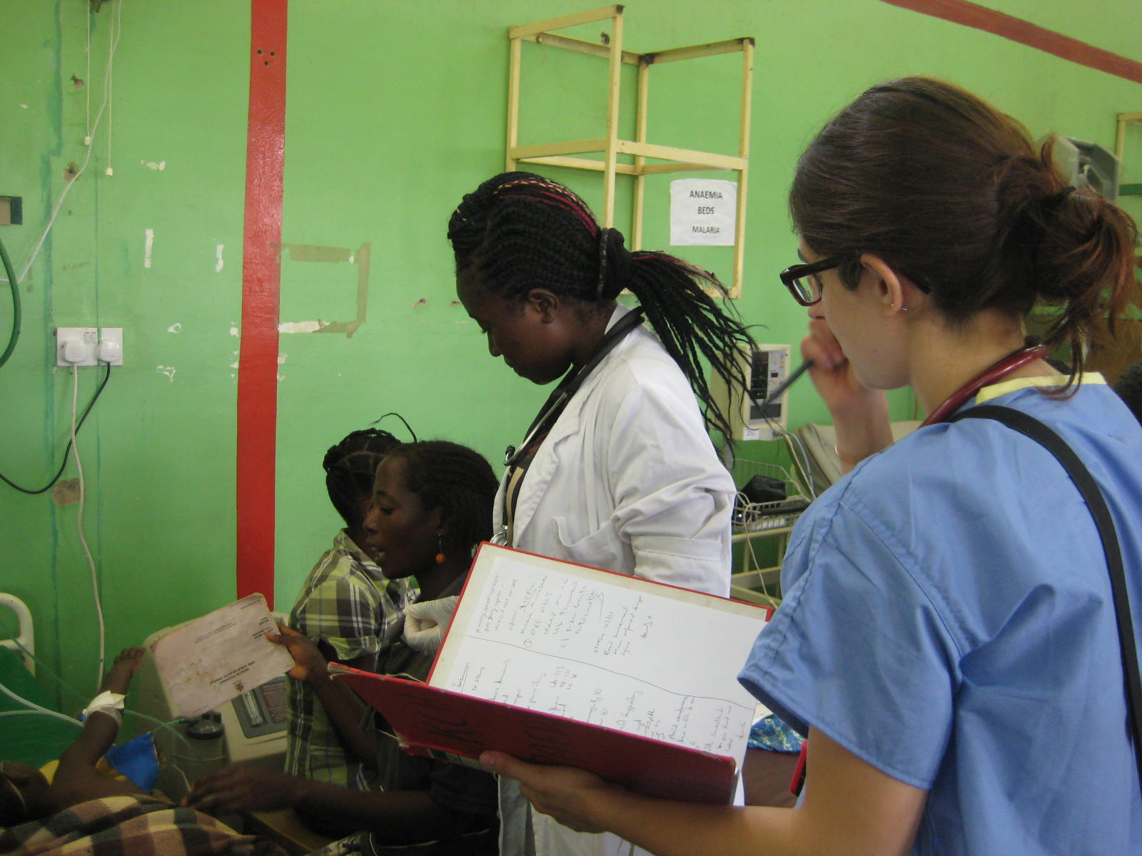
Travel, Health and Safety Risk Management
Key Partners for developing and maintaining Safety and Risk Management for traveling Residents
Provosts Office
Office of International Activities
UNC Hospital Office of Graduate Medical Education
Medical School, Associate Dean
UNC Hospital Occupational Health Services
Communication with hosting partner site should the risk be while they are in country
UNC SOM Emergency Plan
Following a post assessment of the risks of international electives following three significant international crises in a single year regarding UNC student groups and hosting organizations, the OIA worked with the University system to define and implement the UNC SOM Emergency Plan
Clear communication plans in the event of an emergency, closer collaboration with the Provosts Office, closer adherence with residents and students in their pre-travel requirements, and formal pre-departure training

Slide 16
UNC Office of International Activities Travel, Health and Safety Risk Management
Medical Evaluation: UNC Occupational Health Services provides pre-international travel health vaccinations, on-site HIV PEP kits and treatment protocol for UNC/H residents traveling on approved GH electives internationally
Cost absorbed by UNC Hospital
29 Residents have received travel medicine since the initiation of this partnership
International health, evacuation, and repatriation insurance
The UNC System has contracted with Geo Blue Worldwide to provide comprehensive coverage at a low cost at $1.42/day
minimum of 2 days and a maximum combined total of 30
Required by UNC for all traveling UNC affiliates
Register travel dates and location with the online UNC Global Travel Registry
Oversees by Office of the Provosts: regulates activities in countries for which the U.S. Dept of State issues a travel warning and countries for which the CDC has issued a travel notice
The UNC Registry functions as a communication mechanism to notify, contact, locate UNC affiliates in areas of risk
Register travel dates with the U.S. State Department
Provides region-specific alerts
Notes:
Discuss identifying at risk sites and coordination with OHS to verify resident compliance

Slide 17
Lessons Learned
What works well:
Support from UNC faculty and international partner sites in supporting resident research and collaboration
Visibility with GME quarterly meetings and hospital faculty interested in formal mentoring with their residents
Ability to leverage our experience with travel risk mgmt. to apply to resident international travelers
Partner with IGHID to fund 2 UNC Resident Physician global health scholars in an ID track
Department Buy-in: gaining trust and support from core residency leadership through inclusive decision making in funding selection, campaigning within each department as the GH Scholars Program was designed
Having global health pathways is important for residency programs’ recruitment- we make them “look good”
Notes:
Discuss lessons learned in a large university, interdisciplinary global health setting: what worked and what didn’t work
Depts depend on us to dsceirbe internatonal opportun to residents as a recuitment tool-

Slide 18
Lessons Learned
What did not work well:
Representation among particular disciplines needing more clinical supervision Surgery/interventional- which limits placement
Always challenging to find a convenient time to gather residents
Journal Club
Global Health Scholars Program welcome event
Debriefing post-travel
Notes:
Discuss lessons learned in a large university, interdisciplinary global health setting: what worked and what didn’t work

Slide 19
What we hope for
Re-entry/Debriefing with Residents:
Challenge with finding common meeting time with busy and different schedule.
Create opportunities for resident/medical student mentoring
Assessing whether devoting more time to ongoing global health clinical simulation courses and clinical resources is manageable
Medical Horizons Fellowship: new model for opening access for under represented population pre-med student to join medical student group and resident teachers for global health program in Honduras
Notes:
debriefing, matching residents/students for mentoring, ??? if clinical resources for GH and clinical sim is something we should put more time and energy into.

Slide 20
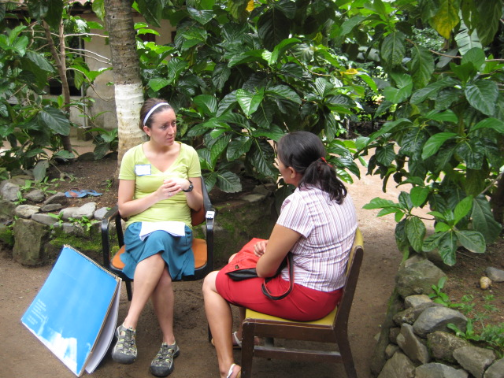
Thank you
UNC Office of International Activities website
http://www.med.unc.edu/oia

