Slide 1
Best Practices for Mitigating Bias and Microaggressions in Case Development
Matthew Holley, PhD (he/him)
Assistant Professor of Clinical Family Medicine | FM
Associate Director, Academy of Teaching Scholars | FAPDD
maholley@iu.edu
@mededmatt
Notes:
Introduce myself and my positionality

Slide 2
Participation is Encouraged
During today’s presentation, please feel free to fully engage by:
Using the chat function
Using the icons to raise your hand
Use your video

Slide 3
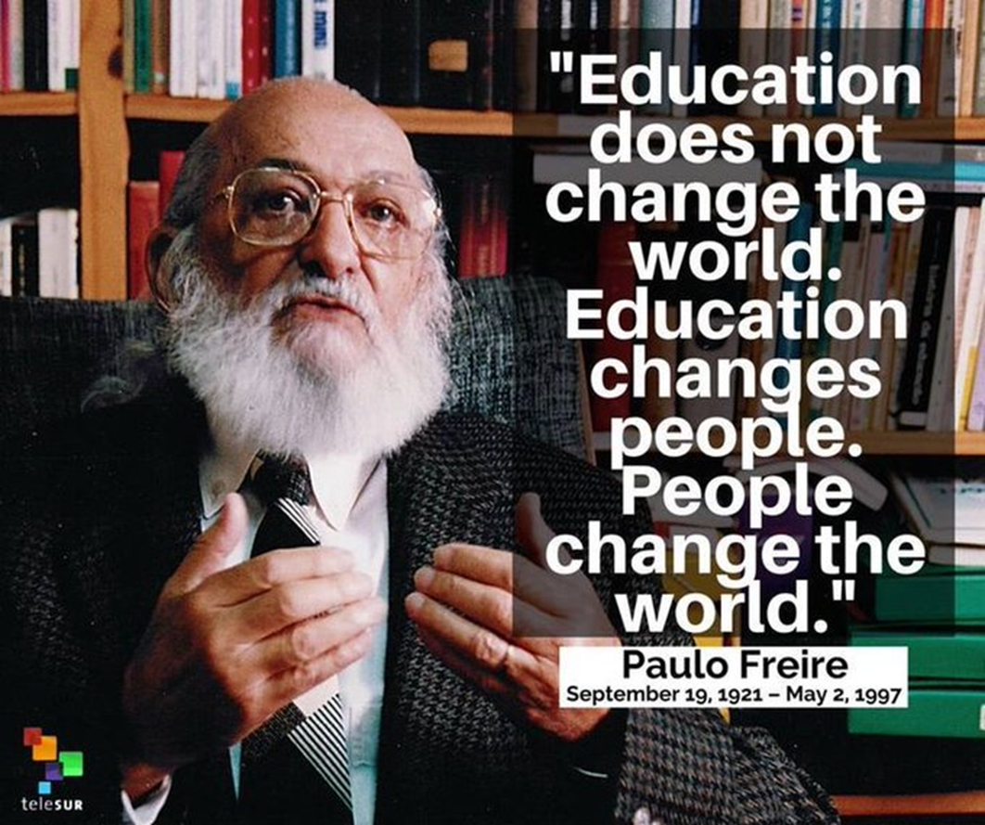
Overview
Definitions: CBL, Unconscious Bias, Hidden Curriculum
Description of the Intervention/Course
Methodology
Example Case
Findings
Best Practices
Resources

Slide 4
What is Case-Based Learning?
Apply their knowledge to real-world scenarios
Work in groups on cases, usually a story
Present a disciplinary problem
Students devise solutions under the guidance of the instructor
Notes:
Students apply their knowledge to real-world scenarios, promoting higher levels of cognition.
Students typically work in groups on cases, usually a story involving one or more characters and/or scenarios.
The cases present a disciplinary problem or problems for which students devise solutions under the guidance of the instructor.

Slide 5
Benefits of CBL
Utilizes collaborative learning
Facilitates the integration of learning
Develops students’ intrinsic and extrinsic motivation to learn,
Encourages learner self-reflection and critical reflection
Allows for scientific inquiry
Integrates knowledge and practice
Supports the development of a variety of learning skills
(Wood, 2005)
Notes:
11:10-11:15
Krista

Slide 6
Bias in Educational Cases

Slide 7
What is bias?
A tendency or inclination that results in judgment without question.
A shortcut to interact with our world
An automatic response

Slide 8
What is Unconscious Bias?
Mental associations without:
Awareness
Intention
Control
These often conflict with our conscious attitudes, behaviors, and intentions.
https://implicit.harvard.edu/implicit/index.jsp

Slide 9
Pros/Cons of Biases
Values in Bias:
Automatic decision making, danger detector, mental shortcut, necessary
Challenges with Bias:
Incorrect application of assumptions, quick emotional decision making
Inherently not evidenced based

Slide 10
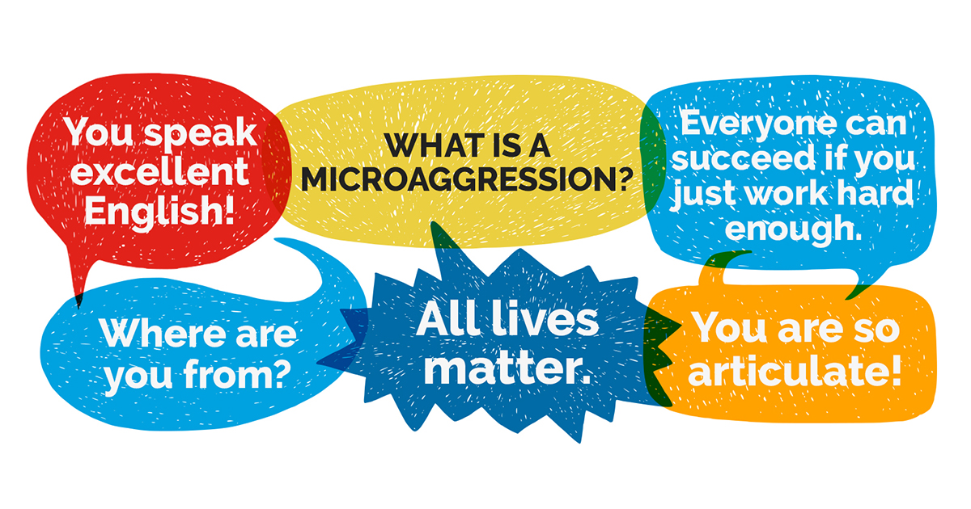
Microaggression
A comment or action that subtly and often unconsciously or unintentionally expresses a prejudiced attitude toward a member of a marginalized group (such as a racial, ethnic or sexual minority).
Remains invisible to the microaggressor or the one holding privilege and evident to the individual targeted.

Slide 11
Bias in Medical Education
The definition of race has changed over time from skin color and genetic differences to its contemporary sociopolitical understanding.
Fluidity of racial categories demonstrates the lack of a sound biological basis, but race continues to be used as a lazy proxy for SSDOH. Inclusion of cultural identifiers such as language, religion, or country of origin, and sexual orientation generally only occurs as markers of risk, presenting a two-fold problem:
When race/ethnicity, cultural identifiers or sexual orientation are mentioned, they tend to be used as shorthand for risk factors, regardless of the actual behaviors of the patients.
When these factors are not mentioned, the patients are assumed to be white and heterosexual, establishing these identities as the norm and conveying the connotation that other identities are abnormal.
Tsai, J, Ucik, L., Baldwin, N, Hasslinger, C, and George, P. (2016). Race matters? Examining and rethinking race portrayal in preclinical medical education. Acad Med. 2016; 91:916–920.

Slide 12
Bias in Medical Education cont.
Flawed epidemiological methods contribute to misrepresentation—from tokenism to erasure of nonwhite/non-cis/non-heterosexual people—but it also stems from societal structures, while simultaneously reinforcing them.
Women are also underrepresented in case presentations and texts regardless of disease prevalence.
All these forms of skewed representation result in reinforcement of implicit bias, worse health outcomes, and policy that perpetuates inequalities.
Karani R, Varpio L, May W, et al.Commentary. Academic Medicine. 2017;92(11S):S1–S6. doi: 10.1097/ACM.0000000000001928.

Slide 13
The “Hidden” Curriculum
The “hidden curriculum” refers to medical education as more than simple transmission of knowledge and skills; it is also a socialization process. Wittingly or unwittingly, norms and values transmitted to future physicians often undermine the formal messages of the declared curriculum. The hidden curriculum consists of what is implicitly taught by example day to day, not the explicit teaching of lectures, grand rounds, and seminars.”(Mahood, 2011)
Institutionally presented patterns, unintended messages, grouped behaviors, interpersonal relationship structures, and absence/out-of-context of information, and also nearly everything in between
The classical definition of hidden curriculum is fairly vague. In order for it to be a useful concept to be explored and applied in an evidence-based manner, it must be quantified (Lawrence 2018)
Slide Adapted from: Melissa Gronceski & Joey Wendt

Slide 14
The “Hidden” Curriculum cont.
How does case-based learning specifically color medical education? (Turbes, 2002)
Under-representations of women, sexual minorities, ethnic minorities
Demographics incongruent with population and disease prevalence
In each clinical case: representation vs. erasure, reality vs. normality vs. stereotype
Slide Adapted from: Melissa Gronceski & Joey Wendt

Slide 15
What is the hidden curriculum being created as the result of unconscious bias and/or microaggressions in IUSM cases?

Slide 16
Elective Timeline
Week #1
Orientation with faculty advisor
Week #2
Presentation about quantitative research
Week #3
Continue Review of cases
Selected readings
Review research done so far
Selection of cases to review
Begin review of cases
Week #4
Prepare and deliver final presentation to elective faculty
Presentation and dialogue with course directors
Finish review of selected cases
Weekly consultation meeting with faculty advisor

Slide 17
How to Assess Cased-Based Curriculum
Krishnan et al (2019) provide a rubric to evaluate cases for teaching structural competency. Their criteria:
Racial and ethnic health disparities are caused by social and structural determinants of health (SSDOH) and not based in genetics or biology.
Providers should look to SSDOH to understand patient behaviors, rather than attributing patient behavior to patient’s race/culture.
Description of patients’ histories, health beliefs, and practices should direct attention to unique patient circumstances and SSDOH, as opposed to racial/cultural stereotypes.
Treatment plan should include addressing patients’ SSDOH.
Cases discuss implicit bias and critically reflect on racial/cultural disparities.
Cases include a diverse range of patient, provider, and medical student identities and health professional roles, which reflect nationwide sociodemographic statistics.

Slide 18
Methodology
Building on the rubric developed by Krishnan et al, we assessed the cases on a number of qualitative parameters:
We then assessed the cases for bias on a scale of 1 to 5, with a score of 1 indicating no concern for bias and 5 indicating serious bias.
Race & Ethnicity
Occupation/Education
Faith/Religion
Veteran Status
Healthcare Access
Family Status
Disability
Gender
LGBTQ identity
Immigration Status
Mental Health
Substance Use
Notes:
At least 2 reviewers per case

Slide 19
Goldilocks Problem
Too much information becomes essentialist
Too little relies on SP or student to fill in gaps based on their own personal biases

Slide 20
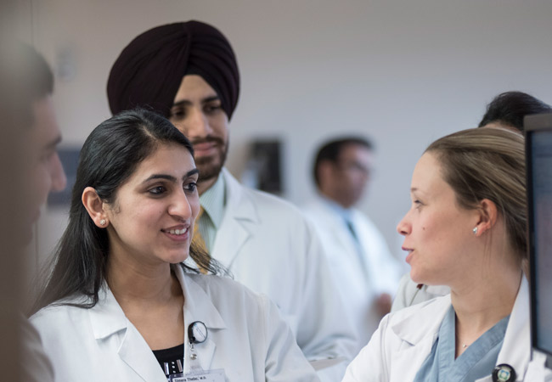
Chat Activity
What words would you change/remove from this case?

Slide 21
Example A
J.J. is a 38-year-old woman who is a heroin addict. She presents to your clinic complaining of chronic back pain. After reading her chart, you note that she has been doctor shopping, trying to get oxycodone. She states that her back pain started 10 years ago after her first child was born. Her pain is unchanged over the past 10 years and she doesn’t complain of any neurological symptoms.
She alleges that she can’t work because the pain is so severe. She claims she last used heroin about 6 months ago. Her family history is significant for a mother who is a methamphetamine junkie. Her physical exam is normal except that she appears very anxious and has track marks on her left arm. Her urine screen is dirty. One of your colleagues overhears you talking about how she is such a difficult patient and mentions that maybe she should be offered substitution therapy.

Slide 22
Example B
J.J. is a 38 year old woman who is a heroin addict. She presents to your clinic complaining of chronic back pain. After reading her chart, you note that she has been doctor shopping, trying to get oxycodone. She states that her back pain started 10 years ago after her first child was born. Her pain is unchanged over the past 10 years and she doesn’t complain of any neurological symptoms.
She alleges that she can’t work because the pain is so severe. She claims she last used heroin about 6 months ago. Her family history is significant for a mother who is a methamphetamine junkie. Her physical exam is normal except that she appears very anxious and has track marks on her left arm. Her urine screen is dirty. One of your colleagues overhears you talking about how she is such a difficult patient and mentions that maybe she should be offered substitution therapy.
Notes:
The importance of person-first language
Person experiencing homelessness
Person with opioid or substance use disorder
Person with diabetes
Don’t Use:
Junkie, addict – instead use person with opioid or substance use disorder
Dirty/Clean urine – instead use urine was positive for…
Habit – instead use person with substance use disorder
Abuse – instead use misuse, inappropriate use
Substitution therapy – instead use medication assisted treatment/therapy

Slide 23
Goals for Continuous Case Review
Improve student ability to take comprehensive social histories
Improve student incorporation of the patient's social background into the patient's treatment
Present cases that consistently represent our diverse population
Allow students to talk about bias and increase awareness of implicit bias
Minimize assumptions rooted in bias when students are eventually caring for patients

Slide 24
Findings 1514 cases reviewed

Slide 25
Findings
Hispanic/Latino patients are seldom represented
Asian patients are seldom represented
LGBTQ patients are seldom represented
Men: Presented with stereotyped mannerisms and behavior
Women: written off as "experimentation"
White patients are on average overrepresented by ~10%
Often times the "default"

Slide 26
Findings
Gender
Females underrepresented in some courses
Consistent lower paying jobs compared to men
Mental Health
Higher number of female cases; when mentioned in men, a clear etiology was mentioned
Lack of adequate attention paid to diagnosis, severity, past interventions
Many groups not mentioned: veterans, transgender patients, etc.

Slide 27
Recommendations for Future Case Creation

Slide 28
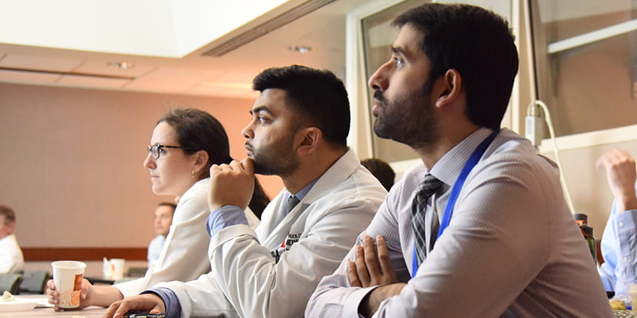
Desired Outcomes
Ongoing review across cases for demographic parity with the state
Case template to be used across all courses
Develop a checklist for creation of new cases
Use cases to break, rather than reinforce, stereotypes

Slide 29
Include a wide variety of patient populations (LGBTQ pts, immigrants, veterans, etc) and backgrounds (racial and ethnic diversity)
Including images
Can take these opportunities to illustrate prevalence in different populations
For marginalized groups, can also take these opportunities to undermine stereotypes (e.g. Latina doctor, trans man with HTN)​
Consistently incorporate sociodemographic information
Notes:
--Patient representation should be reflective of patients in the population at large to prepare for patients that will be seen in practice
--Sociodemographic info in social history

Slide 30
Avoid stereotyping
Does this piece of information affect management?
Does this piece of information have a high risk of misinterpretation?
Avoid placing blame on the individual
Consider ways to highlight complex social situations and evaluate social impact and implications of different diseases
Set up a system for continuous improvement by student reporting of bias concerns
Provide disclosure/warning in cases that may trigger negative reaction
Utilize debriefing

Slide 31
Patient information:
•Age
•Gender
•Pronouns
Past Medical hx: mental health asked about and documented in all patients
•Exact diagnosis
•Severity and etiology
•All medical and nonmedical interventions used past and present
Social hx:
•Race / Ethnicity
•Education
•Occupation
•Religious Affiliation/Identity
•Safety
•Family Status
•Sexual History, incl. M/W/B partners
•Substance Use
•Veteran
•Immigration Status

Slide 32
Checklist
Is patient sociodemographic information reported in the social history?
Is that information relevant? Does it change management of the patient?
Is there irrelevant information, such as adjectives/adverbs describing patient attitudes/actions that do not specifically relate to the diagnosis?
Are social determinants of health (i.e. unemployment, lack of insurance, low literacy, etc.) mentioned? Does their inclusion reinforce stereotypes?
If social determinants are brought up in the case, is there a learning point directed at teaching students to treat patients facing those challenges?
Notes:
Used for writer and as mechanism for workshoping cases amongst peers

Slide 33
Example
Social hx:
Identifies as white
Masters degree in engineering
Raytheon Engineer
Lives in apartment with fiancée, two dogs
Good relationship with much of family except one brother; very involved in community's youth LGBTQ leadership program
Agnostic, grew up Catholic
Reports domestic violence with past relationship, denies history of fear of violence in current relationship
Sex with men, women, transwomen; 2 partners in past 12 months; tested every 6 months; now exclusive with fiancée; has oral and insertive vaginal sex with fingers/toys; does not use protection
Drinks a glass of wine most nights with dinner, beer on the weekends, rare liquor; marijuana monthly; distant past use of MDMA, magic mushrooms
Not a veteran or an immigrant
AZ is a 31-year-old transman (preferred pronouns he/him or they/them) who presents to clinic for his regular yearly physical and blood pressure check.
Past Medical hx:
High blood pressure well-controlled on 10mg lisinopril daily
Generalized Anxiety Disorder (diagnosed during transition 10 years ago) controlled with 75mg sertraline daily and weekly therapy
PTSD (diagnosed after abusive relationship 5 years ago) controlled with sertraline

Slide 34
CBL Resources
Yale CTL site on Case-Based Learning
National Center for Case Study Teaching in Science

Slide 35
References
Karani R, Varpio L, May W, et al. Commentary. Academic Medicine. 2017;92(11S):S1–S6. doi: 10.1097/ACM.0000000000001928.
Sharmna et al. Teaching the Social Determinants of Health: A Path to Equity or a Road to Nowhere? Acad Med. 2018; 93 (1): 25-30.
Krishnan A, Rabinowitz M, Ziminsky A, Scott SM, Chretien KC. Addressing Race, Culture, and Structural Inequality in Medical Education: A Guide for Revising Teaching Cases. Academic Medicine. 2019; 94(4): 550-555.
Krishnan, AM, Rabinowitz, MC, Ziminsky, A, Scott, SM, & Chretien, KC. Supplemental Digital Appendix 1 to Addressing Race, Culture, and Structural Inequality in Medical Education. Acad Med. 2019 Apr; 94(4), 550–555. doi: 10.1097/acm.0000000000002589
Lawrence C, Mhlaba T, Stewart KA, Moletsane R, Gaede B, Moshabela M. The Hidden Curricula of Medical Education. Academic Medicine. 2018; 93(4): 648-656.
Tsai, J, Ucik, L., Baldwin, N, Hasslinger, C, and George, P. (2016). Race matters? Examining and rethinking race portrayal in preclinical medical education. Acad Med. 2016; 91:916–920.
Turbes S, Krebs E, Axtell S. The Hidden Curriculum in Multicultural Medical Education: The Role of Case Examples. Academic Medicine. 2002; 77(3): 209-216.

Slide 36
We all have our "blind spots" and may miss things that others may bring to our attention. No one is perfect. This is a learning process for everyone involved and we can all benefit from each other. Special thanks and appreciation: Krista Longtin, PhD Alvaro Tori, MD Sylk M. Sotto, EdD, MBA, MS Brownsyne Tucker-Edmonds, MD, MPH, MS TraNeka Pippens IUSM Students

Slide 37
Questions
Matthew Holley, PhD
he/him/his
Assistant Professor of Clinical Family Medicine
Associate Director of Medical Student Education
Statewide Course Director
Foundations of Clinical Practice – Year One
Associate Director, Academy of Teaching Scholars
Faculty Affairs | Professional Development | Diversity – IUSM
317.278.5076 direct line
maholley@iu.edu

