Slide 1
Apps to Support Medical Decision
Making and Patient Care
Emily Fargo, PharmD, BCPS
Ardis Copenhaver, PharmD, BCPS
Sara Weinstein, PharmD
Emily Bobrzynski, PharmD
Pharmacy Residents | Faculty Development Fellows
UPMC St. Margaret
Notes:
Each introduce ourselves

Slide 2
Disclosures
We have no financial disclosures.
We have some app loyalty, but we did our research.

Slide 3
Objectives
Active participants will be able to:
Describe how mobile applications (apps) can be used at the point of care
Demonstrate to patients and family medicine learners how to use the recommended medical apps
Utilize appropriate and effective mobile applications in practice to generate clinical recommendations

Slide 4
Time Breakdown
2 minutes | Welcome & Introduction with Objectives
4 minutes | Audience downloads applications
11 minutes | American College of Cardiology Anticoagulation Evaluator
11 minutes | About Herbs
11 minutes | Contraception
11 minutes | GoodRx Pro and Formulary Search
5 minutes | Questions and Wrap-Up
5 minutes | Survey

Slide 5
Please get into groups of 2-3 people and take this time to download the following apps (between your group) onto your mobile device:
ACC Anticoag Evaluator
About Herbs
Contraception
GoodRx Pro
Formulary Search
Notes:
<iframe width="640" height="360" src="https://www.youtube.com/embed/zVHWhLme2NQ" frameborder="0" allow="autoplay; encrypted-media" allowfullscreen></iframe>

Slide 6
Review Criteria: S.P.P.A.C.E
S – Source/Sponsors
P – Platform
P – Pertinence to Primary Care
A – Authoritativeness/Accuracy
C – Cost
E – Ease of Use

Slide 7
ACC Anticoag Evaluator
S
P
A
E
American College of Cardiology with Daiichi Sankyo Inc.
Helps clinicians make informed decisions regarding antithrombotic therapy for patients
Validated by ACC’s anticoagulation workgroup; Updated May 12, 2017; well-referenced
Easy to use layout; Does not provide “best” therapy; Internet required only to download new content

Slide 8
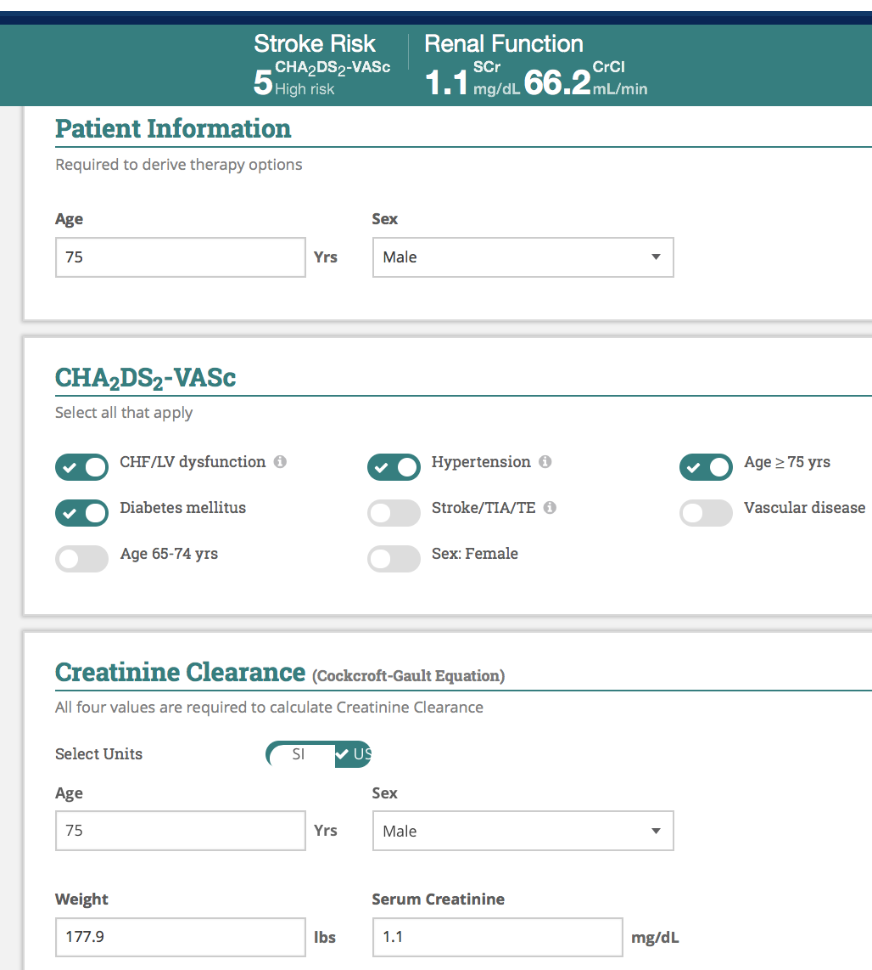

Slide 9
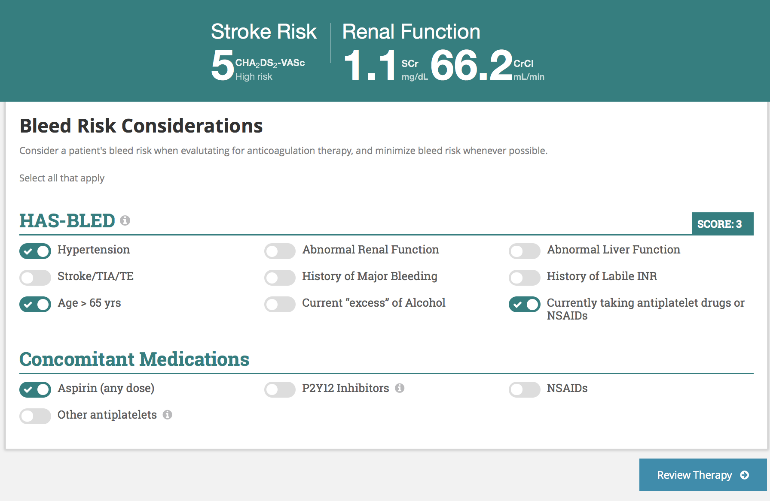

Slide 10
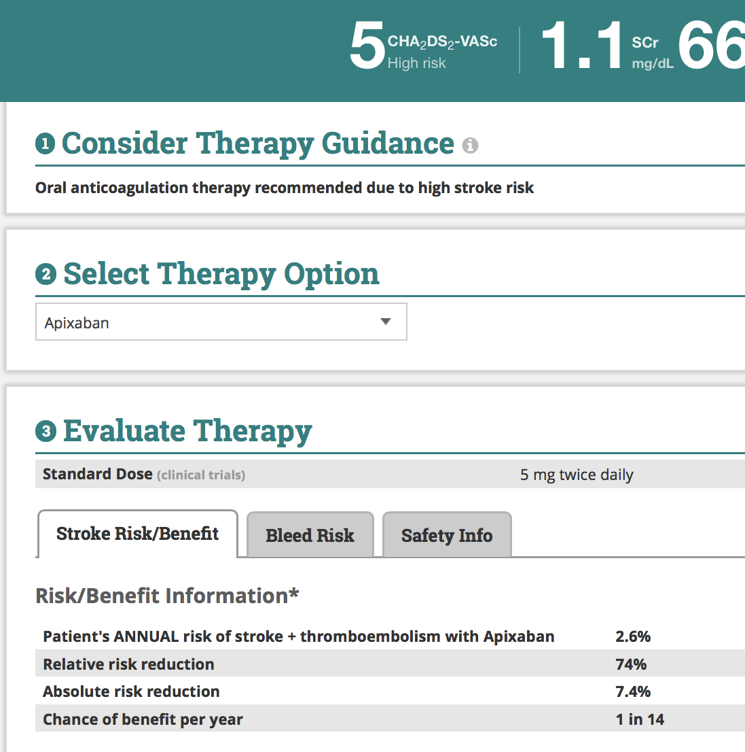

Slide 12
Activity
SM is a 66 year old female (wt = 155 lbs) with a PMH of T2DM and HTN. She was recently diagnosed with A. Fib after being admitted to the hospital for s/s of palpitations. Her labs are WNL with a SCr is 1.3 mg/dL. Current medications include ASA 81 mg daily, Metformin 1000 mg BID and Lisinopril 20 mg daily.
After weighing the pros and cons the patient determines she would prefer to start anticoagulation.
What is her CHA₂DS₂-VASc?
4 (Age, DM, HTN, female)
What is her HAS-BLED?
3 (Age, HTN and currently taking an antiplatelet)
If you were to choose apixaban what dose would you start?
5 mg BID

Slide 13
About Herbs
S
P
A
E
Memorial Sloan Kettering Cancer Center
Provides evidence-based information about herbs and integrative medicine
Validated by world premier cancer center; weekly updates; well-referenced
No Internet connection needed; personalize to fit practice; share content easily via e-mail
Notes:
S – Source/Sponsors: About HERBS is presented by Memorial Sloan Kettering Cancer Center’s Integrative Medicine Service. This app works on iPad, iPhone, and iPod Touch devices
P – Pertinence to Primary Care: provides evidence-based information about herbs, botanicals, supplements, and integrative medicine
A – Authoritativeness/Accuracy: Validated by a world premier cancer center; content is updated weekly and is well-referenced with objective data and scientific references.
E – Ease of Use: Very user friendly; you can access content offline after the app has been downloaded (essentially no internet connection is needed), personalize your favorites by boomarking; and share content by emailing monograph links directly from the app

Slide 14
Navigating the App
Notes:
First we’ll navigate how to use the app, starting with the browse function

Slide 15
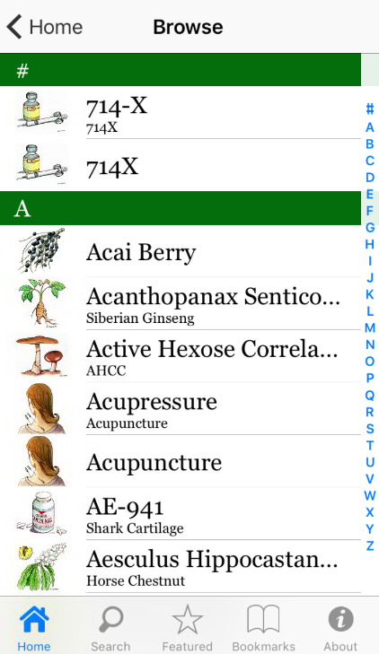
Notes:
Browse through more than 200 monographs of botanicals, supplements, and complementary therapies
The content describes the structure, potential uses, adverse effects, and drug interactions of herbs
I do want to highlight that the app has more than just herbs –it includes integrative medicine therapies as well – for instance here you can see acupuncture listed.

Slide 16
Navigating the App
Notes:
You can also search for particular agents at the point of care

Slide 17
Patient Encounter
53 y/o female with symptoms consistent with rhinovirus
Wants to know about efficacy of Echinacea in treating the common cold
Notes:
The search function will be helpful at the point of care when you have a patient that comes in and asks you about the efficacy of Echinacea for treating the common cold

Slide 18
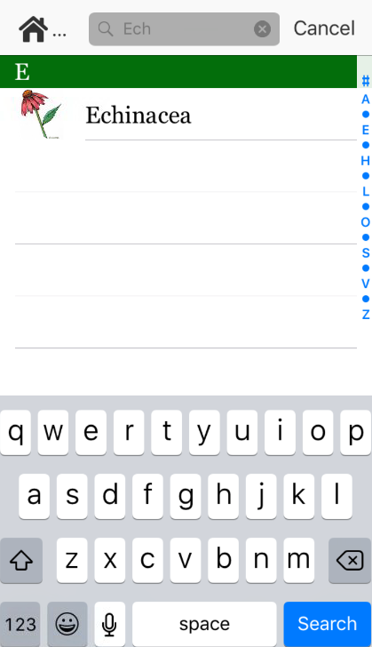
Notes:
Search for echinacea

Slide 19
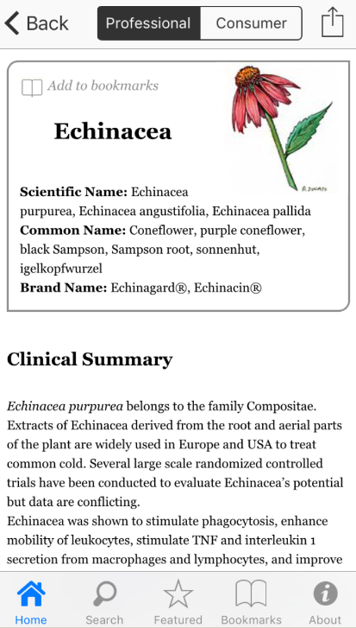
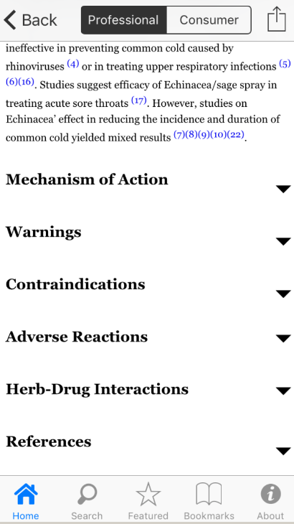
Notes:
You’ll find two different versions of each monograph: one for healthcare professionals and one for consumers
Under professional resources tab there is the clinical summary – which suggests that Echinacea is likely ineffective in preventing the common cold caused by rhinoviruses or in treating URIs.
Under clinical summary can review MOA, warnings, CI, ADR, and professional references

Slide 20
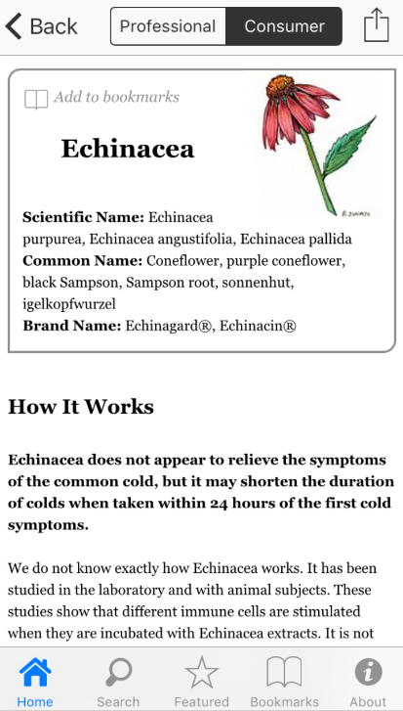
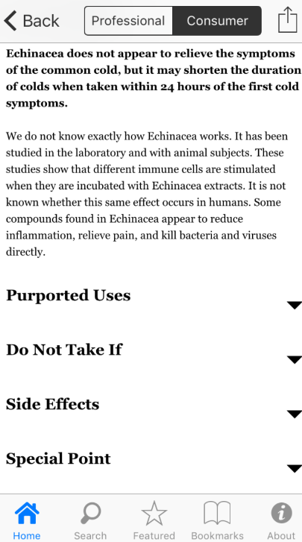
Notes:
Consumer friendly drug monograph
How it works, side effects

Slide 21
Navigating the App
Notes:
Navigation panel on bottom

Slide 22
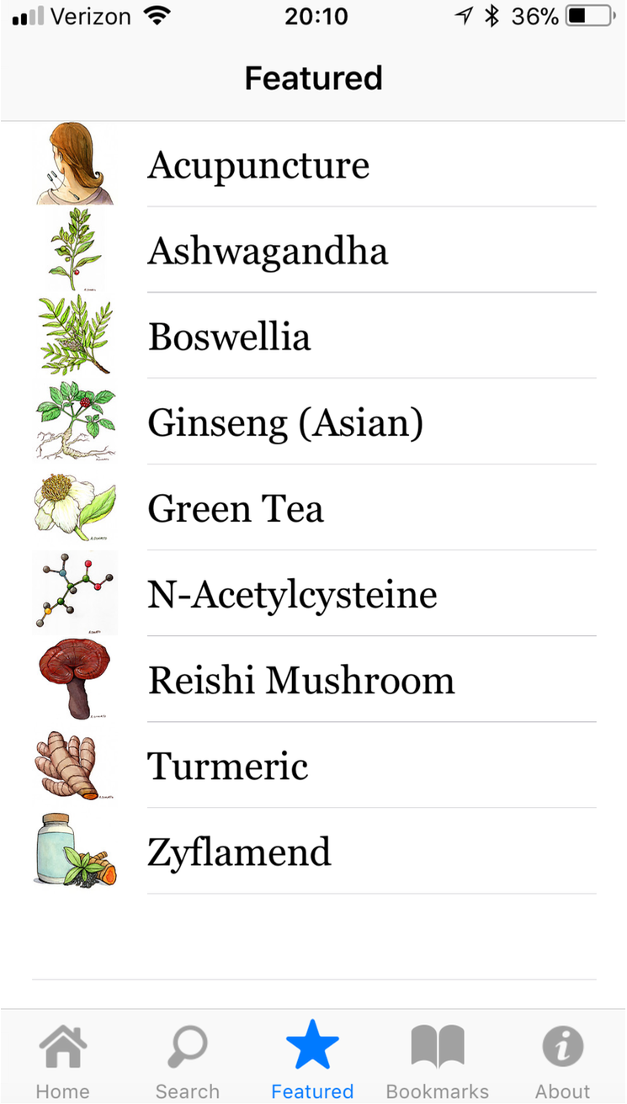
Navigating the App:
Featured
Notes:
Featured menu shows commonly referenced products

Slide 23
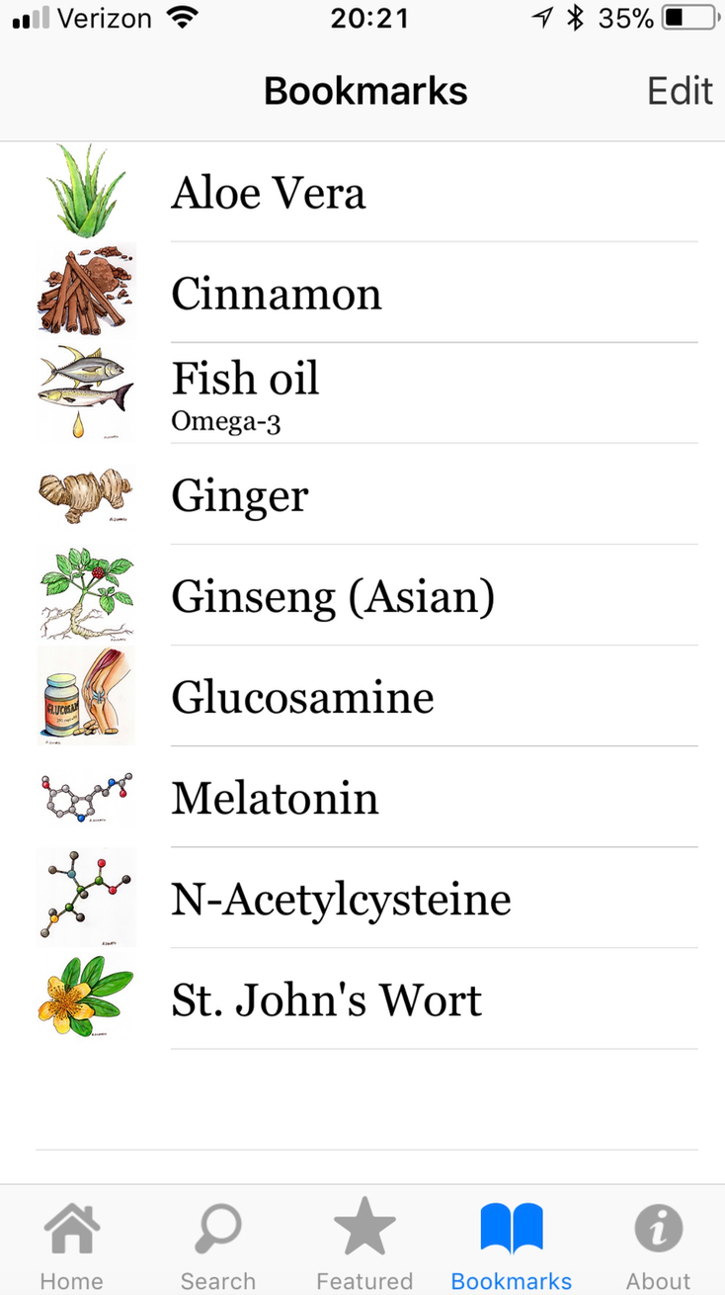
Navigating the App: Bookmarks
Notes:
Can save favorites through bookmarks

Slide 24
Navigating the App: Adding Bookmarks
Notes:
Saving to bookmarks is also very easy, when you are on the drug monograph you want to save, just click add to bookmarks on the top

Slide 25
Patient Case
59 y/o female with colorectal cancer admitted for refractory n/v secondary to recurrent SBO
Failed previous trial of haloperidol
Antiemetic regimen:
Prochlorperazine 25 mg PO q6h PRN
Transdermal scopolamine
Also taking turkey tail??
Notes:
That’s pretty much it for the app, we’ll break here into a think pair share group activity
This is a real patient case that I encountered on the inpatient palliative medicine service
The team presents the case of a 59 y/o female with colorectal cancer admitted for refractory n/v 2/2 recurrent SBO
Had tried various combinations of antiemetics with little relief, and then we also find out she’s taking turkey tail
So now we’re all wondering…what is turkey tail?
Is it a good idea to be taking it??
Could it be contributing to nausea and vomiting?

Slide 26
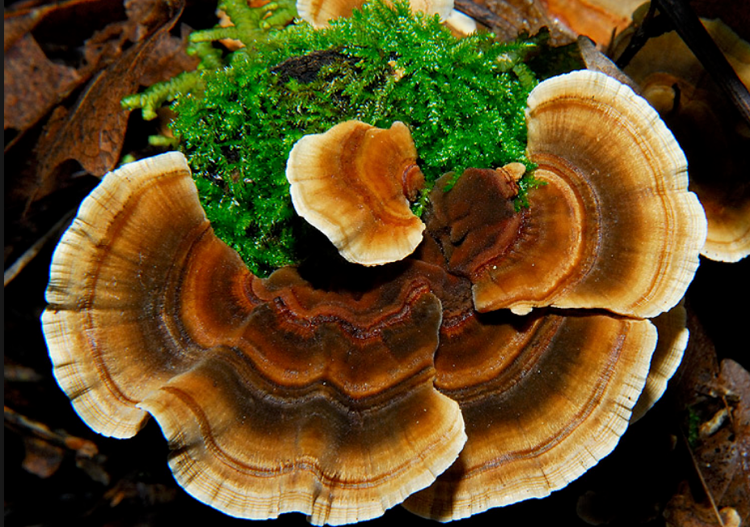
The Turkey Tail Case Activity
Work in pairs to complete the following:
What is turkey tail?
What’s the indication for this patient?
Is it causing and/or exacerbating her symptoms?
59 y/o F with a history colorectal cancer presenting with refractory n/v 2/2 recurrent SBO
Notes:
How to include timer?

Slide 27
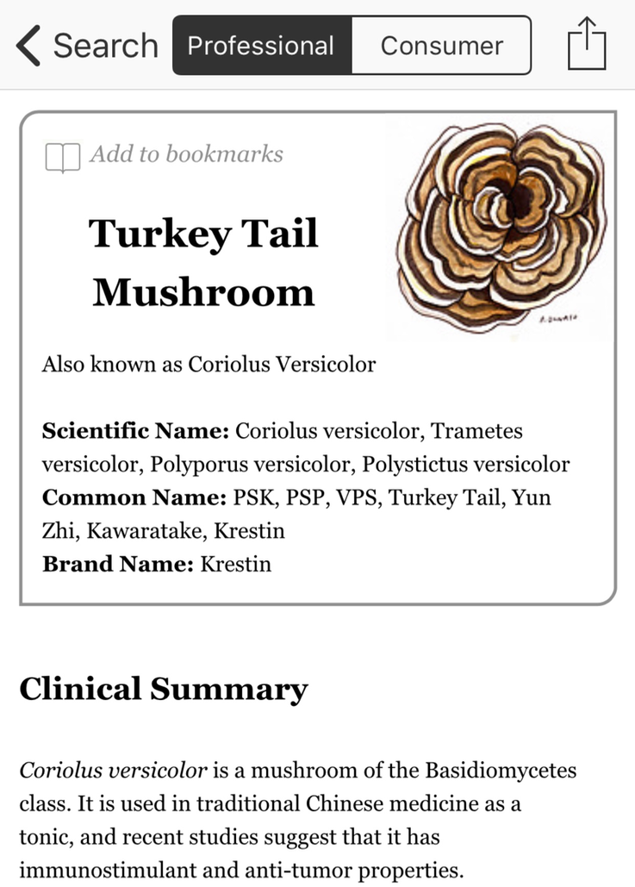
What is turkey tail?
Notes:
Search turkey tail, find immediately that it’s a type of mushroom
Includes scientific name, common name, and brand formulation

Slide 28
What’s the indication?
Colorectal cancer
Notes:
PSK developed for cancer treatment in Japan,
PSK appears to improve survival rates in gastric and colorectal cancers when used as an adjuvant

Slide 29
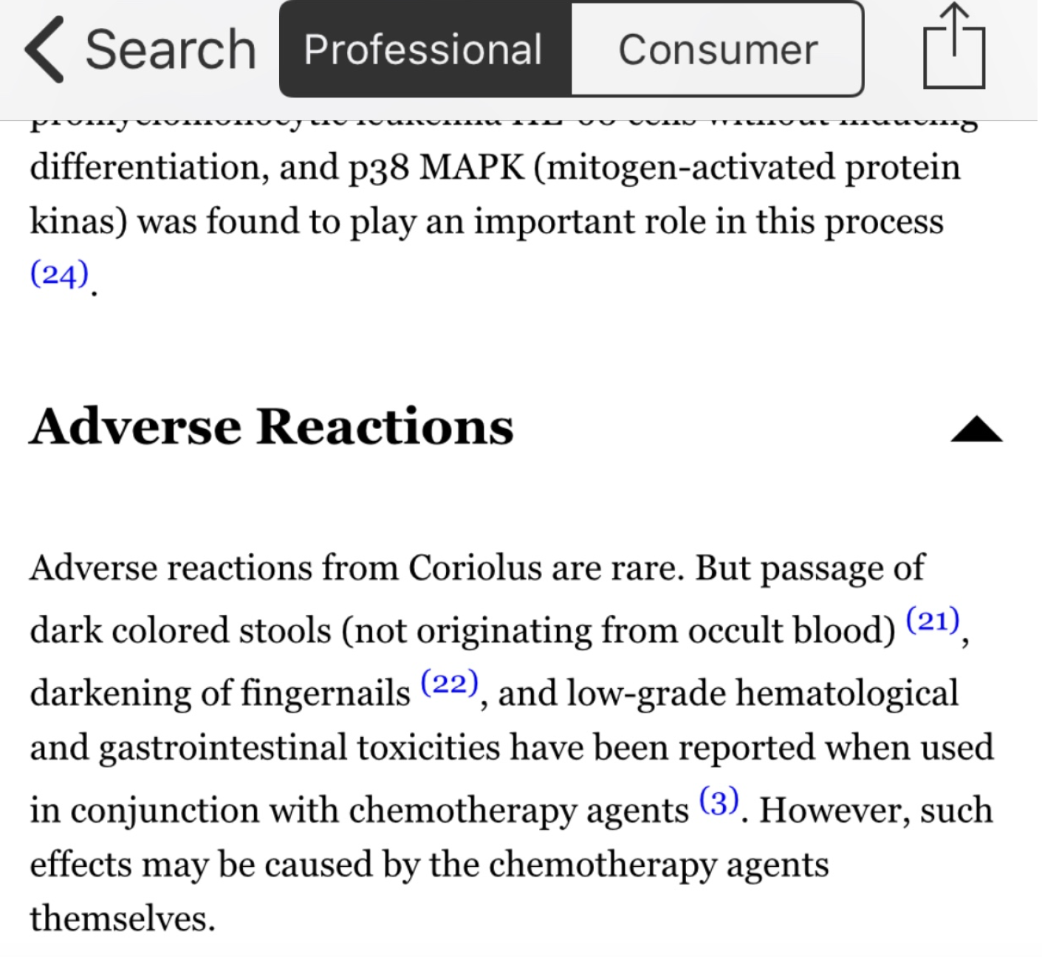
Is it exacerbating her symptoms?
Possible GI toxicity
Notes:
Low grade GI toxicities, unclear if causally related to turkey tail or concurrent chemo regimen

Slide 30
Contraception
S
P
A
E
Reproductive Health Access Project (RHAP) and UHS Wilson Family Medicine residency faculty
Helps clinicians provide prompt and skillful provision of contraceptive care to women and couples
Incorporates information from the CDC, RHAP, and FDA-prescribing information; updated regularly
Easy to use layout; automatically self-updates information; does not require internet to use

Slide 31
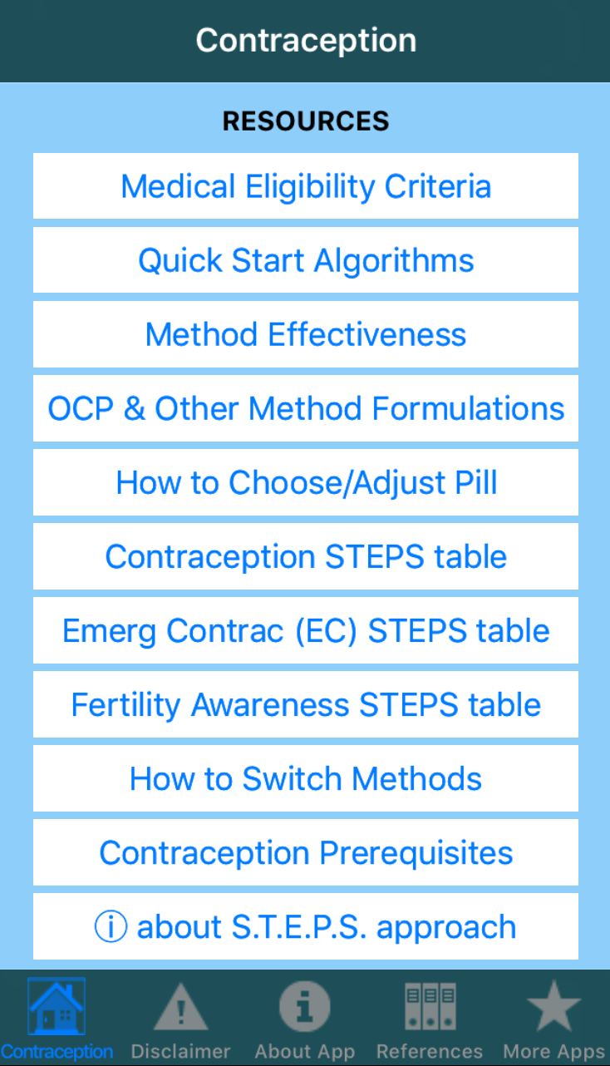

Slide 32
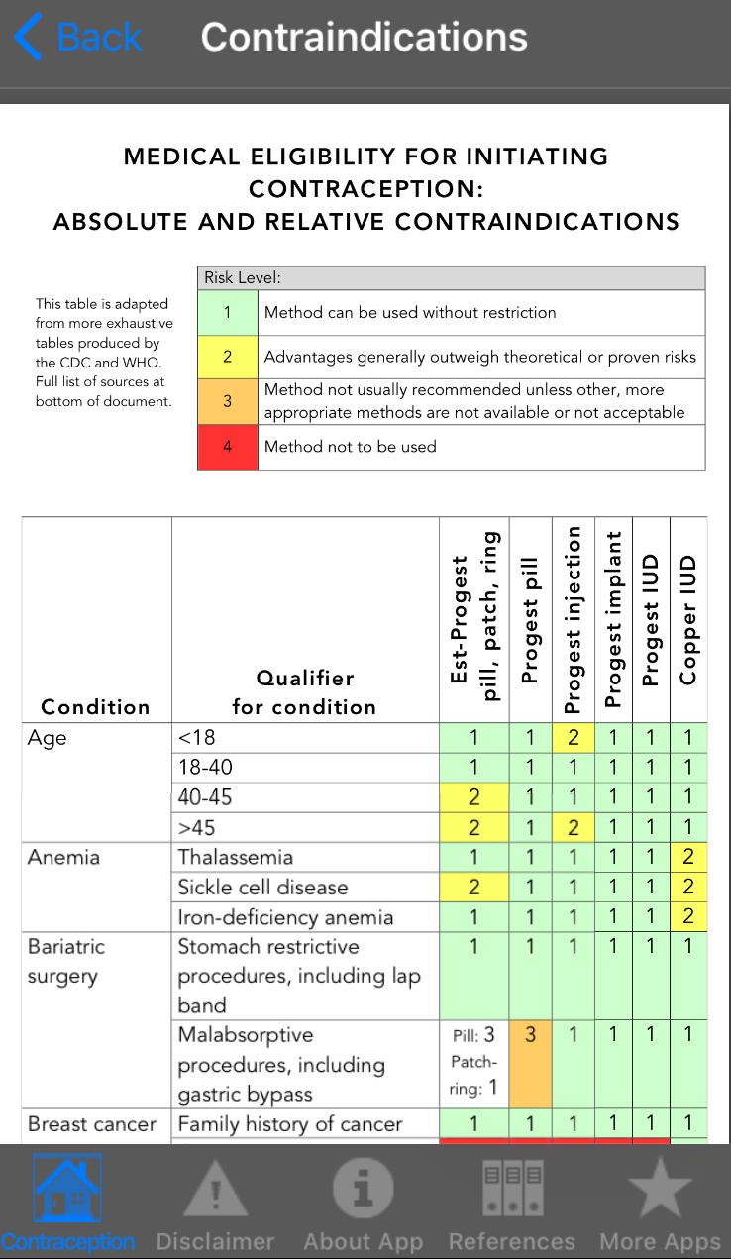
Conditions:
Age
Anemia
Bariatric surgery/obesity
Cancers
Depression
Diabetes
Drug interactions
Endometriosis/PID/uterine fibroids
GI disease
Headaches
HIV/STIs
Hypertension
Heart disease/stroke
Liver disease
Postpartum/post-abortion
Rheumatoid arthritis
Smoking
Seizure disorder
Surgery
SLE
Thyroid disorders
Venous thrombosis
Notes:
GI disease = gallbladder, IBS

Slide 34
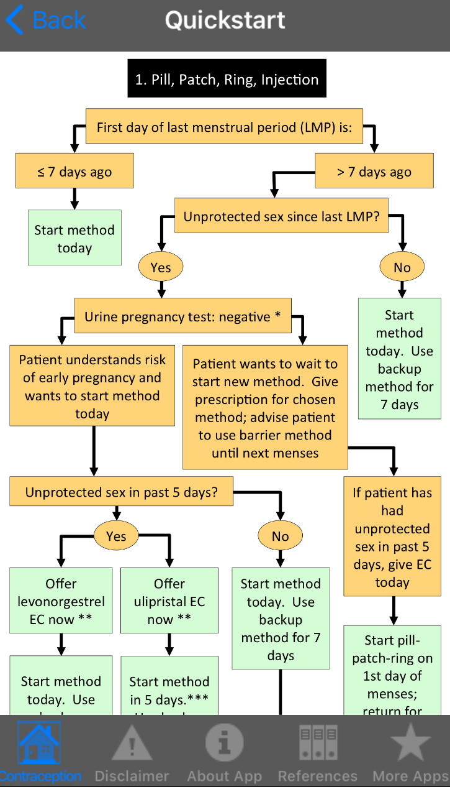
Quickstart Algorithms:
Pill, patch, ring, injection
Progestin IUD or implant
Copper IUD
Recommendation

Slide 36
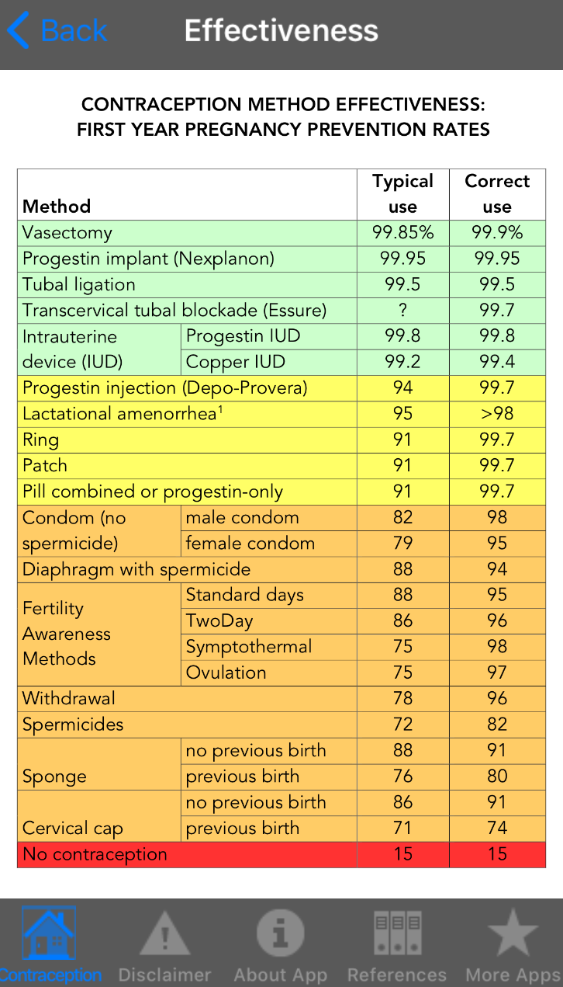

Slide 38
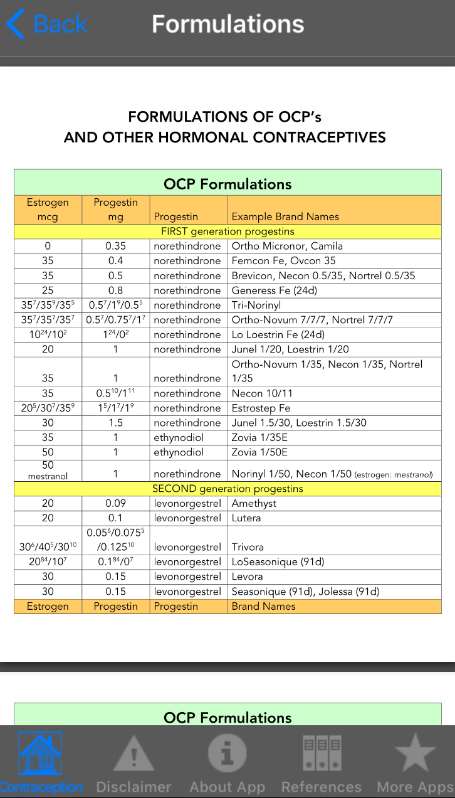
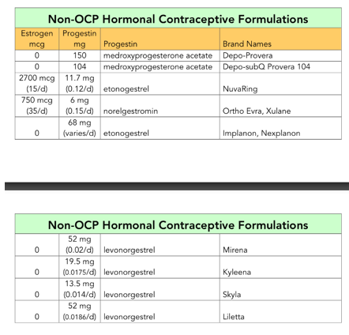
Highlights:
Hormone doses
Progestin generations
Brand names
Monophasic vs Triphasic

Slide 40
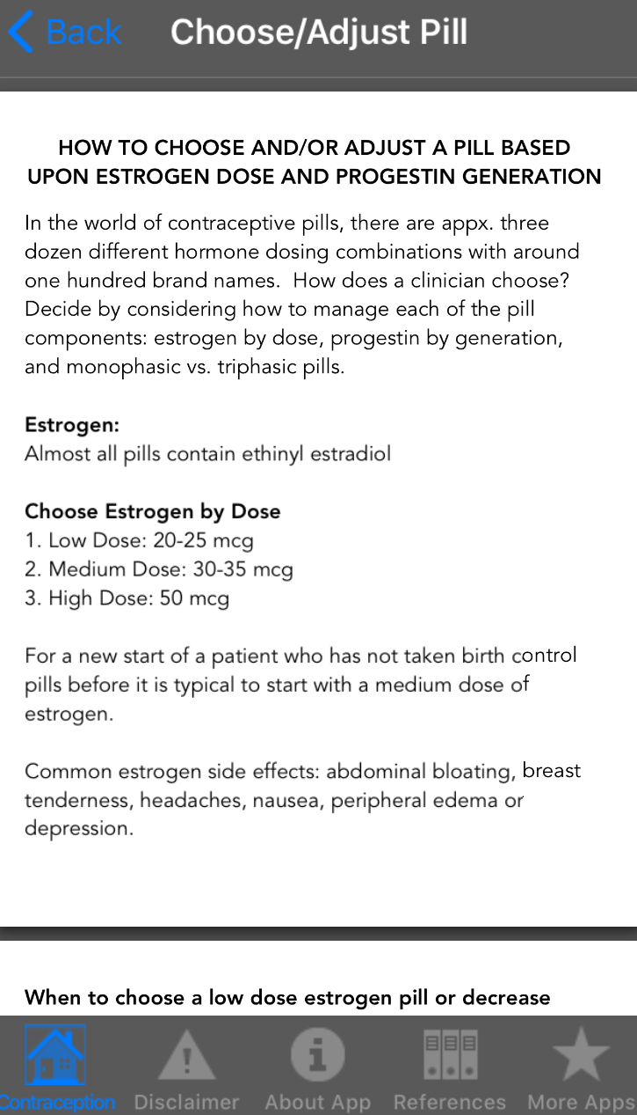
Information about:
Estrogen doses & side effects
Progestin generations & side effects
Monophasic vs Triphasic

Slide 42
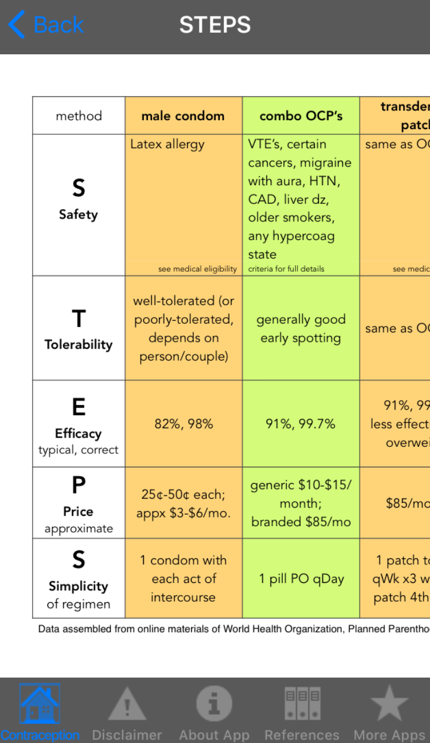
Methods:
Condoms
Oral OCPs
Transdermal patch
Vaginal ring
Progestin-only OCP
Progestin injection
Progestin IUD
Copper IUD
Progestin implant
Vasectomy
Tubal ligation/blockade
Lactational amenorrhea
Fertility awareness methods
Withdrawal
Diaphragms + spermicide
Sponge, cervical cap
Abstinence
Safety
Tolerability
Efficacy
Price
Simplicity

Slide 43
Notes:
EC: levonorgestrel (Plan B), ulipristal (Ella), copper IUD, CHC
FAMs: basal body temp method, cervical mucus (Billings, Creighton, TwoDay method), calendar rhythm methd, standard days method, symptotheraml method, Marquette method

Slide 44
Notes:
EC: levonorgestrel (Plan B), ulipristal (Ella), copper IUD, CHC
FAMs: basal body temp method, cervical mucus (Billings, Creighton, TwoDay method), calendar rhythm methd, standard days method, symptotheraml method, Marquette method

Slide 45
Activity
19 yo F is a new patient who comes to your clinic requesting a change in birth control pills. She has been taking Amethyst® for the past 7 months, and she complains of increased weight gain and intermittent bleeding. Patient is overweight (BMI 28), has depression, hx of severe headaches (non-migrainous), and smokes ½ ppd.
Is a combined hormonal contraceptive an appropriate option for this patient?
If so, what product would you switch her to?

Slide 46
Is a combined hormonal contraceptive an appropriate option for this patient?
BMI 28
Depression
Smokes ½ ppd
(19 yo)
Ehhh
Severe HA
Notes:
EC: levonorgestrel (Plan B), ulipristal (Ella), copper IUD, CHC
FAMs: basal body temp method, cervical mucus (Billings, Creighton, TwoDay method), calendar rhythm methd, standard days method, symptotheraml method, Marquette method

Slide 47
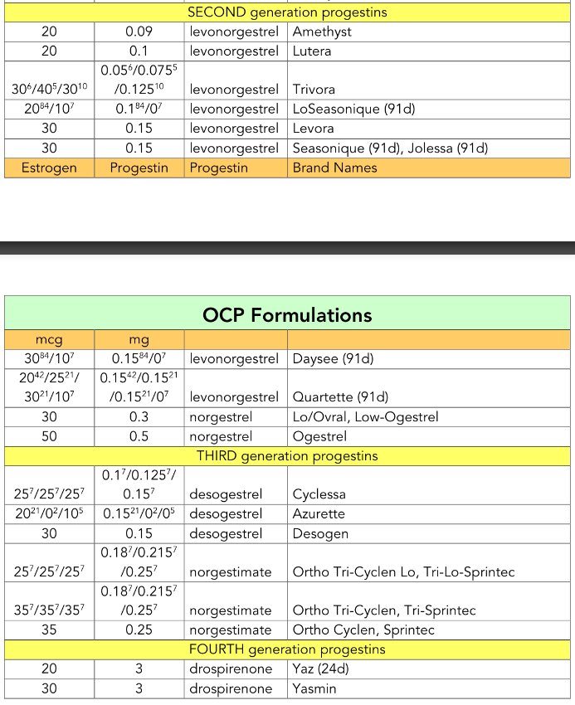
Notes:
EC: levonorgestrel (Plan B), ulipristal (Ella), copper IUD, CHC
FAMs: basal body temp method, cervical mucus (Billings, Creighton, TwoDay method), calendar rhythm methd, standard days method, symptotheraml method, Marquette method

Slide 48
GoodRx Pro
S
P
A
E
GoodRxPro (Healthcare Professionals)
Assists medical professionals quickly find current prescription dosage forms and pricing and local discounts on medications
Up-to-date pricing of medications based on local pharmacy pricing (independent/compounding pharmacy not included)
Quick access, easy to use form layout, and send GoodRx Coupons to patients by email or text message (SMS)
Notes:
GoodRx gathers current prescription drug prices and discounts to help improve adherence and affordability for patients. Provides current price at local and mail order pharmacies, manufacturers co-pay cards, pharmacy membership program, Medicare co-pay information and valuable saving tips.
Source: GoodRx
Platform available: iPad/iPhone/iPod touch, Android, Desktop
Authoritativeness/accuracy/currency of information: Developed for healthcare professionals, updated with retail pricing of medication based on dosage form, strength, and quantity
Cost: Free
Ease of Use: Easy to use form layout, simply populate fields and it find the medication at local pharmacies in the specified location
Sponsers: Good Rx

Slide 49
Utilizing GoodRxPro - Activity
CJ is a 31 year old female in her 2nd trimester of pregnancy with a uncomplicated urinary tract infection and currently being treated with Ceftriaxone
Next Step: Discharge on oral antibiotics to complete a 7 day course of treatment
Which antibiotic should we choose?
Cefpodoxime 100 mg by mouth twice a day
or
Cefdinir 300 mg by mouth twice a day

Slide 50
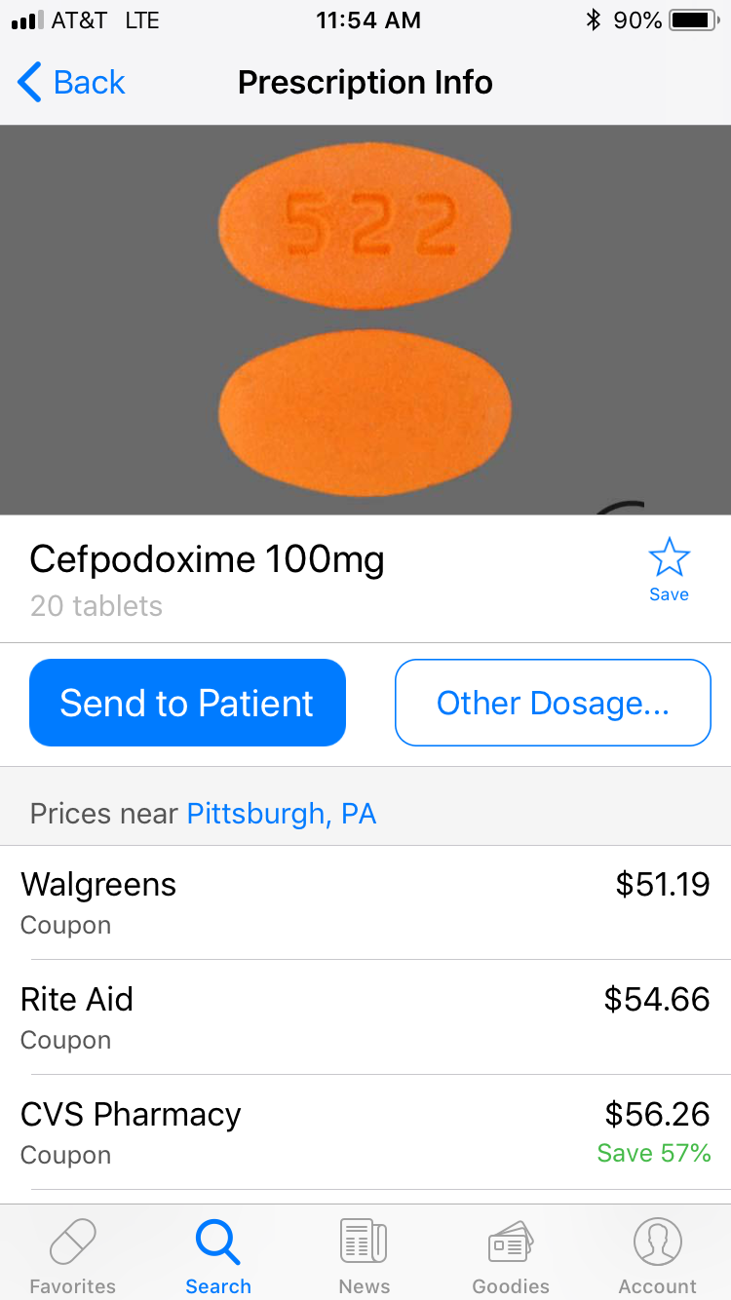

Slide 51
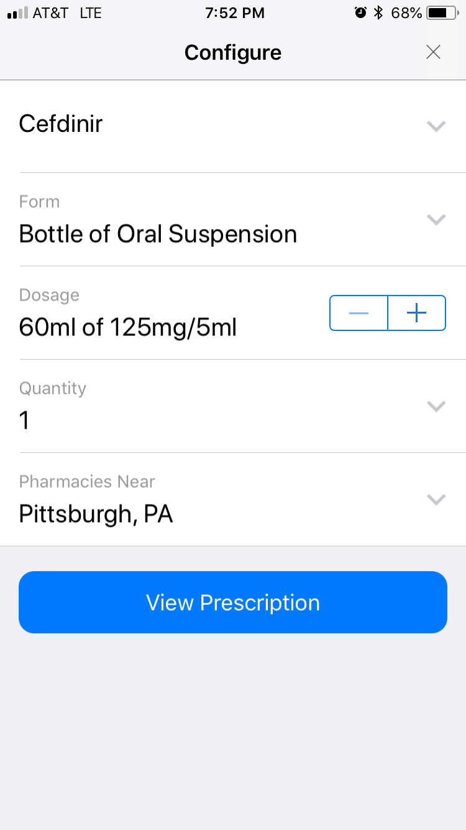
The patient is able to afford cefdinir capsules
However, you learn the patient would prefer a liquid…
Does cefdinir comes as a liquid and is this affordable?

Slide 52
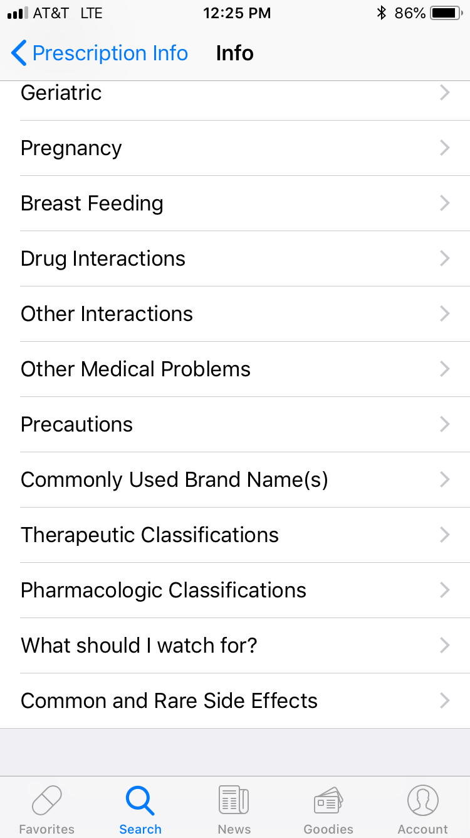
General Summary – Lacks Information
Notes:
GoodRx Pro provides additional information on medications often found in other resources (i.e. package insert, UpToDate, Micromedex, and Dynamed). The information provide is a brief summary and lack completeness compared to other drug information resources.

Slide 53
Formulary Search
S
P
A
E
Managed Markets Insight & Technology, LLC.
Assists prescribers in selecting clinically appropriate and affordable medications based on individual formularies
Accurately specifies preferred medication based on state-to-state Commercial, Medicare, and Medicaid formularies
Simple, easy-to-use format, up-to-date based on individual prescription benefit plans

Slide 54
Utilizing Formulary - Activity
RJ is 56 year old male with uncontrolled diabetes with an A1c of 11.1%
Current Medications
Metformin 1000 mg by mouth daily
Glipizide 10 mg by mouth daily
Next Step: Begin Long-Acting Insulin at 10 units subcutaneously at bedtime
Which brand of insulin glargine should we select based on the patient’s insurance coverage?
Lantus Solostar U-100 Insulin
or
Basaglar Kwikpen U-100 Insulin
Notes:
Patient continues to be resistant to lifestyle modification and has agree insulin therapy is the next step.
Discontinue Glipizide

Slide 55
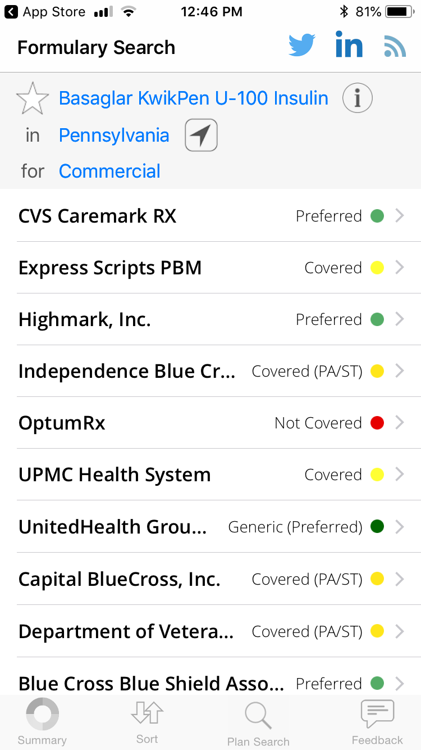

Slide 56
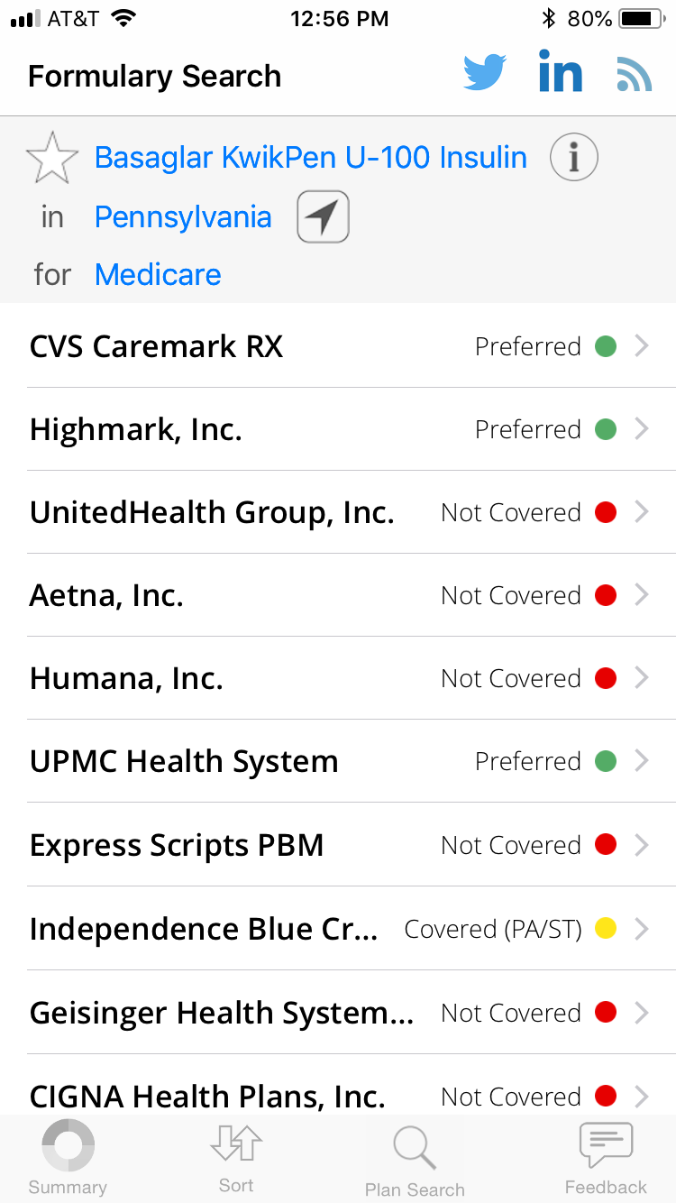
Medicare
Medicare

Slide 57
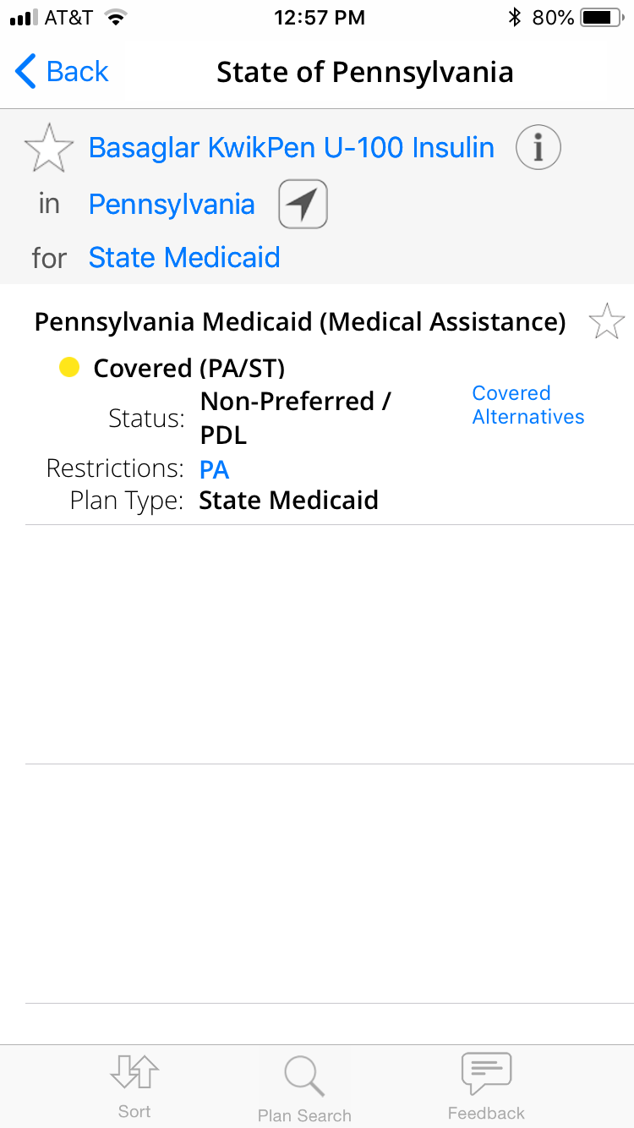

Slide 58
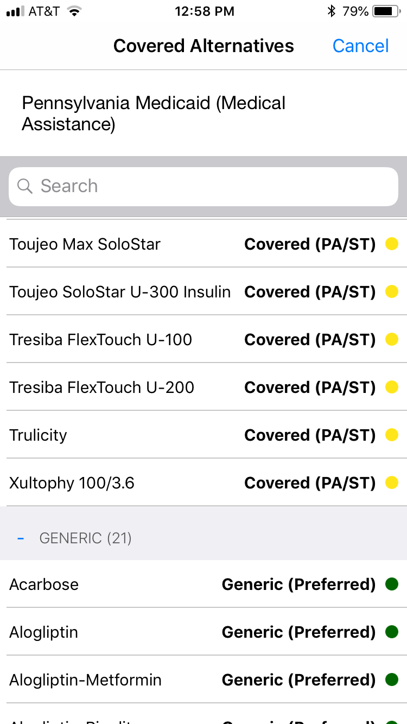

Slide 59
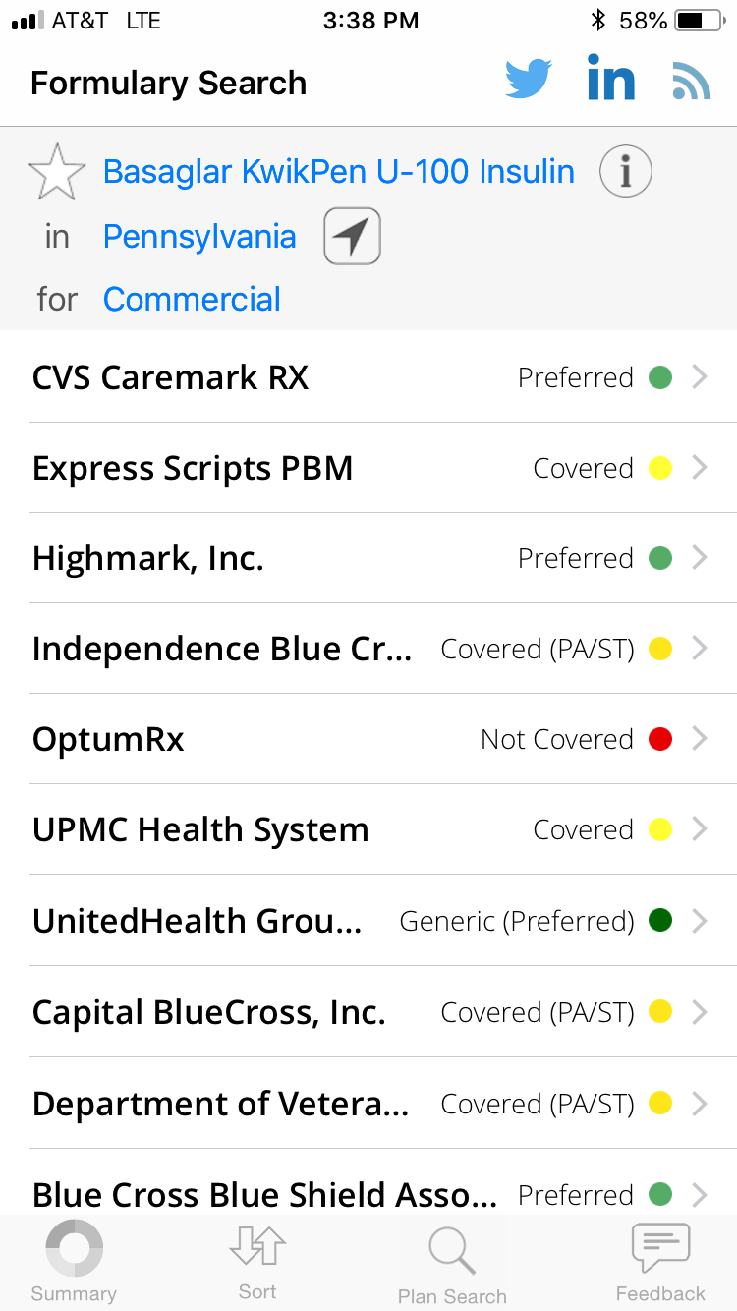
Co-pays
Notes:
Sort by Lives/Name/Status
Application does not specify co-payments for individual plans

Slide 60
Objectives
Active participants will be able to:
Describe how mobile applications (apps) can be used at the point of care
Demonstrate to patients and family medicine learners how to use the recommended medical apps
Utilize appropriate and effective mobile applications in practice to generate clinical recommendations

Slide 61
Which app are you most likely to utilize?

Slide 62
iContraception
QXCalculate
STFM SHOTS – AAP mobile app
ASCCP – not free! PAP management
LactMed
ASCVD calculator
BRISK – breast cancer risk assessment
MenoPro
EPSS – AHRQ prevention calculator (funding going away?)
MedCalc!!!
Bridge Anticoagulate – ACC (when to bridge, etc) – only for A. fib
iPro MAPPP = way better than Bridge Anticoagulate!
IDC (infectious disease compdium)
FHR 5 Tier (fetal heart rate)
Infant risk center
Johns Hopkins Antibiotic Guide ($30/year)
Smiles for Life – oral health app
PreOp Eval
Opioids
Journal Club
FPM Ancza - favorite
Urintel
Doximity Dialer
Bilicalc
Polypharmacy (deprescribing)
ePocrates $$$
MediSafe
Pneumovaccine

Slide 63
A special thanks to our UPMC St. Margaret Faculty Development Fellowship

Slide 64
Please evaluate this presentation using the conference mobile app! Simply click on the "clipboard" icon on the presentation page.

