Slide 1
Primary Care Practices and Payers
The value of deeper partnerships on the journey toward
population health

Slide 2
Brief introduction….
Colorado community based health plan.
In operation since 1974
Serving all populations – approximately 275,000 enrollees.
Creating health equity and generational impact through transformation.
Now, a UnitedHealthcare enterprise – March 2017

Slide 3
So close…yet so far apart.
Often a shared vision & values set.
Inescapable logic regarding the value of comprehensive, whole person primary care.
Lost in translation. Lost in transaction.

Slide 4
Transformation is a bi-directional process.
Volume machines are well-oiled and spin at high RPM.
Attempting defy gravity by creating a new center.
We need better evidence about what to do.

Slide 5
The perils of transformation
There is nothing more difficult to take in hand, more perilous to conduct, or more uncertain in its success, than to take the lead in the introduction of a new order of things. Because the innovator has enemies in all those who have done well under the old conditions, and lukewarm defenders in those who may do well under the new
This coolness arises partly from fear of the opponents, who have the laws on their side, and partly from the incredulity of men, who do not readily believe in new things until they have had a long experience of them.
N. Machiavelli

Slide 6
Attributes of High Value Primary Care*
3 themes: Risk-stratified care management, careful selection of specialists, “care traffic control”….
Payer role insufficient: “The multi-decade failure of payer efforts to serve this role in isolation from primary care sites via telephonically mediated nurse care managers suggests that primary care represents an advantaged platform for care coordination.”
But necessary: ”[W]ill require much more easily accessible information on all care being received by patients as well as greater transparency on how physicians perform relative to peers.”
*Milstein, et al. Annals of Family Medicine - Nov/Dec 2017

Slide 7
Where we trip
Measurement
Attribution
Data sharing
Coordination & stratification
Segmentation
Compensation

Slide 8
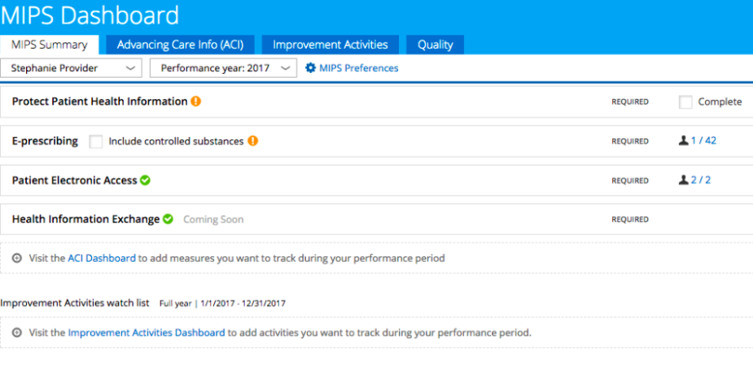
Measuring everything (but too little)
Too many measures
Missed risk & over treatment
Looking backwards instead of forwards
Misalignment of methods and domains
Regulatory & corporate inertia

Slide 9
Attribution – Where are my patients?
What’s up with this list?
Blind spots beyond countable encounters.
Big difference between what is, the way we think and what really matters.

Slide 10
Big data – small ball.
Many payers, little aggregation.
Minimal interoperability & data blocking.
Patients (and their full SDoH context) are missing.

Slide 11
The care management industrial complex
Coordination is symptomatic of fragmentation.
Economic and practical barriers.
Platforms vs. networks.
Redundancies, gaps & other maldistributions.

Slide 12
Segments & slices
We can’t all be Stars.
My patients (aren’t) sicker.
Market share & price discrimination.

Slide 13
Compensation & productivity
Caught between two distant worlds.
Gymnastic accounting.
Dearth of business intel.

Slide 14
Unlearning helplessness

Slide 15
Partnership pathways to better value
Attribution
Bilateral validation
Non-traditional encounters
Data Sharing
Agreed measure value sets
Coordination
Patient choice
Community standards & specs
Simple touches, alerts & updates
Rights & roles architecture
Resource adjusted risk scoring
Clinically-pertinent use cases

Slide 16
Partnership pathways to better value
Multi-payer Collaborative
Aligned Measures & Peer Benchmarking
Enhanced APM
Data Aggregation

Slide 17
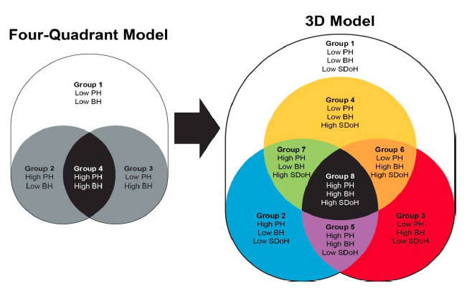
Whole person stratification

Slide 18
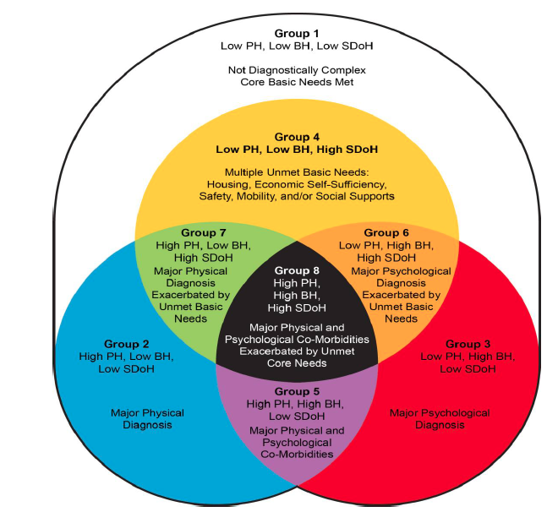
Resource adjustment in primary care

Slide 19
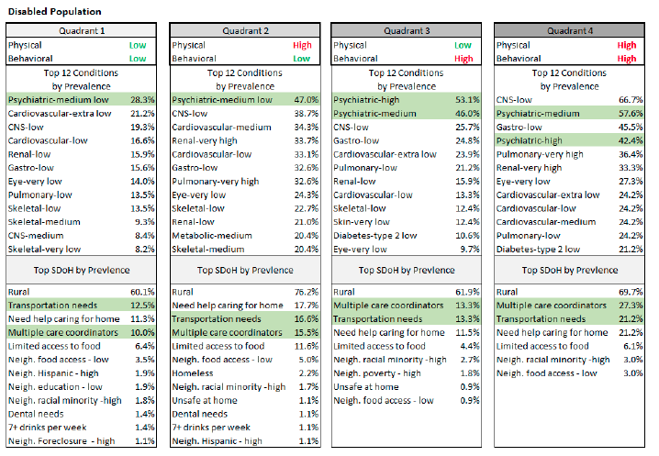
Smarter payment, better partnership

Slide 20
Please evaluate this presentation using the conference mobile app! Simply click on the "clipboard" icon on the presentation page.

