Slide 1
What (and who) is Balint
Powerpoint a collaboration of the members of the American Balint Society
Today’s Presenters:
Phil Phelps, Jeff Sternlieb, John Freedy and Allison Bickett

Slide 2
“At the center of medicine there is always a human relationship between a patient and a doctor.”
-Michael Balint

Slide 3
Michael Balint
Born in 1896 in Budapest, son of a GP
Psychoanalytic training in Berlin and Budapest, emigrated to London, worked at the Tavistock Clinic
He and a social worker named Enid Eichholtz (who later became his wife) began training/research seminars for GP’s after WW II
1957 “The Doctor, His Patient and the Illness” was published

Slide 4
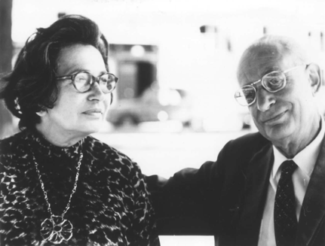
Michael and Enid Balint

Slide 5
What is the function of a Balint Group?
To provide a safe place for reflection
To reflect on “blind spots” or assumptions re: the doctor/patient relationship
To help members develop a “tool” for metabolizing emotional aspects of work
Explore how feelings and thoughts affect the doctor-patient relationship
Expand capacity for “holding” difficult situations with patients
To help members feel less isolated, more open to learn and less conflicted

Slide 6
What are the characteristics of a Balint Group?
Two leaders
Focus on the doctor-patient relationship
Preference for an ongoing case
Fixed membership (ideally)

Slide 7
What a Balint group is not
Prescriptive, didactic
Problem solving/advice giving
Support group
Traditional Case Consultation
M & M
Psychotherapy Group

Slide 8
Ground Rules
Confidentiality
Respect, Turn Taking
Avoid advice
No criticism

Slide 9
What makes a “good case”
Patients who make you “groan” when you see them on the schedule
Patients about whom we have strong feelings about or feel conflicted
Patients who leave us feeling unfinished, whom we lose sleep over
Patients who bubble up in the moment
Patients with whom we have ongoing relationships

Slide 10
How is a case presented?
Presentations are spontaneous
Basic information about the patient and medical issues
Description of the doctor-patient relationship
Aspects of the case you find challenging or conflicting

Slide 11
The Group Convenes
Leader
Leader
Notes:
Composition:
small groups of 6-12 participants, members are clinically active providers
defined group leader, usually a physician with active clinical contact and a psychologist or mental health provider

Slide 12
Calling for the Case
Leader
Who’s got a case?
Leader
Notes:
The group begins with: who’s got a case?

Slide 13
Group Process
Leader
I do.
Leader
Notes:
a member volunteers to present the details of a case

Slide 14
The Case Arrives
Leader
Sophie is a 79 yr old blind woman….
Presenter
Leader
Notes:
a member volunteers to present the details of a case

Slide 15
Clarifying Questions
Leader
Are there any questions of fact?
Presenter
Leader

Slide 16
The Presenter gets to Listen
Leader
Lets let the presenter just listen while we ‘work the case'
Leader
Presenter
Notes:
The group begins with: who’s got a case?

Slide 17
Imagining Patient and Doctor
Leader
If I were the doctor, I might feel…
Leader
Presenter
Notes:
participants explore the patient, the doctor, their roles and relationship

Slide 18
Group Exploration Continues
Leader
This image just popped into my mind of a…
Leader
Presenter
Notes:
participants openly hypothesize about the dynamics which could exist for each character

Slide 19
The Presenter Rejoins Discussion
Leader
Leader
Notes:
Composition:
small groups of 6-12 participants, members are clinically active providers
defined group leader, usually a physician with active clinical contact and a psychologist or mental health provider

Slide 20
Functions of Group Members
To explore the doctor-patient relationship
Be divergent in thinking (speculate)
Explore from own perspective vs. imagining the presenter’s experience

Slide 21
Function of the Balint Leaders
create and maintain a safe space
structure and hold the group over time
encourage reflection, empathy and compassion
attend to group development

Slide 22
Balint Training Opportunities
Balint Intensive Leadership Training
Spokane, Washington-April 25-28, 2019
Intensive “To Go”- Contract for ABS credentialed leaders to come to your site
Americanbalintsociety.org
Opportunities for other Balint events can be found

Slide 23
Potential Benefits for Participants
You decide

