Slide 1
Use of a Novel HIPAA Training Module to Improve Third-Year Medical Student Preparedness for Clinical Rotations
Nicole Bentze, DO, FAAFP
Tatianna Pizzutto, MS3
Florida State University College of Medicine

Slide 2
Disclosures
The authors have no financial relationships to disclose.

Slide 3
Learning Objectives
Identify potential violations of HIPAA and threats to patient privacy that medical students may be exposed to or involved in when interacting with physicians, residents, patients and families in any clinical setting.
Discuss challenges facing medical students regarding HIPAA and propose potential solutions by participating in a sample breakout session.
Implement pertinent components of this training module into their training institution’s existing HIPAA instruction for students and residents.

Slide 4
Background
Need for HIPAA training
Medical students can unwittingly become liabilities if patient privacy is breeched.
Need for practical, real life scenarios
Need for Curriculum change
Prior lecture riddled with complicated legal terminology.
Examples were not clearly applicable to the unique situations faced by medical students.
Notes:
Medical students are both excited and terrified to start clinical rotations and participate in patient care.
Several teaching institutions have HIPAA lectures or training modules that must be completed prior to participating in patient care.
New PowerPoint self-directed, written in “plain language”,

Slide 5
Unique Situations for medical students
Required to complete patient logs.
Participating in Teaching Rounds, Morning Report, Noon Conference, etc.
Possession of protected health information (PHI) (daily schedules, round reports, copy of “interesting” EKGs, imaging, etc.)
Notes:
Each school has different requirements for patient logs. Inconvenient at times, mobile apps for E*value and other software not as easy to use to document during patient care.
What can be said in the patient rooms vs nursing stations, hallways, cafeteria, etc
How to handle patient lists, shred as soon as information no longer needed.
Texting issues without using secure apps
Discussion of ”interesting cases” with those outside the teaching program. Must de-identify patient and facility

Slide 6
Unique Situations for medical students
Communication with residents and attending physicians.
Social media posting.
Study groups and colleagues outside of training site.

Slide 7
Novel Curriculum
On line, self-guided PowerPoint presentation.
Created in collaboration with Carol Ann Kalish, Esq., Chief Legal Officer of Sarasota Memorial Hospital
47 slides
Built in 17 question quiz, multiple attempts allowed for correct answer and 100% grade required to pass.

Slide 8
Novel Curriculum
Interactive Scenarios
Small group sessions to work on case scenarios
Inpatient and Outpatient specific examples
Recognize potential HIPAA violations
Brainstorm possible ways to avoid or decrease risk

Slide 10
Brief Break Out Session
Divide into groups
5 minutes to discuss a sample case scenario
Report possible threats
Propose possible solutions

Slide 11
Pilot
Self-directed, on-line PowerPoint with quiz questions completed by ALL FSU students during MS 3 Orientation.
Sarasota Regional Campus had an additional interactive case-based workshop
Central campus conducted a general survey of all students for the entire orientation.
Pre- and Post-Workshop Surveys were conducted by the workshop creator

Slide 12
2016 M3 Orientation Online HIPAA Lecture
Notes:
Comment that if just the online lecture, students would not appreciate the topic or feel that learning about HIPAA is important.

Slide 13
Pre-Workshop Survey
1 = Strongly Disagree | 2 = Disagree | 3 = Neutral | 4 = Agree | 5 = Strongly Agree
1 2 3 4 5 | I can define the basic principles of HIPAA.
1 2 3 4 5 | I can effectively safeguard patient protected health information (PHI). .
1 2 3 4 5 | I can appropriately report a potential HIPAA violation.
1 2 3 4 5 | I understand the importance of HIPAA as it relates to my role as medical student in the clinical setting.
1 2 3 4 5 | The on-line HIPAA module was effective for learning.
1 2 3 4 5 | The information presented in the on-line HIPAA module was valuable to me.
1 2 3 4 5 | The on-line HIPAA module was enjoyable.

Slide 14
Pre-Workshop Survey Results

Slide 15
Pre-Workshop Survey Results

Slide 16
Post-Workshop Survey
1 = Strongly Disagree | 2 = Disagree | 3 = Neutral | 4 = Agree | 5 = Strongly Agree
1 2 3 4 5 | I can define the basic principles of HIPAA.
1 2 3 4 5 | I can effectively safeguard patient protected health information (PHI).
1 2 3 4 5 | I can appropriately report a potential HIPAA violation.
1 2 3 4 5 | I understand the importance of HIPAA as it relates to my role as medical student in the clinical setting.
1 2 3 4 5 | The HIPAA workshop was effective for learning.
1 2 3 4 5 | The discussions during the HIPAA workshop were valuable to me.
1 2 3 4 5 | The HIPAA workshop was enjoyable.

Slide 17
Post-Workshop Survey Results

Slide 18
Post-Workshop Survey Results

Slide 19
Medical Student Comments: Instructions – “Comment on one new thing you learned as a result of this workshop”
“How to handle reporting HIPAA violations” | “Protect password and delete pictures!”
“Not being able to use initials of patients. I will make sure to use more measures to de-identify in the future” | “Be extra cautious using social media. Things can snowball out of your control”
“A lot of grey areas, creative problem solving is a must” | “Thought more about the implications of preceptor-student communication”
“Photos being uploaded to the cloud can pose a HIPAA threat”

Slide 20
Medical Student Comments: Instructions – “Please provide suggestions for Improvement”
“For the online ppts, having the quiz at the end may be helpful. Or at least have the questions not precede the information we need to know to answer correctly!”
“Make online lecture shorter”
“Small group workshop much better than online lecture”
“Loved the workshop, definitely needs the pre-ppt to know ‘the rules’ but the ppt was too long and I skipped through most of it”

Slide 21
Issues Identified by Students as a Result of Workshop
Having “too much” access to patient personal health information (PHI)
Hierarchy of attending physicians, residents, & even ancillary staff creates a huge power differential in minds of students
Fear of poor evaluation or reputation
Uncertainty of how to report HIPAA concerns (to whom, etc.)
Concept of “forethought produces better outcomes”

Slide 22
Future Plans for Improvement
Streamline on-line course. Shorten PowerPoint Change slide order so questions immediately follow the material
Continue to gather new scenarios based on student experiences.
Expand workshop to more campuses
Adapt for intern/residency program orientation
Encourage others to incorporate pertinent components into HIPAA training modules

Slide 23
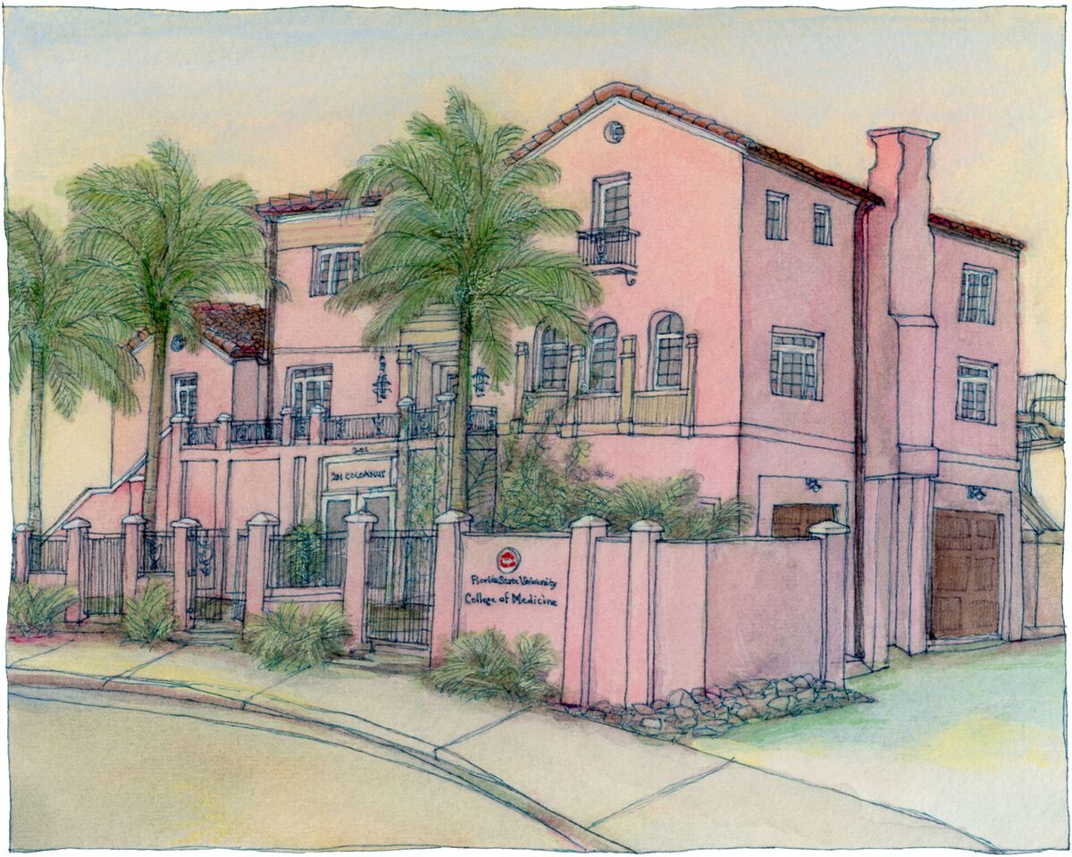
Contact Information
Nicole Bentze, D.O.
Nicole.Bentze@uhsinc.com
Tatianna Pizzutto, MS3
tmp10c@med.fsu.edu
Thank You
A special thank you to Cynthia Samra, MD for her help with editing this presentation.

Slide 24
Please evaluate this presentation using the conference mobile app! Simply click on the "clipboard" icon on the presentation page.

