Slide 1
Family Medicine’s Continued Growth & Development in Ethiopia
John G Halvorsen, MD, MS
Weyinshet (Winnie) Gossa, MD

Slide 2
Workshop Objectives
Following this workshop, attendees will be able to:
Describe Ethiopia’s key ethnographic, geographical, & political features
Describe the Ethiopian medical education & healthcare systems
Tell the chronological history of FM in Ethiopia

Slide 3
Workshop Objectives
Discuss the future of FM in Ethiopia with respect to:
Factors supporting the growth of FM
Factors threatening FM’s continued development
The challenges facing FM
The opportunities for FM
Describe immediate “next step” priorities for FM in Ethiopia

Slide 4
This is
Ethiopia

Slide 5
Geography
Almost twice the size of Texas
Lowest point: 148 M (486 ft) below sea level (Danikil Depression)
Highest point: 4550 M (14,928 ft) above sea level (Ras Dashen)
Addis Ababa: 2,300 M (7,546 ft)
Addis temperature: 60.5 F; average monthly variation 5.4 F

Slide 6
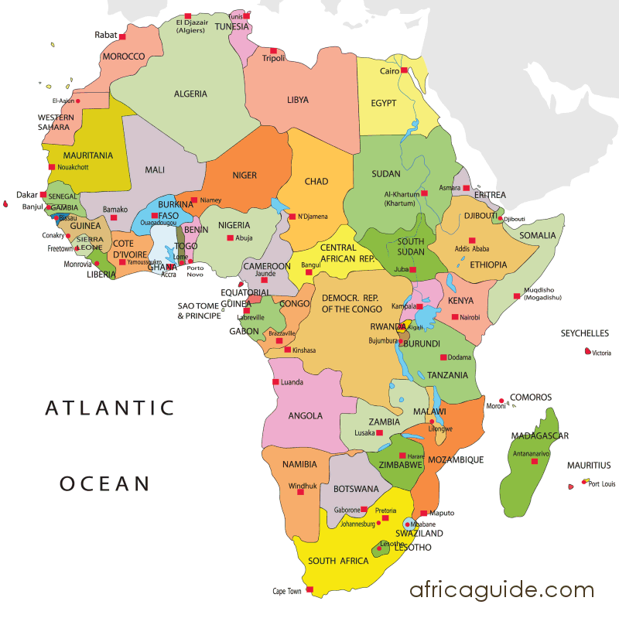

Slide 7
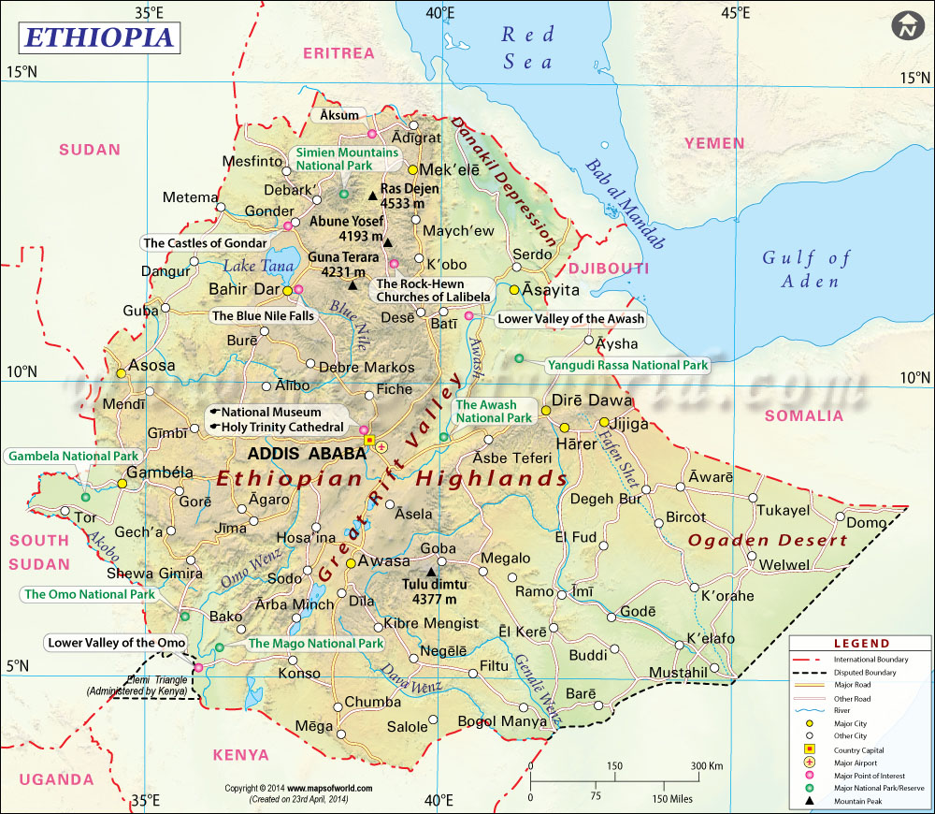

Slide 8
History
Oldest human ancestors – 5.8 to 5.2 million years ago
Africa’s oldest independent country (>2,000 years old), never colonized
Menelik I (?son of Sheba/Solomon) founded Ethiopian empire
4th century Christianity introduced from Egypt, Syria
7th century rise of Islam; Ethiopia isolated
1500s Portuguese re-established contact
1700s, “Era of Princes”

Slide 9
History
1869 Emperor Tewodros unites; succeeded by Emperor Yohannes
1889-1913 Emperor Menelik II; defeats Italians in 1896 at the Battle of Adwa (still a national holiday); succeeded by Lij Ilyassa
1916 Christian nobility depose King Iyassa because of his Muslim sympathies
Make Menelik II’s daughter, Zewditu, Empress in 1917
Appoint her cousin, Ras Tafari Makonnen, as regent & successor
1930 Ras Tafari assumes name, Haile Salassie, assumes throne

Slide 10
History
Mengistu led Marxist revolution 1974
Mengistu overthrown, exiled 1991
Current constitution adopted in 1994; implemented 1995
Now Federal Parliamentary Republic with nine ethnically-based states & 2 self-governing administrations
First PM, Meles Zenawi, died 2012, with peaceful transition to his Deputy PM Hailemariam Desalegn

Slide 11
Religion
Coptic Christianity introduced 341CE
615 CE, Muhammad sent followers to Ethiopia to escape persecution in Mecca; welcomed by King Axum
Current religions
Ethiopian Orthodox 43.5%
Muslim 33.9%
Protestant 18.6%
Traditional beliefs 2.6%
Roman Catholic 0.7%
Other 0.7%

Slide 12
Economic Data
Currency: Ethiopian Birr (± 20 to the dollar)
GDP per capita: $1,900
GDP growth rate: 6.5%
Inflation rate: 8.8%
Health expenditures: 4.9% GDP
Poverty: 29.5% of population (25.7% urban; 30.4% rural)
Urban unemployment: 17.5%
Unemployment, youth 15-24: 25%

Slide 13
Population Statistics
Total: 94,352,000 (50.2% male; 49.8% female)
Urban: 10.1%
Urbanization rate: 3.5% per year
Median age: 17.8 years (17.6 male; 18 female)
Life expectancy: 62.2 years (59.6 male; 64.7 female)
Literacy (> age 15): 49.1% (57.2% male; 41.1% female)
Education: Mean of 7 years

Slide 14
Population Statistics (cont)
Population growth rate: 2.88%
Birth rate: 36.9/1,000
Death rate: 7.9/1,000
>13 ethnic groups: Oromo, 34.4%; Amhara, 27%; Somali, 6.2%; Tigray, 6.1%; Sidama, 4%)
Languages: >13; English the major foreign language

Slide 15
Health Statistics
Mean maternal age at first birth: 19.6 years
Maternal mortality: 412/100,000 live births
Infant mortality: 48/1,000 live births
Birth attended by skilled provider: 28% (80% urban; 21% rural)
Contraceptive prevalence: 37.9%
Childhood nutritional status
56% Stunted (chronic malnutrition)
13% Wasted (acute malnutrition)
31% Underweight

Slide 16
Health Statistics
All basic immunizations, age 12-23 months: Overall = 39%; Urban = 65%; Rural = 35%
Hospital bed density: 6.3/1,000
HIV prevalence (adult): 1.15%
Adult risk factors:
Elevated blood glucose: 7.3% (M); 7% (F)
Elevated blood pressure: 33% (M); 28.3% (F)
Obesity: 0.9% (M); 1.6% (F)

Slide 17
Health Statistics: Top 10 Causes of Death
1. Lower respiratory tract infections (15%)
2. HIV/AIDS (7.3%)
3. Diarrheal diseases (6%)
4. Birth asphyxia/birth trauma (4.3%)
5. Protein-energy malnutrition (4.1%)
6. Stroke (4.1%)
7. Preterm birth complications (3.9%)
8. Neonatal sepsis/infections (2.3%)
9. Tuberculosis (2.3%)
10. Meningitis (2.3%)

Slide 18
Medical Education
Federal Ministry of Education
University-based
6 years following high school
Federal Ministry of Health
Established 2010; regionally distributed
Entrance requires a “first degree” – college graduation
4 years
Residency training – based in MoH certified “teaching hospitals”
All programs 3 years long

Slide 19
Health Workforce
High level professionals: Medical specialists & GPs
Middle level professionals: First degree & diploma level health professionals
Low level professionals: All certificate level health workers excluding the front line workers
Front line health workers: Primary health workers, primary midwife & health extension workers

Slide 20
Health Professionals
Overall health workforce = 1.3/1000
Doctors, health officers, nurses, midwives = 0.7/1000 (WHO recommendation is 2.3/1000)
Physician/population ratio: 1/42,706 (.023/1000 -- among the lowest in sub-Saharan Africa)
Nurses: 1/5,000 (WHO minimum)
Increasing trend to train low- to mid-level health professionals (HEWs, HOs, nurses, midwives)

Slide 21
Health Professionals/1,000
Physician 0.023
Specialist 0.013
Health officer 0.021
Pharmacist 0.008
Nurse 0.258
Midwife 0.018
Health assistant 0.019
Health extension worker 0.394

Slide 22
Health Workforce Distribution
83% rural population is underserved
Skilled workforce highly skewed toward private & non-governmental organizations, serving a fraction of the population
Health workforce migration threatens workforce density

Slide 23
FMoH Training Initiatives
Training in Public Health
8 schools in 2005
57 schools in 2015
34 universities with degree programs
23 regional health sciences colleges with technical/vocational programs
Now 33 medical schools & 3,427 enrolled students
Over 38,000 HEWs now trained/deployed
5,431 HOs trained

Slide 24
FMoH Training Initiatives
3-year Master’s program to train HOs in emergency OB & newborn care
Now 49 midwifery schools
Pre-deployment training for MDs
Incentive packages to retain highly skilled, highly qualified professions
A major concern: Educational quality, strength of practical clinical skills of graduates, ability to work in their area of study

Slide 25
Ethiopian Health Tier System
Primary level
Rural
Health Post (3-5,000)
Health Center (15-25,000)
Primary Hospital (60-100,000)
Urban
Health Center (40,000)
Secondary level: General Hospital (1-1.5 million)
Tertiary level: Specialized Hospital (3.5-5.0 million)

Slide 26
Health Services by Tier Facility
Health Posts: community-based basic health services
Health Centers: preventive, curative, inpatient, ambulatory, & dental services; treatment of common psychiatric disorders
Primary Hospital: preventive, curative, inpatient, ambulatory, emergency surgery services; referral for Health Centers; training for nurses & paramedics
General Hospital: inpatient & ambulatory services; referral for Primary Hospitals; training for HOs, nurses, emergency surgeons
Specialty Hospitals: inpatient services; referral for General Hospitals; physician specialty training

Slide 27
Primary Health Care Unit
5 Satellite Health Posts – each staffed with 2 HEWs
1 Health Center
1 Primary Hospital
Health facility construction from 2005 to 2015 resulted in
16,440 Health Posts
3,547 Health Centers
311 Primary Hospitals

Slide 28
The Chronological History of Family Medicine in Ethiopia

Slide 29
FM in Ethiopia: 1997-98
Ethiopia government develops a Health Sector Development Plan
designed in 4 phases to:
• Enroll more medical students
• Educate/deploy more Health Extensions Workers, Health Officers, Midwives
• Train Health Officers for surgical/OB emergencies

Slide 30
FM in Ethiopia: 2001-2005
Government focuses on:
• Training more Health Extension Workers (HEWs)
• Constructing more health posts, health centers, hospitals throughout the country
• Expansion of Community Health Centers in Addis

Slide 31
FM in Ethiopia: 2008
AAU hosts International Workshop on Postgraduate Programs
• 11 faculty from University of Toronto (UT) attend
• Discuss the value of FM for Ethiopia with
AAU Medical School Dean (Milliard Derbew),
President of EMA (Yirgu Hiwot),
Co-leader of AAU-UT Psychiatry Project (Atalay Alem)

Slide 32
FM in Ethiopia: 2009
UT faculty provide CME session on the roles, responsibilities,
& scope of FM practice to the Ethiopian Medical Association
(EMA)

Slide 33
FM in Ethiopia: 2010
• Philpott J, Derbew M. Use of a CME workshop to introduce and promote the specialty of family medicine in Ethiopia. African Journal of Primary Healthcare and Family Medicine 2010;2(1), art.#155, 3 pages, DOI:10.4102/phcfm.v2i1.155 (Available at http:www.phcfm.org)
• Formal meeting with Dr Tedros Adhanom Gebreyesus (FMoH), Dean Derbew (AAU), and UT faculty regarding FM
• 2010 University of Wisconsin (UW) begins formal participation with UT & AAU through the US government-funded Medical Education Partnership Initiative (MEPI) grant
• First draft of a FM curriculum completed

Slide 34
FM in Ethiopia: 2011
• UT faculty present FM to EMA annual meeting
• 2011-12, FM Mini-fellowships
8 AAU faculty from IM, Peds, Surgery, OB-Gyn, Pub Health complete 2-week faculty development workshops with UT & UW focused on learning the scope of FM & the process for training FPs in US & Canada
• Oct 2011 FMoH officially approves FM concept; requests AAU to proceed with a FM residency
• Formal needs assessment conducted to help inform curriculum design

Slide 35
FM in Ethiopia: 2012
• UT faculty present a 2nd EMA CME event on FM
• UT faculty present to WONCA Africa regional conferences
• AAU GME Council approves a FM Curriculum
• Brian Cornelson, UT faculty, commits to extended faculty support for FM residency
• 2 other Canadian FPs, Mike Cotterill and Anji Oberi, join as visiting faculty for 2 years
• Prospective residents recruited through CME events, local advertisements, word-of-mouth

Slide 36
FM in Ethiopia: 2013
• Feb, Dr. Dawit Wondimagegn named inaugural Program Director for AAU FM Residency
• Feb, AAU FM residency begun with 5 residents, quickly expands to 7

Slide 37
FM in Ethiopia: 2014
Philpott J, Cornelson B, Derbew M, Haq C, Kvach E, Mekasha A, Rouleau K, Tefera A, Wondimagegn D, Wilson L, Yigerema M. The dawn of family medicine in Ethiopia. Family Medicine 2014; 46(9) 685-90.
Dr. Wondimagegn presents plenary speech to the AAFP Global Health Workshop on FM coming home to Africa

Slide 38
FM in Ethiopia: 2015
• MEPI grant expires, ending formal UW Department support for AAU FM; individual faculty, especially Ann Evensen, continue active on-site personal & professional support
• UT, through its AAU-UT formal academic affiliation agreement continues academic support; Dr. Cornelson leaves the end of 2015
• Four Western-trained FPs become AAU faculty to support the program longer term: Rachel Nunn (UK), Cara Franey (Ireland), Andrew & Andrea Janssen (US)

Slide 39
FM in Ethiopia: 2015
• FMoH announces intention to expand FM to 5 Universities: AAU, Gondar, Mekele, Hawassa, Jimma
• Consultation regarding expansion of FM training in Ethiopia to public & private institutions (Dahlman; Halvorsen) with FMoH, AAU, Myungsung Christian Medical Center/Myungsung College of Medicine, Soddo Christian Hospital, Aira Hospital, Mekane Yesu Church)
• March 2015: Roadmap for Establishing Family Medicine as Part of the Ethiopian Healthcare System -- document drafted by Dr. Cornelson & Dr. Wondimagegn for the FMoH

Slide 40
FM in Ethiopia: 2016
• FMoH approves/adopts a national curriculum for FM; Andrew Janssen, general editor
• First class of residents graduates from AAU FM residency
• Gossa W, Wondimagegn D, Mekonnen, Wondwossen E, Abebe Z, Fetters M. Key informants' perspectives on development of family medicine training programs in Ethiopia. Advances in Medical Education and Practice 2016;7:261-69.
• Ethiopian Society of Family Physicians (ESFP) founded; Yohannis Yimer, first president

Slide 41
FM in Ethiopia: 2017
• Scope of FM document commissioned & submitted to FMoH
• Gondar: FM Residency starts with 2 residents, but both leave after several months; intention to re-start with 5 residents, fall of 2017
• St Paul's Hospital Millennium Medical College, a FMoH facility, explores starting FM residency
• 4 FM graduates appointed as faculty to AAU FM residency: Meseret Zerihun (Program Director), Elnathon Kerbebew; Assegid Gellata; Nuhamin Tekle will be appointed when she graduates this year
• ESFP: July 2017 holds its first annual meeting; September 2017 sponsors FM Symposium

Slide 42
The Future of Family Medicine in Ethiopia

Slide 43
Growth Factors: National
1. Federal Ministry of Health (FMoH)
• Committed to health system expansion at all levels
• Defined national curriculum for FM
• Scope of practice for FM (operational, not philosophical) drafted
• Support for expanding FM training programs
• FM recognized by the FMoH as a "specialty” & FPs paid at the same rate as other specialists

Slide 44
Growth Factors: National
2. FM developing within the African/Ethiopian context
3. AAU FM graduates now working in the community
4. Healthcare facility expansion continues (primary hospitals, secondary hospitals, community health centers, & health posts)
5. Medical students may begin FM residency before completing their community practice requirement (no need for "GP" practice prior to residency)

Slide 45
Growth Factors: Institutional
1. Addis Ababa University (AAU)
• Administration continues to support FM
Dr. Dawit Wondimagegn (the founding FM residency program director) promoted to Director of the College of Health Sciences with responsibility for all graduate programs in the health sciences & for Black Lion Hospital
• FM occupies defined physical space within the College of Health Sciences building
• Administrative staff support assigned (Solomon)

Slide 46
Growth Factors: Institutional
• 3 Ethiopian residency graduates now full-time faculty (one as Program Director of the Residency); a 4th to be added following her graduation this year
• University of Toronto (UT) continues academic support with workshops/ seminars for faculty development
• 4 Western-trained FPs serve as longer-term (3-5 years) residential FM faculty with their own financial support
• Individual international faculty continue to provide program & faculty support: Ann Evensen, Weyinshet (Winnie) Gossa, John Halvorsen, Nerissa & John Koehn (Gondar)

Slide 47
Growth Factors: Institutional
2. St. Paul's Hospital Millennium College of Medicine seriously contemplating a FM residency that would incorporate a primary hospital & medical center to serve as a model teaching/practice site
3. Private hospitals/medical centers seriously consider FM residencies
• Myungsung Christian Medical Center (MCMC) with its College of Medicine (MCM)
• Soddo Christian Hospital (SCH)
4. University of Gondar intends to re-start a FM residency this year with 5 first-year residents

Slide 48
Growth Factors: Training Programs
AAU
• Soon will graduate its 3rd class
• Recruitment is improving
• Administrative structure is maturing
Formal department structure within AAU guidelines
Residency handbook with resident/faculty expectations
• Evolving/maturing curriculum
• Residents training in multiple hospitals & community health centers around Addis (a benefit that exposes others to FM, but with oversight challenges)

Slide 49
Growth Factors: FM Organizations
1. Ethiopian Society of Family Physicians (ESFP) established
• Completed its first Annual Meeting (July 2017)
• September 2017 FM Symposium
• Vehicle for leadership development & professional advocacy for FM
2. Eastern Africa Health Professions Educators' Association (EAHPEA) now in its 5th year

Slide 50
FM Threats: National
1. Potential weakening of FMoH's commitment to FM
• Strong verbal support; less operational support
• Poorly articulated vision for the role of FM within the system
• Limited, if any, current employment opportunities within the system commensurate with the residents' training
2. Potential conflict/competition from existing specialties & other health providers

Slide 51
FM Threats: National
3. The role of FPs in the expanding healthcare system universally not well understood. Are FPs just better-trained GPs? Are they mini-multi-specialists? Or are they comprehensive population-based providers & system leaders?
4. Inadequate numbers of FM faculty to teach in all training programs as FM expands
5. Over-reliance on other specialists & on foreign/international faculty to lead/teach in FM programs
6. Few strong, qualified Ethiopian FM leaders

Slide 52
FM Threats: Institutional
1. AAU
• Potential weakening commitment when administrative leadership changes
• Competition/conflict from other specialties for resident-training opportunities & FM resident responsibility on attachments
• No opportunity for FM faculty practice within the institution
• No onsite or affiliated outpatient clinic or hospital service to serve as a FM clinical practice or training site

Slide 53
FM Threats: Institutional
2. Potential failure to establish a FM residency in Gondar & in other proposed institutions
3. Inadequate resources to sustain current programs & to support FM development
4. Funding for resident positions (residents must obtain their own financial support)
5. No FM role in the medical student curriculum
6. An educational system that does not stress accountability

Slide 54
FM Threats: AAU Training Program
• Frequent turnover in FM leadership threatens stability
• Potential burnout/dropout for new FM faculty from overwhelming responsibility with limited support
• Over-dependence on leadership from international faculty
• Inability to recruit quality residents who understand FM & the FP’s role & appropriate scope of practice

Slide 55
FM Threats: AAU Training Program
• Inability to model FM & demonstrate its value within the AAU system with a
Faculty/resident practice
Community-based ambulatory care/training center
Inpatient FM service
Population-based primary health care
• Failure to establish other FM training programs; AAU FM becomes an "orphan” program
• Limited opportunities for leadership training & faculty development for current & future faculty members
• Potential internal & external "brain drain" from graduating residents

Slide 56
FM Threats: FM Organizations
Failure of the ESFP to develop into a vital, influential professional organization

Slide 57
FM Challenges: National
1. Meeting the need of Ethiopia’s extensive healthcare under-capacity
2. FMoH
• Building & maintaining alliances & working relationships with critical decision-makers
• Continuing to define/refine the curriculum
• Continuing to define/refine the scope of practice to describe specific roles & responsibilities for FM within the healthcare system
• Collaborating to influence the design & development of a comprehensive primary care system with integrated roles for all healthcare providers

Slide 58
FM Challenges: National
3. Continuing to "sell” (market) FM until everyone "gets it;" FM, as a specialty must become known & understood
4. Gaining support from existing specialties & healthcare providers; building alliances, especially with Public Health
5. Establishing better integration & coordination among all local, national & international FM institutions, faculty, & supporters

Slide 59
FM Challenges: Institutional
1. Expanding FM programs with limited numbers of trained Ethiopian faculty
2. Designing/implementing programs to develop FM faculty as leaders/teachers
3. Demonstrating measurable value to each institution that supports a FM residency program
4. Elevating FM to Department Status in the medical school
5. Defining a role for FM in the medical student curriculum
6. Building internal institutional alliances & working relationships

Slide 60
FM Challenges: Training Programs
1. AAU
• Creating a FM demonstration clinic on campus with an associated inpatient hospital service
• Stabilizing the number & quality of resident attachment training sites
• Implementing commensurate roles & responsibilities for residents when they rotate on attachments with residents from other specialties
• Maintaining & developing current Ethiopian faculty; increasing their self- confidence

Slide 61
FM Challenges: Training Programs
1. AAU (cont)
• Developing more clinical teaching roles for faculty with residents
• Increasing fiscal support for residents, i.e. sponsoring them as residents & supporting resident travel, research, community-based specialty teaching, & other learning opportunities
• Continuing to mature the curriculum so that learning responsibilities, performance, & evaluation match the written curriculum objectives
• Creating a well-articulated & implemented administrative structure & process that can help FM reach Department status within the medical school

Slide 62
FM Challenges: Training Programs
2. Expanding FM training to:
• Gondar & other university-based sites in Jimma, Hawassa, Mekele
• High-potential private hospitals/medical centers: MCMC/MCM, SCH
• Other regional FMoH medical schools where the FP’s practice will be different than that of a FP in large urban communities
3. Recruiting more qualified students into FM from all medical schools (requiring support from the FMoH if it wants to reach its physician workforce goal of 50% FPs)
4. Educating all residents about the appropriate scope of an FP's practice as a community-based generalist, comprehensive primary care provider, & consultant to the lower & mid-level providers

Slide 63
FM Challenges: FM Organizations
1. Maintaining/growing the size & influence of the ESFP
2. Maintaining/growing the EAHPEA
3. Increasing collaboration with regional FM organizations, e.g. WONCA Africa, Kenya Academy of FM, etc.

Slide 64
FM Opportunities: National
1. The extensive need for FM service, coordination, & leadership within the expanding Ethiopian healthcare system remains
2. FMoH remains supportive & open for collaboration in its desire to advance the scope & quality of its healthcare system
3. The gap remains between the primary care currently provided by GPs, HOs, HEWs, & other specialty providers that FPs can fill

Slide 65
FM Opportunities: National
4. The opportunity for FM-trained physicians to become leaders in the healthcare system remains; generalists make the best healthcare leaders
5. The broadly defined scope of practice for FM could make FPs the highest paid specialists
6. With appropriate support at the Ministry levels, a "fast track" could be created to develop & deploy more FM faculty by providing pathways for
• Existing specialists who wish to expand their scope of practice & develop academic skills
• "Practice-qualified" GPs who wish to develop academic skills

Slide 66
FM Opportunities: Institutional
1. AAU
• Dr. Wondimagegn's leadership as Director of the College of Health Sciences provides a level of support at the highest level of leadership at AAU
• Most current residents remain enthusiastic & committed to FM; many also demonstrate leadership potential
2. The interest from St. Paul's Hospital Millennium Medical College provides an opportunity to develop a new program with its own community health center & primary hospital clinical practice & training sites
3. Gondar remains committed to starting a residency

Slide 67
FM Opportunities: Institutional
4. MCMC/MCM & SCH seriously contemplate starting a residency
5. The increasing numbers of medical school graduates, especially those from the regional medical schools, provide an increasing pool of future FM residents

Slide 68
FM Opportunities: Training Programs
1. AAU
• Can build on its growing presence & acceptance within the institution
• Graduates have the opportunity to assume leadership roles
2. Gondar
• Maintains institutional support to establish a residency
3. Many opportunities exist for FM to develop throughout the country, since, at present, only one program exists

Slide 69
FM Opportunities: FM Organizations
1. The ESFP is recognized at the federal level, & could
• Become a major advocate for FM within the healthcare system
• Provide professional support for the discipline & its members
• Coordinate leadership development & continuing education for its members
2. The EAHPEA could become a major regional African organization to support the collegiality & academic growth & development of those committed to FM research & education within the region

Slide 70
Immediate “Next Step” Priorities for FM in Ethiopia

Slide 71
Next Step Priorities: National
FMoH
• Serious re-evaluation & re-commitment to FM within the healthcare system
• Sponsor & advocate for residents entering FM
• Provide employment opportunities for graduating residents as FPs
• Engage graduating residents, Ethiopian faculty, international faculty as collaborators to develop a FM system of care
• FM needs to identify & access critical & influential decision makers at all levels; build relationships with them

Slide 72
Next Step Priorities: Institutional
1. Create a model for FM teaching & practice that would incorporate residents & faculty practicing together & teaching in an AAU clinical outpatient & inpatient setting
2. Expand FM residencies beyond AAU
• Ensure Gondar's success
• Establish a new program at St. Paul's Hospital Millennium Medical College
• Assist private hospitals & medical schools

Slide 73
Next Step Priorities: Training Program
1. Invest in leadership training for all current residents & faculty
2. Expand the numbers & develop the academic skills of FM faculty
3. Integrate FM residents into attachments with other specialty residents sharing commensurate roles & responsibilities
4. Provide for active clinical teaching roles for all current FM faculty with residents

Slide 74
Next Step Priorities: FM Organizations
Strengthen the ESFP as a major organization to provide
professional support & advocacy for FM

