Slide 1
Regional Networks: An approach to enhance global exposure for medical and health professional students in Africa.
Presenters/Authors:
Anna M. Iacone, MS, Eleanor Fitzpatrick, MA
ECFMG-FAIMER
October 5, 2017

Slide 2
Vision Statement
Improving world health through excellence in medical education in the context of ECFMG’s core values of collaboration, professionalism and accountability.”

Slide 3
Programs Supporting IMGs and U.S. GME
ECFMG Certification
ECFMG Certificate Holders Office (ECHO)
ERAS Support Services
Certification Verification Services (CVS)
Exchange Visitor Sponsorship Program (EVSP)
International
Foundation for Advancement of International Medical Education and Research (FAIMER)
Electronic Portfolio of International Credentials (EPIC)
Global Educational Exchange in Medicine and the Health Professions (GEMx)

Slide 4
Foundation for Advancement of International
Medical Education and Research
Non-profit established by ECFMG in 2000
In partnership with ECFMG, FAIMER promotes excellence in international health professions education through programmatic and research activities
Concentrates in Low-income Regions Asia, Africa, and Latin America

Slide 5
Three Specific Strategies:
Faculty Development – Fellowship programs
FAIMER Institute; FAIMER Regional Institutes; International Fellowship in Medical Education (IFME)
Targeted Research - Health workforce policy / practice
International Migration of Physicians
United States Physician Workforce Issues
International Medical Education Programs
Data Resources
Directory of Organizations that Recognize/Accredit Medical Schools (DORA)
International Opportunities in Medical Education (IOME)
Master’s Programs and Ph.D. Programs in Health Professions Education
Postgraduate Medical Education (PME) Project
World Directory of Medical Schools

Slide 6
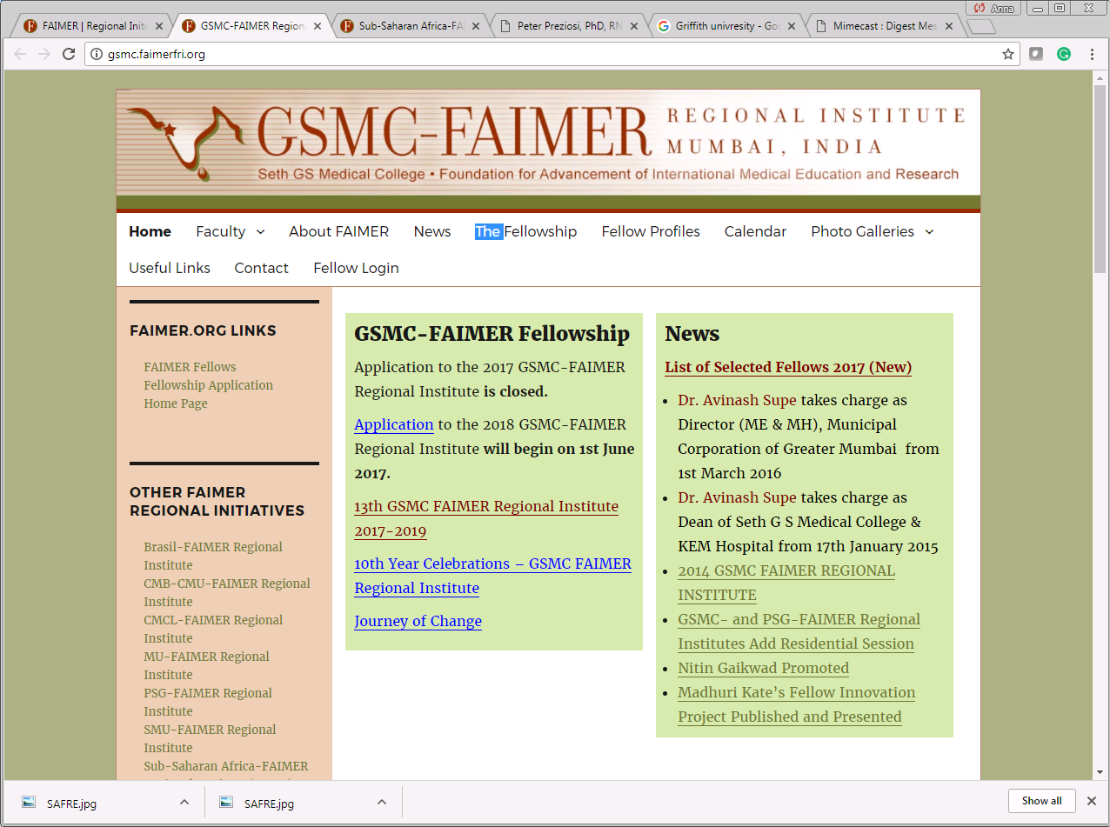

Slide 7
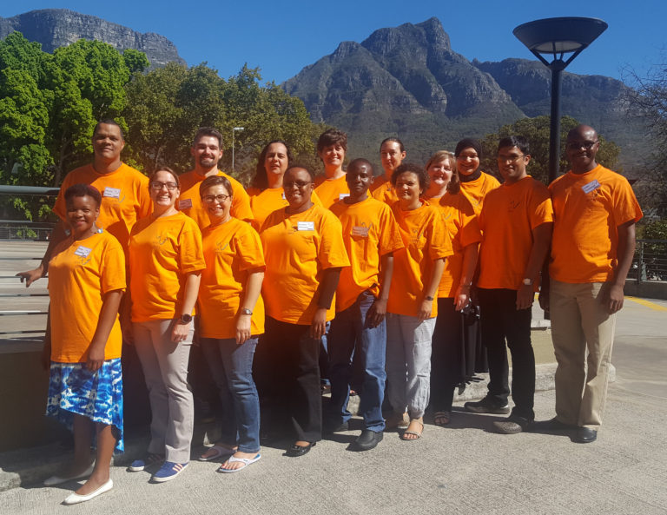
FAIMER in Africa
FAIMER Institute: Philadelphia, USA
Has trained 76 health professions educators from 14 African countries
FAIMER Institute: Sub-Saharan Africa
Began in 2008 in Cape Town, South Africa
Partnership between FAIMER and non-profit company incorporated in South Africa
Has trained 170 health professions educators from 20 African countries
FAIMER in Africa: 2017 FAIMER Fellows

Slide 8
There is a greater need for international perspectives in medical education.
A program to facilitate educational exchange in medicine and other health professions through partnerships.

Slide 9
Background
Limited access for African students to global health opportunities in developed countries
Significant differences in health concerns and health care settings across regions of Africa
African students can gain a “global” experience on their continent
Regional exchanges help to develop future African physicians and health care providers
Regional exchanges strengthen communities while building the African healthcare workforce
GEMx facilitates regional exchanges in Africa
Notes:
due to cost and other challenges.
to serve their health care needs of their own patient populations

Slide 10
How GEMx Works
Web-based system for applications and program management
GEMx Charter – universal agreement amongst partner institutions
Student grant funding provided
Partnership commitment to developing physician and health workforce

Slide 11
AFREHealth: African Forum for Research and Education in Health
Participating Institutions (MEPI)
Jomo Kenyatta University of Agriculture and Technology Kenya
Kampala International University, Uganda
Kenyatta University, Kenya
Kwame Nkrumah University of Science and Technology, Ghana
Makerere University College of Health Sciences, Uganda
University of Kwazulu Natal, South Africa
University of Zambia, Zambia
University of Zimbabwe, Zimbabwe
Medical Elective Types
Cardiac and Cardiac Surgery
Clinical Pharmacology
Genetic, Social Epidemiology
Family Medicine
Internal Medicine
Obstetrics and Gynecology
Pediatrics
Surgery
Tropical Diseases

Slide 12
AFREHealth: African Forum for Research and Education in Health
Participating Institutions (NEPI)
Ekwendeni College of Health Sciences, Malawi
Kamuzu College of Nursing, Malawi
Lusaka Schools of Nursing and Midwifery, Zambia
Makerere University College of Health Sciences, Uganda
Muhimbili University of Health and Allied Sciences, Tanzania
Nursing Electives
Advanced Community and Public Health
Advanced Newborn Care
Community and Science Midwifery
Emergency and Trauma
HIV Management and Guidelines
Oncology Nurse Midwifery
Pediatric Nursing and Child Health
Scientific Writing and Information Literacy

Slide 13
College of Ophthalmology in Eastern Central and Southern Africa (COECSA)
Participating Institutions
Lighthouse for Christ Eye Centre, Kenya
Mbarara University of Science and Technology, Uganda
Rwanda International Institute of Ophthalmology, Rwanda
University of Nairobi, Kenya
The University Teaching Hospital, Zambia
Postgraduate Ophthalmology Resident Electives
Cornea and Anterior Segment
Diabetic Retinopathy
Emergency Oculoplastic & Orbital Glaucoma Surgery
Infectious Keratitis
Medical Diabetic Retinopathy
Ocular Oncology
Ophthalmology Retina
Pediatric Ophthalmology
Strabismus
Small Incision Cataract Surgery

Slide 14
Eastern Africa Health Professions Educators’
Association (EAHPEA)
Participating Institutions
Mbarara University of Science and Technology, Uganda
Makerere University College of Health Sciences, Uganda
Mekelle University, Ethiopia
Omdurman Islamic University, Sudan
Jimma University, Ethiopia
Medicine and Health Professions Electives
Community Based Education Community Based Medicine
Dermatology Venereology
Forensic Toxicology Medicine
General Surgery
Internal Medicine
Pediatrics and Child Health Research Service Program
Ophthalmology

Slide 15
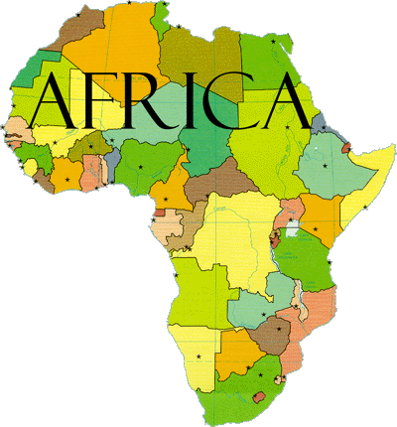
The Aims and Goals
AFREHealth: Seeks to improve health care in Africa through research, education and capacity building.
COECSA: To improve the quality of eye care through training, research and advocacy; provide leadership in eye care; and create a forum for exchange of ophthalmic skills, knowledge and resources in Eastern, Central and Southern Africa.
EAHPEA: An Association for those health Professional educators who work to improve the peoples health by delivering high quality education.
ECFMG-FAIMER: To improve world health through education.

Slide 16
Next Steps
2018 Impact Assessment
Students:
Evaluate skills and knowledge learned
Evaluate future career paths
Compare and contrast learning environments, patient settings, curriculum
Institutions:
Evaluate impact on faculty at host (receiving) institutions
Evaluate impact on institution
Evaluate connectedness between home/host institutions
Networks:
Evaluate how exchanges foster capacity building, research, retention

Slide 17
Information
www.ecfmg.org | www.gemxelectives.org
www.facebook.com/ecfmg
www.facebook.com/gemxelectives
@ECFMG_IMG
@GEMxElectives
Blog: www.gemxelectives.org/blog/

