Slide 1
MACRA Payment Reform Update: Top Ten Questions for 2019
Amy Mullins, MD, CPE, FAAFP

Slide 2
Disclosures
None

Slide 3
Question #1 What is QPP and will it “go away”?

Slide 4
April 2015

Slide 5
MACRA vs. Quality Payment Program (QPP)
Merit Based Incentive Payment System (MIPS)
Advanced Alternative Payment Models (AAPMs)

Slide 7
Question 1a. Are all APMs AAPMs
No!
APMs must meet certain criteria to be AAPMs and gain exemption from MIPS
Base payment on quality measures comparable to those in MIPS, use CEHRT, bear more than nominal financial risk or be a medical home model expanded under CMMI

Slide 8
Current Primary Care AAPMs
Shared Savings Program (Tracks 1+, 2 & 3)
Next Generation ACO Model
Comprehensive Primary Care Plus (CPC+)*
Vermont Medicare ACO Initiative (as part of the Vermont All-Payer ACO Model)
APM List: cms.gov/Medicare/Quality-Payment-Program/Resource-Library/2018-Resources.html

Slide 9
Question #2 How will the weights of the MIPS categories change in 2019?

Slide 10
Performance Category Weights
Quality
2018: 50%
2019: 45%
Cost
2018: 10%
2019: 15%
Cost gradually increase until weighted at 30% in 2022*
Improvement Activities(15%) and Promoting Interoperability (25%) remain the same
*Bipartisan Budget Act of 2018

Slide 11
**Cost will gradually increase until weighted 30% in 2022 (Bipartisan Budget Act of 2018)

Slide 12
Performance Period

Slide 13
Question #3 What is the new performance threshold for 2019?

Slide 14
Performance Threshold

Slide 15
Question #4 Why is my MIPS Payment Adjustment so small in 2019?

Slide 16
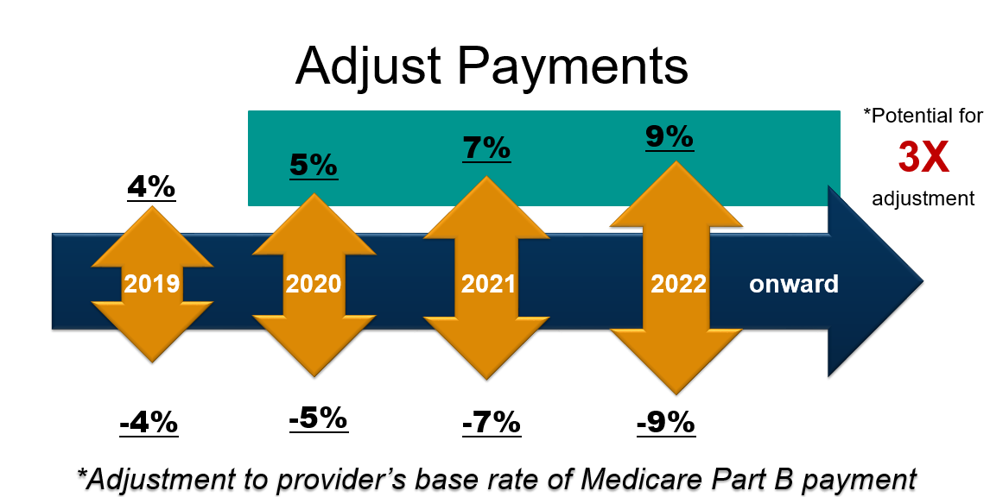
Based on performance two years prior

Slide 17
Question #5 Are there still bonus points in MIPS?

Slide 18
Bonus Points
+6
Small practices:
15 or fewer
Six points added to Quality Score (not Final Score)
Complex Patient
Calculated based on HCC Scores and % of dual eligible patients
Added to final score (max. 5 pts)
+5

Slide 19
Question #6 What are the Low Volume Threshold Criteria?

Slide 20
Low Volume Threshold
Have ≤ $90K in Part B allowed charges for covered professional services
Provide care to ≤ 200 Part B beneficiaries
NEW! Provide ≤ 200 covered services to Part B beneficiaries
Medicare Advantage does not count towards LVT calculations (Part C)

Slide 21
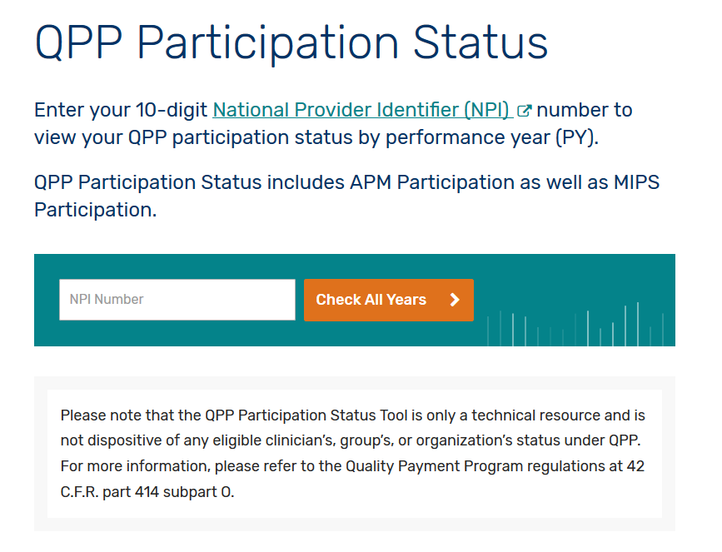
Check Your Status
The Centers for Medicare and Medicaid Services (CMS) has published a CMS Look-Up Tool for clinicians to verify their MIPS-eligibility status by entering their National Provider Identifier (NPI) number
qpp.cms.gov

Slide 22
Question #7 Can I Opt-In to MIPS?

Slide 23
Opt-In
Any MIPS Eligible Clinician that meets or exceeds one or two of the LVT criteria can opt-in to MIPS (new for 2019)
Eligible for both positive and negative payment adjustments
Must make opt-in election through the CMS portal
Once election made, can not be changed for the performance year

Slide 24
Question #8 What changed with Promoting Interoperability? AKA Meaningful Use, AKA Advancing Care Information
This Photo by Unknown Author is licensed under CC BY-SA

Slide 25
Promoting Interoperability (PI)
Update removes Base and Performance scores
Reduces the number of measures in PI
Does not remove “All or Nothing”
Requires adoption of 2015 CEHRT (only required for the 90 days reported)

Slide 26
Question #9 I am an employed physician or a resident, does this apply to me?

Slide 27
MIPS Exemptions
Year 1 Medicare
Eligible Advance Alternative Payment Model with Bonus
Below the Low Volume Threshold

Slide 28
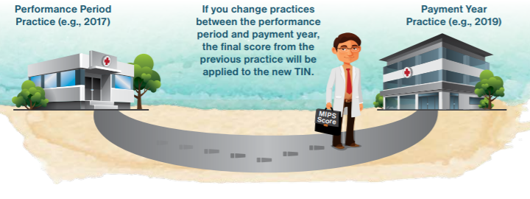
MIPS scores follow you
MIPS scores are publicly available
Consider a practices’ MIPS score as you evaluate employment contracts
*More information in the FPM Employed Physician Supplement

Slide 29
Question #10 What resources are available?

Slide 30
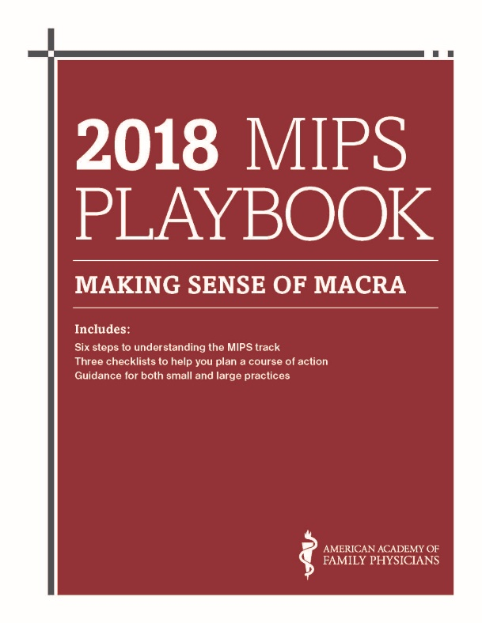
Step-by-Step guide to help:
Understand MIPS reporting requirements
Provides checklists and actionable steps
Prepare for successful performance in the QPP
2019 Playbook Coming Soon
Free for AAFP Members!!
Available at www.aafp.org/MACRAReady

Slide 31
Questions??

