Slide 1
Academic Family Medicine expansion globally The potential and the costs of US involvement
Esther Johnston MD
Elizabeth Hutchinson MD
S44 May 8 11:15-12:15

Slide 2
Notes:
EH and EJ:
Opening questions:
Who has been a planner vs participant?

Slide 3
“A health system where primary care is the backbone and family doctors are the bedrock delivers the best health outcomes, at the lowest cost, and with the greatest user satisfaction.”
The rising importance of family medicine
Dr Margaret Chan
Director-General of the World Health Organization
Keynote address at the 2013 World Congress of the World Organization of Family Doctors
Prague, Czech Republic
26 June 2013
Notes:
EJ The scope of family medicine expansion globally.
From 2010 from the African Journal of Prm Health Care and Fam Med… a consensus statement starts with

Slide 4
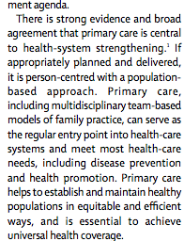
Notes:
EJ ***: Lancet article moved here???

Slide 5
Notes:
EJ The scope of family medicine expansion globally.
From 2010 from the African Journal of Prm Health Care and Fam Med… a consensus statement starts with

Slide 6
2010 Malawi’s Millennium Development Goals
MDG 4: Reduce Child Mortality
Infant mortality rate: 69 per 1,000 (goal: 44.7 per 1,000)
Under-five mortality rate: 122 per 1,000 (goal: 78 per 1,000)
Vaccination rate: 84% (goal: 100%)
MDG 5: Improve Maternal Health
Maternal mortality ratio: 675 per 100,000 (goal: 155 per 100,000)
Proportion of births attended by skilled health personnel: 75% (goal: 100%)
MDG 6: Combat HIV and AIDS, Malaria and other diseases (TB)
HIV prevalence among 15-24 year old pregnant women: 12% (goal: 0%)
Notes:
EJ
The millennium goals are goals that encompass and depends on integration of many layers of health care from public health measures to episodic patient care to continuous care over time to coordination of care across levels of care. II think it is becoming clearer that it is not possible to address these goals in sihloed vertical projects. Family medicine offers a complimentary approach to addressing these goals. Instead of piecing apart components of a problem as is the case with many vertical programs, family medicine offers an approach that addresses the patient as a whole with the context of her community and putting the health problem within the context of their life.

Slide 7
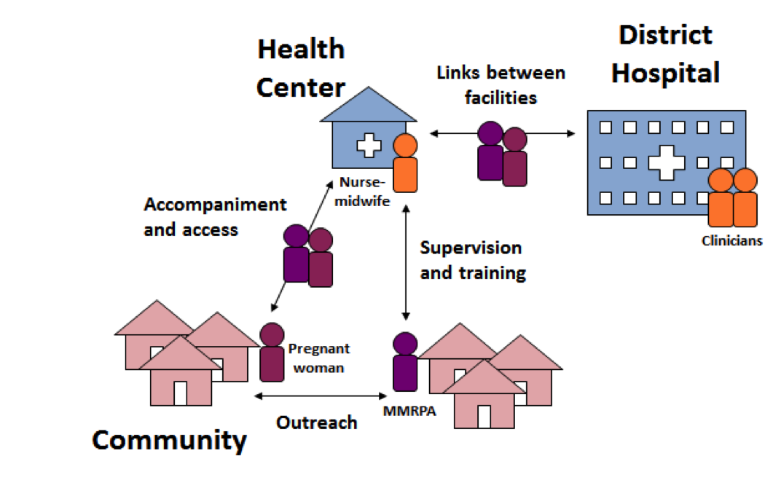
District hospital | Rural hospital | Health Centre
2 Family Physicians
5 Medical Officers | 1 Medical Officer
30 Clinical Officers | 10 Clinical Officers | 2 Clinical Officers
100 Nurses | 20 Nurses | 14 Nurses
 |  | 4 Medical Assistants
Medical staffing goals MOH minimum standards of clinical services
Notes:
EJ
The MSSP sees primary care as part of the solution and has its focus on having the family doctor be the leader of the clinical team in the district setting.

Slide 8
Why do we build global health rotations in family medicine?
Provide a rich global health experience for U.S. Family Medicine residents
Notes:
EH
Audience participation
By the time learners get into residency, many learners (30%) have already experienced working oversees and are drawn to medicine as a result of these experiences.
Residents get it!
rapid globalization & interplay between health in the US and health abroad.
3. understand that there is huge discrepancy in health care in the world, & the health of the citizens helps determine the success of cultures.
4. In this way healthcare is very much part of social justice.
→ They understand that there are risks in participating overseas but they can appreciate the sense of engagement and they appreciate how their skills might be expanded.

Slide 9
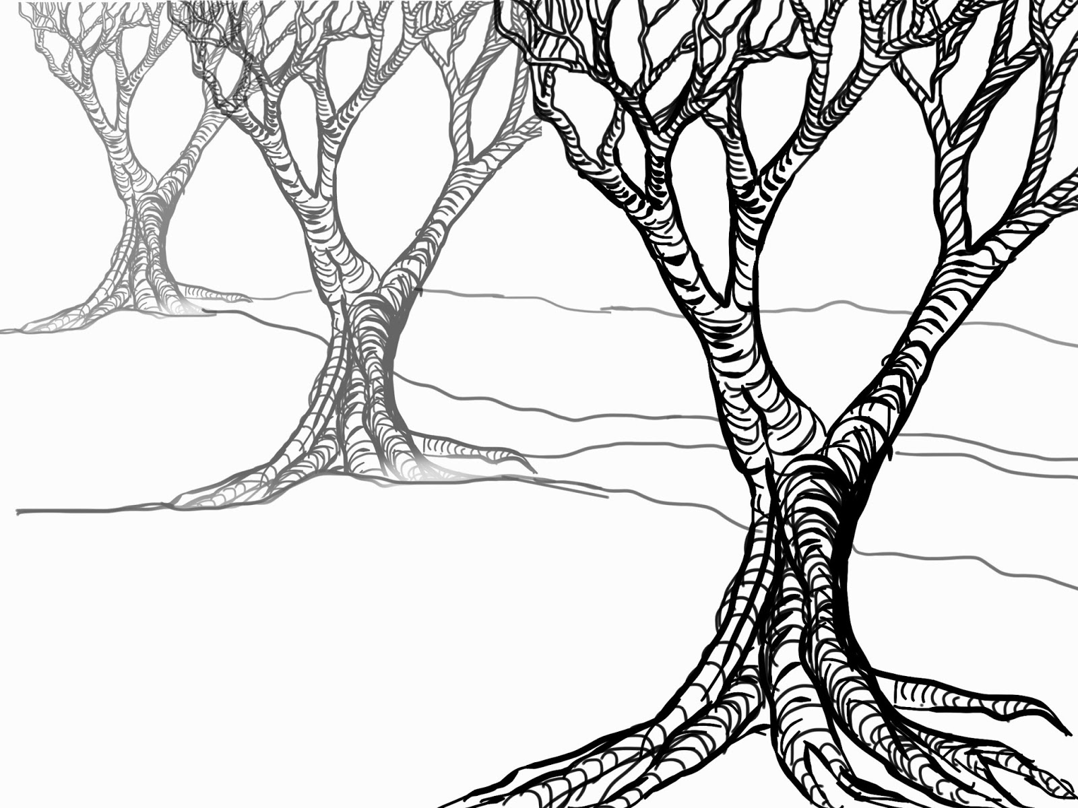
JAMA 1969
“If, as a routine, young American doctors were encouraged
to spend some months working in a developing country the result could only be better medicine at home and abroad.”
Notes:
EH
The ground is fertile, it has been furtile for a long time!
Sending learners overseas is not new, it is not a fad that is going to go away

Slide 10
2017
Global health may make students more likely to chose primary care
(Bruno DM, Imperato PJ, Szarek M. The Correlation between Global Health Experiences in Low-Income Countries on Choice of Primary Care Residencies for Graduates of an Urban US Medical School. Journal of Urban Health)
Practice Location
and practice in an underserved setting
Liaw W, Bazemore A, Xierali I, Walden J, Diller P. Impact of Global Health Experiences During Residency on Graduate
Notes:
EH
These days it may be even more important for addressing very important deficiencies in our medical system: practice in primary care specialties and to practice in underserved communities.

Slide 11
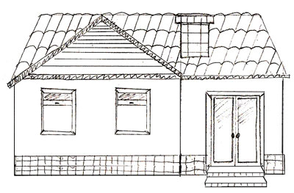
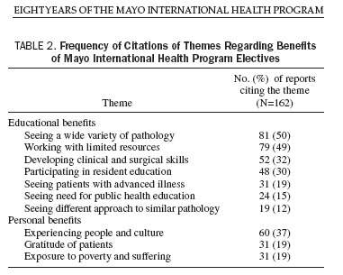
Global Health roration
Notes:
EH
So we dream about building these rotations, a vision as complicated as a house. It is going to take some work. But it will be great for our residents!
Wide variety of pathology, working with limited resources, skill development, advanced disease , public health
Personal: adventure, sensing satisfaction with work such as gratitude of patients, appreciating the vastness of the conditions of the world and that there is suffering and poverty beyond what they have been exposed to.

Slide 12
“ ..to address distribution of health services in resource-poor settings and to tailor clinical interventions by taking into consideration socio-economic disparities”
WE PARTICIPATE IN
AND ADVOCATE FOR
GLOBAL FAMILY MEDICINE
“The acquisition of global, geographic, and culturally specific knowledge and skills will allow the family physician-in-training to formulate an individualized assessment and treatment plan appropriate to a wide range of specific circumstances.
The world is now our community and globalization trends challenge medical education to incorporate knowledge and skills appropriate to our emerging global community.”
AAFP
“Global health should be an integral part of FM training”
Notes:
EH:
Furthermore the: AAFP supports us to do this. AAFP states that….
Taking into consideration socio-economic disparities
to learn to practice and be flexible in a variety of circumstances here and abroad.
To appreciate that we really do live in a global community…
This brings us to a main pitch of our talk as family doctors we have the opportunity to participate..
we know that family medicine--as the bedrock (Margaret Chan says) of our health system here and abroad–
We know that promoting family medicine is one of the most important things we can do to address health care disparities
Our residents know this too.
**We have to work in the locally, nationally and globally on promoting principles of family medicine

Slide 13
Why do we build global health rotations in family medicine?
Provide a rich global health experience for U.S. Family Medicine residents
Assist with the development of the new Family Medicine programs
Notes:
EH
So I will argue that another reason to participate in global health rotations is to support countries who are working to make FM the bedrock of their systems

Slide 14
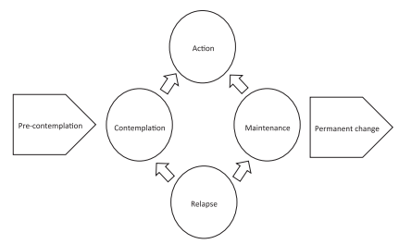
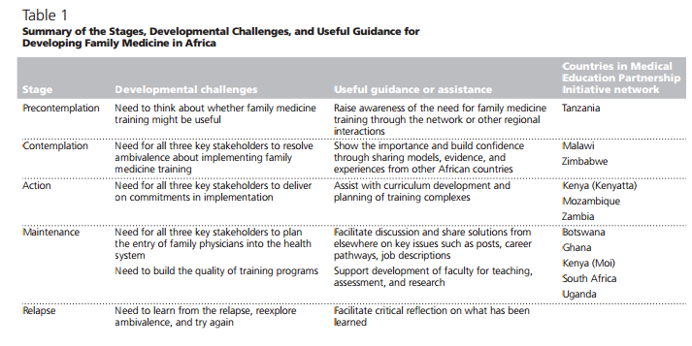
Many African countries are in various stages of developing Family Medicine training programs.
Mash B et al. Guiding the Development of Family Medicine Training in Africa Through Collaboration With the Medical Education Partnership Initiative. Academic Medicine, Vol. 89, No. 8 / August Supplement 2014
Notes:
EH – Bob Mash in his 2014 article about how development of FM in Africa—uses the stages of change model.

Slide 15
Many African countries are in various stages of developing Family Medicine training programs.
Mash B et al. Guiding the Development of Family Medicine Training in Africa Through Collaboration With the Medical Education Partnership Initiative. Academic Medicine, Vol. 89, No. 8 / August Supplement 2014
Notes:
EH – Bob Mash in his 2014 article about how development of FM in Africa—uses the stages of change model.

Slide 16
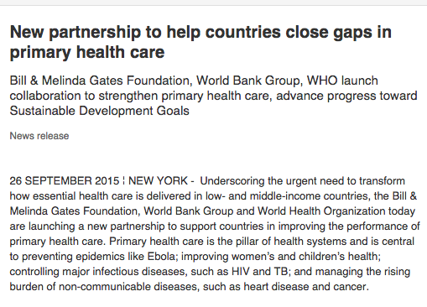
Notes:
EH –
Organizations and people that appreciate the value of global health, are trying to figure out how to support this effort and are developing partnerships

Slide 17
Starting in 2009, Malawi is early in its development and has associated challenges:
A FM EDUCATIONAL ENVIRONMENT
Insufficient number of FM faculty
Lack of academic FM presence
FM principles within the healthcare system are not actualized
Notes:
EH
Malawi story:
One example that we are familiar with is relevant to other countries, Malawi.
2009 start – MH approved, approval for how FM is going to fit into the health system, how it is going to be funded, but now with some very real challenges.

Slide 18
Summary: Report on Global Medical Education (2010)
US ~$113,000 per medical student
Shortage of leaders, mentors and faculty
Profound educational disparity (US, China, Brazil and India have over 150 medical schools each, 36 other countries have none)
Notes:
Education is very expensive. It

Slide 19
Long-term, mutually beneficial partnership
Post-residency global health experience and faculty pipeline for Partner institution
Global Health Service Partnership
Through GHSP, Seed and Peace Corps place yearlong faculty volunteers and provide academic and clinical support, facilitate logistics and infrastructure needs, and provide evaluation systems.
Short-term resident rotations
Clinical care
Continuing education & mentoring
Locally-relevant projects
Resident overlap (orientation & project handover)
Supervised by GHSP Volunteer
Human resource support
Patient care
Trainee and staff training & mentoring
Process/quality improvement outcomes
US academic institution
Partner
institution
Site impact
Notes:
This partnership was envisioned to help provide a commodity with value BOTH to the US institution and the host site.
Long term partership: build relationships through reliable presence (takes time and energy to establish trust, routines). Consolidate efforts
Short term resident rotations: (senior level residents)
Works alongside the GHSP volunteer that is a visiting faculty for at least a year, they are planted and can act as a liason between the site and the short term visitors.
The site experiences: more human resource support = academic teams, patient care = family medicine model. Trainee and staff mentoring and modeling = collegial relationships, mentorship in the formative years for students participating in FM rotation. QI projects come with some money and skilled people at UW>
Support SEED with pipeline development

Slide 20
Ethical considerations
Quality experience
Reduce Barriers
Global Health Rotation
Notes:
EJ: What do we need in order to build these rotations? (participants contribute ideas)
We want to get rid of as many barriers as we can so that residents can have this valuable experience:
Time off of their duties
Financial support for resident travel
faculty and administrative time to organizing the rotation to be a valuable experience.

Slide 21
COSTS
Global Health
Rotation
21
Notes:
EJ: What are the costs that participants have perceived in their work?

Slide 22
Quantifiable
In country consumption
COSTS
Negative impact on patients
SysteM fRagmEntaTion
Workforce distRactIon
dIVersion of attentioN
Global Health
Rotation
What is the role of the visitor?
Power differential
IMPEDIMENTS TO PROGRESS
22
Furthering corruption
Notes:
Groups of 5 people. Pass out concepts. Each person reads a concept.

Slide 23
Working Group on Ethics Guidelines for Global Health (WEIGHT)
Overcoming costs
Mutual and reciprocal benefit
Structured, mentored programs that minimize burden on host country
Ongoing opportunities for unbiased discussion restructure
Crump JA, Sugarman J, The American Journal of Tropical Medicine and Hygiene. 2010
Global Health
Rotation
23
Notes:
EJ

Slide 24
Consultancy
Three minutes propose your question:
What costs are you facing in your program?
Participants ask clarifying questions
Presenter listens to solutions from the group (without talking)
Summary of solutions or proposals
Presenter reflects about what they heard
Notes:
Solicitation of participants.
Presenter comes to the front.
“guidelines” written on a slide
Elizabeth facilitate
Esther takes notes

Slide 26
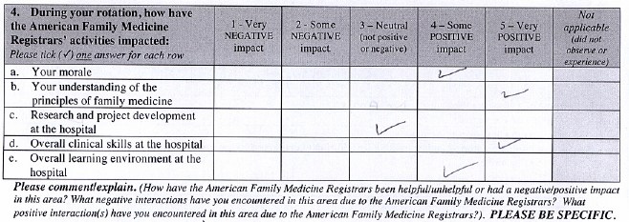

Slide 27
Post rotation reflection survey
As a result of your time in Malawi, do you feel more confident in your ability to adapt your knowledge and skills in order to deliver medicine in different settings (nationally or internationally)? [Concept: Building resilience]
As compared with prior to your time in Malawi, do you feel more or less energized to be a family doctor? [Concept preventing burnout]
Did this experience influence your future plans as a physician?[Concept: global health rotations increase the likelihood that physicians will practice in underserved areas nationally and internationally.]
As a result of the global health oriented teaching (in Seattle) as well as your time in Malawi, what medical knowledge and skills did you acquire? From whom in Malawi did you learn? [Concept increasing medical knowledge and skills]
During your time in Malawi, in what contexts did you teach? Please give examples. (Students, residents, other health care providers, or patients.) [Concept: Supporting academic Family Medicine in Malawi]
What ethical considerations arose during your time in Malawi?[Concept: Preparing US residents to be sensitive to the challenges of working overseas]
What was the most significant contribution that you made in Malawi?[Concept: A US resident rotation can be structured as to contribute to the host country.]
What would you change about the experience?

Slide 28
SURVEY OF WWAMI RESIDENTS 2014 - 2017
Educational benefits
Teaching was one of the most rewarding experiences
Opportunity to enhance diagnostic skills
Personal benefits
More energized
An increase in ability to adapt to different medical environments
Opportunity to engage with a different philosophy of medicine
Increase in commitment to serve underserved communities
Desire to pursue more global health work generally
Global Health roration
Notes:
In the past three years of our program, reflections from the residents who go overseas report the same areas of growth.
Additionally they add themes of improved resilience and satisfaction: more energy, adaptability, engaging with a different way of thinking about medical re. increased commitment to global health and underserved communities.
They have improved their teaching and diagnostic skills

Slide 29
Notes:
EJ – take home points.

Slide 30
References
1. Bruno DM, Imperato PJ, Szarek M. The Correlation between Global Health Experiences in Low-Income Countries on Choice of Primary Care Residencies for Graduates of an Urban US Medical School. Journal of Urban Health : Bulletin of the New York Academy of Medicine. 2014;91(2):394-402. doi:10.1007/s11524-013-9829-4.
2. Liaw W, Bazemore A, Xierali I, Walden J, Diller P. Impact of Global Health Experiences During Residency on Graduate Practice Location: A Multisite Cohort Study. Journal of Graduate Medical Education. 2014;6(3):451-456. doi:10.4300/JGME-D-13-00352.1.
3. Sawatsky AP, Rosenman DJ, Merry SP, McDonald FS. Eight Years of the Mayo International Health Program: What an International Elective Adds to Resident Education. Mayo Clinic Proceedings. 2010;85(8):734-741. doi:10.4065/mcp.2010.0107.
4. Considerations for Physicians-in-Training and Academic Mentors. Journal of Graduate Medical Education. 2012;4(3):301-306. doi:10.4300/JGME-D-11-00299.1.
5. Drain PK, Holmes KK, Skeff KM, Hall TL, Gardner P. Global Health Training and International Clinical Rotations during Residency: Current Status, Needs, and Opportunities. Academic medicine : journal of the Association of American Medical Colleges. 2009;84(3):320-325. doi:10.1097/ACM.0b013e3181970a37.
6. Holm JD, Malete L. Nine problems that hinder partnerships in Africa. The Chronicle of Higher Education. 2010 Jun 14.
7. Lukolyo H, Rees CA, Keating EM, Swamy P, Schutze GE, Marton S, Turner TL (2015) Perceptions and expectations of host country preceptors of short-term learners at four clinical sites in sub-Saharan Africa. Acad Pediatr 16:387–393.

Slide 31
References continued
8. Chetwood, J. D., Ladep, N. G., & Taylor-Robinson, D. (2015). Research partnerships between high and low-income countries: Are international partnerships always a good thing? BMC Medical Ethics, 16, 36. doi:10.1186/s12910-015-0030-z.
9. Crump JA, Sugarman J. Ethical Considerations for Short-term Experiences by Trainees in Global Health. JAMA : the journal of the American Medical Association. 2008;300(12):1456-1458. doi:10.1001/jama.300.12.1456.
10. Crane J. Scrambling for Africa? Universities and global health. The Lancet. 377: 1388–1390.
11. Crump JA, Sugarman J, the Working Group on Ethics Guidelines for Global Health Training (WEIGHT). Ethics and Best Practice Guidelines for Training Experiences in Global Health. The American Journal of Tropical Medicine and Hygiene. 2010;83(6):1178-1182. doi:10.4269/ajtmh.2010.10-0527.
12. Laabes, E. P., Desai, R., Zawedde, S. M. and Glew, R. H. (2011), How much longer will Africa have to depend on western nations for support of its capacity-building efforts for biomedical research?. Tropical Medicine & International Health, 16: 258–262. doi:10.1111/j.1365-3156.2010.02709.x

