Slide 1
I QI U CAN 2! CAN WE ACGME?
Thomas F. Koonce, MD, MPH
Associate Professor, Department of Family Medicine
UNC School of Medicine

Slide 2
GRATITUDE

Slide 3
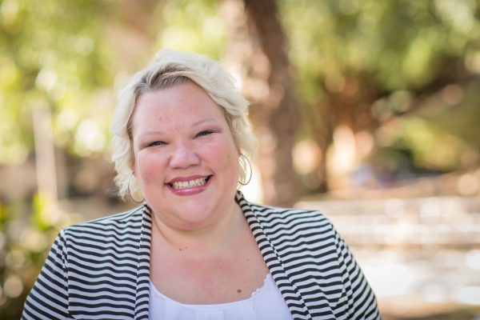
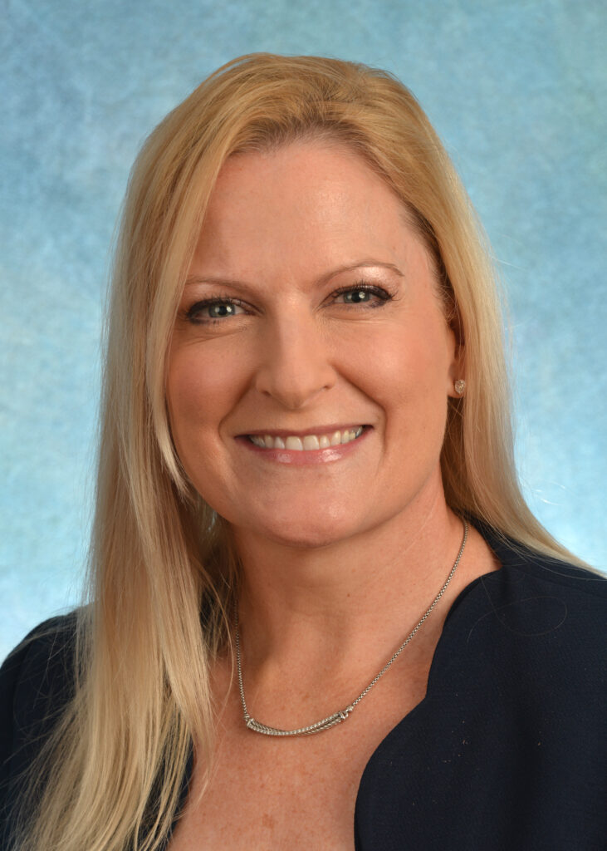
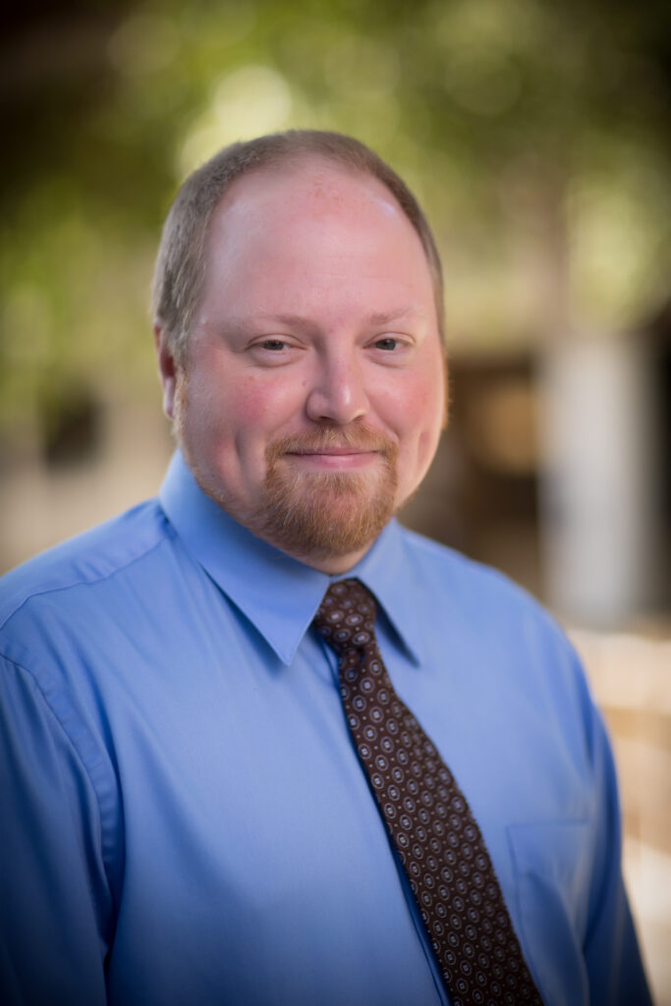
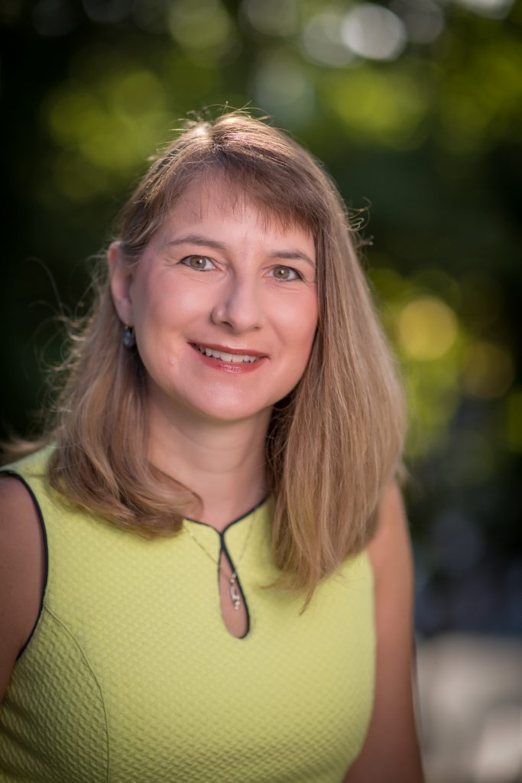
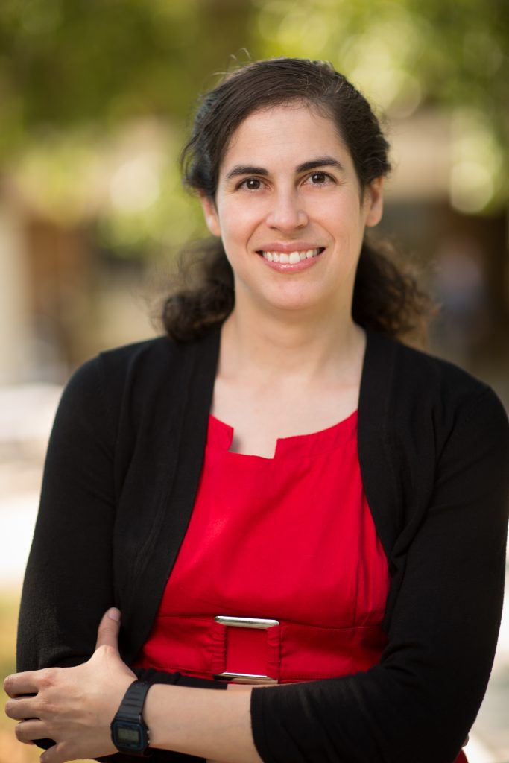
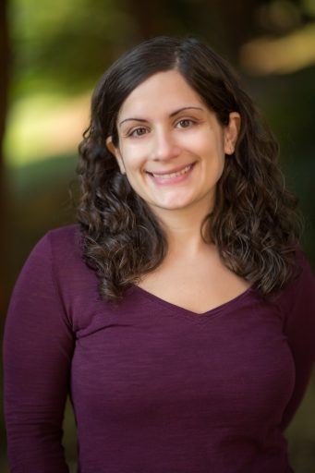

Slide 4
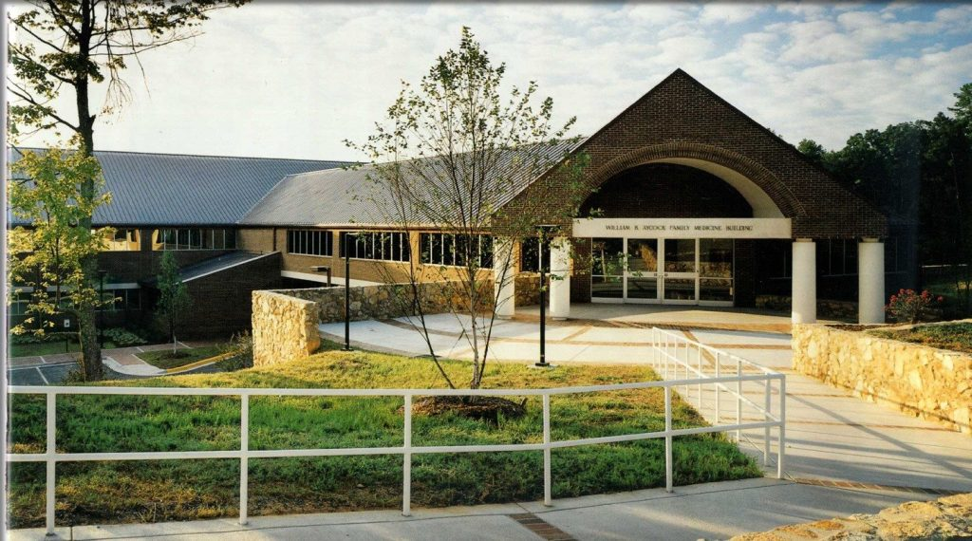

Slide 5
WHY ME?

Slide 6
THE ASK

Slide 7
By the end of our time together, I hope we will:
Know how we implemented a successful QI curriculum in our residency.
Be able to apply lessons learned from our QI journey to address new ACGME requirements.
Leave with specific ideas to address potential ACGME changes.

Slide 8
QUALITY IMPROVEMENT JOURNEY

Slide 9
Physical Environment
Quality Improvement Infrastructure
Quality Improvement Education

Slide 10
Leadership
Commitment to Lean methodology
Universal Application of Principles
Broad incorporation of team members
Hard wiring of processes
Regular review
Physical Environment
Quality Improvement Infrastructure
Quality Improvement Education
Plus 18 months of renovation

Slide 11
Quality Improvement Current State
Robust QI infrastructure
Standard work
Data
Culture
Meaningful, consistent improvements in key metrics
Quality
Access
Patient Satisfaction
Rigorous student, resident, and fellow participation
Engagement
Confidence
Scholarly activity
Leadership in local, regional & national improvement collaboratives.
PCIC
I3
Faculty Development Fellowship

Slide 12
For any QI educational intervention to succeed, ongoing quality improvement work must be an integral part of your culture Any successful QI educational intervention will be experiential Any successful QI educational intervention will involve real efforts to improve patient care and will result in real practice change

Slide 13
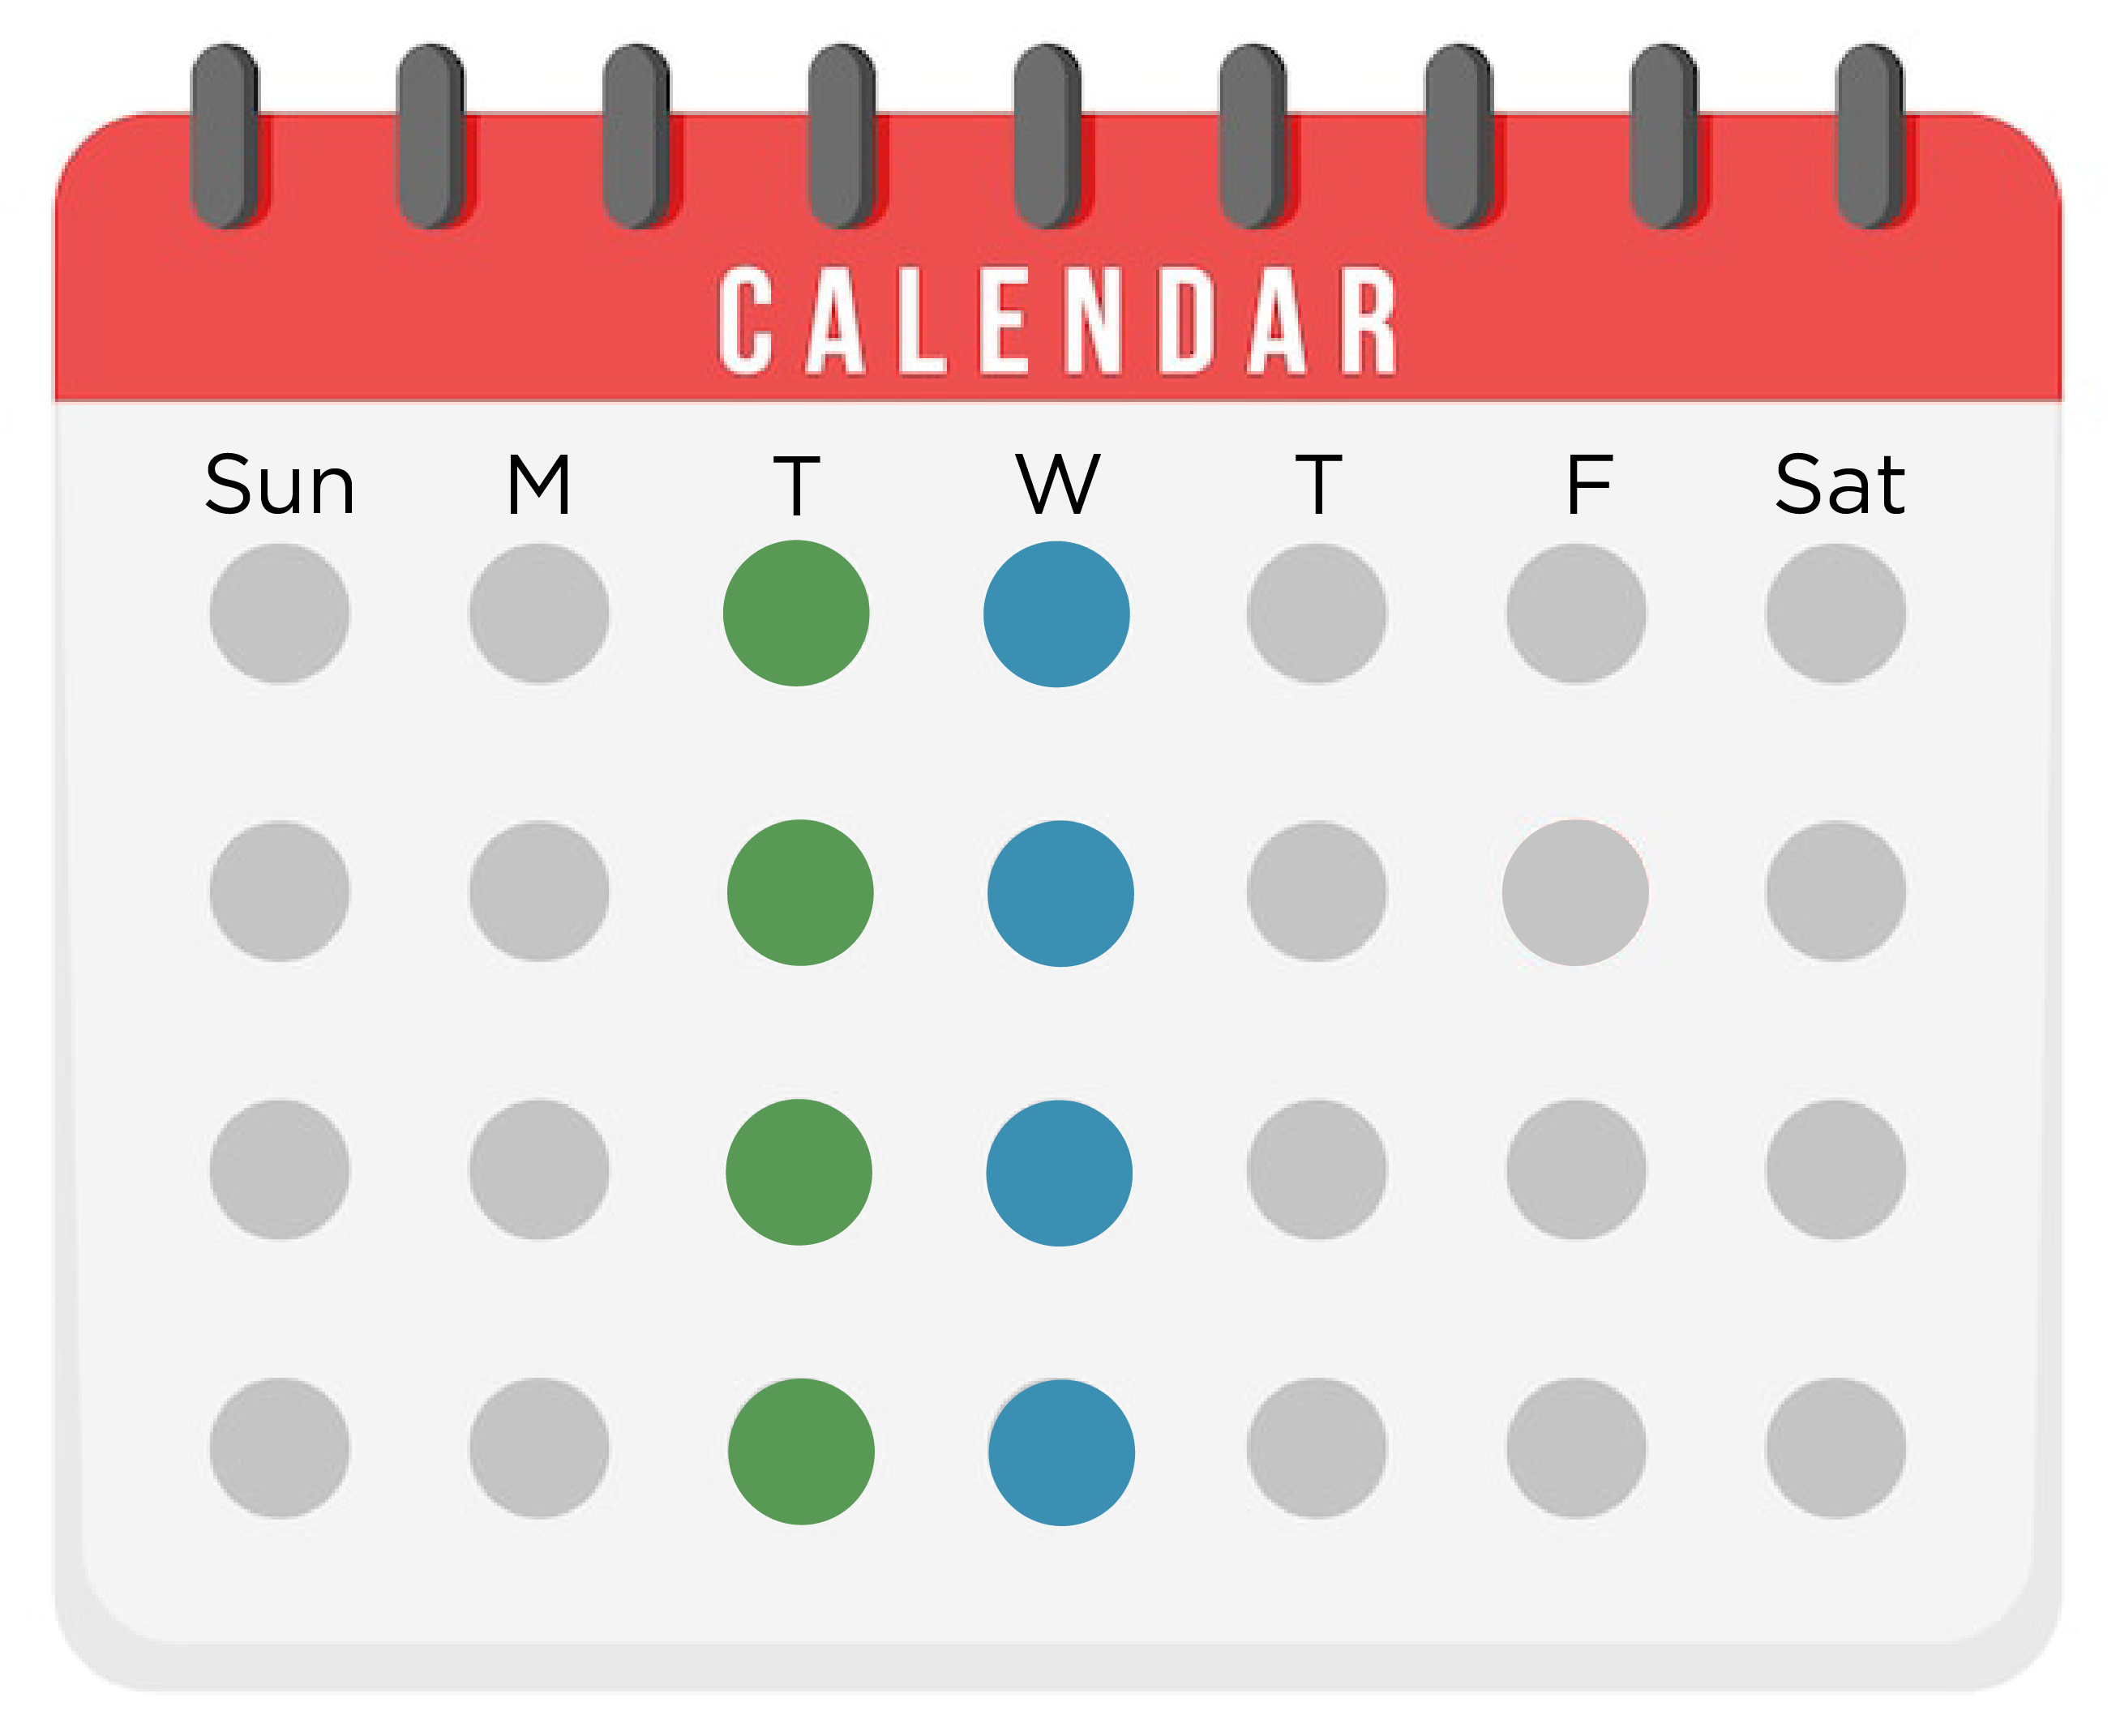
For any QI educational intervention to succeed, ongoing quality improvement work must be an integral part of your culture
Monthly
Quality and Safety Improvement Conference (M&M)
Talking about Quality Improvement
I³ Collaborative Webinars
All-FMC (clinic wide staff meeting)
Team Meetings
Weekly
Clinical Systems Improvement

Slide 14
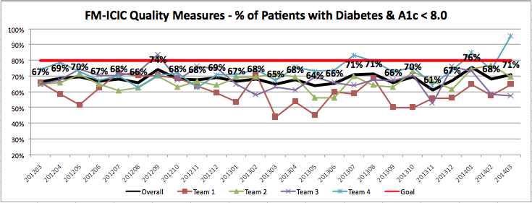
For any QI educational intervention to succeed, ongoing quality improvement work must be an integral part of your culture

Slide 15
For any QI educational intervention to succeed, ongoing quality improvement work must be an integral part of your culture
Do not start by designing an educational intervention. Instead, begin by designing, implementing, and sustaining meaningful QI in your practice. Then involve your residents in that work.

Slide 16
Any successful QI educational intervention will be experiential
R1 6-week Self-Change Project
R2 Multiple Rapid-Cycle Small Tests of Change
R3 Year-Long Quality Improvement project

Slide 17
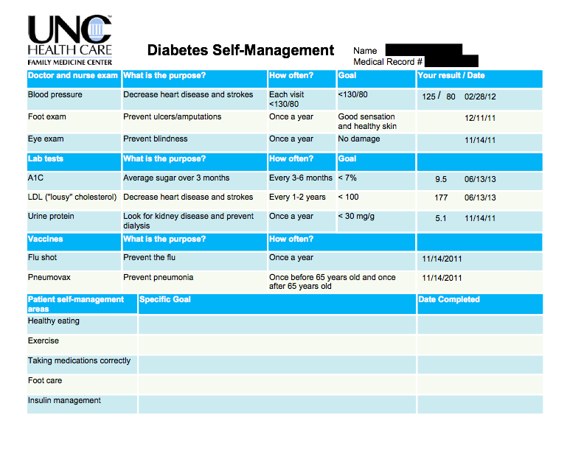
Any successful QI educational intervention will involve real efforts to improve patient care and will result in real practice change

Slide 18
THE PRACTICE
IS THE CURRICULUM
“…the core idea of enabling the practice to drive the curriculum is that residency clinical practices should be exemplars, modeling outstanding care across the continuum, constantly improving and making a difference in communities.”
Do not start by designing an educational intervention. Instead, begin by designing, implementing, and sustaining meaningful QI in your practice. Then involve your residents in that work.

Slide 19
MAJOR revisions
Length of Training
Maternity Care Options
Community focus, patient voice
Master adaptive learning
FMP Metrics -> Panel management
Learning Collaboratives
Diversity, Equity, and Inclusion Focus
Faculty/Administrative Resources

Slide 20
Access and Panel Management

Slide 21
ACCESS AND PANEL MANAGEMENT
Residents must be primarily responsible for a panel of continuity patients, integrating each patient’s care across all settings…
Each resident’s panel of continuity patients must be of sufficient size and diversity to ensure adequate education, as well as patient access and continuity of care.
•Panels must include a minimum of 10 percent pediatric patients.
•Panels must include a minimum of 10 percent older adult patients.
•Panel size and composition for each resident must be regularly assessed and rebalanced as needed.
•Any gaps in the diversity of a resident’s panel (e.g., demographic and medical conditions) should be addressed.

Slide 22
Access and Panel Management Journey
Mutually agreed upon key definitions & values
Talented team members
Individual and Collective Commitment
Methodical annual (but constantly monitored) process

Slide 23
Mutually agreed upon key definitions & values
Commitment to Continuity
Attribution
Rotation Schedules
Clinical Projections
Panel Size

Slide 24
Talented team members
Dedicated process leader
Influential team member
EMR capacity
Data extraction and management capability

Slide 25
Individual and Collective Commitment
Consistent Focus
“Glue Stick”
“Rubber Ducky”
High resident buy-in
Focus on continuity and access at scheduling
Point-of-Care attention to attribution

Slide 26
Methodical annual process
Robust standard work
Two-phase review
Thoughtful panel distribution each spring
Regular monitoring of panel size

Slide 27
How does this apply to proposed ACGME changes regarding panel management and targets?
Mutually agreed upon key definitions & values
Talented team members
Individual and Collective Commitment
Methodical annual process
We Already Balance:
Age
Gender
Diagnosis
Preferred Language
SDOH

Slide 28
Direct Observation and Competency Based Assessment

Slide 29
To optimize CBME, residencies will need to develop learning environments in which residents cocreate their education, reviewing assessments frequently with clinical mentors. This, in turn, will require systems for capturing observations in real time and collating assessments for residents, faculty mentors and the clinical competency committee.

Slide 30
Direct Observation and CBME Journey
Broad Understanding of Milestones
Critical Analysis of Existing Assessments
Thoughtful Data Collection
Clinical Competency Committee

Slide 31
Broad Understanding of Milestones
Deep dive into milestones
Resident education sessions
Faculty training

Slide 32
Critical Analysis of Existing Assessments
Recognized limits of end of rotation evaluations
Competency based assessment forms
Mechanism to capture real time direct observations and associate them with milestones
Real culture of direct observation and feedback

Slide 33
Thoughtful Data Collection
Faculty pre-meeting
Resident self-evaluation
Advisor interprets and collates information
End of rotation evaluations
M3 observations
Advisor estimates milestone achievement prior to CCC

Slide 34
Clinical Competency Committee
Effective – direct observation data largely determines milestone
Efficient – all 42 residents in roughly 2 hours
Continues QI of process

Slide 35
Broad Understanding of Milestones
Critical Analysis of Existing Assessments
Thoughtful Data Collection
Clinical Competency Committee
How does this apply to proposed ACGME changes regarding master adaptive learning?
To optimize CBME, residencies will need to develop learning environments in which residents cocreate their education, reviewing assessments frequently with clinical mentors. This, in turn, will require systems for capturing observations in real time and collating assessments for residents, faculty mentors and the clinical competency committee.

Slide 36
Make your practice a QI exemplar. Involve your residents in that work. The practice is the curriculum! Solve for continuity. Capture direct observations in real time.

Slide 37
BUT WAIT

Slide 38
Notes:
41-44 make it visually appealing

Slide 39
Jury Duty

Slide 40
Jury Duty
COVID

Slide 41
Jury Duty
COVID
MS1’s and Interns arrive
Notes:
Build upon new information

Slide 42
MS1’s and Interns arrive
COVID
Jury Duty
Staffing Shortages

Slide 43
MS1’s and Interns arrive
COVID
Jury Duty
CRA’s
Staffing Shortages

Slide 44
MS1’s and Interns arrive
COVID
Jury Duty
Provider Shortages
CRA’s
Staffing Shortages

Slide 45
Common Agenda
Shared Measurement
Mutually Reinforcing Activities
Continuous Communication
Backbone Support
A Model for Collective Impact

Slide 46
Common Agenda
Shared Measurement
Mutually Reinforcing Activities
Continuous Communication
Backbone Support
STFM

Slide 47
Thank You

