Slide 1
MACRA Update: The Top Eight For 2018
Amy Mullins, MD, CPE, FAAFP
amullins@aafp.org

Slide 2
Disclosures
Amy Mullins has nothing to disclose

Slide 3
Please evaluate this presentation using the conference mobile app! Simply click on the "clipboard" icon on the presentation page.

Slide 4
MACRA
M - making
A - all
C - clinicians
R - really
A - angry
Medicare Access and CHIP Reauthorization Act
Notes:
I have joked in the past that MACRA stands for Making all clinicians really angry….but it in fact, does not~ What we are here to talk about today it the Medicare Access and CHIP reauthorization ACT, or MACRA. This law was passed in April of 2015, and has since had a couple of rule making cycles. This year, 2017, was the first performance period where we could all Pick our Pace. And we just got the new rule for 2018. What I will share with you now are what I see as the top eight updates to the rule for 2018.

Slide 5
What Does MACRA Do?
Merit-Based Incentive Payment System (MIPS)
Consolidates quality programs
Potential for bonus payment for participation
Advanced Alternative Payment Models (AAPM)
Notes:
As we mentioned previously, MACRA introduces two new payment tracks:
One that consolidates quality programs –the Merit Based Incentive Payment System (MIPS)
And Alternative Payment Models (APMs) - which have the potential for bonus payments for participation
We anticipate many of our members will move through MIPS into the alternative payment model track.

Slide 6
Notes:
Here is a graphical representation of the MACRA path you will be venturing on.

Slide 7
2017 Primary Care Advanced APMs
Shared Savings Program (Tracks 2 & 3)
Next Generation ACO Model
Comprehensive Primary Care Plus (CPC+)
Vermont Medicare ACO Initiative (as part of the Vermont All-Payer ACO Model)
*2018 AAPMs announce as approved
Notes:
In the proposed rule, CMS defined those programs that met the criteria necessary to be considered an Advanced APM. They have said they will release an updated list of Advanced APMs annually.

Slide 8
Advanced APMs Perks
Not subject to MIPS
5% bonus 2019-2024
Higher fee schedule update to 0.75% from 2026 onward
Notes:
Qualifying APM participants are excluded from MIPS, and will receive an annual 5% bonus payment from 2019-2024. They will also receive a higher Medicare physician fee schedule update (of 0.75%) starting in 2026.
Physicians and practitioners who participate in qualifying APMs that are not an Advanced APM are not a “qualifying participant” and will be subject to MIPS.
However, APM participation is a clinical practice improvement activity, as defined under MIPS. As a result, these APM participants will receive favorable scoring for this performance category.

Slide 9
MIPS Performance Categories
Quality
Cost
Advancing Care Information (ACI)
Improvement Activities
Notes:
In addition to the more familiar programs that will be used to calculate a MIPS composite score, a new category of clinical practice improvement activities has been introduced.
Physicians will be assessed, and receive payment adjustments, based on a composite score comprised of these four categories.
You will see that many primary care providers are already doing something (if not a lot) in each of these categories.
Physicians will be assessed, and receive payment adjustments, based on a composite score comprised of these four categories.
You will see that many primary care providers are already doing something (if not a lot) in each of these categories.
Quality – Physicians will need to report on 6 measures of their choosing- one being an outcome measure. Those that have been reporting PQRS will be familiar with this process.
Resource Use- Similar to value-based payment modifier, there will be no data submitted by physicians to CMS for this category. CMS will use claims data to calculate the score.
Advancing Care Information- which is the old Meaningful Use, is reported very much the same as the previous program.
Then, there is the new category of Clinical Practice Improvement Activities

Slide 10
Update #1: Low-volume Threshold

Slide 11
Low-volume Threshold
2017: ≤100 Medicare Part B beneficiaries, or received $30,000 or less in Medicare Part B payments
2018: ≤ 200 Medicare Part B beneficiaries, or received $90,000 or less in Medicare Part B payments
Notes:
During the “Pick Your Pace” year of 2017, physicians who provided care to less than or equal to 100 Medicare Part B beneficiaries, or received $30,000 or less in Medicare Part B payments fell below the low volume threshold and be excluded from MIPS. CMS is raising the low volume threshold in 2018 to exclude those who care for less than or equal to 200 Medicare Part B beneficiaries, or receive less than or equal to $90,000 in Medicare Part B payments. Raising the low volume threshold should exclude more small practices from MIPS.

Slide 12
Low Volume Threshold
Notes:
The implications of the new low volume threshold can be varied. Some will be happy about it, because they will be happy to be excluded. Others will feel left out.
In our response to the proposed rule, the AAFP asked CMS to offer a MIPS opt-in pathway for practices otherwise excluded from MIPS based on the low-volume threshold exclusions in the 2018 performance period. We asserted that practices of any size should, if they wish, participate fully in MIPS independently or via virtual groups.

Slide 13
Low-volume Threshold
The Centers for Medicare and Medicaid Services (CMS) has published a CMS Look-Up Tool for clinicians to verify their MIPS-eligibility status by entering their National Provider Identifier (NPI) number
qpp.cms.gov

Slide 14
Update #2: Virtual Groups

Slide 15
Virtual Groups
Virtual Group
10 or fewer
Geography or Specialty
Written Agreement
One Year
“All or Nothing”
Combined Score applied to NPI
Notes:
A virtual group is a collection of individual physicians, or groups of up to 10, who choose to report to MIPS together. The provision to establish virtual groups was written into original MACRA legislation with intent to help those in smaller practices who are MIPS participants participate successfully in the program.
By reporting as a virtual group, the MIPS score for the virtual group will be applied to each member at the individual level. There are no restrictions on how many individuals or groups may come together as a virtual group, specialty types within a virtual group, or geography restrictions for participants.

Slide 16
Virtual Groups
Those who fall below the low volume threshold can participate in virtual groups, but will not receive a payment adjustment
(either positive or negative)
Notes:
If a physician is below the low volume threshold, they may participate in a virtual group, but would not receive the payment adjustment (either positive or negative).
The AAFP has advocated that this provision be removed

Slide 17
Update #3: Cost

Slide 18
Cost
Quality
2017: 60%
2018: 50%
2019: 30%
Cost
2017: 0%
2018: 10%
2019: 30%
2017- Cost 0% of the MIPS final score
2018- Cost accounts for 10% MIPS final score
2019- Cost will account for 30% for the MIPS final score
Notes:
The Cost category counted for 0% of the MIPS final score in 2017. CMS has continued with this weighting for the 2018 performance period but will increase the weighting for cost to XX% in performance period 2019. As the weight of the cost category increases, the quality category weight will proportionally decrease.
Although there is no weight attached to the cost category, physicians will receive feedback on their performance which they should use to plan for future years. In addition, the cost category continues to require no data submission from physicians as CMS will calculate performance based on claims

Slide 19
Update #4: Performance Period

Slide 20
Performance Period
2017- Pick Your Pace
2018 – Quality/Cost (Full Year) | ACI/ IA (90 Days)
Quality/Cost Performance Period
Feedback Available 2019
2018
2019
2020
ACI/IA Performance Period
Payment Adjustment 1/1/2020
Data Submission Deadline 3/31/2019
Notes:
In performance period 2018, all physicians that are MIPS participants must report on quality, improvement activities (IA), and advancing care information (ACI). Cost, as previously mentioned, is calculated by CMS and carries a weight of ten percent. Physicians are required to report ACI and IA for ninety days which is like the “Pick Your Pace” requirements for categories if they were reported by the physician.
The quality category carries the biggest change in terms of the performance period. During the transition year, physicians could report on just one measure for as little as one day to get credit and avoid a negative adjustment. However, CMS is now requiring a full year’s worth of data for the quality category. Six measures, one being an outcome measure, are still required to be reported.
While CMS initially proposed a full year of quality reporting for 2018, the AAFP advocated for just ninety days and CMS finalized that in the rule. As with ACI and IA, the ninety days of reporting must be consecutive. Also, the ninety days of reporting for these three categories do not need to be done in a simultaneous fashion. (this paragraph is written as an alternative if CMS chooses to take our suggestion to go only with 90 day reporting)

Slide 21
Update #5: Improvement Activities (IA) and PCMH

Slide 22
IA and PCMH
2017: One member of the TIN could have PCMH “recognition” for 100% IA credit
2018: 50% of TIN members need PCMH “recognition” for the TIN to receive full IA credit

Slide 23
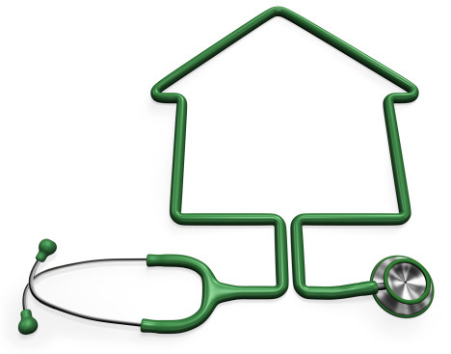
IA and PCMH
Recognized/Certified still defined as: NCQA, AAAHC, TJC, URAC, and Accrediting bodies that have certified 500 or more practices
IA still account for 15% of MIPS final score

Slide 24
Update #6: Bonus Points

Slide 25
Small Practice Bonus Points
Small practices: 15 or fewer
Five points added to MIPS Final Score
Must submit data in at least one MIPS category
+5
Notes:
Since MACRA was signed into law, the AAFP has advocated for concessions to be made for small practices. For performance period 2018, CMS is adding five points to MIPS final score of small practices (those with 15 or fewer clinicians) who submit data on at least one MIPS category. This should be helpful in 2018 since the performance threshold, the number needed to beat to avoid a negative adjustment, has been raised to fifteen.

Slide 26
Complex Patient Bonus Points
# of Dual Eligible
Complex Patient Bonus
Points
(Max. 5)
Average HCC Risk Score
_______
5
+
x
=
Total Medicare Patients Seen
Notes:
In addition to the small practice bonus, CMS is adding points to the MIPS final score based on patient complexity. The bonus will be based on the average Hierarchical Condition Category (HCC) risk score for the physician or group with which they report. CMS will calculate the average risk score for a MIPS eligible clinician or group by averaging the risk scores for beneficiaries cared for by the MIPS eligible clinician or clinicians within the group. The HCC risk scores will be calculated based on the calendar year immediately prior to the performance period
Example from Final Rule – pg. 728 Display Version
For example, a MIPS eligible clinician who sees 400 patients with dual eligible status out of 1000 total Medicare patients seen during the second 12- month segment of the eligibility period would have a complex patient ratio of 0.4, which would be multiplied by 5 points for a complex patient bonus of 2 points toward the final score.
We proposed to define the proportion of full-benefit or partial-benefit dual eligible beneficiaries as the proportion of dual eligible patients among all unique Medicare patients seen by the MIPS eligible clinician or group during the second 12-month segment of the eligibility period which spans from the last 4 months of a calendar year prior to the performance period followed by the first 8 months of the performance period in the next calendar year (September 1,
2017 to August 31, 2018 for the 2018 MIPS performance period)

Slide 27
Complex Patient Bonus Points
Dual Eligible Ratio
Avg. HCC Risk Score
2.5 Bonus Points
200
______
5
1.5
+
x
=
1000
= .20
Notes:
In addition to the small practice bonus, CMS is adding points to the MIPS final score based on patient complexity. The bonus will be based on the average Hierarchical Condition Category (HCC) risk score for the physician or group with which they report. CMS will calculate the average risk score for a MIPS eligible clinician or group by averaging the risk scores for beneficiaries cared for by the MIPS eligible clinician or clinicians within the group. The HCC risk scores will be calculated based on the calendar year immediately prior to the performance period
Example from Final Rule – pg. 728 Display Version
For example, a MIPS eligible clinician who sees 400 patients with dual eligible status out of 1000 total Medicare patients seen during the second 12- month segment of the eligibility period would have a complex patient ratio of 0.4, which would be multiplied by 5 points for a complex patient bonus of 2 points toward the final score.
We proposed to define the proportion of full-benefit or partial-benefit dual eligible beneficiaries as the proportion of dual eligible patients among all unique Medicare patients seen by the MIPS eligible clinician or group during the second 12-month segment of the eligibility period which spans from the last 4 months of a calendar year prior to the performance period followed by the first 8 months of the performance period in the next calendar year (September 1,
2017 to August 31, 2018 for the 2018 MIPS performance period)

Slide 28
Update #7 Performance Threshold

Slide 29
Performance Threshold
Exceptional Performance: 70
Performance Threshold in 2018: 15
Performance Threshold in 2017: 3
Notes:
As MIPS evolves, the performance threshold will change. After the first two years of the program, when the threshold is set by the Secretary of HHS, the threshold will be the mean or medial of the previous years MIPS scores.
In 2017, the threshold was 3, this is why Pick Your Pace allowed you to avoid a negative payment adjustment. Reporting just one measure, regardless of performance on that measure, got you 3 points.
In 2018, the threshold has been raised to 15. This is still an achievable goal- for example, the IA category is worth 15 points and most, if not all FPs can get full credit in that category. This would get you over the threshold.
Also, the bonus points just discussed will allow small practices and those with more complex patients to get more credit added to their final score.

Slide 30
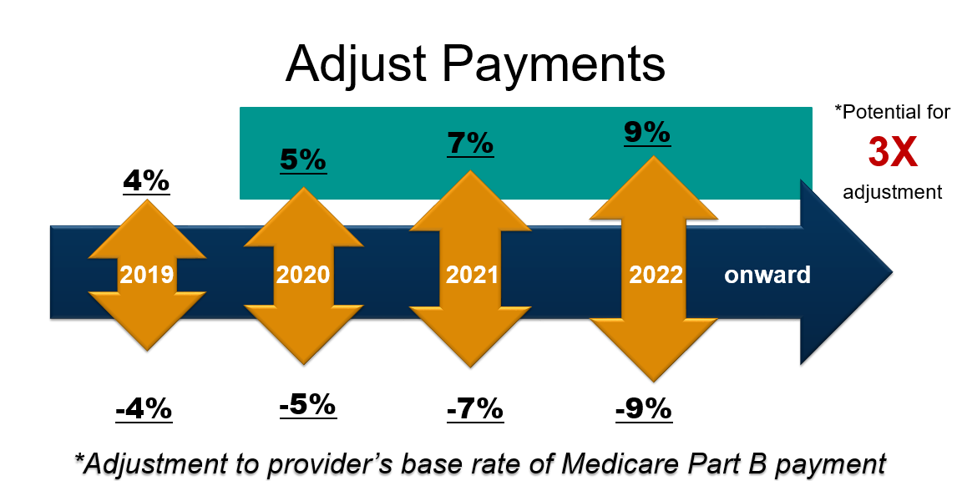
Notes:
That threshold score is what will determine your payment adjustments, both positive and negative.

Slide 31
Update #8 Employed Physicians and Residents

Slide 32
Employed Physicians and Residents
MIPS scores follow you
MIPS scores are publicly available
Consider a practices’ MIPS score as you evaluate employment contracts
*More information in the FPM Employed Physician Supplement
Notes:
Employed Physicians and Residents may wonder why they could care about MACRA – but you should.
Many don’t realize that your MIPS scores follow you
They will become publicly available on the CMS website
Consider a practices’ MIPS score as you evaluate employment contracts
You are MIPS eligible in year two of Medicare Part B billing under your own NPI
Consider this when moonlighting

Slide 33
Resources Available
aafp.org/MACRAReady
qpp.cms.gov
FPM
TCPI: aafp.org/tcpi
QPP Service Center: 866-288-8292

Slide 34
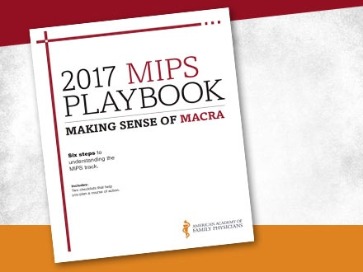
MIPS Playbook
Step-by-Step guide
2017 MIPS Playbook available
2018 MIPS Playbook Coming Soon

Slide 35
Questions?
Amy Mullins, MD, CPE, FAAFP
amullins@aafp.org

