Slide 1
Call It What It Is: Confronting Bias
Charlotte Navarre, RN
Jennifer Hill, PhD
Rachel Jackson, MD
Notes:
Jen

Slide 2
Disclosures
We have no conflicts of interest
We have nothing to disclose
Notes:
Jen

Slide 3
Warning
Some content may be disturbing.
Notes:
Jen

Slide 4
Providence Oregon FMRP
7-7-7 community program with two clinic sites
18 physician faculty, 3 BH faculty
Tier 4 PCMH certified, Track 2 CPC+
Integrated BHI, PharmD, Case Management Services
Notes:
Rachel

Slide 5
Goal and Objectives
Increase your ability to confront workplace bias by:
1) Naming two impacts of workplace bias.
2) Describing an ethical framework for responding to bias expressed by patients in the medical workplace.
3) Demonstrating two recommended verbal responses to expressed bias.
Notes:
Rachel

Slide 6
Bias in Medicine
A 2017 WebMD/Medscape survey of over 1000 health care professionals found patient and family bias to be common across disciplines and practice settings
Academic teaching faculty have little to no training on how to address bias when it is directed toward students or residents
Most targets of bias of any kind do not report this but the emotional burden contributes to burn out.
Notes:
Charlotte

Slide 7
Notes:
Charlotte

Slide 8
Notes:
Charlotte

Slide 9
Notes:
charlotte

Slide 10
Bias and Discrimination is bad for your physical and emotional health
Repeated exposure to bias, racism and discriminatory practices causes chronic stress
Low birth weight and preterm deliveries in African American and Puerto Rican women has been linked to repeated exposure to racism
A 2013 study on the effects of bias of any kind on adults is associated with depression, anxiety, low self esteem, shame, anger and non-productive coping mechanisms
Notes:
Charlotte

Slide 11
Notes:
Charlotte

Slide 12
The Survey
Web-based survey created on survey monkey
84 total respondents: Faculty, residents, PAs, CCCs, MAs, other providers & staff
48 Milwaukie respondents (100 %), 36 SE respondents (84%)
Notes:
Jen

Slide 13
Notes:
Jen

Slide 14
Notes:
Jen

Slide 15
I have experienced the following at work:
Notes:
Jen
39% (n=33) of our sample had at least one experience of bias/discrimination
Other experiences:
Antisemitism
less capable due to motherhood
Licensure discrimination with previous NQS
Certain staff members that speak a common language will speak in that language while working. Co workers do not know what they are saying. Also jokes between certain cultures ok , but if someone not from that culture says same thing, then considered racism.
Sense of fear of bringing up concerns regarding employee(s) of a different race than me for fear of being considered "racist" by the employee, leadership and HR. Also, I also fear losing my job because I am not in the "minority" category even though I feel I am an excellent employee.
Inappropriate comments from patients that are borderline sexual. "You are fine." "As long as I get to see you." Etc etc. As well as coworkers being told borderline sexual comments.

Slide 16
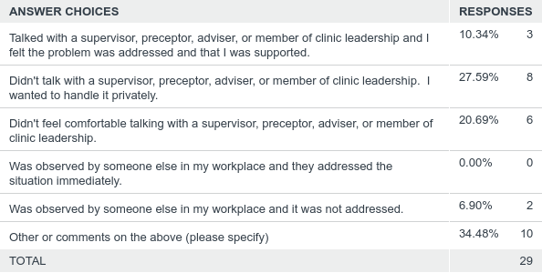
During or after an incident of overt workplace bias/discrimination, I:
Answered: 29 Skipped: 55
Notes:
Jen
Patients are not mean about it, and probably don't mean harm. They would never call a male physician that though.
Most were minor. Handled things independently with patients. At times, shared my experience with colleagues or leadership as a way to feel more supported
I heard the comment but didn't take it personally.
dismissed it.
Did not feel that it needed to be addressed further
Didn't really think anything of it at the time.
Sometimes I talk about it with support staff, sometimes not. People have been supportive for the most part. Sometimes I just don't want to bring it up, because I don't want experience those feelings again.
i talked with my supervisior several times about it, but nothing was done until i told them i would got to H.R.
Usually do not bring this up because the ageism happens daily or more often. I would bring up more overt harassment if it occurred.
I have not shared with anyone about "other experience of discrimination or bias"

Slide 17
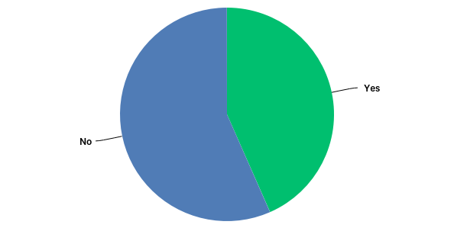
Have you experienced sexism, sexual harassment, ageism, racism, ageism, or other overt bias/discrimination in another job or in another setting?
Notes:
Jen
43% (n=33) yes compared to 39% (n=33)

Slide 18
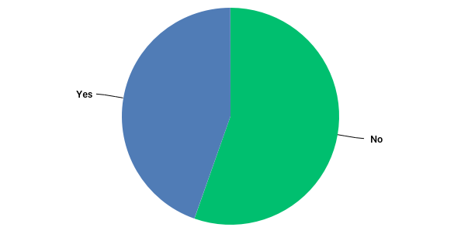
While at work, have you observed someone else experience an incident of sexism, sexual harassment, racism, ageism, or other overt bias/discrimination?
Notes:
Jen
44% (n=33)

Slide 19
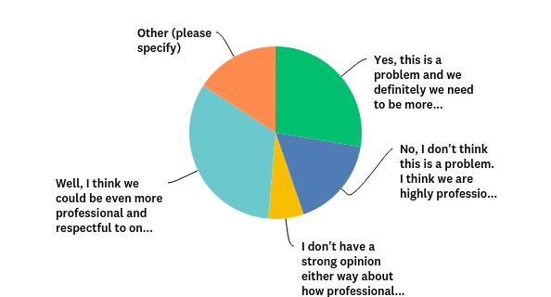
Do you personally think we need to be more professional and respectful to one another?
Notes:
Jen
Yes, 27%
Well, we would be better, but it’s not a problem 32%
No strong opinion 6%
No, 17%
Other 15%
this issue is not from providers, but from peers to peers
We are an informal group and I can see how some people would be irritated by it. However, it's a personality preference and I don't see it as an issue myself. In fact I much prefer it.
I do my best but I am sure that we all have moments when we say inconsiderate things out of exhaustion or frustration. I try to thank support staff for their work regularly and apologize when I make workflow goofs that make their days harder.
There are definitely areas for improvement.
Not sure
I think that the clinics can be rather passive aggressive at times and I think that a lot of this stems from chronic stress from understaffing with more and more demands placed on the clinic. I also believe that there need to be education about not allowing patients to be rude and inappropriate and us tolerating this as a clinic.
I believe this exsists in a very small group of people at SE one team in has people who are very "mean girl" and are unable to be approched about it
I have not experienced this, but I believe others have. I think we do have a problem if people are feeling this way.
I think the professionalism aspect is the lack of equality across the clinic. Favortism seems to be the downfall / lack of holding ppl accountable for their actions.
This is interesting. I think we have a very casual and relaxed workplace environment in terms of faculty and resident interactions. This joking, casual comraderie can be good but can also lead to some borderline behavior. I am not sure if this is what is being referenced. I have not thought we had a significant professionalism problem in the program, but it would be good to hear more specific feedback about this.

Slide 20
What does this look like? A couple common refrains
“Needing a male med student to explain the plan to the husband of the patient”
“Displaying preference for a male resident opinion over a female faculty opinion”
“Deferring to male resident clinician instead of myself as female faculty”
“Assuming I am a nurse” (over and over and over – you know this drill)
“When am I seeing the doctor?”
Notes:
Rachel

Slide 21
Other resident comments
“I have had patients ask staff before they met me if they would be able to understand my English, or calling me Vietnamese”
“Are you old enough to be a doctor?”
“Are you in high school?”
“Honey,” “Sweetie,” etc
Notes:
Rachel

Slide 22
Other experiences are more indirect, and less actionable, but still carry weight
A male patient requests an endocrinology referral for well-controlled hypothyroidism – is it because I’m a woman?
A skeptical mother of a gender-questioning adolescent changes the child’s PCP – was it to get them away from the transgender-identified physician?
A patient says that her echocardiogram made her feel violated, and slips in a vague comment that infers it was because of the ethnicity of the technician
Notes:
Rachel

Slide 23
Discrimination from other providers
Sometimes blatant, but power dynamics and the need to preserve working relationships can make speaking up difficult or awkward.
A much smaller subset of the data, often told as a med school story
“GI professor in medical school stated he bought a longer stethoscope to maintain physical distance from his HIV positive patients”
“[a specialist] suggested that I go out wearing a little black dress and some "knock me down and f*** me boots" instead of sending him consult questions on a Friday night”
Residents and faculty repeatedly mixing up two residents of East Asian descent, and making light of the situation
Notes:
Rachel

Slide 24
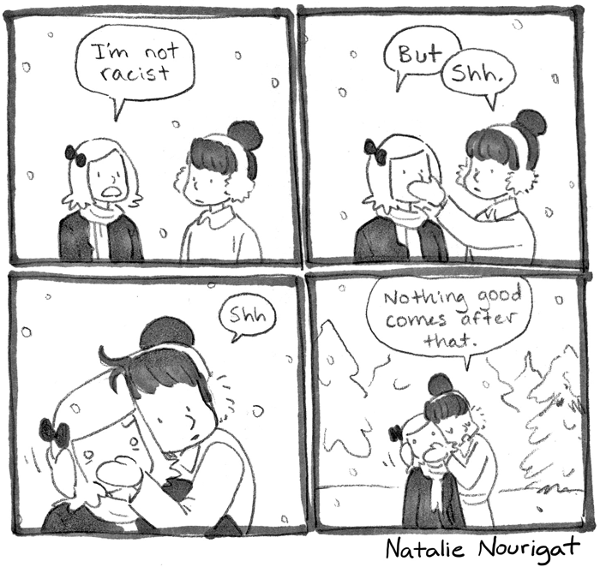
Breathe.
Notes:
Rachel

Slide 25
Show of Hands
Notes:
Rachel

Slide 26
Treatment plan
Increase awareness of the problem
Decrease incidents of expressed bias
Increase ability to recognize and address incidents
Eliminate incidents of expressed bias being directly observed without intervening/responding
Notes:
Jen

Slide 27
Implementing a Response
2 Clinic Case Conferences for all staff and providers
1 Morning Report
1 Faculty/Resident “Summit” on Bias
1 Faculty Meeting to adopt guidelines
1 Presentation to Regional GME (1 FM and 2 IM residency programs)
Notes:
Jen

Slide 28
In Development
Policy Statement and Guidelines into Orientation of New Residents and Faculty
Implicit and Explicit Bias Training into Curriculum
Incorporate Bias Rounds into Morning Reports
Faculty Development Session
Incorporate into Regional GME Wellness Program
Signs in precepting areas
Notes:
Jen

Slide 29
Patient Rights & Employee Rights
Competent patients have the right to refuse medical care, including treatment by a specific provider
This patient right is granted by informed-consent rules and common law that protects patients from battery
Employment rights: a workplace free of discrimination as protected by Title VII of the 1964 Civil Rights Act
Organizations that make race based or other bias based staffing decisions because of patient/family bias, put themselves at legal risk
Employees have successfully sued employers who require employees to accommodate these types of demands
Notes:
Charlotte

Slide 30
Preferences vs. Discrimination
We support our patients when they respectfully state preferences:
Rather have a Spanish speaking provider
Rather have a man talk to me about erectile dysfunction
And try to honor them when we can
We support our caregivers when patients express rejections of caregiver traits
I don’t want a Jew touching my child
I only want a white person to take care of my mother
We do not need to honor those requests
You do NOT have to tolerate expressions of bias or discrimination at work.
Notes:
Charlotte

Slide 31
Interventions for Residents
Discuss bias and mistreatment during orientation and at transitions into more supervisory roles
Curriculum: case discussion in morning report, video precepting, and implicit bias training
Verbal Judo for Bias: Examples handout: on Shared Drive, In Orientation Packet, Posted in Report Room
Notes:
Rachel

Slide 32
Strategies for Faculty
Faculty trainings on recognizing and addressing micro-aggressions, explicit bias on the service and in the clinic
Frontline faculty:
Address the comments, respond to micro-aggressions
Debrief with team in the moment or shortly thereafter
Reinforce importance of trainee safety and well-being
Set expectations for responding in similar situations
Articulate standards of care and what is not tolerated
Notes:
Jen

Slide 33
Recommendations for Programs
Implement confidential annual mistreatment survey of faculty and trainees for longitudinal tracking and intervention
Written policy and chain of command for reporting in residency manual, new faculty orientation
Create opportunities for processing difficult encounters in faculty meetings, debriefs, advisor meetings
Notes:
Charlotte

Slide 34
A Framework for Assessing How to Respond to Patient or Family Bias
Adapted from an ED model by Paul-Emile, Smith, Lo, and Fernandez (2016)
Patients’ medical condition
Patients’ decision-making capacity
Reasons for the behavior: assessing accountability
Effect on the caregiver
Options for response to the bias/discrimination: in clinic and on the service
Notes:
Charlotte
Dealing with Racist Patients
Kimani Paul-Emile, J.D., Ph.D., Alexander K. Smith, M.D., M.P.H., Bernard Lo, M.D., and Alicia Fernández, M.D.

Slide 35
CASE EXAMPLES
Notes:
Rachel

Slide 36
The patient called me ‘colored girl.’ The senior doctor training me said nothing.

Slide 37
54 yo pt with chest pain: you untie the gown to get a good lung exam, and…

Slide 38
You introduce yourself confidently as the doctor and spend 10 minutes taking a history when the patient is interrupted by a phone call:

Slide 39
I can’t talk now, I’m talking to the nurse
When I am going to see the doctor?

Slide 40
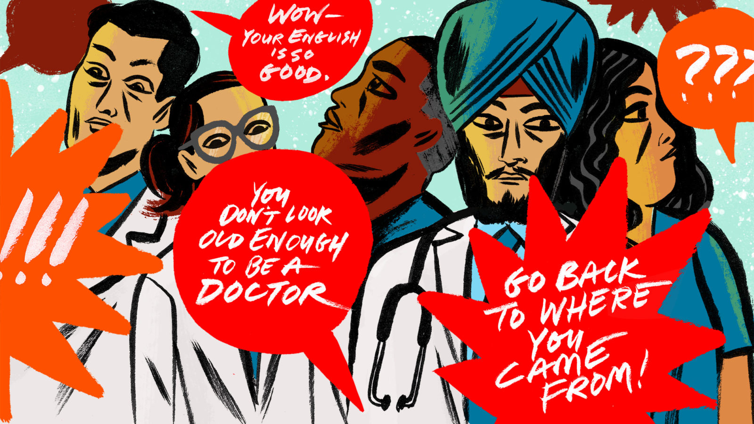

Slide 41
Questions or Comments?

Slide 42
References
Frellick, M: One in Four Doctors Report Recent Sexual Harassment by Patients, https://www.Medscape.com/viewarticle/899362?src=wnl_edit_tpal&uac=234229FN&imp
Paul-Emile, Smith, Lo, & Fernandez: Dealing With Racist Patients, http://www.nejm.org/doi/full/10.1056/NEJMp1514939#t=article
Tedeschi, B: 6 in 10 doctors report abusive remarks from patients, many get little help coping with the wounds, https://www.statnews.com/2017/10/18/patient-prejudice-wounds-doctors/
Weeks, L: When the Patient is racist, how should the doctor respond?: https://www.statnews.com/2017/06/12/racism-bias-patients-doctors/
Whitgob, Blankenburg, & Bogetz: The Discriminatory Patient and Family: Strategies to Address Discrimination Towards Trainees: https://journals.lww.com/academicmedicine/Fulltext/2016/11001/The_Discriminatory_Patient_and_Family_Strategies.21.aspx

