Slide 1
Champion Teams: An Implementation Strategy for Building Interprofessional Practice in Residency Clinics
Jodi Polaha, PhD; Thomas Bishop, PsyD;
Leigh Johnson, MD; Diana Heiman, MD;
Richard Veerman, MD; Brandon Mizell, MD;
Reid Blackwelder, MD
Department of Family Medicine

Slide 2
Disclosures
The authors have nothing to disclose.

Slide 3
Learning Objectives
Upon completion of this session, participants should be able to:
Define the term "learning healthcare system" and its application to Champion Teams.
Describe the utility and keys to implementing Champion Teams in a residency training clinic.
Describe one example of Champion Teams and its application to making data-informed changes to improve team-based care.

Slide 4
Overview
Setting and Rationale for champion teams
Example 1: A fully integrated BHC
Example 2: Improving immunization rates
Key Concepts
Discussion

Slide 5
East Tennessee State University

Slide 6
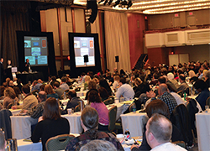
Getting the Evidence to the Endpoint
Notes:
LEIGH – this slide focuses on the difficult of getting evidence from the literature, workshops, or other dissemination sources implemented into practice. The key is – lots of new innovations in team-based care are coming out, they have some empirical support and they are certainly supported by policy but how do we transform practice? A second key point is that this is not a once and done transformation, it is an ongoing process of synchronizing with the evidence base and best practices around team care as new ideas/innovations come out and as your practice has increased capacity to do it (e.g., more funding or a new professional that is available)

Slide 7
Champion Teams: A Definition
Our implementation strategy for building team based care
Notes:
If you set the prior slide up well, this one should be the “punch line”

Slide 8
Putting Wheels on All Our Good Stuff
Notes:
This one is an opportunity that Champion Teams leverage lots of existing skill sets – skills in quality improvement, leadership, team communication and others to “put some wheels on” transformation – to get it going. You might want to end this slide by introducing the examples and pointing out that we will attempt to illustrate Champion Teams in action before we “teach” them outright.

Slide 9
Examples
Key stakeholders
Short, focused meeting schedule
Short-term goals
Data-driven

Slide 10
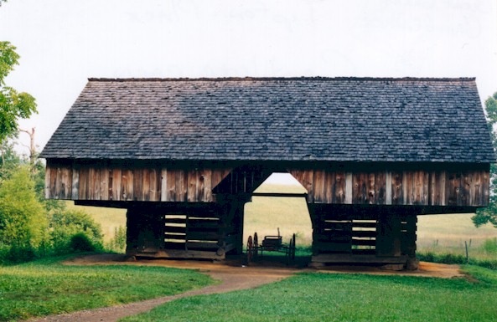
Example 1: A Fully Integrated BHC
Objective: To engage the practice in a fully integrated model of behavioral health service delivery.

Slide 11
Key Stakeholders
Notes:
Who are the champions?
Who are the key stakeholders?
How can we keep it nimble?

Slide 12
Short term goals
Activities
More BHC visibility in atrium
Limit scheduled appointments and no “referrals”
You Tube for Public Relations
Notes:
Activities: Near targets (things we can easily implement), minimal burden
Measurement: Implemetnation Outcomes (not effectiveness) and Proximal Targets (things we can get data on pretty readily, soon)

Slide 13
Meeting Schedule
12:45-1:15 on Fridays:
December 14, 2015
January 22, 2016
February 5, 2016
February 19, 2016
March 11, 2016
May 13, 2016
Notes:
Key Elements:
Short
Frequent
Accessible
PDSA worksheet at each meeting

Slide 14
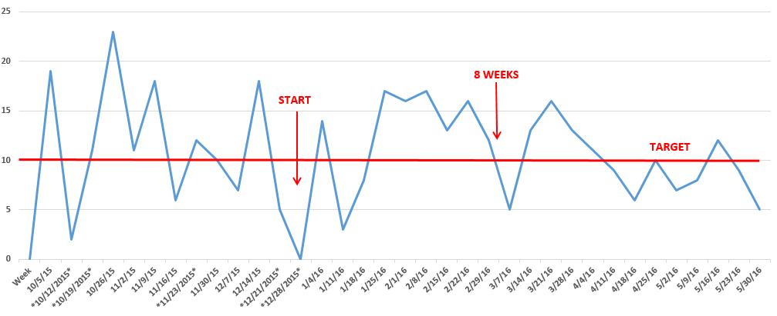
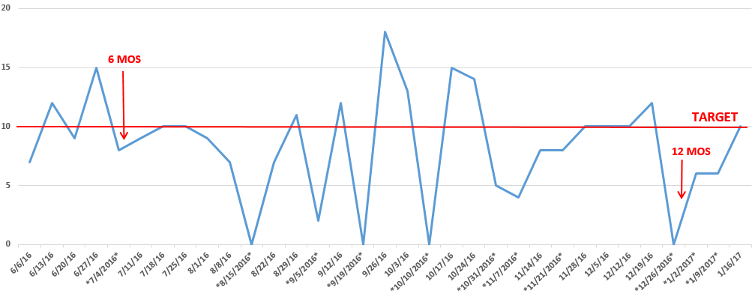
Data Driven
Notes:
Tracked filled appointments
goal for scheduled appointments: 2/provider/ half day

Slide 15
Lessons Learned
Patients expect behavioral health services on site
Providers prefer this model
Culture change takes time, we continue to meet

Slide 16
Our Champion Teams
Example 1: A fully integrated BHC
Example 2: Increasing medical visit attendance
Example 3: Integrated pharmacy for CHF
Example 4: Improving immunization rates

Slide 17
Learning Healthcare System

Slide 18
Champion Teams: Essential Elements
Small team paves the way for practice-wide uptake
Champions choose projects relevant to their site
Utilizes QI methods, other best-practice strategies
Efficient, realistic process
Synchronized with clinical operations
Grant-supported architecture

Slide 19
Champion Teams: Added Perks
Grows a learning healthcare system
Serves as faculty development: scholarly activity and transformative learning around clinical interest
Provides opportunities for resident research/scholarly activity

Slide 20
Champion Teams: Administration
Clinic-based members:
In-house processes
Informal vetting
Real world perspective
HRSA-supported members:
Review literature
Data
Funding
Other resources

Slide 21
Discussion
Does your clinic struggle to implement Quality Improvement?
Do you have a process like Champion Teams in your clinic?
What projects at your site might benefit from engaging Champion Teams?

Slide 22
Please evaluate this presentation using the conference mobile app! Simply click on the "clipboard" icon on the presentation page.

