Slide 1
Coronavirus
Fact vs Fiction
Christina Lincoln, DO & Cheryl K. Seymour, MD
Maine Dartmouth Family Medicine Residency
March 31, 2020
Notes:
Can build true/false polling questions on the Zoom platform in sets of 4-6 question per poll.

Slide 2
I got a task from a patient requesting to know her blood type. She states there is a connection to blood type and susceptibility to COVID
More to the story…
A non-peer reviewed article was publishing on a online source suggesting that type A patients are more susceptible based on cohorts from Wuhan and Shenzhen. Article does note that is was early information and should not dictate current patient care while also suggesting that healthcare providers with A blood types would need increased protection and patients may need increased surveillance and treatment options.
https://www.medrxiv.org/content/10.1101/2020.03.11.20031096v2

Slide 3
There is a shortage of PPE and cloth masks are being used as alternative options.
More to the story…
There are many hospitals that have statements about cloth masks. These are for worried well and non clinical members of the community. Those who are caring for isolation patients are still and should continue to utilize appropriate and quality proven PPE.
CDC as last resort mentions cloth masks with numerous other options prior to this option. The specific term on CDC is “last resort”
Any thoughts about why cloth masks may be for community benefit?
https://www.cdc.gov/coronavirus/2019-ncov/hcp/ppe-strategy/face-masks.html
Notes:
For those who feel vulnerable, cloth masks can offer a perception of safety if also utilized with hand hygiene practices, social distancing, and staying at home. For those who feel helpless during this situation, making masks give some purpose and sense of contribution.

Slide 4
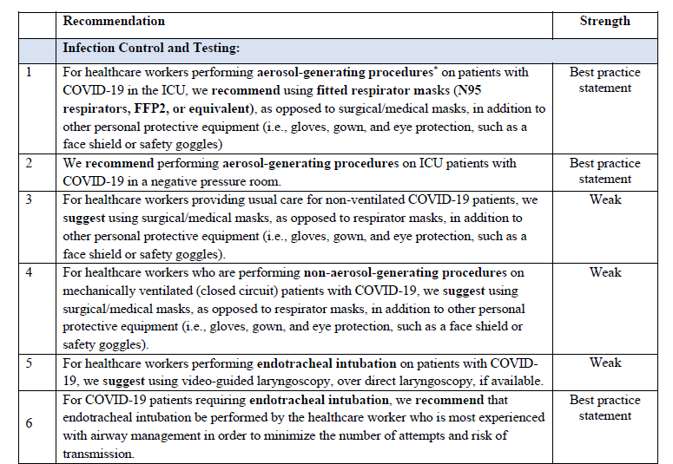
Additional notes on PPE
Society of Critical Care Medicine - Coronavirus Guidelines
Notes:
SCCM - https://journals.lww.com/ccmjournal/Abstract/onlinefirst/Surviving_Sepsis_Campaign__Guidelines_on_the.95707.aspx

Slide 5
Spraying alcohol or chlorine on your body can kill the new coronavirus
More to the story…
With limited supplies of hand sanitizer, patients are resorting to other options in hopes of protecting against the virus. Hand washing is effective and chemical application is high risk for harm. The WHO notes that once a patient has the virus, alcohol and chlorine application does not treat or reduce spread. Again encourage hand hygiene and quarantine as the primary means of reducing spread.
https://www.who.int/emergencies/diseases/novel-coronavirus-2019/advice-for-public/myth-busters

Slide 6
It isn’t safe to receive a letter or a package from China.
It isn’t safe to get take-out from local restaurants.

Slide 7
Packages from China & take-out
More to the story…
From the WHO: The likelihood of an infected person contaminating commercial goods is low and the risk of catching the virus that causes COVID-19 from a package that has been moved, travelled, and exposed to different conditions and temperature is also low.
From NEJM: Severe acute respiratory syndrome coronavirus 2 (SARS-CoV-2) was detectable in aerosols for up to three hours, up to four hours on copper, up to 24 hours on cardboard and up to two to three days on plastic and stainless steel.
https://www.nejm.org/doi/full/10.1056/NEJMc2004973
Notes:
There are still possible exposure risks in visiting restaurants, exchanging credit cards and being within 6 feet of people in public places.
These duration of viability studies inform the recommendation to store N95 masks in paper bags v. plastic containers for example

Slide 8
I should stop wearing contacts to help prevent coronavirus infection.
More to the story…
American Academy of Ophthalmology is recommending that contact wearers switch to glasses if possible in order to decrease the frequency of touching the eyes and risking transmission of the virus. Glasses also serve as an eye shield.
This is expert opinion and not evidence based.
https://www.aao.org/eye-health/tips-prevention/coronavirus-covid19-eye-infection-pinkeye
Notes:
Chinese whistleblower physician who eventually died from COVID-19 infection was an ophthalmologist
https://www.aao.org/headline/coronavirus-kills-chinese-whistleblower-ophthalmol

Slide 9
The new coronavirus only affects older people.
The new coronavirus affects men more than women.

Slide 10
Demographics
More to the story…
Symptomatic infection in children appears to be uncommon
Symptoms in young adults are usually mild, although severe cases have been reported.
In the large Chinese report described next slide, only 2 percent of infections were in individuals younger than 20 years old
In Korea, only 4.8 percent of 4212 infections were in those younger than 20 years old
NEJM 2-28-20 https://www.nejm.org/doi/full/10.1056/NEJMoa2002032
J Korean Med Sci 3-16-20 10.3346/jkms.2020.35.e112
Notes:
Percentage of infections in each age group is directly influenced by who is being tested.

Slide 11
Demographics & Outcomes
Survival by age range in a study of 52 critically ill patients in China
30-39yo 100% recovered
40-49yo 50% recovered
50-59yo 31% recovered
60-69yo 35% recovered
70-79yo 12.5% recovered
80+ 0% recovered
In a study of 1099 hospitalized patients with coronavirus in China, the median age was 47 years, 59% of patients were male, and patients with severe disease were older than those with non-severe disease by a median of 7 years.
The Lancet 2-24-20
https://doi.org/10.1016/S2213-2600(20)30079-5
NEJM 2-28-20 https://www.nejm.org/doi/full/10.1056/NEJMoa2002032
Notes:
In Maine thus far, our 303 cases (as of today) are 50/50 male/female.
So many factors may influence the M/F ratios – cultural differences in terms of who presents to the hospital, who is exposed through what means, etc.
Recovery by age distribution can be helpful in counseling patients and families around prognosis in the critical care unit

Slide 12
All patients with coronavirus have a cough
In a study describing 138 patients with COVID-19 pneumonia in Wuhan
Fever in 99 percent
Fatigue in 70 percent
Dry cough in 59 percent
Anorexia in 40 percent
Myalgias in 35 percent
Dyspnea in 31 percent
Sputum production in 27 percent
2-7-20 JAMA. 2020;323(11):1061-1069. doi:10.1001/jama.2020.1585
Notes:
These are symptoms of patients already sick enough to be hospitalized
Fever may not be present until later in the infection. Cough may not be present in up to 40%
Anosmia, GI symptoms and syncope are being reported anecdotally with some frequency in US media.

Slide 13
Pregnant women and newborns are at higher risk.
More to the story…
In a review of 38 pregnant women with COVID-19, no cases of intrauterine transmission, no viral presence in breast milk or amniotic fluid, and no maternal deaths were documented. There appears to be an increased frequency of preterm labor and cesarean delivery for abnormal fetal heart rate tracings. This is likely related to severe maternal illness, but detailed reports are not available. Some mothers have recovered without undergoing delivery.
The neonatal cases that have been documented have been attributed to close contact with an affected mother or other caregiver.
Transmission etc - https://doi.org/10.5858/arpa.2020-0901-SA 3-17-20
Hospitalized infants – https://doi.org/10.1001/jama.2020.2131 JAMA 2-14-20
Notes:
To avoid droplet spread, many hospital protocols prevent visitors and recommend removing the newborn from the delivery room if mother has been found positive for COVID to prevent transmission to newborn. Mothers are encouraged to pump/express breast milk. WHO supports breastfeeding in COVID positive mothers with the use of surgical mask and hand hygiene.
https://www.who.int/emergencies/diseases/novel-coronavirus-2019/advice-for-public

Slide 14
To prevent a more severe presentation of COVID-19… -I should advise my patients taking NSAIDs chronically to stop
- I should advise my patients taking ACEs chronically to stop

Slide 15
NSAIDs and ACEs/ARBs
More to the story…
Concerns about NSAIDs were raised in a letter to the Lancet with theoretical concerns about up-regulating ACE2 receptors which are the virus point of entry into cells. No clinical evidence supports this claim and the FDA states that there are no contraindications to using NSAIDs at this time.
Similarly, no clinical data exist to support the hypothesis that utilization of RAAS blockers could increase the ability of the virus to enter the lungs. Discontinuation is not recommended by the ACC or AHA.
Citations in comments below
Notes:
https://www.fda.gov/drugs/drug-safety-and-availability/fda-advises-patients-use-non-steroidal-anti-inflammatory-drugs-nsaids-covid-19
https://professional.heart.org/professional/ScienceNews/UCM_505836_HFSAACCAHA-statement-addresses-concerns-re-using-RAAS-antagonists-in-COVID-19.jsp

Slide 16
Patients with suspected COVID who feel short of breath should present to the ER.
More to the story…
Ideally patients would access some kind of phone triage before presenting to the ER. However assessing dyspnea over the phone is challenging.
The Roth score is an evidence based tool to estimate a patients’ level of hypoxia without the use of a pulse oximeter.
In some cases it may be more appropriate to bring the patient into the office to make a more complete assessment of their status.
Clinical Cardiology 10-4-16 https://doi.org/10.1002/clc.22586

Slide 17
The Roth Score
This score is measured by requesting that the patients take a deep breath followed by counting out loud from 1 to 30 in their native language, in a single breath, as rapidly as possible. The time duration was measured on a stopwatch in seconds from number 1 until the highest number reached. The test was repeated after the subject had taken 3 deep breaths.
The result of the Roth score includes 2 measurements:
the duration of time elapsed between counting from 1 to 30 in 1 breath, or until the patient took another breath
the highest number reached in 1 breath
Max counting number <10
or counting time <7 seconds
identified patients with a SpO2 <95%
with sensitivity of 91% and 83%,
respectively
Max counting number <7
or counting time <5 seconds
identified patients with SpO2 <90%
with sensitivity of 87% and 82%,
respectively.
Clinical Cardiology 10-4-16 https://doi.org/10.1002/clc.22586

Slide 18
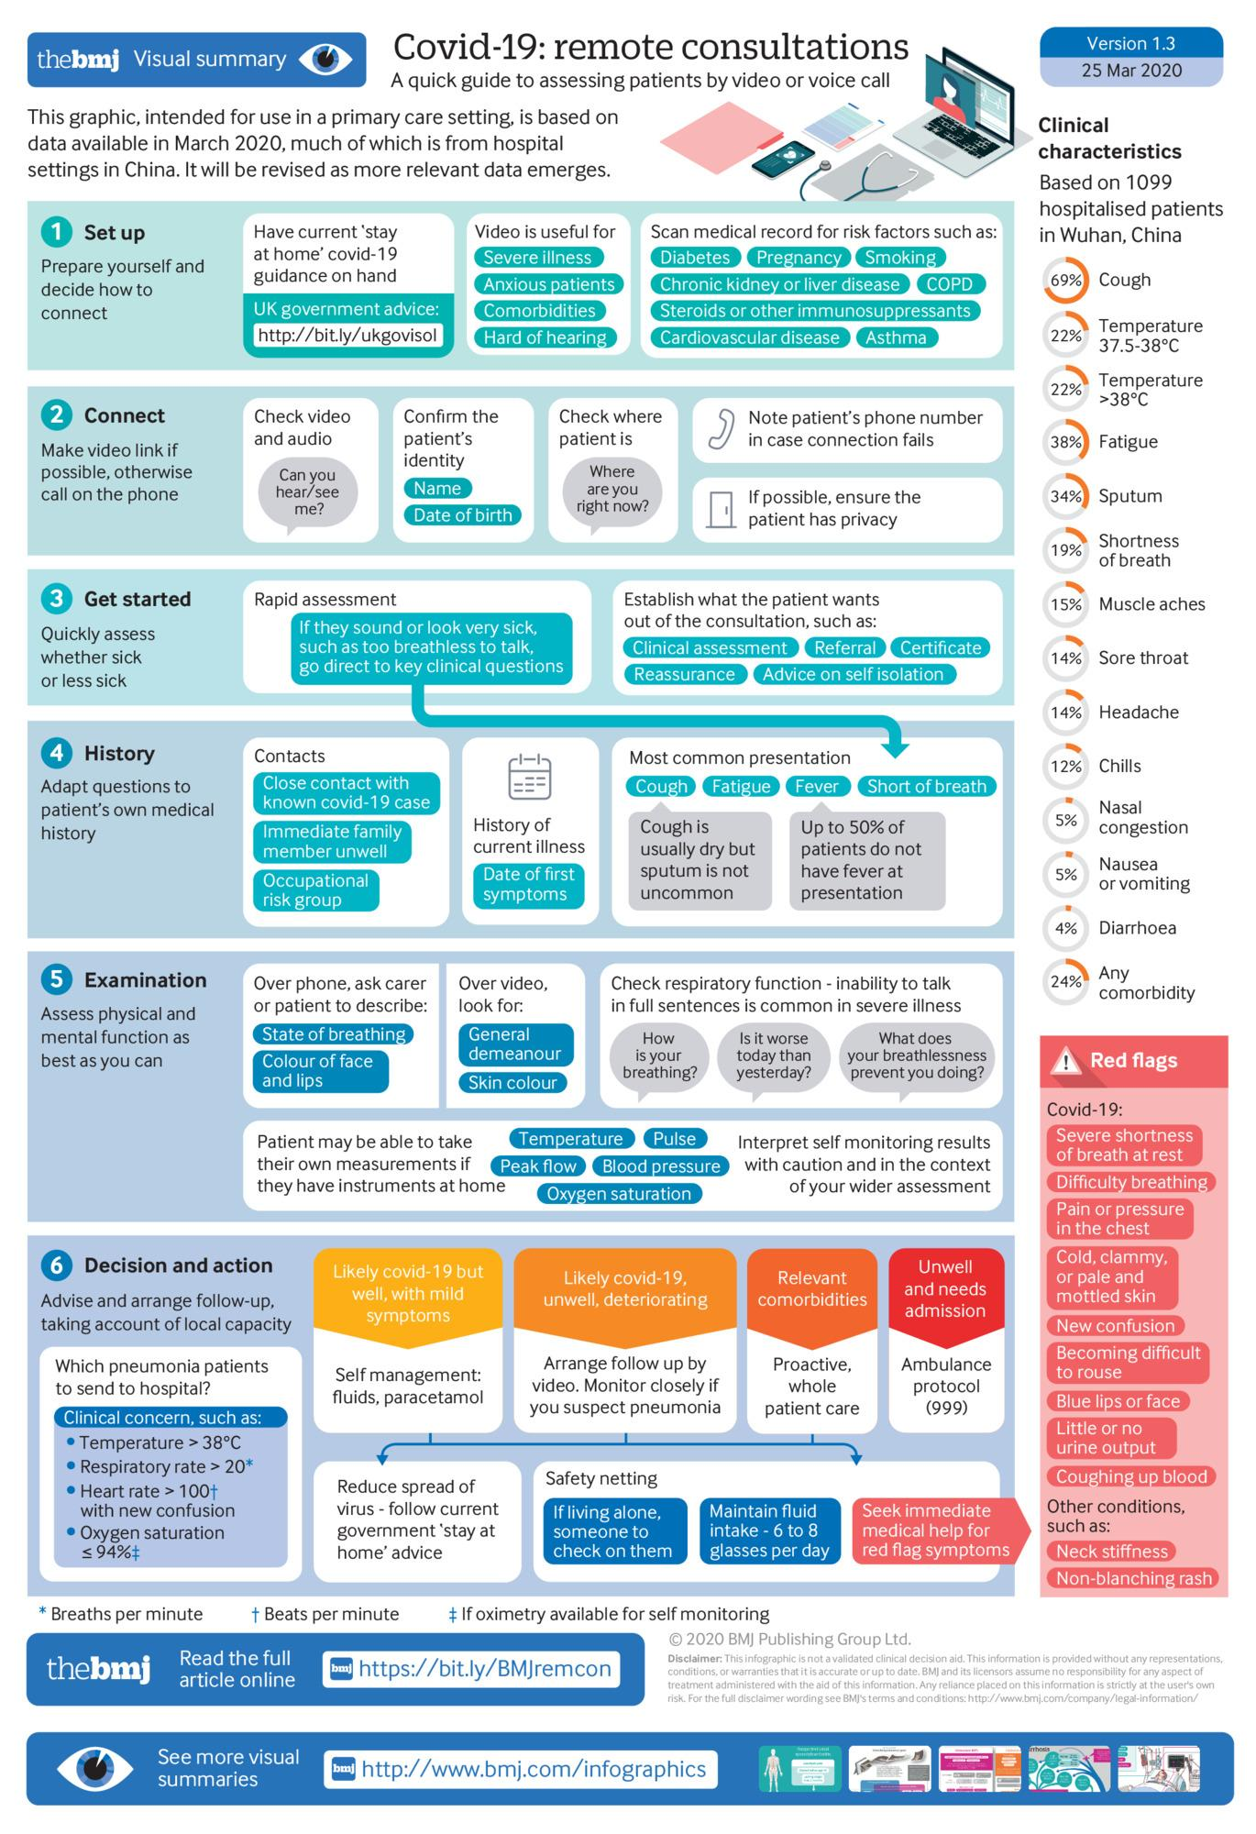
https://www.bmj.com/content/368/bmj.m1182

Slide 19
Notes:
Full article includes a survey of 50 clinicians as to the most useful assessment tools for dyspnea.
Of note - smart phone based SpO2 apps are not felt to be accurate to make clinical decisions “even in austere conditions”
https://www.ajemjournal.com/article/S0735-6757(19)30467-X/

Slide 20
If I get COVID-19, I am now immune and cannot get infected again.
More to the story…
There have not been any clinical trials for evaluation for reinfection. At this time, the expectation would be that recovered patients form acquired immunity and will not be re-infected.
There are speculations that there may be seasonal or repeated recurrence of COVID-19. This is again not been shown in observation or clinical trials, but should be a consideration for future recommendations of patients and is one of the driving forces behind current vaccine development.

Slide 21
If I get COVID-19, my plasma could be a treatment for others.
More to the story…
Trials are underway regarding this idea within the United States.
In China, in an uncontrolled case series of 5 critically ill patients with COVID-19 and acute respiratory distress syndrome (ARDS), administration of convalescent plasma containing neutralizing antibody was followed by an improvement in clinical status.
Patients in the Chinese study were also receiving methylprednisolone and anti-virals.
JAMA. Published online March 27, 2020. doi:10.1001/jama.2020.4783

Slide 22
If I have a known unprotected exposure to coronavirus there is benefit to starting hydroxychloroquine
More to the story…
There is at least one post-exposure prophylaxis study of health care workers underway in the United States (University of Minnesota).
Anecdotally health care workers in other countries are taking hydroxychloroquine both for post and pre-exposure prophylaxis for coronavirus.
There is no evidence (yet) to suggest that either of these strategies are safe or effective.
Notes:
What other preventative treatments are available?
Zinc – no evidence but mechanism might be useful – take no more than a week at a time
Elderberry – recommend against use during infection related to theoretical effects on inflammatory cytokines
Magnesium – no evidence – suggested to be helpful in the context of tachyarrhythmia related to severe infection
Vitamin D and C??

Slide 23
There are a number of effective treatment options currently available for COVID19
More to the story…
Remdesivir – Several randomized trials are underway to evaluate the efficacy of remdesivir for moderate or severe COVID-19 including at Maine Medical Center. Remdesivir is a novel nucleotide analogue that has activity against severe acute respiratory syndrome coronavirus 2 (SARS-CoV-2) in vitro and related coronaviruses (including SARS and MERS-CoV) both in vitro and in animal studies. Any clinical impact of remdesivir on COVID-19 remains unknown.

Slide 24
COVID 19 treatment continued
Chloroquine/hydroxychloroquine – Both chloroquine and hydroxychloroquine have been reported to inhibit SARS-CoV-2 in vitro, although hydroxychloroquine appears to have more potent antiviral activity.
Despite the limited clinical data, given the relative safety of short-term use of hydroxychloroquine, the lack of known effective interventions, and the in vitro antiviral activity, some clinicians think it is reasonable to use hydroxychloroquine (or chloroquine) in hospitalized patients with severe or risk for severe infection if they are not eligible for other clinical trials.
Consider QTc
Proposed dosing: 400 mg twice daily on day 1 then daily for five days, 400 mg twice daily on day 1 then 200 mg twice daily for four days, and 600 mg twice daily on day 1 then 400 mg daily for four days.

Slide 25
COVID 19 treatment continued
Tocilizumab – Treatment guidelines from China's National Health Commission include the IL-6 inhibitor tocilizumab for patients with severe COVID-19 and elevated IL-6 levels; the agent is being evaluated in a clinical trial.
Lopinavir-ritonavir – Lopinavir-ritonavir appears to have little to no role in the treatment of SARS-CoV-2 infection. This combined protease inhibitor, which has primarily been used for HIV infection, has in vitro activity against the SARS-CoV and appears to have some activity against MERS-CoV in animal studies. However, there was no difference in time to clinical improvement or mortality at 28 days in a randomized trial of 199 patients with severe COVID-19 given lopinavir-ritonavir (400/100 mg) twice daily for 14 days in addition to standard care versus those who received standard of care alone.
NEJM March 18, 2020 DOI: 10.1056/NEJMoa2001282

Slide 26
Critical Care evidence base
Cochrane Library – COVID critical care specific
Society for Critical Care Medicine guidelines – limited evidence
Prone positioning
Higher PEEP
ARDS-NET protocols – low tidal volume to prevent lung injury
Conservative fluid strategy
Norepi first line vasoactive agent
Steroids for refractory hypotension or cytokine storm
https://www.cochranelibrary.com/collections/doi/SC000039/full
https://journals.lww.com/ccmjournal/Abstract/onlinefirst/Surviving_Sepsis_Campaign__Guidelines_on_the.95707.aspx

Slide 29
What other questions have you heard that need to be clarified?

