Slide 1
Sustainable neonatal resuscitation training programs amongst medical and nursing students in Dar es Salaam, Tanzania
Presenters: Elise Duggan
Authors: Aliasgar Khaki, Florence Salvatory,
Jason Kroening-Roche, Olivia Kroeining-Roche, Kristen A Cahill,
Esther Johnston

Slide 2
Objectives
Review neonatal mortality rates in Tanzania
Understand current evidence for Helping Babies Breathe in Tanzania
Review evidence based curriculum for neonatal resuscitation
Discuss ways in which global health partnership can promote sustainable neonatal resuscitation programs through university education
Identify ways in which medical and nursing students, with faculty support, can lead neonatal resuscitation trainings impacting the Tanzania community at large

Slide 3
Background: Neonatal mortality
Global 14.45 / 1000 live births ¹
Tanzania 25/1000 live births²
43/1000 live births in urban areas
24/1000 live births rural areas
15% attributed to birth asphyxia³
49% births attended by skilled attendant 2007³
63% of births in health facilities²
Country statistics and global health estimates by WHO and UN partners For information visit the Global Health Observatory (http://www.who.int/gho/en//) Last updated :January 2015
Notes:
Chart shows proportion of deaths in Tanzania of children under 5 due to birth asphyxia
Sources :1. global burden of disease; 2. 2015-2016 tanzanian demographic health survey; 3. WHO global health observatory (http://www.who.int/gho/countries/tza.pdf?ua=1)
Most recent global burden of disease data 2015 estimates early neonatal mortality rate at 14.45 per 1000 live births;

Slide 4
Background: Helping Babies Breathe® (HBB)
Simulation based
Low student to instructor ratio
Curriculum includes:
OSCE
Knowledge check
Skills check
Simulator doll
American Academy of Pediatrics. Helping Babies Breathe. 2010 Available at www.helpingbabiesbreathe.org. Accessed October 11, 2016
Notes:
Background video from HBB if time allows: https://www.youtube.com/watch?v=yi1ufccpVXU&feature=youtu.be
-Kit with simulator dolls, curriculum, visual aids, and test materials facilitates sustainability - consistency and rapid easy integration to curriculum...Helpful for faculty with multiple conflicting responsibilities...
“ Simple resuscitation education such as 'Helping Babies Breathe', which focuses on the very basic steps and pays attention to comprehensive program development with local ownership and accountability, can help transfer competency into clinical practice and lead to sustainable programs impacting neonatal mortality and morbidity” ersdal, singhal 2013 paper

Slide 5
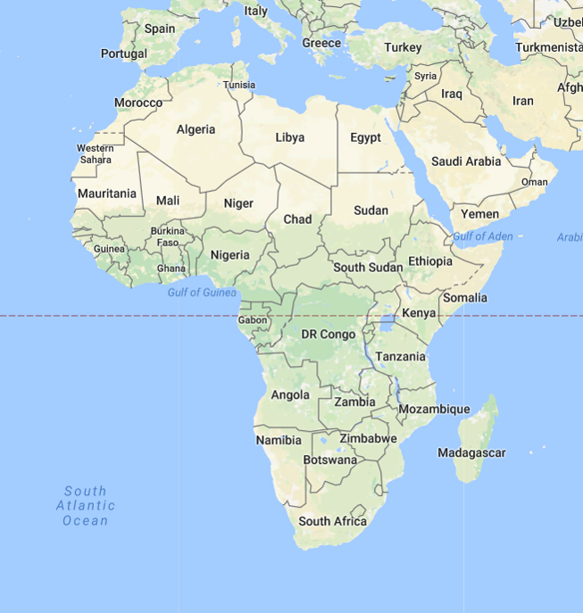
Background: HBB Evidence base in Tanzania
Background rollout of HBB in Tanzania
JHPIEGO/MOH partnership
Initial implementation showed 47% reduction in mortality and fresh stillbirth rates
Msemo, G. et al. Newborn Mortality and Fresh Stillbirth Rates in Tanzania After HBB Training. Pediatrics (2013);131:e353–e360
Arlington, L et al. Implementation of “Helping Babies Breathe”: A 3-Year Experience in Tanzania. Pediatrics Apr 2017
Notes:
side note - paper showing efficacy of peace corps volunteers training health workers in Madagascar

Slide 6
Background: GHSP at HKMU
HKMU is a private university with ~1000 students, founded in 1997
Partnership began in 2014
2-4 volunteers per year in the departments of Community Health Nursing, Midwifery, Pediatrics, and Internal Medicine
Notes:
At Hubert Kairuki Memorial University (HKMU), originally founded as Mikocheni International University (MIU) in 1997, students can earn degrees in medicine, nursing (Bachelor of Science or diploma), and holistic therapeutic counseling (certificate). In addition, HKMU also offers postgraduate diplomas in obstetrics and gynecology, pediatrics and child health, and masters programs in medicine (MMed) (internal medicine, surgery, obstetrics and gynecology, pediatrics and child health), science in public health (MScPH), and social work (MSW). HKMU strives to be an exemplary private university in Tanzania that provides the highest quality education and conducts cutting edge research

Slide 7
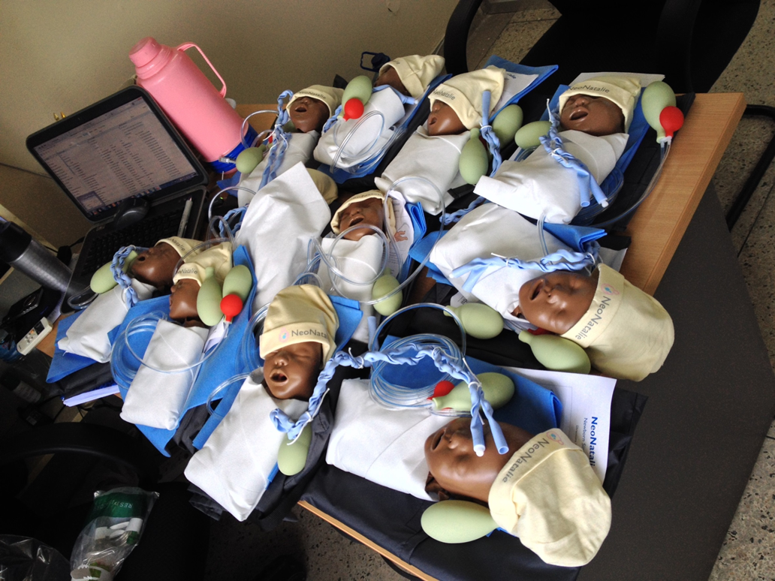
Birth of neonatal resuscitation training at HKMU
Start of neonatal resuscitation trainings in 2015 by first GHSP volunteer in pediatrics department, Dr. Esther Johnston
Inspired by clinical experiences at teaching hospital
Notes:
Key efforts at end of 2014/2015 year to ensure sustainabilitly of program/trainings:
development of core of student trainers/interest group

Slide 8
Timeline: September 2016-Present
Master training of 10 Medical students from MD2-4 by Aliasgar
HBB student group met with incoming GHSP volunteers and faculty developed shared vision for HBB at HKMU
Out of these meetings, the HKMU HBB Medical-Nursing Alliance was formed as a student-faculty partnership
Sustainability was a foundation of the alliance from this point forward

Slide 9
HKMU-HBB Alliance: Objectives
Establish a pipeline of student and faculty trainers from medicine and nursing schools
Train all nursing and medical students in HBB prior to graduation
Integrate HBB into the curriculum of HKMU medical and nursing schools
Generate evidence on the effectiveness of training interdisciplinary teams of nursing and medical students

Slide 10
HBB Alliance Structure
Student-led and faculty supported committees
Curriculum
Evaluation
Outreach
Student president
Monthly leadership team meetings

Slide 11
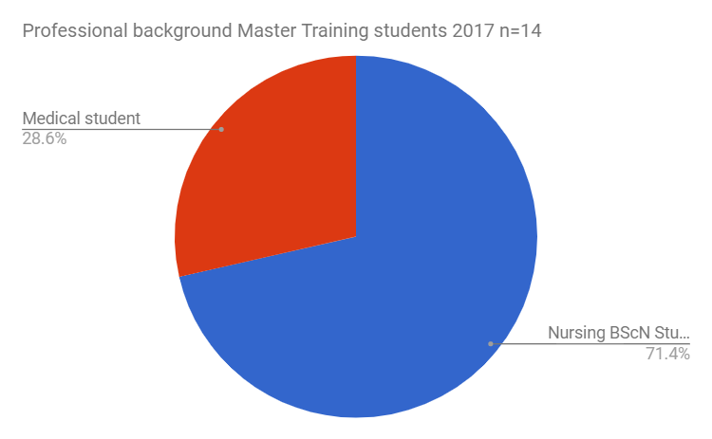
Objective #1: Establish a Pipeline of Trainers
Curriculum committee developed training schedule & checklist
Expansion of number and background of students trained
14 students were trained as “master trainers” in April 2017
Ended academic year with 23 master trainers
Notes:
This graph shows that more nursing students were trained than medical students, which was important for sustainability

Slide 12
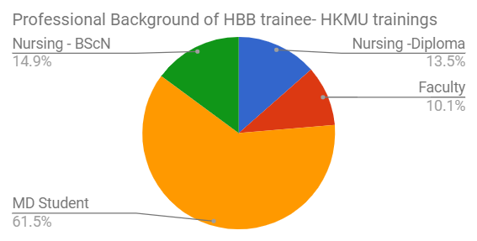
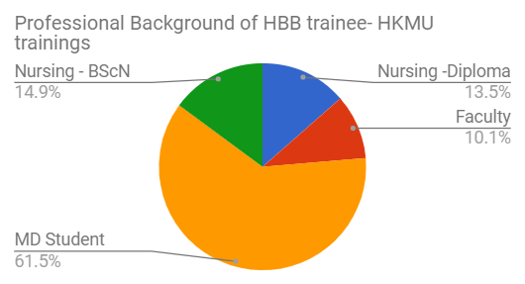
Objective #2: Train all students prior to graduation
Ongoing objective, not yet fully realized
Multiple student-led trainings in 2016/17
37 nursing and medical students trained in November
77 medical students trained in April
20 Diploma nursing students trained in June
Notes:
TOtal of 148 indidviduals trained in standard HBB curriculum at HKMU in 2016/17 academic year. (additional 36 nursing students trained at CUHAS bugando for total of 184 trained at both instiutions:
91 MD4
22 BSCN - students
20 Diploma- Nursing students
15 Faculty (11 HKMU in schools of medicine and nursing 4 GHSP faculty)

Slide 13
Objective #3: Integrate HBB into the curriculum
Faculty trained to increase buy-in and develop skills to support integration and teaching in the curriculum
4 GHSP volunteer faculty & 1 HKMU nursing faculty in Nov. 2016
10 HKMU nursing and medicine faculty in June 2017
HBB training is integrated into pediatric clinical rotation MD4 - spring 2017
A similar process underway in the nursing program
HKMU administration reviewing proposals to formalize HBB training within the curricula in both schools

Slide 14
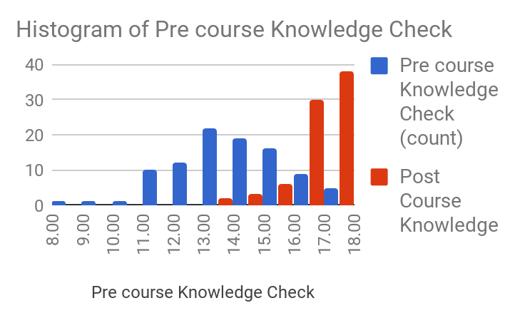
Objective #4: Generate evidence on training interdisciplinary teams of students
Notes:
This chart shows only trainings using 2nd edition Knowledge Check Average n=107* (fall 2015 student trainings used 1st ed which has different score cutoffs)
Pre Course: 13.6 (8-18, SD 1.9)
Post Course: 16.4 (13-18, SD 1.0)

Slide 15
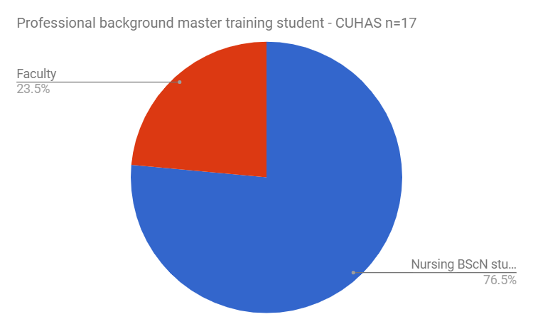
Sustainability through Outreach
Students have interest in sharing the model with others
HBB basic and master trainings conducted at CUHAS in 2017 led by HKMU student master trainers with faculty support
Notes:
Basic training 36 Nursing Students – Feb 2017
Master training 13 Nursing Students 4 Faculty– March 2017

Slide 16
Student Feedback
“It was well taught by the trainers, I enjoyed the simulation we were doing, also the knowledge I got, it's really helpful and applicable in our faculty”
“I liked how the knowledge/presentation was presented. It was simple and easy to understand. Few but very important information. I also liked the practical session trying out practically what we have learned makes learning easy and hard to forget. I also like the equipments for training particularly the baby doll and its heartbeats and breathing. High five to the trainers and their teamwork”
"I can use this skills in clinical practice for future.”
Notes:
“This training if possible should have a regular timetable periodically eg..like after every semester so as keep these skills at the fingertips of the participants!”

Slide 17
Faculty Feedback
It's a good training but I would advise refresher training to be done at least once per semester (to us teachers) after incorporating this program at our university.
Plan for more teaching to other staff even our nursing students.
I will appreciate if the training could be done to other staff in the labor wards, also students who are in their midwifery course to practise this procedure as they are the ones who are going to work and also the incharge in the rural areas whereby they will serve lives of the babies.

Slide 18
Timeline of Activities 2016/2017
September 2016
Master Training
Led by Aliasgar
October 2016
Formation of
HKMU-HBB
November 2016
Training of
GHSP Faculty
November 2016
Training 37
Med/Nursing
January
Training
GHSP IST
April 2017
Master training
14 MD/RN
Students
April 2017
MD4
Pediatrics
June 2017
Facutly
Training
June 2017
Diploma Nursing Student Training
Notes:
Description of activities and trainings
10 workshops to date at HKMU
Training for 4 GHSP faculty Fall 2016
2 Basic training workshops for 36 medical and nursing students and 1 Faculty member November 2016
Master training for 14 nursing /med students April 2016
4 Basic training workshops for 77 medical students in MD4 curriculum April 2017
Basic training of 10 nursing and med student faculty june 2017
Basic training of 20 Diploma Nursing Student training June 2017

Slide 19
Challenges
Maintenance of knowledge and skills
“mannequin maintenance” - self evaluation
Clarity and consistency of OSCE administration
Voluntary vs Required Sessions

Slide 20
Looking forward
Faculty leadership from HKMU and GHSP will continue, with Tanzanian faculty taking on a greater role as time goes on
Upcoming Curriculum Revision at HKMU:
Commitments from Faculties of Medicine 7 Nursing to incorporate HBB training into curriculum review
Additional Outreach: TAMSA training
Increased use of Skills Lab for skills maintenance

Slide 21
Conclusions
The objective of sustainability was a student goal from the outset
Sustainability requires planning
Master trainers were able to effectively teach their peers HBB skills
Faculty support is needed to guide students and ultimately integrate into the formal curriculum

Slide 22
Acknowledgement
JHPIEGO-Donated 10 mannequins and training materials for initiation of training
Ministry Of Health(TZ)-Donated extra manikins which increased the capacity of training
Seed & Global Health Partnership-Provided grant to facilitate trainings at HKMU and CUHAS-Mwanza
HKMU administration
Student Trainers

Slide 23
References
1. Wang H et al.. Global, regional, and national levels of neonatal, infant, and under-5 mortality 1980–2015: a systematic analysis for the Global Burden of Disease Study 2015. Lancet 2016; 388: 1725–74.’
2. Tanzania Demographic & Health survey 2015-2016 Dar es Salaam, Tanzania: National Bureau of statistics.
3. WHO global health observatory (http://www.who.int/gho/countries/tza.pdf?ua=1)
Wall SN et al. Neonatal resuscitation in low-resource settings: What, who, and how to overcome challenges to scale up? IntJ Gynecology & Obstetrics. October 2009, Vol. 107 Supplement
4. Msemo, G. et al. Newborn Mortality and Fresh Stillbirth Rates in Tanzania After HBB Training. Pediatrics (2013);131:e353–e360.

Slide 24
References
5. Wall SN et al. Neonatal resuscitation in low-resource settings: What, who, and how to overcome challenges to scale up? IntJ Gynecology & Obstetrics. October 2009, Vol. 107 Supplement
6. Singhal N, Lockyer J, Fidler H, et al. Helping Babies Breathe: global neonatal resuscitation program development and formative educational evaluation. Resuscitation.2012;83(1):90–96 pmid:21763669
7. American Academy of Pediatrics. Helping Babies Breathe. 2010 Available at www.helpingbabiesbreathe.org. Accessed October 11, 2016
8. Arlington, L et al. Implementation of “Helping Babies Breathe”: A 3-Year Experience in Tanzania. Pediatrics Apr 2017

Slide 25
Asanteni Sana!
Maswali?

