Slide 1
Updates in Insomnia Psychopharmacology
Scott Bragg, PharmD
JJ Benich, MD
John Freedy, MD, PhD

Slide 2
Disclosures
No financial disclosures to report!
No distressing or traumatic content, images, or activities will be discussed

Slide 3
Objectives
Recall 3 changes with the DSM-5 criteria on the diagnosis of insomnia
Apply non-pharmacologic treatments (e.g., sleep hygiene, CBT techniques) to patients
Identify 5 medications that can supplement first line non-pharmacologic treatment in insomnia

Slide 4
Audience Pre-assessment
Which of the following is not part of the DSM-5 criteria for insomnia?
Difficulty initiating or maintaining sleep or early-morning awakening that leads to dissatisfaction with sleep quantity or quality
Resulting sleep disturbance leads to impairment in social, occupational, educational, academic, behavioral, or other important areas of functioning, as well as causing significant distress
Patients experience this even with adequate opportunity to sleep, at least 1 night per week and for at least 1 month

Slide 5
Audience Pre-assessment
Preferred first-line therapy for insomnia?
Melatonin
Cognitive Behavioral Therapy
Zolpidem
Trazodone

Slide 6
Audience Pre-assessment
Which of the following is not part of a good
sleep hygiene routine?
Maintenance of regular bedtimes and rise times
Avoidance of alcohol before bedtime
Avoidance of caffeine in the afternoon
Take 1 to 2 naps during the day
Utilize relaxation techniques

Slide 7
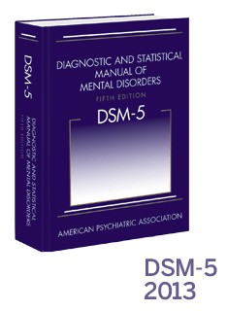
Diagnostic Changes With DSM-5
Sleep-wake disorders comprise 11 diagnostic groups:
Insomnia disorder
Hypersomnolence disorder
Narcolepsy
Obstructive sleep apnea hypopnea
Central sleep apnea
Sleep-related hypoventilation
Circadian rhythm sleep-wake disorders
Non–rapid eye movement (NREM) sleep arousal disorders
Nightmare disorder
Rapid eye movement (REM) sleep behavior disorder
Restless legs syndrome and substance-/medication-induced sleep disorder

Slide 8
Diagnostic Changes With DSM-5
Sleepwalking Disorder and Sleep Terror Disorder
Now categorized as Non-Rapid Eye Movement Sleep Arousal Disorders
DSM-IV group of Not Otherwise Specified Dyssomnias and Parasomnias
Diagnostic criteria now specified for:
1. Restless Legs Syndrome
2. Rapid Eye Movement Sleep Behavior Disorder

Slide 9
Diagnostic Changes With DSM-5
Insomnia Disorder
Sleep disorder related to another mental disorder and sleep disorder related to another medical condition have been removed
Co-morbid nature of insomnia
Treatment should address both insomnia and the medical disorder

Slide 10
Diagnostic Changes With DSM-5
Insomnia Disorder
Distinction between primary and secondary insomnia has been removed
Symptoms need to be present
At least 3 nights per week
At least 3 months

Slide 11
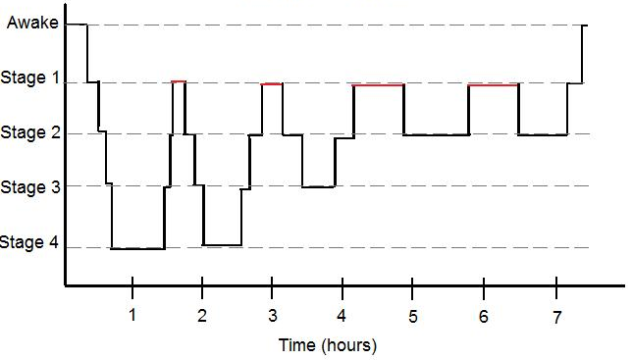
The Stages of Sleep

Slide 12
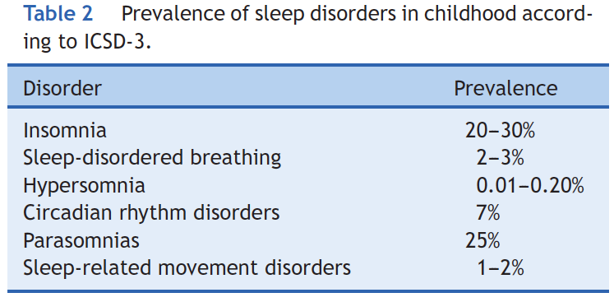
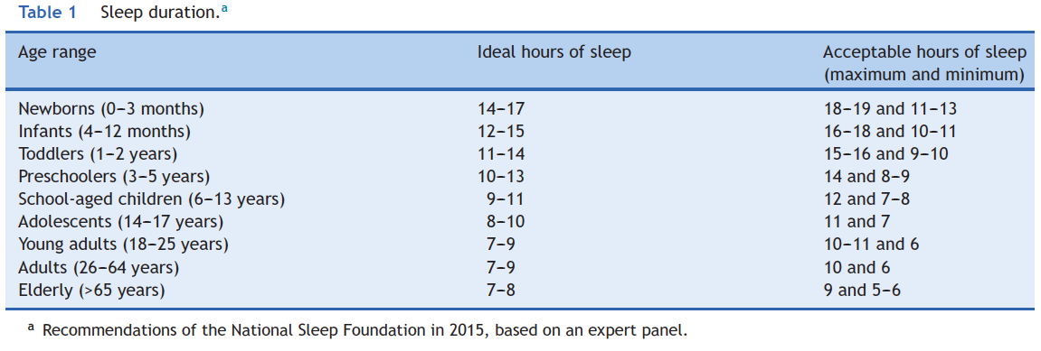
Typical Pediatric Sleep Patterns
Nunes ML, et al. J Pediatr (Rio J). 2015;91:S26–35.

Slide 13
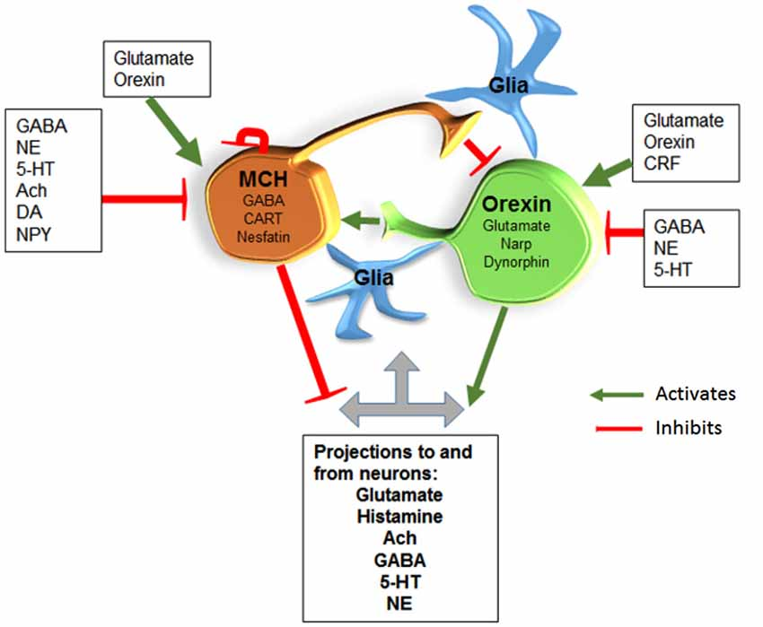
Photo Credit: Konadhode RR, et al. Frontiers in Systems Neuroscience. 2015;8:Article 244.
Notes:
melanin concentrating hormone=MCH
Orexin neurons are active in waking and quiescent in sleep, which is consistent with their role in promoting waking. On the other hand, the MCH neurons are quiet in waking but active in sleep, suggesting that they could initiate sleep.

Slide 14
Sleep Hygiene-Mainstay of Treatment
Environment comfortable and conducive to sleep
Avoid going to bed until drowsy/ready to sleep
Get out of bed if not asleep in 15–20 minutes
Consider sleep restriction
Relaxation training & paradoxical intention
Regular sleep schedule
Avoid daytime napping

Slide 15
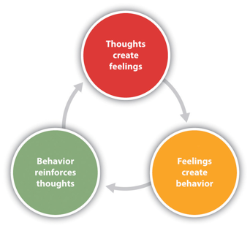
Sleep Hygiene–Mainstay of Treatment
Avoid: caffeine, nicotine, alcohol, & stimulants, but if using not within 6 hours of bed
Exercise regularly, > 4 hours before sleep
Use the bed for sleeping only
CBT (sleep diary, replace dysfunctional beliefs, stimulus control, sleep restriction, relaxation)

Slide 16
Other Co-morbidities to Manage
Obstructive sleep apnea
Avoid sedating meds if possible
Pain disorders
Mood disorders
Other conditions leading to disrupted sleep
(e.g., nocturia, stimulants, EtOH)

Slide 17
Discussion Interprofessional Care Team Roles

Slide 18
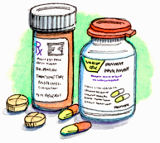
Insomnia Medication Options
Preferred options:
Non-benzodiazepine hypnotics: zolpidem, zaleplon
Melatonin or ramelteon
Other alternatives:
Antidepressants (e.g., doxepin, mirtazapine, trazodone)
Sedating antihistamines (e.g. diphenhydramine)
Orexin receptor antagonists (e.g., suvorexant)
Benzodiazepines

Slide 19
Overarching Concerns for Sleeping Pills
“Hangover” effect
Inducing parasomnia
Increased morbidity/mortality?
Specific side effects per drug
Proctor A, et al. ISRN Pharmacology 2012; Article 914168: 1-14.

Slide 20
Non-benzodiazepine hypnotics
Best options: zolpidem or zaleplon
More selective for α1 on GABA_{A} receptors
Decrease sleep latency by 42 minutes vs. 20 minutes with placebo
Subtle changes on sleep architecture
Concerns with parasomnias
(e.g., amnesia, risky behavior, sleep eating)
Huedo-Medina TB, et al. BMJ. 2012;345:e8343.

Slide 21
Safety Concerns with Zolpidem
Risk of next-morning impairment
Cautions:
Should not drive or do other activities requiring alertness after taking long-acting zolpidem (ER version)
Women max doses: 5 mg IR or 6.25 mg ER
Men max doses: 5 to 10 mg IR or 6.25 to 12.5 mg ER
FDA Drug Safety Communication. May 2013.
http://www.fda.gov/drugs/drugsafety/ucm352085.htm
Notes:
Driving simulation and laboratory studies recently submitted to FDA indicate that zolpidem blood levels above approximately 50 ng/mL appear capable of impairing driving to a degree that increases the risk of a motor vehicle accident. In pharmacokinetic trials of 10 mg Ambien (or bioequivalent zolpidem products) that included approximately 250 men and 250 women, about 15% of women and 3% of men had zolpidem concentrations that exceeded 50 ng/mL approximately 8 hours post-dosing. Three measurements in women and one in men were ≥90 ng/mL at about 8 hours after use.

Slide 22
Non-benzodiazepine hypnotics
Best long-term data (6–12 months)
Used between 3–7 days per week
No increased tolerance, dose escalation, rebound insomnia
Rare abuse and dependence
Possible stimulation, euphoria, & anxiolysis at high doses

Slide 23
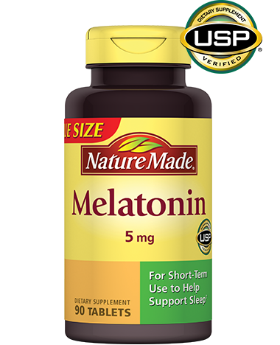
Melatonin and Ramelteon
Weak evidence for insomnia
Decreases sleep latency 7–10 minutes & increases total sleep time 8–10 minutes
Much better evidence for restoring circadian rhythms with shift work or jet lag (also for delirium)
Melatonin is probably a good alternative in the elderly considering its safety profile
Liu J, et al. Int J Clin Pract 2012;66(9):867-73.

Slide 24
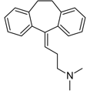
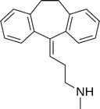
When Should We Use Antidepressants?
Options: doxepin, nortriptyline, mirtazapine, SSRIs
Mechanism: sedition via histamine receptor blockade initially, long-term improves mood disorder
Modest decreased sleep latency and increased total sleep
Goal is depression remission
Buscemi N, et al. J Gen Intern Med 2007;22(9):1335-50.

Slide 25
Doxepin (Silenor)
FDA approved for insomnia at 3 and 6 mg daily dose
Slightly increases total sleep time and decreases sleep latency
Mechanism is unclear, but thought to block histamine; doesn’t show tachyphylaxis like other antidepressants
Also available as 10 mg generic, but not FDA approved

Slide 26
Antihistamines
Only for short term (< 2 weeks)
Examples: diphenhydramine, chlorpheniramine, doxylamine, hydroxyzine
May reduce time sleep latency
Adverse effects: hangover effect, impaired cognition, delirium, anticholinergic effects, tachyphylaxis

Slide 27
Suvorexant (Belsomra)
Orexin receptor antagonist (blocks wake promotion)
Give within 30 minutes of bedtime, without food, & with at least 7 hours planned prior to awakening
Bad drug-drug interactions CYP3A4
Avoid CNS depressants (e.g., opioids,
cannabinoids, alcohol, zolpidem)

Slide 28
Suvorexant (Belsomra)
Contraindications: narcolepsy
Pre-cautions:
Behavior changes (e.g., amnesia, anxiety, hallucinations)
CNS depression
REM sleep changes (e.g., sleep paralysis, cataplexy)
Risky sleep activities (e.g., driving, cooking, eating, sex)
Depression
Abuse
Masters PA, et al. Ann Intern Med 2014;161(7):ITC1.

Slide 29
Benzodiazepines
Pros:
Reduce sleep latency by ~15 minutes
Increase total sleep time
Helps rhythmic movement disorders of sleep
Cons:
Decreased slow-wave & REM sleep, increased stage 2 sleep
Daytime somnolence, abuse, amnesia, poor coordination
Physical dependence (~15–40%)
Rebound insomnia & anxiety if stopping
Buscemi N, et al. J Gen Intern Med 2007;22(9):1335-50.
Proctor A, et al. ISRN Pharmacology 2012; Article 914168: 1-14.

Slide 30
Case Vignettes on Different Patients
For each case identify:
Non-pharmacologic interventions
Medication alternatives

Slide 31
Case Vignette Debrief

Slide 32
Questions
Contact info: Scott Bragg, PharmD
Medical University of South Carolina
braggsc@musc.edu

Slide 33
References
Asnis GM, Thomas M, Henderson MA. Pharmacotherapy Treatment Options For Insomnia: A Primer for Clinicians. Int J Mol Sci. 2016;17(50):1–11.
Benich JJ, Bragg SW, Freedy JR. Psychopharmacology in Primary Care Settings. Prim Care Clin Office Pract. 2016;43:327–340.
Khurshid, KA. Review of Changes in DSM-5 Sleep-Wake Disorders. Psychiatric Times. 2015;32(9):1-4.
Leger D, Partinen M, Hirshkowitz M, et al. Characteristics of Insomnia in a Primary Care Setting: EQUINOX Survey of 5293 Insomniacs for 10 Countries. Sleep Med. 2010;11(10):987–998.
Masters PA. In the Clinic. Insomnia. Ann Intern Med. 2014;161(7):ITC1–15.
Matheson E, Hainer BL. Insomnia: Pharmacologic Therapy. Am Fam Physician. 2017;96(1):29–35.
Schutte-Rodin S, Broch L, Buysse D, et al. Clinical Guideline for the Evaluation and Management of Chronic Insomnia in Adults. J Clin Sleep Med. 2008;(5):487–504.

