Slide 1
Bridging the Gap: How to balance differences between faculty and student expectations
Notes:
Rob

Slide 2
Disclosures None
Notes:
Rob

Slide 3
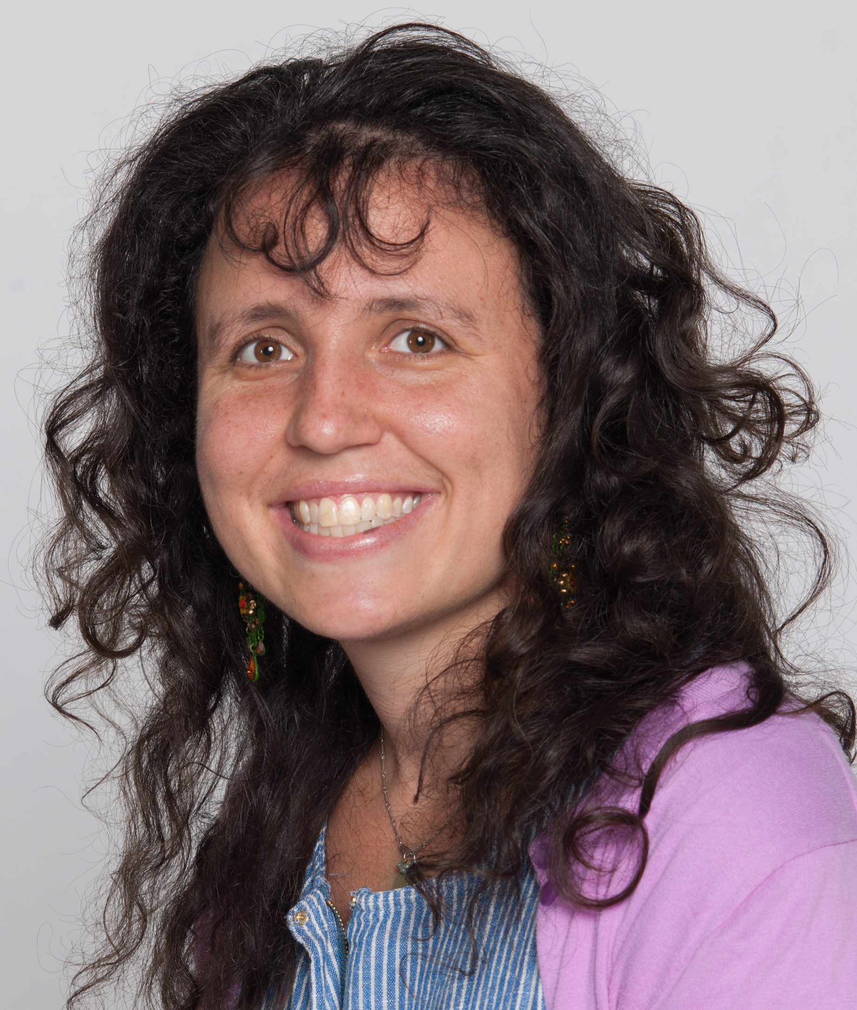
Our team
Joanna Drowos
jdrowos@health.fau.edu
Robert Hatch
hatch@ufl.edu
Suzanne Minor
seminor@fiu.edu
Celeste Rousseau
celesseau@ufl.edu
Daniel Rubin
rubind@ufl.edu
Sarah Stumbar
sstumbar@fiu.edu
Notes:
Rob

Slide 4
Objectives
1. List three examples of educational situations where students and faculty members may have different expectations.
2. More comfortably engage students in discussions about differences in expectations of educational settings.
3. List three approaches that can be used to bring the expectations of students and faculty members into closer alignment.
Notes:
Rob

Slide 5
The Situation – The Student Perspective
With Step 1 pass/fail, clerkship grades are even more critical for matching
Can I do well enough on the exam?
High weighting of shelf in grade de-emphasizes value of clinic
Few datapoints in determining grade
Quality control measures to standardize grading
Is bias influencing my experience or evaluation? (Gender, Race, Sexual Orientation)
Quality control in evaluators/clinical mentors
Sufficient follow through with students' concerns
Students' role in clinic
Notes:
Celeste

Slide 6
The Situation – Faculty Perspective
All learning is valuable
Training to be a physician
Variety of experience is valuable
Experiences you don’t enjoy are important learning opportunities
Learning doesn’t have to be formal
Sites are limited
You aren’t given a grade, you earn it.
Notes:
Suzie

Slide 7
Where is the divide?
Notes:
Joanna

Slide 8
What are other situations where expectations differ?
In the classroom?
At the bedside?
Professionalism?
Communication?
Notes:
Joanna

Slide 9
Strategies for bridging
Notes:
Sarah

Slide 10
Key Take Aways
Always another perspective – assume positive intent
Are you communicating your expectations clearly?
Check the other party’s understanding
Rule out unacceptable conditions
Pause. Get curious. Don’t Judge.
A conversation rather than email
Be willing to have a vulnerable conversation
Need accountability on faculty and student side
Notes:
Dan

Slide 11
References
Williams VN, Medina J, Medina A, Clifton S. Bridging the Millennial Generation Expectation Gap: Perspectives and Strategies for Physician and Interprofessional Faculty. Am J Med Sci. 2017;353(2):109-115.
Marjorie Wenrich, Molly B. Jackson, Albert J. Scherpbier, Ineke H. Wolfhagen, Paul G. Ramsey & Erika A. Goldstein (2010) Ready or not? Expectations of faculty and medical students for clinical skills preparation for clerkships, Medical Education Online, 15:1, DOI: 10.3402/meo.v15i0.5295
Yeager KA, Bauer-Wu S. Cultural humility: Essential foundation for clinical researchers. Appl Nurs Res. 2014; 26(4) https://www.ncbi.nlm.nih.gov/pmc/articles/PMC3834043/#R31

Slide 12
Thank you!
Evaluation
Please be sure to complete an evaluation for this presentation.

