Slide 1
Integrating Pharmacists Into Quality-Improvement Efforts Within Residency Programs
Scott Bragg, PharmD
Morgan Rhodes, PharmD
Mark Humphrey, MD
Lori Mor, PharmD
Kathryn Rice, PharmD

Slide 2
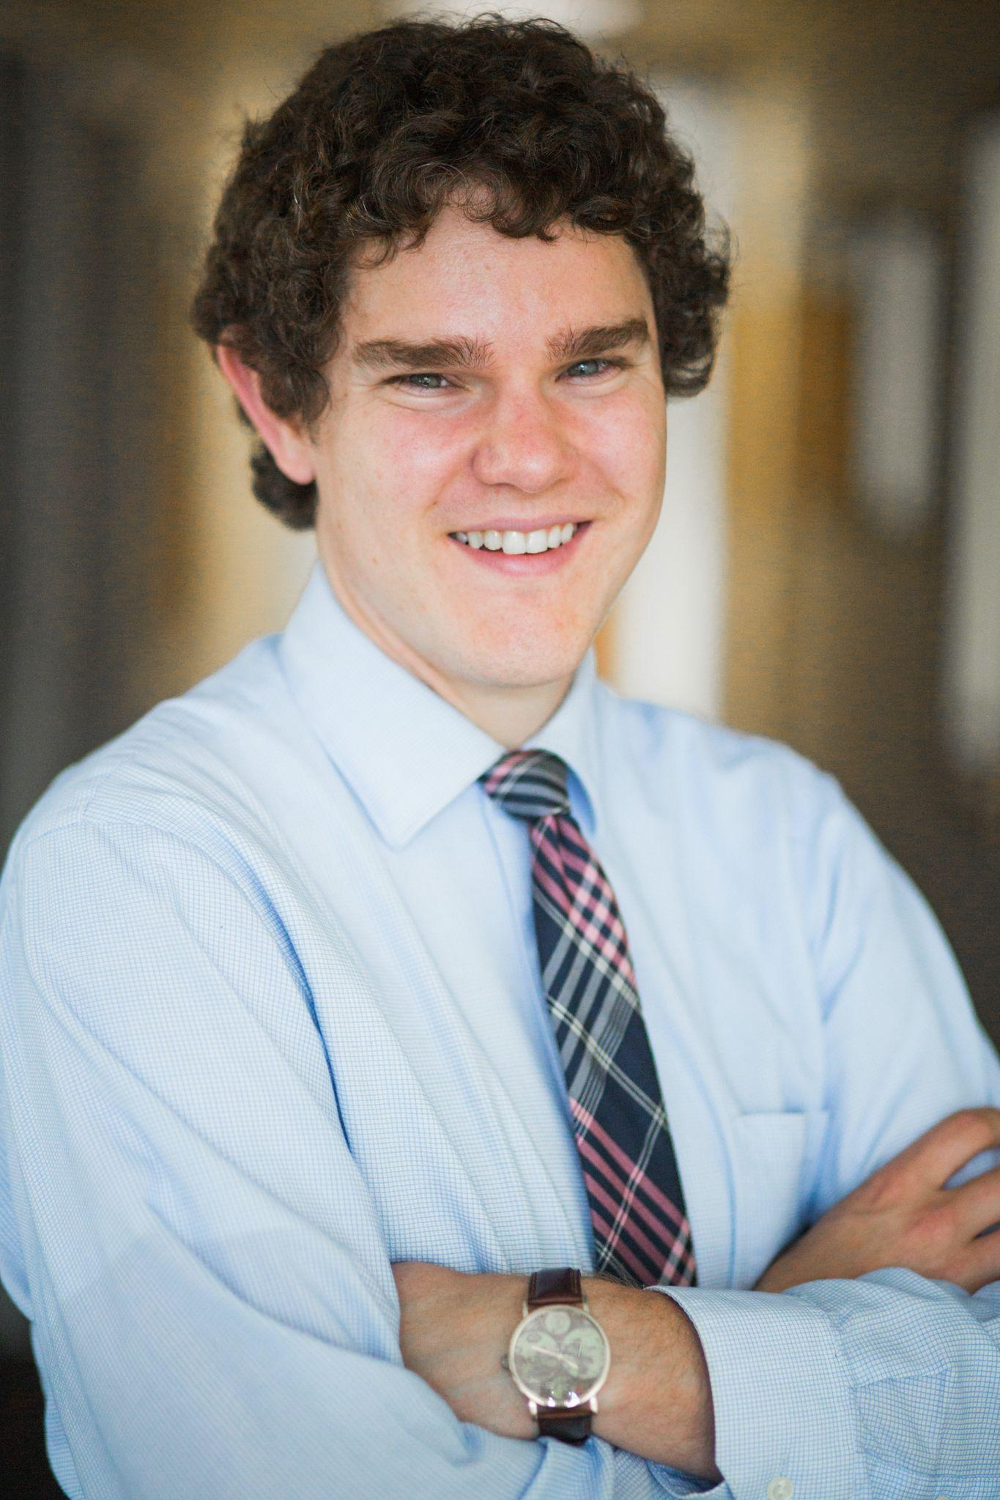
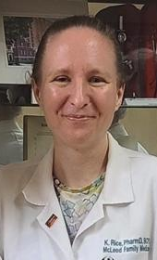
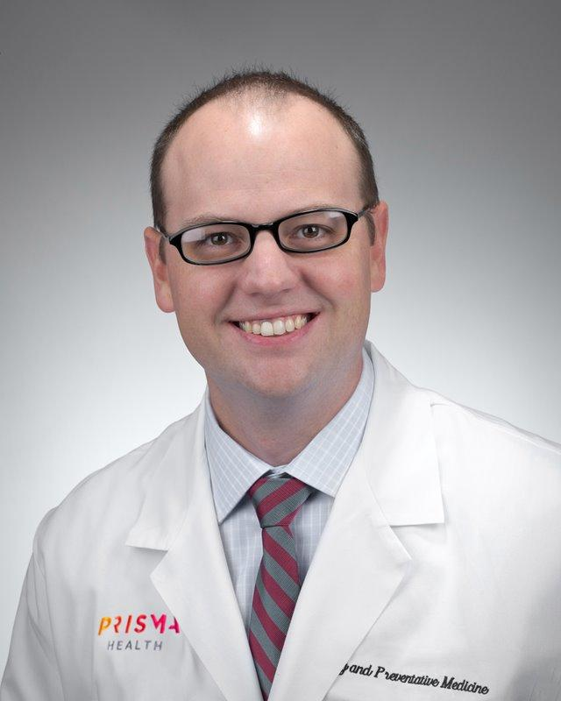
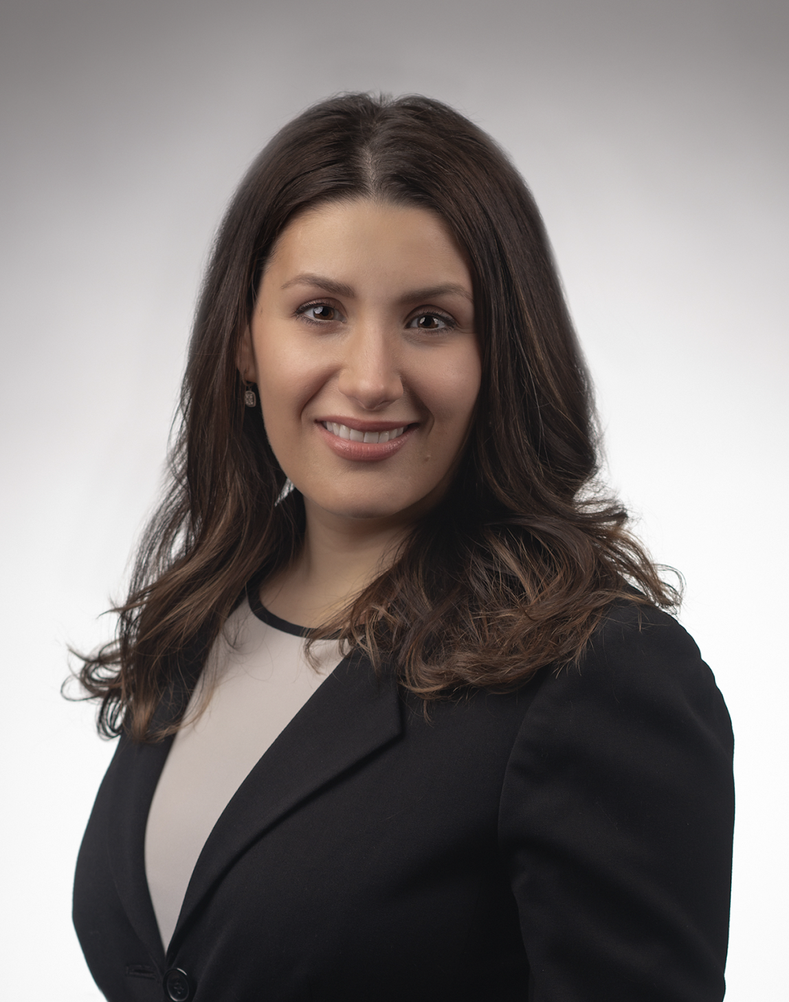
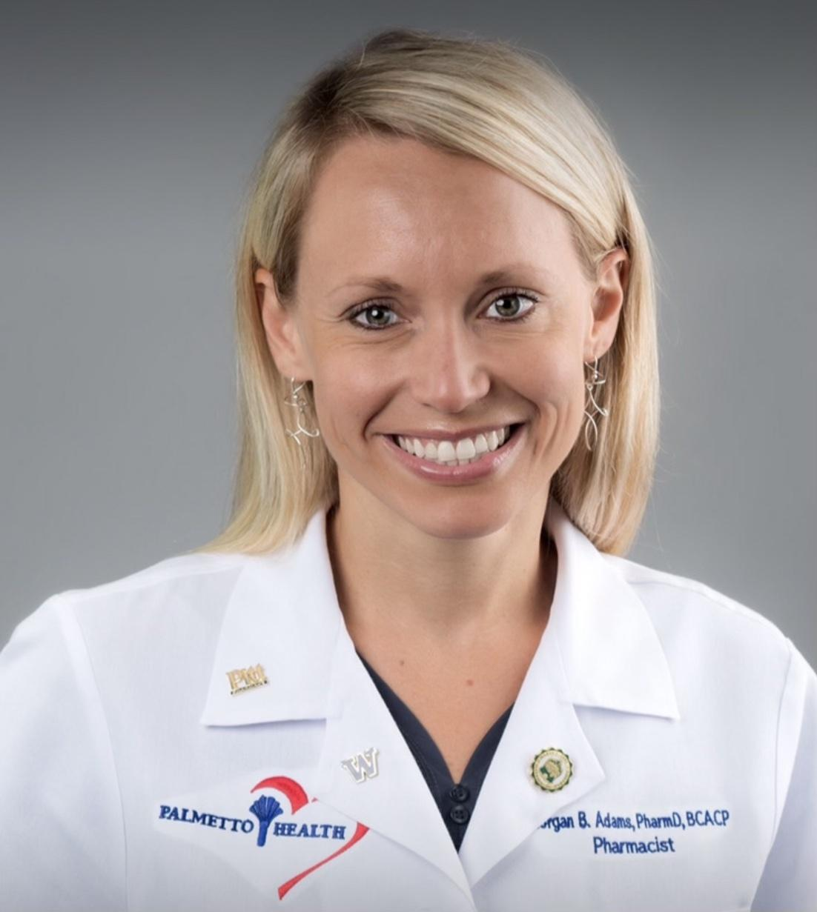
Presenter Introductions
Scott Bragg, PharmD
Medical University of South Carolina
Family Medicine Residency
Kathryn Rice, PharmD, BCPS
McLeod Family Medicine, Florence
Lori Mor, PharmD, BCPS
Prisma Health Midlands-Sumter Family Medicine Residency Program
Morgan Rhodes, PharmD, BCACP
Mark Humphrey, MD, MPH
Prisma Health Midlands- Columbia/UofSC

Slide 3
Objectives
Describe the roles that pharmacists can fill within quality improvement initiatives
Discuss the benefits of pharmacists collaborating in regional learning collaboratives
Identify opportunities to integrate pharmacists and other members of the multidisciplinary team into quality improvement teams

Slide 4
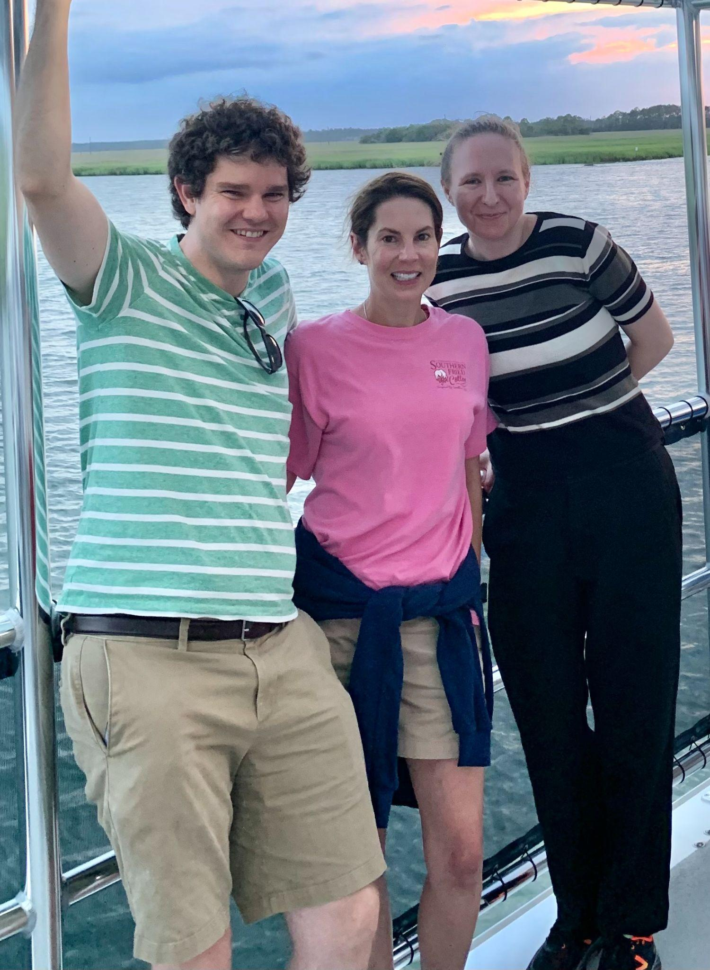
History of the Group
Pharmacist faculty often a QI champion within residency programs
Established an online question based curriculum in the early 2000s
Supported local efforts to contribute to the I3 learning collaborative
Provided support to FM residencies and South Carolina AHEC to improve QI projects and training
Notes:
Kelly

Slide 5
Funding and Roles within South Carolina AHEC
Funding/Support:
SC AHEC focuses >50% of their budget on FM residencies
Supports our annual meeting and conference presentations
Provides LMS to host curricula
Assists with meeting group goals
Pharmacist Roles:
Support other FM pharmacists establishing their practice
Maintain teaching curricula with focus on EBM and teaching QI
Serve as CE speakers
Judge annual AHEC QI symposium

Slide 6
Pharmacist QI Roles at MUSC
Teach QI skills to residents (e.g., population health, healthcare reimbursement, presenting QI projects/data)
Collaborate with faculty/residents on regional meetings at I3
Coach residents on creating a project and building a team
Lead efforts to publish QI projects (e.g., starting/refining new curricula, conducting retrospective reviews)

Slide 7
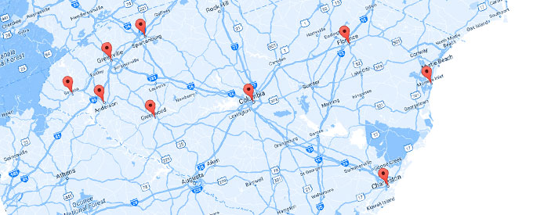
Maintaining a Pharmacist Learning Collaborative
Establish funding source (e.g., South Carolina AHEC)
Support new family medicine teachers
Recognize mutual challenges/opportunities
Identify group goals

Slide 8
Prisma/USC Columbia
Curriculum component | Physician Role | Pharmacist Role
Intern longitudinal project | Co-lead Develop project ideas Provide background on IHI Model for Improvement
Scholarly project | Serve as a project mentor | Provide oversight of the scholarly process Assist with project development and IRB submission (including data acquisition and CITI training) Schedule regular project updates as well as final presentations for the department Review posters and presentations for local, state, and national meetings
Quality team | Participate in weekly multidisciplinary quality team meetings for clinic Engage learners in quality metric and aim statement discussions
Notes:
Scott

Slide 9
Prisma/USC Columbia
Curriculum component | Physician Role | Pharmacist Role
Medical student project | Co-lead Develop project ideas Provide background on IHI Model for Improvement
ABFM QI | Provide instructions to residents | –
Panel management | Provide instructions to residents | –

Slide 10
Prisma/USC Columbia
Benefits of a learning collaborative
Provides a forum to discuss issues affecting local area
Allows for collaborative quality improvement projects and clinical services (e.g. continuous glucose monitoring, etc)
Provides a mechanism for collaborative scholarly work
Keys to success
Program support
Shared common goals (curriculum, QI, etc)

Slide 11
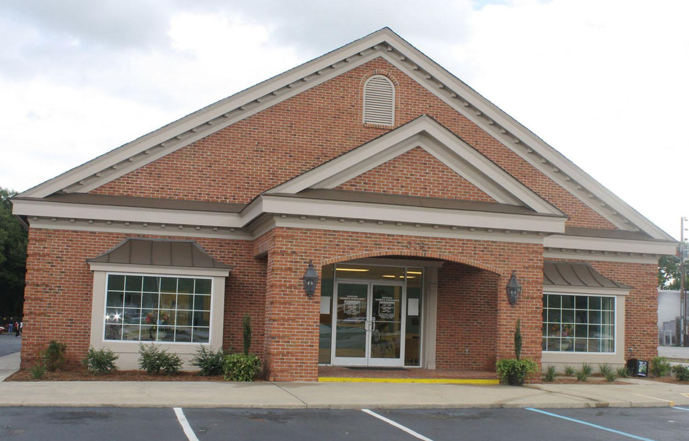
Prisma/USC Sumter
Tandem Health Partnership
Federally Qualified Health Center (FQHC)
Located in Sumter County
Provides opportunity for comprehensive healthcare within a medical home regardless of ability to pay
Serve as a site for longitudinal patient care and resident quality projects
Notes:
Scott

Slide 12
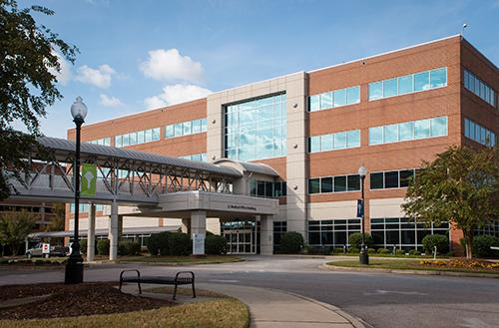
Prisma/USC Sumter
Quality Improvement
Create curriculum
Earn Basic Certificate in Quality and Safety through IHI
Teach and enforce quality improvement concepts
Develop and coordinate project ideas
Assist abstract submission and publication
Serve as a mentor
Submit to ABFM
Research
Expand research curriculum
Coordinate IRB efforts
Assist abstract submission and publication
Notes:
Scott

Slide 13
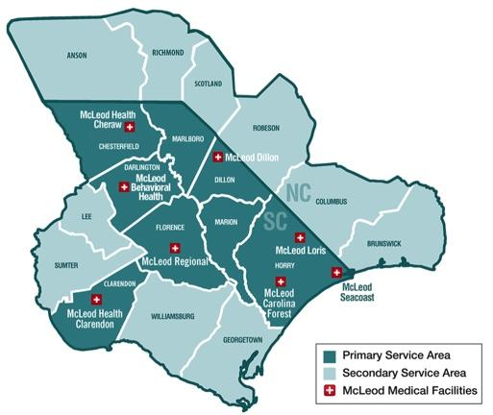
McLeod Regional Medical Center
McLeod Family Medicine Residency expanded from its program to the following rural sites:
Cheraw, SC
Manning, SC
Pharmacist involvement in extending curriculum to rural residency sites
Dr. Kelly Jones (trained in Family Medicine) teaches outpatient pharmacotherapy at each site
Dr. Kathryn Rice (trained in Internal Medicine) teaches inpatient pharmacotherapy at each site
Group presentations/topics discussions for all sites

Slide 14
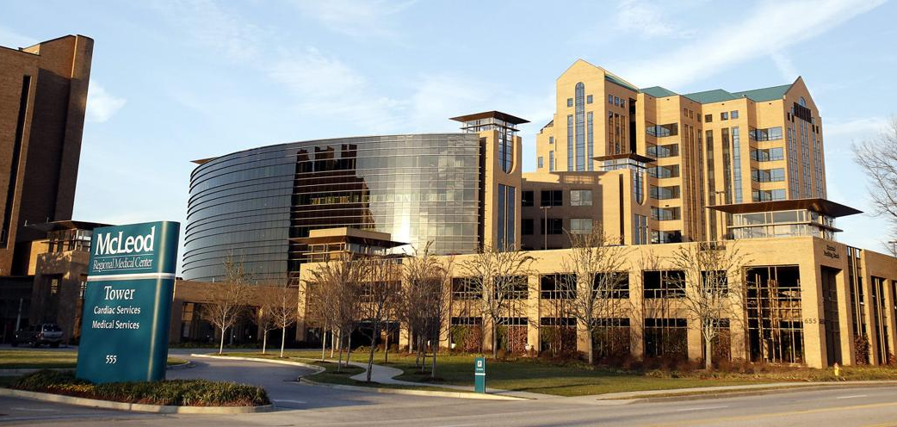
McLeod Regional Medical Center
Evidence Based Medicine curriculum for PGY2 residents
Residents taught how to read and analyze studies and clinical guidelines
Curriculum helps residents in understanding the design limitations of a QI project
Practice Based Learning and Improvement (PBLI) pharmacist involvement:
Leadership role in directing PBLI projects in the core program and rural sites
Develop project manual in conjunction with clinical psychologist
Participate in meetings to coach residents in QI design
Facilitate problem solving during project meetings

Slide 15
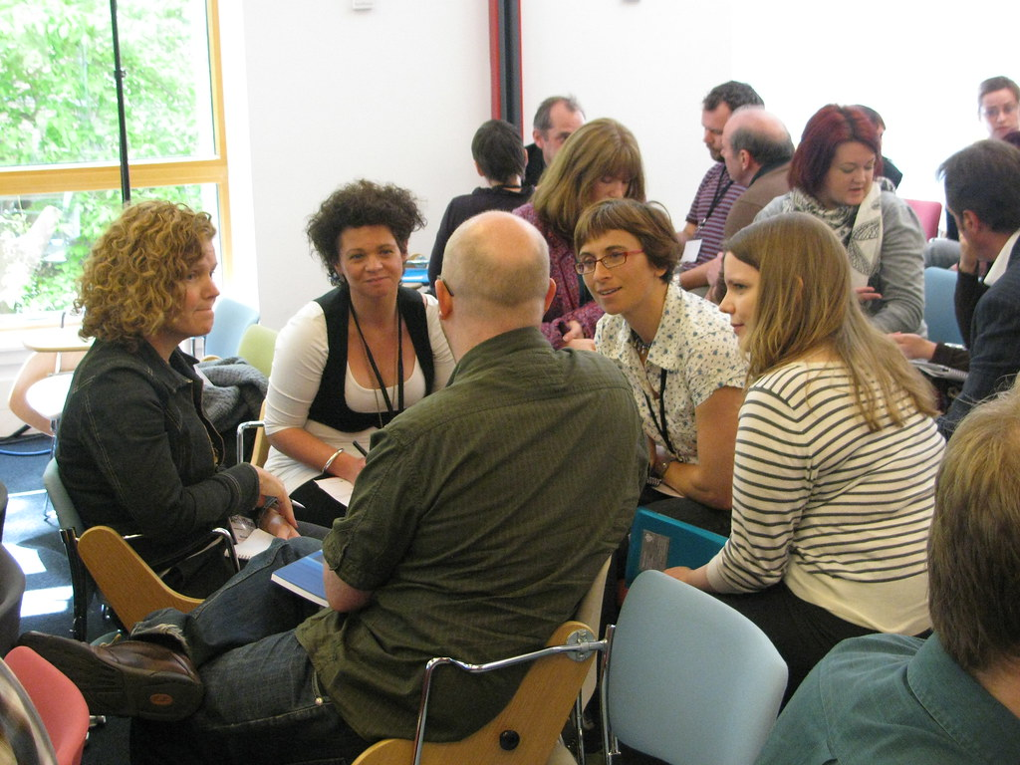
Small Group Discussion
Break into groups of 6–8
Discuss these 3 prompts over 10–15 minutes:
Identify how a pharmacist can help residency practices meet new program requirements from the ACGME
Develop strategies to build & sustain a regional learning collaborative
Highlight opportunities to increase pharmacist engagement with QI efforts at an audience member's respective program

Slide 16
Large Group Debrief
Each group share 1 take home point from small groups
What barriers exist to pharmacist and interprofessional QI integration and how are you addressing these barriers?
What resources are available to create regional learning collaboratives?
Notes:
Resources that may be discussed: STFM and their pilot of structuring regional learning collaborative networks thru a grant with the ABFM, STFM collaboratives, each state’s AHEC, state AAFP chapters, and established research networks (e.g., I3, WWAMI Practice and Research Network, Primary Care Practice-Based Research Networks).

Slide 17
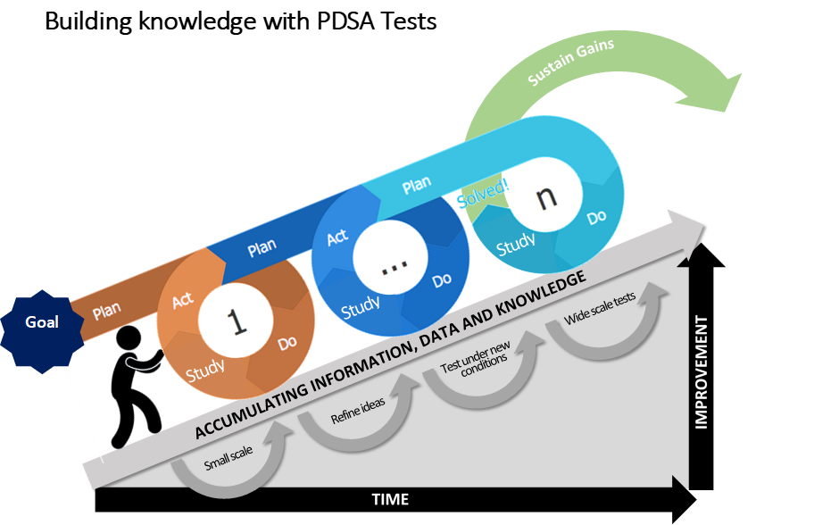
Benefits of Including a Pharmacist on Your Team
Collaborate with QI teaching efforts
Support QI innovation
Reduce the burden on faculty and residents
Different skill sets (e.g., data analysis, writing support, program admin)
Work in positions where scholarship is expected

Slide 18
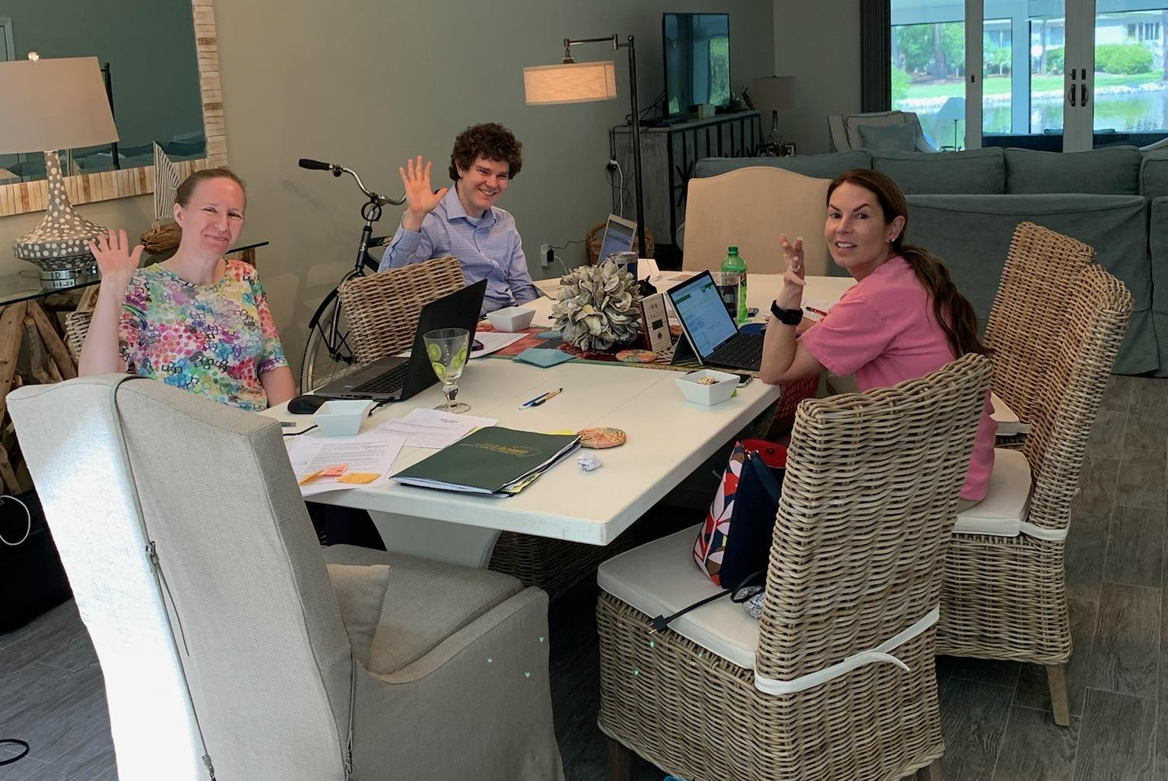
Our Keys to Working in a Learning Collaborative
Strong local buy-in with each program and champion
Central administration support (e.g., AHEC, STFM)
Consistent funding source
Regular meetings
Similar group goals
Scholarly outputs

Slide 19
Questions
Scott Bragg, PharmD
Email: braggsc@musc.edu

