Slide 1
Pre-matriculation Exposure to Pharmaceutical Marketing: Too much, too soon?
University of Washington School of Medicine
Office of Rural Programs
Dave Evans, MD
Toby Keys, MPH
Sharon Dobie, MD, MPH
Mark Ryan, MD
David Satin, MD
Jaime Fitch

Slide 2
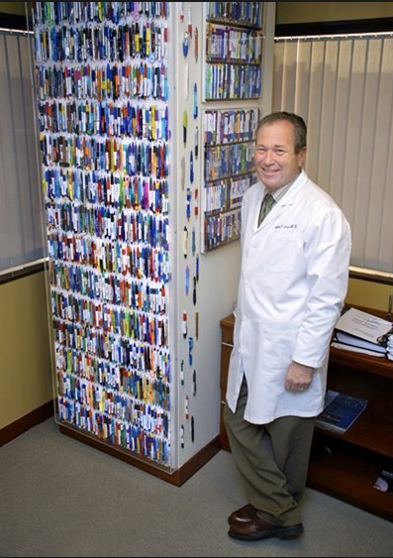
Disclosures
STFM Foundation Group Project Fund

Slide 3
Objectives
Review of current literature on the physician/pharmaceutical industry relationship to medical education
Provide preliminary data on marketing exposure of pre-matriculated medical students
Discuss the context in which it occurs.
Brainstorm the implications of early exposure to pharmaceutical marketing and how medical educators should mitigate its impact.

Slide 4
Notes:
Medical students are frequently exposed to Pharma marketing
Pharma marketing has been demonstrated to influence clinical decision making in ways that deviate from best practices
Little is know about pharmacuetical market exposure among pre-matriculated medical students
- single study from midwest
-prelim data from UW

Slide 5
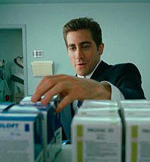
Methods
Survey developed based on previous literature
Received IRB Approval
All public medical schools were contacted and invited to participate

Slide 6
Methods
From June to August of 2017 participating institutions sent the online survey to students who accepted admission to their medical school
Participants were surveyed about the types of pharmaceutical marketing they observed or received and where this marketing took place.

Slide 7
Results Demographics
13 Public Medical Schools
911 pre-matriculated students completed the survey
43% female; 47% male
Mean age: 24.25 yrs
Age range: 21-44 yrs

Slide 8
Participating Schools

Slide 9
Exposure Type by % of Student Respondents Observing Someone Receiving It and Receiving It Themselves (N=911)

Slide 12
Discussion
Significant numbers of pre-matriculated medical students are being exposed to pharmaceutical marketing
The most common exposure (54%) was during shadowing experiences.
Premedical associations may be one way to educate pre-matriculated medical students about pharmaceutical marketing

Slide 13
QUESTIONS

