Slide 1
Technician to Teacher: Bridging the Gap between “Health” and “Care”
A Patient’s Perspective

Slide 2
Disclosures

Slide 3
October 2008
aortic dissection, C – section, CT Scan, airlifted to Vidant, open -heart surgery
April 2009
diagnosed with Loeys – Dietz Syndrome
June 2009
CT scan reveals 6.2 cm aneurysm near top of descending aorta
March 2010
aortic stent placed in arch
October 2009
valve – sparing aortic root replacement via 3rd open – heart surgery
July 2009
descending aortic replacement via thoracoabdominal incision
April 2010
voice implant to repair severed vocal cord
The Aftermath
Patient & Family Advisor
Notes:
…. NIGHTMARES .... ……. JOINED PATIENT ADVISORY COUNCIL

Slide 4
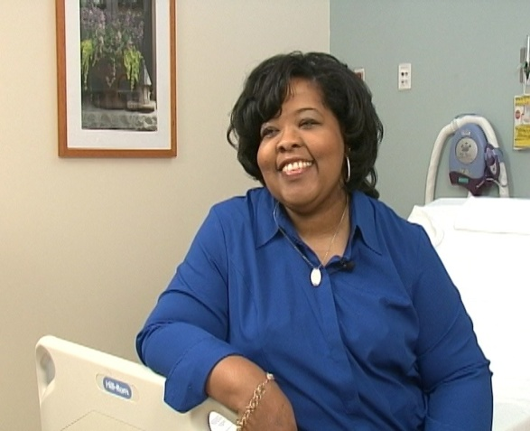
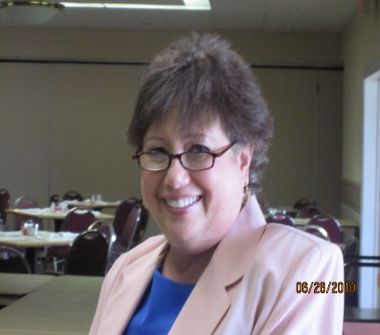
What is a Patient and Family Advisor?
Former patients and families of patients who partner with healthcare
providers to improve care
“from the bedside to the boardroom!”

Slide 5
Objectives:
1. How do we bridge the gap between technicians and teachers in the world of healthcare?
2. How can we build a “culture of engagement” and leverage it to improve quality?
3. Why should we care about the work of patient collaboration now more than ever?

Slide 6
Are YOU a Technician or a Teacher?

Slide 7
“As I look at the entering classes below me, my peers and even those residents and young attendings ahead of me, I find fewer and fewer people who exemplify the characteristics of both a successful physician and a true student of the human condition. We have virtually unlimited access to the most intimate and pivotal moments in the lives of essentially complete strangers. We get to witness the beginnings and ends of lives, the receipt of life-changing news, and the long-term trajectories of both slow recovery and rapid decline. We should, perhaps even more so than sociologists, psychologists and anthropologists, be the ultimate scholars of humanity. Yet, doctors, and residents in particular, are so overworked that they rarely stop to observe the world they exist in, to reflect on it and to share their reflections with others or even just with themselves.”
Amanda King, Yale School of Medicine
“The Dangerous Devolution of Physicians into Technicians”
http://in-training.org/dangerous-devolution-physicians-technicians-10730
Notes:
Consider that Medicine is where Science meets Humanity.

Slide 8
What is Patient and Family Engagement?
“Patients, families, their representatives, and health professionals working in ACTIVE partnership at various levels across the health care system to improve health and health care.”

Slide 9
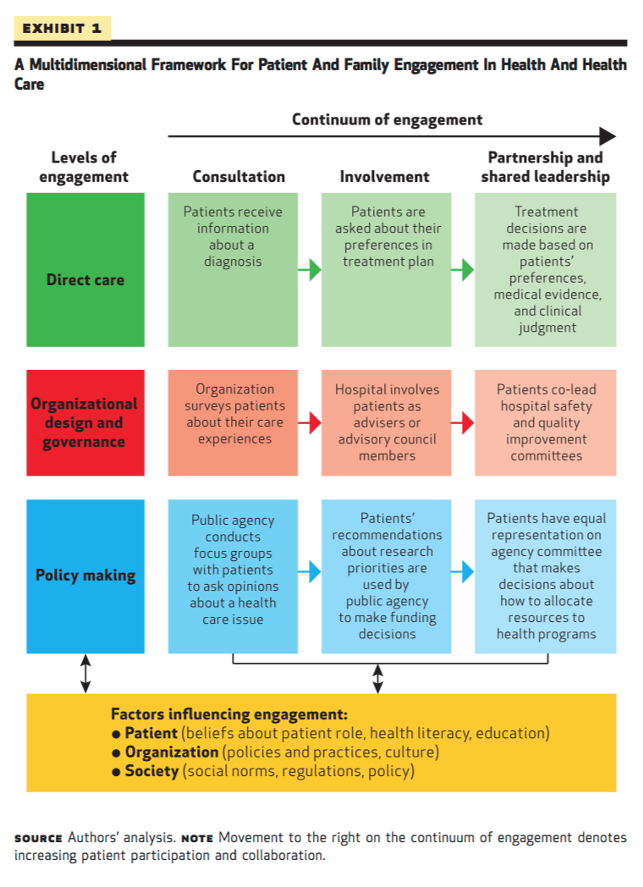
“A Multidimensional Framework for Patient and Family Engagement in Health and Health Care”
Source: Kristin L. Carman, Pam Dardess, Maureen Maurer, Shoshanna Sofaer, Karen Adams, Christine Bechtel and Jennifer Sweeney Patient And Family Engagement: A Framework For Understanding The Elements And Developing Interventions And Policies Health Affairs, 32, no.2 (2013):223-231 doi: 10.1377/hlthaff.2012.1133

Slide 10
Build a Culture of Engagement
Cultivate Compassion
”Empathy is the gateway to compassion. It’s understanding how someone feels and trying to imagine how that might feel for you – it’s a mode of relating. Compassion takes it further. It’s feeling what that person is feeling, holding it, accepting it and taking some kind of action.”
Lori Chandler
“the big think”

Slide 11
Build a Culture of Engagement
Empathy is a MINDFUL emotion.
Compassion is NOT a binary concept.
Compassion is CONTAGIOUS.
2. Communicate
LISTEN: without interrupting and without technological barriers.
Be mindful of non-verbal cues.
Speak like you care …. BECAUSE you care.

Slide 12
Build a Culture of Engagement
3. Collaborate
Inter-professional Teams and Appointments
Shared Decision Making
Family Presence
4. Coordinate (and Navigate)
Take off your “Healthcare Hat.”
Embrace the Darkness.
Guide patients through the land mines.

Slide 13
Build a Culture of Engagement
5. Educate
Embrace your Apple!
Include caretakers and key learners.
Empower patients to ENGAGE.
Make LEARNING a part of your culture at EVERY level.
LEARN while you listen.
TEACH while you talk.
Whatever it takes! (Health Educators, Navigators …. )

Slide 14
Build a System of Engagement WITH Patients
1. Organizational Design and Governance
2. Measures and Research
3. Policy

Slide 15
Medical Education
Provider Training: Role - Play, Shadowing
Staff Education
Peer Educators
Community Educators
Patient & Family Advisors
Education
Safety
Rounding
Facility Design
Literature Review
Quality & Performance Improvement Teams
System Input
Patient Information, Communication & Transparency
Storytelling
Huddles
Board Presentations
Employee Orientations
Videos
Conferences
Staff Meetings
Community Groups
Safety Rounds
Safety Coaches
Safety Event Analysis
Patient Portal
Software & Platform
Design Public Transparency
Unit Rounds
HCAHPS Focused Rounds
Leadership Rounds
Strategic Drill Downs
Unit Based Work Groups
HCAHPS Drill Downs
HAI Groups (CLABSI, Falls …)
Board of Directors
Hiring Committees
Strategic Planning
Vendor Selection
Patient Rooms
Exam Rooms
Waiting Rooms
Family Facilities
Notes:
Lots of PE work has been done in hospitals around the country. Few places have made significant advances in outpatient settings however. The Next Frontier = Ambulatory Care

Slide 16
Build a SYSTEM of Engagement WITH Patients
2. Measures and Research
3. Policy
Are our lawmakers “patient” enough?
Set a place for patients while you set the table.
Caretakers for Congress!

Slide 17
Are YOU a Technician or a Teacher?
“It’s like they were mechanics, and you were a machine. I couldn’t make them see that you were more than that. … You were my wife.
My Husband

Slide 18
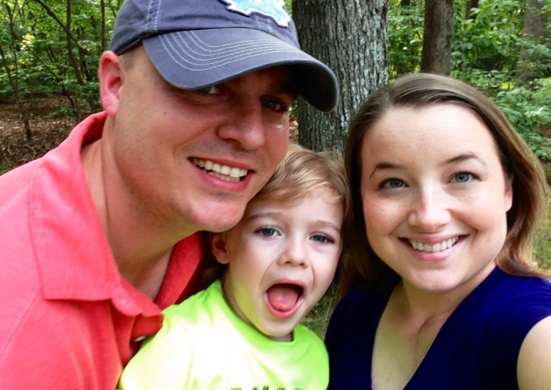
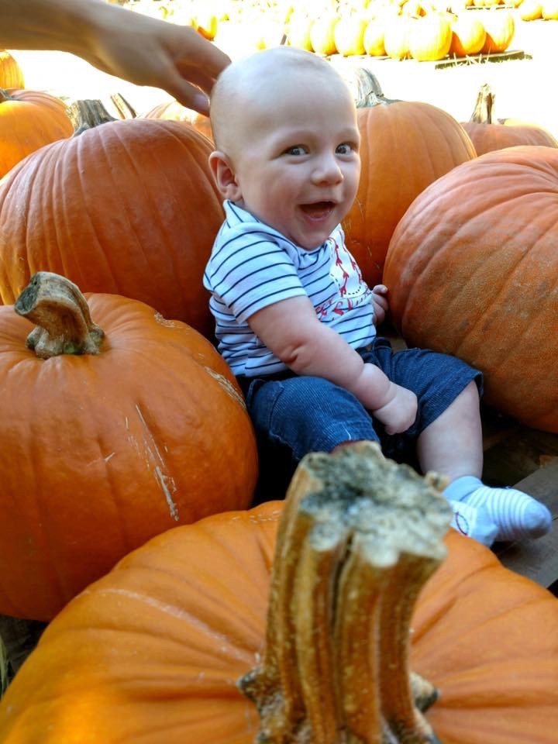
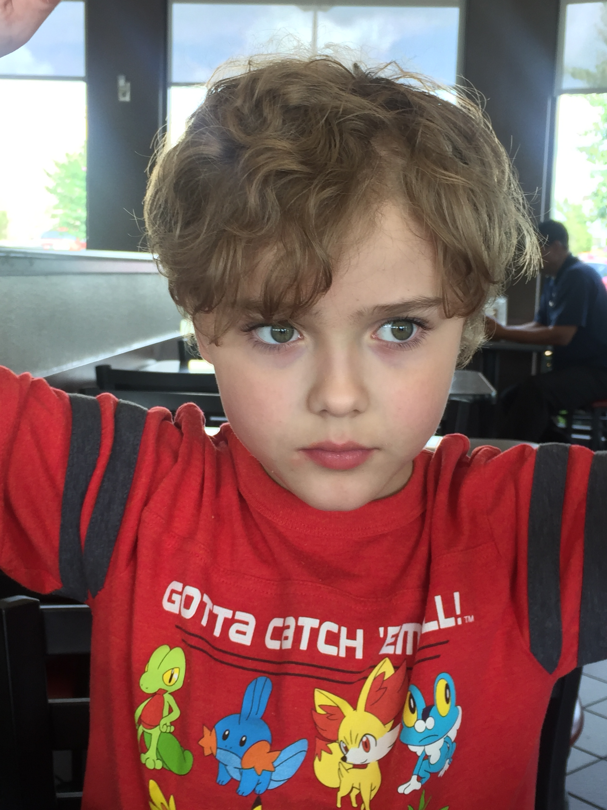
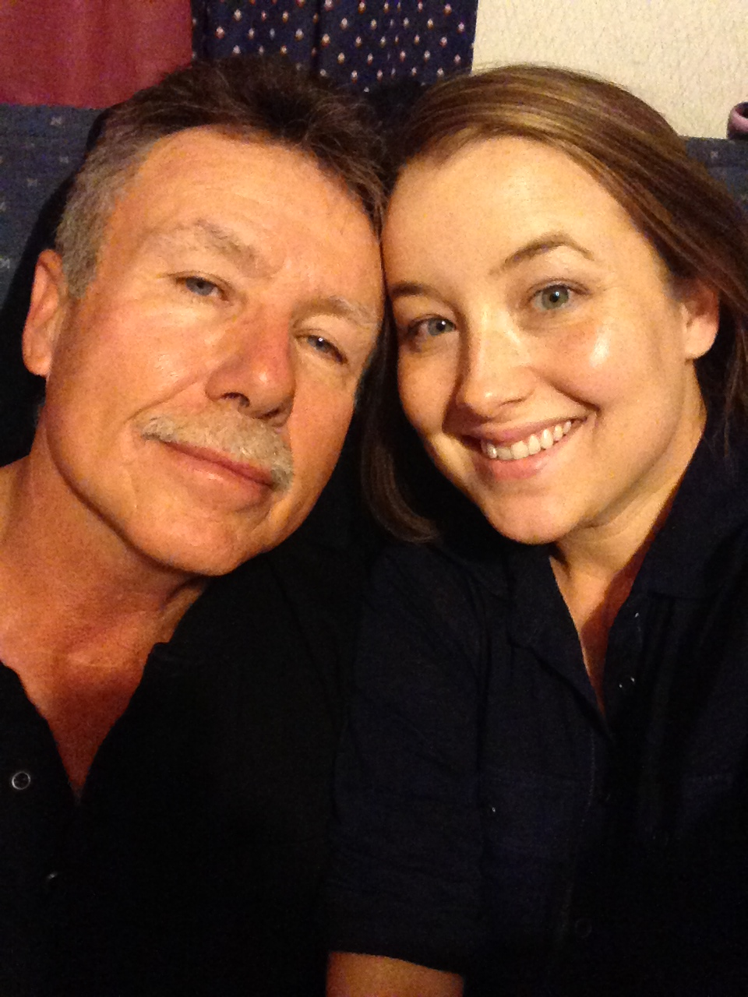
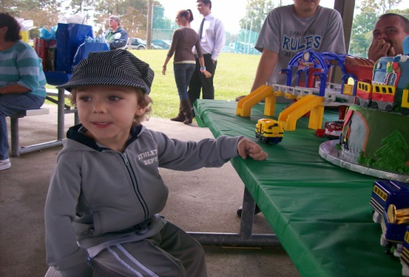
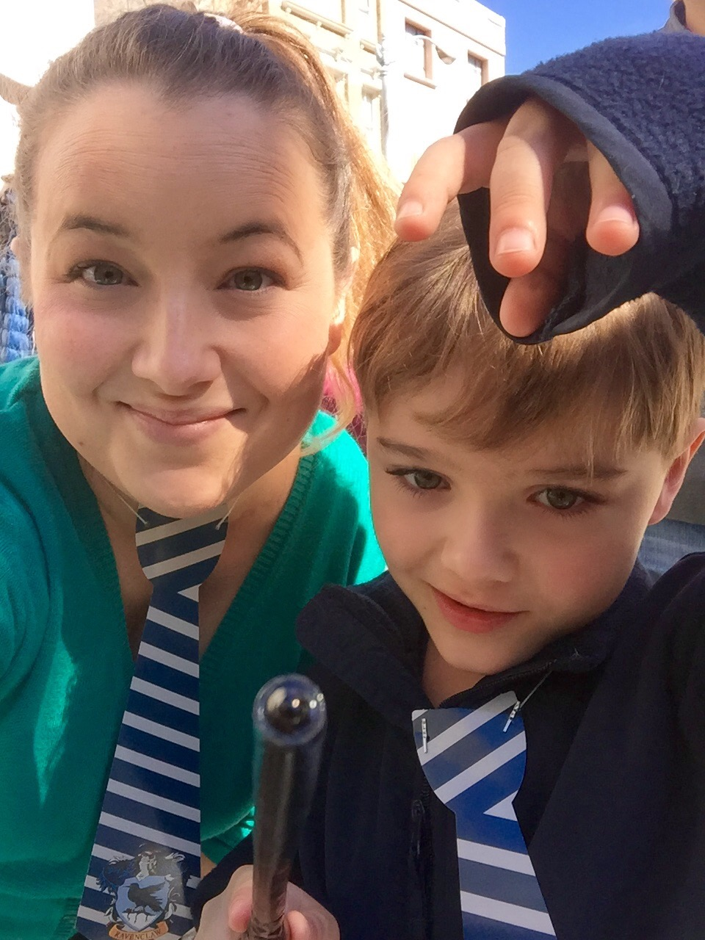
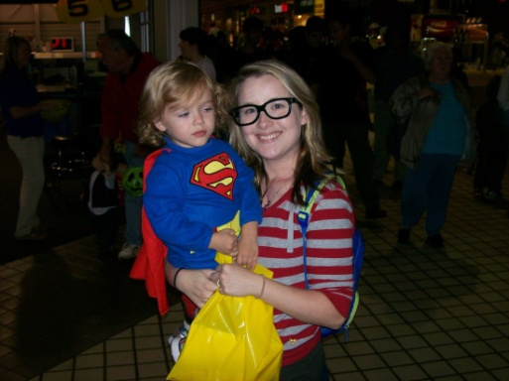
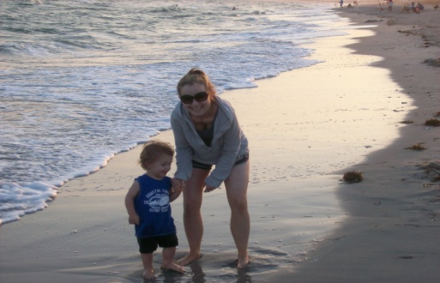
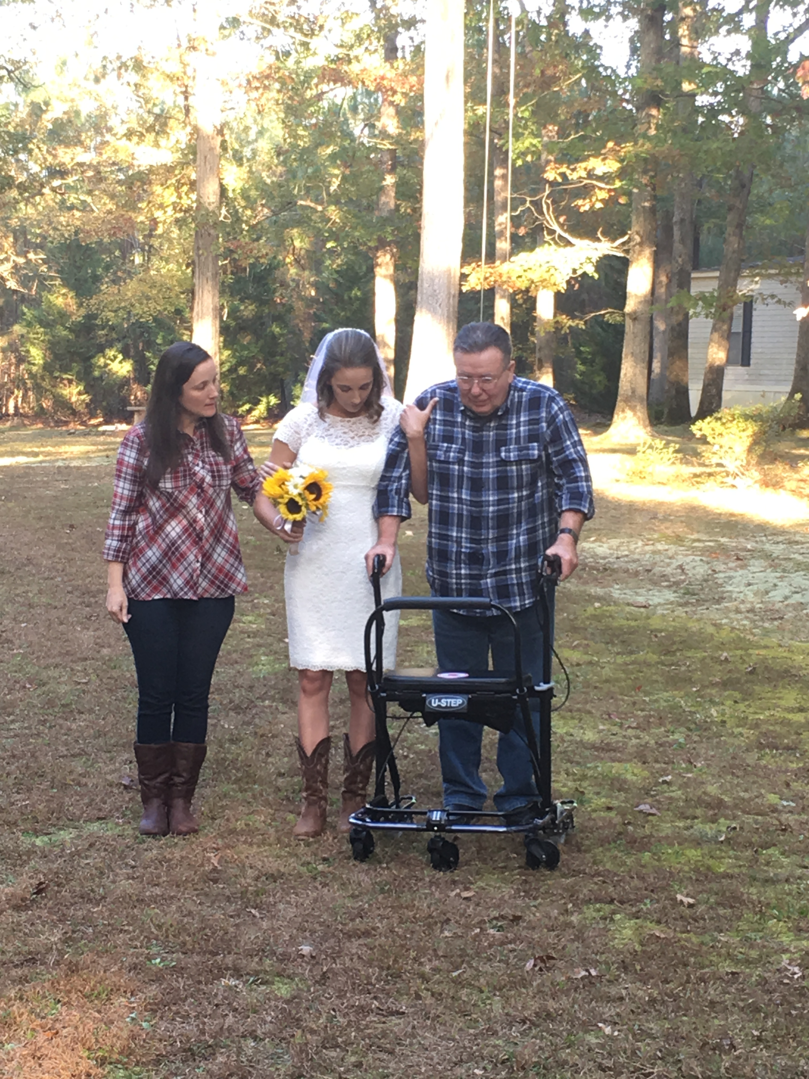
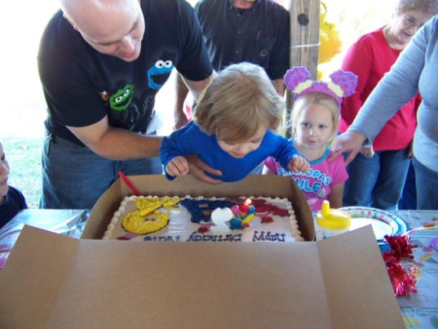
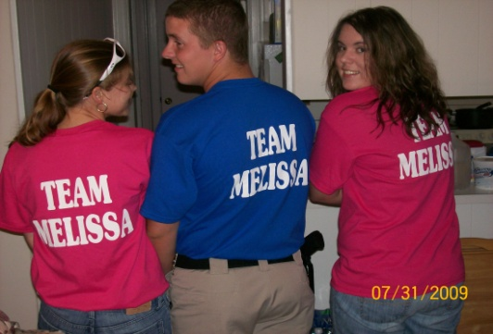
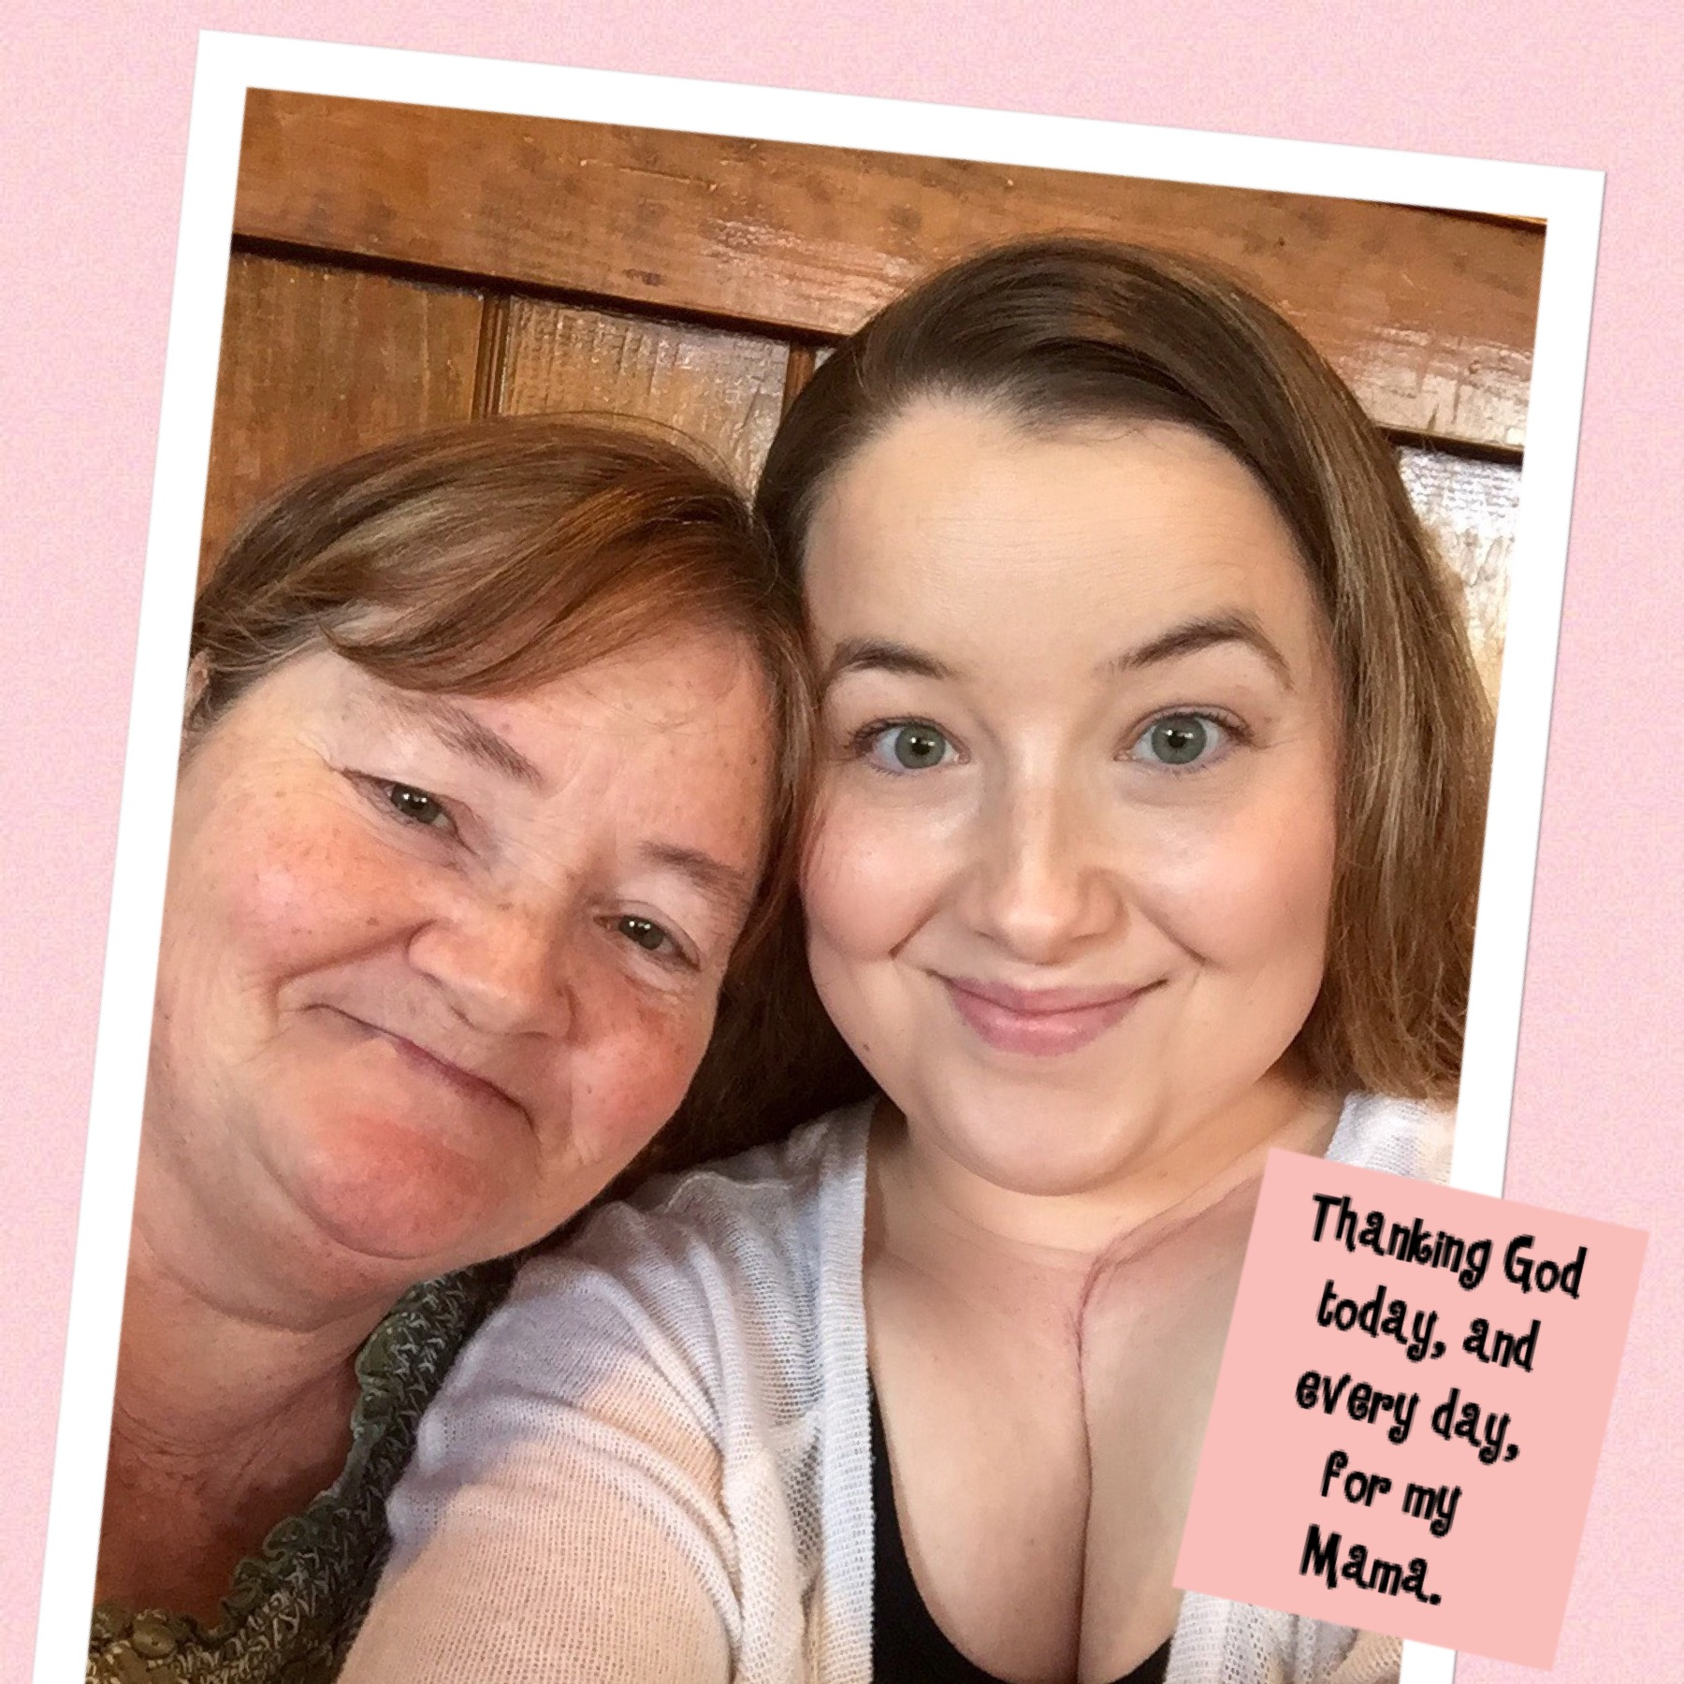
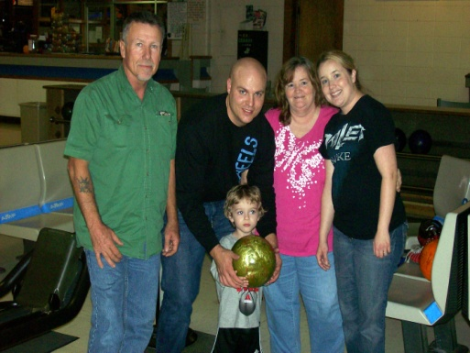
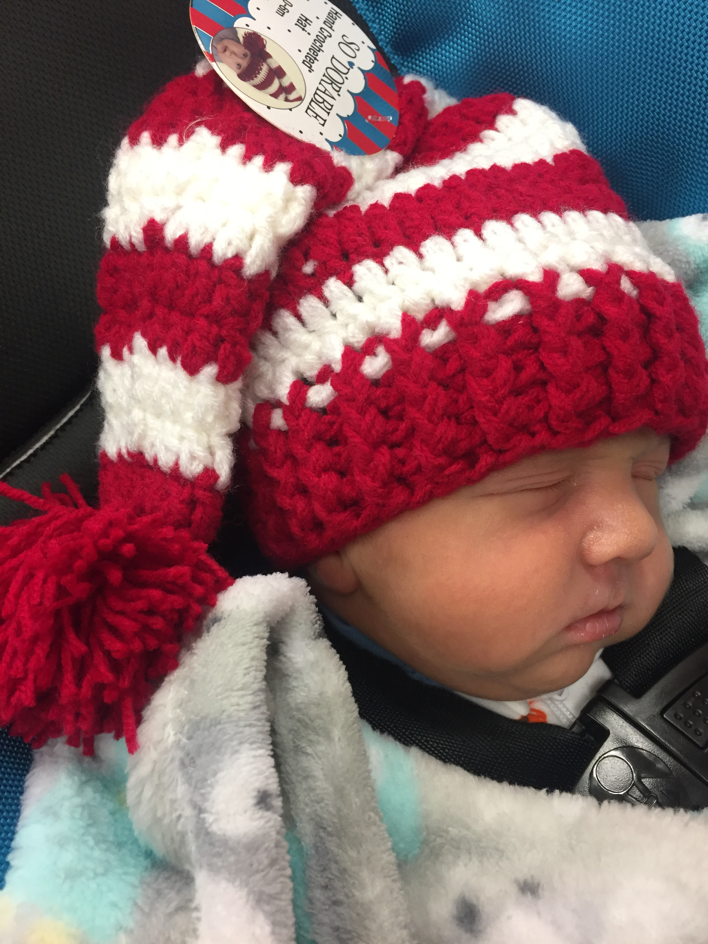

Slide 19
Thank You!
Melissa Thomason
Patient and Family Advisor
melissataylorthomason@gmail.com

