Slide 1
Improving Resident Precepting with OB Reference Algorithms
Patrick Huffer MD
Ronni Hayon MD
Univ. of WI Madison
Dept. of Family Medicine and Community Health

Slide 2
Disclosures
We have no financial or relevant conflicts of interest.

Slide 3
Objectives
Introduce our Obstetrical Reference Algorithms
Demonstrate how the algorithms can be used in clinic, especially by preceptors no longer practicing OB
Share data on efficacy of this tool

Slide 4
Background
Family medicine educators often asked to precept residents on topics with which they are unfamiliar
Examples:
OMT
Procedures
OB
Standards of care and patient safety must be ensured

Slide 5
What are the OB Reference Algorithms?
Designed to be used like ASCCP Pap Smear guidelines
Distill major recommendations of ACOG OB Practice Bulletins and Committee Opinions
Easily-referenced, quick answers for commonly-encountered topics

Slide 6
Implementation
Cards reviewed by OB colleagues for accuracy and input
5 pilot topics introduced to our 4 residency clinics:
Anemia
Thyroid Disease
Hypertensive disorders of pregnancy
Gestational Diabetes
Herpes Simplex Virus

Slide 7
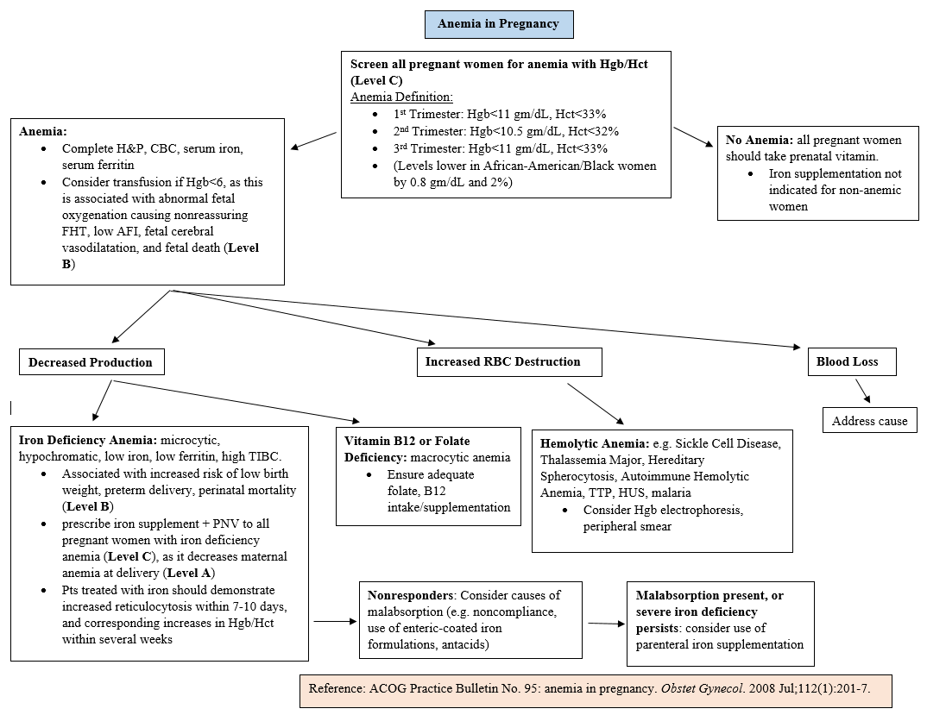

Slide 8
Analysis
Efficacy studied with Pre- and Post-implementation survey (Qualtrics)
Notes:
Pre- and Post-test means/standard deviations compared with one sample paired t-test and McNemar’s test for paired dichotomous data

Slide 9
Survey Responses
Pre-survey 45 Respondents 12 OB Faculty 6 Non-OB Faculty 1 Fellow practicing OB 1 Fellow not practicing OB 5 PGY-1 8 PGY-2 10 PGY-3 2 APPs | Post-survey 15 Respondents 7 OB Faculty 1 Non-OB Faculty 1 Fellow practicing OB 0 Fellows not practicing OB 1 PGY-1 2 PGY-2 2 PGY-3 0 APPs

Slide 10
Survey Responses
11 respondents completed both Pre- and Post-surveys
7 OB faculty
1 Non-OB faculty
1 Fellow practicing OB
1 PGY-2
1 PGY-3

Slide 11
Confidence Levels
Anemia: for each trimester, I know at what threshold Hgb/Hct I should initiate iron supplementation or further workup for cause of anemia.
Gestational Diabetes: I know when it is appropriate to initiate pharmacotherapy (insulin or oral agents).
Thyroid Disease: in pregnant women with preexisting hypothyroidism, I know how to adjust their levothyroxine dose at the onset of pregnancy.
Herpes Simplex: I know at what gestational age to initiate prophylactic antiviral therapy for genital HSV suppression during pregnancy.
Gestational Hypertension: I know when to schedule induction for women with uncomplicated gestational hypertension.

Slide 12
For each question:
Likert scale:
5=completely confident
4=very confident
3=slightly confident
2=slightly unconfident
1=very unconfident
0=no confidence at all

Slide 13
Notes:
Statistics based on the 11 people who completed both pre- and post-surveys

Slide 14
Results
Anemia: for pregnant patients during the 1st trimester, iron supplementation should be started at what Hemoglobin threshold? Hgb<11,<10.2 g/dL in African-American/Black patients
Gestational Diabetes: in patients with GDM, when is it appropriate to initiate pharmacotherapy (insulin or oral agents)? After a trial of diet and exercise therapy has failed
Thyroid Disease: which of the following statements is correct for pregnant women with preexisting hypothyroidism? Levothyroxine dose should be increased by 25% at diagnosis of pregnancy
Herpes Simplex: in pregnant women with genital herpes, when should antiviral therapy be started for suppression of outbreaks? At 36 weeks GA
Gestational Hypertension: when should induction of labor be scheduled for pregnant women with uncomplicated gestational HTN? At 37 weeks GA
Notes:
These are the multiple choice questions respondents were asked to answer. Correct answer in bold.

Slide 15
*p<0.05
(N=11)
Notes:
Data based on the 11 people who responded to both pre- and post-surveys.
Talking points: the majority of respondents were OB-practicing faculty, and even among faculty there is a significant number who are not following guidelines for the questions we asked (e.g. when to start iron supplementation or induce for gestational HTN)

Slide 16
Subgroup analysis
Wide diversity in % correct responses by training level
Example: Hypertension
Notes:
the following chart reflects all 45 pre-survey respondents and 15 post-survey respondents

Slide 17
Notes:
Reflects all 45 pre-survey respondents and all 15 post-survey respondents

Slide 19
How helpful are the OB Reference Algorithms?
Avg: 2.92
1=not helpful at all; does not contain information I need
2=slightly helpful; some information is there, but I still need to look up details
3=very helpful; most of the information I need is there, and I rarely need to turn to other sources

Slide 20
How efficient are the OB Reference Algorithms?
Avg: 2.92
1=not efficient at all; they slow me down
2=slightly efficient; faster to use them than another source
3=very efficient; they dramatically save me time

Slide 21
Length/Detail of the OB Reference Algorithms?
Avg: 2.0
1=too long/too detailed
2=just right
3=too short/not enough information

Slide 22
How do the OB Reference Algorithms perform as a tool for effective medical precepting and teaching?
Avg: 2.83
1=not an effective teaching tool at all
2=slightly effective teaching tool
3=very effective teaching tool

Slide 23
Qualitative Feedback
“Excellent resources. I have found that residents are not consistently aware that they exist.”
“I have seen them and they are great. I just haven't used them during clinic. I'm not sure where they are at our clinic. It may help to make them a vibrant color (like neon green or orange so they are easy to find).”

Slide 24
Qualitative Feedback
“This information is SUPER helpful for me as an R1 - I've completed my inpatient OB experience but haven't started seeing OB patients in clinic yet. I know this will come in handy when I have questions that need to be answered quickly in clinic.”

Slide 25
Future Directions
Expand list of topics
Development of an App for ease of use
Challenges:
keeping topics up to date
National guidelines vs. local practices

Slide 26
References
1. ACOG Practice Bulletin No. 95: Anemia in pregnancy. Obstet Gynecol. 2008 Jul;112(1):201-7.
2. ACOG Practice Bulletin No. 137: Gestational diabetes mellitus. Obstet Gynecol. 2013 Aug;122(2 Pt 1):406-16.
3. ACOG Practice Bulletin No. 82: Management of herpes in pregnancy. Obstet Gynecol. 2007 Jun;109(6):1489-98.
4. ACOG Practice Bulletin No. 148: Thyroid disease in pregnancy. Obstet Gynecol. 2015 Apr;125(4):996-1005.
5. ACOG Task Force on Hypertension in Pregnancy. Hypertension in pregnancy. Report of the American College of Obstetricians and Gynecologists’ Task Force on Hypertension in Pregnancy. Obstet Gynecol 2013; 122:1122.
6. Fuller PD, et al. Residency preceptor development and evaluation: a new approach. Am J Health Syst Pharm. 2013 Sep 15;70(18):1605-8

Slide 27
Please evaluate this presentation using the conference mobile app! Simply click on the "clipboard" icon on the presentation page.

