Slide 1
Evaluation of Antimicrobial Prescribing Patterns at a Referral Hospital in Rural Tanzania
Presenter: Matthew S. Haldeman, MD
Authors: Megan Seddon, PharmD; Anthony Sangare, MD; Peter Kishimbo, MD
Davance Mwosomola, B.Pharm; Jeff Hall, MD; Mark Shaffer, MD;
P. Brandon Bookstaver, PharmD; Antony Nsojo, MD
September 13, 2018

Slide 2
Learning Objectives
The participants will be able to describe current antibiotic utilization patterns in the inpatient setting in Tanzania, and how they may be contributing to the development of antibiotic resistance
The participants will be able to characterize current barriers to optimal inpatient antibiotic utilization in Tanzania
The participants will be able to recognize potential areas of improvement and discuss possible future interventions to optimize inpatient antibiotic use in Tanzania

Slide 3
Financial Disclosures
None to report

Slide 4
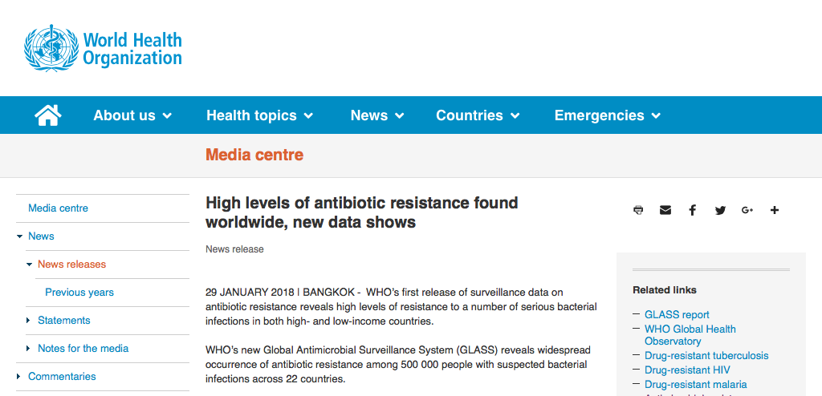
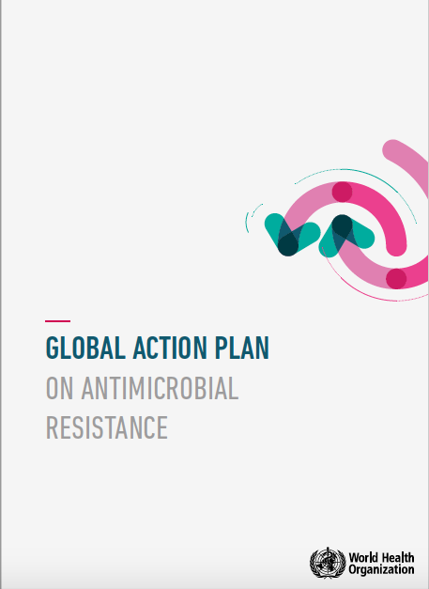
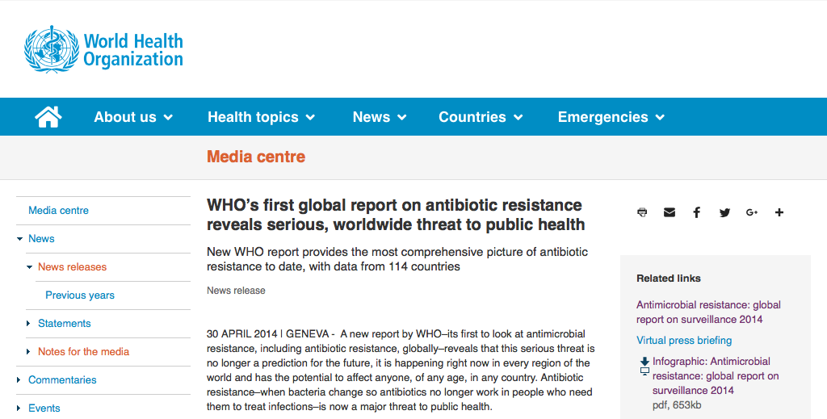
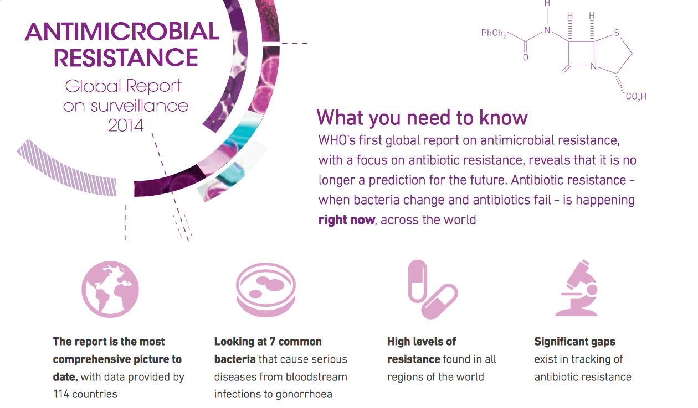
Background: The Problem

Slide 5
Background: AMR in Tanzania
LMICs: May bear a greater burden of AMR¹
Sub-Saharan Africa: AMR is a growing threat, but stewardship efforts are minimal²
Tanzania:
High rates of resistance in E. coli and Klebsiella and high rates of ESBL-producing bacteria³
Rising rates of resistance of gram-negatives to 3rd-generation cephalosporins⁴
Increasing resistance of gram-negatives to TMP/SMX^{5,6}
But: empiric antibiotic recommendations for LMICs are often based on data from high-income countries, which have differing patterns of resistance⁶
Thus: AMR surveillance and antibiotic stewardship efforts needed to develop local recommendations in LMICs

Slide 6
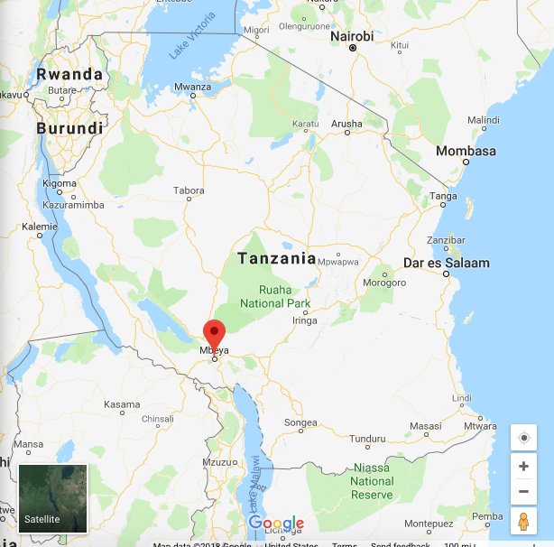
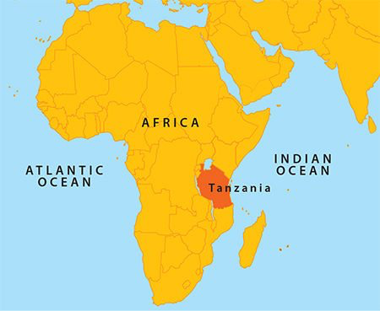
Background: Study Site

Slide 7
Background: Study Site Mbeya Zonal Referral Hospital (MZRH)

Slide 8
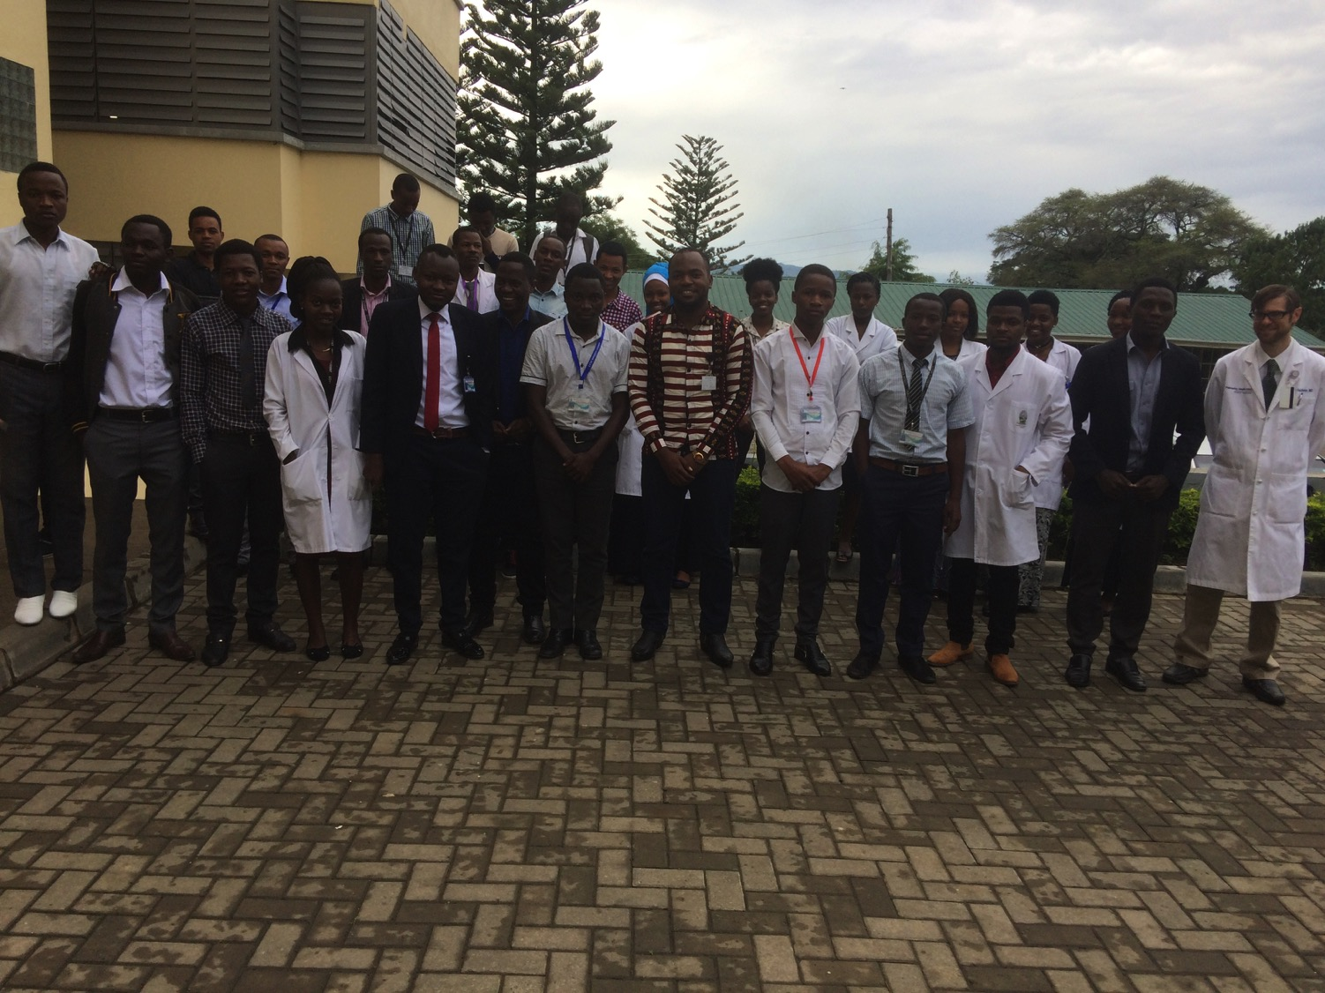
Background: Study Site University of Dar es Salaam College of Allied Health Sciences

Slide 9
Purpose of the Study
The purpose of our study was to evaluate current inpatient antibiotic prescribing habits at MZRH, analyze their potential contribution to local antimicrobial resistance, and assess barriers to optimal antibiotic therapy, which may be used to enhance stewardship efforts in the future.

Slide 10
Methods: Chart Review
2 main components: Chart Review and Clinician Survey
Chart review
Starting January 1st, 2018: charts reviewed chronologically by date of admission
If insufficient data: assigned study number and omitted
If sufficient data:
If antibiotics used: “Full Review”
If no antibiotics used: “Partial Review”
Process continued until 100 Full Reviews completed
Data compiled in Microsoft Excel, and descriptive statistics used
Clinician Survey
16 questions, 13 using a 5-point Likert Scale
Goal: to assess clinicians’ familiarity with the problem of AMR and their confidence in antibiotic choice
Who: all clinicians (attending physicians, interns, registrars, nurses)

Slide 11
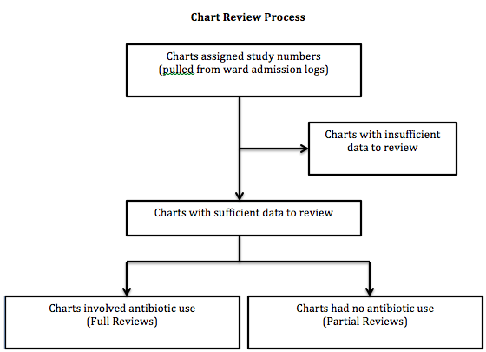
Methods: Chart Review

Slide 12
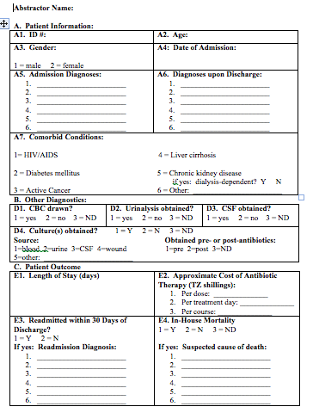
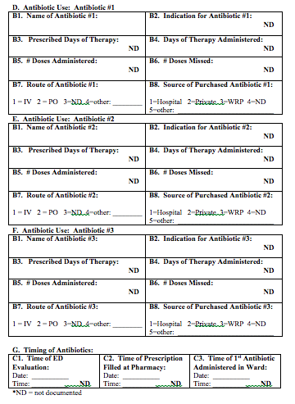
Methods: Chart Review

Slide 13
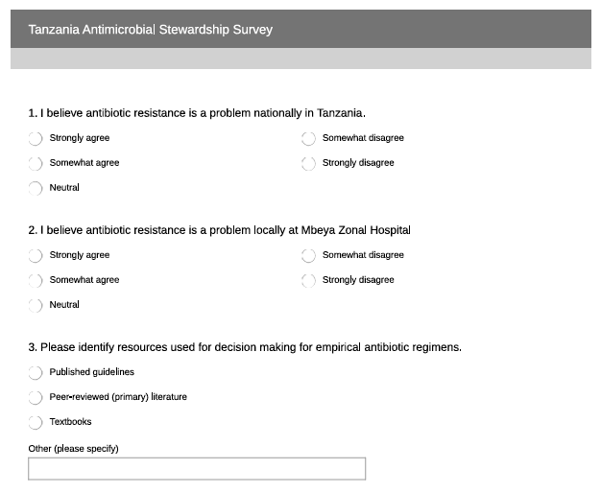
Methods: Clinician Survey

Slide 14
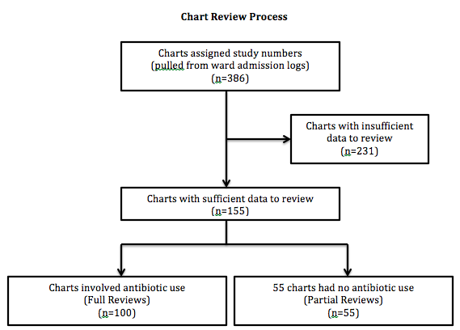
Results

Slide 15
Results: Patient Demographics
Demographics
Gender (n=155 total, n=100 full reviews)
Males 85 (54.8%) total; 50 (50%) of full reviews
Females 70 (45.1%) total; 50 (50%) of full reviews
Age (n=155)
Avg Total 44 years
Avg Male 46 years
Avg Female 41 years
Pertinent Comorbidities
HIV/AIDS 47 (30.3%)
Diabetes mellitus 16 (10.3%)
Active cancer 7 (4.5%)
Liver cirrhosis 4 (2.6%)
CKD-DD 6 (3.9%)
CKD-NDD 6 (3.9%)
Admission Diagnoses (n=154)
Bacterial Pneumonia 36 (23.4%)
HIV/AIDS 36 (23.4%)
Tuberculosis 28 (18.1%)
Kaposi sarcoma 16 (10.3%)
Cardiorenal syndrome 15 (9.7%)
Discharge Diagnoses (n=130)
HIV/AIDS 31 (23.8%)
Mod/severe anemia 29 (22.3%)
Upper GI bleed 24 (18.5%)
Bacterial pneumonia 24 (18.5%)
Tuberculosis 15 (11.5%)
Peptuc ulcer disease 14 (10.8%)
Payer Source (n=154)
Insured 57 (37%)
Cash 97 (63%)

Slide 16
Results

Slide 17
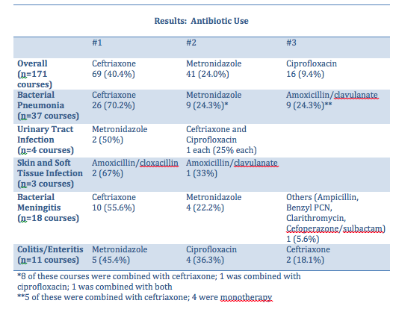
Results

Slide 18
Results

Slide 19
Results: Clinician Survey
Clinician Survey: Other Results
Q3: Please identify resources used for decision making for empirical antibiotic regimens (may choose more than one response)
Published guidelines: 38
Peer reviewed literature: 3
Textbooks: 7
Q16: What is your designation?
5 physicians
6 registrars
29 interns
1 nurse
2 intern nurses

Slide 20
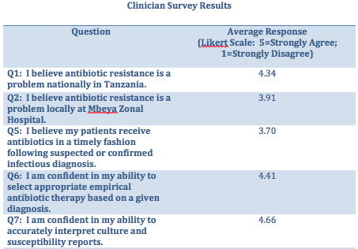
Results: Clinician Survey
1

Slide 21
Discussion
Are current antibiotic prescribing habits possibly contributing to local antibiotic resistance at MZRH?
Overuse of some antibiotics
Ceftriaxone
OK for CAP⁷, meningitis
?Avoid for UTI, colitis, SSTIs (MRSA rates in Tanzania: 16-44%^{8,9})
Metronidazole: not needed in UTI, meningitis
Partial antibiotic courses administered (56.2% of courses incomplete)
Antibiotic course exceeding the prescribed course duration (6.4%)

Slide 22
Discussion
What are the barriers to optimal antibiotic use at MZRH?
Patients’ inability to pay for necessary antibiotics and supplies
Ex: Patients with an infectious diagnosis who received no antibiotic (12/15 = cash pay)
Ex: Difference in mortality trend based on payment method (30/41 = cash pay)
Insufficient use of diagnostics
Cost of cultures, CXRs, etc.
Unavailability of necessary laboratory services at all times
Insufficient clinician awareness of local resistance patterns
Clinician survey: Less confident with AMR patterns locally and nationally
Insufficient communication between clinicians and patients/families

Slide 23
Discussion
Potential future interventions to optimize antibiotic use at MZRH
Develop antibiogram from local culture data
Develop antibiotic prescribing guidebook for clinicians to reference
Train clinicians on appropriate communication with patients/families
Ensure the rounding team reviews the patient’s MAR everyday
Develop an improved social work program
Discount or waive the cost of diagnostics for qualifying patients
Reduce costs of antibiotics at the MZRH pharmacy for qualifying patients
Form a patient assistant fund to make funds available for such patients

Slide 24
References
Harbath, S., Balkhy, H., et al. Antimicrobial resistance: One World, One Fight! Antimicrobial Resistance and Infection Control 2015; 4;49.
World Health Organization. Worldwide country situation analysis: response to antimicrobial resistance. who.int. http://apps.who.int/iris/bitstream/10665/163468/1/9789241564946_eng.pdf?ua=1. Published April 2015. Accessed August 15, 2017.
Global Antibiotic Resistance Partnership—Tanzania Working Group. 2015. Situation Analysis and Recommendations: Antibiotic Use and Resistance in Tanzania. Washington, D.C. and New Delhi: Center for Disease Dynamics, Economics, and Policy.
Moremi, N., Claus, H., Mshana, S. Antimicrobial resistance pattern: a report of microbiological cultures at a tertiary hospital in Tanzania. BMC Infectious Diseases 2016; 16:756.
Mshana, S., Matee, M., Rweyemamu, M. Antimicrobial resistance in human and animal pathogens in Zambia, Democratic Republic of Congo, Mozambique, and Tanzania: an urgent need of a sustainable surveillance system. Annals of Clinical Microbiology and Antimicrobials 2013; 12:28.
Kumburu, HH, Sonda, T., Mmbaga, BT., et al. Patterns of infections, aetological agents and antimicrobial resistance at a tertiary care hospital in northern Tanzania. Tropical Medicine and International Health 2017; 22:4.
Moyo, SJ., Steinbakk, M., Aboud, S., Mkopi, N., Kasubi, M., Blomberg, B., Manji, K., Lyamuya, EF., Maselle, SY., Langeland, N. Penicillin resistance and serotype distribution of Streptococcus pneumoniae in nasopharyngeal carrier children under 5 years of age in Dar es Salaam, Tanzania. Journal of Medical Microbiology 2012; 61: 952-959.
Mshana, SE, Kamugisha, E., Mirambo, M., Chalya, P., Rambau, P., Mahalu, W., Lyamuya, E. Prevalence of clindamycin inducible resistance among methicillin-resistant Staphylococcus aureus at Bugando Medical Center, Mwanza, Tanzania. Tanzania Journal of Health Research 2009; 11(2): 59-64.
Manyahi J. Bacteriological Spectrum of Post-Operative Wound Infections and their Antibiogram in a Tertiary Hospital, Dar es Salaam, Tanzania. 2012.

Slide 25
Questions???

Slide 26
© 2018 American Academy of Family Physicians. All rights reserved.
All materials/content herein are protected by copyright and are for the sole, personal use of the user.
No part of the materials/content may be copied, duplicated, distributed or retransmitted
in any form or medium without the prior permission of the applicable copyright owner.

