Slide 1
How to Determine What to be When you Grow Up: Discovering your Passion
Stephanie Benson, MD, FAAFP
Brandy Deffenbacher, MD
Miranda Huffman, MD, MEd

Slide 2
Who We Are
Stephanie Benson
Southern New Mexico Family Medicine Residency
Stephanie.benson@lpnt.net
Brandy Deffenbacher
University of Colorado Department of Family Medicine
Brandy.deffenbacher@ucdenver.edu
Miranda Huffman
University of Missouri – Kansas City Department of Community and Family Medicine
HuffmanMM@umkc.edu

Slide 3
Disclosures
None

Slide 4
Objectives
Describe the importance of a personal/career passion and how it can improve career satisfaction.
Identify methods and questions that can be used to find and develop one’s personal and career passions.
Write step-wise goals for the incorporation of these passions in the work place.

Slide 5
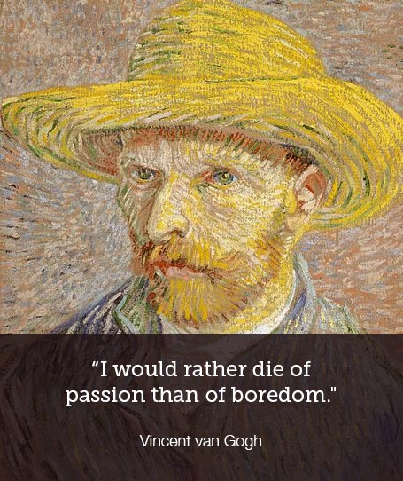

Slide 6
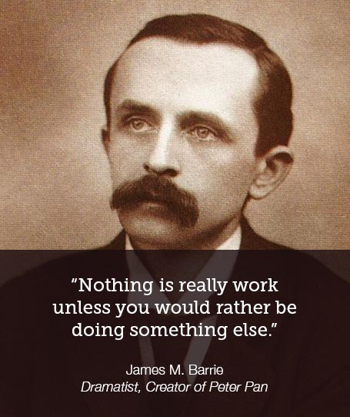

Slide 7
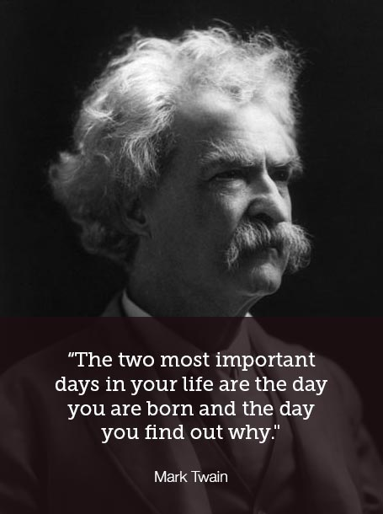

Slide 8
The Importance of Meaning
Shanafelt, et al. 2015
Increased rates of burnout compared to 2011, 54% vs 45%
Declined satisfaction in work-life balance
Disparity in burnout and satisfaction in work-life among physicians compared to the general working population
Mid-career Family Medicine physicians having some of the highest rates

Slide 9
The Importance of Meaning
Jager, et al. 2017
Burned out physicians had lower odds of finding their work rewarding, seeing their work as one of the most important things in their lives, or thinking their work makes the world a better place

Slide 10
Jager, et al. 2017
Burnout associated with lower odds of enjoying talking about their work to others choosing their work life again or continuing with their current work even if they were no longer paid if they were financially stable

Slide 11
The Importance of Meaning
Rabatin et al. 2016
Burnout associated with lower rates of career satisfaction and higher intent to leave their practice
Pololi et al. 2012
Dissatisfaction related to attrition of faculty in U.S. medical schools

Slide 12
The Importance of Meaning
Shanafelt, et al. 2009
Extent to which faculty physicians are able to focus on the aspect of work that is most meaningful to them has a strong inverse relationship to their risk of burnout.
Notes:
Could combine these into one slide just describing the benefits of meaning/purpose in work to improve satisfaction, protect against burnout and attrition, etc.

Slide 13
Notes:
Ask the audience, what are some potential pitfalls for you that are prohibiting you from discovering and pursuing your passion?

Slide 14
Potential Pitfalls
Time
The opinions of others, well meaning or not
Structural/organizational limitations
Competing interests/demands
Fear of failure
Financial demands, fear of loss of income
Notes:
Time- hard to create space for something new when you’re not removing something else. Reducing wasted time, doing things that don’t do not need done or that someone else can do.

Slide 15
“Before I can tell my life what I want to do with it, I must listen to my life telling me who I am.”- Parker Palmer
Notes:
The word vocation is rooted in the Latin for “voice”
We must be deliberate in listening to ourselves, our actions and reactions, intuitions and instincts, and feelings.
From “Let Your Life Speak: Listening to the Voice of Vocation”

Slide 16
“When people have found their calling, they’ve made tough decisions and sacrifices in order to do the work they were meant to do.”
“You don’t just ’find’ your calling — you have to fight for it. And it’s worth the fight.”
David Isay, developer of Story Corps

Slide 17
Finding Your Calling
Your calling is at the intersection of a Venn diagram of three things:
Doing something you’re good at
Feeling appreciated
Believing your work is making people’s lives better

Slide 18
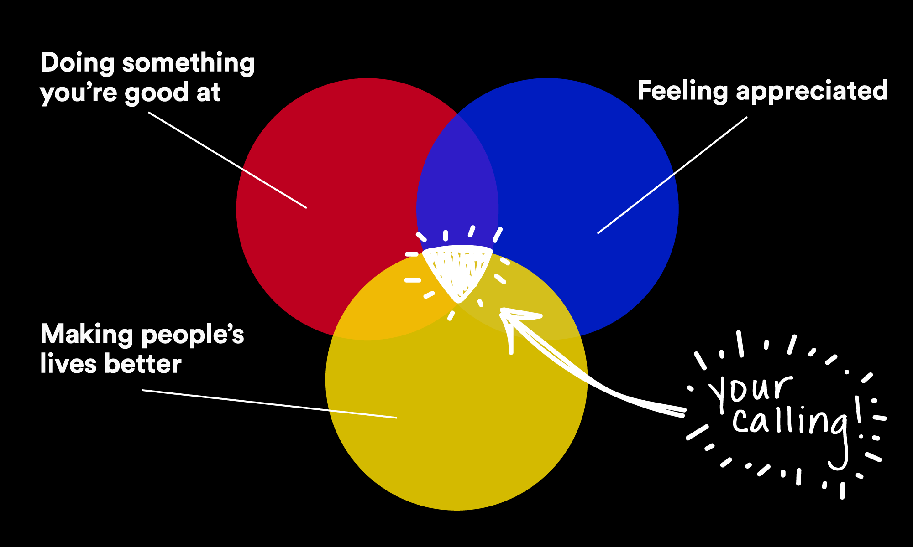
Notes:
Share personal antidotes here
Include comment that this may change over time
Include recognition that this is a process more than a destination
Develop strategies to saying no to things that aren’t at the center of the Venn diagram

Slide 19
Notes:
Verses the other Venn???? Should we even use this one???

Slide 20
Six (more) Ideas for Finding the Work You were Meant to Do
Your calling often comes out of difficult experiences.
Calling often takes courage and ruffles feathers.
Other people often nudge you toward your calling.
What comes after identifying your calling is what really matters.
Age is irrelevant.
Calling often doesn’t come with a big paycheck.

Slide 21
Interview - Small group exercise
Notes:
Have them break in to 2’s, spend 10 minutes interviewing each other.
Come back and discuss if anyone discovered anything new.
Fill out their own Venn diagram

Slide 24
The Meaning Journal
What surprised me today?
What touched my heart today?
What inspired me today?
http://www.rishiprograms.org/programs/all-healthcare-professionals/is-your-fmm-group-counted/
Notes:
On maintaining meaning through reflection…
Rachael Naomi Remen MD- developer of Finding Meaning in Medicine groups- Remen Institute for the Study of Health and Illness at Wright State University

Slide 25
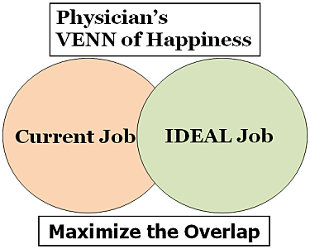
Notes:
Dr. Dike Drummond – add in his FPM articles

Slide 26
http://leoniedawson.com/the-g-o-a-l-system-for-goal-achieving-success/
Notes:
From Leoni Dawson
Verses a SMART statement for an action item for them to take home.

Slide 27
Conclusions
Finding your passion and meaning in your work can improve career satisfaction and protect against burnout.
Using methods such as start-stop-keep, journaling and reflection, and Venn diagrams can help direct you towards your passion.
Writing step wise goals that are motivating, observable, and actionable can help develop a plan to incorporate your passions into the work place.

Slide 28
Please evaluate this presentation using the conference mobile app! Simply click on the "clipboard" icon on the presentation page.

