Slide 1
Taking Care of Ourselves, Taking Care of Each Other: Resilience Promotion for Behavioral Scientists
Valerie Ross & Jennifer Ayres

Slide 2
No disclosures. No disturbing content.

Slide 3
Agenda
Identifying areas of burnout
Resilience promotion during times of stress & struggle
Addressing domains of burnout via resilience promotion
Large group discussion & idea sharing
Commitment to act

Slide 4
Goals and Objectives
We hope this workshop will normalize discussion of burnout and resilience promotion for behavioral scientists working in medicine
Participants will:
Increase awareness of signs and symptoms of burnout
Share strategies for resilience promotion
Receive a list of burnout prevention strategies developed by the group to utilize when they return home

Slide 5
Identifying areas of burnout (Maslach, 2001)
Emotional exhaustion
Cynicism/depersonalization
Decreased personal accomplishment & efficacy
What experiences do you have with burnout? How does it manifest?
Cognitively
Emotionally
Behaviorally
What factors increase your vulnerability to burnout?

Slide 6
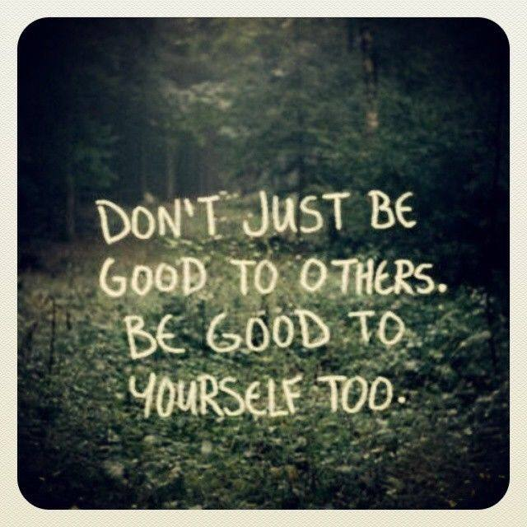
Review, reflect & discuss

Slide 7
Now…let’s talk about resilience

Slide 8
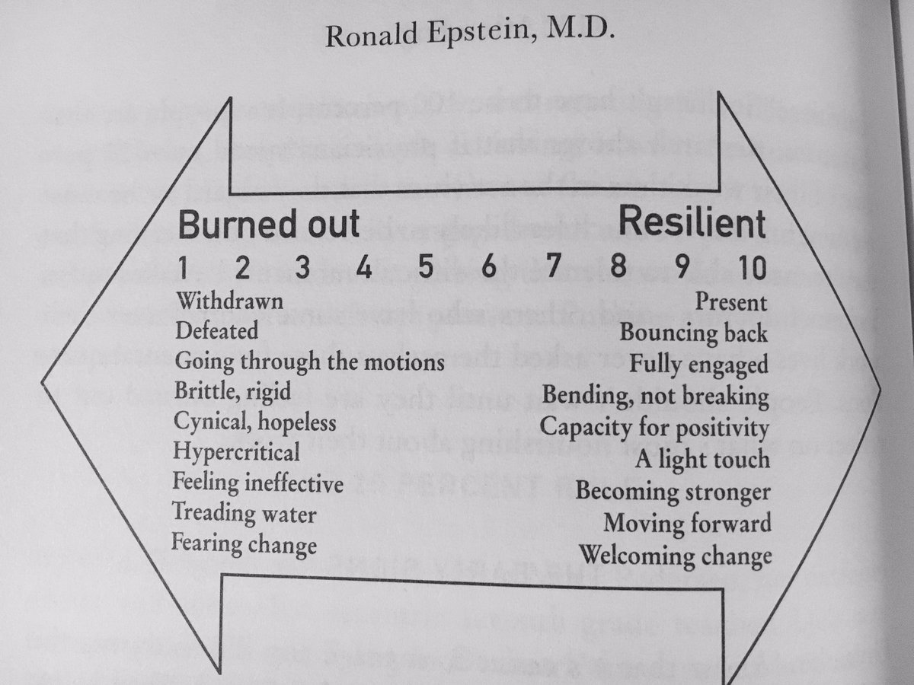

Slide 9
Reflection
Taking care of ourselves…
What is resilience to you?
When have you felt resilient? Describe the moment.
Taking care of each other…
How could we take care of each other?

Slide 10
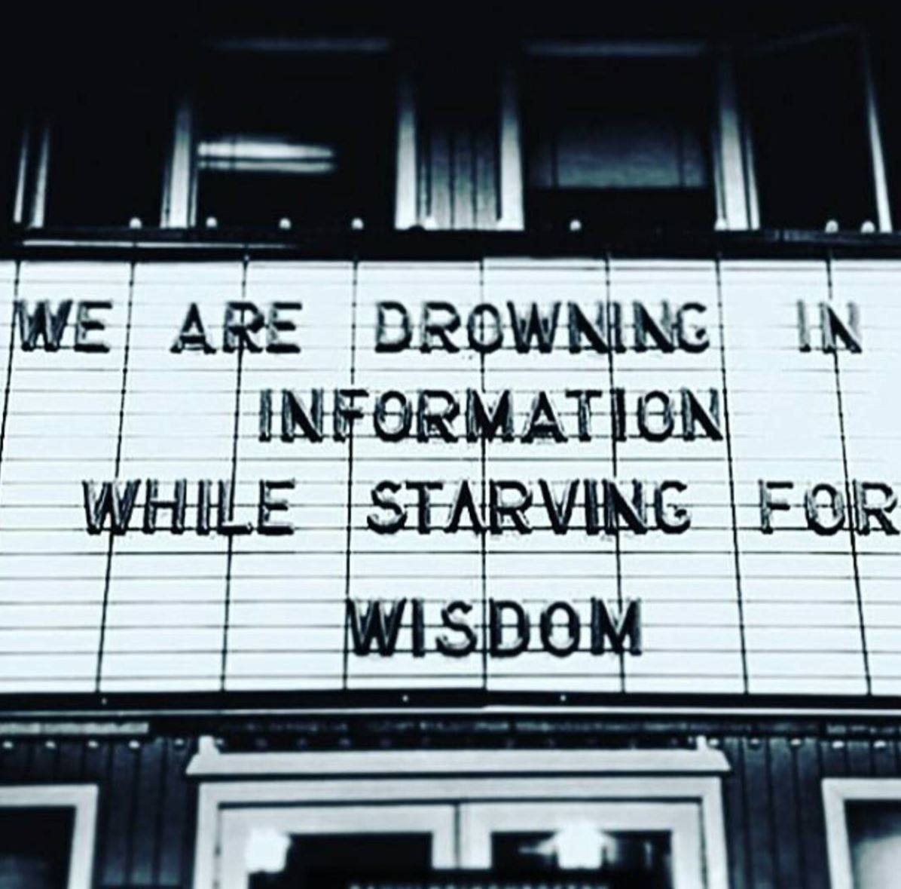
Large group discussion: Idea sharing

Slide 11
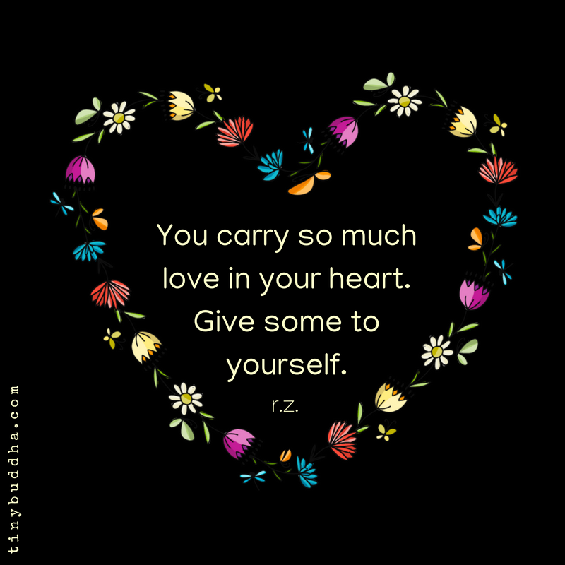
Commitment to act
What resonated with you today?
What are two things you will carry from today?

