Slide 1
The Family Physician’s Role in Eliminating Tuberculosis- A Global Scourge
Marissa J. Levine MD MPH
Professor, USF College of Public Health
Tampa, Fl

Slide 2
OUTLINE
Pretest
Why talk about TB?
TB infection in review
TB screening
LTBI treatment
A population health approach to TB eradication
Summary and Conclusion
Posttest
Please ask questions along the way!

Slide 3
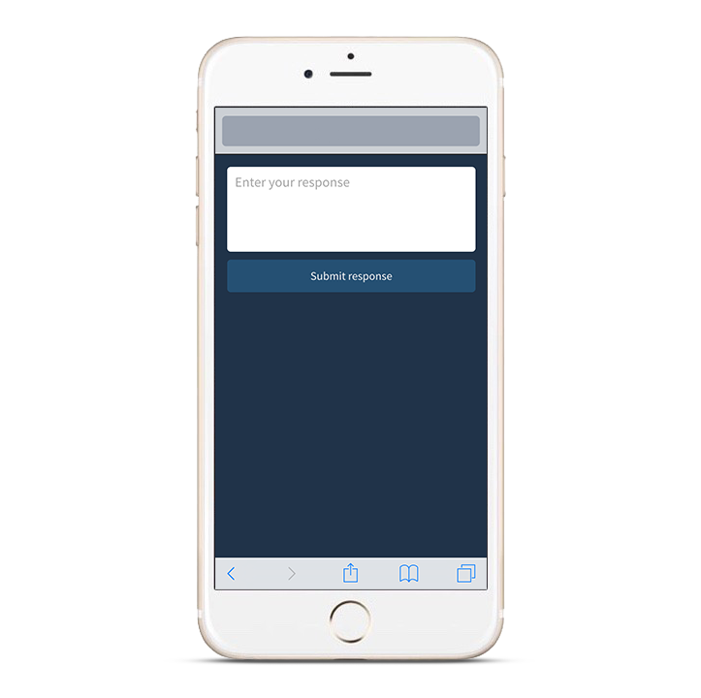
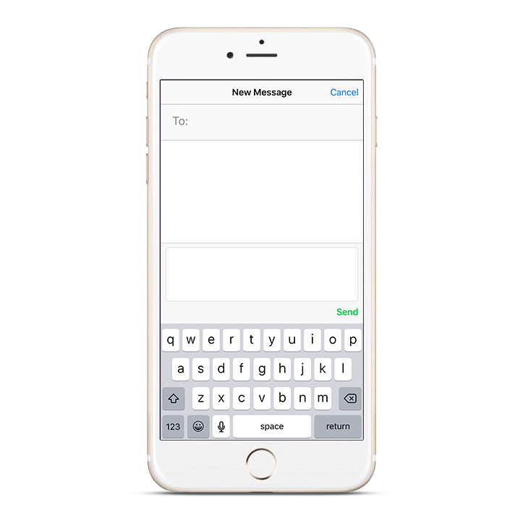
Responding with Poll Everywhere
Pollev.com/marissalevin228
22333
Marissalevin228 +
your response
Web voting
Text voting
Notes:
General use graphics to be customized according to your poll’s instructions

Slide 4
22333
presenterpete
Notes:
Example instruction slide for SMS with Presenter Session (our default)

Slide 5
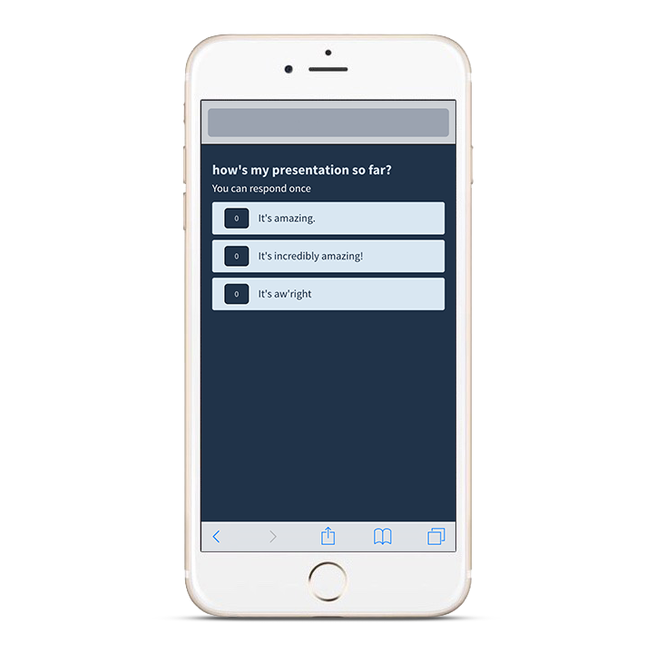
Pollev.com/presenterpete
Notes:
Example instruction slide for using web voting

Slide 6
Why talk about TB?
Tuberculosis is the leading cause of death worldwide from a single pathogen.
Although there has been improvement in decreasing cases of active TB in the US, that effort appears to have stalled.
Most cases of TB in the US occur among foreign born individuals.
Currently, the most likely source of those cases is reactivation of latent TB infection (LTBI)
Blumberg, Ernst The Challenge of Latent TB. JAMA. 2016:316:931-933

Slide 7
The Burden of TB
Global Perspective

Slide 8
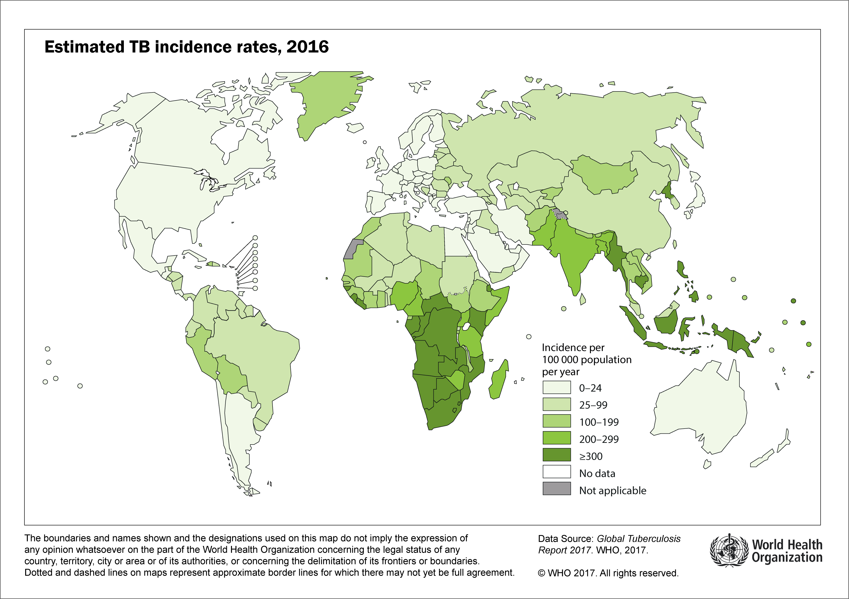

Slide 9
Closer to Home
Data from US Centers for Disease Control and Prevention

Slide 10
Reported TB Cases Among Non-U.S.–Born Persons Compared with All TB Cases, United States, 1993–2016
U.S. overall
Non-U.S.–born

Slide 11
Number and Percentage of TB Cases Among Non-U.S.–Born Persons, United States, 1993–2016

Slide 12
Percentage of Non-U.S.–Born Persons Among All TB Cases, by Reporting Area, 1993 and 2016
1993
2016
NYC
DC
NYC
DC
No cases
<25%
25%–49%
≥50%

Slide 13
Estimates of Percentages of TB Cases Attributed to Recent Transmission Among U.S.-Born and Non-U.S.–Born Persons, 2011–2016

Slide 14
Local Perspective
Data Courtesy of the Florida Department of Health and Duval Health Department

Slide 15
Santa Rosa
Okaloosa
Holmes
Jackson
Escambia
Walton
Washington
Gadsden
Jefferson
Hamilton
Nassau
Bay
Calhoun
Leon
Madison
Baker
Duval
Liberty
Wakulla
Taylor
Suwannee
Columbia
In 2016, 639 tuberculosis cases were reported in Florida. This represents an 6.5% increase in cases since 2015. The TB case rate in 2015 was 3.0 per 100,000 population.
Gulf
Franklin
Lafayette
Union
Bradford
Clay
St. Johns
Dixie
Gilchrist
Alachua
Putnam
Levy
Flagler
Marion
Volusia
Citrus
Sumter
Lake
Seminole
Hernando
Orange
Pasco
Hillsborough
Polk
Osceola
Brevard
Pinellas
Manatee
Indian River
Hardee
Okeechobee
St. Lucie
Risk Factors
Excess alcohol use w/in past year 15% (89/595)
HIV Co-infection 11% (63/595)
Illicit drug use within past year 12% (69/595)
Homelessness 8% (47/595)
Incarcerated at diagnosis 3% (19/595)
Sarasota
Desoto
Highland
Charlotte
Glades
Martin
Lee
Palm Beach
Hendry
Collier
Broward
Monroe
Dade

Slide 16
The Opportunity
Most cases of active TB occur among foreign born individuals
Most of these individuals are in the country for over a year before they develop active TB
That year represents our opportunity

Slide 17
USPSTF 2016 Recommendation
https://www.uspreventiveservicestaskforce.org/Page/Document/UpdateSummaryFinal/latent-tuberculosis-infection-screening

Slide 18
TB Screening
There is no gold standard!
All tests associated with false positives and false negatives
Tests do not predict disease progression (reactivation)
Test are not useful to monitor treatment response

Slide 19
TB Screening- Defining Those at Risk
At Risk for MTBC Infection
Persons who have spent time with someone who has TB disease.
Persons from a country in which TB is common (most countries in Latin America, Africa, Asia, Eastern Europe, Russia and the Caribbean).
Live or work in high-risk settings (correctional facilities, nursing homes, homeless shelters).
Healthcare workers who care for patients at increased risk for TB disease.
Infants, children and adolescents exposed to adults who are at increased risk for TB infection or TB disease.
Mycobacteriology lab personnel.
Adapted from CDC

Slide 20
Risk Assessment – continued
At Risk for Developing TB Disease, if infected*
Persons with HIV infection.
Persons who became infected with TB bacteria in the last 2 years.
Infants and young children under 5 years of age.
Persons who inject illicit drugs.
Persons who are sick with other diseases that weaken the immune system.
Persons with a past history of inadequately treated TB.
Elderly, renal failure, diabetes, silicosis.
* Not necessarily at high risk of MTBC infection
Adapted from CDC

Slide 21
Bright FuturesTM: TB Testing for Children
Bright FuturesTM recommends TB testing for children at high-risk
Risk assessment:
Was your child born in a country at high risk for tuberculosis (countries other than the United States, Canada, Australia, New Zealand, or Western Europe)?
Has your child traveled (had contact with resident populations) for longer than 1 week to a country at high risk for tuberculosis?
Has a family member or contact had tuberculosis or a positive tuberculin skin test?
Is your child infected with HIV?

Slide 22
Testing Workers in Health Care Facilities
Risk classification | Frequency of testing
Low | Baseline; then test if TB exposure occurs
Medium | Baseline, then annually
Potential ongoing transmission | Baseline, then every 8–10 weeks until evidence of transmission has ceased
Consult TB Infection Control for HC Facilities Guidelines: https://www.cdc.gov/mmwr/preview/mmwrhtml/rr5417a1.htm?s_cid=rr5417a1_e

Slide 23
Testing for TB Infection
5 Tuberculin units Purified Protein Derivative – PPD
Delayed hypersensitivity reaction 2-8 weeks after infection
0.1 ml of 5TU injected intradermally
Read at 48-72 hours after application
Reading based on induration not redness
Reported as millimeters (mm) of induration
Read by qualified trained professional only

Slide 24
TST Risk Stratification
>5 mm induration is considered positive in:
HIV-infected persons
Recent contacts with person with active TB
Person with fibrotic changes on CXR consistent with prior TB
Patients with organ transplants and other immunosuppressed patients, including those on equivalent of >=15 mg/day of prednisone for 1 month or more or on TNF-alpha antagonists

Slide 25
TST Risk Stratification
>10 mm induration considered positive in:
Recent arrivals to US (<5 years) from high TB prevalence areas
IDU
Residents/Employees of high risk congregate care centers
Mycobacteriology lab personnel
Persons at risk for progression to active TB
Children <5 years of age

Slide 26
TST Risk Stratification
>15 mm induration is considered positive in:
Persons with no known risk factors for TB

Slide 27
Tests Available – Interferon Release Gamma Assays (IGRAs)
Interferon-Gamma Release Assays (IGRAs) include:
the QuantiFERON®-TB Gold In-Tube assay (QFT-GIT)
the T-SPOT®.TB assay (T-Spot).
The Quantiferon TB Gold Plus was approved by the FDA in 2017 and will replace the QFT-GIT.
A Clinician’s Guide to the TB Laboratory available at: http://www.heartlandntbc.org/assets/products/clinicians_lab_guide.pdf

Slide 28
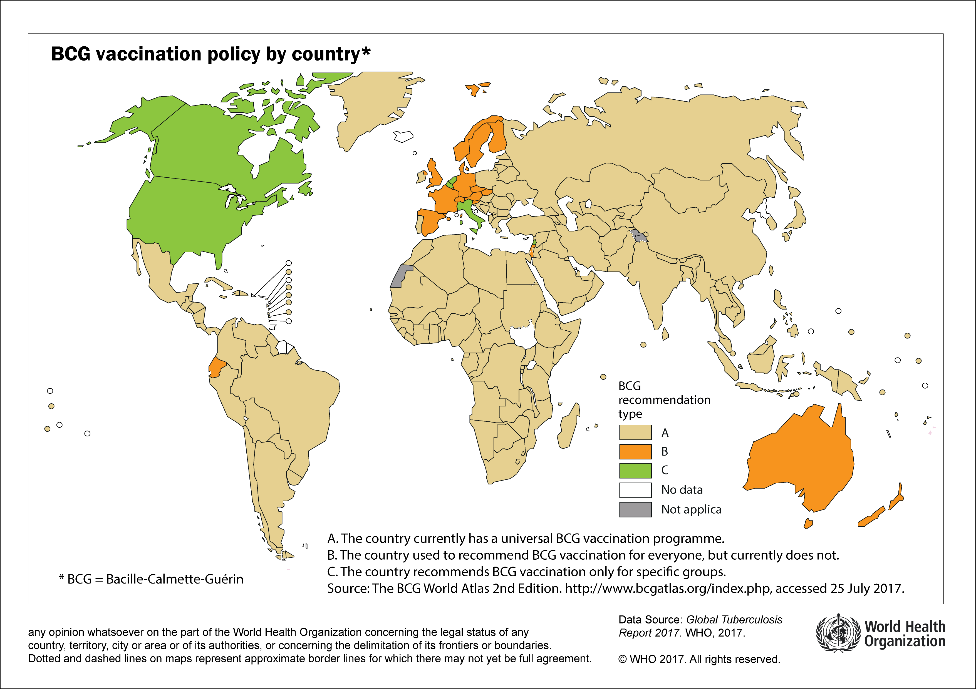

Slide 29
LTBI vs. TB Disease
Person with LTBI (Infected) | Person with TB Disease (Infectious)
Has a small amount of TB bacteria in his/her body that are alive, but inactive | Has a large amount of active TB bacteria in his/her body
Cannot spread TB bacteria to others | May spread TB bacteria to others
Does not feel sick, but may become sick if the bacteria become active in his/her body | May feel sick and may have symptoms such as a cough, fever, and/or weight loss
Usually has a TB skin test or TB blood test reaction indicating TB infection | Usually has a TB skin test or TB blood test reaction indicating TB infection
Radiograph is typically normal | Radiograph may be abnormal
Sputum smears and cultures are negative | Sputum smears and cultures may be positive
Should consider treatment for LTBI to prevent TB disease | Needs treatment for TB disease
Does not require respiratory isolation | May require respiratory isolation
Not a TB case | A TB case
Adapted from CDC

Slide 30
Treating LTBI

Slide 31
Treatment of LTBI – Updated 06/29/18
CDC continues to recommend use of the short-course combination regimen of once-weekly isoniazid-rifapentine for 12 weeks (3HP) for treatment of latent tuberculosis infection (LTBI) in adults.
The updated guidance based on a systematic review resulted in the following additional recommendations:
use of 3HP in persons aged 2–17 years;
use of 3HP in persons with LTBI who are living with human immunodeficiency virus (HIV) infection, including acquired immunodeficiency syndrome (AIDS) and taking antiretroviral medications with acceptable drug-drug interactions with rifapentine*; and
use of 3HP by directly observed therapy (DOT) or self-administered therapy (SAT) in persons aged ≥2 years
* https://aidsinfo.nih.gov/guidelines/html/1/adult-and-adolescent-arv/367/overview.
Borisov AS, Bamrah Morris S, Njie GJ, et al. Update of Recommendations for Use of Once-Weekly Isoniazid-Rifapentine Regimen to Treat Latent Mycobacterium tuberculosis Infection. MMWR Morb Mortal Wkly Rep 2018;67:723–726. DOI: http://dx.doi.org/10.15585/mmwr.mm6725a5.

Slide 32
American Thoracic Society/CDC recommendations for targeted testing and isoniazid treatment for latent tuberculosis infection (LTBI) and monitoring during treatment
Existing recommendations emphasize the careful selection of candidates for LTBI testing and treatment based on risk for infection. Persons who are not at risk for TB infection should not undergo testing for LTBI.
Monthly clinical monitoring, including a brief physical examination, for the signs and symptoms of LTBI treatment–associated adverse events is recommended for all patients.
Patients who have human immunodeficiency virus(HIV) infection, patients who have chronic liver disease, pregnant women, women in the immediate postpartum period (3 months after delivery), and patients who use alcohol regularly should be considered for baseline laboratory hepatic testing.
Sources: CDC. Targeted tuberculin skin testing and treatment of latent tuberculosis infection. MMWR 2000;49(No. RR-6). American Thoracic Society. An official ATS statement: hepatotoxicity of antituberculosis therapy. Am J Respir Crit Care Med 2006;174:935--52.

Slide 33
Who should have baseline LFT’s before initiating LTBI treatment?
Persons with:
HIV
Chronic hepatic disease
Regular alcohol use
Injection drug use
Medications known to interact
And women who are pregnant or postpartum (<= 3 months)

Slide 34
Cases for Discussion

Slide 35
Taking a Population Health Approach
Manage the burden and break the cycle

Slide 36
Summary/Conclusions

Slide 37
References/Resources
CDC Resources (https://www.cdc.gov/tb/publications/ltbi/ltbiresources.htm).
• LTBI Targeted Testing and Treatment Recommendations: CDC Guidance
• CDC Resources for United States Preventive Services Task Force (USPSTF) Recommendations
• LTBI: Fact Sheets for Providers
• LTBI: Fact Sheets for Patients
WHO Global TB report: www.who.int/tb/publications/global_report/en/
LTBI: A Guide for Primary Health Care Providers - https://www.cdc.gov/tb/publications/ltbi/
3 HP FAQs for Providers:
https://www.cdc.gov/tb/education/FAQforProviders.htm

Slide 38
References/Resources (continued)
TB Centers of Excellence for Training, Education, and Medical Consultation (https://www.cdc.gov/tb/education/tb_coe/default.htm) as sources for more resources on LTBI.
§ Curry International Tuberculosis Center
§ Global Tuberculosis Institute at Rutgers, The State University of New Jersey
§ Heartland National Tuberculosis Center
§ Southeastern National Tuberculosis Center
A database of training and education products from the Centers of Excellence is available: https://sntc.medicine.ufl.edu/rtmccproducts.aspx
Find TB Resources https://findtbresources.cdc.gov
Searchable index for clinicians and patients
State TB control programs at https://www.cdc.gov/tb/links/tboffices.htm

Slide 39
© 2018 American Academy of Family Physicians. All rights reserved.
All materials/content herein are protected by copyright and are for the sole, personal use of the user.
No part of the materials/content may be copied, duplicated, distributed or retransmitted
in any form or medium without the prior permission of the applicable copyright owner.

