Slide 1
Suture Workshop

Slide 2
Objectives
Suture
Learn the basics of wound healing and evaluation
Identify the equipment needed
Learn how to select suture and type of repair
Practice simple, vertical mattress, and tip stitches
Biopsy
Learn the types of biopsy and when they are best used
Identify the equipment needed
Practice punch and shave biopsy

Slide 3
Why Suture Wounds?
Faster healing
Less infection
By:
Wound edge apposition
Reduce tension on edges

Slide 4
Why Not?
Old wounds
> 18 – 36 hours
Infection
Refer
Tendon
Nerve
Unable to achieve hemostasis

Slide 5
Preparation
Clean
(Sterile gloves don’t make a difference)
Irrigate if dirty - Tap water OK
No alcohol, peroxide, betadine in the wound!
Anesthetize
Trim hair
Avoid shaving
?? Debride

Slide 6
Epinephrine or not?
Epinephrine
Less bleeding
Numbing lasts longer
No Epinephrine
Worry about distal necrosis
Circumferential fingers, toes, penis
?? Ears (poor blood supple)
? Nose

Slide 7
Instruments
Needle driver
Forceps with / without teeth
Scissors
? Scalpel
Undermining
Debriding

Slide 8
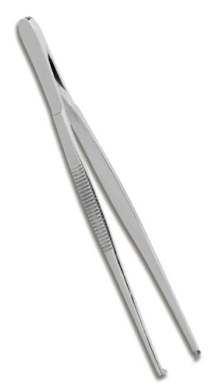
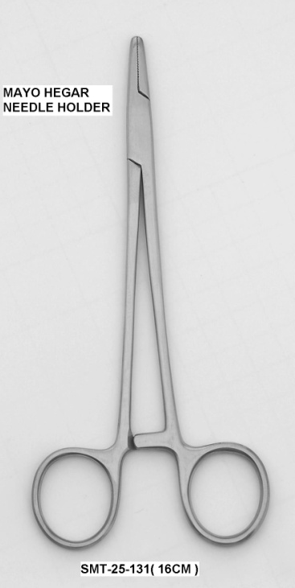
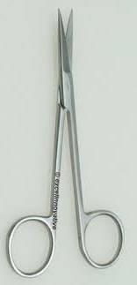
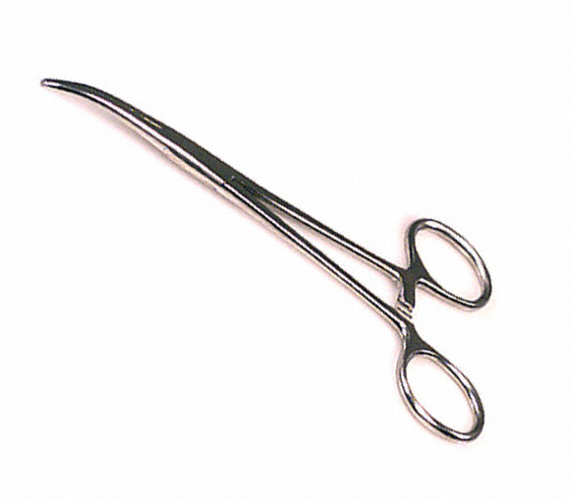
Instruments

Slide 9
What instruments are disposable?
All-metal instruments in the clinic are NOT disposable.
Dermablades, scalpels, biopsy punches are disposable.
Scissors, needle drivers, forceps are NOT disposable.
** You are responsible for disposing of your sharps:
Needles, suture needles, scalpels, punches **

Slide 10
Suture
Absorbable (deep)
Dexon, Vicryl, Monocryl, Chromic
Non-absorbable
Nylon, Prolene

Slide 11
Monofilament vs Braided
Braided
Strong
Easy to tie
Wicks bacteria
More trauma when removed
Monofilament (fishing line)
Weaker, harder to tie, does not wick, less trauma

Slide 12
Sizes
#2, #1, O, 2-O, 3-O, … 6-O, … 10-O
Smaller to the right.

Slide 13
Needles
Taper
Viscera
Cutting
Skin
Hold needle near tip of needle holder at ½ to 2/3 of the way between the tip and suture

Slide 14
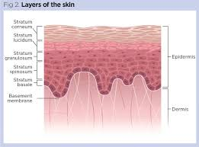
Skin Layers
Line up basilar layers

Slide 15
How tight?
You are just getting the skin edges together
If you pull too tight you cut off blood supply and tissue dies

Slide 16
Types of Repair
Simple
Vertical Mattress
Horizontal Mattress
Tip

Slide 17
Square vs Granny
Place the needle driver parallel to the wound’s direction. Grab the short end.
Hold the longer side of the suture (with the needle) and wrap OVER the needle driver.
Alternate over and under = square knots!!
Surgeon’s knot – first one is wrapped twice

Slide 18
# of throws
Braided – 3 – 5 throws
Monofilament - ~ 6 throws

Slide 19
Simple Sutures
Most wounds
Little to no tension
½ at a time
Surgeon’s knot

Slide 20
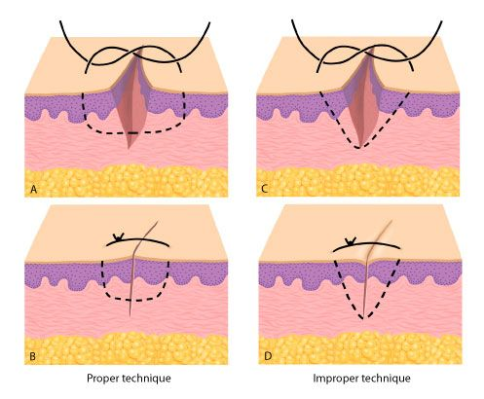
Simple Suture

Slide 21
Simple – Rule of halves

Slide 22
Vertical Mattress
Gaping, high tension wounds
Cosmetic, thin skin
Easier than 2 layer closure

Slide 23
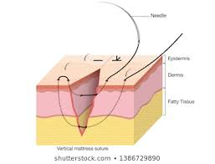
Vertical Mattress
Far, Far
Near, Near

Slide 24
Horizontal Mattress
Rarely used on skin
more likely to cause necrosis
Good for deep layer closure
Close dead space

Slide 25
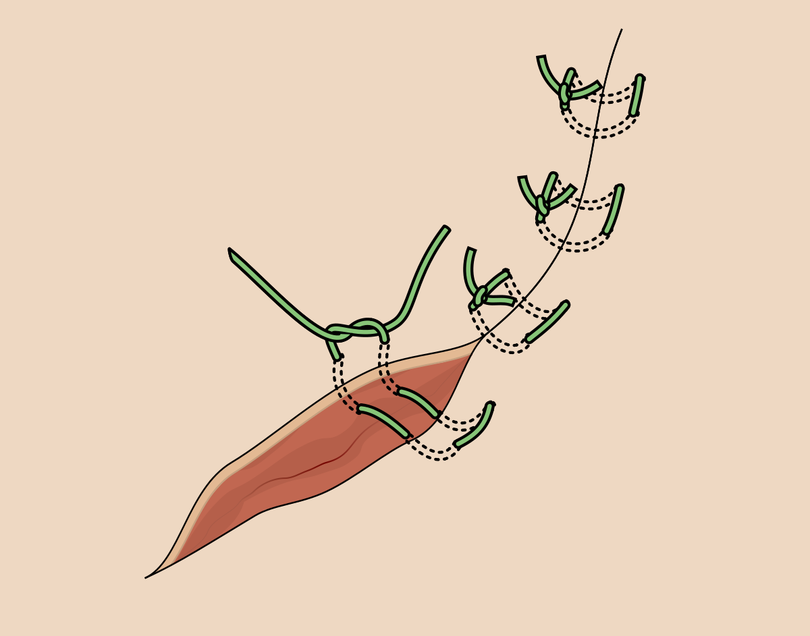
Horizontal mattress

Slide 26
Tip Stitch

Slide 27
Post Procedure Care
Clean off blood
? abx
Occlusive dressing (Tegaderm)
Clean and dry for 12 – 24 hrs
Clean more important than dry

Slide 28
Sutures out when?
Face | 3 - 5
Scalp | 5 - 10
Arms | 7 - 10
Trunk | 7 - 14
Legs | 10 - 14
Hands or Feet | 10 - 14
Palms or soles | 14 +

Slide 29
Billing
Simple
By Length
Intermediate
2 layer
Debridement
Undermining
Complex
We won’t bill

Slide 30
Practice !
Simple
Vertical Mattress
Tip
?? Horizontal Mattress

Slide 31
Biopsy

Slide 32
Biopsy - Why
Remove lesion
Get tissue for lab

Slide 33
Biopsy – Types
Excision
Remove it all
Wide border if possibly malignant
Punch
Take a piece for the lab
Shave
Partial thickness removal

Slide 34
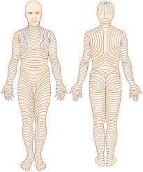
Skin Tension Lines

Slide 35
Anesthesia
Numb around, not through
Not:
Give yourself room to cauterize / sew

Slide 36
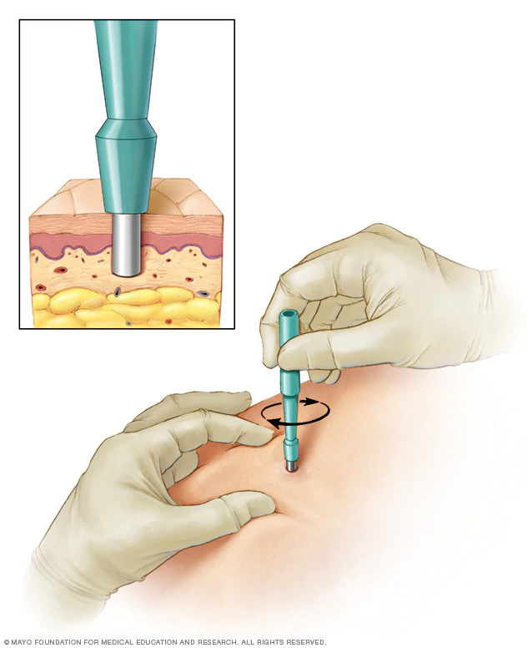
Punch - Instruments
Punch
2.5 – 5 mm
Forceps
Scissors
Specimen container
(Suture, Needle driver)

Slide 37
Punch - Which part?
Entire lesion
If possible
Worst looking part
If looking for cancer
Edge with some normal tissue
Blisters, auto-immune

Slide 38
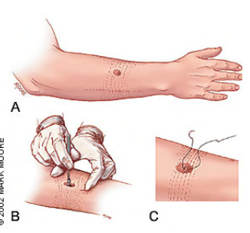
Punch - Technique
Twist punch back and forth to get through skin
Stop when you are through the skin – less resistance

Slide 39
Shave - Instruments
Blade
Scalpel
Dermablade
Forceps
Hemostasis
Bovie, Silver nitrate, Aluminum Nitrate
Specimen container

Slide 40
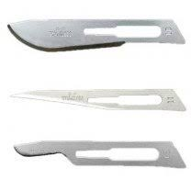
Scalpels
10
11
15

Slide 41
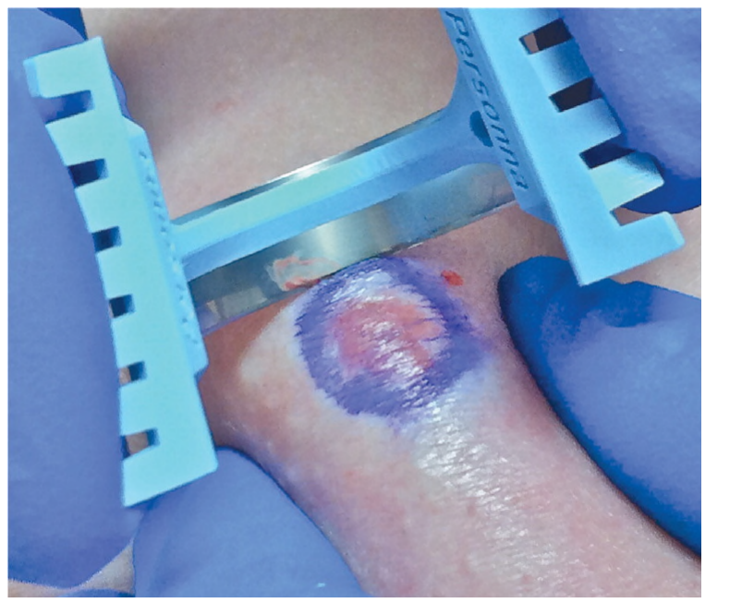
Shave - Dermablade
Scoop – rock back & forth
Change depth by changing shape

Slide 42
Billing
Shave 11102 - 1st 11103 - each subs Punch 11104 - 1st 11105 - Each Subs Incisional / Wedge | 11106 - 1st 11107 - each subs Destruction –benign 17000 - 1st 17003 – 2 – 14 17004 – 15+ Excision – complicated!

Slide 43
Biopsy - Practice
Punch
Shave

