Slide 1
A Program Response to Cases of Student Mistreatment
Presented By: Shannon Samuelson, B.A.
Jennifer Raley, M.D.
Hiba Ali, MS4
Layne Dearman, B.A.
University of Texas Medical Branch Galveston

Slide 2
Presentation Overview
Explanation of Title IX legislation, what it covers, and how it applies in a clinical education environment
How to identify complaints, determine if they meet the criteria for Title IX, and how to proceed with reporting it appropriately
Discuss the emotional toll on students, faculty, coordinators, and the program from each varying point of view
Consider and discuss early detection strategies to prevent future occurrences

Slide 3
Do you know what it is?

Slide 4
What the statute says:
The U.S. Department of Education’s Office for Civil Rights (OCR) enforces Title IX of the education amendments of 1972.
Title IX states that:
“No person in the United States shall, on the basis of sex, be excluded from participation in, be denied the benefits of, or be subjected to discrimination under any education program or activity receiving federal financial assistance.”

Slide 5
What does that cover?
Sex-based discrimination can take multiple forms. Harassers can be students, staff, faculty, or other persons related to the university such as a visiting student or community preceptor. Sexual harassment (including sexual violence) and gender-based harassment are forms of sex-based discrimination.
Sexual harassment is unwelcome conduct of a sexual nature, verbal or non-verbal.
Sexual violence refers to physical sexual acts perpetrated against a person’s will or where a person is incapable of giving consent (e.g., Due to the student’s age or use of drugs or alcohol, or because an intellectual or other disability prevents the student from having the capacity to give consent).
Gender-based harassment is unwelcome conduct based on a student’s actual or perceived sex such as slurs, taunts, stereotyping, or other discriminatory or hostile conduct.

Slide 6
Title iX…
Requires schools and universities to be proactive at being sure that the campus is free of discrimination
Requires that your institution has a procedure and guidelines for handling such cases
Requires that immediate action be taken
Makes the school liable for any retaliation
Allows no-contact directives when necessary
Prohibits “mediation” between parties
Institutions cannot discourage a students future participation or pursuit of education

Slide 7
Title IX Myths
Myth #1: Title IX is controversial
Myth #2: Title IX only applies to athletic programs
Myth #3: Opportunities are now equal
Myth #4: Advocates for victims of Title IX who file complaints of discrimination for others are not protected from retaliation under Title IX
Myth #5: Title IX applies only to discrimination against women
Notes:
Myth of the “promiscuous girl” – Girls who dress provocative are more likely to be victimized. The statistics show that women who walk with their head down, more self-conscious are far more likely to be victimized.

Slide 8
That’s not happening at my school, Right?
According to the questions asked by the Association of American Medical Colleges 2016 Graduate Survey, it is happening more than you might think. Every year students are asked the following questions:
Have you:
Been subjected to unwanted sexual advances?
Been asked to exchange sexual favors for grades or other rewards?
Been denied opportunities for training or rewards based on gender?
Been subjected to offensive sexist remarks/names?
Received lower evaluations or grades solely because of gender rather than performance?
The results may surprise you…

Slide 9
According to the 2016 AAMC Graduate survey
Students reporting at least one incident…
Subjected to Unwanted Sexual Advances: 3.8% or 528/13,897 students
Asked to exchange grades for sexual favors: 1.2% or 167/13,895 students
Denied opportunities based on gender: 5.6% or 778/13,892 students
Subjected to sexist remarks/names: 12.9% or 1792/13,891 students
Lower grade solely because of gender: 5.7% or 792/13,889 students

Slide 10
Other reported mistreatment
Students reporting at least one incident…
Publically Humiliated – 21.2%
Threatened Physical Harm – 1.4%
Physically Harmed – 1.9%
Required to perform personal services – 5.7%
Subjected to offensive remarks related to sexual orientation – 2%
Denied opportunities due to race/ethnicity – 2.9%
Subjected to racially offensive remarks – 6.7%
Received lower grades solely due to race/ethnicity – 6.7%
Denied opportunities based on sexual orientation - 0.5%

Slide 11
From the total surveyed…
Percent of respondents who indicated they personally experienced any of the listed behaviors, excluding “publically embarrassed.”
42.1% - 2013
39.9% - 2014
38.7% - 2015
38.1% - 2016

Slide 12
Indicate below which person engaged in the behavior
Sources of behaviors experienced personally, excluding “publically embarrassed” and “publically humiliated,” as percent of all who answered.

Slide 13
Many students are choosing not to report to anyone..
Did you report any of the behaviors listed to a designated faculty member or member of the medical school administration empowered to handle such complaints?
NO – 79.8%
The results of those who indicated they had personally experienced at least “once” any of the behaviors, excluding “publically embarrassed,” in a previous question.

Slide 14
Of those that did report, who are the reporting to?
Dean of students
Designated counselor/advocate
Other administrator
Faculty member
Other
27.1%
18.8%
23.1%
44.5%
22%

Slide 15
Why not report?
Incident did not seem important
I resolved it myself
I did not think anything would be done
Fear of reprisal
I didn’t know what to do
Other
57.8%
17.5%
36%
27.1%
9%
9%

Slide 16
Witnessing and reporting
Did you witness other students subjected to any of the surveyed behaviors?
18.4% said yes
Did you report any of the behaviors that you witnessed to a faculty member or other administrator?
88.9% said no

Slide 17
What these statistics tell us…
There is a continued need to educate others and shed light on the reality about Title IX violations and their continuing existence in medical education.
There is only a gradual decline in incidents.
There is still an alarming concern of the number of assaults or mistreatment that goes unreported.
Witnesses of these events still do not feel empowered to speak up on their behalf.

Slide 18
Identify, Evaluate, Report
Figure out what you are dealing with…

Slide 19
Identification is more of an art than a science. Often times it is about reading between the lines when students submit an evaluation or provide feedback. Unfortunately, this means that the offense has already occurred.
Things to look for:
Strong negative opinions about preceptors, locations, or requesting not to work with someone specific.
Stating they “felt uncomfortable”
Minimizing others behaviors

Slide 20
When there is something that raises a red flag, the student is the expert about their experience, they need to be asked FIRST. Do not go to the faculty, resident or others for information!
Face to face meetings are best practice.
Note: Your attitude will influence their response.
Ask open-ended questions
Ask for specific details
Ask the specific question – “Do you feel that you were…?” unless it is obvious.
EVALUATE

Slide 21
If a Student say “yes”…
Take the allegations seriously.
Listen, do not fill in words for the student.
Affirm the students decision to report.
If the student does not want you to tell anyone, remind them that it is your job to make sure that these things do not happen and that you are legally required to report these issues.
Do not make any promises that you do not have the control to keep.
As soon as possible, write down what the student said. You may very well be asked to share that information again.

Slide 22
Reporting…
You have 48 hours to report
Every institution has a Title IX Coordinator
Information that may be requested
All Correspondence
Grading information
Contact information

Slide 23
The title IX investigation process…
If yes, the coordinator meets with all the parties to review everyone's legal rights
Case is assigned to as lead and secondard investigator, not the Title IX coordinator
Contact the victim, assesses request for confidentiality, and determines whether to proceed with a full investigation
Both parties are notified whether charges are filed or complaint validated
Investigation conducted and the report sent to the Title IX coordinator to determine if charges are necessary
The accused will have a hearing to determine the responsibility and sanctions
If the accused is charged with a complaint, sanction recommendation will be made based on the severity of the complaint

Slide 24
Effects of Title IX violations on students
Common emotional effects are:
Anxiety
Depression
Withdrawal
Loss of Motivation
Low Self Esteem
“Experiencing significant amounts of discrimination over time can lead to changes in the way the brain processes information, disrupting, for example, the regions involved in planning and decision-making.”
“When we’ve had these experiences and anticipate that other incidents might lead us to be discriminated against, it can interfere with our ability to cognitively function at our best.”
- Vickie Mays, UCLA Fielding School of Public Health Professor in the Department of Health Policy and Management
http://newsroom.ucla.edu/stories/discrimination-can-be-harmful-to-your-mental-health

Slide 25
How to help SOMEONE WHO HAS EXPERIENCED DISCRIMINTION OR SEXUAL VIOLENCE
Do SOMETHING!
Be a good listener and nonjudgmental
Emphasize that it was not their fault
Encourage them to seek resources and services in the community
Remind them that they are not alone
Do research and be understanding

Slide 26
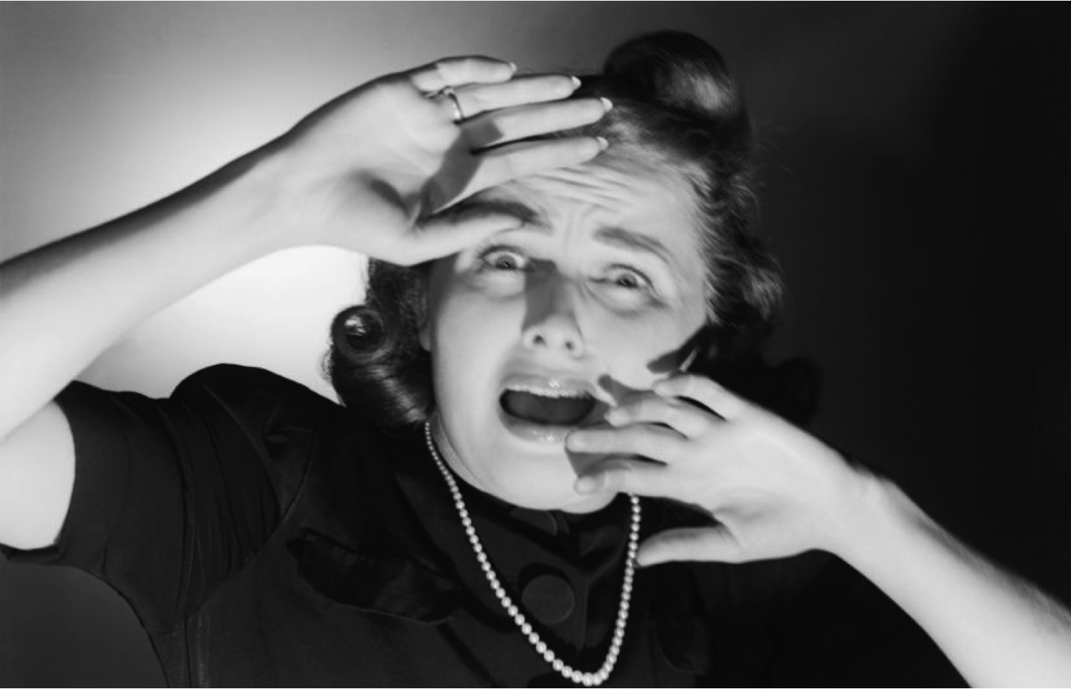
Emotional toll on other parties…
Coordinators, faculty, and administrators also emotionally process Title IX complaints. Anxiety and fear regarding the outcome are also part of the process.
Fear regarding the validity of the complaint
Fear of hostile response or retaliation by accused
If it is an outside preceptor, fear of the program gaining a reputation
Accusations of exaggerating or aggravating a situation

Slide 27
Concerns of the program
Concern of following the protocol correctly but not wanting to be too aggressive
Concern about colleagues getting into trouble
Concern of losing valuable preceptors or community faculty
Concern of students using this as a tool to manipulate

Slide 28
Real Case Scenarios

Slide 29
Scenario One…
INITIALLY…
A female student completed her Clerkship in a rural community and submitted a negative evaluation of her preceptor. The preceptor was a volunteer community faculty member who had been taking students for many years.
Indicated that she enjoyed her time at the site.
Claimed that she received the expected teaching.
Her only complaint was regarding comments that were made during the rotation.
Comments were sexually suggestive regarding patients and demeaning to women

Slide 30
Outcome
The University Title IX investigated the report finding in favor of the student for the creation of a hostile environment.
The community preceptor was ordered to complete sexual harassment and sensitivity training.
The student continued to pursue the complaint and seemingly drafted legal documents against the university.
Had we not followed the Title IX protocol, who knows how it would have ended.

Slide 31
Scenario Two
Hiba Ali completed her Clerkship in a rural community. The Clerkship preceptor was a volunteer community faculty member who had been taking students for many years. Initially, the student did not put any information to indicate an issue had occurred. Fortunately, Hiba’s relationship with a faculty mentor allowed her the support to come forward with her concerns regarding being denied access to learning opportunities based on gendered religious attire.
Thoughts regarding this process from Hiba Ali…

Slide 32
Outcome
The Faculty Clerkship Co-Directors spoke at length with the Community Preceptor on several occasions.
The Community Preceptor denied any intentional discriminatory acts, however, did acknowledge that there were hospital policies that needed revision to accommodate a broader student base.
The hospital has revised the offensive policies.
We were able to use this as a preceptor education opportunity.

Slide 33
How can we work to prevent future issues such as these? Thoughts?

