Slide 1
BEHAVIOR ROUNDS Taking the Lesson to the Learning Environment
Presented by:
Della A. Rees, PhD LPC
Behavioral Scientist, Department of Family Medicine
Maria E. Shreve, MD
Family Medicine Residency Program Director
Vice Chair, Department of Family Medicine Henry Ford Hospital
Henry Ford Hospital-Wayne State University School of Medicine
Family Medicine Residency Program

Slide 2
Disclosures
Neither presenter has any disclosures

Slide 3
Goals and Objectives
The purpose of this presentation is to provide the attendees with the ability to:
Identify the purpose of Behavior Rounds
Application of psychosocial themes to resident selected content
Opportunity to practice facilitating Behavior Rounds with content provided from our home site

Slide 4
Context: Detroit and Family Medicine Inpatient Unit
Detroit | Family Medicine Residency
Urban hospital with 877 beds in Detroit Michigan Poverty rate is 39% Racially truncated, 83% African American, 10.6% White (7.8% non-Hispanic) and 3% “other races” 53% high school graduates 10.5% of Detroit residents are non-English speaking Spanish as the dominant non-English language Significant Arab-American population is in Dearborn, which borders Detroit | Family Medicine Residency staffs a 20-bed inpatient unit in Henry Ford Hospital Top 5 diagnoses on our Floor: Sepsis Hypertensive Heart Disease with Heart Failure Chronic Kidney Disease Acute kidney failure Pneumonia Dominant non-English languages on the floor are Spanish and Arabic Interpreter services are available

Slide 5
Background
2017 ACGME Family Medicine requires “behavioral health curricula is to be integrated into the residents’ total educational experience, including the physical aspects of patient care’.
This is a challenging expectation from Medicine
But why?

Slide 6
Two Disciplines…Two Lenses
MEDICAL LENS | BEHAVIORAL HEALTH LENS
Medicine is precise, specific, and concrete Diagnostic measures come from labs or testing, typically having two outcomes: +/- There is value in quantitative data Medical management is driven by evidence-based findings of strict scientific research, testing that has two outcomes (yes or no) and expectation on health outcome is configured by critical thinking, skill, formulas or algorithms Medicine can typically provide parameters to disease outcome in terms of ‘odds-ratios’ or percent, coming from scientific inquiry | Behavioral Health tends to have fluidity which makes it appear obscure Diagnostic measures are not yes/no There is value from both qualitative and quantitative research Psychiatric management follows the DSM-5; where criteria is specific but can still vary by patient, e.g. any 5 of 8 listed symptoms can diagnose with the disorder Understanding behavior comes from examining the patients’ context: culture, community, family, generational expectations and social ‘norms’

Slide 7
Behavior Rounds
Who, What, When, Why, Where and How

Slide 8
WHO
WHO participates in Behavior Rounds?
The Inpatient Rounding Team
Physician and Physician Learners
Participants change bi-monthly due to rotation changes

Slide 9
WHAT
We considered how to use the inpatient arena to demonstrate lessons from behavioral science as it presents in the context of inpatient care
WHAT we anticipated the content to include was:
Patients demonstrating Drug Seeking Behavior
Family Conflict
Patients with comorbidities including a behavioral health diagnosis

Slide 10
WHEN and WHY
WHEN
Specific Days: First and third Friday of every month
Within specific time constraints: 08:00 – 08:20
This structure fits the Medical Model
WHY (fit the Medical Model?)
Bridge the silos of behavioral and medical in a high stress high acuity environment

Slide 11
WHERE and HOW
WHERE
In Conference Room on the Family Medicine Inpatient Unit
The conference room gives privacy for open dialog.
HOW
Resident driven content
Inpatient based question/concern
Facilitate actions via multiple methodologies

Slide 12
FYI for Behavioral Faculty
When Behavioral Science enters a MEDICAL Inpatient arena, start and stop times are crucial
Be mindful of other inpatient medical floor events:
Medical Rounds, that drive care and discharge
Multi-Disciplinary Rounds occur at certain times to optimize participation
Having loose structure with Behavior Rounds will negatively impacted participation in Multi-Disciplinary Rounds

Slide 13
3 Statements to Initiate Behavior Rounds
Three statements to initiate resident-driven content:
Welcome to Behavior Rounds, this is where we discuss the psychosocial of the bio-psychosocial in Family Medicine……
……What we discuss is up to you, depending on the census….. So, think about your patients and where a social, family, communication, community, or cultural question has presented; or perhaps your wellness - has there been patient care that stirred your personal emotions……
……so, what are we discussing today?
THEN STOP TALKING and wait for the residents to select the discussion point

Slide 14
Typical Content?
Content is always resident/learner-driven
If the residents do not speak up, invite the Senior Resident to solicit an issue from the more junior residents
I have NEVER had to suggest a topic in 6+ years
Behavior Rounds typically focus on communication or differences in social / cultural perspectives.
Examples include:
Managing patient care in a non-western family dynamic
Too many “family members” in the room at once
Non-related person as the family spokesman, such as a pastor
Medical jargon with lower health literacy patients

Slide 15
The Journey: Initially
The content brought up by residents demonstrated their lack of experience, nervousness and insecurity with their position as a physician
We did a lot of ‘reframing’, discussion of standardized tools that could be used on the inpatient unit, and confidence building
Initial Examples
The Patient is drug seeking
The family is intrusive

Slide 16
The Journey: Mid-Academic Year Two
Our residents became more self-reflective within the 20-minute timeframe with Behavior Rounds
There was more active facilitation for the 20-minute interval to respond to the residents own performance goals or gaps that they initiated
Mid-Academic Year 2 Examples
How can I better address Mrs. Smith’s pain?
How do I manage multiple family contacts, like when I have to call several family members to keep them updated on the status of Mr. Jones?

Slide 17
The Journey: Academic Year 6
The residents are self-disclosing and willing to be vulnerable in a group setting with all levels of physicians / learners
This has also provided cross-generational sharing and community building with our residency
Academic Year 6 Examples
I feel badly that Mr. Avery died last night
Did I use my system resources well with Mrs. Abdul’s discharge to the Nursing Home?

Slide 18
Mock Behavior Rounds
DESIGNATED RESIDENT receives content taken from our home site and begins Behavior Rounds by initiating the content (read the card)
DESIGNATED BEHAVIORAL SCIENTIST must support the learning in real time, within a medical model of debrief:
Time frame specific
Promote EBM or standardized tools
Loop in previous academic experiences that may support the content
Be clear, succinct and direct

Slide 19
Mock Behavior Rounds
Break into even groups and decide the role of each participant
The Behavioral Scientist
The Resident who initiates content to discuss
The Inpatient Rounding Team: Physicians and Physician Learners
Each Designated Resident will be given a discussion card
The Behavioral Scientist must respond.
The facilitation of the GROUP discussion is direct, evidence-based, refers to tools or resources
This is NOT a reflective group…..unless the content is about a residents feelings of failure, for example a death

Slide 20
Mock Behavior Rounds
ROLES
Designated Resident will read the discussion point provided, which were based from real discussion points from our home site
Behavioral Scientist will facilitate the Rounds
Inpatient Rounding Team can add to discussion as it progresses, ad lib based on content provided
PROCESS
When told, each Designated Resident will turn over the content card
The Behavioral Scientist will facilitate direct feedback, tools, etc. to the resident-driven content.
Inpatient Rounding Team add content as appropriate
Others might add content / suggestions based on readings or other rotations

Slide 21
Debrief
Behavioralist in Group:
Did you feel confident whatever the resident content was that you could provide support?
Talk about running the Behavior Rounds?
Anyone struggle with the time restriction
Anyone freeze when the brought up their content?
Anyone suggest EBM tools?
Resident’s in Group:
Talk about the behavioral science faculty’s response to the content you brought up
Was the feedback supportive and action oriented
Did you utilize the discussion points as ‘venting’ or learning?

Slide 22
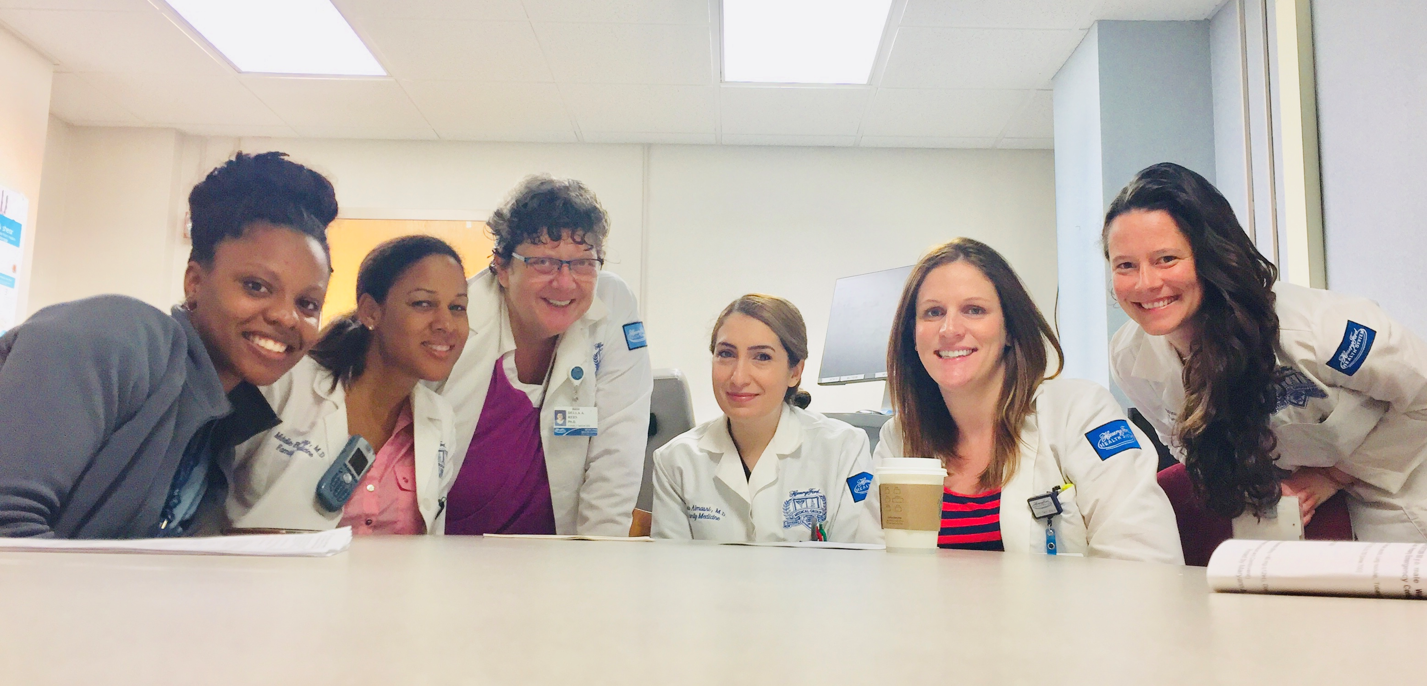
“☹ today was my last Behavior Rounds” Posted on Facebook by 2017 Graduate
Attached with permission

Slide 23
Questions
What questions can we answer?

