Slide 1
Integrating Homeless Outreach: A Longitudinal Component of Family Medicine Residency
Brian Wexler, Ph.D.
Rosa Lucas, RN, FNP-C
Valentin Nuzhny, MD
Christopher Robinson, MD
Eisenhower Health, Rancho Mirage, CA
Presented September 20, 2019
Chicago, IL

Slide 2
Disclosures
Nothing to disclose…

Slide 3
Goals and Objectives
Each participant will understand the early steps in building, or expanding, a Street Medicine team to address complex needs of rough sleepers in your community.
Each participant will be able to discuss, identify and outline resources in their community available to establish and/or expand their homeless medical outreach program.
Each participant will be able to explore ways to effectively network with educational, medical and community organizations to accomplish goals for providing services to the target population.

Slide 4
Presentation Outline:
A quick review of statistics related to homelessness, substance use and mental illness.
A review of our multi-agency multi-disciplinary team approach.
A case presentation.
A review of the financial impact of medical care for the homeless.

Slide 9
From Keck School of Medicine of USC, LA Street Medicine Symposium
ACGME Core Competencies
Patient Care that is compassionate, appropriate, and effective for the treatment of health problems and the promotion of health.
Medical Knowledge about established and evolving biomedical, clinical, and cognate (e.g. epidemiological and social-behavioral) sciences and the application of this knowledge to patient care.
Practice-Based Learning and Improvement that involves investigation and evaluation of their own patient care, appraisal and assimilation of scientific evidence, and improvements in patient care.
Interpersonal and Communication Skills that result in effective information exchange and teaming with patients, their families, and other health professionals.
Professionalism, as manifested through a commitment to carrying out professional responsibilities, adherence to ethical principles, and sensitivity to a diverse patient population.
Systems-Based Practice, as manifested by actions that demonstrate an awareness of and responsiveness to the larger context and system of health care and the ability to effectively call on system resources to provide care that is of optimal value.

Slide 10
The Scope of Homelessness
What are the statistics/prevalence of homelessness, mental illness, and substance use in the US?

Slide 11
A quick look at the overall numbers on homelessness…
There’s a lot of info out there.
United States Department of Housing and Urban Development
Point in Time Estimates of Homelessness, January 2018
552,830 homeless
https://files.hudexchange.info/resources/documents/2018-AHAR-Part-1.pdf

Slide 12
Key Findings from Point-in-Time Estimates of Homelessness 12/2018
On a single night in 2018, roughly 553,000 people were experiencing homelessness in the United States. About two-thirds (65%) were staying in sheltered locations -- emergency shelters or transitional housing programs -- and about one-third (35%) were in unsheltered locations such as on the street, in abandoned buildings, or in other places not suitable for human habitation.
Of every 10,000 people in the United States, 17 experienced homelessness on a single night in 2018.
Over half of all unsheltered homeless people are in Continuums of Care (CoCs) that encompass the nation’s 50 largest cities. Just over a fifth are in CoCs with largely rural populations.
*Continuums of Care (CoC) are local planning bodies responsible for coordinating the full range of homelessness services in a geographic area, which may cover a city, county, metropolitan area, or an entire state.

Slide 13
Key Findings from Point-in-Time Estimates of Homelessness 12/2018
On a single night in 2018, about 36,000 people were experiencing homelessness as unaccompanied youth—that is, people under the age of 25 experiencing homelessness on their own. Most unaccompanied youth (89%) were between the ages of 18 and 24. Just over half of unaccompanied youth were unsheltered (51%), a much higher rate than for all people experiencing homelessness (35%) and a somewhat higher rate than for people experiencing homelessness as individuals (48%).
African Americans are considerably overrepresented among the homeless population compared to the overall U.S. population. While accounting for 13 percent of the U.S. population, African Americans account for 40 percent of all people experiencing homelessness and 51 percent of people experiencing homelessness as members of families with children. In contrast, nearly 6 in 10 people experiencing unsheltered homelessness (most of whom do so as individuals) are white.

Slide 14
Key Findings from Point-in-Time Estimates of Homelessness 12/2018 Homelessness with Families
The number of people experiencing homelessness in families with children continued to decline, by two percent between 2017 and 2018, and by 23 percent between 2007 and 2018. In 2018, more than 180,000 people in families with children were experiencing homelessness, and most people experiencing homelessness in families with children were staying in sheltered locations (91%). A large part of the decline in family homelessness since 2007 has occurred among people staying in unsheltered locations.
In January 2018, just over 180,000 people in 56,000 families with children experienced homelessness, about 62,000 fewer people than in 2010, a 25 percent decline.

Slide 15
Key Findings from Point-in-Time Estimates of Homelessness 12/2018 Homeless Veterans
On a single night in January 2018, 37,878 veterans were experiencing homelessness, accounting for just under 9% of all homeless adults, and approximately 18 out of every 10,000 veterans in the United States.
The number of veterans experiencing homelessness declined by five percent between 2017 and 2018 and dropped by 48 percent since 2009. Decreases in veteran homelessness occurred in the number of veterans staying in both sheltered and unsheltered locations.
Between 2010 and 2018, the number of veterans experiencing homelessness was cut nearly in half (49%), a decline of 36,000 people since 2010.

Slide 18
Where are the homeless?
Half of all people experiencing homelessness were in one of five states: California (24% or 129,972 people); New York (17% or 91,897 people); Florida (6% or 31,030 people); Texas (5% or 25,310 people); or Washington (4% or 22,304 people).
California and New York had the largest numbers of people experiencing homelessness and high rates of homelessness, at 33 and 46 people per 10,000. Hawaii and Oregon also had high rates, with 46 and 35 people per 10,000. While Florida and Texas contributed large numbers of homeless people to the national estimates, they had rates of homelessness lower than the national average of 17 people per 10,000 (15 per 10,000 for Florida and 9 per 10,000 for Texas).
Nearly half of all unsheltered people in the country were in California (47% or 89,543). The state with the next largest number of people experiencing homelessness in unsheltered locations was Florida, with seven percent of the U.S. total (13,393 people)

Slide 19
Mental Illness and Homelessness. What does the research tell us?
A study by the National Institute of Mental Health (2016) found that approximately 6% of Americans are severely mentally ill, compared to the 20-25% of the homeless population that suffers from severe mental illness. Furthermore, 45% of the homeless population shows history of mental illness diagnoses.
Source: https://www.nimh.nih.gov/health/statistics/mental-illness.shtml

Slide 20
What does the research tell us?
How Many People with Serious Mental Illness Are Homeless?
“How many individuals with a serious mental illness are homeless” examines the percentage of homeless individuals with serious mental illness and their abysmal quality of life.
Approximately 33 percent of the homeless are individuals with serious mental illnesses that are untreated;
Many of these people suffer from schizophrenia, schizoaffective disorder, bipolar disorder or major depression;
The homeless population has increased steadily in cities and small towns since the 1970s;
In Massachusetts and Ohio, 27 and 36 percent of people released from mental institutions became homeless within 6 months;
Previously hospitalized people were three times more likely to obtain food from the garbage;
Studies show that psychotic individuals are much more likely to get assaulted or threatened while homeless.
Source: Treatment Advocacy Center, September 2016
https://www.treatmentadvocacycenter.org/fixing-the-system/features-and-news/2596-how-many-people-with-serious-mental-illness-are-homeless

Slide 21
Mental Illness and Homelessness What does the research tell us? Where’s the $?
Though officials believe that they are saving money by releasing patients from mental hospitals, there is a significant cost to the patient and to society at large. “In 2001, a University of Pennsylvania study that examined 5,000 homeless people with mental illnesses in New York City found that they cost taxpayers an average of $40,500 a year for their use of emergency rooms, psychiatric hospitals, shelters and prisons.”
Source: Treatment Advocacy Center
https://www.treatmentadvocacycenter.org/fixing-the-system/features-and-news/2596-how-many-people-with-serious-mental-illness-are-homeless

Slide 22
Mental Illness and Homelessness What does the research tell us?
National Coalition of the Homeless, June 2017:
According to the Treatment Advocacy Center:
One third of people experiencing homelessness in the United States suffer from some form of severe mental illness.
In a 2015 survey performed by the U.S. Conference of Mayors, twenty-two cities were asked for the three largest causes of homelessness in their communities. Mental illness was the third largest cause of homelessness for single adults (mentioned by 40% of cities). For families experiencing homelessness, mental illness was mentioned by 20% of cities as one of the top three causes.
Source: http://nationalhomeless.org/wp-content/uploads/2017/06/Mental-Illness-and-Homelessness.pdf
.

Slide 24
Substance Abuse and Homelessness What does the research tell us? National Coalition for the Homeless June 2017 Source: http://nationalhomeless.org/wp-content/uploads/2017/06/Substance-Abuse-and-Homelessness.pdf
Prevalence: “Narrowing down accurate and recent numbers on the prevalence of substance abuse is extremely difficult. Yet, most statistics prove that substance abuse is much more common among homeless people than in the general population.”
HUD’s 2013 Annual Homelessness Assessment Report states approximately 257,000 homeless people have a severe mental illness or a chronic substance abuse issue
The Substance Abuse and Mental Health Services Administration (2003) estimates, 38% of homeless people were dependent on alcohol and 26% abused other drugs.
According to the 2015 National Household Survey on Drug Use and Health (NSDUH), only 10.1% of people above the age of 12 reported using drugs within the past month.
The Substance Abuse and Mental Health Services Administration (SAMSA) found that 8.4% of adults had a substance abuse issue within the last year.
Alcohol abuse is more common in older generations, while drug abuse is more common in homeless youth and young adults (Didenko and Pankratz, 2007).

Slide 25
SAMHSA: Mental Illness & Substance Abuse in Chronic/Long-Term Homelessness Findings by the Substance Abuse and Mental Health Services Administration, July 2011 Source:https://www.samhsa.gov/sites/default/files/programs_campaigns/homelessness_programs_resources/hrc-factsheet-current-statistics-prevalence-characteristics-homelessness.pdf
Data from research conducted in the past five years indicates that:
About 30% of people who are chronically homeless have mental health conditions.
About 50% have co-occurring substance use problems.
According to analyses of data from the 1996 NSHAPC
Over 60% of people who are chronically homelessness have experienced lifetime mental health problems
Over 80% have experienced lifetime alcohol and/or drug problems
US Census Bureau: National Survey of Homeless Assistance Providers and Clients (NSHAPC)

Slide 26
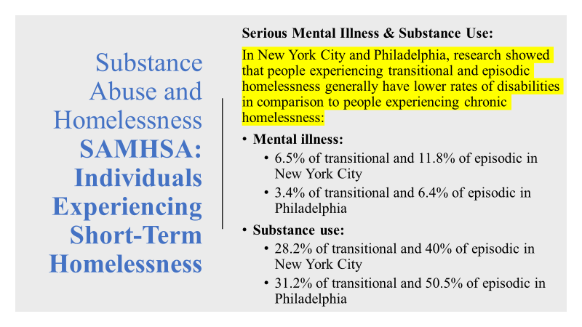

Slide 28
Info from Keck School of Medicine:

Slide 29
Developing a Multi-Disciplinary Multi-Agency Team
How our team began…
Friday
August 29, 2014

Slide 30
Meeting Jim Withers…
More than 2 years of planning…
Shared ideas through Finding Meaning in Medicine.

Slide 31
The agencies. The pieces that came together:
CVVIM. FTHC
Eisenhower and Graduate Medical Education
Family and Internal Medicine Residency Programs
Faculty support
Integration of Street Medicine into the longitudinal curriculum
Indio Police Department and the Quality of Life Program
The Narrow Door
Support from Congressman Raul Ruiz
CSUSB Nursing
… and…

Slide 32
The Mercado
What is the Mercado and why is it important?

Slide 33
Developing Forms for Street Rounds
Demographic/Intake
Consent for Treatment
SOAP Note
Substance Use Survey Form
Team Designation Form

Slide 37
CVVIM Street Medicine Brief Substance Use Questionnaire
1. Do you drink alcohol? ____No ____Yes: How much on a typical day? ______________
Have you ever had a seizure because of alcohol use? ____Yes ____No
2. Are you using any street drugs? ____No ____Yes: What have you used lately?
____Heroin ____Meth ____Marijuana ____Other _____________________________
3. Have you ever been given Narcan? ____Yes ____ No
4. Because of drug or alcohol use, have you ever been to the ER for problems including:
___abscesses, ___seizures, ___dehydration, ___stomach problems, or any ___injuries?

Slide 38
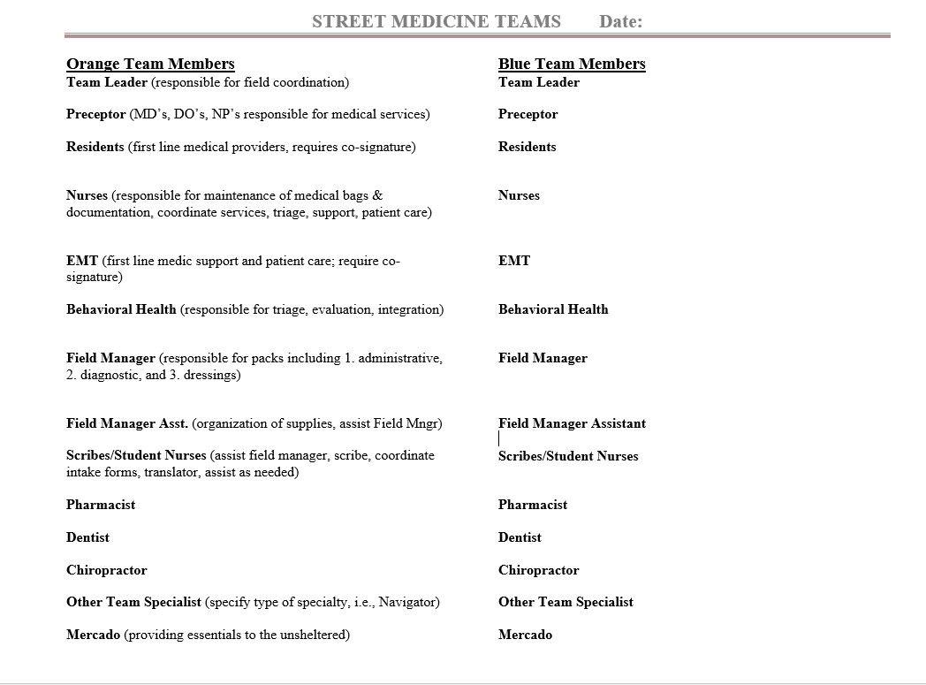

Slide 41
3 years and 3 months later… 172 consecutive Tuesdays!
Street Medicine outreach is integrated into each year during the longitudinal Family Medicine Community Health Curriculum;
Internal Medicine and Emergency Medicine Residents and faculty rotate with the team;
Collecting data to prepare for Addiction Medicine Fellows to begin a treatment program in 2020;
6 volunteers are now in medical school;
Several volunteers pursuing nursing, PA, and other professional medical programs… and…

Slide 42
6/2016 - 12/2016 = 178 encounters with 119 unique patients. Average 6.8 patients/night. 7% African American 11% Caucasian 36% Hispanic/Latino < 1% Native American 3% Other 48% unknown/refused 1/2017 - 12/2017 = 440 encounters with 240 unique patients. Average 8.5 patients/night. 2% African American 9% Caucasian 28% Hispanic/Latino < 1% Native American 2% Other 58% unknown/refused
Statistics on Street Rounds
Total encounters 6/2016 to 8/2019 = 1,383
Ages between 17 and 80; Average ages are between 40 - 60
1/2018 - 12/2018 = 449 encounters with 258 unique patients. Average 8.6 patients/night.
4% African American
10% Caucasian
24% Hispanic/Latino
0% Native American
<1% Other
61% Unknown/refused
1/2019 - 8/31/2019 = 315 encounters with 210 unique patients. Average 9.8 patients/night.
3% African American
12% Caucasian
31% Hispanic/Latino
< 1% Native American
< 1% Other
52% Unknown/refused

Slide 55
Bringing it home: A case presentation
Christopher Robinson, MD
Family Medicine Resident, PGY-3
Eisenhower Health

Slide 67
The Economic Impact of Homelessness
Valentin Nuzhny, MD
Family Medicine Resident, PGY-3
Eisenhower Health

Slide 68
Goal: To Analyze Financial Impact and Educational Benefits that Street Medicine Offers to the Coachella Valley.
Abstract
In collaboration with Volunteers in Medicine Clinic and Narrow Door, a Street Medicine team consisting of health care professionals, provides direct patient care to a significant population of homeless and unsheltered individuals in the eastern Coachella Valley in southern California. The team recently celebrated its three-year anniversary of consecutive weekly outings. Range of services varies from vital sign checks, glucose checks, to abscess drainages and splints for suspected fractures. Patients are provided with resources and encouraged to follow up at free medical clinics for continuity of care.
The goal of this research is to estimate long- and short-term cost benefits to local community hospitals given the range of services provided. We also aim to explore educational benefits for family medicine residents, given exposure to interesting pathology as well as numerous procedures.

Slide 69
Is there a need?
According to the Centers for Disease Control and Prevention (CDC), Americans made 136.1 million visits to one of the country’s nearly 5,000 emergency rooms in 2012. Approximately 20 million of the patients arrived by ambulance. About 43% of all hospital admissions originate in an emergency room.
The main reason that so many emergency room visits are for non- urgent care is that hospital ERs are required by federal law to provide care to all patients, regardless of their ability to pay. Since they can’t be turned away, patients without insurance, or the necessary funds to pay out-of-pocket costs, often utilize emergency rooms as their main health care provider. This places tremendous strain on ERs, and limits their ability to attend quickly to health emergencies.
It is estimated that more than $18 billion could be saved annually if those patients whose medical problems are considered “avoidable” or “non-urgent” were to take advantage of primary or preventive health care and not rely on ERs for their medical needs.

Slide 70
$$$....
In 2012, there were 36.5 million hospital stays in the United States, with an average length of stay of 4.5 days.
California: Hospital cost per day:
• State/local government hospitals — $2,680/day
• Non-profit hospitals — $3,500/day (Eisenhower Health)
• For profit hospitals — $2,140/day
California average admission rate for hospitals is roughly 8.5% (85/1000).
Eisenhower Medical Center admission rate is around 22%.

Slide 71
$$$....
In 2012, there were 36.5 million hospital stays in the United States, with an average length of stay of 4.5 days.
California – Hospital cost per day:
• State/local government hospitals — $2,680/day
• Non-profit hospitals — $3,500/day (Eisenhower Health)
• For profit hospitals — $2,140/day
California average admission rate for hospitals is roughly 8.5% (85/1000).
Eisenhower Medical Center admission rate is around 22%
Condition | Emergency Room Cost
Allergies | $345
Acute Bronchitis | $595
Earache | $400
Sore Throat | $525
Pink Eye | $370
Sinusitis | $617
Strep Throat | $531
Upper Respiratory Infection | $486
Urinary Tract Infection | $665
Abscess Drainage | $629

Slide 72
Where does Street Medicine come in???
Over the last three years Street Medicine volunteers provided a wide range of health-related services with primary focus on preventative medicine.
Primary Prevention—intervening before health effects occur.
Secondary Prevention—screening to identify diseases in the earliest stages.
Tertiary Prevention—managing disease post diagnosis.
Services provided include but not limited to the following: treatment of skin lesions, insect bites, allergic rashes, abscesses from IV drug use, and basic wound care.
With limited resources and equipment in the field, teams often rely on physical exam and procedural skills to manage and diagnose variety of conditions: diabetes, hypertension, coughs, colds, lung infections, arthritis and back pain. Primary prevention measures include: providing combination immunizations for tetanus (TDaP), flu vaccine, Hepatitis A vaccine, distributing condoms, and at times prophylactic antibiotics.

Slide 73
Where does Street Medicine come in???
Furthermore, substance abuse affects above 75% of the population being treated, including heroin, IV heroin, benzodiazepines, methamphetamines, crack cocaine, and alcohol. Many suffer from behavioral health/mental health issues, are often paranoid, anxious, fearful and insecure. A great majority are homeless and often prefer to live on the street because of the sense of community a settlement offers, or failure to follow/understand rules for government housing programs. This provides a unique opportunity to understand and identify with local communities and their needs. Homelessness is associated with enormous health inequalities, including shorter life expectancy, higher morbidity and greater usage of acute hospital services.
Our analysis intended to approximate long and short-term cost benefit to local community hospitals given the range of services provided.

Slide 74
Numbers…..
DATA:
May 2016 through December 15, 2018, a total of 1,160 individual contacts to 522 distinct individuals.
In 2017, 743 individual contacts to 295 distinct individuals.
In 2018 (1/1 to 12/15) we had 417 contacts with 227 distinct individuals.

Slide 75
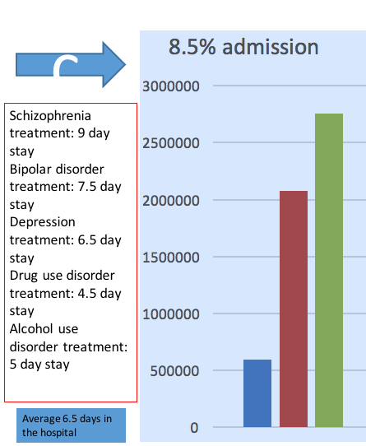
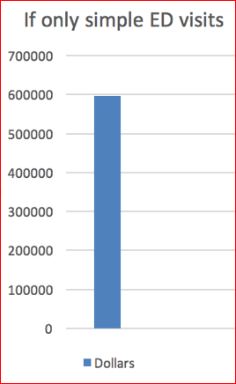
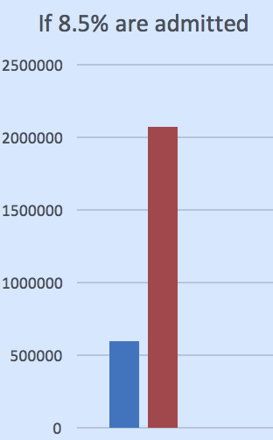
Numbers…..

Slide 76
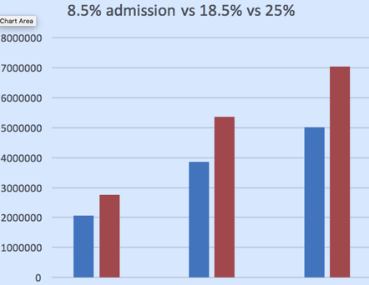

Slide 77
How does participation in Street Medicine benefit the Residents???
An email questionnaire was sent out to our resident cohort with three questions:
1. Do you feel like your experience on street medicine rotation helped you become more confident in your physical exam skills?
2. Do you feel like your experience with procedures (abscess drainage, splints, vaccination administration) on street medicine was beneficial?
3. Do you feel like your experience on street medicine made you more connected and aware of the community you serve?

Slide 78
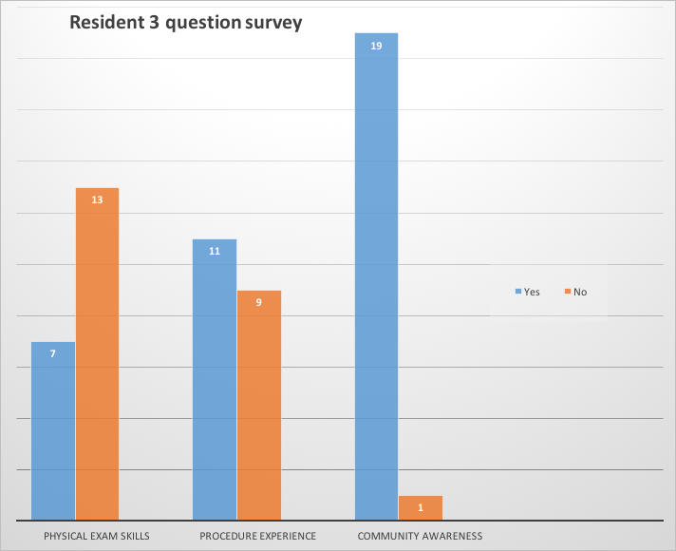
Results….

Slide 79
Conclusion
The focus of this presentation was to explore financial gain to local hospitals from having a community service like street medicine which targets the health needs of homeless population.
Although benefits are many, we were able to calculate potential financial burden hospitals avoid by way of direct patient care provided by Street Medicine volunteers as well as primary, secondary, and tertiary disease prevention.
Additionally, we postulated correctly that there is mutual benefit that resident volunteers receive in the form of being able to understand and appreciate their community, improve/perfect procedural techniques, as well as become more confident in physical examinations while relying less on common technology of hospital/clinic setting.
Street Medicine proves to be an invaluable service to the people, and to the community.

Slide 81
Resources

Slide 83
Questions?
Discussion?

Slide 84
Thank you!

