Slide 1
Building a wisdom community in residency to foster a resilient, lifelong workforce
Claudia W. Allen, PhD, JD
Theodore Siedlecki, Jr., PhD
John D. Gazewood, MD, MSPH
Kelly Grob, MD
University of Virginia Family Medicine Residency
April 30, 2019

Slide 2
Disclosures
No conflicts or funding to disclose.

Slide 3
Goals and Objectives
After the session, participants will be able to:
Describe the links between emotional intelligence and excellence in patient care, and between meaning-making and a resilient lifelong workforce.
Identify three or more ways that natural PGY bonding can be nurtured to build a wisdom community to cultivate emotional intelligence and meaning-making;
Identify and access a three-year curriculum, utilizing both PD and behavioral medicine faculty teaching, to build specific emotional intelligence, reflection and meaning-making skills.
Participants will be able to access on the STFM digital resource library:
Three-year curriculum to promote wisdom

Slide 4
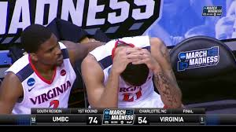
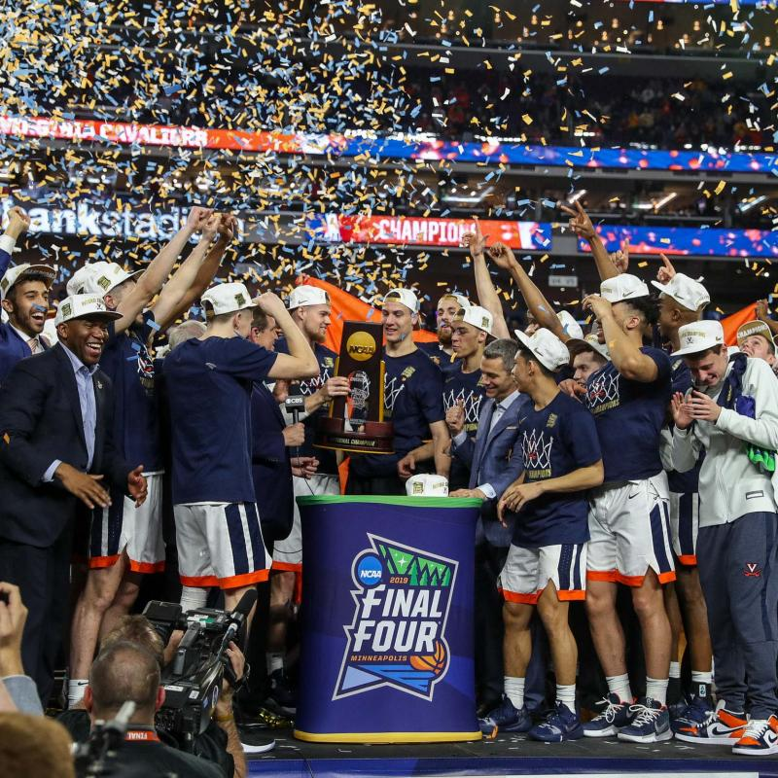
2018
2019
"If you learn to use it right, the adversity, it will buy you a ticket to a place you couldn't have gone any other way.“
Tony Bennett
UVA Coach

Slide 5
Paired reflection
Think of a time when you faced a steep challenge or experienced a failure…where your abilities and emotional capacities were exceedingly challenged; you were very stressed and may have even doubted that you could make it.
But you not only made it, you ended up a little wiser.
In pairs, share your experience, including
1) One way you ended up a little wiser, and
2) One factor that helped you gain that wisdom.

Slide 6
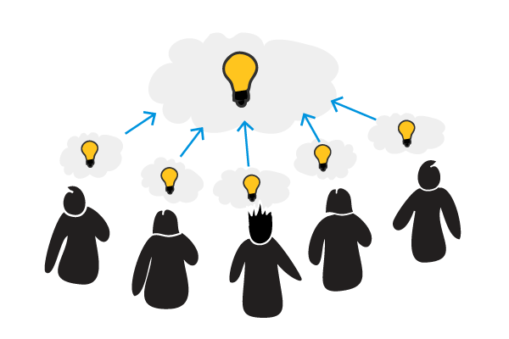
Large group sharing: How were you wiser? What helped you get there?

Slide 7
Does research support these ideas?
Emotional intelligence associated with better skills, resilience and empathy in physicians (Arora, 2010).
Reflection associated with increased performance (DiStefano et al) and improved medical diagnostic skill (Mamede et al, 2008).
Social connection associated with fewer trauma symptoms in women who experienced domestic violence.
A growth mindset associated with better performance, greater well being, greater resilience of students (Yeager and Dweck, 2012).

Slide 9
Tolerance for
Ambiguity
Perspective
Taking
Reflection
Emotional
Intelligence
Humility

Slide 10
Reflective
Cognitive
Affective

Slide 12
Reflection
Story-telling
Self-awareness
& Mindfulness
Group Support

Slide 13
Promoting Growth in Practical Wisdom Curricular Elements
Information Mastery
Professionalism/Health Equity
Resilient Practitioner
Clinical Experience
Reflection
Community

Slide 14
Community of Safety and Caring
WISDOM
Reflection
on
Clinical
Experience
Info Mastery
Medical Knowledge
P.O.E.M.
Moral Context
Professionalism
Health Equity
Resilient Practitioner
Emotional Intelligence

Slide 15
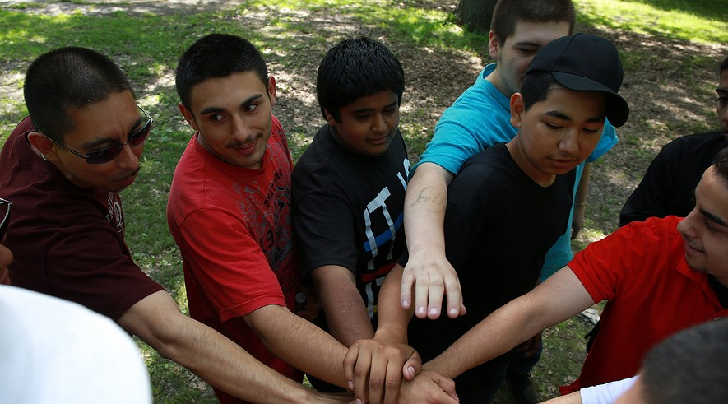
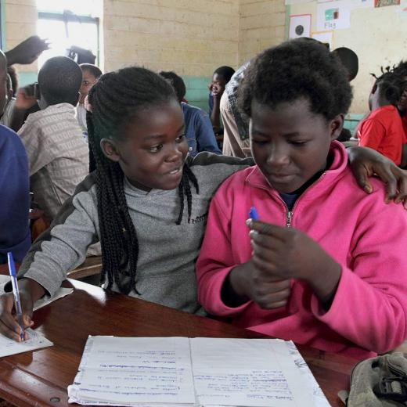
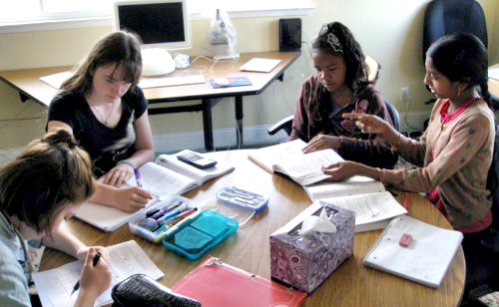
It’s not just about parent-child attachment.
Personal friendships that are “emotional, trusting and intimate” have been associated with both academic learning and emotional growth. Alexakos et al.

Slide 16
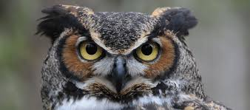
Knowledge – wisely applied
Information mastery curriculum.
Second year scholarly EBM project.
All didactics include a discussion of evidence.

Slide 17
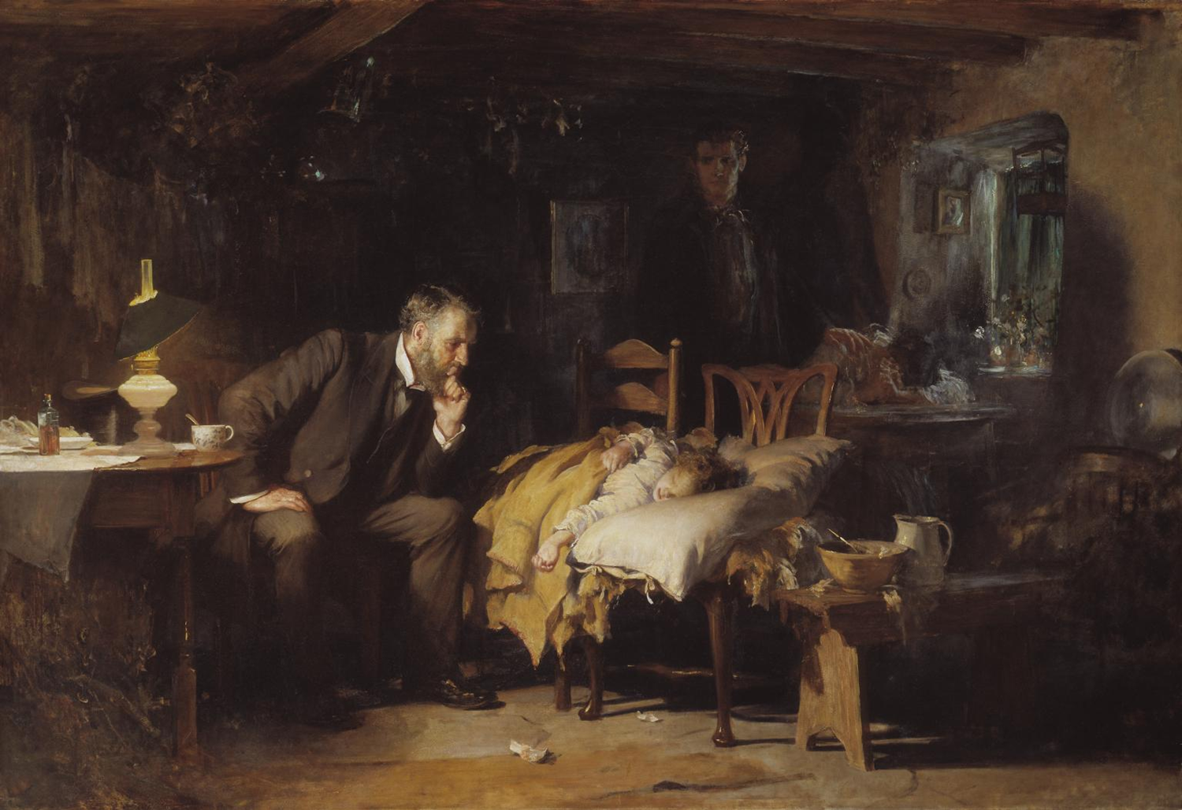
Moral Context - Professionalism

Slide 18
Moral Context - Professionalism
Professionalism Curriculum
3 years
Reading/Discussion; Reflection; Cases
Health Equity Curriculum
3 years
Lecture/discussion; self-assessment; reflection

Slide 19
Emotional Intelligence

Slide 20
A Time at a Crossroads

Slide 21
Reflection on Experience

Slide 22
Practice Inquiry
Monitor and label own and others’ emotions
Active listening
Discriminate emotions in a complex situation
Consider how emotions of self and others affect thinking and behavior
Integrate knowledge and emotion
Food
Sommers et al, Practice Inquiry: Clinical Uncertainty as a Focus for Small-Group Learning and Practice Improvement. J Gen Intern Med. 2007 Feb; 22(2): 246–252.

Slide 23
Lucia Sommers and Tina Kenyon, 2008

Slide 24
Comments from the PD

Slide 25
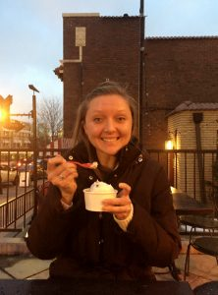
Comments from Chief Resident Kelly Grob, MD

Slide 26
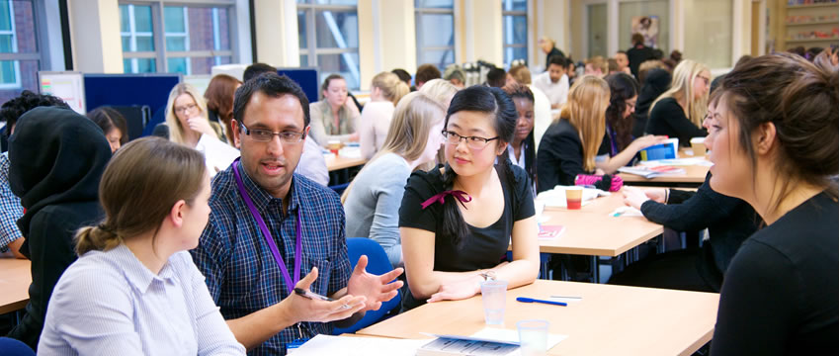
How do YOU use residency groups to grow wisdom?
In groups of 4, share.
Have each group summarize one of the ideas for the larger group.

Slide 27
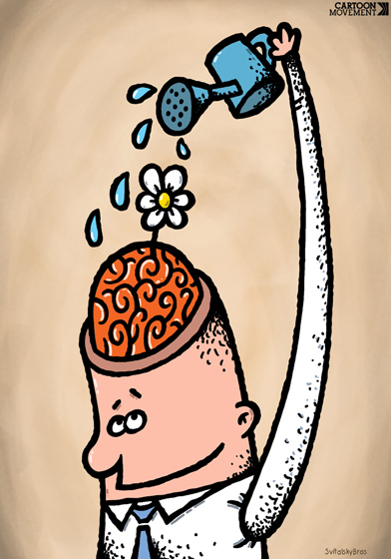
What idea have you heard today that you might try in your residency?

Slide 28
Final Comments and Questions…
Our contact information:
Claudia W. Allen, PhD cmw3u@virginia.edu
Ted Siedlecki, PhD ts6c@virginia.edu
John D. Gazewood, MD jdg3k@virginia.edu
Kelly Grob, MD keg3a@virginia.edu

