Slide 1
But I already know that! Teaching family medicine residents when they don’t know what they don’t know.
Friday, September 23, 2016
Thomas Bishop, Psy.D. | Julie Rickert, Psy.D. | Eman Jammali, M.D.
Assistant Professor of Family Medicine | Associate Professor | PGY-2 Family Medicine Resident Physician
Quillen College of Medicine/ETSU | University of North Dakota School of Medicine and Health Sciences | University of North Dakota School of Medicine and Health Sciences

Slide 2
Disclosures
Nothing to Disclose – only that we engage in cognitive bias
All of the pictures in this handout version are owned by the authors. If you are accessing this by September 28^{th (2016)}, you can access the original presentation with video clips and pictures (Fair Use Act) by clicking on and or pasting this URL into your browser: https://we.tl/lVYuG0NnOV

Slide 3
Objectives
Identify cognitive biases which may interfere with resident learning
List 3 activities to help learners become aware of their blind spots and engage actively in the learning process.
Identify challenges and opportunities for using these in a family medicine residency program

Slide 4
We Know When Things are Warmer…Right?
Video clip from:
Derek Muller (2012) “Misconceptions about temperature” Veritasium August 24, 2012 https://www.youtube.com/embed/vqDbMEdLiCs

Slide 5
Who has had this experience?
Today we are going to work on chronic pain communication scripts

Slide 6
Oh, I already know how to talk to my patients
Oops, I have to make a phone call
Oh, is that my pager?
I’m already good at that, you don’t mind if I get caught up on paperwork do you?
I have a patient in labor

Slide 7
Participation: What experiences have you had?

Slide 8
Are we rational decision-makers?
We all believe this right?
Clip from Hank Green (2014) “I love science (clean version).” Vlogbrothers April 25, 2014 https://www.youtube.com/watch?v=IC0m31P_qyk
I love Science by Hank Green and the Perfect Strangers
Used in accordance with the Fair Use Act standards. Please support the creator by visiting the original link at www. youtube.com/watch?v=IC0m31P_qyk

Slide 9
If we are all on the pro-science Evidence-Based Bandwagon, why does this happen?

Slide 10
During a discussion of the data about the effectiveness of different interventions for morbid obesity.
Video clip of Dr. Jammali, “but I know someone who….”

Slide 11
Is this the same thing?
Dr. Axe, nutrition for ADHD and “I’ve been diagnosed with ADHD my whole life.”

Slide 12
Cognitive Biases
Anchoring
Availability
Framing Effect
Visceral Bias
Confirmation Bias
Blind Obediance
Self-serving Bias
Unpacking Principle
Ogdie AR, Reilly JB, et al. Acad Med 2012

Slide 13
Cognitive Ease and Cognitive Strain
Cognitive ease feels good but makes you gullible.
Major factor for advertising
How do we see this in our medical learners?
Cognitive strain feels bad but improves critical thinking.
Availability Bias

Slide 14
Derek Muller (2016) “The illusion of truth” Veritasium July 21, 2016 https://www.youtube.com/watch?v=cebFWOlx848
Veritasium video “The illusion of truth”
Availability Bias

Slide 15
A later clip
Derek Muller (2016) “The illusion of truth” Veritasium July 21, 2016 https://www.youtube.com/watch?v=cebFWOlx848
Veritasium video
“The illusion of truth”
Availability Bias

Slide 16
Michael Shermer TED talk
Confirmation Bias
Dowsing for evidence – when you only count the hits
Michael Shermer (2008) “Why people believe weird things.” TED Talks April15, 2008. https://www.youtube.com/watch?v=8T_jwq9ph8k
Michael Shermer (2008) “Why people believe weird things.” TED Talks April15, 2008.

Slide 17
What patient situations are like this?
When do physicians dowse?
Airbourne
Magnets
Surgery for back pain
Drug seekers
Advice giving works!
Confirmation Bias

Slide 18
Video clip
I don’t care about duty hours or physician wellbeing
Visceral Bias
Notes:
Other examples: avoid things that make them feel uncomfortable (At risk drinking/SBIRT, cultural humility)

Slide 19
Emotion and Identity
Physicians push themselves.
Self-serving Bias or Blind Obedience to older expectations?

Slide 20
When you aren’t aware of a knowledge deficit
Resident Physicians are not accurate in determining their level of sleepiness.
Howard, S. K., Gaba, D. M., Rosekind, M. R., & Zarcone, V. P. (2002). The risks and implications of excessive daytime sleepiness in resident physicians. Academic Medicine, 77(10), 1019-1025.
Overconfidence Bias
Self-serving Bias

Slide 21
When you overestimate how easy it will be to learn something.
Destin Sandlin (2015) “The backwards brain bicycle.” SmarterEveryDay 133 April 24, 2015.
https://www.youtube.com/watch?v=MFzDaBzBlL0
Overconfidence Bias

Slide 22
When you think you know what your patients want
Overconfidence Bias
Healthcare Triage Clip
Aaron Carroll (2015) “Patients bossing doctors around? It’s a myth” Healthcare Triage 02/20/2015 https://www.youtube.com/watch?v=ztFS23LtMzE

Slide 23
Be very, very careful what you put into that head, because you will never, ever get it out. -Cardinal Wolsey (1471-1530) This, ironically, is a disputed quote – perhaps by Cardinal Wolsey, but illustrative nonetheless

Slide 24
Persuasion can reinforce mistaken beliefs
Aaron Carroll (2015) “Studies Confirm, Vaccines Still Don't Cause Autism. But Are These Studies Helping?” Healthcare Triage 7/13/2015 https://www.youtube.com/watch?v=j_zqBPuPx8w
Aaron Carroll Healthcare Triage 7/13/2015
Backfire Effect

Slide 25
Does this happen for us?
I wonder if my education about physician well-being reinforces previously held beliefs that “I’m fine/strong/hard-working enough, and if they would only ease up on the paperwork and documentation I have to do I’d be fine.”

Slide 26
What is going on?
What is the first knee-jerk reaction when someone says you’re wrong?

Slide 27
Motivational Interviewing
Catalina Triana has presented about incorporating MI into the process of education.

Slide 28
When faced with, “If you could make my paperwork less, that would help my well-being, but no offense – I don’t really see the point of talking about physician well-being,” what might a MI informed response look like?

Slide 29
Bias toward action or away from action
Tight glycemic control
Medication during pregnancy
Benzodiazepines
End of life care
This also appears to be a factor in people who choose not to vaccinate. Preference for sins of omission rather than commission.

Slide 30
Cognitive Biases Recognized by Residents
Cognitive Bias | %
Anchoring | 87.8%
Availability | 75.6%
Framing Effect | 56.1%
Blind Obedience | 53.7%
Unpacking | 53.7%
Confirmation | 48.8%
Diag. Momentum | 48.8%
Visceral bias | 48.8%
Ogdie AR, Reilly JB, et al. Acad Med 2012

Slide 31
The Importance of Context
Chronic Illness
Night Float
Unpacking Principle
Anchoring
Availability
Handoff
Vague History
Specialty Service
Framing Effect
Too busy
Diagnostic Momentum
Blind Obediance
Too many patients
Confirmation Bias
Lack of Confidence
Hierarchy
Transfer
Provider Fatigue
Consultants Integral
Visceral Bias
Provider Disinterest
Ogdie AR, Reilly JB, et al. Acad Med 2012
Notes:
We then examined the intersection of biases and contextual factors and have displayed here the most common.
Not powered to look at associations
Interesting and needs further study
Suspect complex interplay
31

Slide 32
Parallel process with patient bias
Sometimes it is easier to see bias in others. Then perhaps you can find it in yourself.

Slide 33
Getting a flu shot
Agenda Setting
vs
It may be a bit of a hassle.
Sometimes it may cause a bit of discomfort.
Sometimes it doesn't work.
When it does work you may never know what it protected you from.
Once you know you need it it’s too late.

Slide 34
Asking our patients to choose physical therapy instead of opioids for chronic pain
Asking our providers to let go of advice-giving and use Motivational Interviewing
vs
I’ve always done it the other way
The other way is easier
The other way seems to work
It takes too much time
I don’t believe it will work

Slide 35
Big Pharma controls the doctors – you are just shills
Look at this guy, he is just a drug seeker.

Slide 36
Don’t give options if it’s not an option
Parents who consider whether-or-not to give vaccines before birth are less likely to give them.
Agenda setting from the first patient interviews during orientation.
Scripting activity is required

Slide 37
Increase Engagement
Consider the Mythbusters method
Even though anecdotes are not science, they are good for teaching
Bringing learners to the point where the information makes sense and feels comfortable (Cognitive ease) is important.
Remember physicians are still humans

Slide 38
Referring to a study about being able to apply knowledge about the bystander effect when the information about bystander effect was presented first and subject anecdotes second and the different results when the anecdotes about subjects were provided first. Stop and pair and share after each segment
Derek Muller (2016) “Why anecdotes trump data.” Veritasium March 23, 2016 https://www.youtube.com/watch?v=s7MTM4BKZ_E
Homework: Consider watching the entire video link at end

Slide 39
How can we apply this?
Use patient examples liberally and with specific purpose.
Identify how bias might cause you to want to ignore or deny the research data.

Slide 40
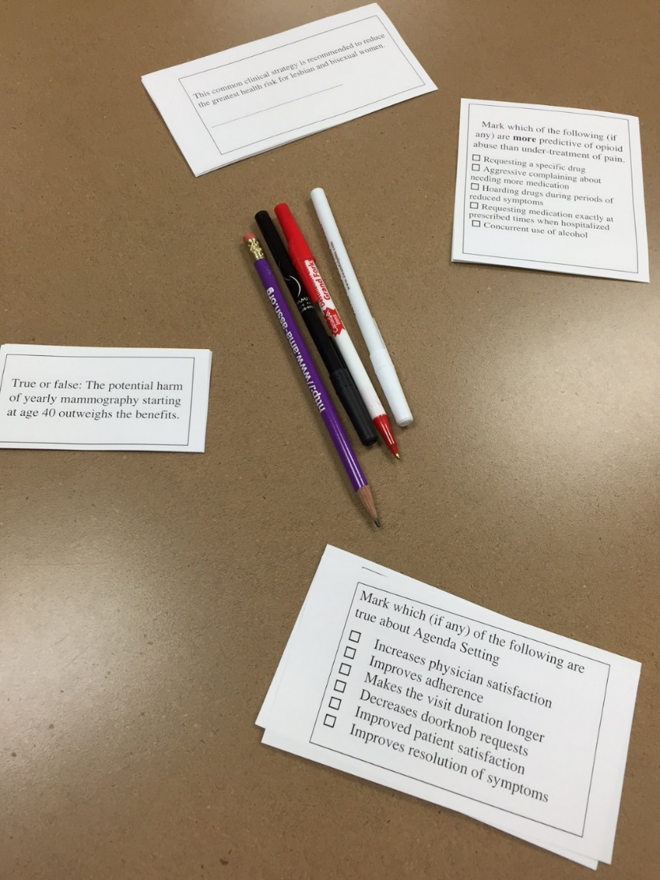
Get a little more skin in the game
Forced risk-taking
Vide clip from Derek Muller (2012) “Why do you make people look stupid?” Veritasium March 17, 2012
Use pretests and elicit biased belief.

Slide 41
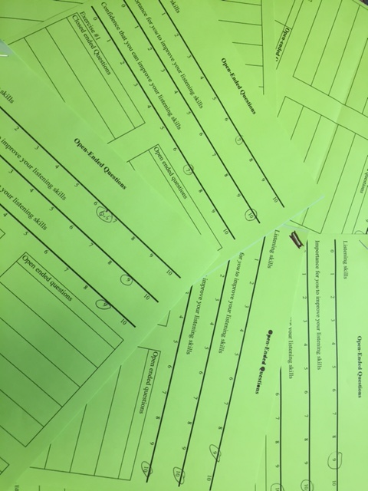
Board Review Questions

Slide 42
You all did this too at the beginning
How do you think it affected your learning?

Slide 43
Tincture of time
Resistance in your medical learners at one point of time does not mean that they won’t re-evaluate when faced with predicted experiences.

Slide 44
Video interviews of residents about Agenda Setting
“I started using Agenda setting more often when I noticed I was getting “oh by the way requests when I was out of that part of the medical record.”
“I learned over time that taking a few seconds at the beginning saved me a long time and it didn’t come at the expense of relationship or quality of care.”
“You should make them try it 5 times” [Did you notice a difference after 5 times?] “It took me a little longer.”

Slide 45
Video Interview about when the morbid obesity data kicked in
I had been working with my patient (BMI in 40s) for six months on diet and exercise, and I realized this wasn’t going to work, and that I could refer her for bariatric surgery.

Slide 46
Slowly, but surely, they will start to catch the bias in their own thinking.
Video clip: I was doing informed consent for a circumcision and because aware of how my experience and religious bias impacted my use of the AAP guidelines.

Slide 47
Now its your turn
Divide up in small groups
Spend five minutes with one of these biases
Confirmation bias
Anchoring bias
Fundamental attribution bias
Hand out the list of cognitive biases
Consider the following:
How do we recognize the bias?
How do we correct it?
How do we use its existence to help us?

Slide 48
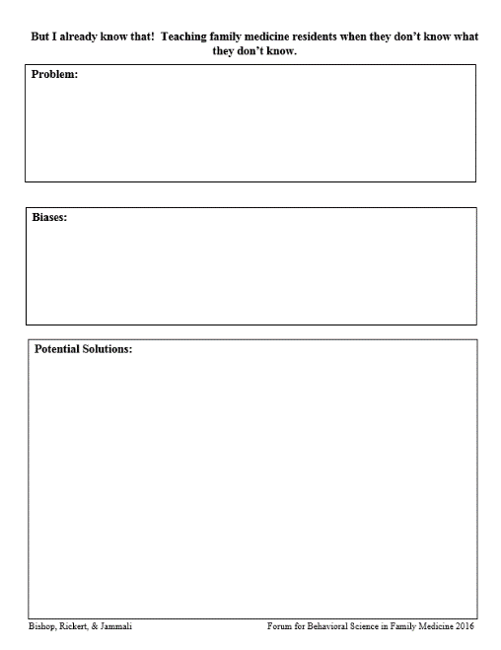
Another exercise: Please get back in your groups and pull out your problem sheet. Each group can work on one problem identified in the beginning. Identify the biases which might impact learning and potential solutions.

Slide 49
Discussion

Slide 50
Summary
Residents and humans: They are influenced by cognitive biases that interfere with learning.
Anchoring, Availability, Framing Effect, Confirmation Bias, Visceral Bias, Blind Obedience, Self-serving Bias, Overconfidence bias, Unpacking principle, among many others.

Slide 51
Summary
Many strategies can influence biases
Increase metacognition by teaching about biases and practice applying these to patient encounters and common clinical situations. (teaching slides are appended after references)
Increase awareness through pre-testing
Emphasize parallel process
Use bias to influence bias – anecdotes, rich engaging education
Take advantage of some great internet resources.(more information and links are appended after references)

Slide 52
Summary
As Family Medicine educators, we have the challenge and the duty to identify and address these human factors that interfere with learning.
Bias is pervasive: Once the initial education is complete, vigilant preceptors and peers can help address bias in most residency situations.

Slide 53
Thank you!
Please fill out the evaluations for us!
You are welcome to use any of our materials if you reference the source.
A big file with video clips will be available for downloading from WeTransfer until 9/28/16.
Go to this URL:
A stripped down and smaller version will be uploaded to STFM’s new site.
BISHOPTW@mail.etsu.edu julie.rickert@med.und.edu eman.jammali@med.und.edu

Slide 54
References These are the ones about bias, there are a few in the body that refer to the specific facts under discussion.
Croskerry, P. (2013). From mindless to mindful practice—cognitive bias and clinical decision making. N Engl J Med, 368(26), 2445-2448.
Eva, K. W., Armson, H., Holmboe, E., Lockyer, J., Loney, E., Mann, K., & Sargeant, J. (2012). Factors influencing responsiveness to feedback: on the interplay between fear, confidence, and reasoning processes. Advances in health sciences education, 17(1), 15-26.
Ogdie, A. R., Reilly, J. B., Pang, M. W. G., Keddem, M. S., Barg, F. K., Von Feldt, J. M., & Myers, J. S. (2012). Seen through their eyes: residents’ reflections on the cognitive and contextual components of diagnostic errors in medicine. Academic Medicine: Journal of the Association of American Medical Colleges, 87(10), 1361.
Shaw, D., & Elger, B. (2013). Evidence-based persuasion: an ethical imperative. Jama, 309(16), 1689-1690.

Slide 55
YouTube clips
Video clips can be very engaging.
These clips are used under the Fair Use Act (small portions used for educational purposes). We do not own the rights. Please be sure to credit the creators if you use them.
Downloading and editing keeps your presentation moving briskly – but do test for playback and audio in advance. I used Movie Maker

Slide 56
Healthcare Triage
YouTube Channel
Evidence-based medicine
Human face

Slide 57
YouTube clips
Aaron Carrol (2015) “It’s Hard to Change Physician Behavior” Healthcare Triage 03/27/2015 https://www.youtube.com/watch?v=WdU3dbdsh6U
Aaron Carroll (2015) “We’re probably screening for breast cancer too much” Healthcare Triage 04/24/2015 https://www.youtube.com/watch?v=D1mObgVdgdU
Aaron Carroll (2015) “Patients bossing doctors around? It’s a myth” Healthcare Triage 02/20/2015 https://www.youtube.com/watch?v=ztFS23LtMzE
Aaron Carroll (2015) “Studies Confirm, Vaccines Still Don't Cause Autism. But Are These Studies Helping?” Healthcare Triage 7/13/2015 https://www.youtube.com/watch?v=j_zqBPuPx8w
Aaron Carroll (2016) “Doctors and Depression” Healthcare Triage 02/23/2016 https://www.youtube.com/watch?v=3lda4KyXbLE

Slide 58
Hank Green (2014) “I love science (clean version).” Vlogbrothers April 25, 2014 https://www.youtube.com/watch?v=IC0m31P_qyk
Hank Green (2015) “The science of anti-vaccination.” SciShow February 19, 2015 https://www.youtube.com/watch?v=Rzxr9FeZf1g
Michael Shermer (2008) “Why people believe weird things.” TED Talks April15, 2008. https://www.youtube.com/watch?v=8T_jwq9ph8k
Destin Sandlin (2015) “The backwards brain bicycle.” SmarterEveryDay 133 April 24, 2015. https://www.youtube.com/watch?v=MFzDaBzBlL0

Slide 59
Derek Muller (2016) “The illusion of truth” Veritasium July 21, 2016 https://www.youtube.com/watch?v=cebFWOlx848
Derek Muller (2012) “Why do you make people look stupid?” Veritasium March 17, 2012 https://www.youtube.com/watch?v=cY_o4A1wzsg
Derek Muller (2016) “Why anecdotes trump data.” Veritasium March 23, 2016 https://www.youtube.com/watch?v=s7MTM4BKZ_E
Derek Muller (2014) “Can you solve this?” Veritasium February 24, 2014 https://www.youtube.com/watch?v=vKA4w2O61Xo
Derek Muller (2012) “Misconceptions about temperature” Veritasium August 24, 2012 https://www.youtube.com/embed/vqDbMEdLiCs

Slide 60
How About An Intervention?

Slide 61
What can we do?
First of all don’t make the fundamental attribution error!
Don’t overestimate the influence of personality characteristics
“Those millennials!”

Slide 62
Educate about bias and cognitive errors
The next group of slides are ones you can use with your medical learners.

Slide 63
Bias and the science of anti-vaccination
Hank Green (2015) “The science of anti-vaccination.” SciShow February 19, 2015 https://www.youtube.com/watch?v=Rzxr9FeZf1g

Slide 64
So, how can we overcome the confirmation bias:
Seek information that can falsify your beliefs
Helps you avoid the confirmation bias as you seek new information
Ask questions that lead to concrete answers
→ Helps you avoid the confirmation bias in interpreting information
Avoid conveying your beliefs and intentions when asking questions to your teammate or to consumers
→ Helps you prevent the confirmation bias in others
This video is useful to teach about confirmation bias. Derek Muller “Can you solve this?” Veritasium 2-24-14 https://www.youtube.com/watch?v=vKA4w2O61Xo

Slide 65
What are Some High Risk Situations?
Is this patient handed off to me from a previous shift Diagnosis momentum, framing
Was the diagnosis suggested to me by the patient, Premature closure, framing
nurse or another MD ?
Did I just accept the first diagnosis that came Anchoring, availability, search satisficing, to mind ? premature closure
Did I consider other organ systems besides the Anchoring, search satisficing, premature closure
obvious one?
Is this a patient I don’t like for some reason ? Affective bias
Was I interrupted/distracted excessively while All biases
evaluating this patient?
Did I sleep poorly last night? All biases
Am I feeling fatigued right now? All biases
Am I cognitively overloaded or over-extended All biases
right now?
Am I stereotyping this patient? Representative bias, affective bias, anchoring, fundamental attribution error
Have I effectively ruled out must-not-miss diagnoses? Anchoring, overconfidence, confirmation bias

Slide 66
5 Basic Questions to Help Avoid Cognitive Errors
What are traps I might fall into
What else can it be?
Is there anything that doesn’t fit?
Is there’s more than one thing going on?
Is this a case where I need to “slow down”?

Slide 67
Heuristics
Pattern Recognition
Illness Scripts
Gestalt
Instance Scripts
i.e “Blink”; “Thinking Fast”
Notes:
Annotations
After a single course of treatment, RTX + MTX maintained responses in the majority of patients for up to 48 weeks.
At 48 weeks, ACR20, 50, and 70 responses were significantly better for the RTX + MTX arm compared to MTX alone.
The percentage of EULAR responders was greater in the RTX + MTX arm compared to MTX alone.
CTX does not appear to provide any additional benefit over MTX, and therefore, combinations with CTX are not being pursued further in clinical trials.

Slide 68
Heuristics
Can be good:
provide cognitive “short cuts” in the face of complex situations
Help us to be efficient
Can be bad:
They tend to be thinking traps – so beware!
Can adversely influence our diagnostic decisions
Croskerry, P. Acad Med 2003; 78:775-80.
Notes:
Annotations
After a single course of treatment, RTX + MTX maintained responses in the majority of patients for up to 48 weeks.
At 48 weeks, ACR20, 50, and 70 responses were significantly better for the RTX + MTX arm compared to MTX alone.
The percentage of EULAR responders was greater in the RTX + MTX arm compared to MTX alone.
CTX does not appear to provide any additional benefit over MTX, and therefore, combinations with CTX are not being pursued further in clinical trials.

Slide 69
Cognitive De-biasing Strategies to Reduce Diagnostic Errors
Develop insight/awareness | Consider alternatives
Metacognition | Decrease reliance on memory
Specific training | Simulation
Cognitive forcing strategies | Make task easier
Minimize time pressure accountability | Feedback
**See Croskerry, 2003

Slide 70
Strategies in Decision Making
Pattern recognition
Bottom-up & Top-down processes
Rule out worst-case scenario (ROWS)
Exhaustive method
Hypothetico-deductive method
Formulation of a “short-list”
Heuristics
Rules learned on the job
Cognitive disposition to respond (CDR)

Slide 71
Bias hunter
Patient encounters, vignettes, and even memes.
Get in the habit of looking for bias.
There are 2 patient vignettes.

Slide 72
My father believed any ailment from psoriasis to poison ivy could be healed with Windex.
– My Big Fat Greek Wedding

Slide 73
Diet and exercise can improve outcomes for overweight people, so I am going to keep encouraging my 300 pound patient to go back to Nutrisystem. This guy lost over 100 pounds.
Mingrone, et. al. (2015) Lancet

Slide 74
Patient: I want to see a chiropractor for my GERD.
What effect does chiropractic treatment have on gastrointestinal (GI) disorders: a narrative review of the literature
….. One advantage of a narrative review is that it enables practitioners to learn about the effect a wide variety of treatment options have (or do not have) on a condition or group of conditions- in this case GI disorders- published in various article formats, ranging from well designed clinical trials to commentaries.
Angus, K., Asgharifar, S., & Gleberzon, B. (2015). What effect does chiropractic treatment have on gastrointestinal (GI) disorders: a narrative review of the literature. The Journal of the Canadian Chiropractic Association, 59(2), 122.
Ernst, E. (2011). Chiropractic treatment for gastrointestinal problems: a systematic review of clinical trials. Canadian Journal of Gastroenterology and Hepatology, 25(1), 39-40.

Slide 75
What examples of this do we see in the alternative medicine field?
What about traditional medicine?

Slide 76
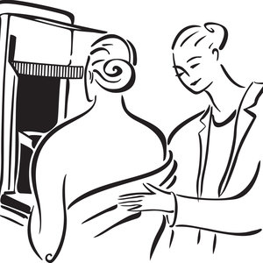
How should this affect practice?

Slide 77
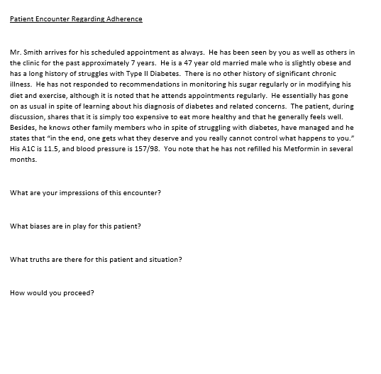
Patient encounter scripts

Slide 78
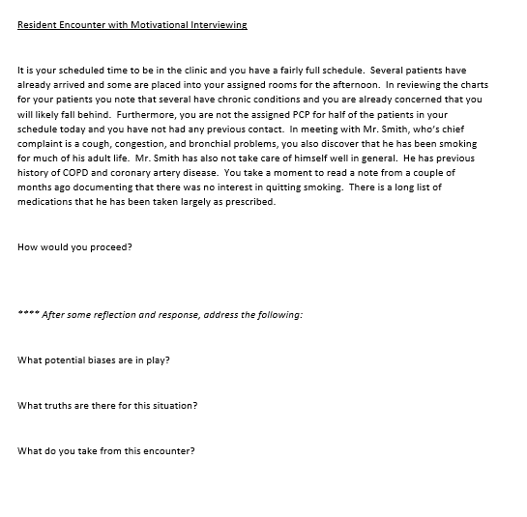
Patient encounter scripts

Slide 79
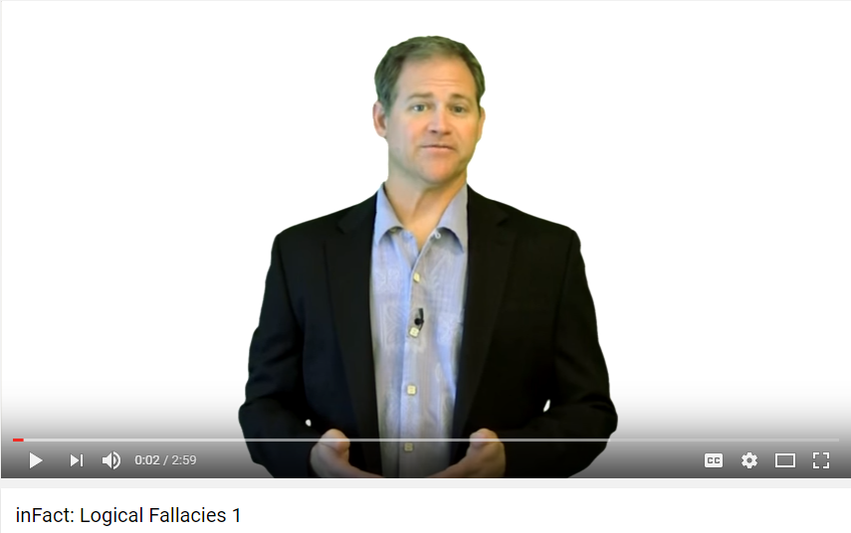
Other video resources about bias and decision-making
inFact series on logical fallacies
https://www.youtube.com/watch?v=1N3TROA8MYY
https://www.youtube.com/watch?v=Z71w-rHkeSk
https://www.youtube.com/watch?v=nmRCpqO_1JA

