Slide 1
Physician Wellness The relationship between positive state of mind and perceived stress: A CERA study
Julia Fashner, MD, MPH, FAAFP
Family Medicine Researcher
RoseAnne Illes, PhD
Director of Behavioral Medicine, Assistant Professor
FSUCOM Family Medicine Residency at Lee Health System

Slide 2
Objectives
Explore two scales to see if they can measure wellbeing.
Validate the two scales which have not been studied in family physicians.
Explore variables which may contribute to the scores on each of these scales.

Slide 3
Our research was part of a larger omnibus survey conducted by the Council of Academic Family Medicine (CAFM) Educational Research Alliance (CERA).
The request to participate was sent by e-mail to 3670 general members of the Society of Teacher of Family Medicine in January 2016 (34% response rate).
Our questions included 6 items from the validated Positive State of Mind Scale (PSOMS) and 10 items from the validated Cohen Perceived Stress Scale (CPSS).
Notes:
We received IRB permission from the American Academy of Family Physicians, Lee Memorial Health Systems and Florida State University to conduct this research project.

Slide 4
Positive State of Mind Scale
These next questions are about the kind of satisfying states of mind that you may have experiences in the past week. | Unable to have it 0 | A lot of trouble having it 1 | Some trouble having it 2 | Have it easily 3
Focused attention: Feeling able to attend to a task you want or need to, without many distractions from within yourself. | 30 2.9% | 167 16.3% | 552 53.8% | 277 27%
Productivity: Feeling of being able to stay at work until a task is finished, do something new to solve problems, or express yourself creatively. | 47 4.6% | 191 18.6% | 480 46.8% | 308 30%
Responsible Caretaking: Feeling that you are doing what you should do to take care of yourself or someone else. | 77 7.5% | 235 22.9% | 434 42.3% | 280 27.3%
Restful Repose: Feeling relaxed, without distractions or excessive tension. | 109 10.6% | 249 24.3% | 490 47.8% | 178 17.4%
Sensuous Nonsexual Pleasure: Being able to enjoy bodily senses, enjoyable intellectual activity, doing things you ordinarily like, such as listening to music, enjoying the outdoors, lounging in a hot bath. | 61 6% | 209 20.4% | 379 36.9% | 377 36.7%
Sharing: Being able to commune with others in an empathetic, close way as in talking, walking, going out, or just being together. | 23 2.2% | 81 7.9% | 394 38.4% | 528 51.5%
Notes:
The PSOMS asks about the kind of satisfying states of mind experienced in the last week.
The participant answers if he/she is unable to have it, a lot of trouble having it, some trouble having it or have it easily.
Each item is scored 0 to 3 and then totaled for all 6 items.

Slide 5
Cohen Perceived Stress Scale
The following questions ask about your feelings and thoughts during the past month. | Never 0 | Almost Never 1 | Sometimes 2 | Fairly often 3 | Very often 4
In the past month, how often have you been upset because of something that happened unexpectedly? | 40 3.9% | 315 30.7% | 517 50.4% | 133 13% | 21 2%
In the past month, how often have you felt unable to control the important things in your life? | 97 9.5% | 324 31.6% | 376 36.7% | 171 16.7% | 58 5.7%
In the past month, how often have you felt nervous or stressed? | 34 3.3% | 184 17.9% | 437 42.6% | 260 25.3% | 111 10.8%
In the past month, how often have you felt confident about your ability to handle personal problems? | 4 .4% | 41 4% | 212 20.7% | 405 39.5% | 364 35.5%
In the past month, how often have you felt that things were going your way? | 12 1.2% | 54 5.3% | 321 31.3% | 439 42.8% | 200 19.5%
In the past month, how often have you found that you could not cope with all the things you had to do? | 170 16.6% | 365 35.6% | 295 28.8% | 133 13% | 63 6.1%
In the past month, how often have you been able to control irritations in your life? | 11 1.1% | 76 7.4% | 326 31.8% | 425 41.4% | 188 18.3%
In the past month, how often have you felt that you were on top of things? | 33 3.2% | 161 15.7% | 320 31.2% | 379 37% | 133 13%
In the past month, how often have you been angry because of things that happened that were outside of your control? | 131 12.8% | 389 37.9% | 353 34.4% | 123 12% | 30 3%
In the past month, how often have you felt that difficulties were piling up so high that you could not overcome them? | 242 23.6% | 367 35.8% | 260 25.3% | 111 10.8% | 46 4.5%
Notes:
The CPSS asks about feelings and thoughts during the past month and how often the participant has felt or thought a certain way.
The responses include never, almost never, sometimes, fairly often or very often.
Each item is scored on a 5-point scale (0 to 4), with four items with italics being reversed for scoring, and then all items are totaled for the score.
An average score is 13.
Scores of 20 or higher on CPSS are considered high stress.

Slide 6
Results
Chi-square test demonstrated no statistically significant differences in gender, age, ethnicity, rank, or degree between those who did and those who did not complete our survey questions.
Using the Wilcoxon rank sum test there was no statistically significant difference for years in practice for those who were included and those not included in our statistics.
Notes:
STATA 14 was used for analysis.
Demographic questions were categorical except for years in practice, which the participant could fill in.
We had a total of 1,026 who completed all the demographic data and our questions to use for our statistics.

Slide 7
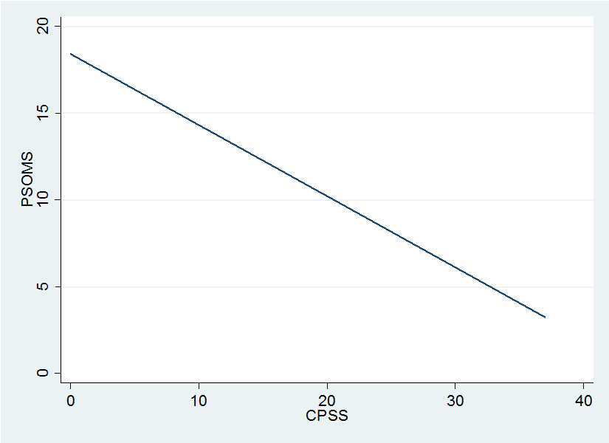
Validity
The Cronbach’s alpha for PSOMS was 0.87 and for CPSS was 0.90.
PSOMS and CPSS are negatively correlated. Coefficient = -0.41, R²=0.54, p <0.0001
Notes:
For our sample of academic family physicians, the Cronbach’s alpha for PSOMS was 0.87 and for CPSS was 0.90, showing good reliability and validating our sample.
The total scores for PSOMS and CPSS were not normally distributed
Linear regression showed that PSOMS and CPSS are negatively correlated.

Slide 8
Contributing variables
The multivariate multiple regression analysis showed the demographic variables would predict 6% of the score for PSOMS and 8% of CPSS.
Statistically significant items for PSOMS were:
Gender -0.49 (95% CI -0.97 to -.002; p=0.049)
Year 0.58 (95% CI 0.36 to 0.80; p<0.000)
Ethnicity 0.32 (95% CI 0.0028 to 0.64; p=0.048)
Significant items for CPSS were:
Gender 1.94 (95% CI 1.1 to 2.8; p<0.000)
Age -0.66 (95% CI -1.1 to -0.24; p=0.002)
Rank -0.51 (95% CI -0.85 to -0.17; p=0.003)

Slide 9
Gender differences
There were statistically significant differences between men and women for:
PSOMS mean score men 12.5 and women 11.7 (t-test P=0.0004).
CPSS mean score men 14.1 and women 16.6 (t-test P<0.0001).
Mean years in practice men 21.5 and women 15.1 (t-test p<0.0001).
Notes:
There were gender differences noted and these findings were presented by poster at AAFP FMX in Oct. 2016.
There was a statistically significant difference between men and women for mean score on PSOMS, 12.5 and 11.7 respectively (t-test P=0.0004).
There was a statistically significant difference between men and women for mean score on CPSS, 14.1 and 16.6 respectively (t-test P<0.0001).
Theses differences are not likely to be clinically significant, as it is just a difference of one point, moving from sometimes to fairly often.
There was a statistically significant difference between men and women for mean years in practice, 21.5 and 15.1 respectively (t-test, P<0.0001).

Slide 10
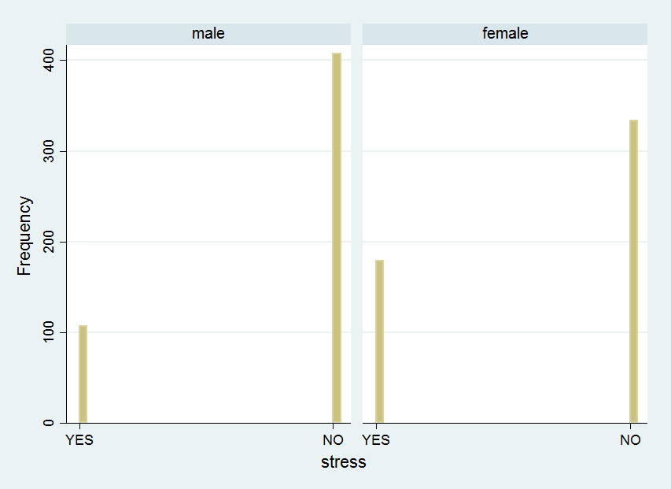
Gender difference
There was a statistically significant difference for those with high stress (score>20 on CPSS; N=296) (X²=25.52, P<0.0001).
Notes:
There were statistically significant differences between
gender and age categories (Χ2 =87.4, P<0.001)
gender and rank categories (Χ2 =87.4, P<0.001)
gender and role categories (Χ2 =16.4, P=0.012)
gender and ethnicity categories (Χ2 =17.8, P=0.001)
No statistical significant difference for gender and degree (Χ2 =0.0089, P=0.93).

Slide 11
Limitations
This is a survey of academic family medicine and may not represent the entire specialty.
This is a convenience sample with responder bias.
There are likely other moderating variables in this population that impacted responses, but were not evaluated in the survey questions particularly for women.
There are other measures used for burnout and wellness.
Notes:
This is a survey of academic family medicine and may not represent the entire specialty. Recruitment was limited to those who were on the listserve for STFM general membership.
There may be moderating variables in this population that impacted their responses, but were not evaluated in the survey questions.
There are other measures used for burnout. In the future comparing these measures to other questionnaires like ours would be beneficial.

Slide 12
Conclusions
By correlating the wellness score and stress score, we can suggest that a higher PSOMS has lower CPSS.
Women have lower PSOMS and higher CPSS.
Investigation into the context of what impacts female physicians PSOMS is necessary
There are other facets of physical, mental and emotional health, which would create a more complex picture.
Notes:
Women have lower PSOMS and higher CPSS. This may be due to better self assessment for female gender or inaccuracy/underreporting for male reporting. Further this may be an indication of the stress females experience in a male dominated career.
Age and years in practice were higher for the male gender. Medicine has been male dominated for many years and this reflects in our findings in this survey, along with rank and role of the physicians also.

Slide 13
Next steps
Change the conversation from burnout to wellness.
The ACGME has recently used a resident and fellow committee to conduct an appreciative inquiry into wellness. While mental health disorders have been the focus, one recommendation was to encourage additional study of wellness.
A CERA survey 0f program directors examined what type of stress management programming are in place. Only 50% of family medicine programs responded.
98% had access to counselors, social workers, or mental health providers
97% had support group or Balint
83% had stress management lectures or workshops
79% have resident retreat
The STFM Foundation has announced 2017 project funding for a task force on resident wellness to develop guidelines on curriculum.
Notes:
There are editorials calling for culture change in medical education. (EH 2009, Lefebvre 2012)
medical school, residency, academic medical center, hospital, accreditation organizations
In considering what can be done to promote wellness, one author
While many of the suggestions focused on mental health disease (depression),

Slide 14
Additional resources
Eckleberry-Hunt J, et al. Changing the conversation from burnout to wellness: Physician well-being in residency training programs. J Grad Med Educ. 2009.
Lefebvre D. Perspective: Resident physician wellness: A new hope. Acad Med. 2012.
Daskivich T, et al. Promotion of wellness an mental health awareness among physicians in training: Perspective of a national multispecialty panel of residents and fellows. J Grad Med Educ. 2015.
Drummond D. Physician burnout: Its origins, symptoms and five main causes. FPM. 2015.
Gardiner P, et al. The incorporation of stress management programing into family medicine residencies – results of a national survey of residency directors: A CERA study. Fam Med. 2015.
Dyrbye L and Shanafelt T. A narrative review on burnout experienced by medical students and residents. Med Educ. 2016.

