Slide 1
Collaboration at a systems level for safe and ethical Global Health Engagement
Maria Gabriela Castro MD Miko McFarland
Sam Matheny MD MPH Niamh Minion
Family & Community Medicine UK Education Abroad

Slide 2
Activity Disclaimer
ACTIVITY DISCLAIMER
It is the policy of the AAFP that all individuals in a position to control content disclose any relationships with commercial interests upon nomination/invitation of participation. Disclosure documents are reviewed for potential conflicts of interest (COI), and if identified, conflicts are resolved prior to confirmation of participation. Only those participants who had no conflict of interest or who agreed to an identified resolution process prior to their participation were involved in this CME activity.
Maria Gabriela Castro MD, Sam Matheny MD MPH, Miko McFarland and Niamh Minion have indicated they have no relevant financial relationships to disclose.

Slide 3
Learning abroad: past and present
Pictures removed for upload
Notes:
Sam
Our College of Medicine began sending students abroad in the 1960’s with the goal of preparing them for rural practice by teaching them the skills of community diagnosis, a reverse innovation that started in South Africa as Community Oriented Primary Care and was practiced in many communities. These rotations were arranged in the home countries of international fellows that had a relationship with our university. The logistics were simple - faculty corresponded about the visit, had a handshake agreement about goals and activities and the student stayed with the host faculty member. The university purchased airfare and the student was off.
Since then, the evolution of our international programs has expanded the scope of all participants - university administration, faculty and students. And nobody goes anywhere without the requisite paperwork:
Affiliation agreement
Voluntary Faculty appointment
Various insurances
Liability waivers
Signed assurances that they have reviewed and agree to all of the pertinent health and safety regulations for international travel
Participation in international rotations among medical students has increased dramatically of the last 20 years. Over 30% of medical students will participate in an international rotation during their 4 years nationally. That number is about 10% at our institution, however our cohort of students often travel multiple times during their 4 year tenure so the burden or work (and paperwork) is still significant. And most of these experiences occur within Family Medicine so we are the primary faculty responsible for creating, implementing and maintaining our opportunities and their supporting processes.
Niamh
During the same time that UK’s College of Medicine began sending students abroad on international and clinical rotations, UK faculty members were also taking students abroad. However, it was not until 1986 that an official university office was established to coordinate and oversee the logistics for student travel. Since then, the Education Abroad, as part of the University of Kentucky International Center has expanded to become a comprehensive resource for international experiences for students.

Slide 4
Agenda
Question for today: How can health colleges and international program offices
collaborate to improve international learning experiences for health profession students?
What we will discuss:
Common and uncommon health & safety risks
Role of international programs office
Our collaboration for better learning
Notes:
Audience: What kind of programs do you represent?
Medical Student? Resident? Community?
MgC
Several publications describe best practices and core competencies for pre-departure training, however we did not find any mention of collaboration with international program offices like EA. Historically these programs have only supported undergraduate education. However as global health programs expand to include a variety of health professions and other learners, there appears to be a natural alignment and incentive to at least share processes and resources, and ideally to develop these processes and resources together. To that end,
Describe common and uncommon health and safety situations encountered on international rotations, the questions these bring up for medical educators
Describe the role of the international programs office including the systems and resources in place institutionally to address these common and uncommon risks
Outline the steps that we took and describe our collaboration between the college of medicine and international programs office to support educational, health and safety goals for global health learners
We describe the experience for college of medicine but plan to generalize this model for use among all health colleges at our institution

Slide 5
One case
Institutional prep: no gloves
Student prep: no training
Our prep: no plan
Mvc pics removed for upload
Notes:
Sam
This was eye-opening. About 5 years ago three of our medical students were some of the first responders to a major collision while on rotation at Zimba Mission Hospital in Zambia.
10+ people in pickup truck, head on collision, several casualties immediately and impending; major trauma; students called to assist - no supplies, no gloves, no plan for emergency preparedness
What is the local protocol in the event of an exposure?
What prophylaxis is available on site - if any?
What should student be instructed about returning for treatment to the United States?
What other precautionary measures should be addressed?
This event captured our attention in terms of reviewing our protocols for safety.

Slide 6
More cases
Illness
Intoxication
Political demonstrations
HIV exposure
Natural disasters
Pics removed for upload
Notes:
Less
Diarrheal illness (most common) alone and in groups
Intoxication, hangovers
Political protests, no students involved
Needlestick injury in surgery from HIV + source
What pre-departure training/preparation did the student receive in order to respond to emergency situations?
What information do students have about exposure to blood-borne pathogens?

Slide 7
What we haven’t seen (yet)
Common health & safety scenarios managed by an International Office:
Behavioral infractions or crime
Sexual misconduct
Mental health
Injury or hospitalization
Death
Acts of terrorism
and more ...
Pics removed for upload
Notes:
MgC
But what we’ve seen is just the tip of the iceberg. As responsible faculty, we have the following questions:
Who is accounting for the safety and well-being of affected students and faculty?
Who is following the developments of this incident and what is the crisis response protocol?
Who is reporting to senior leadership? Who is fielding news media requests?
When should parents and emergency contacts be alerted? And by whom?
So we recognized that we needed a larger scope of protocol and resources to address the needs of all the stakeholders in addition to just handling the situation with the student.
NIAMH, CAN YOU SPEAK TO THIS SECTION? Yes
These are some other Health & Safety Scenarios Commonly Managed by an International Office. These scenarios can scale from impacting one individual, a group of students or an entire region. Some of these are more serious or involve other stakeholders. In the event of health or safety threats, we might need to think about our response to:
Student, student’s family
Host faculty, organization
Local authorities
Supervising faculty member
College and University leadership - dean, provost, president
Media

Slide 8
The Role of a Central International Office
Scope can vary by institution, but is guided by national standards
e.g. The Forum on Education Abroad’s Standards of Good Practice
Coordination of institutional resources and expertise
e.g. Dean of Students, International Risk Management, Counseling Center, etc.
Compliance with institutional and/or state and federal regs
e.g. Institutional policies and on international academic travel, Clery Act, Title IX, VAWA
Pre-departure support of rotation students
e.g. University of Minnesota’s Global Ambassadors for Patient Safety (GAPS) Training
Notes:
Miko
Central international offices facilitate academic programming abroad - traditionally at the undergraduate level - by partnering with other academic departments, third party party (or affiliate) providers and non-U.S. institutions. The breadth of experiences and programming may vary by institution, but can include study, intern, research, service or teaching opportunities. Traditionally, the field of education abroad has largely been focused on the academic/skill development and personal growth benefits of being immersed in another culture (i.e. studying abroad helps students be open-minded, become better problem solvers, cope with ambiguity, think about their discipline within an international context). However, the terrorist attacks on 9/11 created a paradigm shift that continues to gain momentum today, especially in reaction to the current global climate following the terrorist attacks in Paris fall 2015. That shift paradigm shift has led to greater institutional focus on the health, safety, security and accountability of all student travelers, not just undergraduates. We are tasked with preparing students and training faculty to appropriately respond in the event of an international emergency.
So what credibility and value can we bring to the table in supporting medical students abroad?
Our profession is guided by national standards, both scholars and practitioners who actively engage in research, educational training, quality assurance and data collection in order to promote best practices in education abroad programming.
Centralized international offices should be well-connected to other institutional expertise that allows us to respond to an emergency with a collective voice. So for example, we work closely with offices such as Legal Counsel, Dean of Students, International Risk Management and the professional counseling staff.
If you are situated at a public or Title IV- funded institution, your university may be required to comply with federal regulations that govern student health and safety reporting under the Jeanne Clery Act, Title IX and VAWA. International offices should be well-versed in these requirements for the purposes of international education.
Most international offices are already supporting undergraduate student travelers prior to departure. More sophisticated units are supporting students pre-, during and post-experience. There will be international travel resources and expertise that may serve multiple student populations, including medical students. For example, University of Minnesota’s Learning Abroad Center supports GAPS, a free and publically accessible patient safety training program.
What additional health and safety resources could be accessible through your institution’s international office? (next slide)

Slide 9
International Health & Safety Resources:
External Resources:
U.S. Department of State
U.S. Embassies
Smart Traveller Enrollment Program
International Medical Insurance and Risk Consultancies
Overseas Security Advisory Council
CDC traveler’s health information
Best practices from benchmark Institutions
Institutional resources coordinated through EA:
Student Health Services including Behavioral Health
Travel Clinic
University Insurances - travel, medical, malpractice
Senior International Officer
International Risk Management
Dean of Students
Legal Counsel
Disabilities Resources
Institutional Compliance Coordinators
Institutional Public Relations
Notes:
Miko
International office’s health, safety and security response protocol should be informed by external resources and guided by internal (or institutional) ones:
One such example is available as a handout at the table, which is a pamphlet produced by one of education abroad’s leading national associations: The Forum on Education Abroad. This document addresses the scope of an international office (with regards to health and safety preparedness) and the charge we maintain to 1.) Plan and Prepare; 2.) Train and Teach 3.) Respond and Communicate; 4.) Assess and Improve
NIAMH - Should we prepare a handout to share on PEP prophylaxis and/or the health care student handbook? - we can upload as an e-resources to fmdrl so that they have it for reference - the handbook has not been stylized but we could add it afterwards to the online resources if all agree
We would also like to share a handout of the external resources you see here, which encompasses the scope of resources that should or could be referenced to inform an institution’s decision on how to respond to a crisis. For example, we often use the U.S. Department of State’s alert/warning system as a yardstick to assess the level of risk associated with travel to that country.
International offices should - in theory - have access to additional institutional expertise and may be well-versed in managing the issues you all raised toward the beginning of this presentation. Based on the nature and scale of the incident, an international office would upon one or more of these institutional resources to guide and support a crisis response.
Are there any questions about the offices listed? This list is not exhaustive of all resources, so what other office may be included or helpful in supporting the health and safety of medical students?
To set the stage, we are an office that facilitates international academic programming, adheres to national best practices and are guided by both external resources and institutional expertise in order to mitigate risk to our students, faculty and the institution…(next slide).

Slide 10
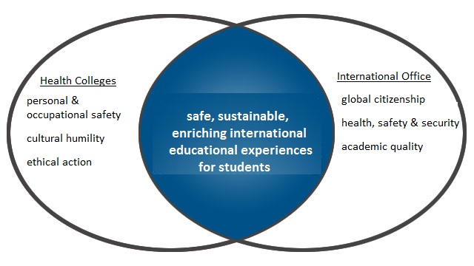
Similar goals, parallel processes,
overlapping responsibilities
Notes:
MgC: goals, processes
Our common goals is to create safe, sustainable, enriching international educational experiences for students
As health colleges, that includes teaching our students about several things that might not be pertinent outside the health professions :
personal and occupational safety specific to a clinical environment and specific to the geographic site
This includes guidance for exposure to blood-borne pathogens and treatment with HIV post-exposure prophylaxis
it also includes making our students aware of the cultural and power dynamics with patients and with the host community
including potential negative impacts and invisible costs to our host partners
Finally, it includes addressing the scope of supervised and unsupervised clinical activities in order to preserve patient privacy and safety.
EA’s mission is similarly to develop global citizenship, maintain health, safety and security and ensure academic quality of programs.
It’s evident that we have similar goals, parallel processes and overlapping areas of responsibility.
So the work ahead of us was to share information about our processes and then redesign them to reduce unnecessary redundancies, to cover gaps, to deliberately reinforce critical areas then add the remaining elements within our separate areas of expertise.

Slide 11
Our Collaborative Model:
roles and responsibilities
Health Colleges
Site and faculty selection
Student selection
Scholarships*
Course goals & objectives
Predeparture Training*
Global Health Ethics
Cultural Humility
Site specific health & safety
Partner site communication
Education Abroad
Data collection & management
Rotation and scholarship application*
Scholarships*
Predeparture Training*
General travel health & safety
Emergency preparedness
Travel, medical, malpractice insurance*
Emergency contacts
* common items
Notes:
MgC:
So this shows how we outlined our roles and responsibilities, specifically the shared aspects of our model are marked.
As health professions faculty we know our students and we know the educational aims of our programs, therefore we had to become involved in selection and funding preferences. We also have to direct the predeparture training with regard to the course goals, and the content specifc to health professions training.
EA - Niamh:
We address academic, travel safety and cultural implications for undergraduate and non-clinical travelers. Our contribution as the centralized international office was to provide informational sessions on travel logistics, university protocols for health and safety, to clarify lines of communication in the event or emergencies and to demystify the process of the various insurances.
EA Goals for safety and logistics- institutional support from international office - NIAMH AGAIN?
International crisis communication protocol
Travel medical insurance
General travel logistics(i.e. communication, packing, etc.)
Pre-Departure Orientation:: standardization of university required information, reducing redundancy
Faculty training for on site faculty program directors
Site specific information - Collaboration between GHI and UKIC
Specific travel logistics (i.e. immunizations, PEP, transportation)
Cultural considerations
Passport and Visas

Slide 12
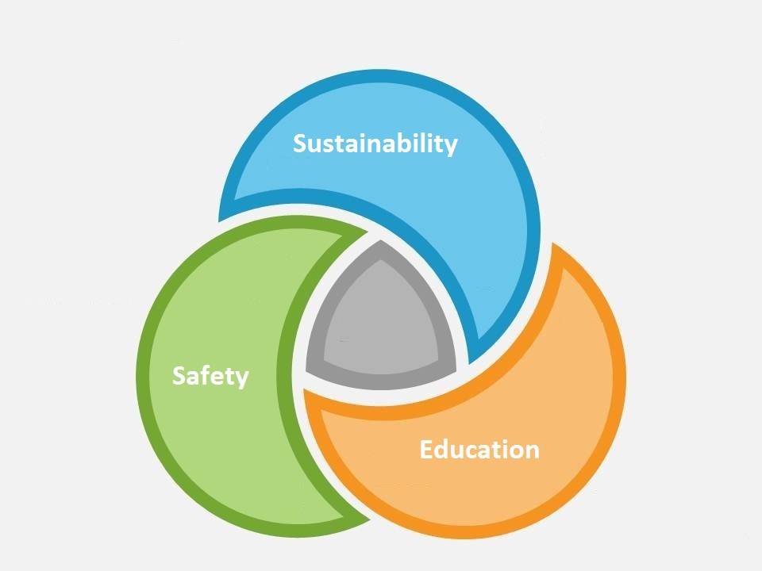
Establishing our collaborative model
Bidirectional communication between program leadership about goals, needs and scope
Alignment of best-practices from both fields
Joint adaptation of processes and protocols for mutual benefit
Identification of barriers
Close communication around events for continuous process improvement
Notes:
MgC this is what it took to put our model together
Establish bidirectional communication to learn about goals, needs and scope
Health colleges will need to communicate about trainee needs
Specifically: are these clinical, research or other experiences;
What will their goals and objectives?
What risks are associated with their roles and responsibilities on this rotation?
What resources does the host site have?
What type of services does your CIO provide?
2. Look for alignment in best-practices from each field
to understand other factors driving the process
3. Learn and adapty your processes and protocols for mutual benefit
Jointly adapt health trainee preparation and event management processes and protocols
4. Identify barriers that hold you back
What is keeping you from working together? software, calendars, culture?
5. Communicate closely on incidents to best use resources and improve the process:

Slide 13
Results
Centralized data collection Joint Predeparture Training Crisis Response
Notes:
MgC: the solutions
Here are 3 examples of opportunities for alignment that we found
Common application: Students are entered directly into their db but can also indicate site preferences and apply for scholarships. EA will keep the db but we have access to the same information about site preferences and we can supply the site information that students won’t necessarily have.
Common selection and funding process: We also had separate scholarship applications so some students who we didn’t select for the rotation received funding through EA under different criteria. We now have a course director advise the committee regarding funding preferences.
Joint orientation: we had difficulty getting students to individually attend the standard EA sessions, so invited EA to participate in the mandatory orientation to address problems and questions that students had regarding the EA application. This reduced the number of times that EA had to answer the same question and it increase the rate of app completion among our students. We have also prepared joint predeparture orientations for other courses imminent to travel to review travel logistics, concerns about safety and intentionally remind them of important protocols. And EA is much better positioned to do so than we are.
Improved communication - as a results of all these changes, we actually have a better understanding of how we can work synergistically toward our common goals

Slide 14
Our lessons learned
Program culture and structure can be a barrier to collaboration
Recognizing common goals can help us integrate parallel processes
Synergizing expertise enhances educational experiences
Colocation improves communication
Shared process development -> improved outcomes
Notes:
Sam
Collaboration between medical educators and campus international educators strengthens the policies, procedures and technology that support global health initiatives for all health professions.
We feel that the following components are key to a collaborative approach:
Initial communication about the scope - while we list general responsibilities for each partner here, the nature of your collaboration will be unique to your setting. Before discussing the individual time, effort and support that each will provider, a focus on program needs with a frank discussion about what you are doing and what you are not doing yet will open up opportunities for discussion. differ among programs.
Some of the major challenges in working across departments and disciplines are mundane things but can put an immediate halt to collaboration - understanding the systems within which another department or discipline is working will be key to finding opportunites for synergy. In our case this was understanding their goals, responsibilities and scope of work, software, processes and protocols
Finally, finding the low hanging fruit - where are your gaps and redundancies, how can you divide and conquer or work synergistically to reduce the burden on either without leaving behind important responsibilities

Slide 15
How to get started?
Identify international program administrators
Start a conversation to discuss goals and scope
Identify gaps and synergies between programs
Communicate as you operationalize
Notes:
NIAMH, COULD YOU DO THIS SLIDE? YES
I THINK THIS IS A GREAT CLOSING STATEMENT AND RECOMMEND THAT WE MOVE THIS TO THE LAST SLIDE:
While we have ultimate responsibility for preparing students and creating safe and valuable educational experiences, our expertise lies in the theoretical more so than the practical aspects of intersecting with university and international systems in these matters and our efforts are best directed to designing the educational experience. However, our responsibility to the student and to the university is best met by interfacing with our centralized international office to avail ourselves of their structure and access to resources.

Slide 16
Thanks and please rate our session!

