Slide 1
Building Skills for Reflective Practice to Create Meaning in Medicine
Amy M. Romain, LMSW, ACSW
Amy J. Odom, DO
Sparrow/MSU Family Medicine Residency Program

Slide 2
Disclosures
We have nothing to disclose.
image removed

Slide 3
Goals and Objectives
1.Describe the importance of including a focus on reflective practice in your curriculum.
2.Obtain, adapt and implement one or more reflective experiences in your program.
3.Create evaluations of the reflective experiences that link to professionalism sub competencies in Milestones 2.0.

Slide 4
Agenda
Reflective Practice Defined
ACGME Requirements and Milestones
Overview of Longitudinal Reflective Practice Curriculum
Thoughts on Evaluation
Engagement Tips
Discussion
image removed

Slide 5
Reflective Practice
image removed
Notes:
AO Definition
Why it’s important
epstein ?
Signpost the resources

Slide 6
ACGME Common Program Requirements for Family Medicine
Self - Reflection is a thread that goes through the wellbeing requirements but more importantly is core to professional and personal growth
Pages 50-51 of ACGME Common Program Requirements for FM
“Wellbeing” - proactive attention to life inside and outside of medicine
ACGME Common Program Requirements for Family Medicine. Revised: June 2019; effective: July 1, 2019. Retrieved on 10/20/20 from https://acgme.org/Specialties/Program-Requirements-and-FAQs-and-Applications
Notes:
Well-Being - Psychological, emotional, and physical well-being are critical in the development of the competent, caring, and resilient physician and require proactive attention to life inside and outside of medicine. Well-being requires that physicians retain the joy in medicine while managing their own real-life stresses. Self-care and responsibility to support other members of the health care team are important components of professionalism; they are also skills that must be modeled, learned, and nurtured in the context of other aspects of residency training. Family Medicine Residents and faculty members are at risk for burnout and depression. Programs, in partnership with their Sponsoring Institutions, have the same responsibility to address well-being as other aspects of resident competence. Physicians and all members of the health care team share responsibility for the well-being of each other. For example, a culture which encourages covering for colleagues after an illness without the expectation of reciprocity reflects the ideal of professionalism. A positive culture in a clinical learning environment models constructive behaviors, and prepares residents with the skills and attitudes needed to thrive throughout their careers.

Slide 7
The Core of Reflective Practice Curriculum
Residents will be competent in looking inward and asking themselves:
Who Am I?
How am I doing?
What do I need?
Why is/isn’t this meaningful?
What can I do about it?
How can I grow?
Notes:
AR competent - it doesn’t have to be comfortable
How am i doing (what am I thinking/feeling)

Slide 8
Reflective Practice Curriculum Overview
image reflecting our curriculum as a ferris wheel removed
Notes:
AO Much of what we do, we learned from our colleagues in the STFM Family and Behavioral Health Collaborative and here at the Forum
Examples of brief discussions – check in/prompts
Self compassion - tell and do AR
Positive Psych - AR
Life management skills- (margin /quad, self management goals )
Art examples – show pictures AO
Reflective writing examples – go do one and return for discussion AO
Book clubs- using other works to guide discussion and reflection AR
Giving/Receiving Feedback - looking inward, listening, being open to what you see AO

Slide 9
Mindfulness
Guided Discussions
Self-
Compassion
Positive Psychology
Who am I?
What can I do about it?
How can I grow?
Feedback
Why is this meaningful?
Life Management Skills
What do I need?
How am I doing?
Book Clubs
Art
Reflective
Writing
Notes:
AO
curriculum wheel for reflective practice
constantly using/ changing/ exchanging, not set in stone
ideas flow on and off like people on a f

Slide 10
Brief, Guided Discussions
Intentional prompts used during small group gatherings
Encourage reflective thinking
Have a shared experience with peers
Process difficulties
Capitalize on the positives
Improve empathic listening skills
Notes:
AO
Check in for SSS and BMR Guided discussions during wellness lunch

Slide 11
What is a change you have made in your personal life during the pandemic ?
Tell us about something for which you are thankful.
Tell us something good that has happened to you recently and describe your role in that event.
Tell us about a struggle or challenge you are experiencing… and something you are celebrating.
As you reflect on the past year, what are you most proud of?
What is something you’ve done for your wellbeing in the past few weeks?
Notes:
AO- infuse positive psych, vulnerability, and self compassion into discussions
allow sadness and discomfort , model it
be able to sit with the suffering of others and
be able to celebrate
responsive to what is happening in the moment
not balliant
A lot has happened in 2020 we have been responding to pain and supporting others - what is something that you have done for yourself?

Slide 12
Take a moment to reflect and share in the chat box...
A lot has happened in 2020, we have been responding to rapid changes, losses, challenges and supporting others.
What is something you do to cope with these challenging times?
Notes:
5 min time limit?

Slide 13
Mindfulness
Overview
Evidence
Practice a variety of skills
Breathing
Progressive muscle relaxation
Guided Imagery
Meditation
image removed
Notes:
AR -
Begin with Brene Brown Vulnerability during BMR - core… sign post the invitation and give permission to be vulnerable as an important first step to growing
Start in the intern year in BMR, workshop on Mindfulness - introduce concept and prior knowledge/experience. Sample mindfulness skills and engage in brief Meditation, breathing exercises, progressive muscle relaxation, guided imagery in a variety of learning settings to help them get a little more comfortable. Small dose, move slowly, allow safety in process and role with resistance
Self-compassion - tie in to negative self-talk and feeling uniquely flawed. Fight, flight, freeze translation to …. site neff +
Tell one/do one - loving kindness meditation vs. rock in rolling river

Slide 14
Self-Compassion
Core concepts and evidence
Physiology of Self-Criticism
Apply to personal situation
Listen for it and revisit
Practice Skills
Loving Kindness Meditation
Self-Compassion Letter
image removed
Notes:
AR
Self-compassion - tie in to negative self-talk and feeling uniquely flawed.
Physiology of self-criticism and how it triggers the Fight, flight, freeze response Sharpen our ability to listen for the self-criticism and then revisit the concept and practice of self compassion
Lead loving kindness meditations or do an exercise where the residents write themselves a letter (as if they were writing to a dear friend) about the struggle they are experiencing There are lots of great resources out there - Kristin Neff and Chris Germer

Slide 15
Positive Psychology
Positive Psych. overview
Evidence
Practice skills together
3 Good Things
Gratitude Letter
Make it part of culture
Guides “check in”, staff meetings
Role model re-framing or evoking the positives
Name it
image removed
Notes:
AR
teaching resource on STFM Resource Library from Linda Myerholtz, PhD Martin Seligman Shawn Achor - The Happiness Advantage & Ted Talk start in intern year… then try to make part of the culture, names (add citations/resources). Gretchen Rubin ted talk
the evidence … ways to practice positive psych: satisficing, capitalization, gratitude, 3 good things
Share the “lesson from the sun flowers”

Slide 16
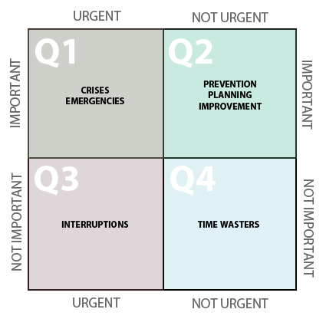
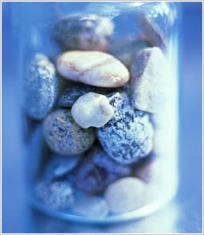
Life Management Skills
“Margin is the space between our load and our limits”
Swenson, R. A. (2004). Margin: Restoring Emotional, Physical, Financial, and Time Reserves to Overloaded Lives. Rev. ed. Colorado Springs, CO: NavPress.
Covey, Stephen R. (2004). The 7 Habits Of Highly Effective People: Restoring The Character Ethic. New York : Free Press.
Swenson, R. A. (2004). Margin: restoring emotional, physical, financial, and time reserves to overloaded lives / Richard A. Swenson. Rev. ed. Colorado Springs, CO: NavPress.
Notes:
AO Margins/quadrants personal goal setting wellness goals/ learning goals
Big Rocks
Reflective work for personal growth translate what we do in medicine into our personal growth

Slide 17
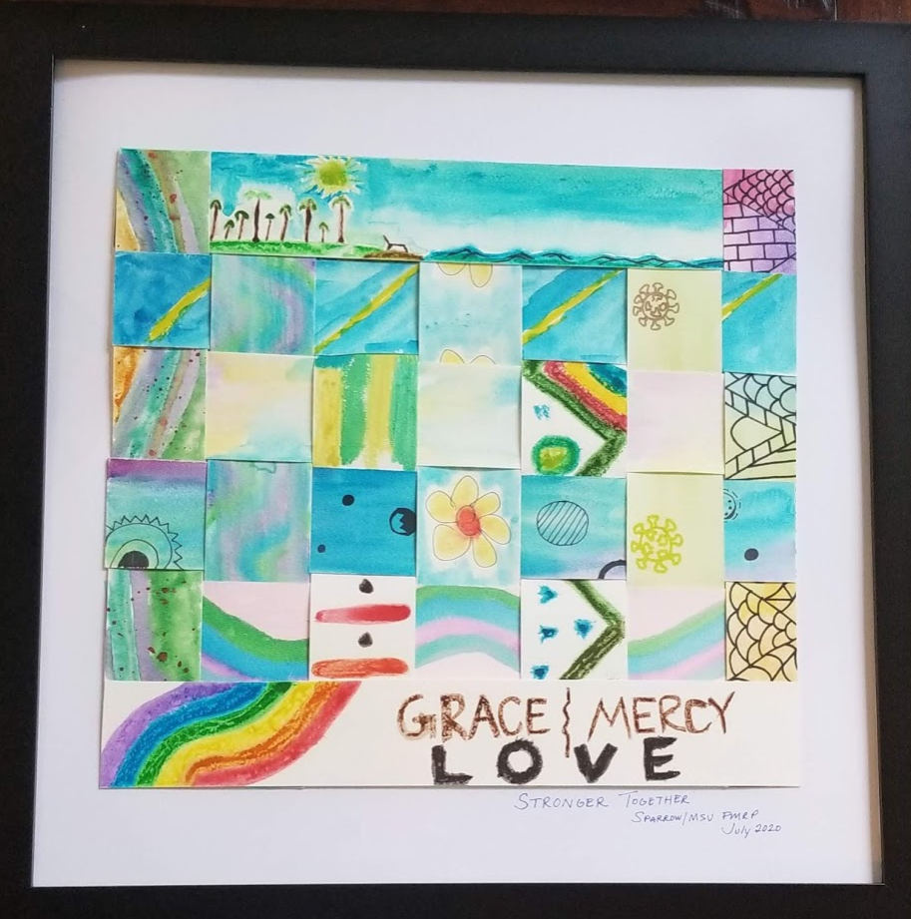
Art
Reflection through process, product and sharing stories
Notes:
AO Art- as a program (wing pictures/ weaving pictures)
Who am I -
Art as a process (therapy) = retreat pictures collective work
Offer a variety of mediums - low bar, make it safe and fun
Life maps
photovoice
digital pictures

Slide 18
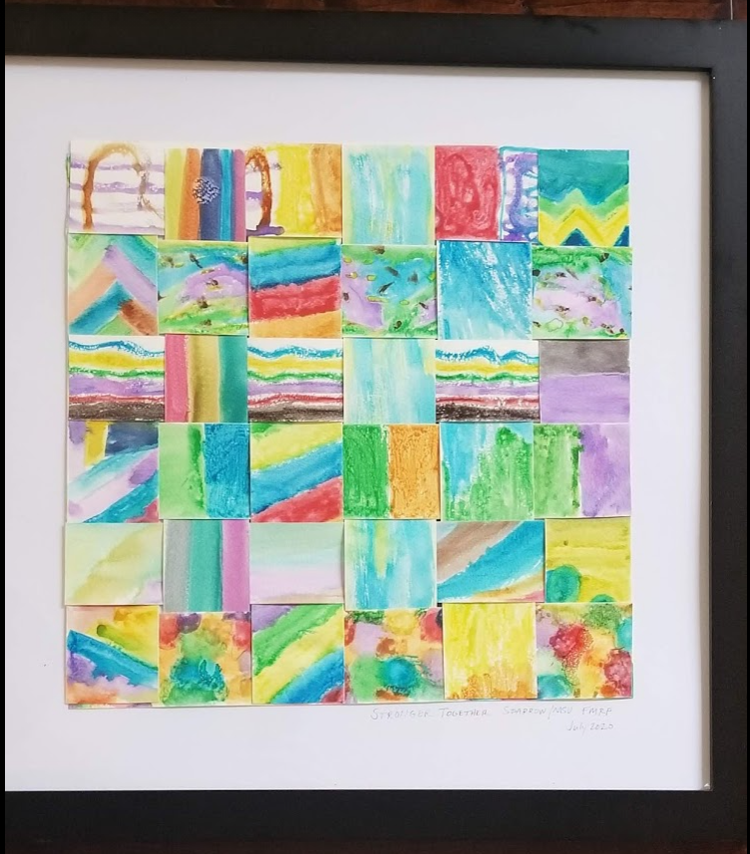
This slide contained images of a variety of art exercises/experienced used in our curriculum.
Life Maps
Individual Art
Collaborative Group Art Projects
Photovoice - Photography Exercise

Slide 19
Reflective Writing
Structure the writing so they don’t think too hard about it!
55 word stories
6 word stories
Critical Incident
Prompted free writes
Collective Poetry
image removed
Notes:
55 word
6 word
critical incident
prompted free write
collective poem
Expose them to different ways to process.

Slide 20
Collective Hope: A Collaborative Poem Sparrow /MSU FMRP May 2020- in the time of SARS-CoV-2
To Dickinson hope is that thing with feathers
That perches in the soul
And sings the tune without the words
and never stops at all
She inspired us to look for signs of hope in nature
To see hope in the sun sparkling on the snow knowing warmer days will come
To see hope in the sunshine falling on a garden of flowers
And in the buds and greenery of the returning Michigan Spring.
To believe hope springs forth from flowers blooming
after the pouring rain
And informs us that despite the storm
the sun will come again...
image removed
Inspired by Kwame Alexander poet-in-residence National Public Radio https://www.npr.org/2020/04/30/845910766/if-the-trees-can-keep-dancing-so-can-i-a-community-poem-to-cope-in-crisis
Notes:
read whole poem

Slide 21
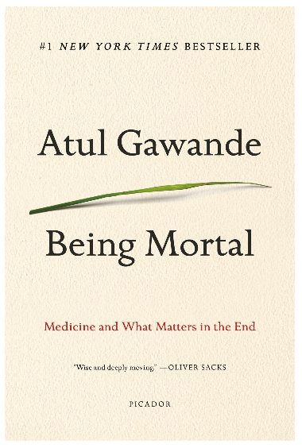
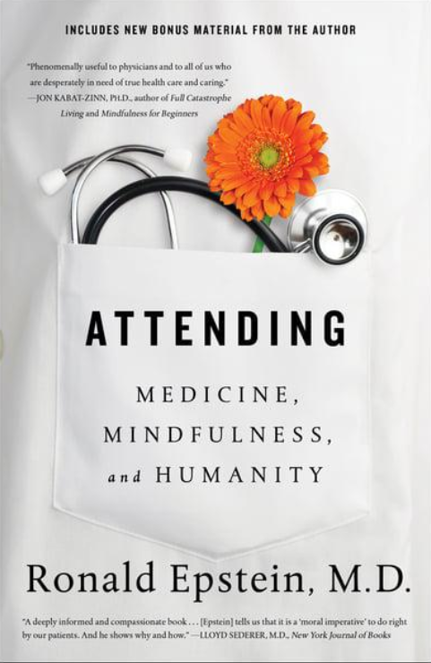
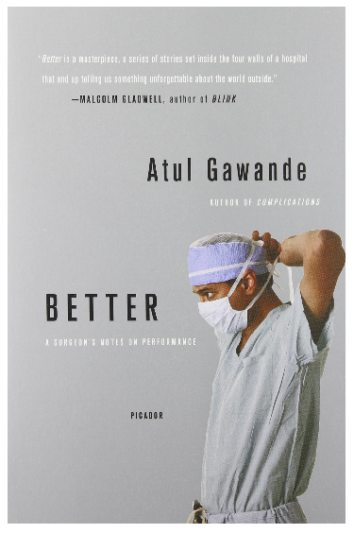
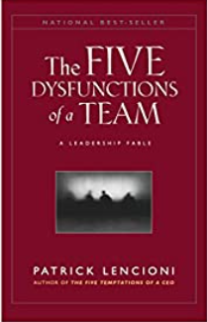
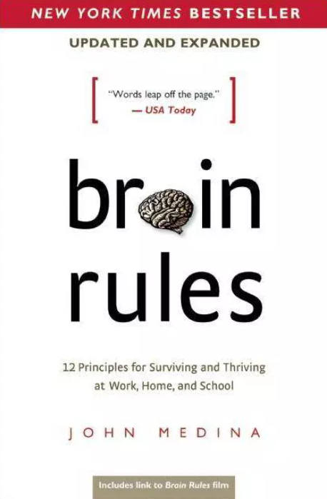
Book Clubs
Notes:
AR Books we’ve read with faculty: 5 Dysfunctions of a Team, Being Mortal, White Fragility; Epstein’s book. Create our own discussion guides or adapt from things available online. Intern year, small group, comfortable intimate setting These books really help readers think about the questions - how am i doing, what do i need, meaning, etc.

Slide 22
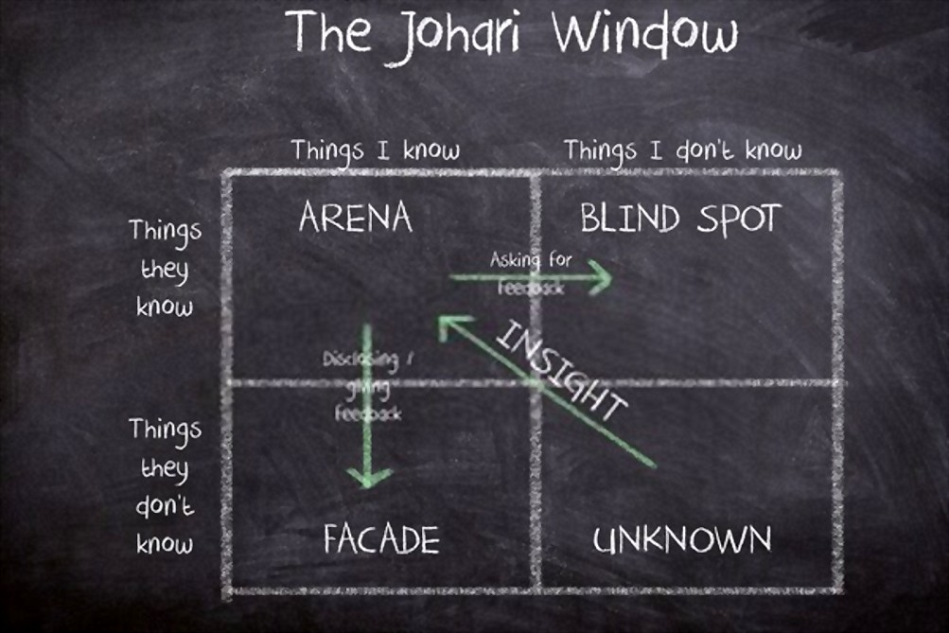
Giving and Receiving Feedback
Algiraigri, A. H. (2014). Ten tips for receiving feedback effectively in clinical practice.
Medical education online, 19(1), 25141.
Notes:
AR Failure bows (the arena/open)
Foster a culture of giving and receiving feedback. Rooted in the ability to be vulnerable, reflective and open… necessary for learning and growth.

Slide 23
“Reflective Practice Elective”
image removed
2 week elective, personalized to needs of resident
Objective: Offer a pause to engage in self-reflection and self-paced discovery of resources, literature and tools related to reflective practices, mindfulness, grief/loss and focus on family.
Resources: books, journal articles, podcasts, phone apps, and websites related to mindfulness, meditation, self-compassion, grief/loss, caregiving, narrative medicine
Deliverables: log hours with description of how time used, debrief/reflect with faculty, submit narrative piece for publication
Notes:
AR - consult FBH collaborative and used what we already have My hope for you is that this rotation will foster your ability to stay grounded, resourced, and connected to the things that matter most. May this include the space to look inward and discover what you need, to be a support to your dad, and to engage in little bits of self-care, during this difficult time. ~AMR
Resident selected material and activities based on her innate wisdom of what resonated with her at that time... total of 20 hours of focused reading, reflection and activities during the two weeks. Invited to seek additional material/resources outside this list of suggestions if desired.
Deliverables Log hours (1 required- What’s Your Grief podcast: Returning to Work after the Death of a Loved One Debrief with Dir. BM, reflect on the rotation experience and consider the impact of loss on herself and the care of her patients. Submit a reflective piece for publication in professional journal

Slide 24
Including Reflective Practice Skills in Evaluation
10 Reflective Activities required
half are structured
many are prompted
track in New Innovations
Advisor meetings
Wellbeing meetings fall/spring
focus on learning / wellbeing personal goals
self-reflection on professionalism
Captured in NI
Notes:
AO-
advisor meetings - “evaluation” with those
“required 10 reflections” - many are prompted (5 happen in structured way)

Slide 25
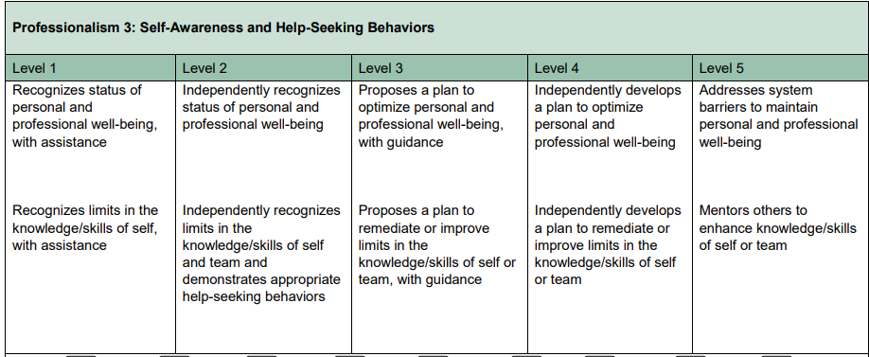
Reflective Practice in Milestones 2.0
ACGME Family Medicine Milestones. Revised: October 2019: effective July 1, 2020.<br>Retrieved on 2/18/20 from https://acgme.org/Portals/0/PDFs/Milestones/FamilyMedicineMilestones2.0.pdf?ver=2019-10-21-152802-123
Notes:
AO can argue that the skills in self reflection appear sprinkled throughout the subcompetencies and milestones. Especially throughout the professionalism subcompetency- recognizing lapses in profesionalism in self and others, understanding the importance of task completion and commitment to work. However 2 subcompetencies most directly call out reflective practice PBLI 2 and Prof 3

Slide 26
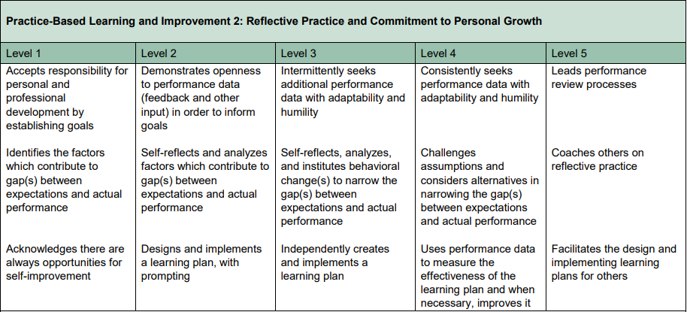
Reflective Practice in Milestones 2.0
ACGME Family Medicine Milestones. Revised: October 2019: effective July 1, 2020. Retrieved on 10/20/20 from https://acgme.org/Portals/0/PDFs/Milestones/FamilyMedicineMilestones2.0.pdf?ver=2019-10-21-152802-123
Notes:
AO can argue that the skills in self reflection appear sprinkled throughout the subcompetencies and milestones. Especially throughout the professionalism subcompetency- recognizing lapses in profesionalism in self and others, understanding the importance of task completion and commitment to work. However 2 subcompetencies most directly call out reflective practice PBLI 2 and Prof 3

Slide 27
Tips for Engagement
Create safety
Embrace vulnerability
Participate with them
Offer a variety of experiences image removed
and mediums
Encourage sharing
Consider small bites
Faculty development
Invite faculty to join based on their interests
Notes:
AR

Slide 28
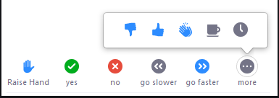
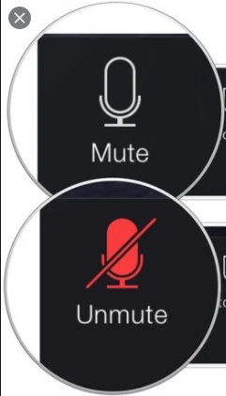
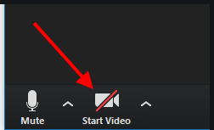
1. Raise Hand if you desire to add a comment or question
2. Unmute when called on
3. Consider starting your video for the conversation
Please share other Reflective Practice resources you use in the chat box. We will add these to our resource list to be posted to the Digital Resource Library!

Slide 29
Mindfulness
Guided Discussions
Self-
Compassion
Positive Psychology
Who am I?
What can I do about it?
How can I grow?
Feedback
Why is this meaningful?
Life Management Skills
What do I need?
How am I doing?
Book Clubs
Art
Reflective
Writing
Notes:
AO
curriculum wheel for reflective practice
constantly using/ changing/ exchanging, not set in stone
ideas flow on and off like people on a f

Slide 30
Collaborative Resources for Reflective Practice Curriculum will available on the STFM Resource Library by Mon. Nov. 9th
Contact us!
amy.romain@sparrow.org
amy.odom@sparrow.org

