Slide 1
Model of a Resident-Led Refugee and Immigrant Primary Care Clinic in an Urban Academic Medical Center
William Buoni, MD
Jamie Robinson, MD
The Ohio State University Wexner Medical Center

Slide 2
Objectives
Learn three general facts about the Bhutanese/Nepali community
Understand barriers to healthcare for Bhutanese Nepali refugees
Learn about challenges of continuity care of patients with refugee status
A model for establishing a primary care resident continuity practice, with a focus on an under-served patient population

Slide 3
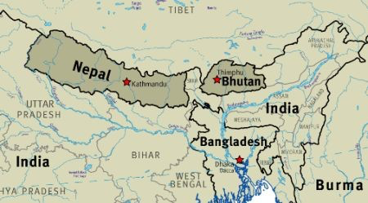
Notes:
Columbus, Ohio, is home to 15-20,000 Bhutanese Nepali refugees who were the victims of ethnic cleansing in Bhutan. Due to decades in refugee camps, this population suffers from high rates of mental health disorders and complicated medical conditions.

Slide 4
Description of a Model of a Resident Led Refugee and Immigrant Primary Care Clinic
Refugees and immigrants have complex health care needs to be addressed by a primary health care clinic. Refugees specifically, may suffer from mental health disorders at a high rate. They may also possess potentially serious medical conditions not often encountered in a local primary care practice.
I and a group of other family medicine residents sought to address these issues at our home continuity clinic with the Bhutanese-Nepali refugee population
Notes:
Agricultural people who have been placed into urban areas. Have education but are in different environment

Slide 5
Description of a Model of a Resident Led Refugee and Immigrant Primary Care Clinic
Much emphasis has been placed on the immediate medical needs of refugees upon arrival in resettlement countries, while ongoing care may be overlooked. We are sharing our efforts regarding the initiation and development of a clinic that provides long-term primary care.
The goal of our efforts was to provide culturally sensitive care with attention to a patient’s psychological, social and economic background
The context of a person's care may include such elements such as a person's attitude toward illness, belief systems, cognitive ability, emotional state, family life, finance, and previous health care experiences.

Slide 6
Notes:
Discuss Where Ohio is for those who are not familiar

Slide 8
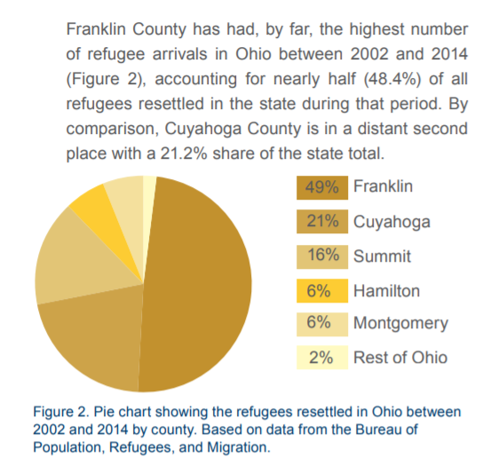
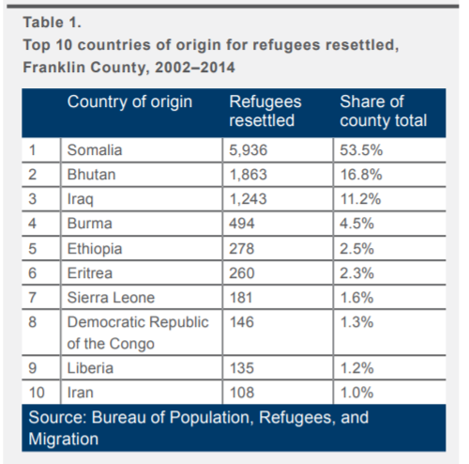
Ohio Demographic
October 2016 – July 2017, Bhutanese accounted for 27% of all refugee arrivals in Franklin County, OH
These numbers do not account for secondary migration
Notes:
The Refugee Processing Center (RPC) is operated by the U.S Department of State (DOS) Bureau of Population, Refugees, and Migration (PRM) in the Rosslyn section of Arlington, Virginia USA.

Slide 9
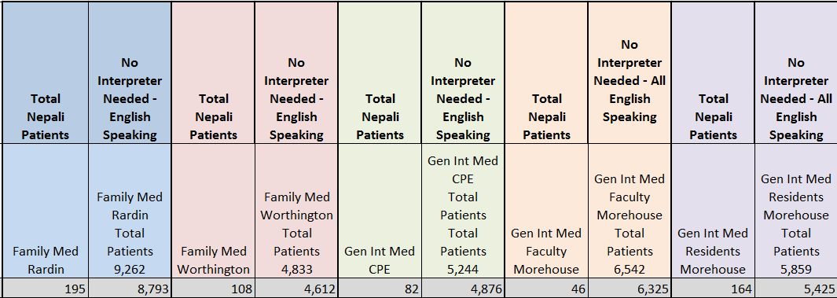
Clinic Demographics
April 1st , 2014-March 15, 2015

Slide 10
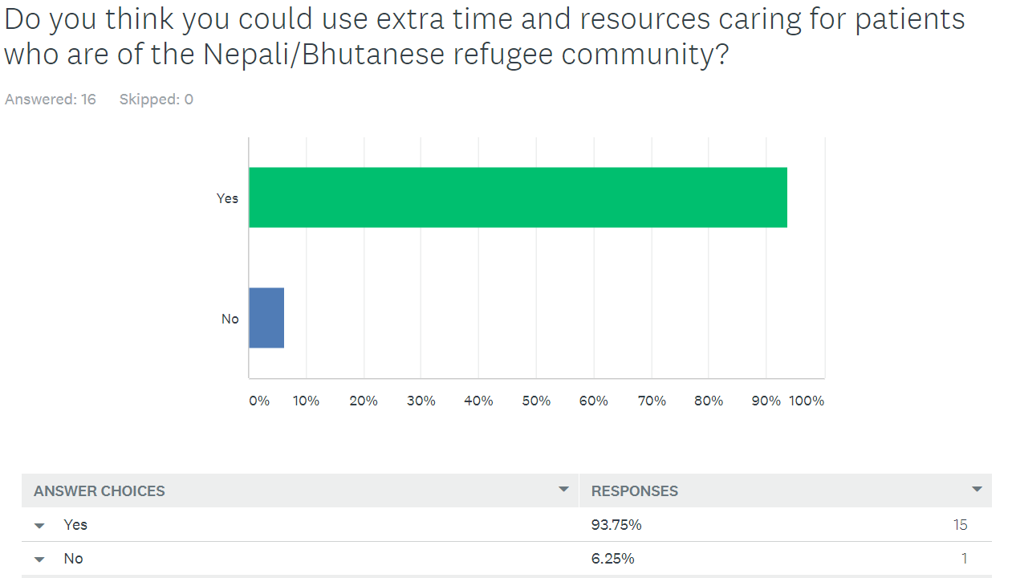
Notes:
Not necessarily for research, but for gauging resident sentiment when working with this population. Resident’s believed that the care they were giving did not seem equal. How were we handling the care of this group

Slide 11
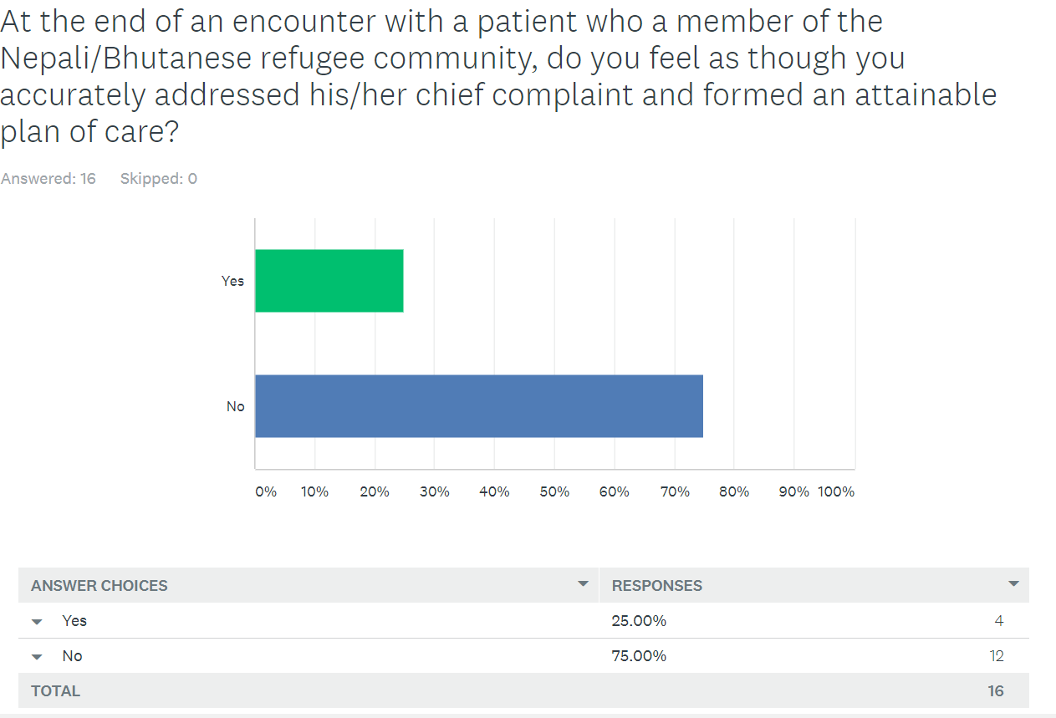

Slide 12
Resident Survey Comments
“I think that having dedicated time for such patients could help tremendously with the workflow and timing of care in clinic (ex. significant extra time getting checked in/roomed)”
“Scheduling live interpreters would be helpful too.”

Slide 13
Barriers to Bhutanese/Nepali Refugee Care at Academic Resident Clinic
Lack of continuity, due to changing resident schedule
Short visit for complex medical needs
Limited interpreter access, few interpreters for entire medical center, relying on video/phone interpreting
Lack of refugee specific mental health resources
Lack of knowledge of primary care of refugee
Lack of staff/institutional “buy-in”
Deficiency of cultural competency
Notes:
Buoni…..Resident schedules change frequently and patients are scheduled with many different providers. Regular appointments scheduled for 20 min or less. If an interpreter is needed it should be scheduled for 40 min. That sometimes does not happen and visit even with an interpreter is scheduled for 20 min. Not everyone is interested in working with this population because of their complex needs.

Slide 14
Challenges?
Notes:
Buoni

Slide 15
Clinical Model
“Immigration Health Clinic”
A multidisciplinary team (MDT) is composed of members from different healthcare professions with specialized expertise. They collaborate to carry out treatment recommendations that facilitate quality for the patient
Four hour clinic once a week with two residents and 1-2 faculty attendings
Consultation from: Psychology postdoctoral fellow, pharmacist, and social worker
Patients are scheduled for 1.0 hour appointments
Two residents are scheduled to see 4 patients each
Each 2nd and 3rd year resident rotates through each week
Agreement with interpreter services from the medical center to provide live interpretation
Notes:
Buoni

Slide 16
Solutions to Barriers?
Notes:
Buoni

Slide 17
Challenges of Immigration Health Clinic
Half of patient’s do not have live interpreter
Establishing a name of the clinic, refugee vs immigrant
Ethical dilemma, is this separate but equal care?
Staff, faculty, and resident “buy-in”
Lack of resident continuity
Notes:
Buoni

Slide 18
Successes of Immigration Health Clinic
Over half of patients now have live interpreter available, less reliance on video interpreting
Continuity through attending physician preceptors
With implementation of clinic, more educational time dedicated to discussing refugee care and specific issues facing Bhutanese/Nepali community
Fulfilling culturally competent care as ACGME requirement
Notes:
Buoni

Slide 19
Future Plans of Immigration Health Clinic
Depending on US policy for refugees, incorporating additional nationalities of patients with significant language and cultural barriers
Survey from patients via interpreter
Incorporating refugee specific mental health resources and screening
Outreach into the refugee community with a comprehensive range of service
Non- health services (e.g. legal, housing, education, transport)
Notes:
Buoni

Slide 20
References
http://www.cdc.gov/immigrantrefugeehealth/pro files/bhutanese/medical-screening/index.html
http://www.cdc.gov/mmwr/preview/mmwrhtml/ mm6226a2.htm
www.crisohio.org
http://www.culturalorientation.net/providing-orientation/overseas/programs/rsc-south-asia/bhutanese-highlight
http://www.wrapsnet.org/admissions-and-arrivals/
http://www.crisohio.org/wp-content/uploads/2016/04/IMPACT-OF-REFUGEES-ON-CENTRAL-OHIO_2015-SP_I.pdf

Slide 21
Questions?

