Slide 1
LGBTQ*-Specific Medical Education at the University of Kentucky
Jessica Adkins, MD Candidate 2020
Keisa Fallin-Bennett, MD/MPH
Rachel Looff, MD Candidate 2019
Notes:
MSE Education Conference submission 2017 - Poster
Abstract
The lesbian, gay, bisexual, transgender and queer/questioning (LGBTQ*) community continues to face bias in the healthcare system that contributes to their increased risk for health disparities. Current literature indicates that education of providers can mitigate health disparities but that education at most schools is lacking. The purpose of this project was to evaluate first (M1) and fourth (M4) year medical students’ perceptions concerning LGBTQ*-specific medical education at the University of Kentucky.
In this presentation we will discuss the results at our institution, draw some comparisons to the extant literature and engage the audience in discussions surrounding implementation of appropriate types and quantity of LGBTQ* education in medical school.
Full Abstract
Purpose. The lesbian, gay, bisexual, transgender and queer/questioning (LGBTQ*) community continues to face bias in the healthcare system that contributes to their increased risk for health disparities. Current literature indicates that education of providers can mitigate health disparities. According to a survey of Medical Deans, existing curricula are lacking in LGBTQ* specific content. The purpose of this project was to evaluate first (M1) and fourth (M4) year medical students’ perceptions concerning LGBTQ*-specific medical education at the University of Kentucky.
Methods. An IRB- approved M1 and M4 survey were designed to match the areas of training assessed in the literature as well as new questions concerning prior experience, educational preferences and confidence in LGBTQ* care. In January 2016, all students from the M1 and M4 class were invited to participate via email.
Results. 56/140 M1 students (40%) and 54/118 M4 students (46%) completed the survey. Results show high perceived comfort in LGBTQ*care but less preparedness on individual topic areas such as gender identity. There was strong support among all students for more education, especially clinical experiences, interview training, and electives.
Conclusions: In our first year of surveying medical students about LGBTQ* education, we are finding a desire for more education, specific perceived weakness in the curriculum, and some mismatch in perceived comfort globally versus in specific skills. We will continue the survey in subsequent years as well as use the results to guide recommendations concerning curricular and extra-curricular training opportunities in LGBTQ* health.
Relevance to Medical Education
This study was conducted by and for medical students to further their own educational opportunities. An M2 student active in both the LGBTQ* health professions organization and as a committee member in our LGBTQ* clinic initiative drafted the surveys, obtained IRB consent and implemented the project. An M1 student performed the majority of the analysis as a summer 2017 research project. We matched questions asked in the classic study of medical school deans (Obedin-Maliver, et al. JAMA, 2011) in order for the survey to have potential for generalization, but also believe that each medical school must take the initiative in gaining feedback for quality improvement that will work on the local level, and through the presentation of our survey design and results seek to promote similar local efforts.
Innovation
Though there are a smattering of studies on LGBTQ* education of health professionals in the literature, there are surprisingly few that ask students directly about their own perceptions and experiences. We wanted to fill that gap in a way that could be used locally and directly for actionable feedback relating directly to our student population, but also in a way that could be comparable to some national data over time. Our main innovation was to combine the topic areas studied by the well cited Stanford group with specific questions about our own students’ preferences. There are also no longitudinal studies of medical education in the literature to our knowledge. We fully intend to continue the survey longitudinally to improve our design, have a larger pool of participants, and to assess change over time.
Obedin-Maliver, et al. Lesbian, gay, bisexual, and transgender-related content in undergraduate medical education. JAMA, 2011; 306(9):971-977

Slide 2
Background: Barriers to Care
Homophobia, real and perceived
Breach of confidentiality and disclosure of orientation or gender identity
Misconceptions about risk factors and recommended screening
Need for holistic care beyond sexual issues
Alencar Albuquerque G, de Lima Garcia C, da Silva Quirino G, et al. Access to health services by lesbian, gay, bisexual, and transgender persons: systematic literature review. BMC International Health and Human Rights. 2016;16:2. doi:10.1186/s12914-015-0072-9.
Notes:
The aim of this project is to analyze and describe medical students’ responses to a recent survey at UK COM. This 2017 survey investigated students’ experience with LGBTQ education in the UK COM curriculum, and their self-reported preparedness to treat this growing patient population. This analysis will evaluate and describe the quality of our current LGBTQ training in an effort to optimize training for future physicians and improve outcomes in this often-disparaged population.
The project will do so by first describing the survey respondents, which included 47 first-year students (34% of the M1 class) and 40 fourth-year students (34% of the M4 class). The ability to describe the gender identity and sexual orientation of the wider class population is limited, due to the personal nature of this information. We will go on to illustrate in histograms the age of respondents and years elapsed between undergraduate degree and medical school enrollment. We will represent the respondents’ sexual orientation and gender identity in pie charts. The M1 data will be illustrated separately from the M4 data.

Slide 3
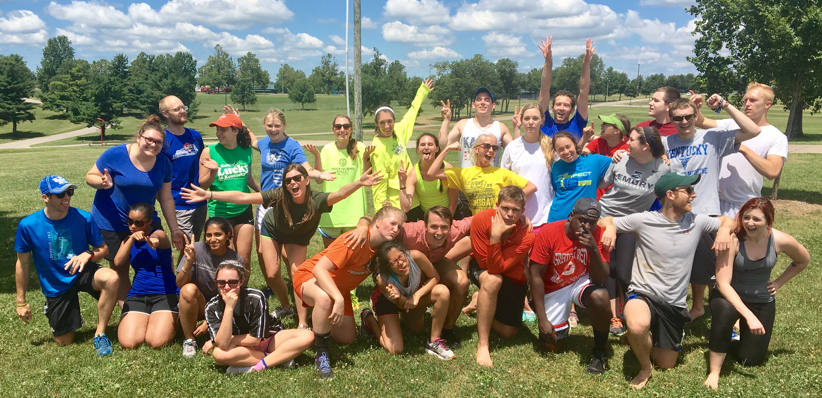
Aims of the Survey
Evaluate current medical student training in issues specific to LGBTQ* patients
Identify opportunities for improvement in pre-clinical and clinical curriculums
Assess the effect of curriculum changes by administering the survey annually
Prepare physicians in order to improve outcomes for this often-disparaged population
Notes:
The aim of this project is to analyze and describe medical students’ responses to a recent survey at UK COM. This 2017 survey investigated students’ experience with LGBTQ education in the UK COM curriculum, and their self-reported preparedness to treat this growing patient population. This analysis will evaluate and describe the quality of our current LGBTQ training in an effort to optimize training for future physicians and improve outcomes in this often-disparaged population.
The project will do so by first describing the survey respondents, which included 47 first-year students (__% of the M1 class) and 40 fourth-year students (__% of the M4 class). The ability to describe the gender identity and sexual orientation of the wider class population is limited, due to the personal nature of this information. We will go on to illustrate in histograms the age of respondents and years elapsed between undergraduate degree and medical school enrollment. We will represent the respondents’ sexual orientation and gender identity in pie charts. The M1 data will be illustrated separately from the M4 data.

Slide 4
Methods
February 2017 survey of M1 and M4:
LGBTQ education in UK COM
Preparedness to treat LGBTQ* patients
Attitudes about 16 LGBTQ* issues
34% response rate from each class
M1: 47/140
M4: 40/118
Notes:
The aim of this project is to analyze and describe medical students’ responses to a recent survey at UK COM. This 2017 survey investigated students’ experience with LGBTQ education in the UK COM curriculum, and their self-reported preparedness to treat this growing patient population. This analysis will evaluate and describe the quality of our current LGBTQ training in an effort to optimize training for future physicians and improve outcomes in this often-disparaged population.
The project will do so by first describing the survey respondents, which included 47 first-year students (__% of the M1 class) and 40 fourth-year students (__% of the M4 class). The ability to describe the gender identity and sexual orientation of the wider class population is limited, due to the personal nature of this information. We will go on to illustrate in histograms the age of respondents and years elapsed between undergraduate degree and medical school enrollment. We will represent the respondents’ sexual orientation and gender identity in pie charts. The M1 data will be illustrated separately from the M4 data.

Slide 5
Student Age
(0%)

Slide 6
How many years elapsed between your undergraduate degree and the time you entered medical school?

Slide 7
M1 Students: how much experience have you had interacting with or learning about LGBTQ* individuals?

Slide 8
Gender Identity

Slide 9
Sexual Orientation

Slide 10
Comfort Level

Slide 11
How important do M1 students think it is, as future physicians, to learn about each of the following healthcare issues?

Slide 12
How do M4 students rate preparedness for addressing healthcare issues unique to LGBTQ* individuals?
= in national study*** boundary of students (M3+) who answered ”not at all prepared” or ”insufficiently prepared” versus “prepared,” ”well prepared” or “extremely well prepared”
Notes:
***White W, Brenman S, Paradis E, et al. Lesbian, gay, bisexual, and transgender patient care: medical students’ preparedness and comfort. Teach Learn Med 2015;27(3):254-63.
2493 third-year and above students at five US/Canada medical schools in 2009-2010.

Slide 13
How often in future practice do M4 students anticipate encountering each of these issues?

Slide 14
M4 self-reported preparedness vs. anticipated clinical frequency

Slide 15
M4 Student Perspectives
= in national study*** boundary of students who rated LGBT curriculum as ”very poor,” ” poor” or “fair” versus ”good” or “very good”

Slide 16
What types of education regarding LGBTQ*-specific populations of health issues do you think medical students should receive?
Notes:
Standardized patient training and exams (.489 / 0.475)
Lectures and class presentations (.319 / .575)
Education integrated with diversity sessions (.340 / .400)
Interview training (.532 / .375)

Slide 17
Which additional training opportunities in LGBTQ* health would you be interested in receiving, now or in the future?
Notes:
Pre-clinical elective opportunities (.319 / .550)
Clinical elective opportunities (.277 / .575)
Shadowing opportunities (.660 / .575)
Standardized patient training and exams (.489 / 0.475)
Lectures and class presentations (.319 / .575)
Education integrated with diversity sessions (.340 / .400)
Interview training (.532 / .375)
Residency track (.064 / .051)

Slide 18
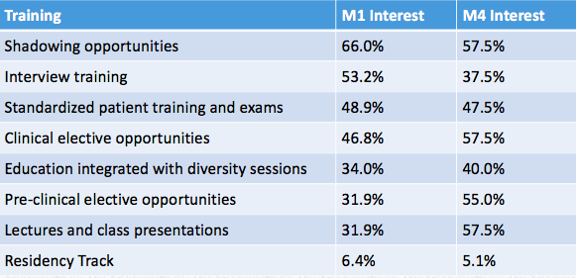
Students want more LGBTQ*-specific education
Notes:
In order of highest M1 interest

Slide 19
Correlative Data
Significant correlation of
M1 comfort level
M1 prior experience interacting with or learning about LGBTQ* individuals
M1 Prior Experience | M1 Overall Comfort
 | Somewhat Uncomfortable | Neutral | Somewhat Comfortable | Comfortable | Total
A lot | 0 | 1 | 1 | 14 | 16
Moderate | 1 | 1 | 4 | 15 | 21
A little | 1 | 0 | 8 | 0 | 9
None | 0 | 0 | 0 | 1 | 1
Total | 2 | 2 | 13 | 30 | 47
Pearson X² = 25.552, DF = 9, p = 0.002418
No significant association in either class:
Comfort with gender
Comfort with years elapsed
Comfort with age

Slide 20
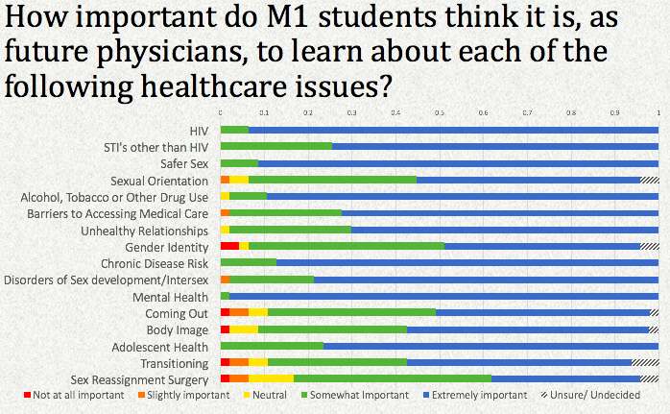
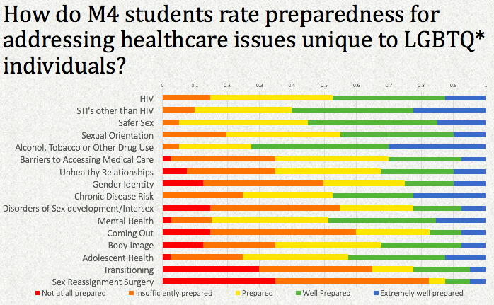
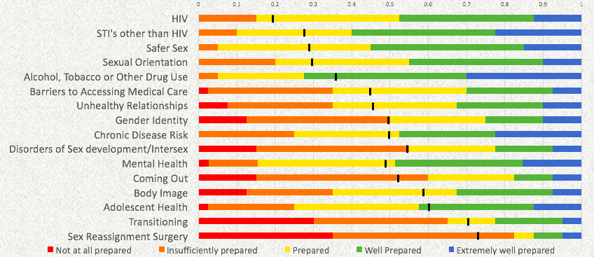
Pre-clinical perspectives vs. clinical experience

Slide 21
How does UKCOM compare?
UKCOM results are congruent with national results from medical college deans in 2009-2010
37.5% of M4: “quality of LGBTQ* education is high – somewhat high”
24.2% of deans**: “coverage of LGBT-related curriculum is good – very good”
Congruent with national results from medical students 2009-2010
62.5% of UKCOM students: “quality of LGBTQ* education they received is neutral or worse”
67.3% of nation-wide students***: “quality of LGBT education fair or worse”
At UK and nationwide
students feel most prepared to treat HIV and STIs
Least prepared to discuss sexual reassignment surgery and gender transitioning
** Obedin-Maliver, et al. Lesbian, gay, bisexual, and transgender-related content in undergraduate medical education. JAMA, 2011; 306(9):971-977
Notes:
** Obedin-Maliver, et al. Lesbian, gay, bisexual, and transgender-related content in undergraduate medical education. JAMA, 2011; 306(9):971-977
132 allopathic or osteopathic medical school deans in Canada and US in May 2009 – March 2010 (132 out of 176 surveyed fully completed questionnaire)

Slide 22
Looking ahead
M4 students are not satisfied yet, but excited about growth opportunities
70% would appreciate more education
Improve education on subjects of concern:
Barriers to access
Gender identity
Coming out
Sexual identity disorders
Gender transitioning, gender confirmation surgery

Slide 23
First-year and fourth-year students alike want more LGBTQ*-specific training
Shadowing opportunities
Interview training with standardized patients
Clinical and pre-clinical electives

Slide 24
Thank you! Jessica Adkins M.D. Candidate, 2020 jessica.adkins@uky.edu

