Slide 1
“Hello…? It’s me…? I wonder if after your hospitalization you’d like to meet…?” A Transitions of Care Program in a Family Medicine Residency
Corey Lyon DO
Kathryn Boyd-Trull, MD
Joanna Stratton, Ph.D., LMFT, LP
University of Colorado, Department of Family Medicine

Slide 2
Disclosures
None

Slide 3
Objective
Describe the key components to a successful transitions of care program
Exposure to the transitions process developed by AF Williams FMC and the Family Medicine Service
Review the early outcomes from our transitions of care process and TCM billing

Slide 6
Scope of the problem
Literature review reveals that 1 in 5 hospitalized patients are readmitted within 30 days of discharge*

Slide 7
Denver Post, January 14, 2015

Slide 8
With no transition process…
Patients are
Confused
Isolated
Struggle getting services they need
Alone
Avoidable mistakes occur

Slide 9
Our AIM:
1. Providing safe transitions of care from in-patient to outpatient care.
2. Decreasing re-admissions by eliminating delay in accessing next steps of care.
3. Increase follow up with PCP in timely fashion

Slide 10
University of Colorado FMR
Urban Academic Residency
10-10-10
Family Medicine Service
Combined mom/baby and adult service
Average census 12-16 pts/day
AF Williams FMC
>35,000 visits annually
14,000 empaneled patients

Slide 11
Baseline AFW/FMS TOC data
30 day re-admissions
Baseline Average 25%

Slide 12
Readmit Rate 2014 AFW patients on FMS

Slide 13
Process Development
Identified key players
Started with old plan
Rapid Improvement Events
identified problems
identified solutions
Process map developed

Slide 14
Our Team
Providers
Psychologist
RN Care Manager
Clinical pharmacist
Nurse
Clinic Business Manager
PAR
Social Worker
Residents
Patients

Slide 15
Notes:
Communication
Pt demographics
Pt handoff to outpt setting
Timely d/c summary/accurate d/c summary
D/c planning
Unable to reach pt
Overwhelmed pts – lots of information, multiple calls
Unsure of pt support system
No contact
How to reach pt, difficulty with reaching over phone
Who calls, who’s job
Operations/role confusion
Lack of time/assigned resources
f/u appts not clearly defined
EPIC
Demographics
Report
Canceled pts drop off..

Slide 18
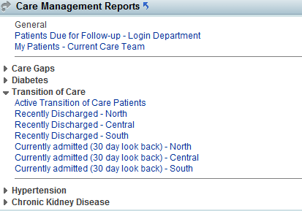

Slide 20
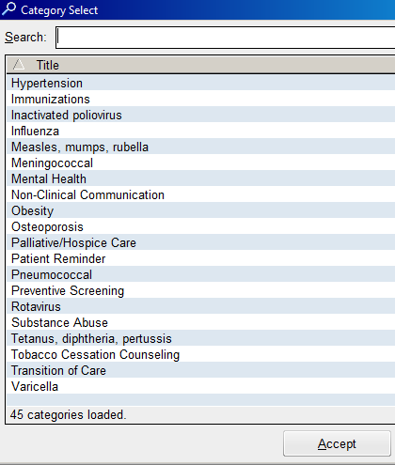
Within a Patient Outreach encounter, users can track TOC outreach and start a TOC episode of care

Slide 21
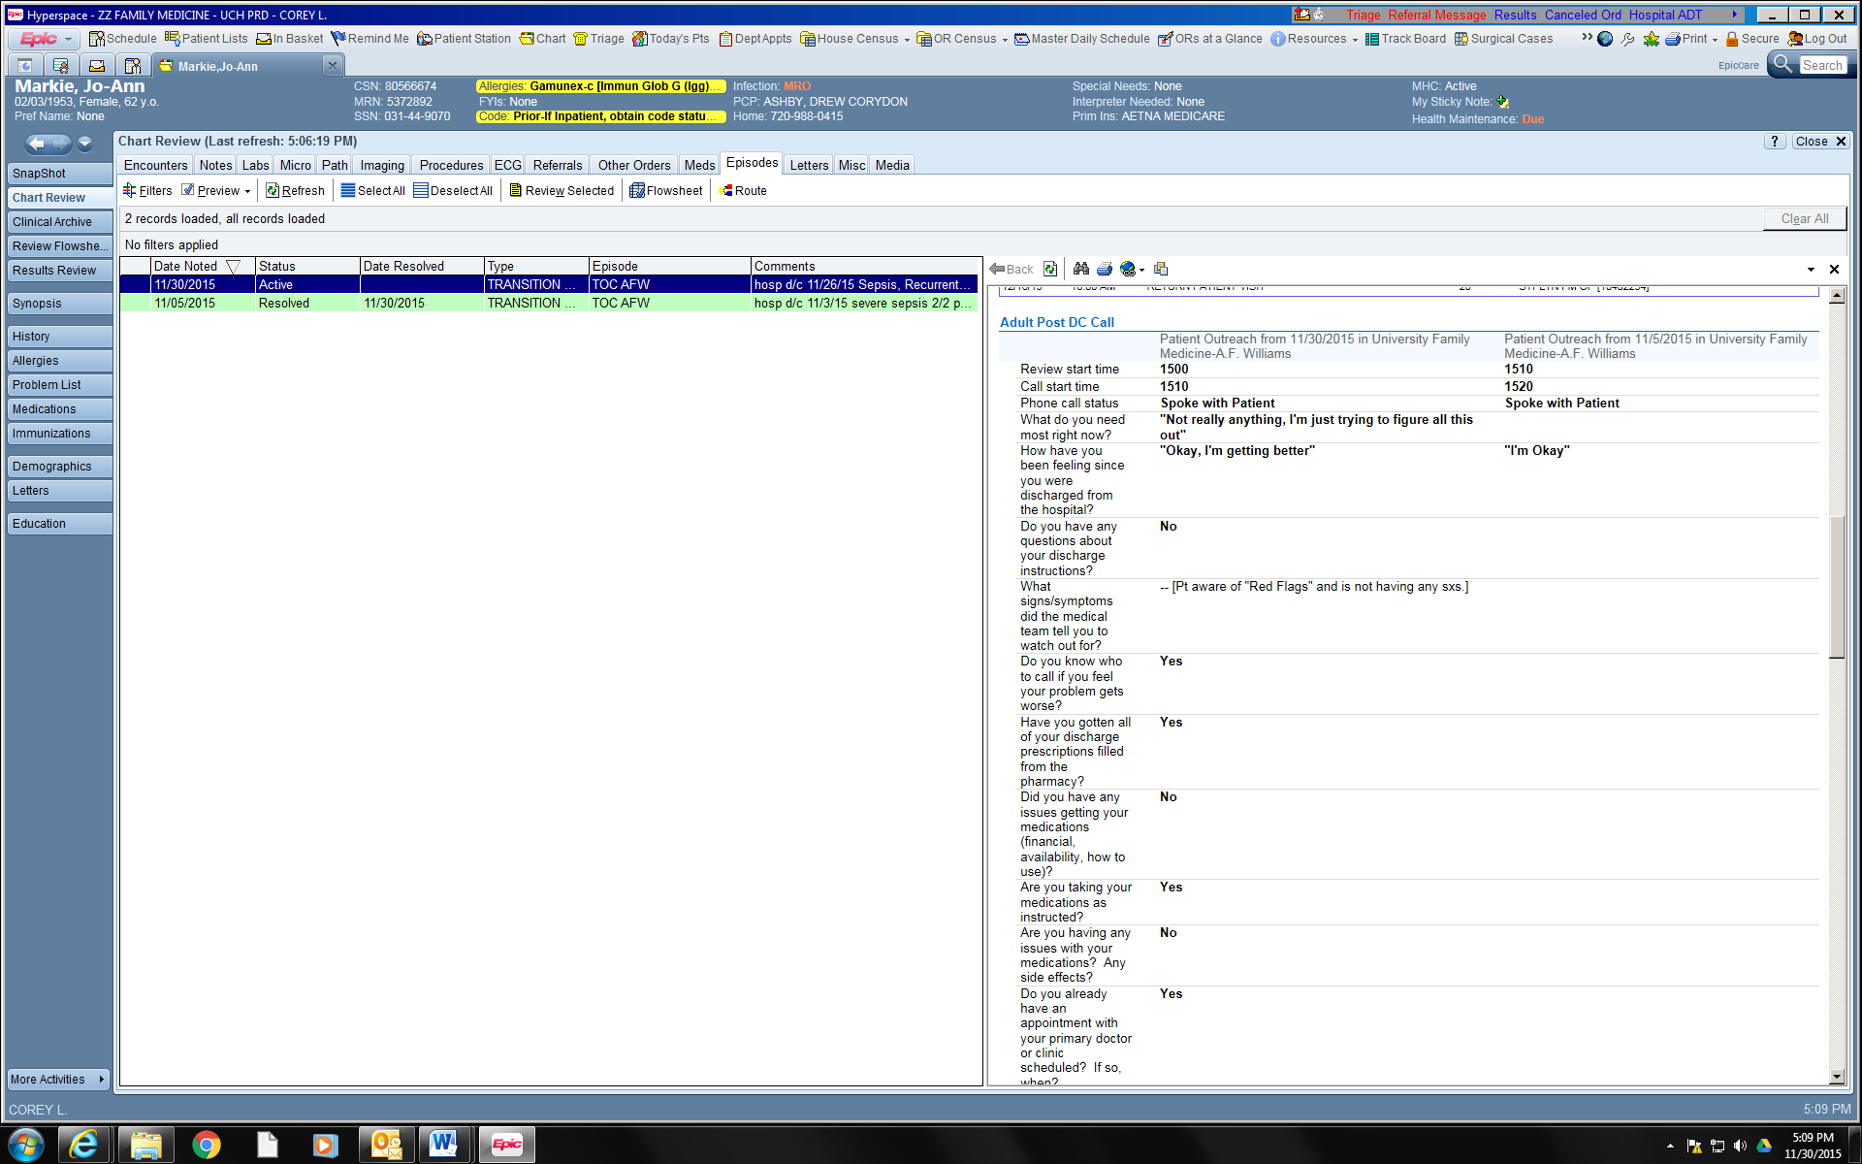
Quick Navigator Flowsheet

Slide 22
Snapshot of TOC Outreach Call

Slide 23
Template Questions
What do you need most right now?
Do you already have an appointment with your primary doctor or clinic scheduled? If so, when?
Do you have any questions about your discharge instructions?
Do you have any appointments with other providers? If so, who are you seeing and when is that scheduled?
What signs/symptoms did the medical team tell you to watch out for?
Were you able to get the tests or procedures that were recommended for you after your discharge? If not, why not?
Do you know who to call if you feel your problem gets worse?
Did your discharge plans include a visiting nurse or home health aide?
Have you gotten all of your discharge prescriptions filled from the pharmacy?
If you had home services and/or equipment ordered, have you received them? (such as O2, CPAP, hospital bed, etc)
Did you have any issues getting your medications (financial, availability, how to use)?
Have you been readmitted to a hospital or gone to an urgent care center since you were discharged?
Are you taking your medications as instructed?
Do you feel you have adequate support at home? If so, who (name(s) of Caregiver)?
Are you having any issues with your medications? Any side effects?
Are there any other questions or concerns you have?

Slide 25
Pharmacy note

Slide 26
30 Day re-admission – Family Medicine

Slide 27
Re-Admission Data

Slide 28
Re-Admit data (cont.)
* P<0.001
 | Baseline Jan 2015 – August 2015 (90% CI) | Post Intervention September 2015-April 2016 (90% CI)
Discharges | 700 patients | 748 patients
Readmit rate | 24.6% (22.4-26.9) | 14.2%* (11.3-17.5)
Average length of stay | 4.4 days | 4.1 days
LACE+ score | 54.4 | 52.4
*P<.001

Slide 29
TOC pre to post 30 day readmit summary
30 day re-admissions
Post intervention
12 month Average 14.2%
35%
25%
15%
5%

Slide 30
TOC visit results 9/1/2015 – 7/5/2016 discharges
TOC visit status | Count | Baseline rate | Post Int. rate | Relative change from baseline
Canceled | 51 | 23% | 10% | 57% reduction
Completed | 414 | 57% | 84% | 47% increase
No show | 28 | 8% | 6% | 25% decrease
Scheduled appt. date not yet lapsed | 5
Total scheduled visits | 498

Slide 31
Near Miss counts by category 9/1/2015 – 7/5/2016 discharges
Near Miss type | Near Miss count
Symptomatic | 25
Medications | 50
Transportation | 22
Follow up appointment issues | 9
Behavioral health | 1
Social/Home health concerns | 12
Health literacy | 1
Miscellaneous | 2
Total | 122
Total patients contacted | 530
Near Miss rate | 23%

Slide 32
Near Miss Stories
Discharge with no insulin syringes
-Home health was ordered at d/c
patient listed as NOT homebound
Needed to arrange home health
Discharged with 4 meds for h. pylori
atrium was out of one so pt didn’t pick up any
Pt c/o red, swollen arm at IV site
Arranged ultrasound – dx with UE DVT
No transportation arranged for f/u visit

Slide 33
TCM Codes
99495
Contact (phone or electronic) with patient within 2 days discharge
Face-to-face visit, 14 calendar days of discharge
99496
Contact (phone or electronic) with patient within 2 days discharge
High complexity medical decision making
Face-to-face visit, 7 calendar days of discharge
Moderate complexity medical decision making

Slide 34
TOC billing
Established patient charges
99213 - $191
99214 - $294
TCM charges
99495 - $518
99496 - $760

Slide 35
Financial Benefits
Established Patient (99213)
Transitions of Care TCM
$191 x 248 = $47,368/year
$760 x 248 = $188,480/year
DIFFERENCE $141,112

Slide 38
TCM Guidelines
TCM commences upon date of discharge and continues for the next 29 days.
Interactive contact with the patient or caregiver within 2 business days of discharge, which may be direct (face-to-face), telephonic or by electronic means.
A face-to-face visit within one of the specified time frames as stated above. Additional E/M services after the first face-to-face visit may be reported separately.
Medical Necessity complexity (MDM) is based on E/M guidelines definitions, which refer to number of diagnoses and management options, amount of date to be reviewed, complexity of that data and risk of significant complications.
Medical reconciliation and management must occur no later than the date of the face-to-face visit.
Reported only once per patient within 30 days of discharge.
Notes:
The physician who reports a global procedure code is not permitted to use these codes.
but another physician could??

Slide 39
The patient voice
Notes:
“I cannot thank you enough for the phone call because I got so frustrated regarding the small lines on the syringe. In the hospital, they told me that it was very important to be precise with my insulin. Diabetes is new to me and I worried that if I took too much or too little it would be a big problem and I would make myself sick. When I got the phone call, I told her that that I was nervous about using the syringe and that I had stopped taking my insulin. In the hospital, my discharge was so fast and I did not even know that the syringe was going to be a problem yet. Cindy told me she understood my concerns. She worked with the pharmacist at your clinic and offered syringe with larger numbers and lines. This phone call meant everything to me.”
“When I got discharged from the hospital, I got so much information. I needed a day for my brain to get in gear. So when Cindy called, we talked about my pain and I mentioned that I had a big bruise on my arm and it hurt. In the hospital, they gave me heat for this rash. When I got home, I would have kept using the heat. Cindy sounded concerned and recommended that I got get an ultrasound. It revealed a blood clot in my arm! The call was perfect timing. The outcome could have been worse and I could have gone back to the hospital. I am one of those people that likes to think I can do it alone. I hate to be a pain or a bother. So when Cindy called me- I could have cried. I needed help but I wouldn’t have asked for it. She called me several more times and I know she did that because she really cared about me. I am so grateful.”

Slide 40
Keys to success
Evaluating existing models
Modifying to our system/clinic
Outreach call
Quality of the call
Dedicated responsibility
Dedicated time
Data
Clinical resources
Interdisciplinary access
Pre-discharge inpatient training
Access to outpatient care

Slide 41
Next Steps
Expand RN Care Management outreach calls to clinic RNs
Expand patients outreach
OB and newborn
Outside hospitals
Home Visits
Formalize support role to sustain workload
Modify discharge conversation in the hospital
Follow re-admission data

Slide 42
Thank you
Questions and Discussion
Corey.lyon@ucdenver.edu
Kathryn.boyd-trull@ucdenver.edu

Slide 43
Please evaluate this presentation using the conference mobile app! Simply click on the "clipboard" icon on the presentation page.

