Slide 1
The IAM Mobile App
Notes:
The IAM mobile app stimulates reflective learning when linked to clinical information derived from “push” (alerting) services or “pull” databases. The context for the former are information services to update clinicians. The context for the latter are searches in knowledge resources to address information needs for specific patients in practice.
The IAM mobile app is available for iOS and Android devices.

Slide 2
The IAM app provides periodic notifications to gently raise awareness of priority topics

Slide 3
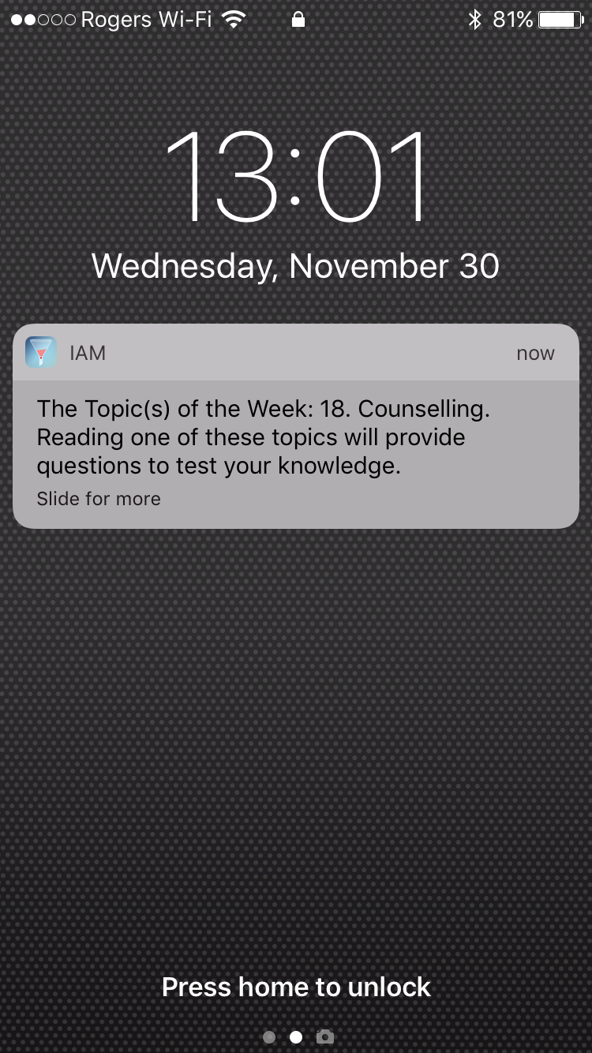
Notes:
This is an example of an IAM Mobile ‘alert’ to one priority topic.

Slide 4
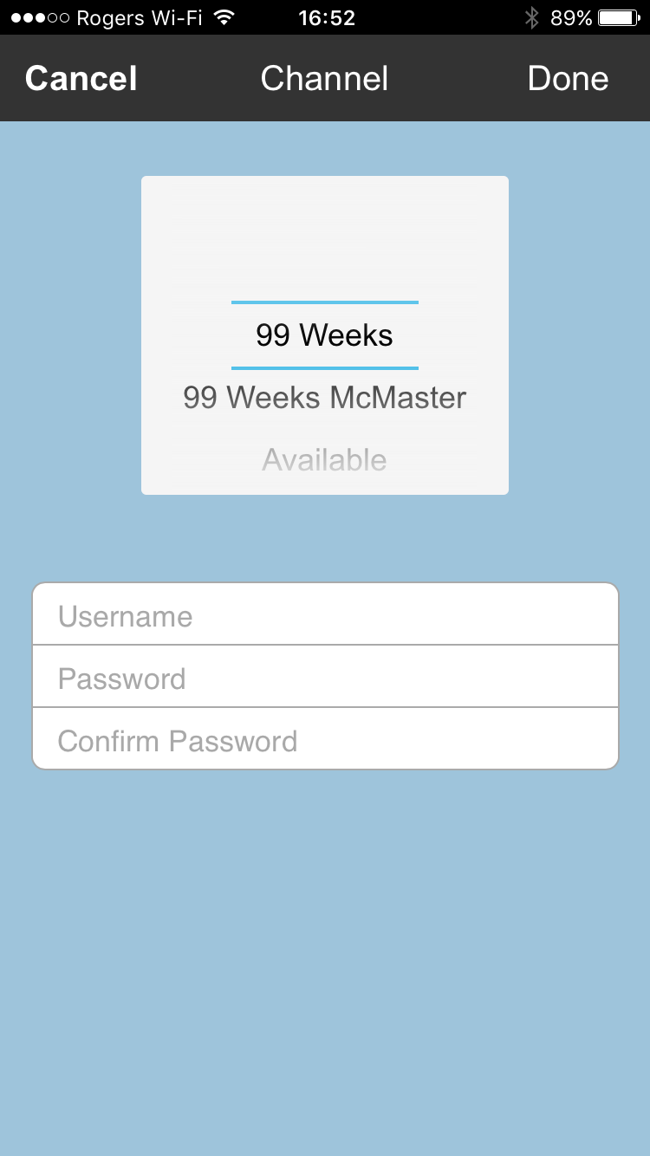
Notes:
The IAM mobile app provides multiple channels. The first channel was designed for residents at McGill and the other for residents at McMaster. Both channels provide content on priority topics in Family Medicine. We call these the ‘99 weeks’ channels.

Slide 5
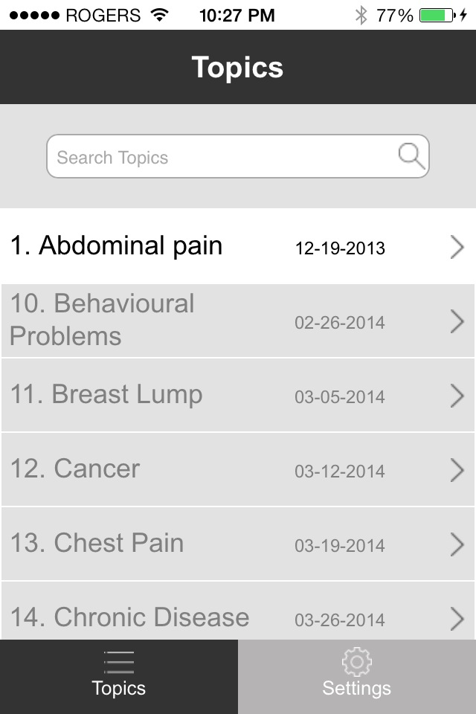

Slide 6
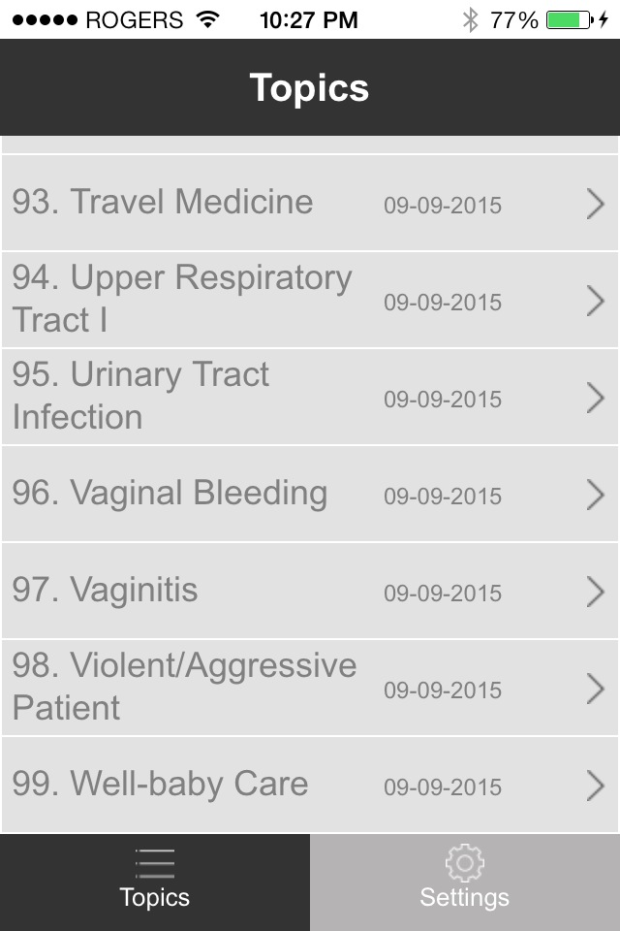

Slide 7
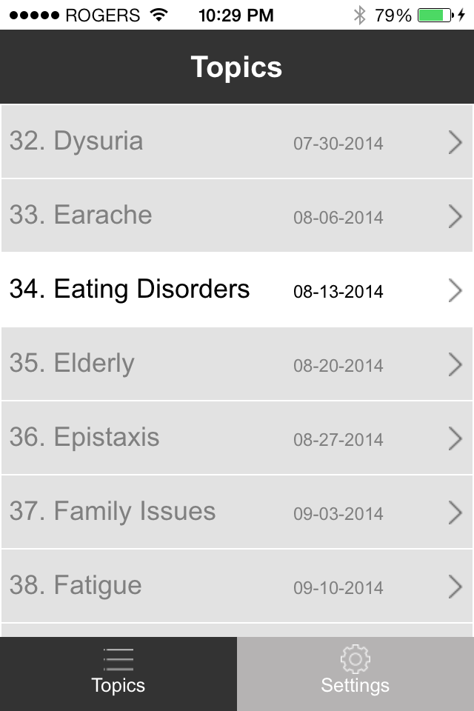

Slide 8
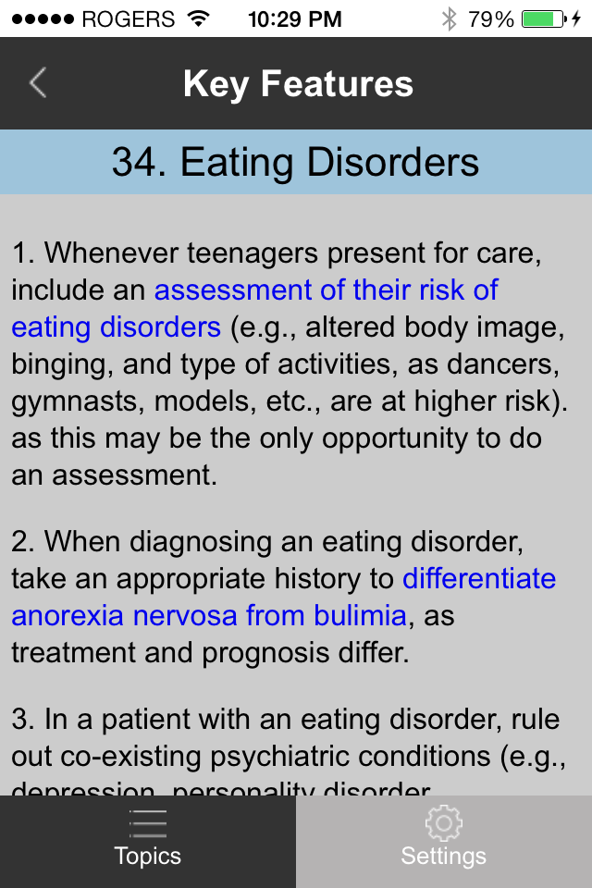

Slide 9
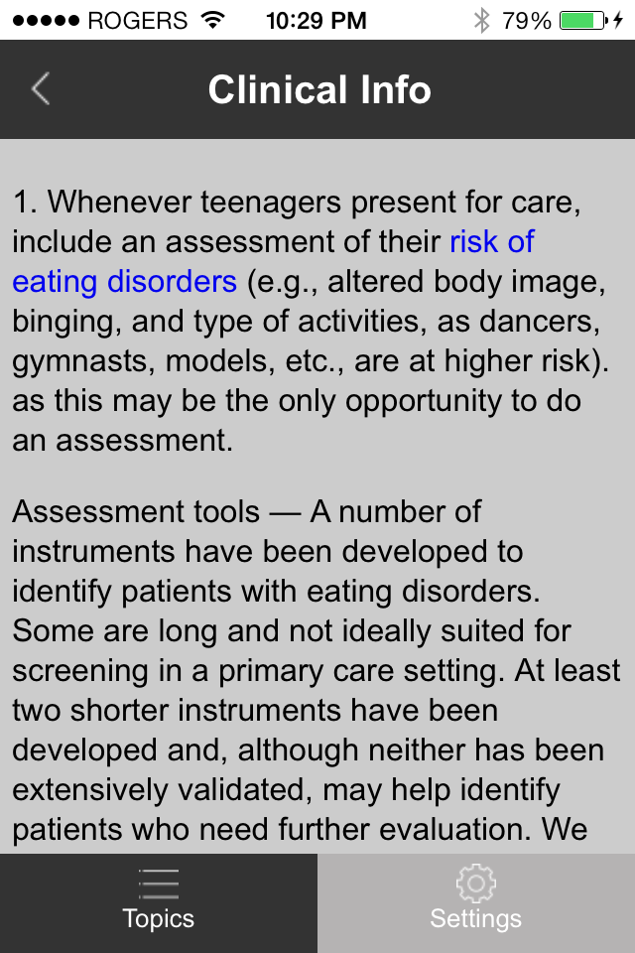

Slide 10
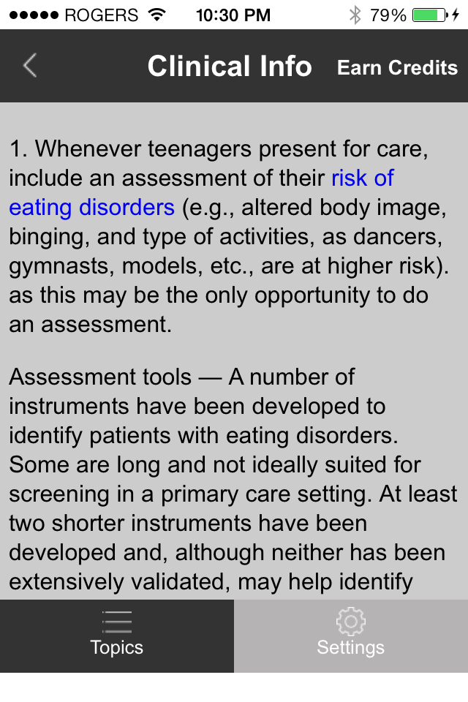

Slide 11
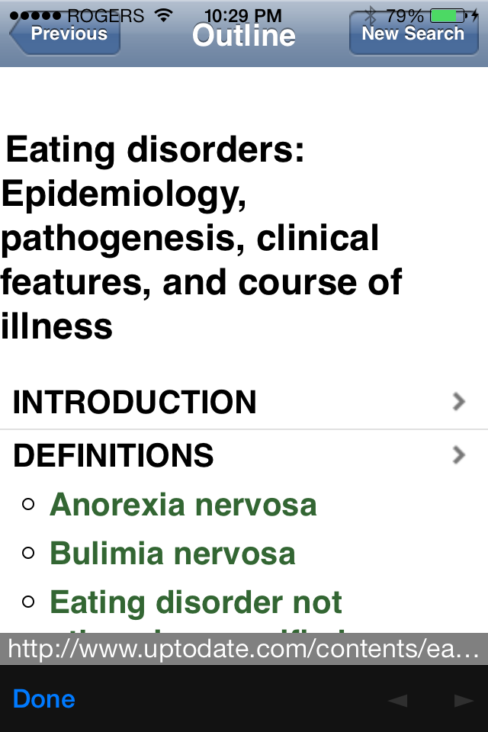

Slide 12
The IAM mobile app provides test questions and feedback to enhance knowledge acquisition and retention

Slide 13
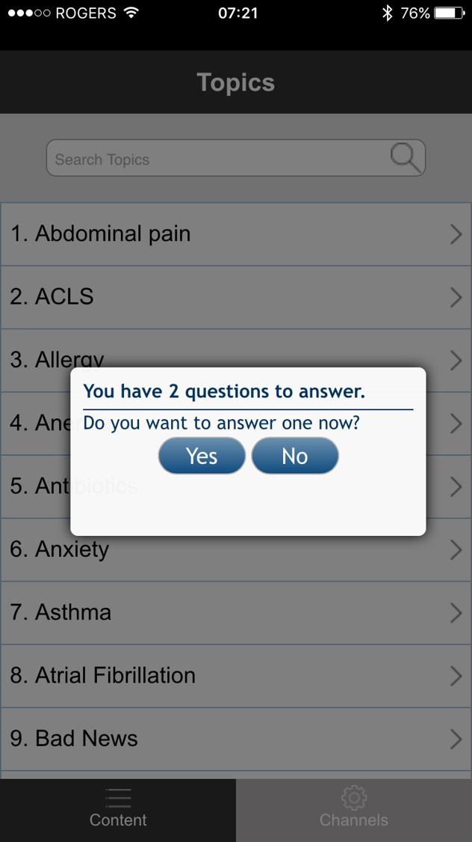

Slide 14
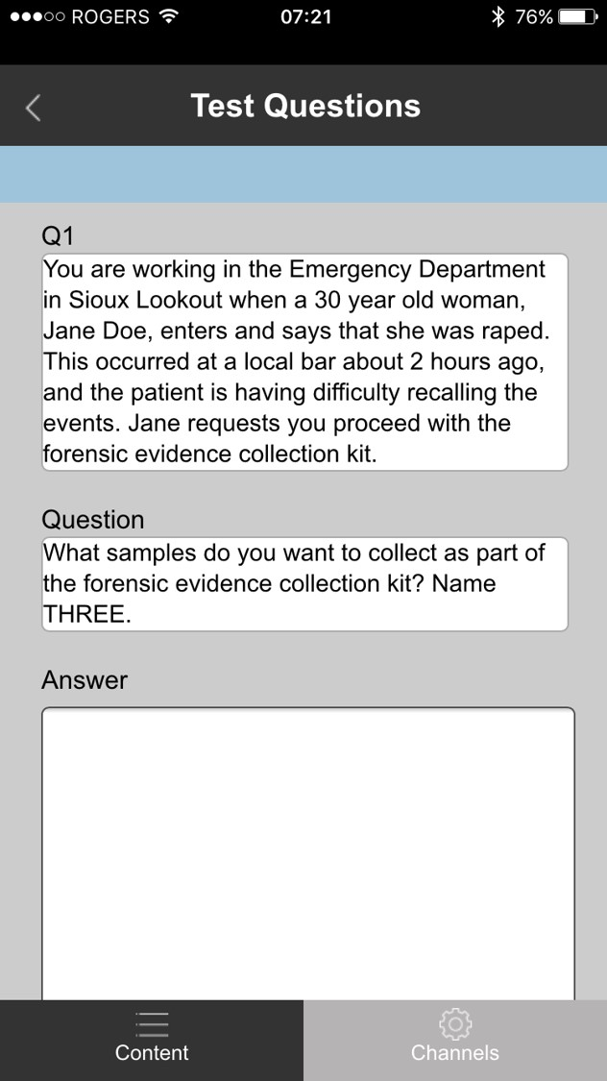

Slide 15
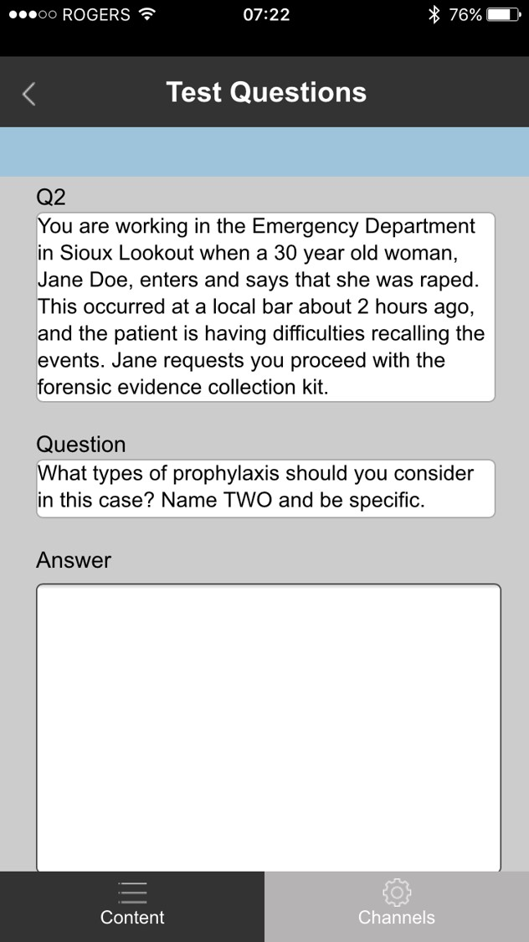

Slide 16
The research-proven IAM questionnaire can stimulate reflective learning

Slide 17
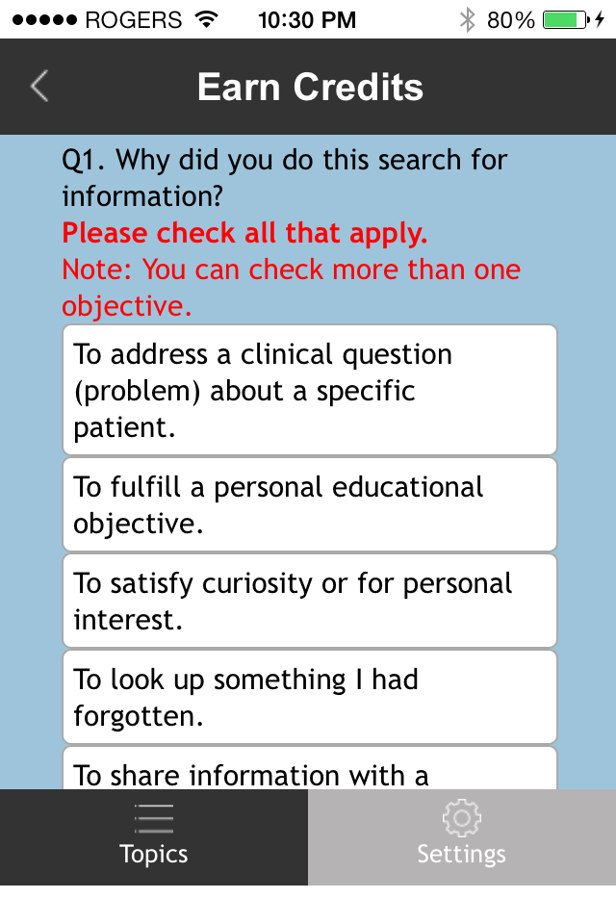
Notes:
This is the ‘pull’ version of the IAM questionnaire, designed to stimulate reflective learning.

Slide 18
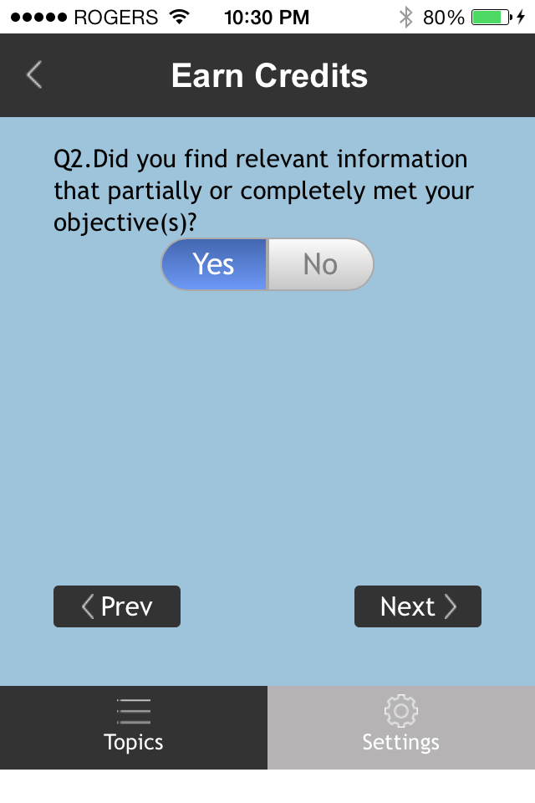

Slide 19
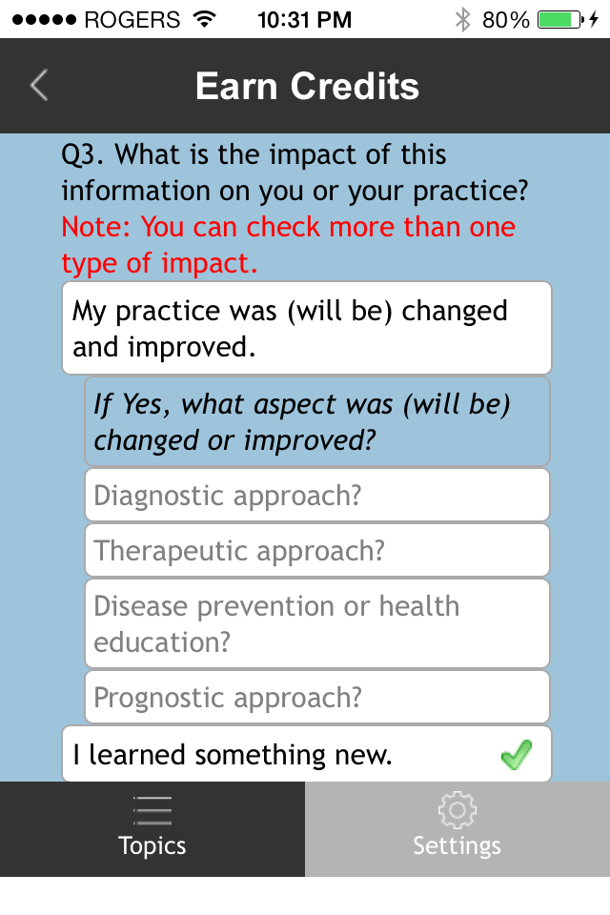

Slide 20
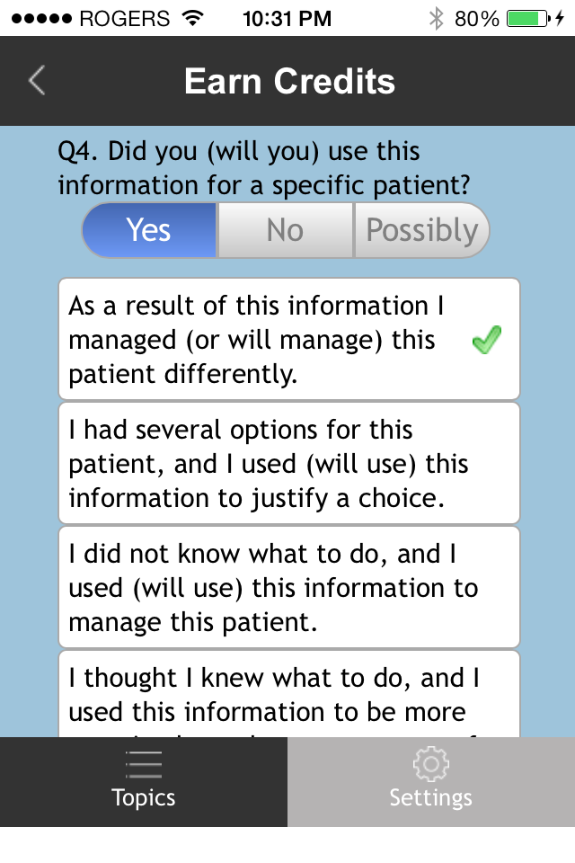

Slide 21
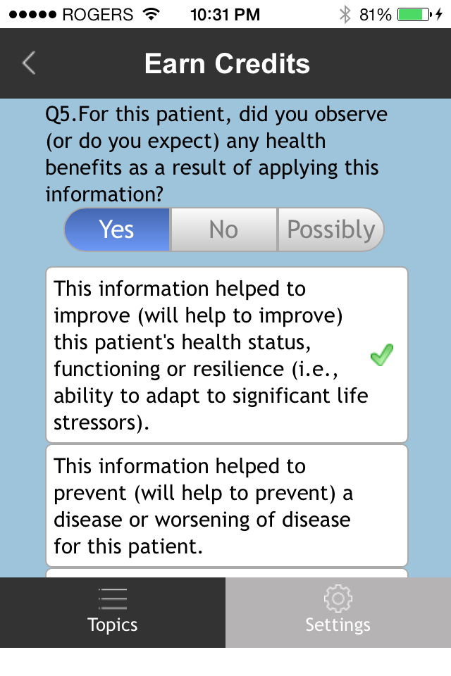

Slide 22
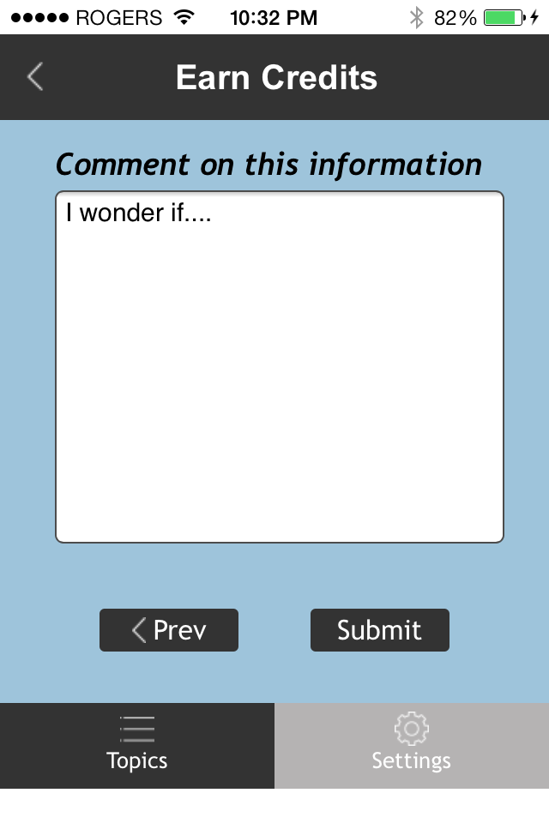

Slide 24
Notes:
Inaugurated in 2007, the ITPCRG promotes and encourages research and teaching of health informatics in primary care. Our purpose is to support research and research capacity-building for addressing complex interventions using qualitative, quantitative and mixed methods. ITPCRG researchers supervise graduate students (MSc and PhD) as well as postdoctoral fellows.
ITPCRG researchers developed and validated the Information Assessment Method (IAM). The IAM (www.mcgill.ca/iam) is a popular tool to systematically document a health professional’s reflection on the relevance, use and health benefits associated with clinical information, either delivered by or retrieved from online resources.
In addition, the IAM helps document reflective learning, which is at the base of continuing education in the health professions. The IAM enhances continuing education through stimulation of reflective learning, evaluation of resources, and two-way knowledge exchange between information users and providers. Thousands of Canadian physicians and pharmacists routinely use the IAM for assessing synopses of research-based clinical information. For example, in 2006 the Canadian Medical Association implemented an IAM-based program that allows physicians to earn Continuing Education credit for each POEM® they rate, using the IAM questionnaire. Since 2012, more than one thousand completed IAM questionnaires are submitted each day, by physicians and pharmacists.
https://www.mcgill.ca/familymed/research-grad/research/projects/itpcrg

