Slide 1
DiSC ASSESSMENT:
Using Behavioral Styles to Promote Leadership and Communication
Stephanie Nader, LCSW
Laura Schaecher, LCSW
Community Health Network Indianapolis, IN
Behavioral Forum
September 23rd 2016

Slide 2
Disclosures
We do not have financial connections to DiSC materials

Slide 3
Objectives
Identify your dominate DiSC behavioral style
Develop awareness of how your style impacts others.
Describe characteristics of each DiSC style
Explore the use of DiSC assessment to improve communication at your program

Slide 4
Who We Are

Slide 5
Community Health Network
10 – 10 – 10
Community Based Program
Longitudinal Curriculum
Team Based Structure
Behavioral Team

Slide 6
Ancient Wisdom
We see the world,
not the way it is,
but the way we are.
~Talmud

Slide 7
DiSC ~ What IT IS . . . IS NOT
IS
Describes PREFERRED WORK AND BEHAVIORAL STYLE in different situations
Behavioral inventory based on self-perception (Not a 360)
Often tied to strengths
Descriptive
IS NOT
Predictive of success in a specific job
A personality test
Does not limit a person's ability to develop in another direction or work environment
Does not classify people into better or worse, crazy or sane
Does not measure intelligence, professional skills, or APTITUDE

Slide 8
William Moulton Marston
William Moulton Marston's life story is an interesting one—filled with accomplishments that at first seem totally unrelated. He was a lawyer, a psychologist, invented the first functional lie detector polygraph, created the DISC model for emotions and behavior of normal people, authored self-help books and created the Wonder Woman comic.

Slide 9
Cornerstone Principles
All DiSC styles and priorities are equally valuable. We are all a blend of all four styles.
Gaining a better understanding of yourself is the first step to becoming more effective when working with others.
Learning about the DiSC styles of other people you work can help you understand their priorities and how they differ from your own.
You can improve the quality of your work place by using DiSC to build more effective relationships.

Slide 10
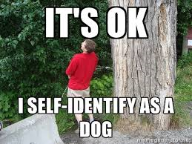
GROUP EXERCISE: SELF IDENTIFY
Notes:
Have everyone choose btwn Questioning (C) vs. Accepting (I) and stand in front of that post it
How does success at your job influence choice of behaviors?
Does you choice change when you think of yourself outside of work?
Have everyone choose between Active (D) and Thoughtful (S)
Repeat same questions

Slide 11
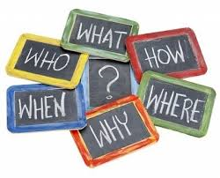
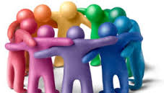
QUESTIONING VS ACCEPTING
Notes:
Have everyone choose btwn Questioning (C) vs. Accepting (I) and stand in front of that post it
How does success at your job influence choice of behaviors?
Does you choice change when you think of yourself outside of work?

Slide 12
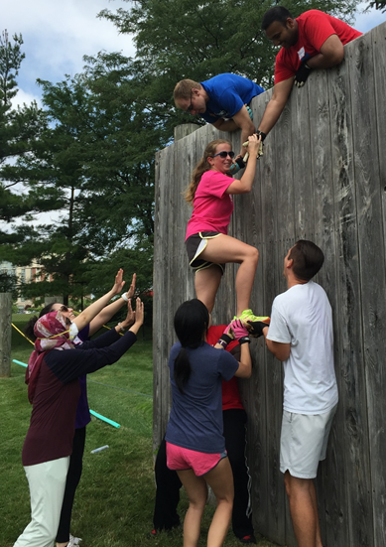
ACTIVE VS THOUGHTFUL
Notes:
Have everyone choose between Active (D) and Thoughtful (S) and stand in front of that post it
How does success at your job influence choice of behaviors?
Does you choice change when you think of yourself outside of work?

Slide 13
So what are you?

Slide 14
DiSC® BEHAVIORS
D
Dominance
Active
Fast Paced
Assertive
Dynamic
Bold
i
C
Influence
Conscientiousness
Accepting
People Focused
Empathizing
Receptive
Agreeable
Questioning
Logic Focused
Objective
Skeptical
Challenging
S
Steadiness
Thoughtful
Moderate Paced
Calm
Methodical
Careful

Slide 15
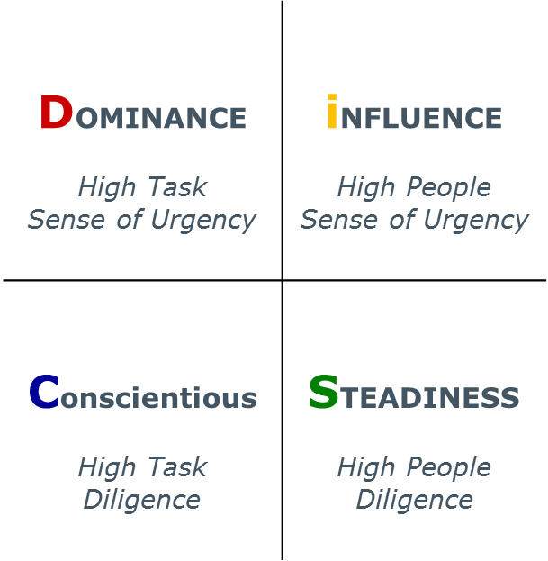
Take action
 | Goal | Fear
D | Results | Being taken advantage of
i | Fun in the experience and popularity | Being rejected or disliked
S | Appreciation and security | Being asked to change, losing sense of security
C | Accuracy and precision | Being criticized for poor quality
Tasks
Relationships
Let things
happen
Notes:
This overview depicts behavioral preferences.
Explain Task vs. People orientation and Fast vs. Slow approaches. 15 – 18% D’s – Drive Ideas
“Fast” indicates a sense of urgency (active approach), extroverted 25% I’s – Engage People
“Slow” indicates a methodical approach. (passive approach), introverted 40% S’s – Implement
“Task” is Thinking and antagonistic 15 – 18% C’s – Make sure we did it right
“People” is Favorable, feelings, relations
Explain the combination of Task/Fast = D (Challenge)
Fast/People = I (Contacts)
People/Slow = S (Consistency)
Slow/Task = C (Constraints)
These are all observable behaviors. DiSC measures behaviors and emotions.
Diagnol opposites have the most to learn from each other

Slide 16
When overdone . . .
Strength
Weakness
D
Decisive
Impatient
I
Outgoing
Talks too much
S
Stable
Slow to change
C
Quality Driven
Nit Picky

Slide 17
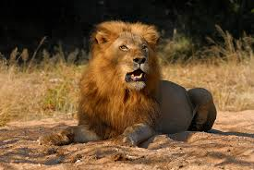
TIPS FOR RELATING TO D’s
Be sure to
make communication brief and to the point respect their need for autonomy be clear about rules and expectations let them initiate show your competence stick to the topic show independence eliminate time-wasters
Be prepared for
blunt, demanding approaches lack of empathy lack of sensitivity little social interaction
High D’s want others to be direct, straightforward, and open to their need for results.
Notes:
27

Slide 18
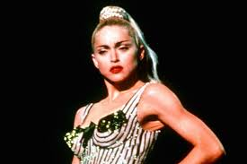
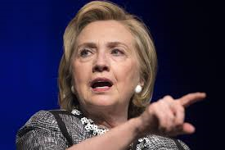
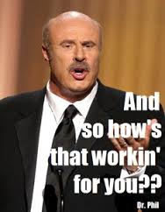
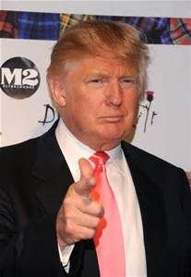

Slide 19
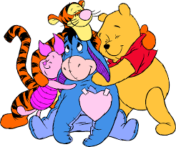
TIPS FOR RELATING TO I’s
Be sure to
approach them informally be relaxed and sociable let them verbalize thoughts and feelings keep the conversation light provide written details give public recognition for individual accomplishments use humor
Be prepared for
attempts to persuade or influence others a need for the limelight overestimation of self and others overselling ideas vulnerability to perceived rejection
High i’s want others to be friendly, emotionally honest, and to recognize the high i’s contributions.
Notes:
28

Slide 20
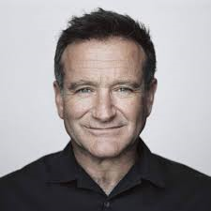
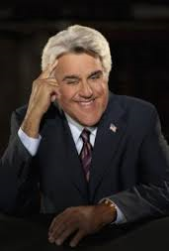
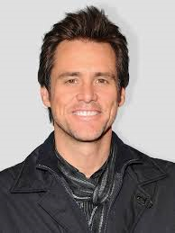
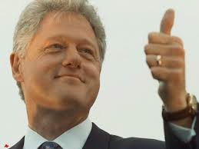
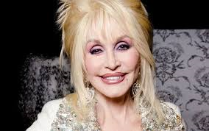

Slide 21
TIPS FOR RELATING TO S’s
Be sure to
be systematic in your approach provide a consistent and secure environment let them know how things will be done use sincere appreciation show their importance to the organization let them adapt slowly to change
Be prepared for
friendliness to colleagues and supervisors resistance to change difficulty identifying priorities difficulty with deadlines
High S’s want others to be relaxed, agreeable, cooperative, and appreciative.
Notes:
29

Slide 22
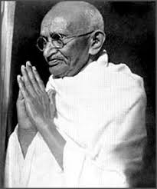
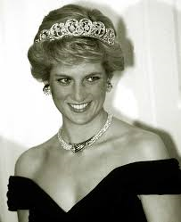
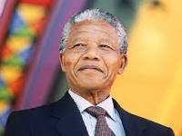
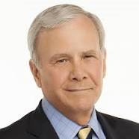
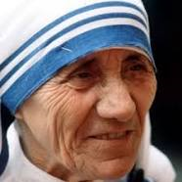

Slide 23
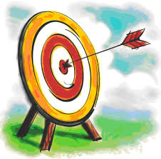
TIPS FOR RELATING TO C’s
Be sure to
provide clear expectations and deadlines show dependability demonstrate loyalty be tactful and emotionally reserved allow precedent to be a guide be precise and focused value high standards
Be prepared for
discomfort with ambiguity resistance to vague or general information desire to double-check little need for affiliation with others
High C’s want others to minimize socializing, give details, and value accuracy.
Notes:
30

Slide 24
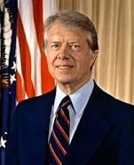
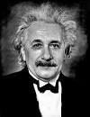

Slide 25
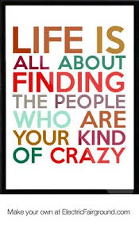
Go to the side of the room that identifies your dominant behavioral style.

Slide 26
Get to Know Your People ☺
Identify 3 strengths of your behavioral style
Identify 2 strengths of each of the other behavioral styles and 1 characteristic of that style that can be difficult to work with
Share with the larger group
Notes:
Allow – 15 minutes for identify strengths and challenges and 5 minutes for sharing

Slide 27
Family Photos
D-Style
Has a gold leafed, leather-bound album. Doesn’t know where the pictures are.
I-Style
Has pictures in cell phone, envelopes and in different closets.
C-Style
Picks 5-6 pictures out of all that best highlight the moment, labels them, and then puts the album on a bookshelf.
S-Style
All pictures are in albums in the family room.

Slide 28
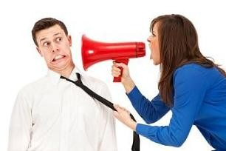
When Responding to Conflict
What do our Dominating D’s do….
Become overly assertive
Overly controlling
Strong – willed
Attempt to impose thoughts and feelings on others

Slide 29
When Responding to Conflict
What do our Influencing I’s do….
May be explosive
Emotionally attack others and their ideas
Use put downs to discredit others
Tell people how he/she “feels” about things

Slide 30
When Responding to Conflict
What do our Steady S’s do…..
May give in to keep peace and reduce conflict
Appear to agree with others
Tolerate things even though he/she may disagree
Desire to save the relationship even if it hurts them the most

Slide 31
When Responding to Conflict
What do our Conscientious C’s do….
Less assertive
Keep thoughts to self
Withdraw from people and/ or undesirable situations
Start planning their next move

Slide 32
Making DiSC A Part of Our Culture
Every Resident & Faculty completes an assessment
It is posted in our clinic, on resident ILPs
Frequently referred to during teaching

Slide 33
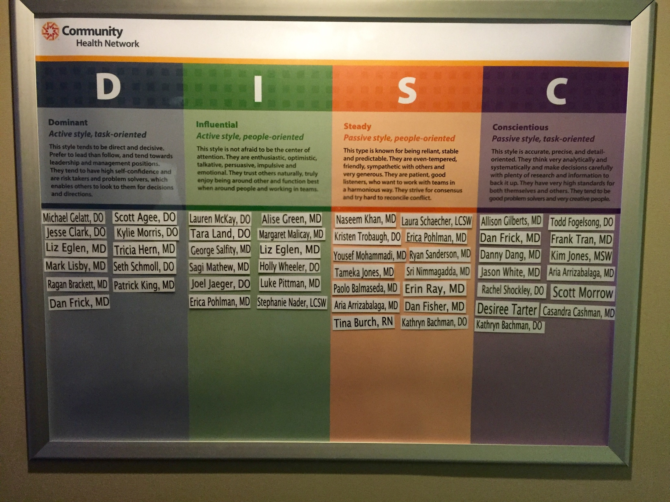
Making DiSC A Part of Our Culture

Slide 34
Parting thought . . .
“In matters of style,
swim with the current;
in matters of principle,
stand like a rock.”
--Thomas Jefferson
Notes:
Concluding:
We all come to the table with a different lens…Question: how do you think this course on Behavioral Styles and How we lead relates to the Values class?
How about the Emotional Intelligence class?
As leaders you are expected to be more self aware, and to stretch when necessary to expand our ability to ________?

Slide 35
Questions?
References
https://www.discprofile.com/

