Slide 1
Running Lapse: Approaches to Measuring Specific Patient Safety and Professional Conduct Milestones That Can be Elusive
Tina Kenyon, ACSW, Teri Brehio, MD, Jane Sanborn, Jacki Morse, MD, MPH, Alex Brown, PhD
NH Dartmouth Family Medicine Residency at Concord Hospital, Concord, NH
Notes:
Tina, Alex, Jacki – Thank you to our colleagues Dr Teri Brehio who co-authored this presentation but could not attend the conference, and our data coordinator Jane Sanborn who made these activities run so smoothly.

Slide 2
Presentation Objectives
Provide practical experience with tools presenters use across
all 3 years to measure learners’ mental models regarding Patient Safety and Professional Conduct Milestones
b) Identify tools participants use to measure these Milestones in their
programs
c) Collaboratively generate creative approaches to measuring these
behaviors in the future
Notes:
Alex

Slide 3
Workshop Agenda – 90 minutes
Introduce presenters, share objectives, frame session structure 3 minutes
Overview of Competency Day structure/stations 10 minutes
Participants break into 3 groups 2 minutes
Each group rotates through 3 stations to experience all 3 year-appropriate exercises (PGY 1,2,3) for 15 minutes each 45 minutes
Large group reconvenes to share observations from stations 20 minutes and models they are currently using to measure these Milestones
Summary, complete evaluation 10 minutes
Notes:
Alex

Slide 4
Brief Background of Activities
“Competency Day” – annual event at NHDFMR since 2003
Designed to measure various Milestones not measured easily/elsewhere (e.g. professionalism, knowledge of ethical principles and study designs)
Advance introduction, reassurance regarding purpose/outcomes (e.g. “snapshot” of resident skill AND adequacy of curriculum)
Morning session, breakfast, 3 stations of 40 min each, 1 40 min break
Notes:
Tina – There are a number of practical details in the planning and implementation of these activities, and we will post the wonderful summary our data coordinator Jane Sanborn generated as a guide

Slide 5
Overview of Activities
A “proxy” measurement with limitations
Interactive, some stations have pre-work
Some stations 1-1, pairs, small group
Verbal and written feedback provided
If resident does not pass, provide remediation then re-test
Faculty team debrief re resident performance and station design – identify curricular gaps and potential improvements
Notes:
Tina

Slide 6
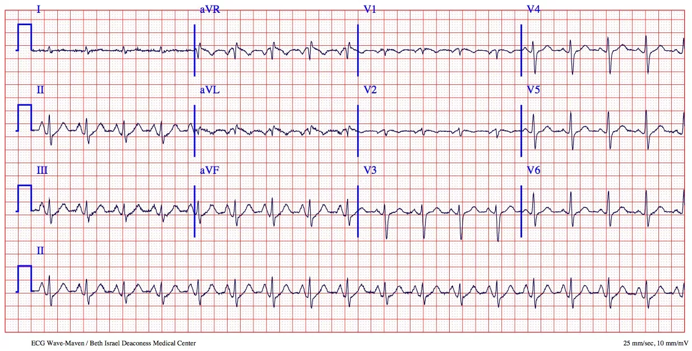
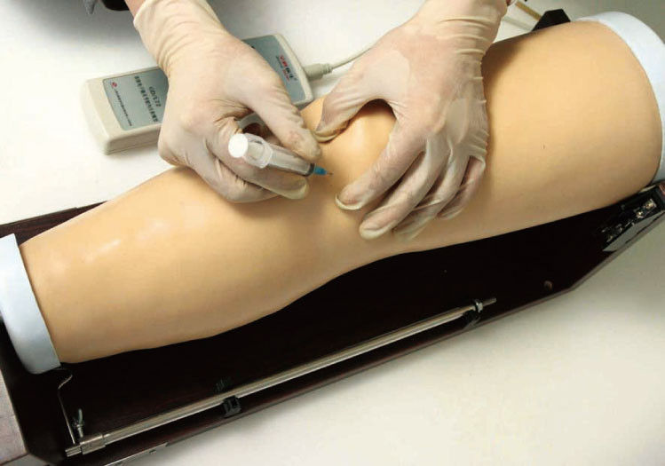
Different activities for each class:
PGY 1 –
Patient safety
Evidence-based practice
Quiz (ethics, studies, fatigue signs)
EKG module on line (during break)
PGY 2 –
Professionalism scenarios
Joint injection procedure
Using registries
PGY 3 –
Safety and professionalism
Ethics
Chronic care
Notes:
Jacki – Overview of stations
the EKG module in PGY 1 is an on-line resource that provides batches of 20 EKGs and multiple choice answers, so easy to incorporate.
The resident receives the correct answers and a score after each batch. They can often get through 2 batches and still have a break.

Slide 7
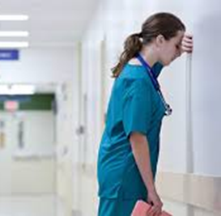
Station Milestones Measured
PGY 1 - Patient Safety
Understands that effective team-based care plays a role in patient safety (SBP 2)
Identifies appropriate channels to report unprofessional behavior (Prof 2)
Has insight into his or her own behavior and likely triggers for professionalism lapses, and is able to use this information to be professional (Prof 2)
Understands the mechanisms that cause medical errors (SPB 2)
Recognizes medical errors when they occur, including those that do not have adverse outcomes (SBP 2)
Pre-work video: https://www.coursera.org/learn/patient-safety-systems-view/lecture/H5Fb4/swiss-cheese-model
Notes:
Alex – We are looking at whether residents at this stage have a basic sense of how to recognize and report lapses and errors; In this station, the assigned pre-work is watching a 7 minute video from Johns Hopkins explaining the Swiss Cheese Error Model – (show of hands) – how many people are familiar with the Swiss Cheese model? (Clarify for those who aren’t familiar). During the station, we use this content to see if residents demonstrate our Just Culture/non-punitive systems approach when an error is made instead of “assigning blame”

Slide 8
Station Milestones Measured
PGY 2 - Professionalism
Recognizes physicians have an obligation to self-discipline and self-regulate (Prof 1)
Has insight into own behavior and likely triggers for professionalism lapses, and is able to use this information to be professional (Prof 2)
Identifies appropriate channels to report unprofessional behavior (Prof 2)
Recognizes professionalism lapses in self and others (Prof 2)
Reports professionalism lapses using appropriate reporting procedures (Prof 2)
Recognizes signs of impairment in self and team members, and responds appropriately (Prof 4)
Notes:
Jacki – in 2nd year, we are looking at their recognition of lapses, in addition to how they have or would report professional lapses. We also want to know if they are aware of impairment in themselves and others.

Slide 9
Station Milestones Measured
PGY 3 - Safety and Professionalism
Uses current methods of analysis to identify individual and system causes of medical errors common to family medicine (SBP 2)
Develops individual improvement plan and participates in system improvement plans that promote patient safety and prevent medical errors (SBP 2)
Engages in self-directed and practice improvement activities that seek to identify and address medical errors and patient safety (in daily practice) (SBP 2)
(PGY 3 residents also complete a robust QI project)
Notes:
Tina – Since we have determined they demonstrate the ability to recognize and report errors and professionalism lapses in the first two years, we move to how they would operationalize improvement from an individual and a systems-level. This station is one element of our approach to quality improvment. Their QI project is a significant learning opportunity to actually implement improvement strategies.

Slide 10
Activity Flow for Workshop Stations
Stations – 15 minutes each
PGY 1 – Patient Safety - Alex
PGY 2 – Professionalism - Jacki
PGY 3 – Safety and Professionalism - Tina
Description of activities and brief experience
Sharing content, process, evaluation – information will be posted in STFM Resource Library
Notes:
Jacki – Set up – Everyone will experience each station, and we will keep time. The actual time given for these exercises is 40 minutes, so we are abbreviating them for this workshop. In each station, we will ask for a volunteer to be the resident, and the facilitator will be the faculty. While we are demonstrating each exercise, observers will also be engaged in thinking them through. After everyone has rotated through all the stations, we will come back together to continue the conversation in the large group.

Slide 11
Sample Resident Feedback
I enjoyed the stations. I learned something from each station. Very well organized - left me thinking about my future practice. (PGY3)
Great to see the rest of the PGY 3 class all at once
It would be nice to have testing/teaching scenarios like EKG’s, CXR or special tests on physical exam (PGY2 – changed for following year)
Think of picture as a whole when a mistake is made (PGY 1)
More information ahead of time to reduce anxiety (PGY1)
Excellent use of time, appreciate feedback in real time and opportunity to ask questions (PGY1)
Notes:
Tina – sample of responses. We have found very few negative comments over the years, and have received many valuable suggestions for subsequent improvement. For example, some residents were quite anxious about this event despite our attempts at reassurance. So, the following year, we were very deliberate about setting the stage in person and through email.

Slide 12
Large Group Debrief
What are your thoughts about the stations?
What questions do you have?
How are you measuring these Milestones in your program?
What other ideas do we have about different ways to measure these?
Notes:
Alex

Slide 13
Summary Points
Interactive scenarios are one method of measuring several Milestones not easily captured in daily practice
This format reveals both resident AND curricular areas for growth
Faculty and residents learn from each other
Providing residents with resources to manage similar situations in the future is helpful
Notes:
Tina – since we hopefully don’t work in systems where there are frequent lapses in professionalism, we need to have some way to determine resident knowledge about lapses and errors. We have learned about gaps in our program by identifying patterns of responses, and that has helped us improve. Both faculty and residents enjoy these activities, which offer opportunities for teaching as well as assessment.

Slide 14
Contact Information
Tools will be posted on STFM Resource Library
Contacts:
Tina Kenyon, ACSW tkenyon@crhc.org
Alex Brown, PhD pbrown@crhc.org
Jacki Morse, MD, MPH jmorse@crhc.org

Slide 15
Please complete your session evaluation and help us make future presentations better!

