Slide 1
Using a New Mobile Application to Evaluate Collaborative Practice in Family Medicine
STFM Conference on Medical Student Education, 2017
Lauren Collins, MD
Shoshana Sicks, EdM
Alicia Muratore, MSIII

Slide 2
Objectives
Describe a new mobile tool for gathering patient feedback on team-based care in Family Medicine (FM)
Apply lessons learned for 360-degree competency-based assessment of collaborative practice to enhance care delivery in Family Medicine
Describe how this tool can help to support new efforts to achieve the Quadruple Aim

Slide 3
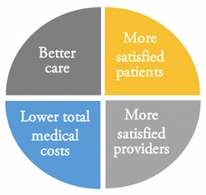
Collaborative Practice and the Quadruple Aim
Improved patient outcomes
Interprofessional team training recommended to increase patient safety and quality health care (Institute of Medicine, 1999)
Increased patient satisfaction
Shown to increase patient satisfaction and improve the culture (Reeves, et al., 2008)
Decreased costs
Shown to reduce errors in the ED
(Reeves, et al., 2008)
Increased provider satisfaction
Acknowledged role of workforce,
importance of restoring joy, meaning to practice
(Sinsky, et al., 2013)

Slide 4
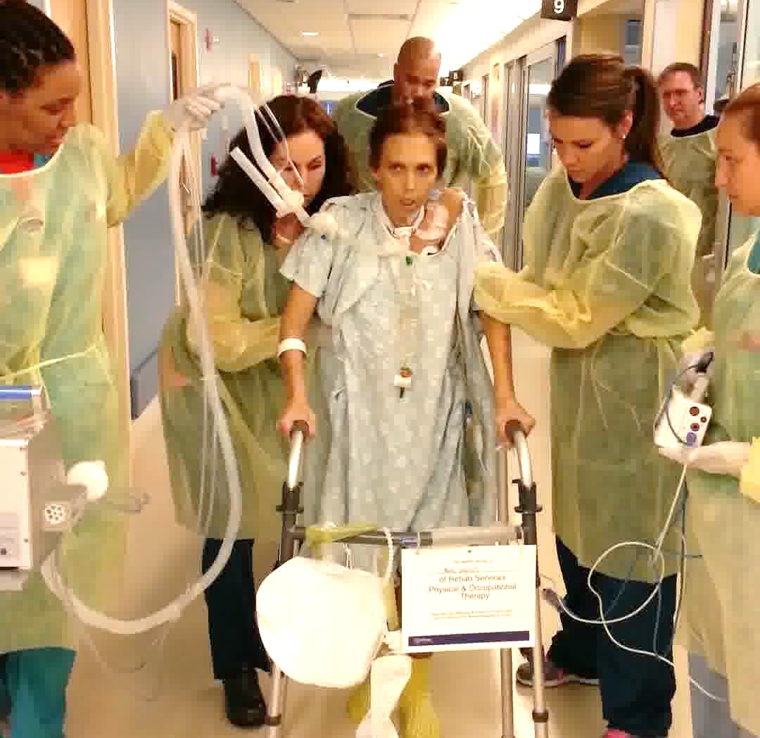
IPE and Collaborative Practice

Slide 5
Background
Interprofessional team-based collaborative practice (CP) is the new standard of care for Family Medicine
IPE Competencies (IPEC, 2011 & 2016):
Interprofessional Collaboration
Communication
Values/Ethics
Teamwork
Roles/Responsibilities

Slide 6
Background: Current Patient Assessment Tools
Hospital Consumer Assessment of Healthcare Providers and Systems (HCAHPS)
Clinician and Group Consumer Assessment of Healthcare Providers and Systems (CG CAHPS)
Lack of tools that accurately measure achievement of collaborative practice competencies
Lack of studies that gather real time patient feedback
Notes:
While ‘Patient-centeredness’ has been an integral part of our healthcare vocabulary for many decades, its measurement has become increasingly important for training and reimbursement purposes. In an effort to better elicit patient perspectives, Family Medicine practice teams, like many other healthcare delivery teams, are often assessed by standardized patient satisfaction surveys and quality metrics.
Both the Hospital Consumer Assessment of Healthcare Providers and Systems (HCAPHS) and Clinician and Group Consumer Assessment of Healthcare Providers and Systems (CG CAHPS) are two tools used by more than 90% of FM practices to gather information on patient perceptions of care, including access to care, courtesy and helpfulness of the office staff and the communication skills of physicians.¹⁵
While these patient satisfaction surveys have been widely adopted and have led to new efforts at quality improvement across the country, critics of the tools cite that they are lengthy, expensive to administer, and may lead to inappropriate medical testing and care. Results are often received with skepticism by providers due to concerns about response bias and the long lag time between a health care visit and data collection.¹⁶⁻¹⁸ While the benefits of the tools may remain under debate, they are still missing one key element: they do not attempt to gather patient perceptions of teamwork or interprofessional collaborative practice.

Slide 7
Background: Education and Accreditation
New accreditation requirements:
Liaison Committee on Medical Education (LCME), Accreditation Council for Graduate Medical Education (ACGME), and American Board of Medical Specialties (ABMS)
Core Entrustable Professional Activity (EPA)
EPA 9 - Collaborate as a member of an interprofessional team
EPA 13 - Identify system failures and contribute to a culture of safety and improvement
Notes:
Just as FM practices are under increasing pressure to undergo rapid cycle improvement to enhance patient satisfaction and transform care delivery, there has been a simultaneous push in medical education, as evidenced by new and evolving requirements from the Liaison Committee on Medical Education (LCME), Accreditation Council for Graduate Medical Education (ACGME), and American Board of Medical Specialties (ABMS), to prepare a workforce that is equipped to practice as part of a highly functioning interprofessional team. Specifically, Core Entrustable Professional Activity (EPA) 9 (Collaborate as a member of an interprofessional team) and EPA 13 (Identify system failures and contribute to a culture of safety and improvement) have been identified as critical expectations for entrustment among all medical school graduates. To address the Quadruple Aim and reduce medical errors, medical students and residents are expected to complete their training as expert team members, equipped with tools to support interprofessional team members in delivering safe, patient-centered care once in practice.¹⁹⁻²¹

Slide 8
Addressing the Gap
Gap in IPE literature regarding effect of IPE
on patient outcomes
“Recommendation 1: Interprofessional stakeholders, funders and policy makers should commit resources to a coordinated series of well-designed studies of the association between IPE and collaborative behavior, including teamwork and performance in practice. These studies should be focused on developing broad consensus on how to measure interprofessional collaboration effectively across a range of learning environments, patient populations, and practice settings.”
Time is now to develop a “best-in-class” instrument!!
(IOM, 2015)
Notes:
Despite a demand for high quality team-based practice from both education and delivery systems, our ability to measure this important dimension of healthcare has lagged. Most IPE and CP assessment tools to date have examined “attitudes;” little research has demonstrated changes in behavior of participants in interprofessional education (IPE) programming and CP training. In fact, a 2015 report from the IOM highlighted the need for a validated ‘best-in-class’ tool to assess interprofessional CP.⁵ This report also identified a significant gap in the literature, linking effective team function and improved patient experience and outcomes.^{7,22,23}

Slide 9
Project Goal
JTOG® App → streamline all IPE, teamwork and collaborative practice evaluation for 360 degree assessment:
Team (n >1750)
Patient (n = 407)
Caregiver (n = 198)
Individual (n = 10,562)
Notes:
After two years of study, our research team validated a tool, the Jefferson Teamwork Observation Guide (JTOG), to assess and identify behaviors consistent with effective team functioning.²⁴ Since completion of the validation study in 2015, this survey was then converted to an app, and individual, patient, and caregiver (e.g. family member or chosen support person) versions of the app were also developed to allow for 360° assessment of teamwork and to enhance patient safety. For this study, the mobile version of the newly adapted “Patient” JTOG tool was administered with volunteer FM patients in both the inpatient and outpatient (a level three Patient Centered Medical Home) setting at a large, urban academic health center. We had three primary aims with the research presented in this study: 1) to pilot the Patient JTOG with a diverse population of FM patients as a test of feasibility of administration; 2) to report preliminary information on the reliability and validity of the adapted tool; and 3) to provide guidance for the application of the Patient JTOG in clinical practice and research.
This fall, we have gone through an iterative process of CQI as we pilot and refine all four versions (team, individual, patient and caregiver/family member) of the mobile “wrapped” version of the JTOG app before proceeding with converting this wrapped app into a “native” application. In addition, we have successfully recruited and trained a group of 10+ research assistants to help with administering the app on tablets with patients and caregivers (in inpatient and outpatient settings), as well as developed a handbook for RAs, which is continuously updated to improve consistency in administration of the tool.
Our first validation study for the Team JTOG was published in JAH this summer, and we now have multiple additional pilots studies underway and planned to further look at the reliability and validity of this team tool in multiple settings, as well as the three new versions of the tool that we have now adapted and are utilizing across the institution.
RAPID adoption of the tool which is now a part of at least three different TJU HRSA grants, as well as two applications (one for ACGME)….currently adopted by 15 different teams at TJU... And requested for use by over 40 other insitutions.
54 individual surveys from NMRCA, the rest from HMP

Slide 10
Patient JTOG
* Patient-Centeredness – a subdomain of Values/Ethics

Slide 11
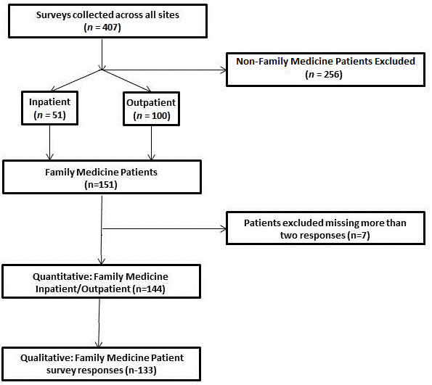
Methods
10 Jefferson teams solicited→ all 10 agreed to participate in study
Trained RAs surveyed patients using secure, portable iPads
Data collected over 7 months
Total patients surveyed in Family Medicine (inpatient and outpatient) = 151
Notes:
The purpose of this study was to pilot the Patient JTOG mobile application prototype with a diverse population of family medicine patients, in both inpatient and outpatient settings, to gather their perceptions of team functioning by family medicine care teams. After being seen by a healthcare team, patients were asked to participate in a short, voluntary survey consisting of ten Likert scale questions and one open-ended question. Questions were mapped to four domains of interprofessional collaborative practice, including communication (C), values/ethics (V/E), teamwork (T), roles/responsibilities (R), and one domain on patient-centeredness (PC). Response options range from 1 – Strongly Disagree to 4 – Strongly Agree, with a ‘Not Applicable’ option available. All items were positively scored and the possible range of the instrument was 8-32. Respondents with no more than two missing or n/a responses were included in analyses (n = 144). Trained research assistants, who were not part of the healthcare team, administered the survey on secure mobile tablets. The study received exempt approval by our Institutional Review Board.

Slide 12
Quantitative Methods
Means and standard deviations
Global JTOG and item-by-item to provide normative data
Correlational Analysis
To estimate the relationships among individual items
Cronbach’s Alpha
Internal consistency of the global Patient JTOG score
Exploratory factor analysis
To investigate the underlying structure of the scale
Feasibility
Examined patterns of missing responses across items and by respondents
Notes:
Feasibility was assessed by examination of patterns of missing responses across items and both across and within respondents, as well as qualitative feedback from patients during administration. We calculated means and standard deviations for the global Patient JTOG score, as well as item by item, in order to explore the performance of the scale and to provide preliminary normative data in this population. We statistically compared the Family Medicine team scores to scores from other teams to gauge the discriminative ability of the instrument. Correlational analysis was used to estimate the relationships among individual items, and Cronbach’s alpha was used to determine the internal consistency of the global Patient JTOG score. An exploratory factor analysis was conducted to investigate the underlying structure of the scale. The global Patient JTOG score was analyzed for its relationship with the ‘overall satisfaction’ item as a validity check for the instrument. We also examined relationships between the global JTOG score and other metrics of team functioning in the clinical setting.

Slide 13
Qualitative Methods
Qualitative item:
“Please list anything your care team did that either positively or negatively affected your experience as a patient or your healthcare outcomes.”
Coding framework → panel of 7 independent coders reached consensus
Categorized as Positive, Negative or Mixed
Also, coded according to each of the 4 IPEC Core Competency domains
Notes:
The qualitative item on the tool asked participants to: “Please list anything your care team did that either positively or negatively affected your experience as a patient or your healthcare outcomes.” A coding framework was established by a panel of seven independent coders based on the total qualitative patient responses that have been gathered to date across our institution (n = 302) from FM and other teams. From the 302 total qualitative comments, a sample was coded by consensus. A trained research assistant then categorized all responses as “positive,” “negative” or “mixed” and coded all comments for the presence of IPEC core competencies. A second research team member then reviewed the coded qualitative comments and made suggestions for revision. Finally, the coded comments were reviewed by a third team member and consensus reached between all three.

Slide 14
Results: Demographics
Notes:
Data were collected at a large academic institution in both inpatient and outpatient sites served by Family Medicine teams. During the seven months the survey was offered, 151 patients at both sites completed the survey (n inpatient = 51, n outpatient = 100). See Figure 1 for a study diagram. Participants ranged in age from 18-90⁺ years old. They were predominately female (n = 113, 75%).

Slide 15
Results: Demographics, cont.
Notes:
Thirty-six respondents (24%) were Caucasian, 99 (66%) African-American, and 14 (9%) indicated other. Ten (6.6%) of the respondents identified as Hispanic. The representation of participants was consistent with the demographic of the population served by this practice.

Slide 16
Quantitative Results: Summary
Feasible to administer
only ‘missing at random’ items
very few ‘not applicable’ responses (<4.4%)
87.1% of patients strongly agreed that teamwork is important in patient care
High internal consistency → Cronbach’s alpha = 0.93
One factor underlying the items
A principal components factor analysis yielded a single-factor solution accounting for 66.37% of the item variance
Global JTOG scores correlate with overall satisfaction with team (r=.54, p<.001)
Notes:
Seven respondents were excluded from analysis for incomplete responses. Of these, six were missing three items each, and the seventh was missing four. After excluding these seven, there were a total of five missing responses in the entire dataset (<0.01% of all data). The excluded respondents were mixed equally between the inpatient and outpatient settings, and analysis of their scores calculated from available items indicated no significant difference in their global JTOG scores. We therefore consider them missing at random.
Respondents have a ‘not applicable’ (n/a) option for every item. In total, there were 51 ‘n/a’ responses across all items, a rate of 4.4%. The range of n/a responses across items was 0-20. Across participants, the items ‘listen’ and ‘discuss’ (items 4 and 2) generated the most n/a responses, with 16 and 20 n/a responses respectively.

Slide 17
Patient JTOG Items
Notes:
Patient JTOG data were available for six other settings: four outpatient specialty clinics and two inpatient hospital medicine teams.

Slide 18
“Global” JTOG Scores
Notes:
Global JTOG scores ranged from 29.10 (SD = 3.39) to 27.54 (SD = 3.70), with no significant differences between the settings. The two FM settings we examined here scored 27.14 (SD = 3.62) (inpatient) and 28.38 (SD = 3.86) (outpatient), with no statistically significant difference between them.

Slide 19
Inter-item Correlation Matrix
Yielded a single-factor solution accounting for 66.37% of the item variance
One domain measuring collaborative practice – consistent with 2016 IPEC update
Notes:
Correlations ranged from 0.554 to 0.746 (all p’s < .05). Cronbach’s alpha was 0.93, representing a high degree of inter-item correlation. A principal components factor analysis was performed on the data, and yielded a single-factor solution accounting for 66.37% of the item variance. The correlation of the global JTOG score with the overall satisfaction item was r = .54, p < .001.

Slide 20
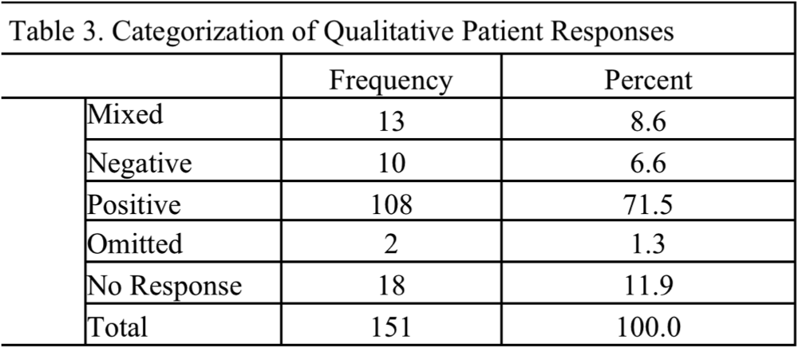
Qualitative Results (n=133 FM patients)
Notes:
Summary categorization data for the qualitative results can be found in Table 3. Of the 133 comments from FM patients, 108 (71.5%) were categorized as “positive,” 10 (6.6%) as “negative” and 13 (8.6%) as “mixed.” Two comments (1.3%) were omitted from the study because they could not be classified as positive, negative or mixed. When coded for interprofessional collaborative practice competencies, 71 (47%) comments centered on communication, 64 (42%) on patient-centeredness (a sub-domain of values/ethics), 38 (25%) on teamwork, and 4 (3%) on roles and responsibilities. Sixty-one (46%) responses reflected multiple competencies, with 41 (27%) highlighting communication and patient-centeredness, 18 (12%) including both communication and teamwork and 12 (8%) focusing on both teamwork and patient-centeredness. Overall, 104 out of 133 comments (69%) were coded with specific competencies, highlighting the ability of FM patients to recognize these collaborative practice attributes in the provision of their healthcare.

Slide 21
Qualitative Results, cont.
Notes:
Any competency = 1 or more competencies coded. This does not equate to 100% since many comments contained more than one competency

Slide 22
Qualitative Results, Cont.
Frequency of Overlapping Competencies
Combination | Frequency | Percentage
Multiple Competencies | 61 | 46
Communication & Patient-Centeredness | 41 | 27
Communication & Teamwork | 18 | 12
Teamwork & Patient-Centeredness | 12 | 8
Notes:
Multiple competencies = any comment coded with more than one competency. The percentages do not equate to 100% because there are other combinations not listed here and because the comments with combinations are included in the “multiple competencies” category

Slide 23
Qualitative Results, cont: Sample
Not much concern of the situation of the patient, indifferent. Avoid flexibility. Couldn't help get resources. Would be superficially nice but not actually helpful. They don't care because it isn't their suffering and it's not their pain.
-Outpatient
Positive. They came in at separate times but all knew [the] same info. They had read the charts and done their studying.
-Inpatient
My doctors are nice, but I don't know what's going on.
-Inpatient
The doctor always discusses what we should do. She takes time and is thorough. If not sure about something, she is always willing to reach out to other team members for consult. The team all knows what's going on with me.
-Outpatient
They talked outside my door about me. I wonder where's the rules that protect the patient's privacy. They gave me a pill without telling the cardiac doctor. The dose was too much and caused problems when going to the bathroom.
-Inpatient
Notes:
Analysis of the open-ended comments from both the inpatient and outpatient respondents revealed several key findings. In the inpatient setting, the two most frequently mentioned positive attributes of the medical teams were friendliness and a willingness to explain and listen to patients. When teamwork was mentioned in a positive manner, the team was lauded as “professional” and “well prepared;” however, patients did notice and comment when cohesive teams were not present during inpatient rounds. Analysis from the outpatient responses revealed additional findings. The majority of positive patient comments identified the medical team as being welcoming, caring, friendly, and patient-centered. For example, several patients commented that they appreciated being greeted at check-in and called by their names. Other patients reported increased satisfaction when they felt that their opinions were solicited and valued by the medical team. Assistance with referrals and providing adequate patient education regarding specific conditions were behaviors that were noted by patients as positive attributes. The few negative comments centered on long wait times in the office setting.

Slide 24
Lessons Learned
FM practice teams welcome real-time, actionable patient feedback on CP behaviors
Patients are eager to provide feedback on team behaviors
RAs need sample scripts and adequate training
Patient feedback might be biased by presence of RA
Major takeaways →
Mixed-methods study confirms overlap of 4 IPEC competency domains → 1 global domain of Collaborative Practice
Patient JTOG provides a reliable, easy to use measure of a team’s collaborative practice behaviors
Notes:
One of the lessons learned through the administration of this adapted patient measure is the importance of providing sample scripts and adequate training for our research assistants. By providing advanced training for our RAs, they could more effectively guide patients to consider each member who is part of the care team, to encourage patients to use the “n/a” option as appropriate, and to clarify that this tool is designed to capture a one time experience with a care team and not a longitudinal relationship with a provider or an entire hospital stay.

Slide 25
Where are we now?
Gathered patient data from a variety of teams at TJU
Developed longitudinal quantitative/qualitative feedback reports for teams
Working with educational and practice teams to address performance improvement based on JTOG feedback
Completed large scale validation study of Patient JTOG
360°JTOG App → Available for dissemination in 2017
Plan for multi-institutional studies underway
Notes:
Our study confirms the feasibility of using an adapted version of the JTOG, the Patient JTOG, to elicit patient perceptions of collaborative practice in inpatient and outpatient family medicine. By completing this survey on a mobile app prototype, patients were able to provide real time actionable feedback to care delivery teams, and data reports were sent back to teams to enhance quality improvement measures. Findings from this large pilot study confirm that the Patient JTOG can be used to gain a global picture of patient-centered collaborative practice, and data collection is easily transferable to other institutions looking to gather similar data from their patients. A full validation study of the Patient JTOG is now underway to assess the reliability of this adapted version of the JTOG, and a multi-institutional study is planned to assess the application of the tool in other healthcare institutions.

Slide 26
Where are we heading?
By employing all 4 different versions of the JTOG with students and residents who rotate through FM, with preceptors who supervise them, and with the patients and caregivers served by these teams, we hope to gain a robust view of collaborative practice in FM that will help to:
Guide performance improvement in practice
Define national benchmarks in interprofessional CP
Enhance the delivery of team-based care in Family Medicine

Slide 27
Questions?
Jefferson Center for InterProfessional Education (JCIPE)
Email: JeffCrtInterproEd@jefferson.edu
Follow us on Twitter @JeffCIPE

Slide 28
References
Sinsky, CA, Willard-Grace, R, Schutzbank, AM, Sinsky, TA, Margolius, D, Bodenheimer, T. In search of joy in practice: A report of 23 high-functioning primary care practices. Annals of Family Medicine 2013;11(3), 272-278.
Interprofessional Education Collaborative. Core competencies for interprofessional collaborative practice: 2016 update. Washington, DC: Interprofessional Education Collaborative, 2016.
World Health Organization. Framework for action on interprofessional education & collaborative practice. Geneva, Switzerland: WHO Department of Human Resources for Health. 2010. http://whqlibdoc.who.int/hq/2010/WHO_HRH_HPN_10.3_eng.pdf. Accessed December 7, 2016.
Interprofessional Education Collaborative Expert Panel. Core competencies for interprofessional collaborative practice: Report of an expert panel. Washington, DC: Interprofessional Education Collaborative. 2011. http://www.aacn.nche.edu/education-resources/ipecreport.pdf. Accessed December 7, 2016.
Institute of Medicine. Measuring the impact of interprofessional education on collaborative practice and patient outcomes. Washington, DC: National Academies Press. 2015.
Institute of Medicine. Crossing the quality chasm: A new health system for the 21st century. Washington, DC: National Academies Press, 2001
McMillan, S. S., Kendall, E., Sav, A., King, M. A., Whitty, J. A., Kelly, F., & Wheeler, A. J. Patient-Centered Approaches to Health Care: A Systematic Review of Randomized Controlled Trials. Medical Care Research and Review, 2013;70(6), 567–596.
Mead N, Bower P. Patient-centred consultations and outcomes in primary care: a review of the literature. Patient Educ Couns, 2002;48(1):51-61.
Olsson, LE, Jakobsson Ung, E, Swedberg, K, Ekman, I. Efficacy of person-centred care as an intervention in controlled trials - a systematic review. Journal of Clinical Nursing, 2013;22(3–4), 456–465.
Ashby ME, Dowding C. Hospice care and patients’ pain: communication between patients, relatives, nurses and doctors. Int J Pall Care Nurs 2001;7(2):58.
Dowsett SM, Saul JL, Butow PN, Dunn SM, Boyer MJ, Findlow R, Dunsmore J. Communication styles in the cancer consultation: preferences for a patient-centred approach. Psycho-oncology 2000;9(2):147-156.
Kwan J, Sandercock P. In hospital care pathways for stroke. Coch Database Sys Rev 2004;4.
Simces Z. Exploring the link between public involvement/citizen engagement and quality health care. A review and analysis of the current literature. Ottawa: Health Canada, 2003.

Slide 29
References, cont.
Shoemaker SJ, Fuda KK, Parchman M, Schaefer J, Levin J, Hunt M, Ricciardi R. Atlas of Instruments to Measure Team-based Primary Care Report. Prepared by Abt Associates under Contract # HHSA 290.2010.0004I, Task Order #5. AHRQ Publication No. 14-0063-EF. Rockville, MD: Agency for Healthcare Research and Quality. 2014. http://primarycaremeasures.ahrq.gov/team-based-care/downloads/ccteam/Team-based_Primary_Care_Atlas.pdf. Accessed November 10, 2016.
Agency for Health Care Research and Quality. http://www.ahrq.gov/cahps/surveys-guidance/cg/about/index.htm. Accessed November 10, 2016.
Shaller, D. The Evolving CG-CAHPS Landscape : What’s Next for Ambulatory Practices? Agenda • CAHPS Program Overview • Current CG-CAHPS Landscape • CAHPS Consortium Research and New Directions, 2015.
Giordano, LA, Elliott, MN, Goldstein, E, Lehrman, WG, Spencer, PA. Development, Implementation, and Public Reporting of the HCAHPS Survey. Medical Care Research and Review, 2009;67(1), 27–37.
Anhang Price, R, Elliott, MN, Cleary, PD, Zaslavsky, AM, Hays, RD. Should Health Care Providers be Accountable for Patients??? Care Experiences? Journal of General Internal Medicine, 2014;30(2), 253–256.
The Joint Commision. https://www.jointcommission.org/specifications_manual_joint_commission_national_quality_core_measures.aspx. Accessed December 66, 2016.
Berwick, DM, Nolan, TW, Whittington, J. The triple aim: Care, health, and cost. Health Affairs, 2008;27(3), 759–769.
Menscer, D. REPORTS OF THE COUNCIL ON MEDICAL EDUCATION. American Medical Association, 2016.
Reeves, S, Zwarenstein, M, Goldman, J, Barr, H, Freeth, D, Hammick, M, Koppel, I. Interprofessional education: effects on professional practice and health care outcomes. Cochrane Database of Systematic Reviews. 2001;1.
Strasser DC1, Falconer JA, Herrin JS, Bowen SE, Stevens AB, Uomoto J. Team functioning and patient outcomes in stroke rehabilitation. Arch Phys Med Rehabil. 2005 Mar;86(3):403-9.
Lyons, K. J., Giordano, C., Speakman, E., Smith, K., & Horowitz, J. A. Jefferson Teamwork Observation Guide ( JTOG ): An Instrument to Observe Teamwork Behaviors, n.d.
Interprofessional Education Collaborative. Core competencies for interprofessional collaborative practice: 2016 update. Washington, DC: Interprofessional Education Collaborative, 2016.
Elliott MN, Zaslavsky AM, Goldstein E, et al. Effects of survey mode, patient mix, and non- response on CAHPS hospital survey scores. Health Serv Res. 2009;44(2 pt 1):501-518

