Slide 1
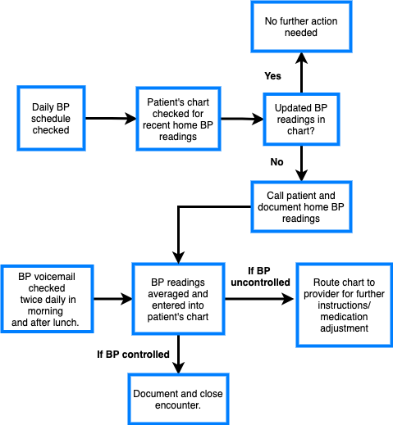
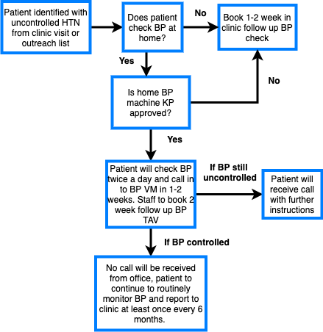
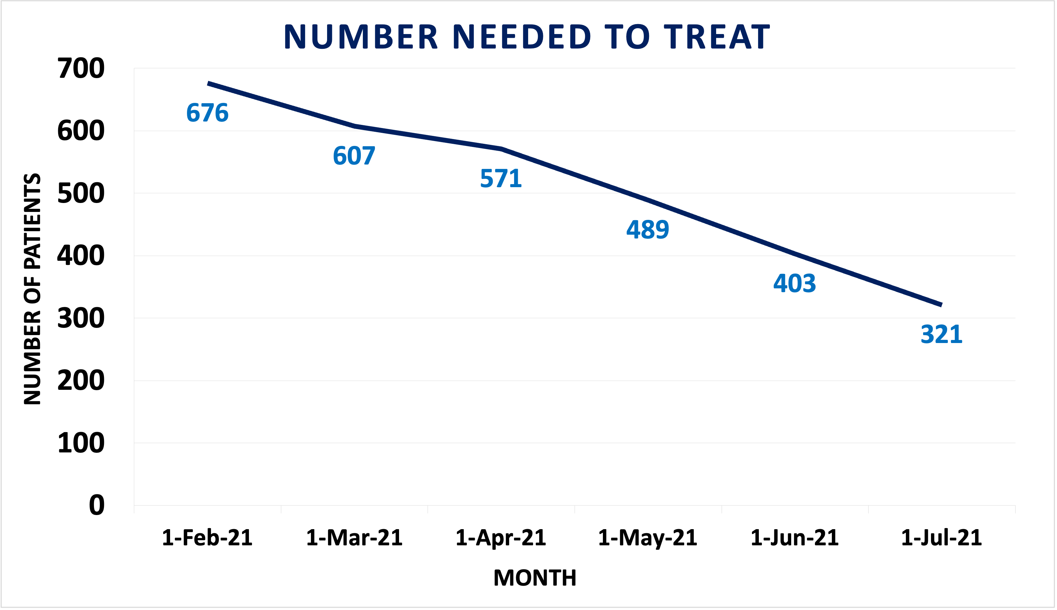
BP Call Back Line:
A Patient-driven Workflow to Improve Control of Hypertension at Home During the COVID-19 Pandemic
Kimberly Ontiveros-Gomez BSc Candidate, Payam Sazegar MD, Francesca Adriano MD, Vidush Athyal MD
Study Objectives
To develop a standard protocol for monitoring home BP measurements in order to improve hypertension (HTN)control rates at a large Family Medicine Center during the COVID-19 pandemic.
To reduce quality care gaps in HTN management created by telemedicine adoption in 2020 and allow for timely medication adjustments without the need for in-person visits.
Patient Workflow
Figure 1a: Workflow followed by patients to monitor and report home BP readings.
Staff Workflow
Summary of Findings
The NNT fell from 676 patients to 321 patients, for an improvement of 53% overall, by the end of 20 weeks. For African American patients, the NNT fell from 66 to 37 (44% reduction) and for all patients Ages 65-75 the NNT fell from 255 to 60 (76% reduction). The larger improvement for the senior population may have been due to many seniors already having a practice of monitoring their BP at home. No racial disparities were observed in the initial cycle.
Figure 1b: Workflow followed by staff to document and follow up home BP readings.
Introduction
Increased telehealth utilization in a pandemic imposed challenges to HTN care quality, as NCQA requires documented clinic BP<140/90 every year with recent acceptance of home digital arms cuffs as an alternative.
During late fall 2020, several hundred patients in our large Family Medicine Residency clinic were considered "uncontrolled" because they had not had BP measurements in clinic during the calendar year.
When NCQA agreed to accept home BP measurements as a suitable alternative (under most circumstances) our FMC we needed an accelerated rollout of a simple, patient-friendly protocol to allow physicians to quickly identify and treat patients with uncontrolled HTN.
Conclusions
Implementing a direct line for reporting home BP readings with simple patient instructions is a promising tool for improving HTN control rates in primary care.
Limitations
There is no control group available for comparison in the current study.
With some patients now returning to clinic for BP checks, it is difficult to control for the effect of this in driving some of the NNT reductions. However, there was still a high volume of virtual care compared to in-person care at our FMC during the observation period of this study.
Methods
Our Family Medicine Center (14959 patients; 3955 with HTN) piloted a simple patient-driven protocol to address this care gap. Patients were notified of our dedicated BP phone line on a rolling basis, during in-person/virtual appointments, as well as population outreach. Patients were instructed to provide 3 BPs taken by arm cuff over 1 week.
Staff monitored the BP line, documented, and averaged the patients home BP readings. If these were above the BP target (set by JNC 8), a message was sent to their primary care provider. The PCP would then review home BP readings and adjusted medications as needed.
Patients would receive call backs only if they were uncontrolled and needed further follow up.
Number Needed to Treat
Figure 2: Data collected from February 2021 to July 2021 demonstrated a downward trend in the number of patients needed to treat (NNT) to achieve population targets set by KP Southern California (78% for Age 18-65 and 82% for Age 65-85)
Number Needed to Treat Per Category
Future Directions
Development of a standardized method to accurately teach patients to check their BP at home.
Obtain data from similar sized practices within KP for further comparison and to control for potential confounders.
Figure 3: Data collected from February 2021 to July 2021 grouped by different categories based on age and race.
References
Logan AG, Irvine MJ, McIsaac WJ, et al. Effect of home blood pressure telemonitoring with self-care support on uncontrolled systolic hypertension in diabetics. Hypertension. 2012 Jul;60(1):51-7.
Piette, J. D., Datwani, H., Gaudioso, S., et al. (2012). Hypertension Management Using Mobile Technology and Home Blood Pressure Monitoring: Results of a Randomized Trial in Two Low/Middle-Income Countries. Telemedicine & E- Health, 18(8), 613–620. ​
Pickering TG, Miller NH, Ogedegbe G, Krakoff LR, Artinian NT, Goff D. Call to action on use and reimbursement for home blood pressure monitoring: executive summary a joint scientific statement from the American Heart Association, American Society of Hypertension, and Preventive Cardiovascular Nurse’s Association. J Am Soc Hypertens. 2008 May-Jun;2(3):192-202. ​
Verberk WJ, Kroon AA, Kessels AG, de Leeuw PW. Home blood pressure measurement: a systematic review. J Am Coll Cardiol. 2005 Sep 6;46(5):743-51.
Contact: Kimberly Ontiveros-Gomez
Kimberly.a.Ontiveros-Gomez@kp.org

