Slide 1
What do I do now?
The Ethics of Honoring the Patient’s Voice
Aaron Grace, Psy.D.
Heather Kirkpatrick, Ph.D., ABPP
September 2017

Slide 2
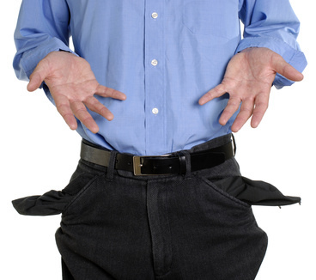
Disclosures
We have nothing to disclose.

Slide 3
Goals and Objectives
Participants will be able to apply an ethics decision making tool to challenging clinical scenarios
Participants will be able to articulate personal characteristics that intersect with ethical guidelines in difficult ways (i.e., ethical “blindspots”)
Participants will be able to modify this activity to engage their own residency settings

Slide 4
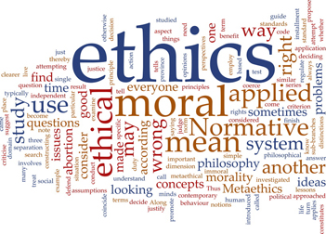

Slide 5
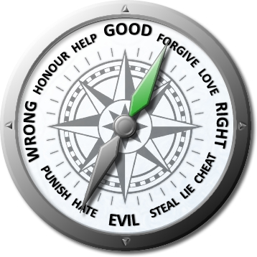
What are Ethics NOT?
Ethics are not Laws and are not Morals
Notes:
. That colleague I was talking about is on the Ethics committee, and she said they get ethcis consults sometimes where really the implicit question is “am I protected legally?” So really their job is to clarify. And the bottom line is: “Oh you want to know if it’s ethical to withdraw futile care from this terminally ill patient who made it clear that they didn’t want life support and the guardian is also recommending withdrawing life support but there are 8 family members who do not have guardianship who are yelling at you to continue treatment? Yes it’s ethical to discontinue treatment. But you might get sued of course. J” I’m sure you run into that too.

Slide 6
Types of Ethical frameworks
Consequentialism approach/Utilitarianism
Rights Approach/Duty Ethics
Virtue Ethics

Slide 7
Consequentialism/Utilitarian Ethics
Balancing the greatest good for most number of people while reducing harm for greatest number of people.

Slide 8
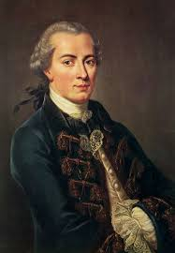
Duty/Rights Approach
Derived from Kant’s categorical imperative
The best ethical action is that which protects the ethical rights of those who are affected by the action.
It emphasizes the belief that all humans have a right to dignity.
“Act in such a way that you treat humanity, whether in your own person or in the person of another, always at the same time as an end and never simply as a means to an end.”
The list of ethical rights is debated; many now argue that animals and other non-humans such as robots also have rights.
Notes:
https://www.brown.edu/academics/science-and-technology-studies/framework-making-ethical-decisions

Slide 9
Competing frameworks
 | Consequentialist | Duty | Virtue
Deliberative process | What kind of outcomes should I produce (or try to produce)? | What are my obligations in this situation, and what are the things I should never do? | What kind of person should I be (or try to be), and what will my actions show about my character?
Focus | Directs attention to the future effects of an action, for all people who will be directly or indirectly affected by the action. | Directs attention to the duties that exist prior to the situation and determines obligations. | Attempts to discern character traits (virtues and vices) that are, or could be, motivating the people involved in the situation.
Definition of Ethical Conduct | Ethical conduct is the action that will achieve the best consequences. | Ethical conduct involves always doing the right thing: never failing to do one's duty. | Ethical conduct is whatever a fully virtuous person would do in the circumstances.
Motivation | Aim is to produce the most good. | Aim is to perform the right action. | Aim is to develop one’s character.
https://www.brown.edu/academics/science-and-technology-studies/framework-making-ethical-decisions
Notes:
https://www.brown.edu/academics/science-and-technology-studies/framework-making-ethical-decisions

Slide 10
Bioethics
Study of moral values and judgments as they apply to medicine
4 Main principles
Narrative ethics
Religious Ethics

Slide 11
Ethical Principles
Autonomy
Beneficence
Non-Maleficence
Justice

Slide 12
Autonomy
Universal right to self-determination
Sometimes contrasted with Paternalism
Influenced by humility—we cannot know 100% what is best for someone as we don’t walk in their shoes
Requires capacity on the part of the individual

Slide 13
Beneficence
Action done to benefit others
Goal is to improve the situation or alleviate suffering
May also address removing harmful issues/symptoms/situations

Slide 14
Non-maleficence
First do not harm
Some argue is the primary principle
Related to concerns about negligence

Slide 15
Justice
Fair, equitable and appropriate distribution of resources
Distributive Justice
Procedural Justice

Slide 16
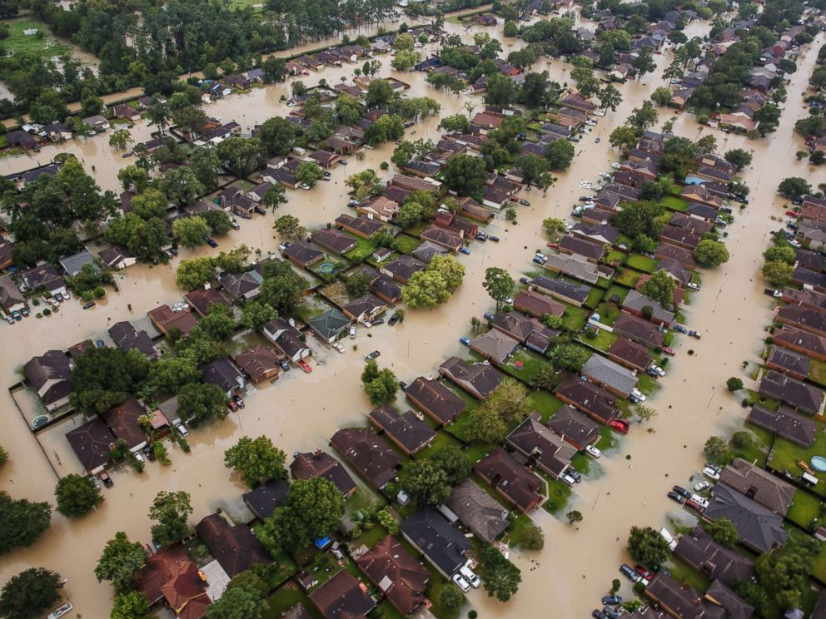
Distributive Justice
Distributive justice deals with issues of treating patients equally.
Physicians should treat similarly situated patients similarly and allocate resources justly.
In the face of limited health care resources, physicians should practice cost-effective medicine.
Physicians should make recommendations and decisions based on ethically pertinent considerations.

Slide 17
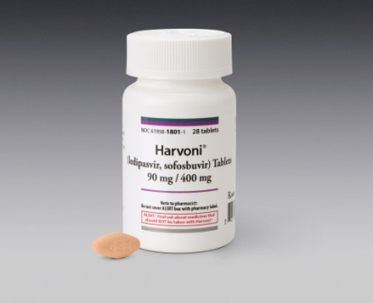
Fairness (Justice)
The principle of procedural justice (Fairness) requires that the process for making decisions for patients be fair and just.

Slide 18
Narrative Ethics
“Foremost among them is a focus on the patient as narrator of his or her own story, including the ethical choices that belong to that story. In an ideal form, narrative ethics recognizes the primacy of the patient’s story but encourages multiple voices to be heard and multiple stories to be brought forth by those whose lives will be involved in the resolution of a case. Patient, doctor, family, nurse, friend, and social worker, for example, may all share their stories in a dialogical chorus that can offer the best chance of respecting all the persons involved in a case.”
Jones, A. H. (1999). Narrative in medical ethics. BMJ : British Medical Journal, 318(7178), 253–256.
Notes:
Jones, A. H. (1999). Narrative in medical ethics. BMJ : British Medical Journal, 318(7178), 253–256.

Slide 19
Narrative Ethics
May be accessed by asking some questions of patient or provider
Tell me about this person…..I don’t know them, what are they like?
What do you think this person’s past actions have indicated are important values?
What is this family really concerned with?
Jones, A. H. (1999). Narrative in medical ethics. BMJ : British Medical Journal, 318(7178), 253–256.
Notes:
Jones, A. H. (1999). Narrative in medical ethics. BMJ : British Medical Journal, 318(7178), 253–256.

Slide 20
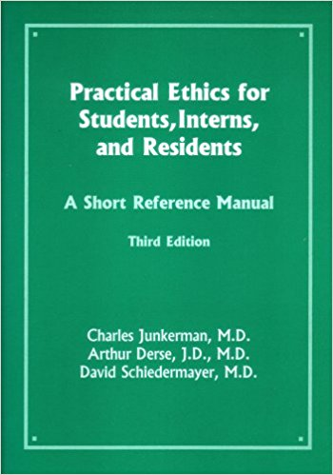

Slide 21
Adapted from AR Jonsen, M Siegler, W Winslade, Clinical Ethics, 7th edition. McGraw-Hill, 2010

Slide 22
Five Box Technique
Non-Maleficence
Am I protecting this patient from harm?
Am I protecting the staff and other patients from harm?
Autonomy
Am I respecting this person as well as his/her wishes and values?
What is / was important to this person?
Justice
Are there other obligations in this case? Is the care equitable and a just use of resources?
Clinical Integrity
Beneficence
Am I benefitting the patient with this care plan?
Am I being the best clinician I can be and staying true to my values?

Slide 23
Small Group Exercise Debrief

Slide 24
Self Reflection Debrief
Which statements did you put dots next to (feel conflicted about)?
Can you recognize which ethical principles are involved in those statements?
How did those areas come up in your small group exercise?

Slide 25
Taking this home……
What did you learn today?
What did you learn about yourself today?
How could you imagine this working with your residents and colleagues?
What barriers do you foresee?
Where do we fit it in?

Slide 26
Aaron Grace, Psy.D.
aaron.grace@phci.org
Heather Kirkpatrick, Ph.D., MSCP, ABPP
heather.kirkpatrick@ascension.org

