Slide 1
Medical error 1
Using stories to understand physician error and growth
Image by Sherry Adkins, Author owned

Slide 2
Our story
Hear the story

Slide 3
Our story
Hear the story
Take 3 minutes to reflect in writing:
Why did this happen?
What did the physician feel?
What did they do? What would you do?
Did the physician recover? How?
How did the patient discover and process?
Did anyone learn from the error?
What surprised you?

Slide 4
Sharing wisdom about error - causes
Why did this happen? What causes error?
Notes:
To err is human, to persist in error is diabolical. - Georges Canguilhem, French philosopher and physician who specialized in epistemology and the philosophy of science (in particular, biology) 1904-1995
80% of errors or adverse events are system derived-who

Slide 5
This Photo by Unknown Author is licensed under CC BY-NC-ND
Notes:
80% of errors or adverse events are system derived-who

Slide 6
Sharing wisdom – doctors have feelings
What emotions did the physician experience?
Notes:
Identify and manage/rehearse emotions
As the days stretched into weeks, people ceased to be interested. I realised that for them it was now old news, despite the fact that I still dreamt about it. It was time to move on. My thoughts about the incident changed with time. Regardless of the actual events, I realised that it was my fault. I could not avoid the fact that I was responsible for the patient's death... Interestingly, suicide never entered my mind. If it had, however, would it have been an inappropriate response? I'm not sure. Surely there is a price for the responsibility we handle
So where am I now? As I write this, the memory still makes my hands shake. The emotions are always there. But I am okay. I can function and be an effective doctor and spouse. I can live with my fallibility. I continue to try to do my best for the patients. But now I truly understand the consequences of failure. I do not presume this to be a blueprint of what to do in these circumstances. But I know that this will happen again to someone else, and they should know that they are not alone. Looking back. BMJ. 2000 Mar 18;320(7237):812. PMID: 10720395; PMCID: PMC1117802.

Slide 7
Sharing wisdom about error – coping
How did the physician face/process the error? What did they do? What would you do?
Are there any beliefs we have to give up to face error more honestly?

Slide 8
Sharing wisdom – caring for the patient
How did the patient discover and process the error?
Did the doctor-patient relationship end, survive, or grow?
Notes:
clinicians feel guilty after medical mistakes, family members often have similar or even stronger feelings of guilt.
patients and their families may fear further harm, including retribution, if they express their feelings or even ask about mistakes they perceive.
clinicians may turn away from patients who have been harmed, isolating them just when they are most in need.
Rather than simply assigning blame, patients and families want both to understand their situation fully and to know what the event has taught caregivers and their institutions.

Slide 9
Sharing wisdom – using error for good
How can we learn from error (individuals, colleagues, as a profession)?
Anything else that is good that can come from error?

Slide 10
What about forgiveness?
'What are the words and actions of individuals (and the policies/practices of institutions) that offer injured patients the possibility of forgiving those responsible?’
'We are able to forgive mistakes but not indifference, not denial and hiding...it is difficult when no one will face us whom we can forgive.' -Roxanne Geoltz
'We want to be paid, and if we can't have Jesse back, we want to be paid in understanding, and if we can't have understanding then we want to be paid in money' -Gail Rowe
Berlinger, N. (2007). After Harm: medical error and the ethics of forgiveness. Baltimore: Johns Hopkins Press.
Notes:
forgiveness, encompasses shared understanding, rekindled trust, acceptance, and closure

Slide 11
Mistakes happen
Brian Goldman: Doctors make mistakes. Can we talk about that? | TED Talk
Notes:
CONSIDER INCLUDING A POWERFUL VIDEO – SEARCH FOR BRIAN GOLDMAN CANADIAN ER PHYSICIANS WITH EXCELLENT TED TALKSBrian Goldman: Doctors make mistakes. Can we talk about that? | TED Talk

Slide 12
Factors related to error and response
Curiosity
Situational and self awareness
Honesty – face realities even when unpleasant
Service oriented - moral calling or personal mission that drives us to do the right thing
Resilience (self esteem, 'practice' mindset, attribution style)
Inexperience, role confusion
Notes:
Self esteem confidence in one's worth
Attribution style – why did this happen/transitory or permanent factors and internal or external

Slide 13
Barriers to acknowledgement and growth
Beliefs
Aren't doctors supposed to be perfect? ...imperfect but good?
Will they think I am stupid, lazy, incompetent, don’t care?
Worry about consequences
Sanctions or litigation, patient relationship
Culture
Lack of support, isolation
Uncertainty of clinical situation
Notes:
Where does our authority come from?
If culture changes, what will I gain/ lose? Power, authority...transparency

Slide 14
Coping – wisdom through error
Healing the Healer Complete Film (harvard.edu)
Notes:
Error common exp. phys and phys-pt relationship can survive/thrive
17:50, consider playing part or sharing for later viewing
CONSIDER INCLUDING PRE-MADE MATERIALS SEARCHING FOR HEALING THE HEALER FILM HARVARD…Healing the Healer Complete Film (harvard.edu)

Slide 15
How could I cope? What could I learn or unlearn?
How do you know when you are nervous or upset?
Make a strategy for reducing, acknowledging, and processing medical error in your career.
Notes:
Self awareness, rehearsing coping

Slide 16
How the wise have coped...'wisdom exemplars'
Talk
Disclose and apologize
Forgiveness
Moral context
Deal with imperfection
Become an expert
Prevent recurrence/teamwork
Teach others
Notes:
Share vulnerabilities

Slide 17
More ways...
Write/journal
Cognitive reframing
...
Notes:
Share vulnerabilities
write/journal and use cognitive reframing

Slide 18
Do I acknowledge and learn from error in my practice?
What and who do you need to grow this ability?
Notes:
Your patients will help you grow into the doctor you dream of being...just by needing you.

Slide 19
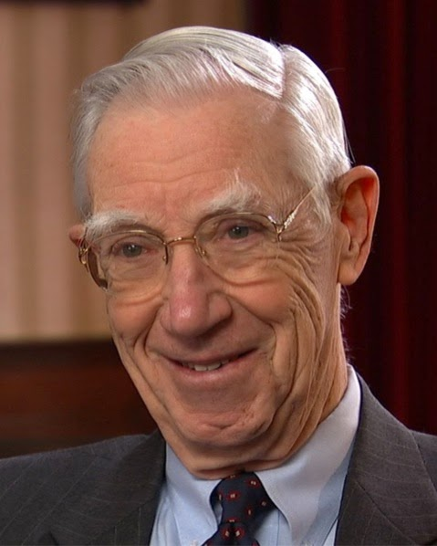
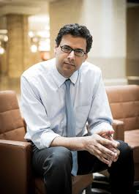
What and who do you need to grow?
Examples, mentors, coaches
Expectations
Courage
Support
Community
Safe places to practice
This Photo by Unknown author is licensed under CC BY-NC.
This Photo by Unknown author is licensed under CC BY-NC-ND.
Notes:
Courage - do something scary, strength in the face of pain or grief – from inside
CONSIDER INSERTING IMAGES OF FACULTY FROM YOUR PROGRAM WHO ARE CHAMPIONS, OR RESEARCHERS/ACTIVISTS THAT YOU ADMIRE (FOR EXAMPLE DR LUCIAN LEAPE, DR ATUL GAWANDE, DR MARGARET PLEWS-OGAN

Slide 20
Facts?
We all fail at times, even smart hard-working doctors
Error profoundly impacts patients and care team
Goal to be honest and learn from errors
I am devoted to my patients and can do hard things for them
I can acknowledge and use medical error for a purpose
I can grow and become wiser in the face of adversity

Slide 21
'We do not receive wisdom, we must discover it for ourselves, after a journey which no one can take for us or spare us...
the lives that you admire...the attitudes that seem noble...represent a struggle and a victory.' - Marcel Proust
Image by Sherry Adkins, Author owned

Slide 22
Resources
Berlinger, N. (2007). After Harm: medical error and the ethics of forgiveness. Baltimore: Johns Hopkins Press.
Hilfiker, D. (1985). Healing the wounds: A physician looks at his work. New York: Pantheon Books.
Institute of Medicine (US) Committee on Quality of Health Care in America. To Err is Human: Building a Safer Health System. Kohn LT, Corrigan JM, Donaldson MS, editors. Washington (DC): National Academies Press (US); 2000.
Gawande, A. When Doctors Make Mistakes. The New Yorker, February 1, 1999
Ofri, D. 2020. When we do harm. Beacon Press.
Learning from Medical Errors (Part 1) | IHI - Institute for Healthcare Improvement. https://www.ihi.org/education/IHIOpenSchool/resources/Pages/Activities/PerspectivesTheMistakePart1.aspx
Looking back … BMJ 2000; 320 :812
Patient safety curriculum guide: multi-professional edition (who.int). https://www.who.int/publications/i/item/9789241501958
Truog RD, Browning DM, Johnson JA, Gallagher TH. Talking with patients and families about medical error. Baltimore, MD: Johns Hopkins University Press; 2011.
Wisdom Through Adversity - University of Virginia School of Medicine. https://med.virginia.edu/wisdom/

Slide 23
Medical error 2 Ethics and culture
Image by Sherry Adkins, Author owned
Our expertise makes us competent, but our values make us trustworthy. - Rabow et al
Notes:
CONSIDER USING POLL EVERYWHERE SOFTWARE TO CREATE REAL TIME ENGAGEMENT IN DISCUSSION QUESTIONS
Welcome to error session 2. if you have not gotten to complete your pre-session survey and this is your first session, pls see your email
Last time we got to explore error through a mentor's story, today we will reflect on some of our own experiences to discuss ethics related to error and how our professional culture impacts patient outcomes related to error
In addition to clinical competence...professional formation—the moral and professional development of students, their ability to stay true to their personal service values and the core values of the profession, and the integration of their individual maturation with growth in clinical competency. The goal of professional formation is to anchor students to foundational principles while helping them navigate the inevitable moral conflicts in medical practice. Dr Parmelee, dean of education wsu, psychiatry, and dr rachel remen, founder of rishi/healers art

Slide 24
Reflect Write for two minutes
Try to remember a time when you made a mistake (medical or not)
How did you respond?
What helped you or what kept you from facing the error or 'doing the right thing'?
Notes:
Alternative reflection –think of a colleague/teacher/mentor/person you admire – what is so great about them?

Slide 25
What are the responsibilities of a profession?

Slide 26
Characteristics / responsibilities of a profession
Essential services
Specialized knowledge
Service to patient/client, commitment
Standards
Public trust
Authority and Accountability
...
The principal objective of the medical profession is to render service to humanity with full respect for the dignity of man.
- 1957 ethical code of the AMA
Notes:
1957 ethical code of the American Medical Association: “The principal objective of the medical profession is to render service to humanity with full respect for the dignity of man. Physicians should merit the confidence of patients entrusted to their care, rendering to each a full measure of service and devotion.

Slide 27
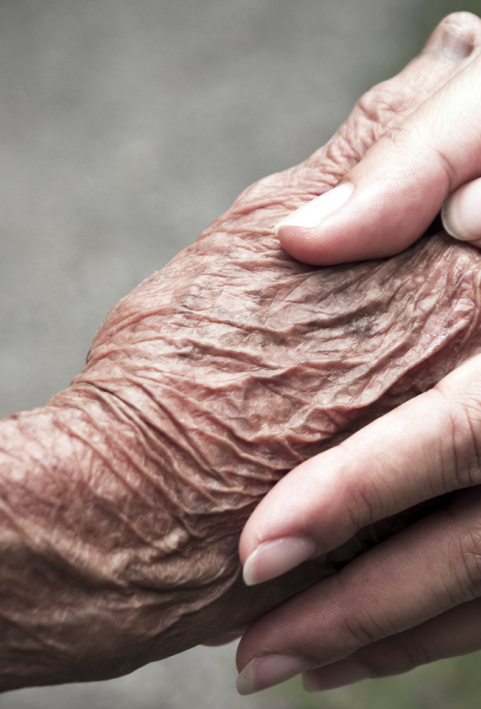
What ethical principles or values are related to error?
This Photo by Unknown author is licensed under CC BY-SA-NC.
Notes:
Thinking about your story...did any ethical principles or values come to mind? Related to med error in particular?
discussing key related professional values.
Targets predisposing beliefs/attitude - doctors should disclose; enabling- professional community/orgs for just culture

Slide 28
Ethical principles/values related to error
Beneficence/Nonmaleficence, autonomy, justice
Practice – continuous improvement
Service – how do you define
Authority
Honesty
We become just by doing just actions, temperate by doing temperate actions, brave by doing brave actions. -Aristotle
This Photo by Unknown author is licensed under CC BY-SA-NC.
Notes:
beneficence, nonmaleficence, autonomy, and justice
Autonomy basis for informed consent, truth-telling, and confidentiality. worth→self determination/choice
Virtues are thus habits of character cultivated through practice that result in the actions essential for an individual to flourish. What then, does this mean for practitioners of medicine? Pellegrino wrote that the medical virtues “focus primarily on those traits necessary to do the work of medicine well. The good that medicine seeks … is ultimately the preservation, promotion and restoration of health” [14]. Pellegrino lists what he takes to be six essential virtues for the clinician: fidelity, honesty, compassion, effacement of self-interest, courage, and justice [5].
Forgiveness and relationship repair
Societal trust
Transparency – legitimacy/authority/trust
SERVICE - commitment to benefit for their own sake and good the subjects of care, the knowledge of practice, and the civic and medical institutions that safeguard health
concept of service has four essential elements: to secure the health of people and the institutions that sustain it; to provide health care equally and nonjudgmentally and to treat people as ends, never as means; to assure the integrity of medical knowledge; and to do this all with benevolent intent.
all people are worthy and should be treated with the same dedication, thus embracing the principles of equality and justice. obligation of practitioners to help the community by assisting the civic institutions that maintain its health, and by educating its people and taking part themselves in preventing disease.
Commitment to patient and profession

Slide 29
Fears and barriers to acknowledging error...
What makes it hard?
This Photo by Unknown author is licensed under CC BY-NC-ND.
Notes:
Targets Skill -process fear/rehearse response. Skills anticipate barriers
Fear/defensiveness our natural human response to error...park your fear

Slide 30
Trust
Can we trust society? Our patients? Each other?
Can they trust us?
This Photo by Unknown author is licensed under CC BY.
Notes:
Trust helps but how safe does our environment need to be...
firm belief in the reliability, truth, ability, or strength of someone or something:
Story of facing my fear and trust in God/myself to continue based on faith and commitment/love for patients and my profession
Now we are going to switch gears...

Slide 31
Reflect Write for two minutes
Think about your medical career
What was it like?
Remember a clinical environment that you thought was remarkable – good for patients and/or good for the team
If you can't recall a positive environment, describe a negative one

Slide 32
Culture
The single greatest impediment to error prevention in the medical industry is that we punish people for making mistakes.
Dr. Lucian Leape, Professor, Harvard School of Public Health Testimony before Congress on Health Care Quality Improvement
This Photo by Unknown author is licensed under CC BY-NC.
Notes:
This statement may be controversial to you...let's consider it
Our profession has a culture, our specialty, our organization. Let's talk about that.

Slide 33
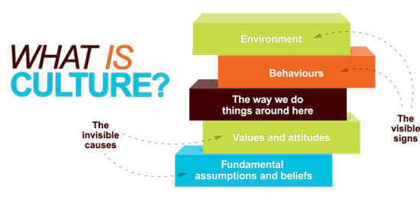
Medicine’s culture
Expect perfection
Blame and punishment for individual
Hide mistakes
This Photo by Unknown author is licensed under CC BY-NC-ND.
Notes:
Shared values (what is important) and beliefs (how things work) that interact with an organization’s structure and control systems to produce behavioral norms (the way we do things around here).
- James Reason British psychologist in human error and error management, view mistakes as consequence of...
Error – preventable adverse effect of care
error is something wrong that is done when not knowing any different, versus a "mistake" implies something wrong that is done when knowing better.

Slide 34
What culture would achieve better outcomes for patients and teams?
This Photo by Unknown author is licensed under CC BY-ND.
Notes:
Twenty-two studies met inclusion criteria. Ten studies showed a relationship between both safety culture and clinical errors with burnout. Two of 3 studies reported an association between burnout and patient outcomes. Fewer studies focused on engagement. Most studies exploring engagement and safety culture found a moderately strong positive association. The limited evidence on the relationship between engagement and errors depicts inconsistent findings. Only one study explored engagement and patient outcomes, which failed to find a relationship. Systematic rev 2021

Slide 35
Safety culture
Informed - gets data (incidents and near misses)
Reporting - workers know it is safe and effective to report
Just - rewards for providing safety information
Flexible - adjusts to new dangers and opportunities
Learning - draws conclusions and adapts
- James Reason, as described in Making Healthcare Safe
- Mossburg, Sarah E. MS; Dennison Himmelfarb, Cheryl PhD. The Association Between Professional Burnout and Engagement With Patient Safety Culture and Outcomes: A Systematic Review. Journal of Patient Safety: December 2021
This Photo by Unknown author is licensed under CC BY-SA-NC.
Notes:
The concept of safety culture originated outside health care, in studies of high reliability organizations, organizations that consistently minimize adverse events despite carrying out intrinsically complex and hazardous work. High reliability organizations maintain a commitment to safety at all levels, from frontline providers to managers and executives. This commitment establishes a "culture of safety" that encompasses these key features:
acknowledgment of the high-risk nature of an organization's activities and the determination to achieve consistently safe operations
a blame-free environment where individuals are able to report errors or near misses without fear of reprimand or punishment
encouragement of collaboration across ranks and disciplines to seek solutions to patient safety problems
organizational commitment of resources to address safety concerns

Slide 36
Just culture
Shared accountability
Awareness
Policies
Principles into daily practice (procedures)
Responding punitively... should be reserved for those who have willfully and irremediably caused harm, because punishment creates blame-based workplace cultures that deter reporting, which makes patients less safe.
Why Accountability Sharing in Health Care Organizational Cultures Means Patients Are Probably Safer. Deborah M. Eng, MS, MA and Scott J. Schweikart, JD, MBE
AMA J Ethics. 2020;22(9):E779-783.
This Photo by Unknown author is licensed under CC BY-SA-NC.
Notes:
Just Culture refers to a values-supportive system of shared accountability where organizations are accountable for the systems they have designed and for responding to the behaviors of their employees in a fair and just manner.
Because human errors should be regarded as expected, organizations should routinize processes, limit negative consequences when errors occur, and support and educate those who have erred.

Slide 37
How are we doing with safety culture at our sites?
Great, I feel comfortable sharing concerns
Neutral
Poor, it is not safe to share concerns
This Photo by Unknown author is licensed under CC BY-SA-NC.
Notes:
Just Culture refers to a values-supportive system of shared accountability where organizations are accountable for the systems they have designed and for responding to the behaviors of their employees in a fair and just manner.
Because human errors should be regarded as expected, organizations should routinize processes, limit negative consequences when errors occur, and support and educate those who have erred.

Slide 38
Is it worth changing culture? Will that 'fix' things?
Cost of current way
How hard to change/is it possible?
What would it cost us to change?
How safe does our environment have to be to 'do the right thing'?
This Photo by Unknown author is licensed under CC BY-NC-ND.
Notes:
Where does our authority come from?
If culture changes, what will I gain/ lose? Power, authority...transparency...uniqueness of physician
Remember David Hilfiker and his courageous report of sig error in his career/NEJM 1984 and Healing the Wounds

Slide 39
What do you need to change the culture?
Image by Sherry Adkins, Author owned

Slide 40
What do you need to change the culture?
Role models
Courage
Draw from patients? Family? Colleagues? Faith?
Support – find your tribe
Local ecosystem – residency, DAGMEC, systems
Orgs – AHRQ Patient Safety Net, IHI, AHRQ WebMM
Outside medicine?
Safe places to practice skills
This Photo by Unknown author is licensed under CC BY-SA-NC.

Slide 41
How can colleagues help?
This Photo by Unknown author is licensed under CC BY-ND.

Slide 42
How can colleagues help?
Peer with an ear, share stories, ask about emotional impact
Encourage quality improvement, promote learning institution
Link with teaching opportunities
Enrich moral context
Universal disclosure and coaching program
Cultivate self forgiveness, 'imperfect but good doctor'
Foster reflective practice
This Photo by Unknown author is licensed under CC BY-NC-ND.
Plews-Ogan M, May N, Owens J, Ardelt M, Shapiro J, Bell SK. Wisdom in Medicine: What Helps Physicians After a Medical Error? Acad Med. 2016 Feb
Notes:
61 physicians (SE,NE,W). Investigators identified themes reflecting what helped physician wisdom exemplars cope positively, recommendations for hc institutions

Slide 43
How can colleagues help?
The next time an error troubles you, or you see an error that might trouble a colleague...
Share
Grab 1-2 buddies and talk about your reflections from today (5 minutes)
Your response to error
Your residency’s culture
This Photo by Unknown author is licensed under CC BY-NC-ND.

Slide 44
How can patients help?
This Photo by Unknown author is licensed under CC BY.
Notes:
If patients are part of the team…their safety concerns will be welcomed and acted upon.
When patients are not considered part of the care team, they (and the team) may be reluctant to report concerns.
If patients do report safety concerns, they may be unsuccessful in having the care team respond to prevent potential sentinel events.

Slide 45
Human beings make errors, even smart and hard working doctors
Error impacts patients and care team
We should be honest and learn from errors, even if it's hard
Our colleagues and patients can help us improve error culture
Notes:
You can have a career that you are proud of, you can aspire to be honest and courageous, even in the face of error, and colleagues and patients can help us build a culture of safety. Next time we will review some local policies and practices and practice some skills (self awareness, disclosure, root cause reflection, coping).

Slide 46
Resources
Leape LL. Making Healthcare Safe. Springer; 2021.
Faculty
Fellow residents (local and dagmec, regional and beyond)
Plews-Ogan M, May N, Owens J, Ardelt M, Shapiro J, Bell SK. Wisdom in Medicine: What Helps Physicians After a Medical Error? Acad Med. 2016 Feb;91(2):233-41.
Patient Safety Network Home | PSNet (ahrq.gov). https://psnet.ahrq.gov/
IHI Open School Patient Safety Curriculum | IHI - Institute for Healthcare Improvement. https://www.ihi.org/education/IHIOpenSchool/Courses/Pages/2019-IHI-Open-School-Patient-Safety-Curriculum.aspx
National forum
Frankel A, Haraden C, Federico F, Lenoci-Edwards J. A Framework for Safe, Reliable, and Effective Care. White Paper. Cambridge, MA: Institute for Healthcare Improvement and Safe & Reliable Healthcare; 2017. (Available on ihi.org)
Code of Medical Ethics overview | Ethics in Healthcare | AMA (ama-assn.org). https://www.ama-assn.org/delivering-care/ethics/code-medical-ethics-overview
Why Accountability Sharing in Health Care Organizational Cultures Means Patients Are Probably Safer. Deborah M. Eng, MS, MA and Scott J. Schweikart, JD, MBE. JAMA J Ethics. 2020;22(9):E779-783. doi: 10.1001/amajethics.2020.779.
Rabow MW, Remen RN, Parmelee DX, Inui TS. Professional formation: extending medicine's lineage of service into the next century. Acad Med. 2010. February; 85 2: 310- 317. doi: 10.1097/ACM.0b013e3181c887f7.
Mossburg, Sarah E. MS; Dennison Himmelfarb, Cheryl PhD. The Association Between Professional Burnout and Engagement With Patient Safety Culture and Outcomes: A Systematic Review. Journal of Patient Safety: December 2021 - Volume 17 - Issue 8 - p e1307-e1319

Slide 47
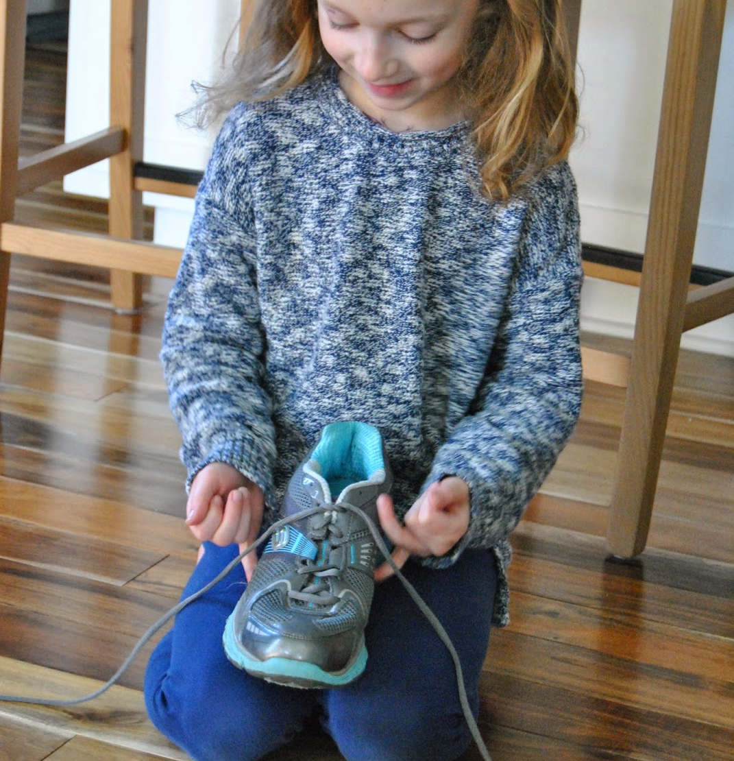
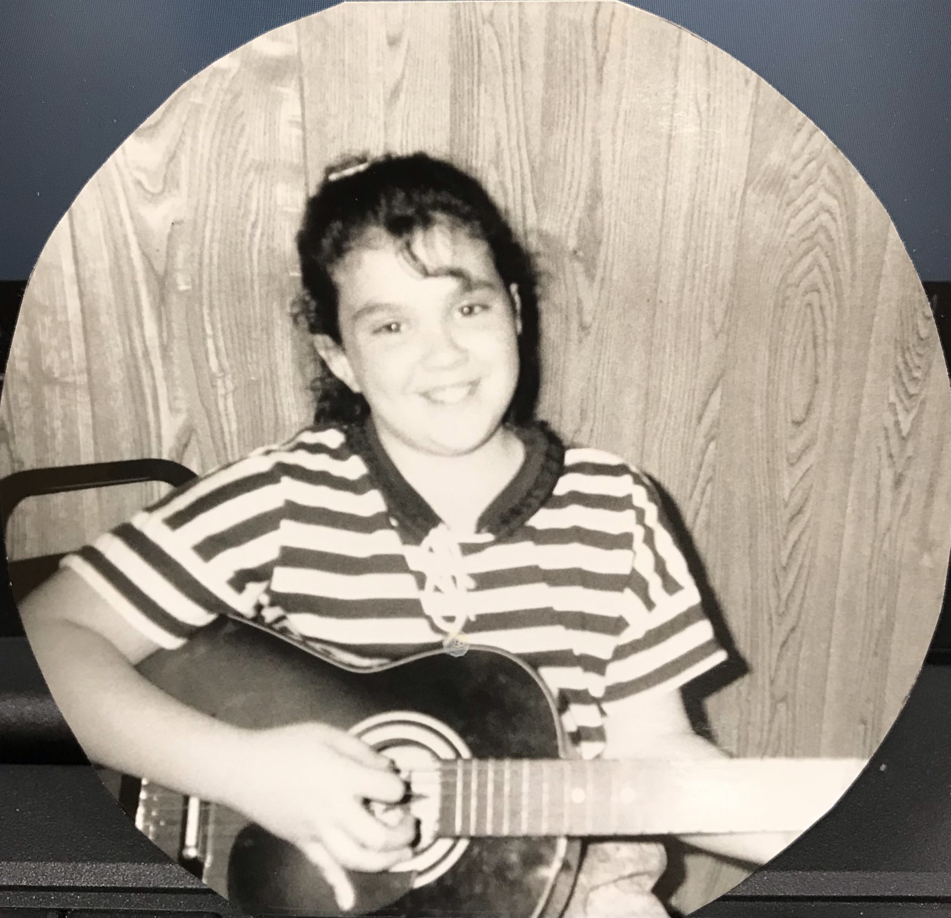
Medical error 3: Practice makes better
This Photo by Unknown author is licensed under CC BY-NC.
This Photo by Unknown author is licensed under CC BY-SA-NC.
Image by Sherry Adkins, Author owned
Notes:
Congratulations today is the third and final session on medical error. Is there anyone here today who did not get to participate in sessions one or two? If so and you want to complete the pre session survey please check your email and complete now. Last time we discussed the ethics related to medical error and today we will start practicing some of our skills. Learning takes a lot of courage- you have to be willing to be honest about your skills and knowledge and be willing to fail in order to learn. Let’s take this chance to learn in a safe setting. Remember any discussion of error is protected and private today. We are using this for learning and improvement

Slide 48
Practice! Self awareness
How are you feeling today? (poll)
Can you be more specific? Do you feel ready to learn? Take care of patients?
Notes:
Survey question
Practicing self-awareness can improve our confidence in reducing risk for error.
More specific

Slide 49
Facts?
Human beings make errors, even smart and hard working doctors
We are aware of ourselves and our environment, anticipating when we and our colleagues are at higher risk for error
In spite of the barriers, we will be honest and learn from our errors
We will not abandon our patients or our colleagues after error
We will practice self care after an error and get help when we need it
Practice makes better

Slide 50
Local policies related to error
Sponsoring institution GME - [All "incidents" should be reported promptly to the hospital /Department of Legal Affairs and Risk Management. Consult hospital director of medical education for specific directions. ]
Primary care center- [It is the responsibility of every employee to report incidents/errors as a means to assess and improve processes and systems related to safe patient care and/or operations and to identify potential claims. Identification and review of all errors, near-misses, adverse events, and system weaknesses provides opportunities to learn from the event/error.]
Primary adult hospital – [Guidelines for the process of communicating and disclosing information to the patient...when an unanticipated outcome of a treatment and/or procedure occurs. ]
Primary pediatric hospital- [The purpose of this policy is to define the process for continually monitoring, internally reporting and investigating the following: injuries to patients or others within the hospital’s facilities...Documentation is necessary to assure that appropriate measures are taken to prevent a recurrence and to monitor and improve patient care. ]
Notes:
Near misses are incidents that we 'catch' before harm comes to a patient

Slide 51
Local policies ...
 | Error/quality improvement | Patient disclosure | Physician support | Risk management
Sponsor |  |  |  | x
Family practice | x |  |  | x
Hospital | ? | x |  | x
Childrens Hospital | x | x | x | x
Notes:
Consider how good are these policies? ?poll?
Edit for your own program

Slide 52
Local practices related to error
What have you seen?
Notes:
Policy does not always translate into practice- what practices do you see?

Slide 53
Local practices related to error
Sponsor GME - How to report
Primary outpatient site - How to report
Primary inpatient institution– How to report
Primary pediatric institution – How to report
Incident reports can be done anonymously, are protected (do not reference in patient chart)
Notes:
IR software-aware?
care for patient, notify supervisor, report...disclose/document/RCA...crisis mgt team...employee assist/peer supp
How are we doing practice-wise at clinical sites?

Slide 54
People at rotation sites
Sponsoring institution GME - individual and pic
Family practice - individual and pic
Hospital – Individual and pic
Childrens Hospital – individual and pic
First stop is always your supervisor/faculty/program director
Notes:
Update for your program

Slide 55
If you were a patient impacted by error, what would you want?
Notes:
First, to be taken care of medically

Slide 56
Key principles of open disclosure
Open and timely communication (tip – park your fear)
Acknowledge the incident
Express of regret/apology (end with empathy, assuring your availability)
Recognize reasonable expectations of patient/family
Support for staff
Confidentiality
Notes:
Doctors/humans are emotional. Acknowledge and park your natural Fear/defensiveness w error...we may worry what will happen to me?
allow pt to express/sit w emotion...“will I (or my loved one) be ok?
learning how we respond to the emotions of others helps us rehearse/prepare
respond to emotional concerns with empathy and reassurance. Respond to cognitive concerns with information.
End with empathy, reassurance (if possible), and assuring your availability, making sure questions have been addressed.

Slide 57
Practice! Disclosure
Take a look at your case in a group of 3.
Choose a role (doctor, patient/family, observer).
Role play for 2 minutes then switch.
Debrief/discuss as a group
Video - Medical Error: A Case Based Approach
Notes:
Residents can improve their confidence in error disclosure and management by practicing.
CONSIDER INCLUDING PRE-MADE VIDEO ON SKILLS SEARCH Medical Error: A Case Based Approach to Apology and Disclosure Video - Brigham and Women's Hospital
watch portion of video…https://www.youtube.com/watch?v=3OsA0z7j4WM
Groups of 3 with a case, use local cases (SHORT prompt) when possible

Slide 58
Root cause analysis, reminders
Rigorous confidential approach to answering
What happened?
Who? When? Where?
How severe was the harm?
What's the likelihood of recurrence?
What were the consequences?
Focus on prevention, system vulnerabilities
Examine communication, training, fatigue, environment, policies, barriers
Sentinel event - a patient safety event that results in death, permanent harm, or severe temporary harm.
Notes:
So we have taken care of our patient medically, talked to them about what happened, now we want to prevent the error if possible in future. RCA is a way to do this work. There are many reasons for medical error, in fact physician cognitive or procedural error is not the most common cause.

Slide 59
Practice! Root cause analysis
Choose the last mistake you made (outside medicine), or a near miss...reflect on root causes for this over the next 2 minutes.
Notes:
Residents can improve their confidence in error prevention and management by practicing root cause analysis/reflection.
Use non medicine 'case' for reflection?
Switch back to RCA reminders slide

Slide 60
Where to get emotional support
Where do you get emotional support? (poll)
Notes:
Poll question

Slide 61
Second victim trajectory of recovery
chaos and accident response
intrusive reflections
restoring personal integrity
enduring the inquisition
obtaining emotional first aid
moving on
drop out
Survive
thrive
Scott SD, Hirschinger LE, Cox KR, McCoig M, Brandt J, Hall LW. The natural history of recovery for the healthcare provider "second victim" after adverse patient events. Qual Saf Health Care. 2009 Oct;18(5):325-30.
Notes:
You may recall a study that we have referenced through this series, relating to physician response to error. there appears to be a common trajectory, with differing endpoints (drop out, survive, thrive)
Scott et al 2009. interview findings with 31 second victims. volunteers representing different professional groups were solicited for private, hour-long semi-structured interviews. Univ Missouri Healthcare
Tradjectory is largely predictable…office of clinical effectiveness at UMHC…after studying support infrastructures from Critical Incident Stress Management techniques23 24 and a formal support network known as Medically Induced Trauma Support Services,25 the OCE initiated a focused and deliberate set of actions and a research plan

Slide 62
Practice! Coping
How do you cope with a mistake, near miss, or even just a bad day at work? (poll)
Notes:
Residents can improve their confidence in error management by rehearsing or planning coping skills.
How do you cope with error, near miss, or even just a bad day at work?

Slide 63
Practice! Coping Exemplar reminders:
Talk, disclose and apologize
Forgiveness
Moral context
Deal with imperfection
Become an expert
Prevent recurrence/teamwork
Teach others
Write a letter to a colleague or future self to read in the wake of a self-perceived failure. 2 min
What do you want to remind them of?
What do you hope they will feel and do?
Where can they find strength and support?
Notes:
Remembering our study of wisdom exemplars (those who have thrived after error), write a letter…61 physicians (SE,NE,W). Investigators identified themes reflecting what helped physician wisdom exemplars cope positively, recommendations for hc institutions
Residents can improve their confidence in error management by rehearsing or planning coping skills.
Alternate: What is my story today? What makes it different from other days? Take 2 minutes individually to respond.

Slide 64
Notes:
I know you may already have some ideas for personal coping, from your wellness curriculum/plan or from other experiences. There are many resources for coping, including things you can do on your own if you are not ready to reach out to someone else yet (consider the University of Wisconsin's integrative health section on relaxing and healing

Slide 65
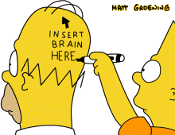
Medical Error
You are a human
Humans make mistakes
Humans can survive and grow from mistakes
We learn best in a supportive environment
Where we can process and grow as an individual, as a team, as an organization, as a profession so we can
…....................keep helping patients
This Photo by Unknown author is licensed under CC BY-NC-ND.

Slide 66
I am a healer, yet sometimes I do more harm than good...
At some point we must all bring medical mistakes out of the closet. This will be difficult as long as both the profession and society continue to project their desires for perfection onto the doctor. Physicians need permission to admit errors. They need permission to share them with their patients. The practice of medicine is difficult enough without having to bear the yoke of perfection.
David Hilfiker
Hilfiker D. Facing our mistakes. NEJM 1984; 310: 118-122.
Notes:
I want to remind you that we are all responsible for the state of our profession. One of my heroes is David Hilfiker- a family physician (rural MN) who wrote a seminal article in 1984 in NEJM relating the story of a medical error. This is an excerpt of that writing.
CONSIDER INSERTING A PHOTO OF DR HILFIKER

Slide 67
Resources
Stacy Flowers, PsyD (doctor of psychology), Kelly Rabah, MSW CPHQ CPHRM SSGB (Director of Patient Safety & Quality Improvement)
Local algorithm/policies, mentors and peers
Patient Safety Network Home | PSNet (ahrq.gov). https://psnet.ahrq.gov/
IHI Forum | IHI - Institute for Healthcare Improvement. https://www.ihi.org/education/Conferences/National-Forum/Pages/default.aspx?utm_campaign=us-6292022-all-forum2022-all-dmt-b--kt-text(sem)&utm_content=link----inperson1&utm_source=bing&utm_medium=cpc&utm_term=awareness--registernowv&msclkid=73305f378ab11f90d4143dd25e468807
Getting it Right: Cases to Improve Diagnosis | Earn CME/MOC | ACP (acponline.org). https://www.acponline.org/cme-moc/online-learning-center/getting-it-right-cases-to-improve-diagnosis
Medical Error: A Case Based Approach to Apology and Disclosure Video - Brigham and Women's Hospital - Bing video. https://www.bing.com/videos/search?q=disclosure+videos+uva+medical+error&&view=detail&mid=49487000B55A488B04D849487000B55A488B04D8&&FORM=VRDGAR&ru=%2Fvideos%2Fsearch%3Fq%3Ddisclosure%2Bvideos%2Buva%2Bmedical%2Berror%26FORM%3DHDRSC4
Root Cause Analysis - VHA National Center for Patient Safety (va.gov). https://www.patientsafety.va.gov/professionals/onthejob/rca.asp
Patient Safety Fellowship - The University of Toledo (utoledo.edu). https://www.utoledo.edu/med/fellowships/patient-safety/
VA Patient Safety Fellowships - VHA National Center for Patient Safety. https://www.patientsafety.va.gov/professionals/training/fellows.asp
Fischer MA, Mazor KM, Baril J, Alper E, DeMarco D, Pugnaire M. Learning from mistakes. Factors that influence how students and residents learn from medical errors. J Gen Intern Med. 2006 May;21(5):419-23.
Hilfiker D. Facing our mistakes. NEJM 1984; 310: 118-122.
Plews-Ogan M, May N, Owens J, Ardelt M, Shapiro J, Bell SK. Wisdom in Medicine: What Helps Physicians After a Medical Error? Acad Med. 2016 Feb
Scott SD, Hirschinger LE, Cox KR, McCoig M, Brandt J, Hall LW. The natural history of recovery for the healthcare provider "second victim" after adverse patient events. Qual Saf Health Care. 2009 Oct;18(5):325-30.
Integrative Health Teaching Modules & Handouts - Clinician and Patient Education (wisc.edu). https://www.fammed.wisc.edu/integrative/resources/modules/
Notes:
Thank you for going on this exploration with me. I invite you to complete the post-curriculum survey , please check your email for this. If you are interested in more about any of the resources or want to discuss this topic further, please message me. I hope you will consider participating in the post curriculum survey, it will help make our curriculum stronger.

